Slide 1
High Power / Low Energy Radiator and Absorber
Pavel Degtiarenko
Radiation Physics Group at RadCon
October 9, 2015

Slide 2
Radiator/Absorber Design
Utilize the concepts from the US Pat.#8,334,523 B1: “Moving Core Beam Energy Absorber and Converter”
Make the radiator ~1 mm thick W or Re in the shape of a flat ring, mounted on the internal rotating wheel which is suspended in the flow of coolant (water)
Place the Radiator close to the entrance, using higher energy beam electrons to generate higher energy gammas for isotope production
Use the coolant (water) thickness behind the radiator to range out beam electrons and to limit the power reaching the Target
Coolant flow through the box will be capable to take more than 100 kW off the radiator /absorber. The larger the diameter, the larger the cooling capacity

Slide 3
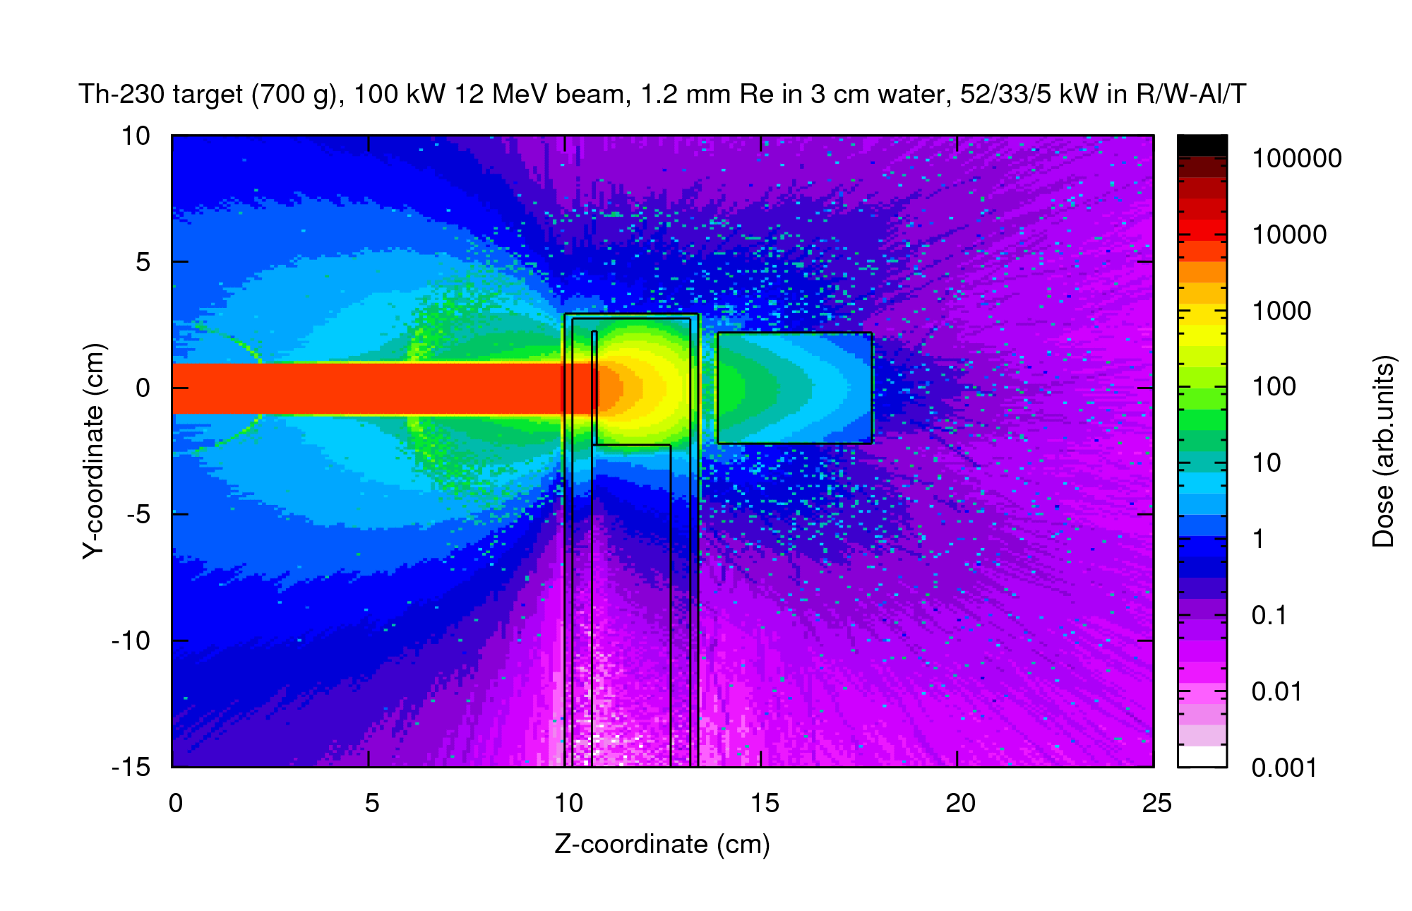
Test Setup
Absorber: H₂O, 30 mm
Radiator: Re, 1.2 mm
Target: ²³⁰Th, 700 g
Vacuum Window: Al or Be, 2 mm
Enclosure Box: Al or Be, 2 mm
Rotating Wheel: Al or Be

Slide 4
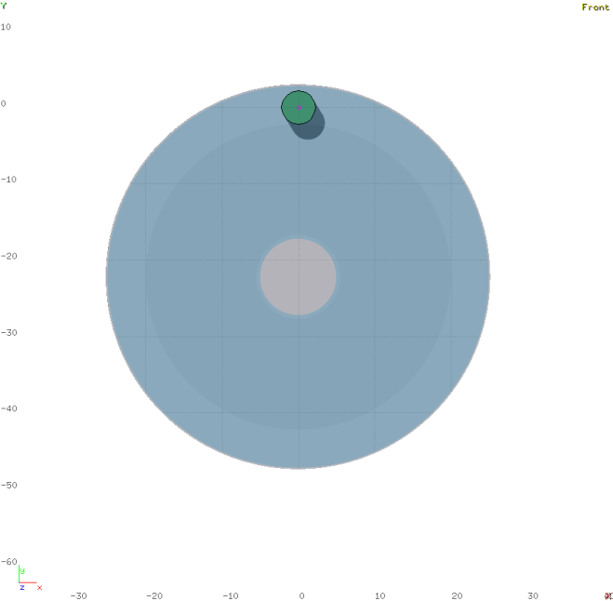
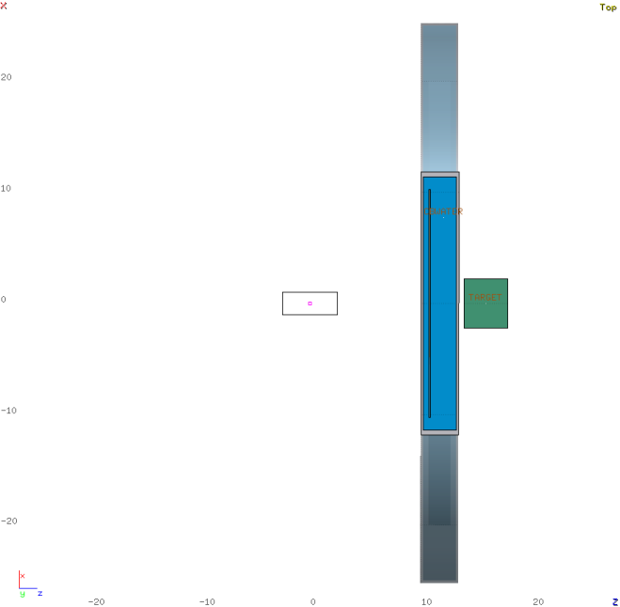
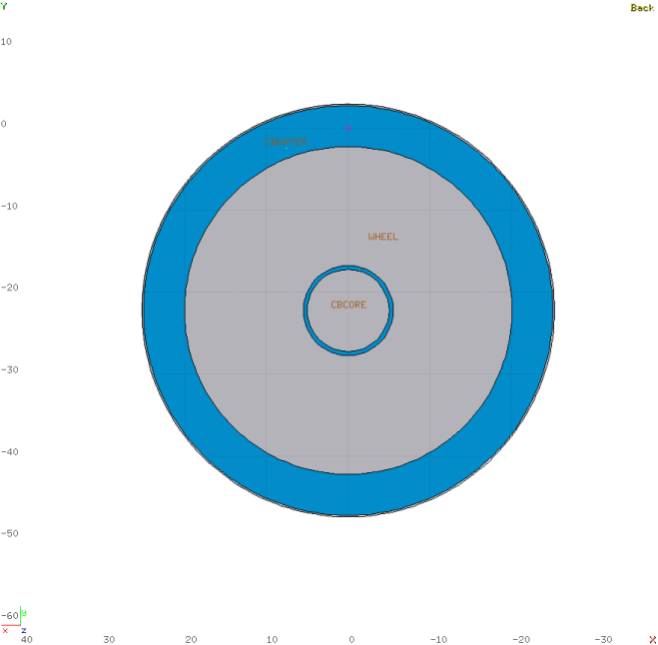
Sample Test Geometry (FLUKA)
Target: ²³⁰Th, 700 g
Rotating Wheel: Al or Be
Radiator: Re, 1.2 mm

Slide 5
Discussion
Low Energy setup (beam energy under the threshold of two-neutron production, E<~12 MeV) is attractive because of low production of accompanying radioactivity, both in the ²³⁰Th(γ,n)²²⁹Th, and in ²²⁶Ra(γ,n)²²⁵Ra reactions
The rotating-in-the-flow-of-coolant radiator solution allows the design of high power (100s of kW) irradiation facility
At low energies, the low-Z coolant (water) may serve as an energy absorber / filter, limiting power deposition in the targets (replacement for the magnetic field filter)

Slide 6
Extras

