Slide 1

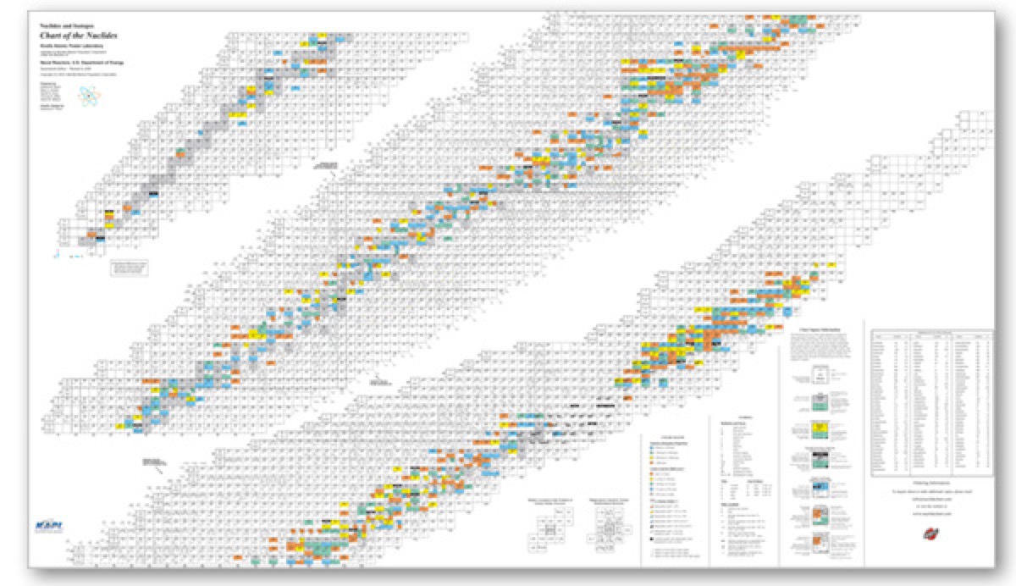
Isotope Production at LERF
Andrew Hutton
Jefferson Lab
for
  Hari Areti, Pavel Degtiarenko, Joe Gubeli, Kevin Jordan, George Kharashvili, George Neil Jefferson Lab
  Sundaresan Gobalakrishnan, Jamal Zweit Virginia Commonwealth University
  Doug Wells New Mexico Tech
AccApp’17 Quebec City August 1, 2017

Slide 2
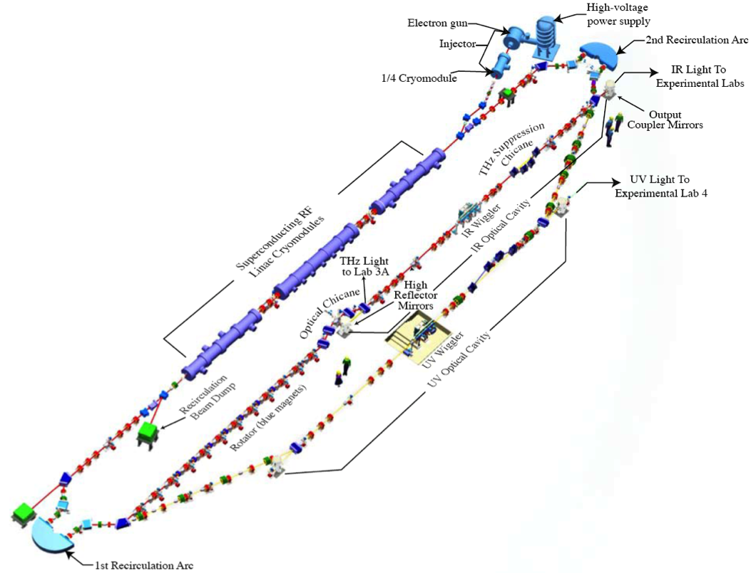
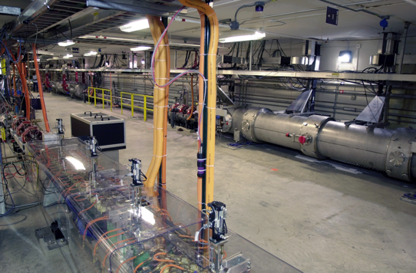
JLAB Low Energy Recirculator Facility (LERF)
LERF is an Energy Recovery Linac
World’s first high power FEL
Still holds power records for FEL and ERL operation
Beam accelerated from 9 to 170 MeV and then decelerated back to ~10 MeV, to recover the energy
2

Slide 3
LERF Capabilities
The ERL in the LERF is available for:
  Fixed target experiments at medium current
  Internal target experiments at high current
  Offline accelerator research and development
  Diagnostic development
  FEL studies in the IR and UV
  THz production
    Parameter Maximum value
    Current (ERL) 8 mA
    Energy 170 MeV
    Charge 150 pC
    Frequency 75 (750) MHz
    Current (fixed target) 0.5 mA

Slide 4
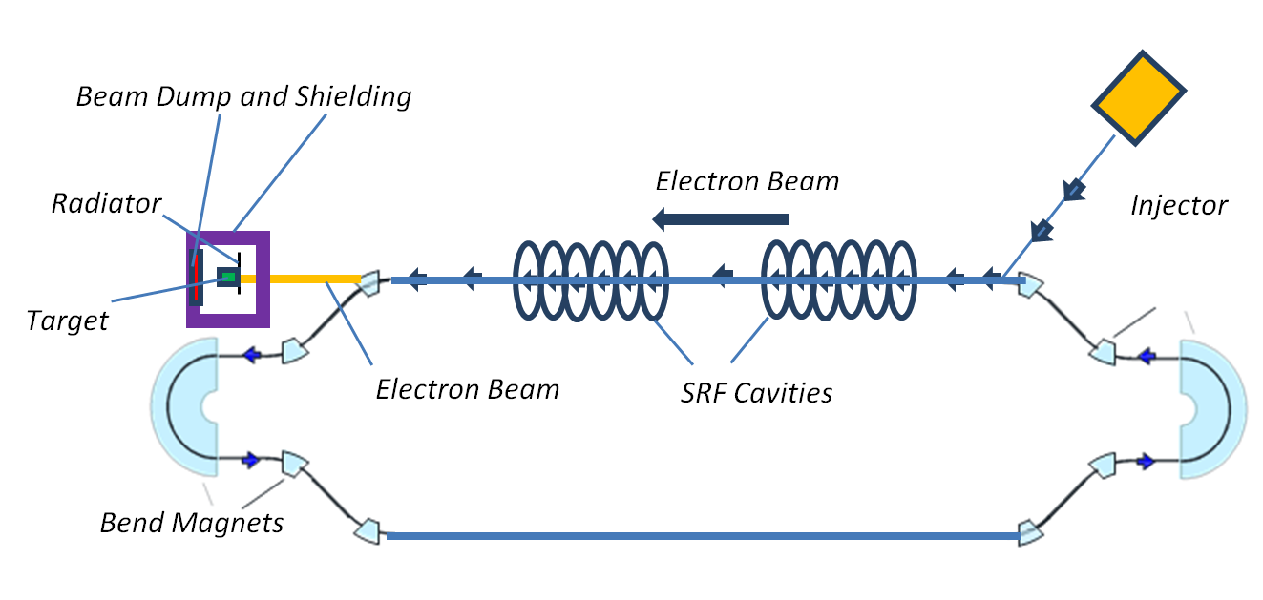
Jefferson Lab for Isotope Production
Low Energy Recirculator Facility (LERF) is proposed for isotope production in non-ERL mode
  Up to 150 MeV energy electron beam
  Up to 100 kW beam power

Slide 5
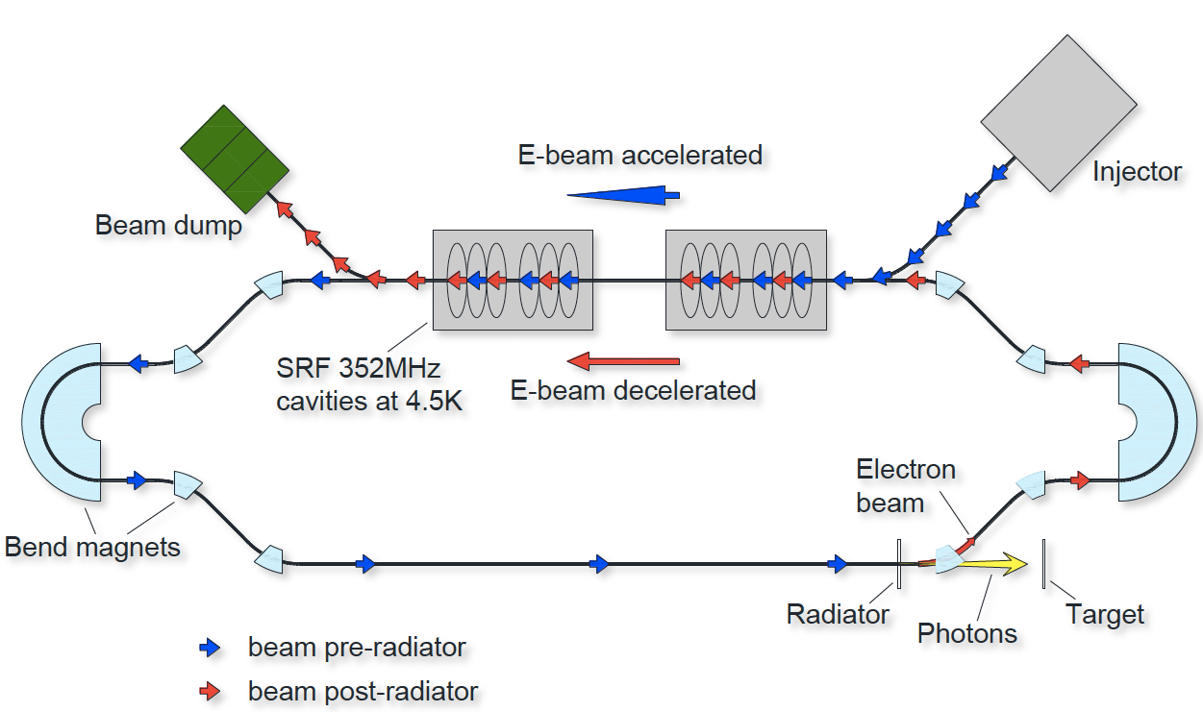
Schematic of ERL-Based Isotope Production
LERF can also produce isotopes in ERL mode
Presentation by Rol Johnson in Radio-Isotope-1 Session on Tuesday

Slide 6
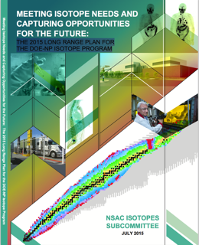
NSAC Isotopes Recommendations on Isotope R&D
“Continue support for R&D on the production of alpha-emitting radioisotopes”
“Support R&D into the production of high specific activity theranostic radioisotopes”
“Continue support for R&D on the use of electron accelerators for isotope production”
“Support R&D on the development of irradiation materials for targets that will be exposed to extreme environments to take full advantage of the current suite of accelerator and reactor irradiation facilities”
This study addresses all of these

Slide 7
Isotope Production Collaboration
Jefferson Lab:
Hari Areti, Pavel Degtiarenko, George Kharashvili, Joe Gubeli, Kevin Jordan, George Neil
  Radiation physics, health physics, Monte-Carlo modeling, radiation metrology, high-power SRF electron accelerators, targetry, beam diagnostics, beam dumps
Virginia Commonwealth University:
Jamal Zweit, Sundaresan Gobalakrishnan
  Radiochemistry, radiopharmaceuticals, medical imaging, nanotechnology
New Mexico Tech:
Doug Wells
  Photonuclear physics, activation analysis, isotope production

Slide 8
Recent Activities
2012 – Proposal for isotope production using LERF in ERL configuration submitted to DOE Isotope Program
  not funded (DE-FOA-000743)
2015 – Pre-R&D Proposal Funded by DOE Isotope Program
2015 – White paper for photoproduction of ⁶⁷Cu
2016 – R&D proposal for ⁶⁷Cu production – DOE Isotope Program
  not funded in 2017, under consideration for 2018 funding (DE-FOA-0001588)
2017 – US patent application: ⁶⁷Cu Photoproduction in Gallium
2015/2017 – Proof of concept studies
  ⁶⁷Cu production in gallium and zinc targets at CEBAF injector
  ⁶⁷Cu separation from gallium at VCU

Slide 9
⁶⁷Cu for Targeted Radiotherapy
Theranostic radionuclide
  141 keV mean energy β⁻ for therapy (range in tissue is about a cell diameter)
  185 keV energy γ for SPECT imaging
  Can be paired with ⁶⁴Cu for PET imaging
Near-ideal half-life of 61.8 hours
  Convenient for production, transportation, and delivery to patient
  Same order as biological half-life of copper and zinc (⁶⁷Cu decays to stable ⁶⁷Zn)
Favorable biochemistry – approved for human trials
  Not a bone or an organ seeker
  Not acutely toxic – both copper and zinc are essential trace nutrients

Slide 10
Demand and Availability of ⁶⁷Cu
  Historical lack of an adequate and reliable supply has impeded the development of ⁶⁷Cu applications
Estimate of potential long-term US demand based on treating half of all new Non-Hodgkin Lymphomas gives ~12,000 Ci / year
Smith, Bowers, Ehst, “The production, separation, and use of ⁶⁷Cu for radioimmunotherapy: A review“, Applied Radiation and Isotopes 70 (2012) 2377–2383
⁶⁷Cu is currently produced at:
  Brookhaven National Laboratory: Proton irradiation of zinc, produced periodically, ~60% of activity upon delivery is composed of ⁶⁴Cu
  Argonne National Lab LEAF: Photoproduction reaction producing 100 mCi batches on demand, expandable to 2 Ci batches
  Idaho Accelerator Center: Photoproduction in zinc up to 10s of mCi / week, not intended for human use
Higher specific activities and improved radiological purity are desired

Slide 11
    Photoproduction of ⁶⁷Cu in Gallium via ⁷¹Ga(γ,α)⁶⁷Cu (1)
Gallium has favorable properties for high power targets
  ✔ Low melting point of 30 °C
  ✔ High boiling point of 2204 °C
  ✔ Low vapor pressure
  ✖ Corrosive to metals except tungsten and tantalum
50 kW irradiation of a Gallium target once per week will produce*
  100s mCi of ⁶⁷Cu per week in natural gallium
  > 1 Ci/week in ⁷¹Ga (40% of natural Gallium)
  Typical medical dose of ⁶⁷Cu – order of 10 mCi
  * Yields are calculated using FLUKA and scaled with data

Slide 12
    Photoproduction of ⁶⁷Cu in Gallium via ⁷¹Ga(γ,α)⁶⁷Cu (2)
Modest cross-section of ⁷¹Ga(γ,α)⁶⁷Cu reaction can be compensated by high beam power and a thick target
Koning et al. "TENDL-2015: TALYS-based evaluated nuclear data library”
https://tendl.web.psi.ch/tendl_2015/tendl2015.html

Slide 13
    Photoproduction of ⁶⁷Cu in Gallium via ⁷¹Ga(γ,α)⁶⁷Cu (3)
Isotope production
Bremsstrahlung photons
High-Z Radiator
50 kW Electron beam
Beam Pipe
Coolant flow
Cooling Jacket
Target container
Coolant lines
Liquid gallium

Slide 14
Overall Objectives and First Steps
The overall objective is to integrate
  Production
  Chemical Separation
  Delivery
First (opportunistic) steps
  Confirm ⁶⁷Cu production in gallium
  Chemically separate ⁶⁷Cu from gallium
  Investigate ⁶⁷Cu delivery mechanisms

Slide 15
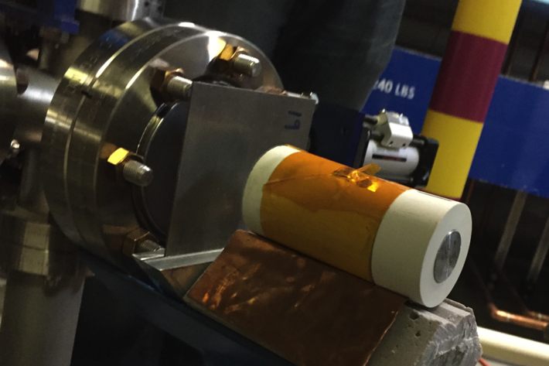
First Opportunistic Irradiation Test
Irradiation of Gallium and Zinc targets during beam studies in CEBAF injector:
  18.5 MeV (to avoid interference from ⁶⁷Ga), 2.5 µA, 1 h
  ~ 0.1 µCi ⁶⁷Cu detected in each target
Natural Gallium target
Boron Nitride crucible
Beryllium window
Natural Zinc target
1mm Tungsten radiator
Kapton tape to prevent Gallium spills

Slide 16
Chemical Separation Test
Chemical separation test at Virginia Commonwealth University (VCU)
  1 mCi of 67Cu was obtained from the National Isotope Development Center
    Shipped from BNL to VCU
  The sample was dissolved in hydrochloric acid and added to gallium chloride in solution
  Separation by liquid-liquid extraction and column chromatography recovered ~95% of the radioactive copper after a single pass

Slide 17
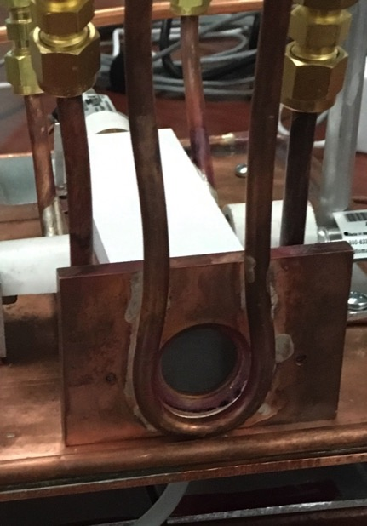
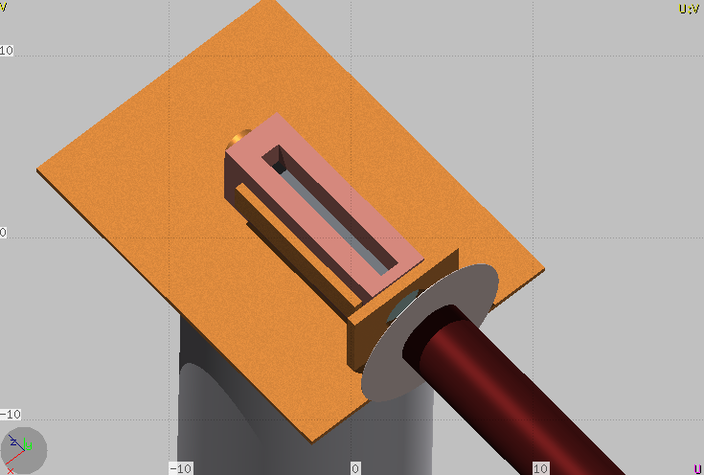
Second Opportunistic Irradiation Test (1)
During 2017 beam studies of 4K operation in CEBAF injector, there was a parasitic opportunity for isotope irradiation
  85 g gallium target irradiated for several hours at 18.65 MeV, 50 µA (~1 kW) with the goal of chemically separating ⁶⁷Cu
Hexagonal Boron Nitride Capsule
Gallium Target
Beryllium Window
Tungsten radiator

Slide 18
Second Opportunistic Irradiation Test (2)
Due to failure of monitoring instrumentation, run was terminated earlier than anticipated
~130 µCi ⁶⁷Cu was produced, ~70 µCi was available at the time of sample retrieval (aimed to produce ~500 µCi)
Due to transportation and communication issues did not proceed with chemical separation
The two, low-energy irradiation tests showed reasonable agreement with the model predictions
  FLUKA (our primary tool for activation calculations) appears to overestimate ⁶⁷Cu yields in Gallium by approximately a factor of 2 at 18.5 MeV maximum bremsstrahlung energy

Slide 19
Summary and Proposed Future Work
⁶⁷Cu production via the ⁷¹Ga(γ,α)⁶⁷Cu reaction at LERF:
Production of high specific activity, theranostic isotope using a high-power electron accelerator
  Measured photoproduction of ⁶⁷Cu at low energies (< 20 MeV)
    No ⁶⁴Cu content detected
  Chemically separated ⁶⁷Cu from Gallium
    Obtained from BNL, then dissolved in Gallium
  Proposed future work
    Complete smooth integration of photoproduction and chemical separation
    Produce ⁶⁷Cu in Gallium target at optimal electron beam energies (> 30 MeV)
    Develop high power target system
Investigate photoproduction of α-emitters
  ²²⁵Ac production in ²²⁶Ra, ²³⁰Th, ²³²Th targets

