Slide 1
The Low Energy Recirculator Facility Isotope Opportunities Laboratory Facilities
Andrew Hutton
Notes:
Research Coordinator (RC): deals with activities, scheduling and conflicts of equipment or other resources.
Most activities will be lab-centric.
Shukui is currently safety warden (SW) for Building 18, but it’s unfair to make him SW for all activities.

Slide 2
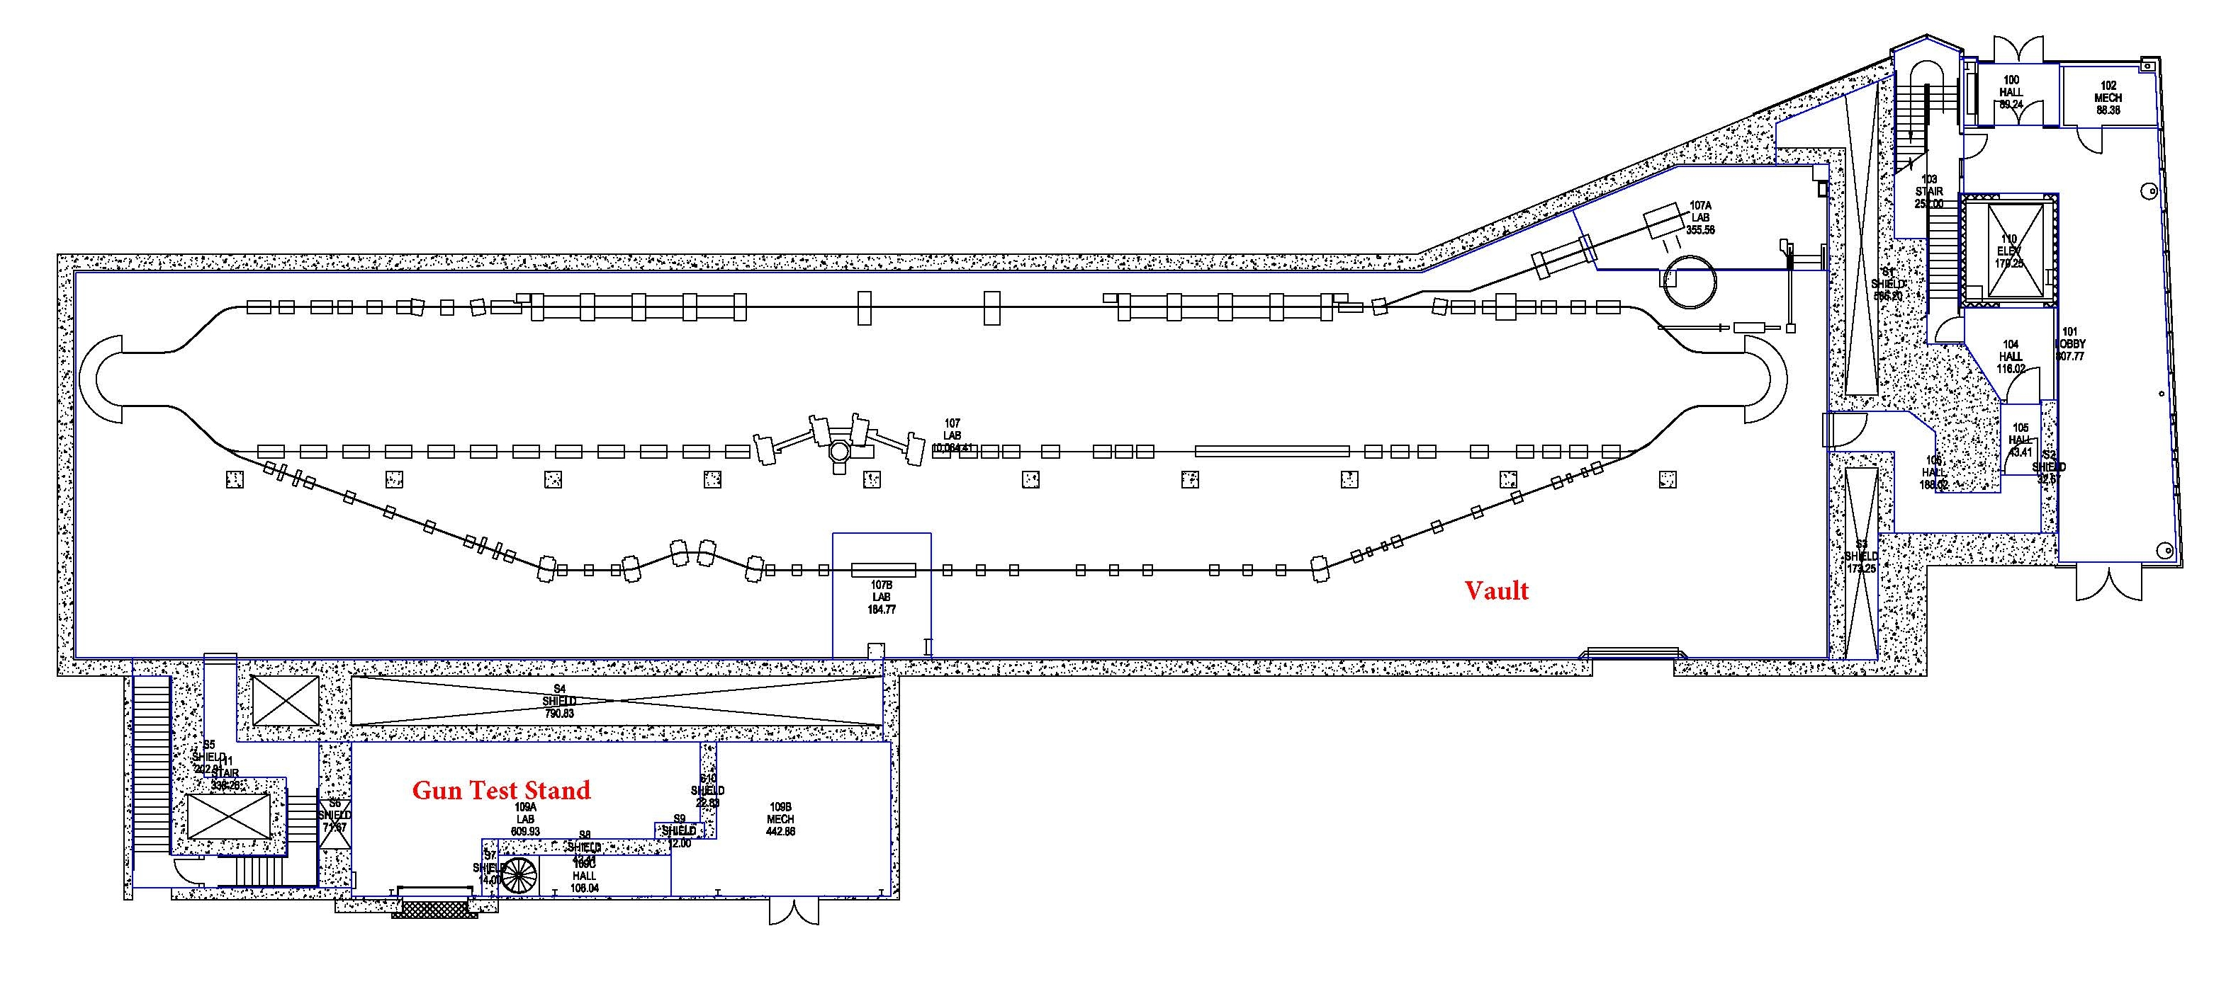
LERF Lower Floor
Isotope Production Area
LCLS II Cryomodules

Slide 3
Introduction to Isotope Production at LERF
Most isotopes in use today are generated from reactors or cyclotrons
Isotopes produced in reactors are mainly from the neutron, gamma (n, γ) reaction (radiative capture)
Cyclotrons bombard a target with a stream of heavy charged particles (commonly protons)
Electron linacs use a radiator to produce bremsstrahlung photon beams which interact with a target which creates isotopes of interest
Bremsstrahlung is produced as the electrons are slowed down in their interaction with matter (the radiator)

Slide 4
Schematic of Photonuclear Reaction

Slide 5
CW SRF Electron Linacs
CW electron linacs offer unique advantages over traditional techniques
They are reasonably simple devices to operate and maintain
JLab has extensive experience built up over more than a quarter century in the design, fabrication and operation of CW SRF electron linacs
JLab is uniquely placed to provide an alternative to more traditional production techniques using reactors or high-energy positive ion accelerators
Electron beam energies over the range of 20 to 100 MeV are ideal for photonuclear production of isotopes such as ⁶⁷Cu, ¹¹¹In, ¹⁷⁷Lu and ²²⁵Ac
LERF is currently capable of accelerating 1 mA of electrons to 20 – 40 MeV
While the specific activity of a produced isotope for photonuclear reactions is not so high (≤1 Ci/g), the efficiency of production can be considerably higher with gammas than for protons and neutrons

Slide 6
Example of ⁶⁷Cu
We have focused on the machine parameters necessary to produce ⁶⁷Cu, but the flexibility of future electron facilities will not be limited to one specific isotope
⁶⁷Cu is an example of an isotope produced through the photonuclear reaction ⁶⁸Zn(γ, p)⁶⁷Cu, and is ideally suited to be produced with a high-power CW electron linac
⁶⁷Cu is an important isotope, approved for human trials and identified by DOE as a high-priority research isotope
It is useful for both therapy and imaging as it emits both a beta particle for therapy and a gamma ray that can be used with standard SPECT (Single Photon Emission Computed Tomography) imaging systems

Slide 7
Present ⁶⁷Cu Production Rates
We expect to be able to exceed the production rates of a traditional
electron linac because SRF cavities can accelerate CW beam current

Slide 8
Need detailed layout of Isotope Production Area
Should show target area and how radiated targets are put into a container and shipped out

Slide 9
Need photos of present Isotope production area

Slide 10
Need long-view photos of vault showing LCLS II modules and the LERF on the right

Slide 11
Need concept for high power target

Slide 12
LERF Labs
LERF has 7 user labs (two of the labs are split in half)
All had expensive equipment optimized for research using FEL light
Includes several high-power lasers and a micro-machining facility
We have spent a lot of effort developing plans to re-purpose the labs
The criteria were:
Maintain compatibility with future free electron laser experiments
The in-vacuum light distribution system has been left intact
Make optimal use of the existing equipment
Some equipment has been re-allocated to a different lab
Each lab now has an assigned research topic
A Scientific Program Coordinator (SPC) and a Lab Coordinator (LC) have been appointed (all self-nominated)

Slide 13
Oversight
Scientific Program Coordinator (SPC)
Identify Users and resources to take advantage of Lab capabilities
Schedule time for Users and define the safety envelopes for applications
Verify that all safety documents are filed and up-to-date
Approve activities in the Lab
Lab Coordinator (LC)
Work with the SPC to schedule activities in the Lab
Coordinate with the Safety Warden to resolve safety issues
Manage the housekeeping activities with Users to keep the Lab neat, orderly and operating smoothly
Work with Users to carry out activities safely in the Lab and make sure that Users understand all safety documents and complete appropriate training

Slide 14
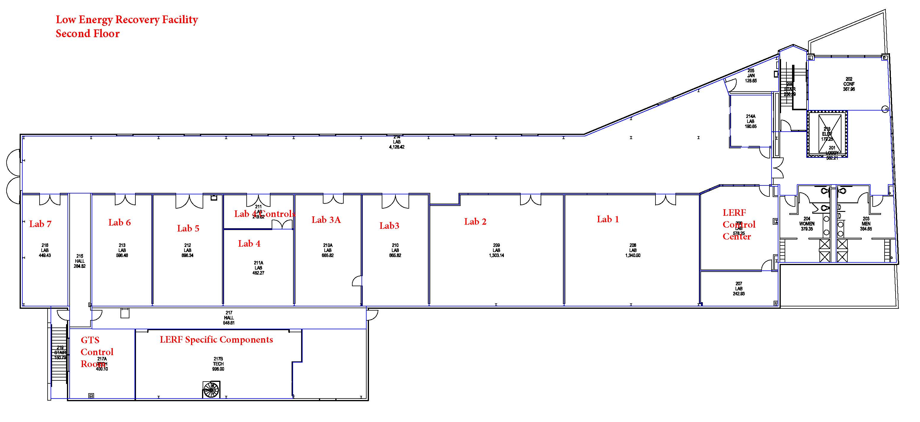
Upper Floor Layout
We are here
RF Power Amplifiers for LERF and LCLS II

Slide 15
Need long-view photo of LCLS II SSAs and the LERF HPAs

Slide 16
Overview of LERF Labs
Lab # | Square Footage
1 | 1340
2 | 1303
3 | 665
3a | 665
4 foyer | 220
4 lab | 482
5 | 696
6 | 596
7 | 450
All labs contain penetrations to the vault below.
Labs 1 through 6 have working laser safety systems (No LSS in Lab 7).
Each lab has a separate power panel, compressed air, etc.
Notes:
There is also LCW water in each lab with capacity for CW in some.
Lab 7, aka Equipment Room, servers can be removed.
In the past, penetration has been used for optics reach to vault.

Slide 17
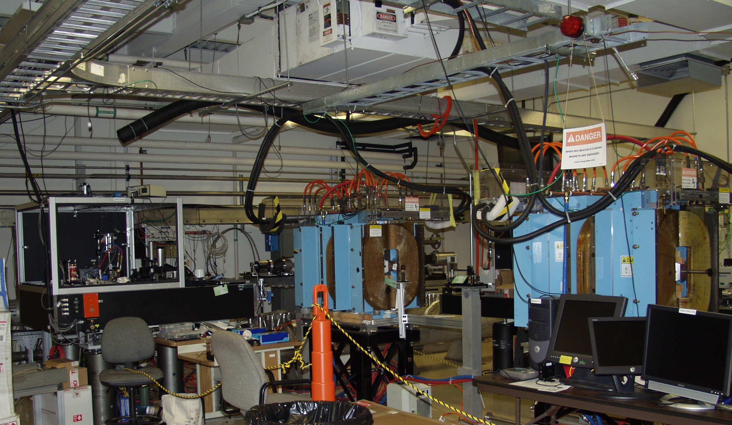
Lab 1: Dark Matter & Related Experiments
Lab 1 was used for the LIPSS experiment and is currently being used for testing the equipment for the PHADE experiment
Also an excellent location for any future free electron laser experiments
The Vacuum Ultra Violet light is fed from the vault with the minimum number of mirrors
SPC – George Neil
LC – Kevin Jordan
Notes:
UV and IR are also fed here from the vault.
Other activities in Lab 1 now, Dark Matter search activities ongoing. Could rename from Dark Light to Dark Matter Lab.
Should chicane magnets be taken out? Jim Boyce trying to get funding for Chameleon search; he will continue to test apparatus.
W&M interested in Jim’s Chameleon search. Profilometer could be moved to Lab 2 for use there.
Potential uses include future Project E tests.
Research Coordinator George Neil, Deputy RC Kevin Jordan
Safety Warden George Neil for now, need to identify and train suitable SW
Lasers on table are functional (SB) but are not being used; Tsunami can be moved to another lab e.g., Lab 5

Slide 18
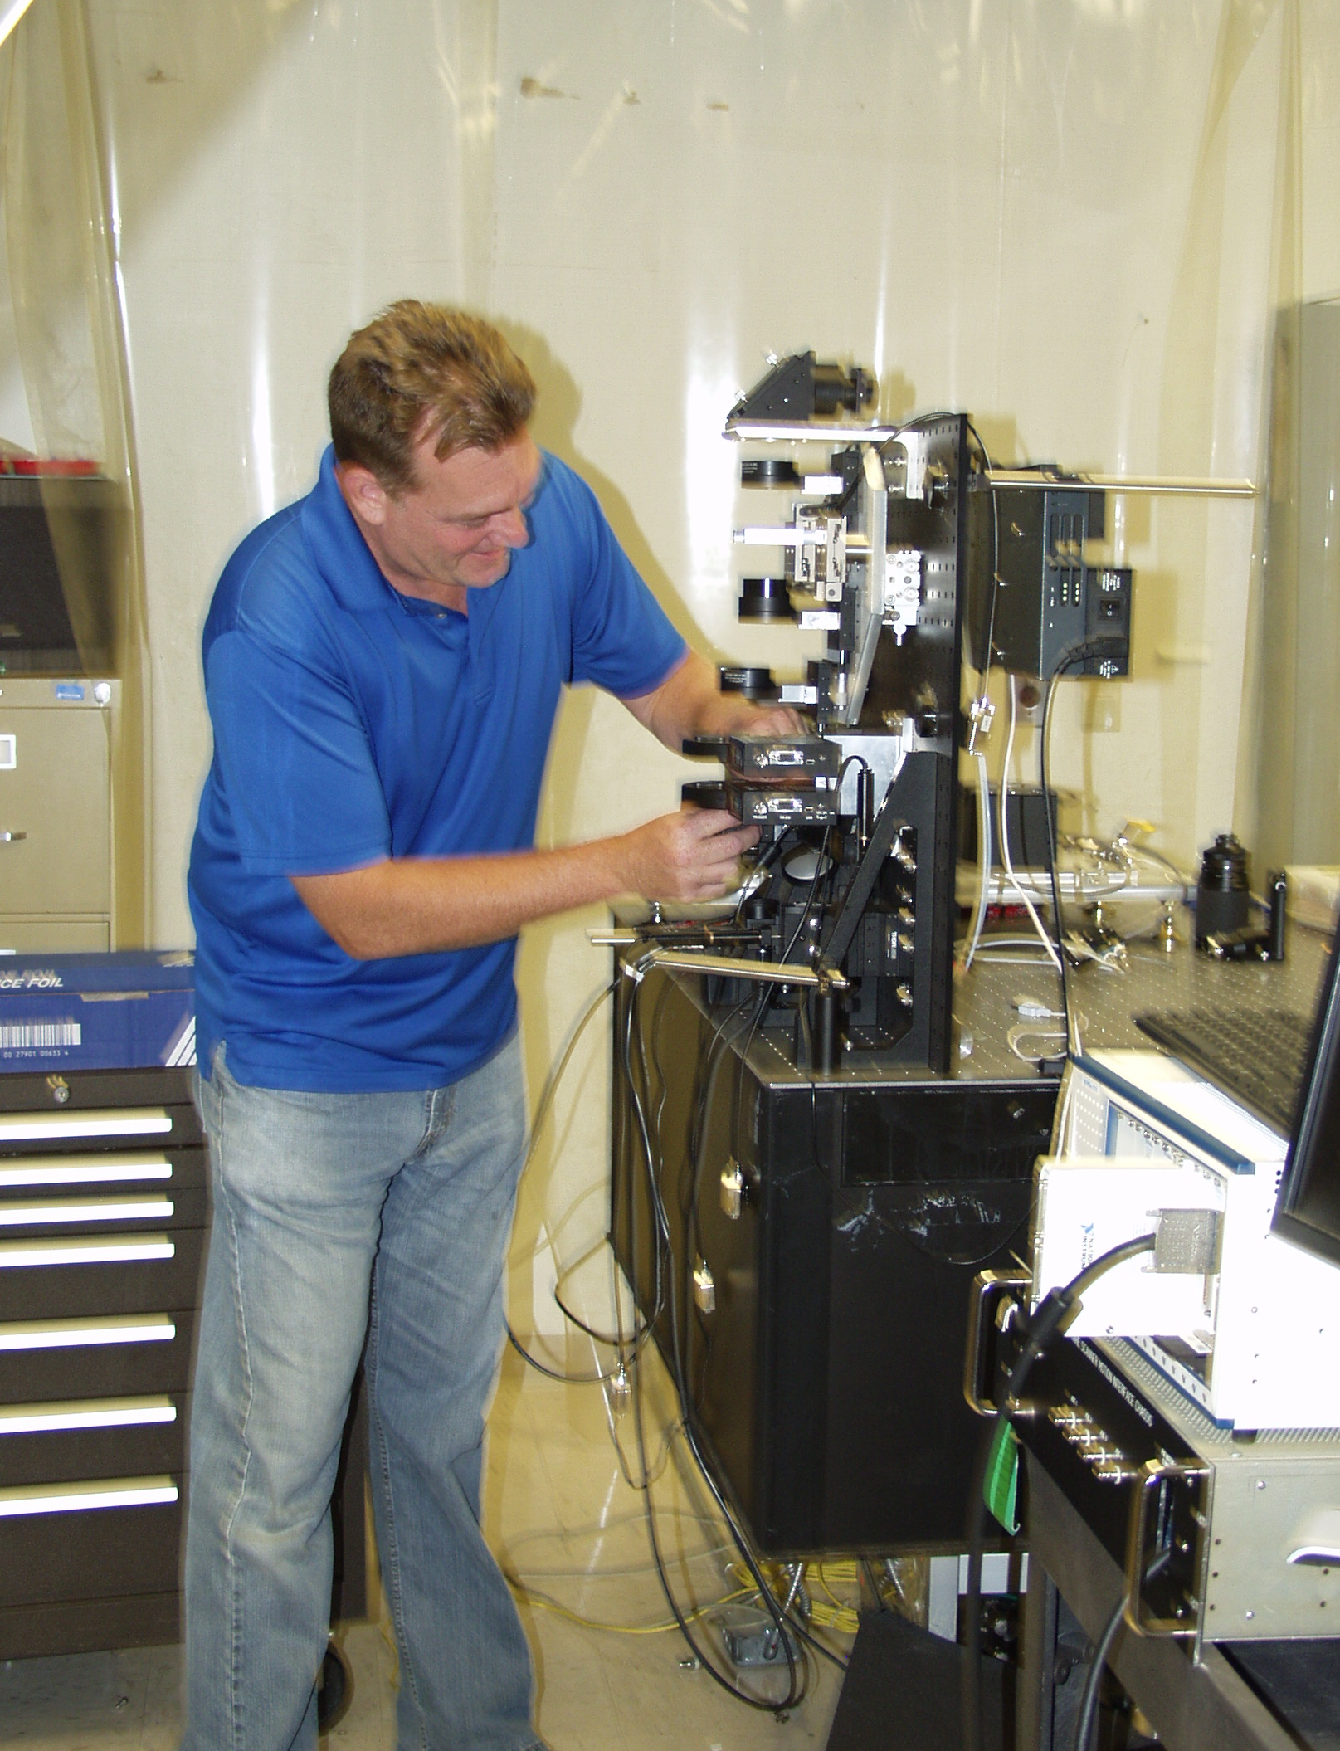
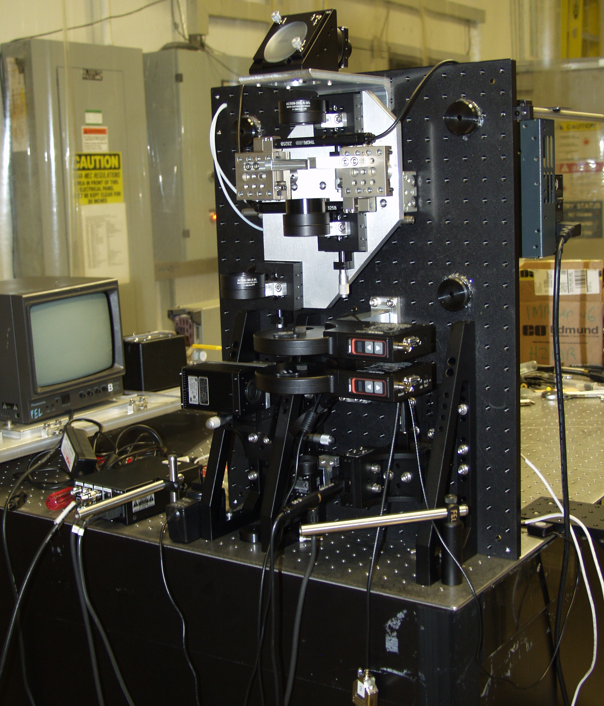
Lab 2: Diagnostics Research and Assembly
Lab 2 contains the hutch for the high power laser, clean areas for assembly, and is well suited to Joe Gubeli's diagnostics development work.
Also contains optical metrology and a mirror test stand
The Optical Profilometer currently housed in Lab 1 is an excellent complement to the equipment used in diagnostics and optics work
SPC & LC – Joseph Gubeli
Notes:
Lab 2 also contains other optical metrology and mirror test stand (goes with Profilometer to support optics work) ongoing optics and diagnostics work
RC and SW will be Joe Gubeli. If he becomes the primary/major user, will need a separate safety warden

Slide 19
Lab 3: Ultrafast Photonics
Lab 3 is being used as an Ultrafast Photonics Lab
A suitable laser is already installed and functioning
Collaboration with Sandra Biedron, Colorado State
Lab 3 is the only JLab space that is safe for TeraHertz work
The penetration to the LERF vault is adjacent to the UV wiggler and the hutch in the room was designed/designated for TeraHertz work
Studies of TeraHertz from LERF are not currently funded, but there is interest in Lab 3 for pump-probe experiments using lasers
The hutch and equipment are being preserved to maintain the option
SPC & LC – Shukui Zhang
Notes:
THz is booming in the rest of the world, although no one has reached the intensity of this lab yet.
Now have CSU laser and collaboration with CSU (funded). Collaboration uses laser and potentially also accelerator downstairs (Colorado State University at Fort Collins)
Can make THz with this laser whether accelerator is running or not.
RC Shukui, need SW who is not RC. Matt Poelker has accepted.

Slide 20
Equipment in the TeraHertz Hutch

Slide 21
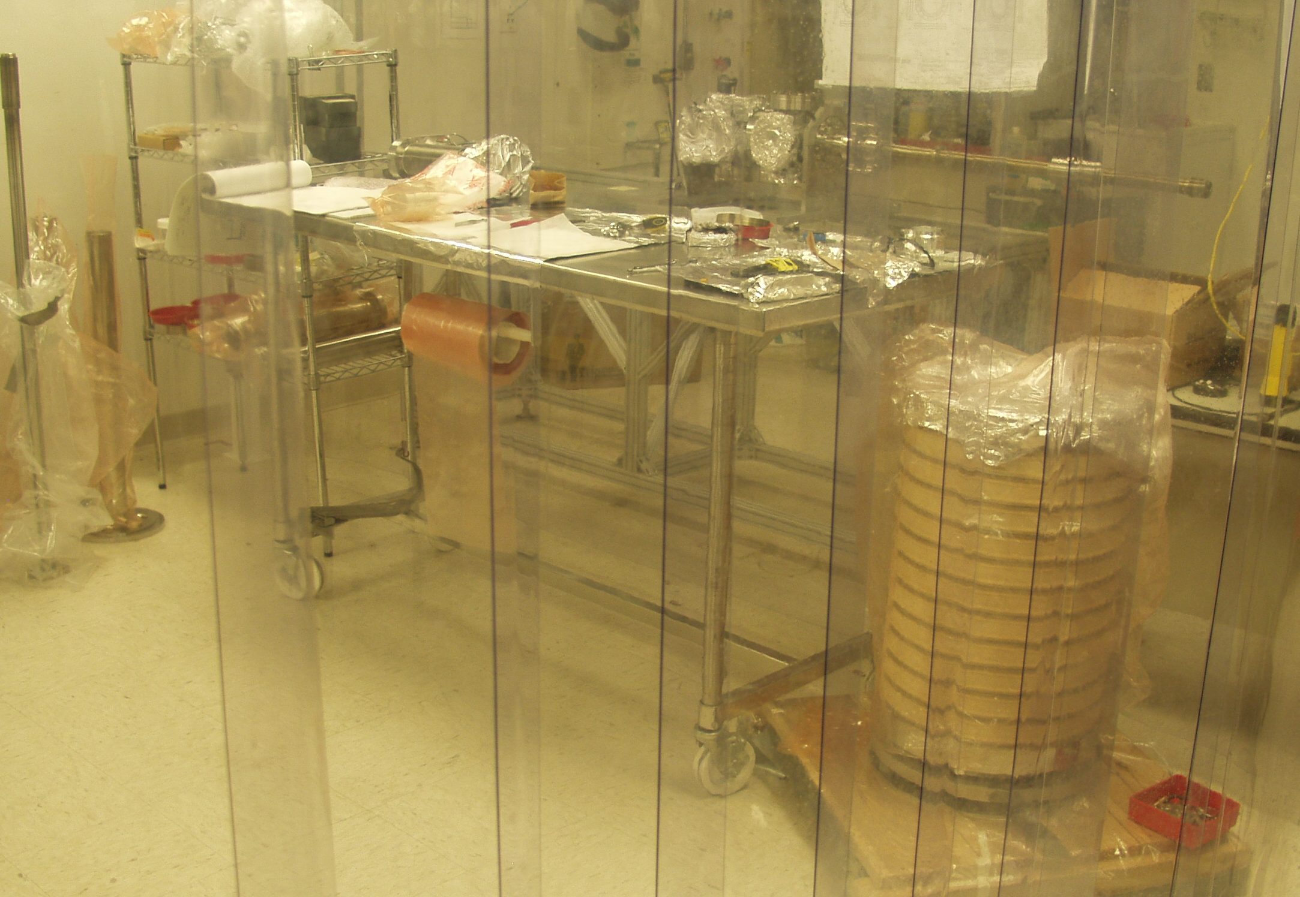
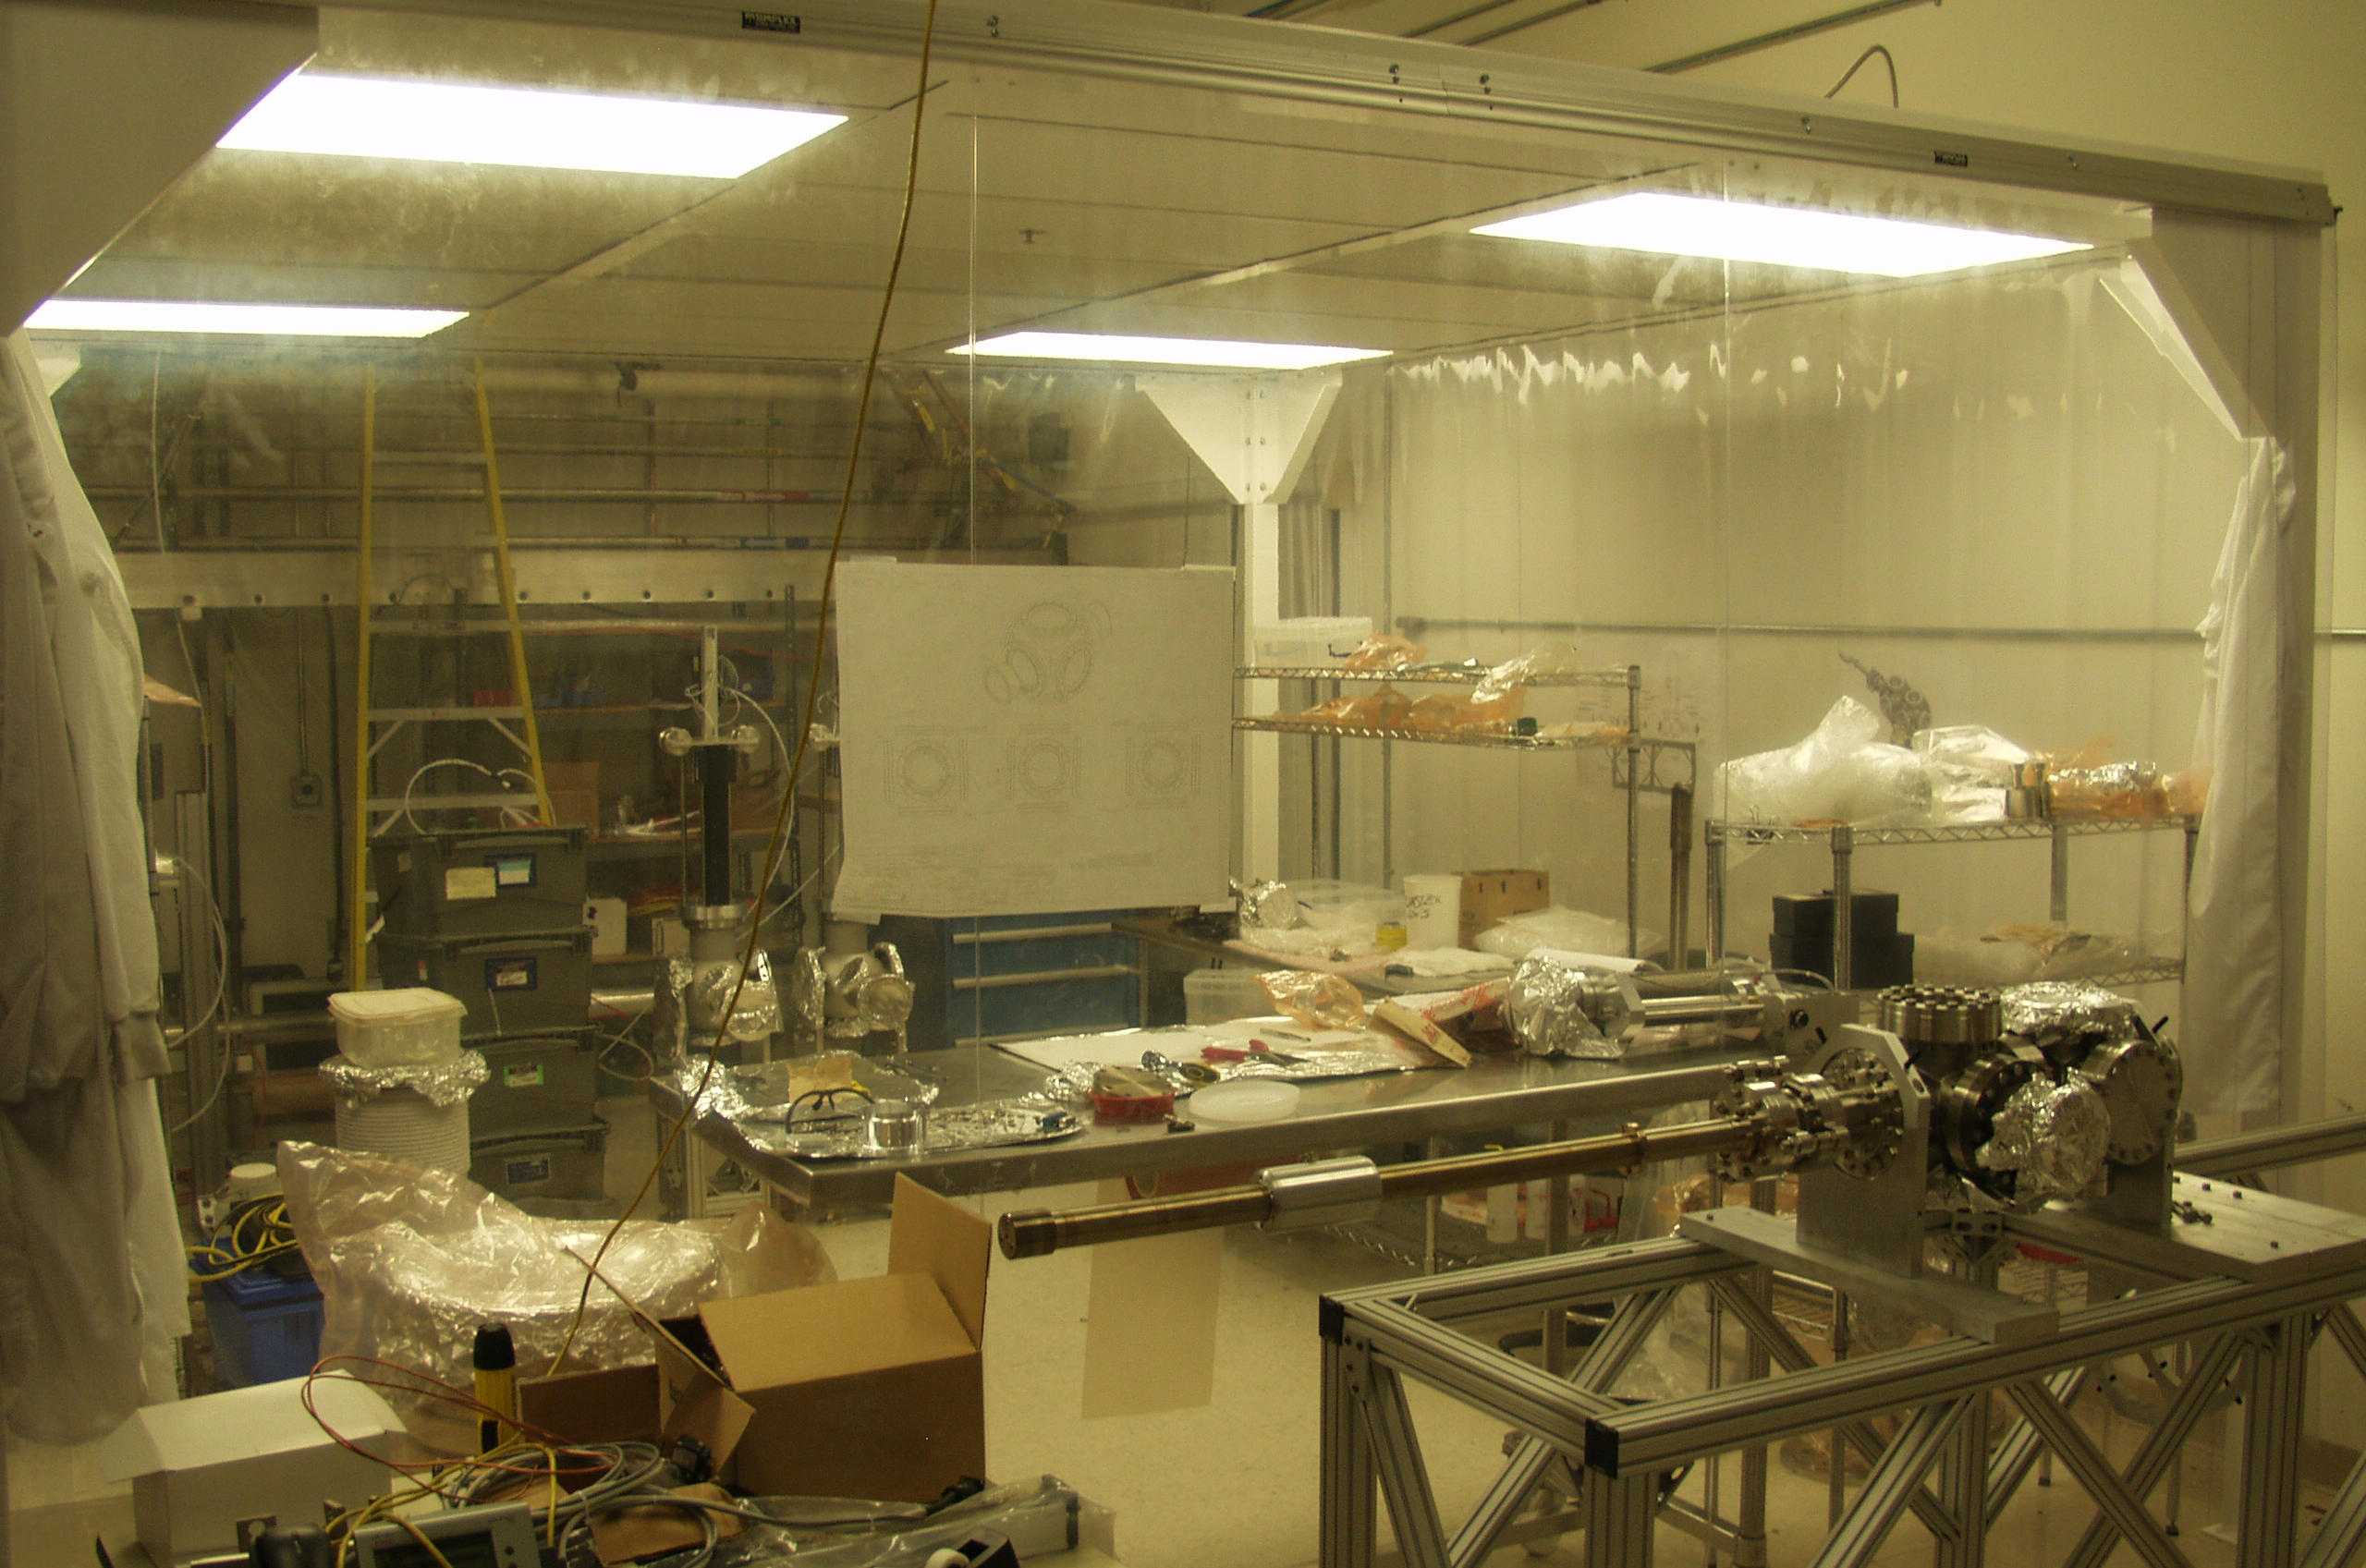
Lab 3a: General Purpose Clean Assembly Lab
Lab 3a and its large clean area is a General Purpose Clean Assembly Lab
Already heavily used for clean assembly
Nanotube research (BNNT) developed here, has been moved out to a spin-off company with facilities on the other side of Jefferson Avenue
SPC – Carlos Hernandez-Garcia
LC– Don Bullard
Notes:
Are there other areas serving this purpose? This area is unique because of the clean tent, __________________________________
Anything wood or cardboard will be moved out along with unassociated equipment (coordination with KJ). Proper shelving and work surfaces will be moved in.
Rename General Purpose Clean Assembly Lab
RC Carlos Hernandez-Garcia
SW Carlos Hernandez-Garcia

Slide 22
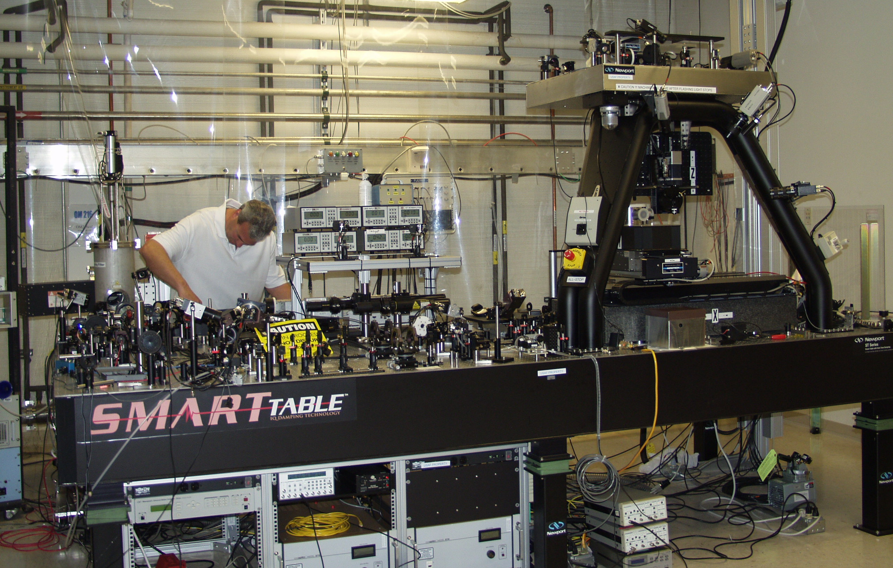
Lab 4: Laser MicroEngineering Station
Laser equipment available, but currently underutilized, can be used to treat, machine or cut materials, etc.
The solid state laser can be used in IR and UV ranges
Equipment can be used to lay material on niobium
SPC – Steve Benson
LC – Joseph Gubeli
Notes:
Nice system, underutilized. Has solid state (SS) laser, Michael Kelley would like to continue surface treatment activities there (wider specific are treated at any given time)
MK teaching at ODU. W&M and VT, has students available.
Micromachining station can be used to lay material on Nb
Research Coordinator was not assigned, nor was the Safety Warden

Slide 23
Lab 5: Pulsed Laser Deposition and Materials Characterization
Lab 5 is being used for UV lamp studies and materials modification
Physics Division also performs Çerenkov mirror measurements here
Space reserved for other Physics Division needs
The laser in Lab 5 is in need of repair
The solid state laser from Lab 4 could be adapted, or we may have another appropriate laser when the requirements are known
Michael Kelley is developing a proposal for use of this Lab to extend surface treatment of niobium and pursue additional applications
SPC – Steve Benson
LC – Kevin Jordan
Notes:
Mike Kelley making progress in surface treated Nb and would like to expand this activity. Use of Labs 4&5 would be ideal.
Verity laser is the kaput one referenced above. Tsunami could be used here,
Pump for regen amp is dead and obsolete; Titan regen amp is repairable and nice system.
Need to replaced Quantronics system
Useful is sub pico-second _________ and millisecond pulses. May need new money.
Steve Benson is RC and Kevin Jordan is SW (knows there’s a lot of cleanup to be done).
MK will be principal customer here when research is funded; has funding for student. Needs formal proposal (expecting May 7)
We need additional proposals for continued use in order to reach Lab/equipment potential.
3D laser printer is messy and cannot go into lab 4; could go into Lab 5.
George Neil knows of funding source from HEP. Proposals must address the specific focus areas of interest to HEP, must be in $250k-$300k per year range and solve an HEP problem. Watch for FOAs; prepare by June for probable August/September submissions deadlines. Eric Colby will participate in allocations

Slide 24
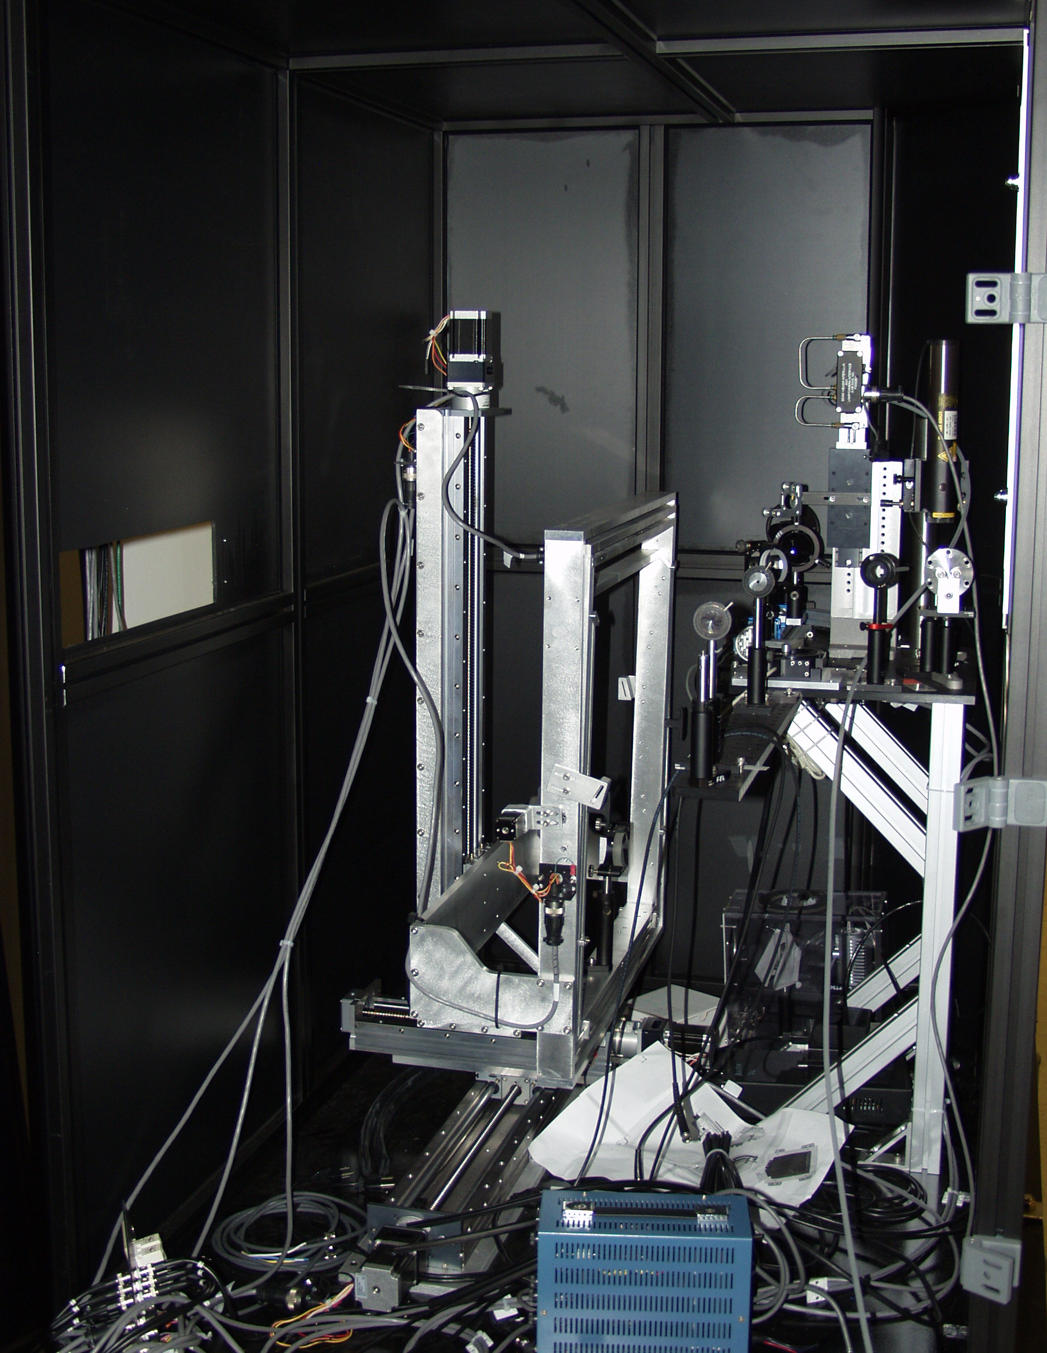
Equipment in Lab 5
Pulsed Laser Deposition and Materials Characterization
Physics work: Çerenkov Mirror Measurement

Slide 25
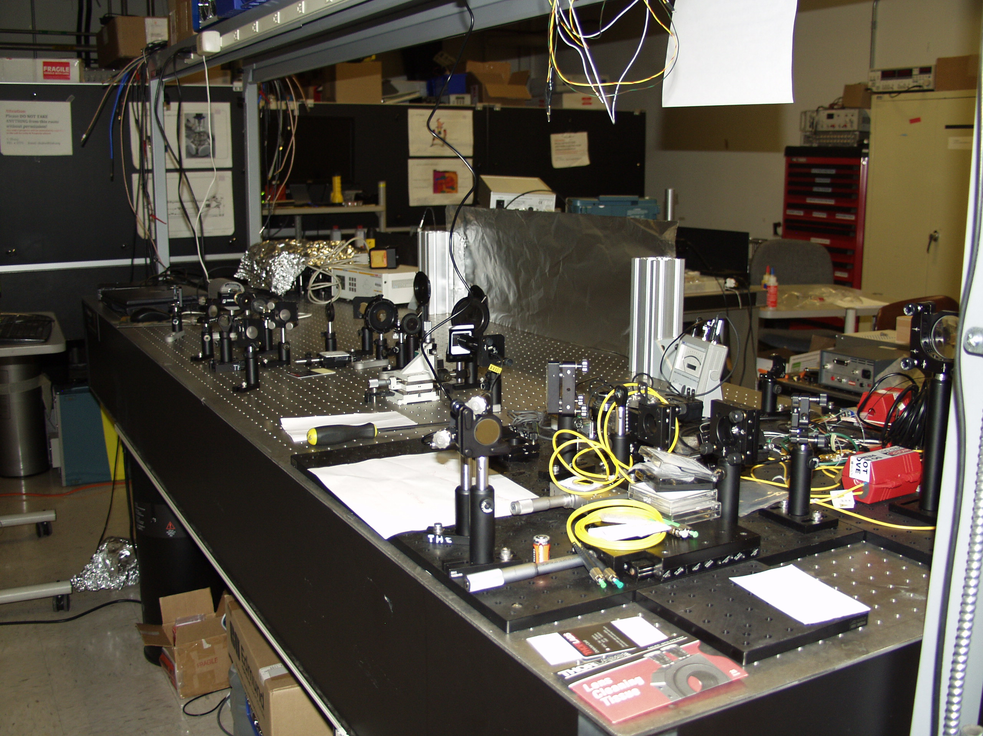
Lab 6: Laser Development for CEBAF and LERF
Lab 6 is a general laser development lab
Ideal space to develop upgrade for Compton Polarimeter in Halls A & C
SPC – Matt Poelker
LC – Shukui Zhang
Notes:
Replace time bandwidth laser with ______________
UITF caused loss of laser test room (will be pulled into UITF laser room only), this space would replace
Replace Compton polarimeter with pulsed light in Halls A&C
Rename lab to Laser Development for CEBAF and LERF, not just for injectors, but also available for Physics Halls
RC Matt Poelker
SW Shukui Zhang

Slide 26
Lab 7: PSS & Network Racks
Lab 7 Currently houses PSS and Network racks for the building
An existing high power box supply could eventually be installed
Would provide redundant power for LERF Arc magnets
Isotope Production Lab
Lab has a direct connection to the area in the vault where we propose to produce isotopes
This would be the best place to stage targets, etc.
SPC – will be appointed when there is a scientific program for the lab
LC – Jim Coleman
Notes:
Racks are servers not network; who should remove?
Box power supply connection good in time for Dark Light run (FY16 or 17?)
Controls for Isotope Production
George Kharashvili’s Hot Cell
Jim Coleman to produce layout and submit to George and Evelyn.
RC Jim Coleman and SW is Jason Delk
Jason could replace Shukui as SW for vault and 2nd floor all but labs including drive laser clean room and mini lab behind control room. He needs to be replaced as Building 36 SW in order to reduce extra duties. Area 51 will be Carlos’ SW duty.
Laser labs are excellent locations for training students; demonstrations for students to observe.
Charles Sukenik would like to look at facility, invite him next month for tour. Charles has UVA collaborators who would also find the labs useful.
Maintenance of Laser Safety Systems is a responsibility which needs to be assigned: Jim Coleman has taken the task for now, but the responsibility needs to be passed to PSS. Current PSS group needs experience in Laser SS… (Doesn’t Physics have a laser lab on 2nd floor ARC?)

