Slide 1
Isotope Kick-Off Meeting
August 3, 2018

Slide 2
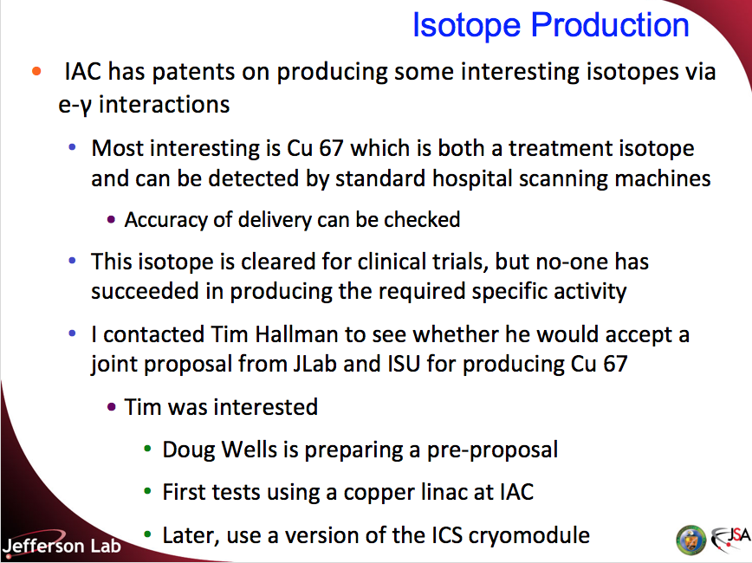
Background
Isotope production was proposed in the 2012 Strategic Planning exercise
Submitted proposal to DOE in 2012
  “Synthesizing Isotopes Using Energy Recovered Linacs”
    PI was Andrew Kimber, only JLab involved
  DOE told us we needed collaborators with isotope expertise
Tried to submit a proposal to DOE in 2014; missed deadline
  Collaborators: Doug Wells, Jamal Zweit and colleagues at VCU
Submitted proposal to DOE in 2016
  Same collaborators
  No official response
  Reviewed well (informal communication)
We prepared to submit proposal in 2018
  Informed that our 2016 proposal is funded
  JLab situation has changed
    CEBAF not available for irradiations

Slide 3
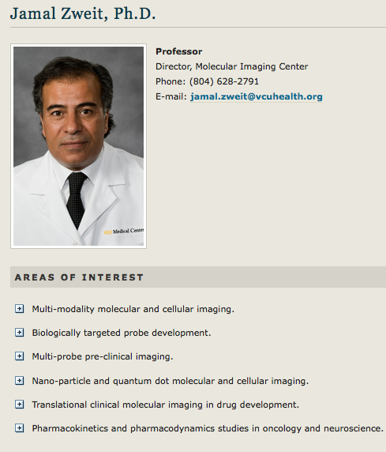
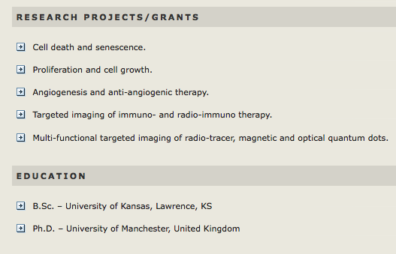
Our Collaborators – Jamal Zweit, VCU
I have worked with Jamal and Sundaresan Gobalkrishnan since 2013
Sundaresan and Huseyin Cicek will be active collaborators at VCU

Slide 4
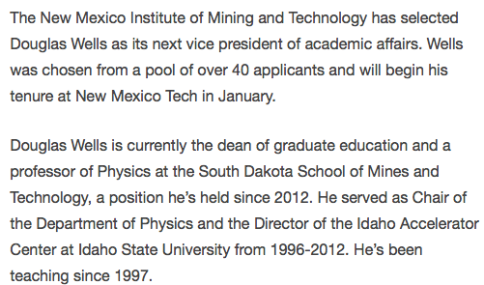
Our Collaborators – Doug Wells, NMT
I have worked with Doug since 2006
  He came to JLab to give a seminar on the Idaho Accelerator Center
2016 proposal was submitted when Doug was in South Dakota
  Funding is being re-routed to New Mexico Tech

Slide 5
Deliverables in Project Proposal
1. Prepare and configure LERF’s injector beamline for low energy, high current electron beam delivery
2. Simulation (GEANT4, MCNP, FLUKA and ANSYS) studies of:
  a. Beam exit window optimization for thermal distribution and power handling
  b. Converter optimization (thickness, type, configuration) for thermal distribution and power handling
  c. Target system to handle up to 50 kW of beam power
3. Experimental verification of the simulations of exit window and radiator capabilities at LERF injector
4. Experimental verification of the power handling capability of target system at LERF injector
5. Determination of currents for high energy runs for isotope production at CEBAF injector
6. Validation of the simulation code with experimental results by irradiation at CEBAF injector and measurement at VCU
7. Extraction and purification of 67Cu from both Ga and Zn targets after each irradiation
8. Measurement of yields, radiochemical and chemical purity after each irradiation
9. Training of a graduate student
All irradiations will now be in the target area in LERF behind the green shielding blocks

Slide 6
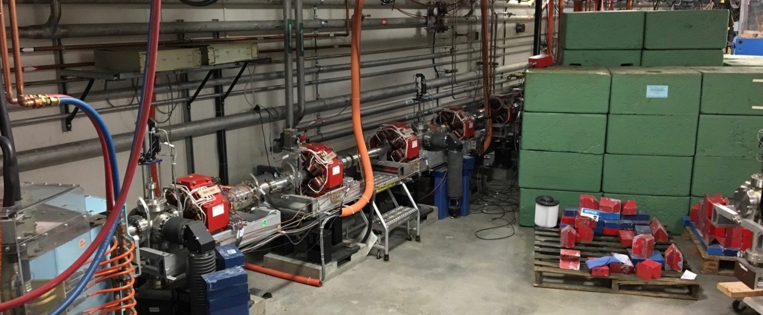
Area Where Target Will Be Installed
This is the area where the target will be installed
  Upstream bend brings beam behind dump shielding
  Radiation shielding will be required
This is a major design and construction activity for the Isotope Project

Slide 7
Deliverables in Updated Project
1. Prepare and configure LERF for low energy, high current electron beam delivery
2. Simulation (GEANT4, MCNP, FLUKA and ANSYS) studies of:
  a. Beam exit window optimization for thermal distribution and power handling
  b. Converter optimization (thickness, type, configuration) for thermal distribution and power handling
  c. Target system to handle up to 50 kW of beam power
3. Experimental verification of the simulations of exit window and radiator capabilities at LERF
4. Experimental verification of the power handling capability of target system at LERF
5. Determine optimum parameters for routine isotope production
6. Validation of the simulation code with experimental results by irradiation at LERF and measurement at VCU
7. Extraction and purification of 67Cu from both Ga and Zn targets after each irradiation
8. Measurement of yields, radiochemical and chemical purity after each irradiation
9. Training of a graduate student

Slide 8
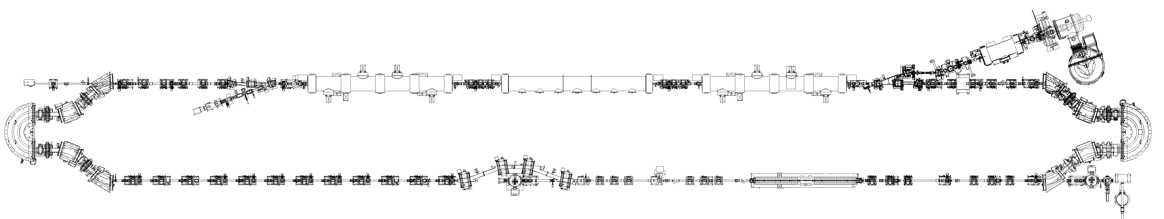
Details of Scope
Prepare and configure LERF for 10, 18.5, 40 MeV electron beam delivery to target behind green shielding blocks with up to 50kW beam power
  No recirculation
  Single cryomodule (recommissioned for magnetization and Q₀ studies)
  Installation of beamline (cannot be the same as before)
  Hot Check Out
  Target Area Re-commission gun
  No installation
LCLS II Cryogenic Header

Slide 9
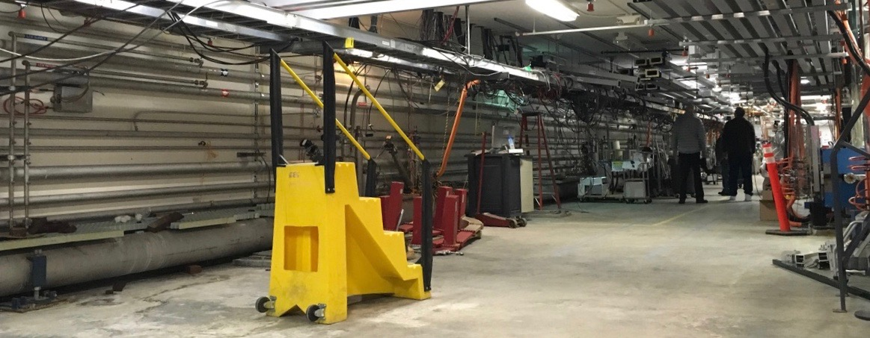
Beamline to be Installed
This is the beamline where the cryomodules used to be
The upstream beamline was removed for installation of LCLS II cryogenics
  New beamline must be installed, working around the LCLS II cryogenic header
This activity will not be funded by the Isotope Project
  Part of the LCLS II installation costs

Slide 10
Details of Scope (cont.)
Design the target using simulations (GEANT4, MCNP, FLUKA and ANSYS):
  Beam exit window optimization for thermal distribution and power handling
  Converter optimization (thickness, type, configuration) for thermal distribution and power handling
  Design of target system designed to handle up to 50 kW of beam power (10 MeV, 5 mA; 40 MeV,1.25 mA; 50 MeV,1 mA)
  Student from New Mexico Tech?
Fabricate the beam exit window, converter and target, including removal and handling system
  Funding supports a few (2-4) irradiations with 18.5 and 40 MeV, ~1 mA
  Remote handling capability should be minimum necessary for the tests
Experimental verification of the power handling simulations of target system (10 MeV, ~ 5 mA)
Determine optimum parameters for routine isotope production
  Production runs are beyond the scope of the Isotope R&D Project

Slide 11
Details of Scope (cont.)
Validate simulation of isotope production using experimental results: irradiation at JLab and measurement at VCU (18.5 and 40 MeV runs)
  Irradiate both Gallium and Zinc targets (Zinc target behind the Gallium target)
  Removal of irradiated targets
  Packaging of irradiated targets
  Transfer of irradiated targets to VCU
    Carry out trial transfer with unirradiated gallium target (early test)
Extraction and purification of 67Cu from both Gallium and Zinc targets after each irradiation (VCU)
Measurement of yields, radiochemical and chemical purity after each irradiation (VCU)
Training of a graduate student (NMT)

Slide 12
Timeline in Project Proposal – Year 1
We will use the first year to model and simulate isotope production as well as thermal and mechanical processes and begin the designs for the beam exit window, the radiator and the target system
During this year, we will prepare LERF beam line
During the first two quarters, we will also develop separation techniques to carry out radionuclide measurements and radiochemical separation of irradiated targets in the 3rd quarter
At LERF, we will conduct the first set of irradiation experiments of both gallium and zinc targets, at low power but high energy, to establish processing protocols for isotope separation and chemical and radiochemical purity
Designs of components during this year will lead to their fabrication spanning Quarters 3 to 5
Prior to the first runs, we will prepare the LERF beam line for the tests, compile the experiment readiness documents and obtain approvals from Accelerator Operations, JLab Management and the DOE Site Office

Slide 13
Timeline in Project Proposal – Year 2
During Quarters 4 and 5, the target system will be evaluated without beam, e.g., 50kW heating test, investigating thermal conductivity between the target capsule and the copper jacket
  Any required target modifications will be made
During Quarters 6 and 7, low power isotope production at 18.5 and/or 40 MeV will be carried out at LERF followed by radiochemical separation at VCU
In Quarters 6 and 7, high power beam test of the target system will be done at LERF
During this period, more low power, high energy tests may be done at LERF, followed by radiochemical separation, radionuclide measurements and purity analysis at VCU
The final report of findings will be completed by Quarter 8
Timeline will be revisited to reflect irradiations in LERF

Slide 14
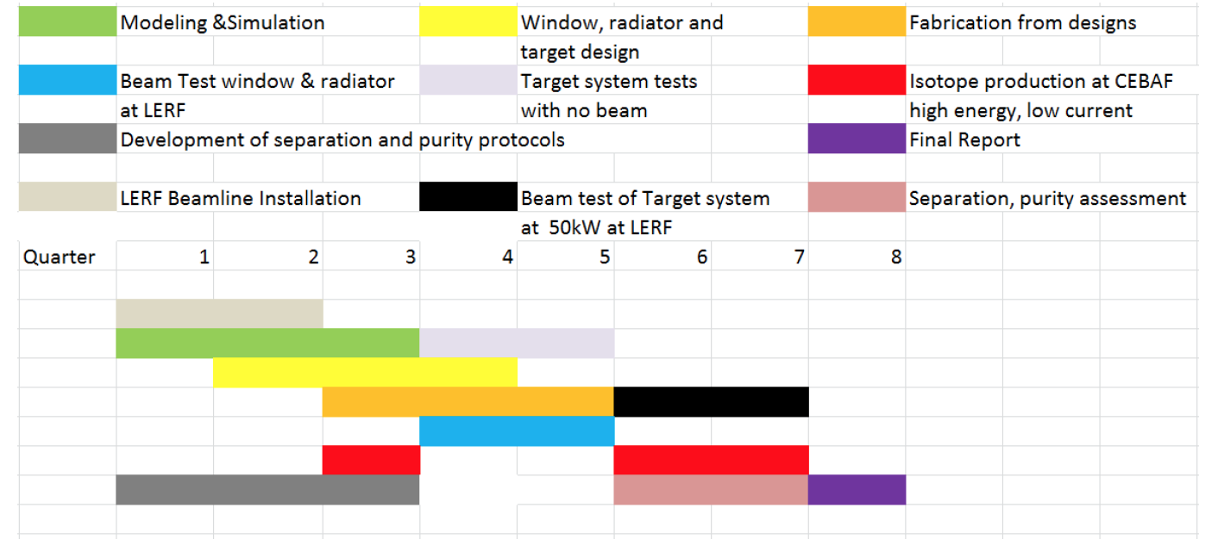
Schedule in Project Proposal

Slide 15
Overview of Budget
All budgets are fully loaded
  JLab - $367,381
  VCU - $280,743
  NMT - $150,986
  Total - $799,110
Full funding for two years has arrived at JLab, on its way to VCU and NMT
  Expected October – November, 2018
  ?

Slide 16
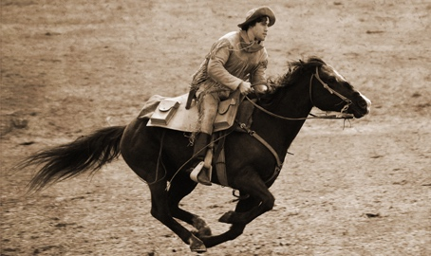
Pony Express
The Pony Express only took 10 days to transfer a letter from Missouri to California!

Slide 17
Overview of Budget
All budgets are fully loaded
  JLab - $367,381
  VCU - $280,743
  NMT - $150,986
  Total - $799,110
Full funding for two years has arrived at JLab, on its way to VCU and NMT
Expected October – November, 2018
  This is all we have to accomplish the scope
Need to keep tight control to ensure that budget is not exceeded
  Applies particularly to LERF preparations
  There is only funding for 2 – 3 LERF operating periods (includes beam commissioning)
We want follow-on funding
  Let’s not strangle the golden goose now it is starting to lay eggs!

Slide 18
Budget Details
Steve Benson held a meeting in June to look at JLab budget details
Incorporated input from the groups who will do the work
Now need to finalize the budget split between FY19 and FY20
Need firm commitments for all the tasks
We will revisit the budget with a smaller group to develop the most cost-effective solutions
  E.g. there are several ways to reconfigure the LERF, we need to balance cost, operability, and conserving future options

Slide 19
Project Planning
Activities between now and September 30
  This will be Quarter 1 of the project
  Define organizational structure – responsibility and authority
  Finalize modified budget – total is fixed
  Finalize modified schedule – must complete by end of Quarter 8
    Internal goal – complete by Quarter 7 at the latest
  Develop at least one milestone per quarter for DOE reporting
    Internal goal should be ~ one quarter earlier than milestone
We expect a new FOA in July 2020
  We plan to submit a proposal for funding from this FOA
  To be competitive, we must:
    Complete all activities in the current project by June 30, 2020
    Demonstrate that we are able to deliver on milestones
    Work safely and efficiently

Slide 20
Roles and Responsibilities
PI JLab | Andrew Hutton | Coordination
LERF Project Coordinator | Anthony DiPette | Installation of beamline, HCO
Target simulations | Joe Gubeli, Mike Aiken | Power Calculations
Target beamline design | Chris Tennant, Joe Gubeli | Beam optics and layout
Target development | Kevin Jordan | Design and fabrication of window, radiator, and target
Planning and budgets | Steve Benson
Target shielding and handling | Keith Welch | RadCon POC
TRP Chair | TBD | Technical readiness approval
PI VCU | Jamal Zweit | Radiochemical separation, radionuclide measurements, purity analysis
PI NMT | Doug Wells | Simulations, Student training

Slide 21
Meeting Agenda
Introduction of Scope and Budget – Andrew Hutton (JLab PI) 20 min
Overview of what has been accomplished so far – Hari Areti 10 min
Organizational structure going forward – Andrei Seryi 10 min
Isotope production mechanism – Pavel Degtiarenko 10 min
Target development – Kevin Jordan 10 min
Example of beamline optics – Chris Tennant 10 min
JLab Approval process – Arne Freyberger 10 min
VCU Plans – Jamal Zweit (VCU PI) via Bluejeans 10 min
New Mexico Tech Plans – Doug Wells (NMT PI) via Bluejeans 10 min

