Slide 1
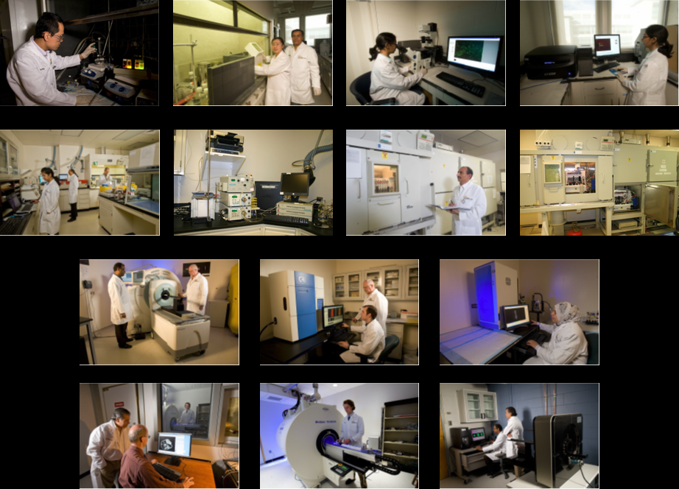
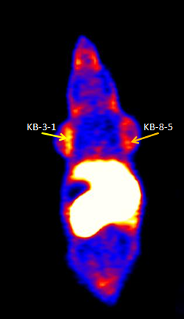
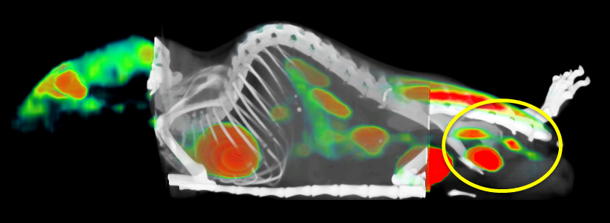
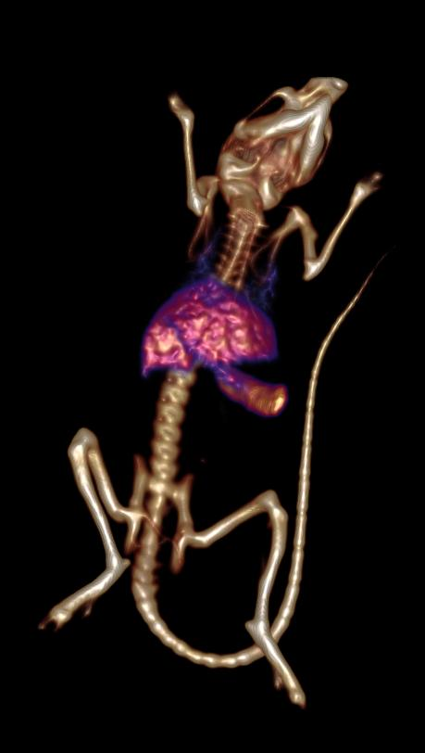
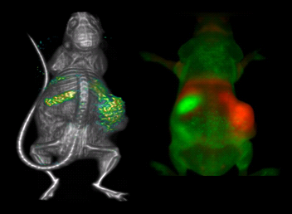
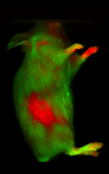
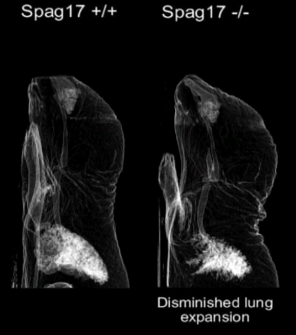
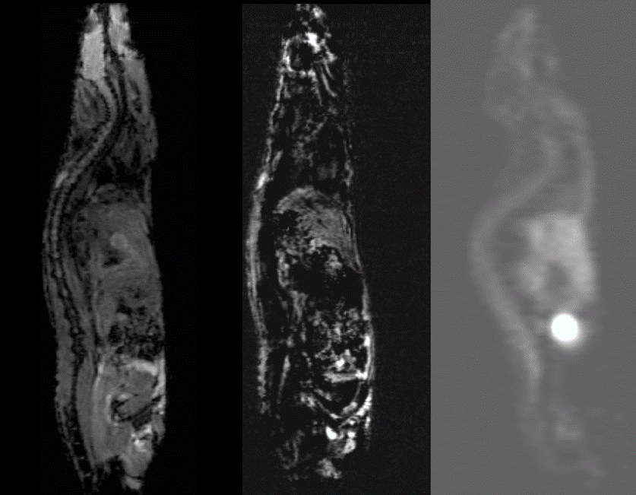
VCU CENTER FOR MOLECULAR IMAGING
Director: Jamal Zweit, PhD, DSc
E-mail: jzweit@vcu.edu Web: www.molecularimaging.vcu.edu
What is molecular imaging?
In a “nutshell,” molecular imaging is concerned with studying the underpinning biology of normal and diseased tissues within the intact environment of live subjects, through imaging signals detected outside the body. Molecular imaging can be defined as the visual representation, characterization and quantification of in vivo biological processes, at the cellular and molecular levels, and within intact living subjects. A number of disciplines, including chemistry, biology, physics, computation, engineering and medicine are integrated in a unique way to yield in vivo information derived from imaging technologies.
The center for Molecular Imaging (CMI) is one of the VCU School of Medicine Research Centers. It is established to foster and facilitate multidisciplinary molecular imaging and nanotechnology research, using advanced imaging technologies. Together, such technologies provide real-time in vivo information within live subjects and the intact living environment. In the era of molecular medicine, this provides a powerful platform towards personalized and precision medicine.
The CMI mission is to lead and foster an interdisciplinary and inter-collaborative molecular and nanotechnology imaging program at VCU. The emphasis is on multi-modality approaches to study biology, biochemistry and pharmacology in vivo. A major component of this mission is to make CMI molecular imaging core facilities available to VCU principal investigators to advance their research and enhance VCU external funding opportunities. Through these combined efforts, the CMI provides a hub for collaborative research with basic (discovery) and clinical scientists at VCU and beyond.
Synthetic Chemistry, Nano-chemistry, Cell and Molecular Biology
Internal Collaborations
School of Medicine
School of Pharmacy
School of Humanities and Life Sciences
School of Engineering
Massey Cancer Center
Radiochemistry (PET/SPECT Tracers)
External Collaborations
University of Virginia
Jefferson Lab
University of Louisville
University of Central Florida
PET/SPECT/CT (Inveon) Fluorescence Imaging (Maestro & FMT)
About the Center for Molecular Imaging (CMI)
Industrial Collaborations
7 Tesla/30 cm MRI/MRS (Bruker – Biospin) microPET R4
IBA Molecular, USA
Protea Biosciences, West Virginia
Ithera Medical, Germany
Monrol, Bulgaria
Trasis, Belgium
Ongoing Projects
Ongoing Projects (cont)
Ongoing Projects (cont)
Mission
Imaging tissue engineering (PI: Boyan, Co-PIs: Zweit, Sundaresan)
Imaging tumor metabolism, proliferation and hypoxia (PI: Pugachev, Co-PIs: Zweit, Sundaresan)
Imaging of Cerium Oxide Nanoparticles (CONPs) for radiation protection (PI: Zweit, Co-PI: Mikkelsen)
Imaging sperm associated antigen (Spag 17) gene knockout (PI: Strauss, Co-PI: Zweit)
Imaging tumor microenvironment (PI: Mikkelsen, Co-PIs: Zweit, Sundaresan)
Multi-modal nanoparticle targeted imaging (PI: Zweit, CoPIs: Sun, Yang)
Image Guided radiotherapy in head & neck cancer (PI: Song, Co-PI: Zweit)
[⁵²Mn]-MIONs for Hybrid PET/MR Imaging (PI: Zweit)
[¹⁸F]-Carboplatin Derivative for cancer theranostics (PI: Zweit, Co-PIs: Sundaresan, Dewkar, Farrell)
Imaging dendritic cell therapy in prostate cancer (PI: Guruli, Co-PI: Zweit)
Imaging mitochondria/ATP synthesis in liver disease (PI: Sanyal, Co-PI: Zweit)
Imaging adoptive immune cell therapy in breast cancer (PI: Bear, Co-PI: Zweit)
Inhibitors of Tumor Selcective Cancer Therapeutics (PI: Grossman, Co-PIs: Zweit, Ellis, Kellogg)

