Slide 1

Cu⁶⁷ Isotope Radiator & Target
Kevin Jordan & Joe Gubeli

Slide 2
Beamline Location
Reinstall 2 triplets on either side of new transfer line
New dipole
& additional
shielding
Take advantage of 1G dump shielding

Slide 3
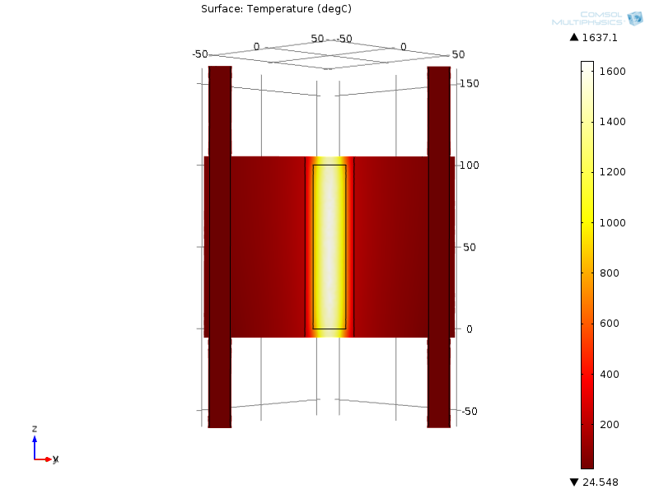
Various Crucible Designs
Start with hexogonal Boron Nitride at 5 kWatt
  Some thermal analysis done
Increase exposure power by 2X each run
50 kWatt is a challenge
  @ 10 GPM, ∆T ~ 20˚C
  1 GPM per 1/4” tube

Slide 4
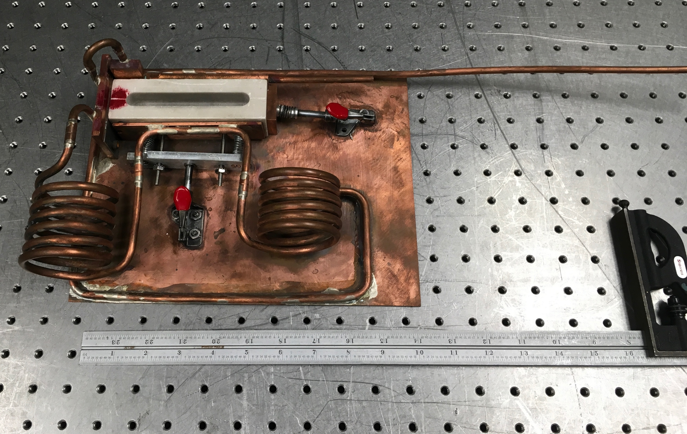
5 kWatt Radiator & Target Assembly
Improved version of last years device

Slide 5

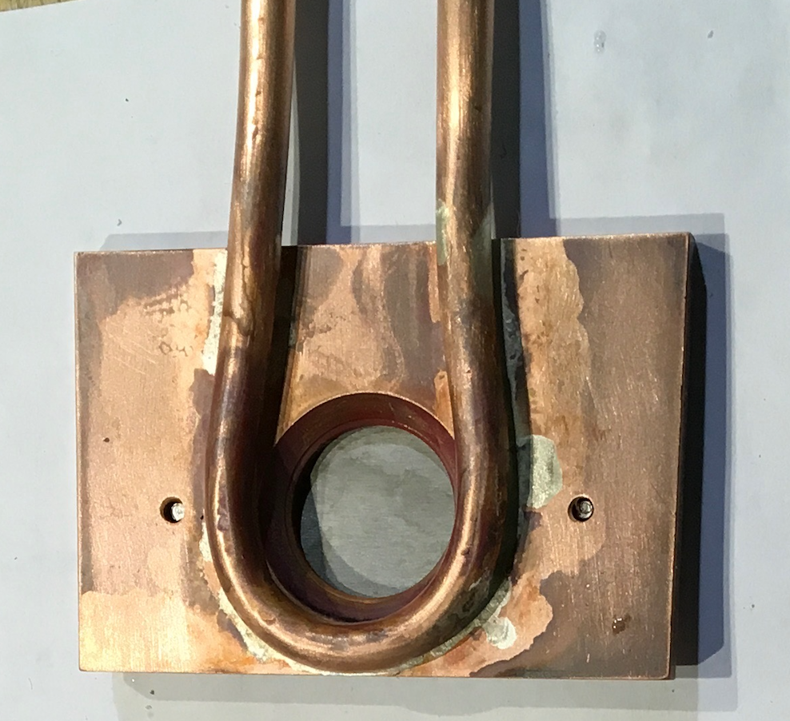
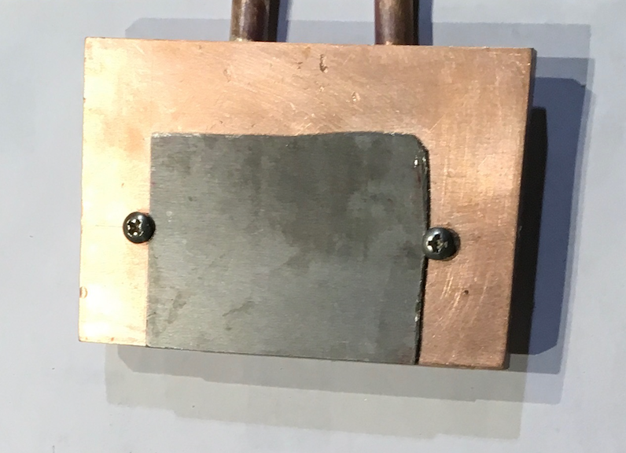
Tungsten Radiator
Water cooling lines
Total power (radiator + target) @5 kWatt, 1 GPM
∆ T= 19˚ C
Front face
Rear face
LCW Cooling lines
Copper support
1mm Tungsten

Slide 6
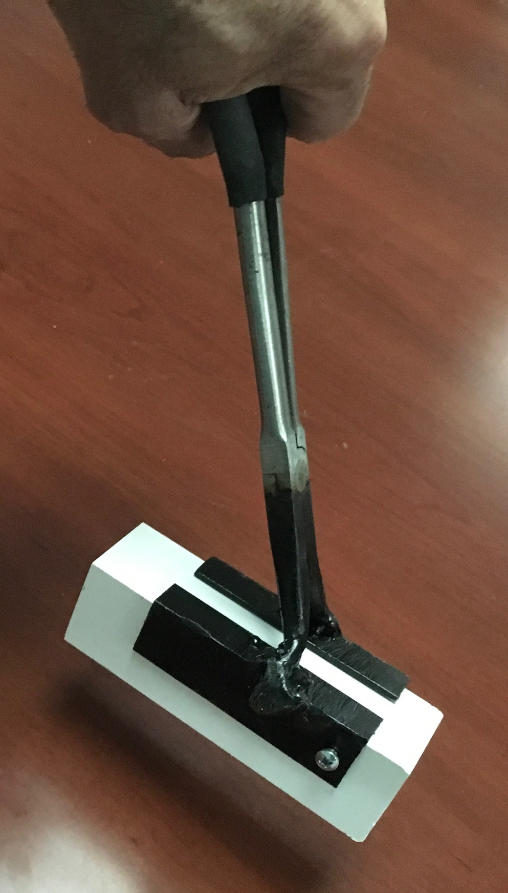
Target Crucible
Material: hBN
  Hexagonal Boron Nitride
Custom pliers to handle hBN crucible
Gallium does not ‘wet’ to hBN
No metal contaminates

Slide 7
Beryllium Window
Electron beam welded .015 inches thick PF-60/ 99.0% min., Beryllium window to a 04.5 inch aluminum single-sided conflat flange over a 02.5 inch aperture. Pressure tested to 1.5 atmospheres
  From Hall C, PR #195038
Expected temperature rise
  1 kwatt load; 4.7˚C rise
Vacuum system tied into Fast valve

Slide 8
Instrumentation
Radiation sensitive detector & camera to monitor beam position on radiator
Thermocouples to monitor critical temperatures
Each point will have redundant TCs, controllers located upstairs
  All monitored in EPICS w/alarm
  Tungsten Radiator
  Boron Nitride target holder
  LCW inlet
  LCW outlet
LCW flow (paddle wheel w/upstairs readout)
LCW return water flow switch

Slide 9
Risks & Hazards
Sealed raised edge on copper plate to prevent spillage in the event of hBN crucible failure
Cover fitted to top of hBN crucible
Long fitted pliers to remove hBN crucible
Extended handle for ALARA
Quick connections on water cooling lines for ALARA
Temperature monitoring to prevent overheating

