Slide 1
Example of Beamline Optics
C. Tennant
August 3, 2018

Slide 2
Requirements
configure 0F, 1F and 2F regions in LERF for isotope production experiments
10.0 MeV at 5 mA (high power target testing)
18.5 MeV at (1-2) mA (production run)
40.0 MeV at (1-2) mA (production run)
need to:
provide lossless transport of different energy beams to target
provide sufficient operational tunability
low energy, high power beams
provide ease of setup
provide ease of verifying setup
maintain ability to recirculate in the IR Upgrade (i.e. keep 3F, 4F and 5F regions intact)
like to:
provide operational flexibility to perform other experiments/measurements

Slide 3
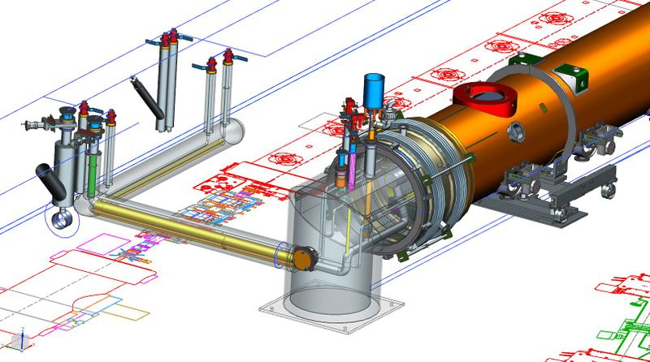
Proposed Configuration
DC Gun
1F03
triplet
Zone 1
2F telescope
Zone 2
merger
dump
4 90°FODO cells
dipole
target
(courtesy J. Gubeli)
need to avoid interference with transfer line

Slide 4
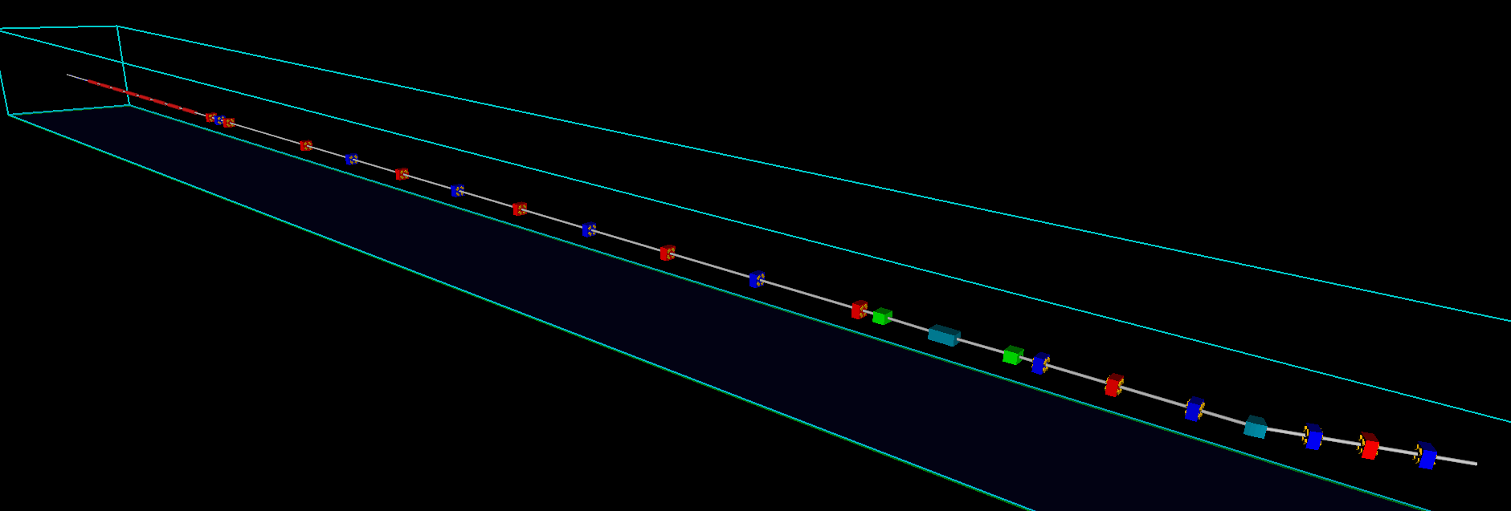
Schematic
1F03
triplet
Zone 2
extraction
chicane
FODO channel
dipole
dipole
extraction chicane
triplet
2F03
2F02
2F01
beam

Slide 5
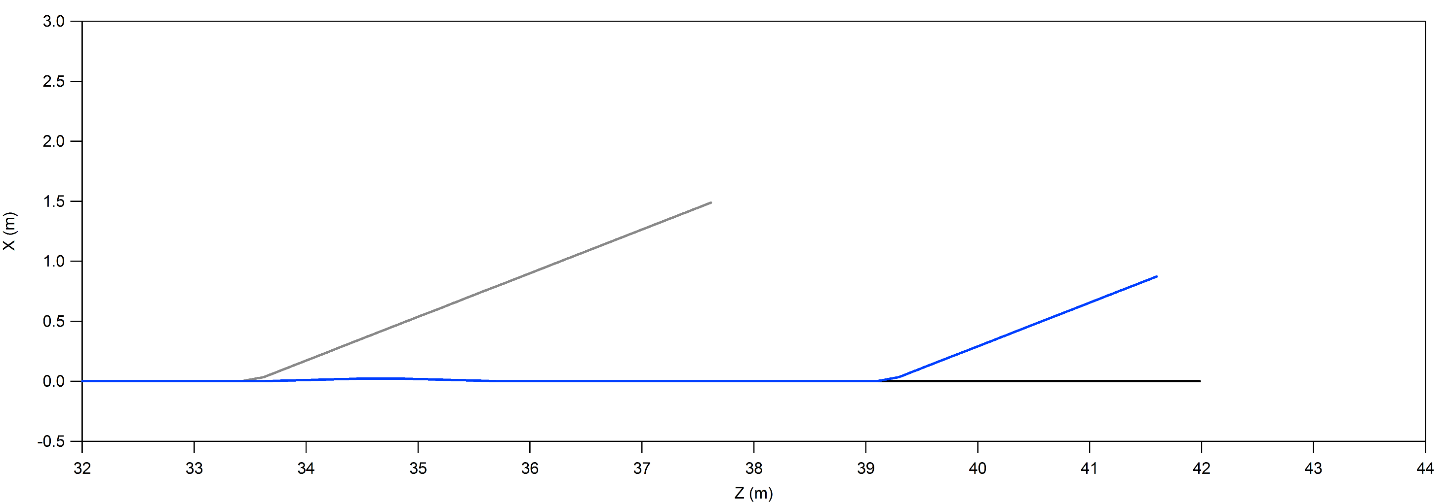
Dump Interference
check possible interference with existing beam dump line
plot is to scale, measurements are roughly accurate (measured by hand)
would like to take advantage of dump shielding for isotope production
2.3 m
dump
2.0 m
target
3.0 m
QX2F01
QX2F02
QX2F03
QX2F04
QX2F05
QX2F06

Slide 6
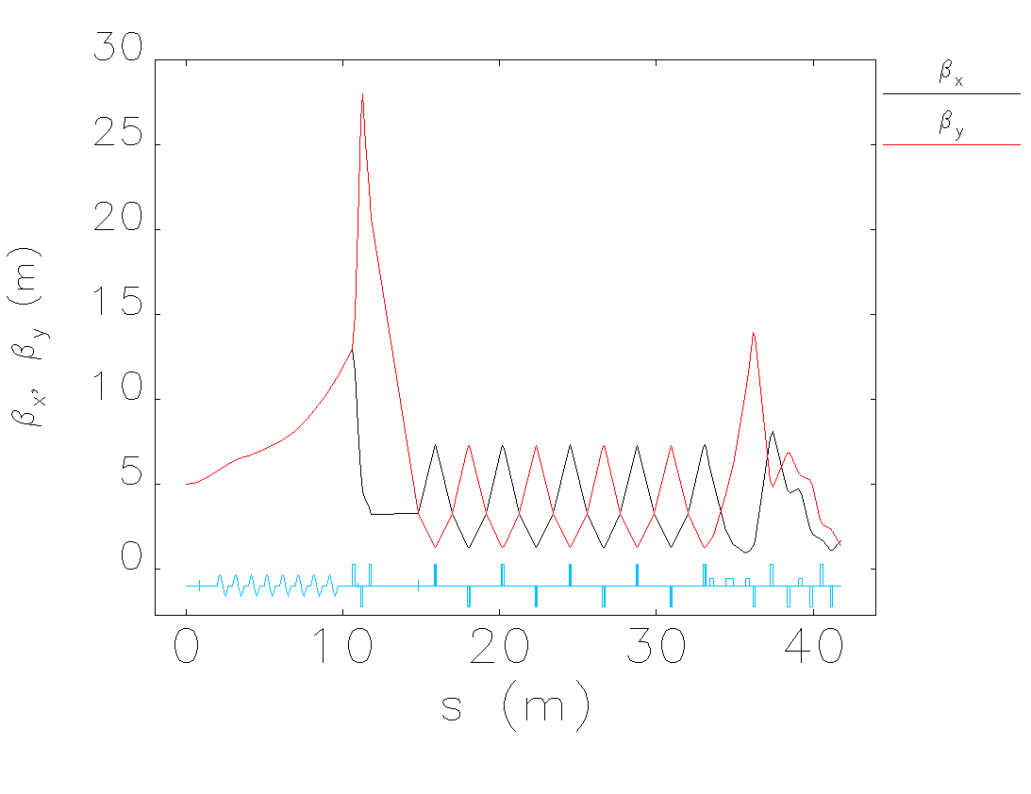
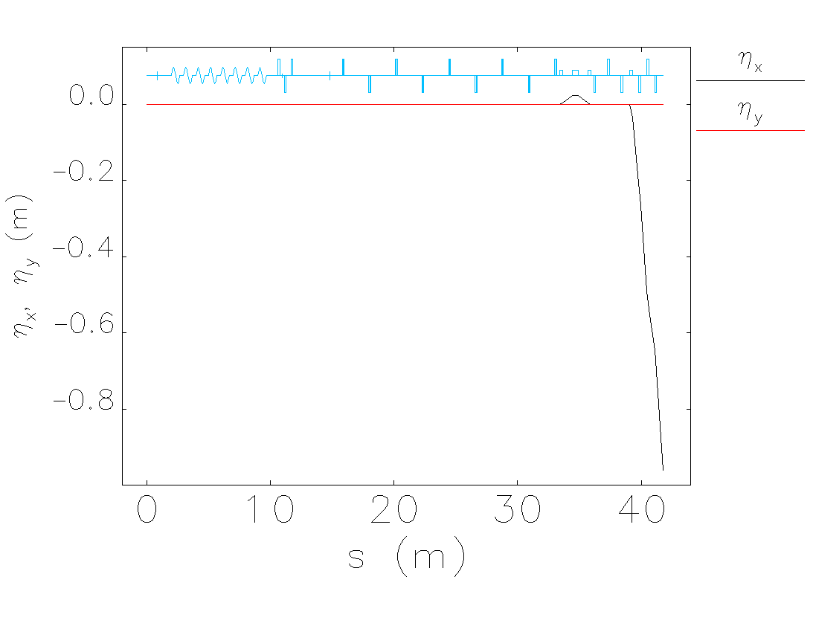
Twiss Parameters
E_{inj} = 8 MeV, E_{final} = 20 MeV

Slide 7
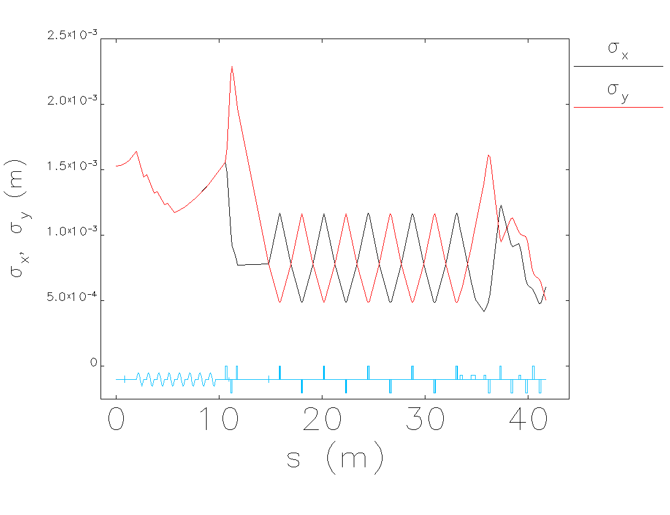
RMS Beam Sizes
given specifications, can provide appropriate spot sizes at isotope target

Slide 8
Setup Procedure
injector set to provide 8 MeV/c
same as Darklight, reduce field emission
beam from injector is not well characterized
limited diagnostics due to space constraints
run Zone 2 (cryomodule formerly in Zone 4) with higher gradient in first 4 cavities and with last 4 cavities set to zero gradient and de-tuned
important to get the RF focusing otherwise beta functions start getting large
use first quad in 1F03 triplet with downstream viewer to do quad scan
find triplet settings to match measured Twiss parameters to FODO channel
verify correct FODO setup by:
visual inspection (viewers)
checking phase advance (correctors and BPMs)
measuring Twiss parameters via quad scans (viewers)

Slide 9
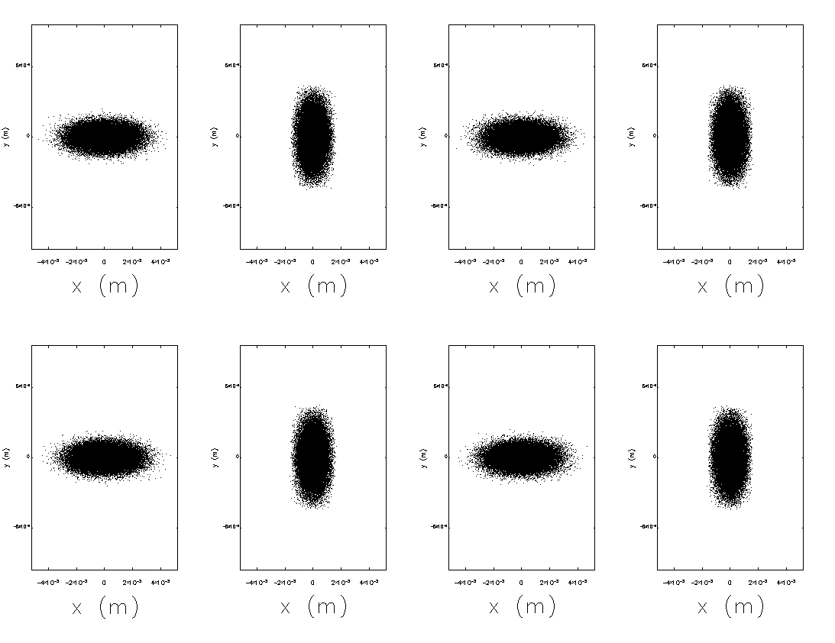
Verifying Setup
using viewers in FODO channel it is straightforward to verify correct setup visually
Q1
Q2
Q3
Q4
Q5
Q6
Q7
Q8

Slide 10
Instrumentation/Diagnostics
8 (FODO channel) + 1 (matching) + 3 (upstream of target) = 12 quads total
instrument the FODO channel same as 3F region
BPMs at every quad
correctors (at least one plane) at every quad
as many viewers as possible
need to replace linac view screens
use LDRD viewer*
this is a standard LERF quad girder
*possibility of doing transverse phase space tomography with high dynamic range diagnostic

