Slide 1
Isotope Production R&D at
Jefferson Lab
Overview of what has been accomplished so far
August 3, 2018

Slide 2
Outline
Preparation for 2016 FOA
Simulations and Tests 2016
Tests and Results 2017
Conclusions

Slide 3
Preparation for 2016 FOA
In order to strengthen the proposal, extensive thermal simulations (Joe Gubeli) have been done in order to understand the design of high power targets
  Target – Material - Gallium (99.9999% chemically pure)
  Target – Thermal - Allowed Temperature rise: 2000⁰ C, max. at 50kW of beam power
  Target Holder – Cooling – Water cooled, cooling water temperature 35⁰ C (to ensure Gallium stays as liquid)
  Target Holder – Chemical – Lowest possible copper content to avoid contamination from other copper isotopes

Slide 4
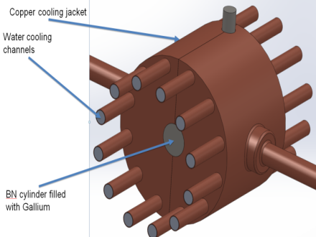
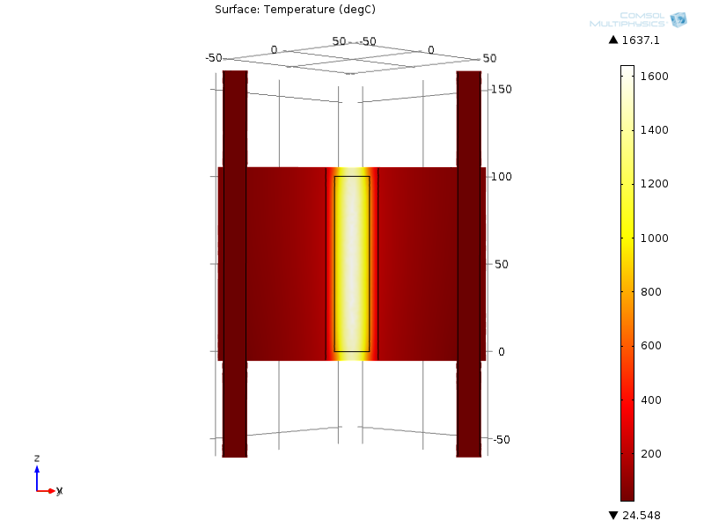
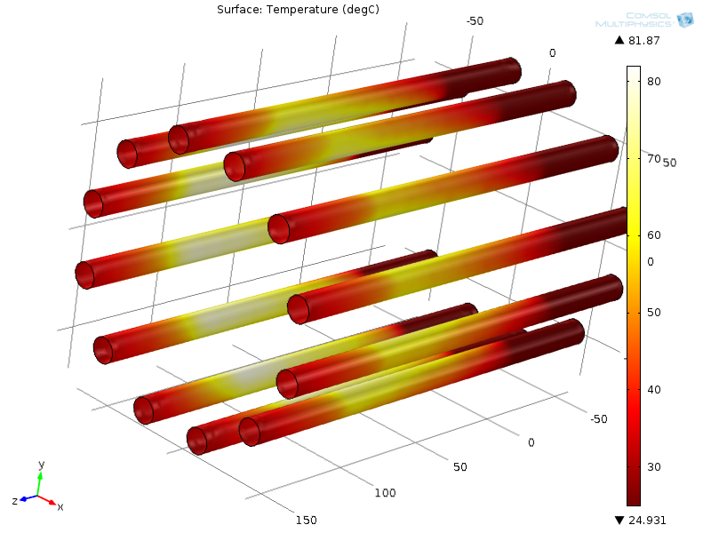
Thermal Simulations 2016
5 GPM water flow through each channel
Radius of Gallium cylinder 10 mm
Length of Gallium cylinder 100 mm
50 kW total beam power
Water wall temperature
Temperature of the target

Slide 5
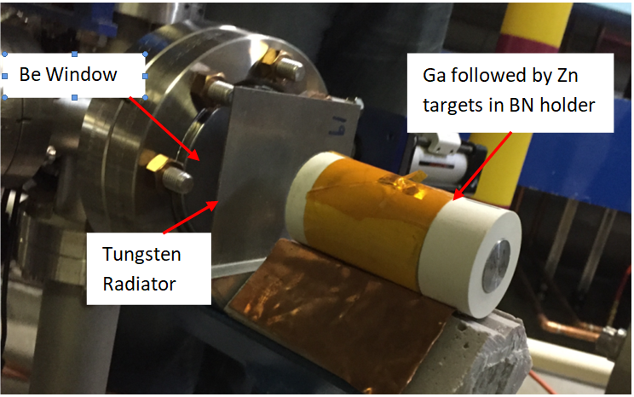
Low Power Beam Test 2016
First Test at low power
Irradiation of Gallium and Zinc targets in CEBAF injector:
  18.5 MeV (to avoid interference from ⁶⁷Ga), 2.5 µA, 1 h
  ~ 0.1 µCi ⁶⁷Cu detected in each target

Slide 6
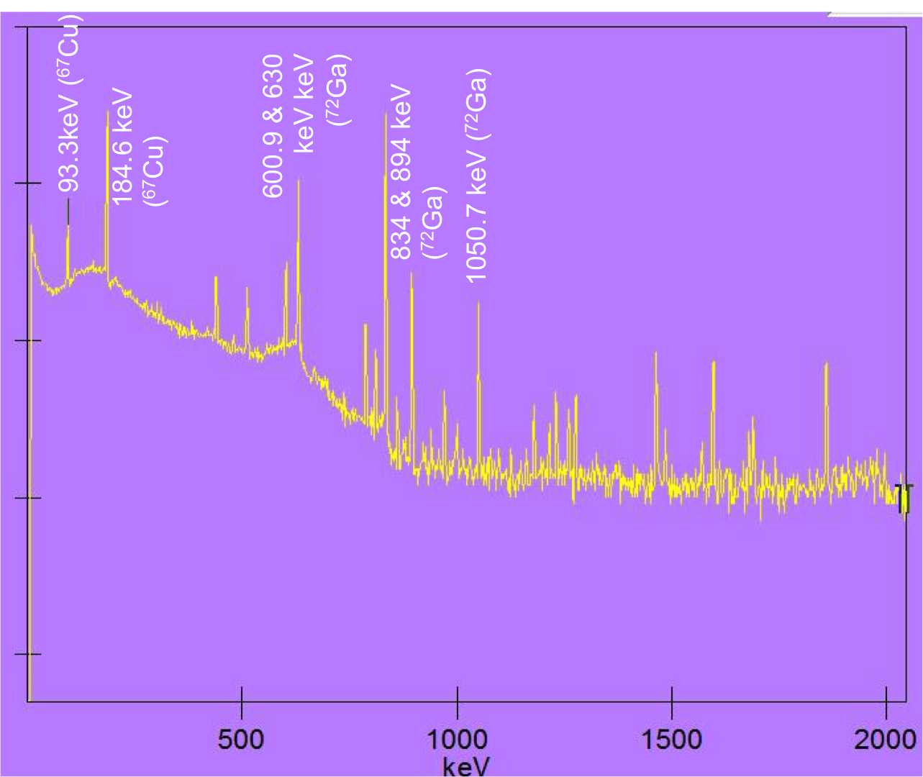
Beam Test Results 2016
Measured decay photon spectrum of gallium target 25 hours after irradiation

Slide 7
Trial Chemical Separation 2017
A small quantity of ⁶⁷Cu was purchased from BNL and delivered to VCU (via FedEx)
At VCU
  The ⁶⁷Cu was added to the dissolved Gallium material and radiochemical separation was performed to “simulate” the radiochemistry procedure, resulting in 92.2% recovery of the ⁶⁷Cu activity without back-extraction
    Back-extraction into an aqueous solution is expected to recover the majority of the ⁶⁷Cu

Slide 8
Higher Power Beam Test 2017
We planned a high power test at CEBAF Injector 18.5 MeV@ 25 µA
Goals:
  Produce ~ 0.5 mCurie of ⁶⁷Cu using 18.65 MeV, 50 μA (~1kW) electron beam irradiating 100 gms of gallium encased in a Boron Nitride crucible
  Chemically separate ⁶⁷Cu from the gallium target at VCU

Slide 9
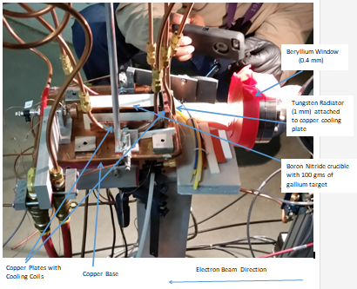
Beam Test Setup 2017

Slide 10
Beam Test 2017
Planned
  Beam set up May 2 – 3
  Installation May 3 – 4
  Run May 5 – 7 (extended to May 8)
  Sample Shipped/Delivered to VCU – May 9/10
Executed
  Beam set up completed – May 3
  Installation completed – May 4
  Beginning/End of run – May 4/May 6
  Sample Shipped/Delivered to VCU – May 8/10

Slide 11
Beam Test Results 2017
About 8 hours after the test started, air pressure was lost on the cooling blocks. A little later the thermocouple read-back on the tungsten radiator was lost. The test was aborted due to lack of monitoring
Produced ~130 μCuries of ⁶⁷Cu (70 µCi was remaining upon the retrieval)
The crucible was removed safely after a two-day delay. The crucible was then wrapped in two layers of kapton, double bagged, packed and shipped to VCU via UPS
The instructions for unpacking the crucible were not provided to the VCU Radiation Safety Officer who performed the unpacking operation, resulting in the loss of Gallium

Slide 12
Conclusions
For the 2016 FOA, we were well prepared after having conducted a beam test at low power
Thermal simulations have been done for one prospective target design
Completed a higher power beam test – valuable learning experience, especially in transporting irradiated material
Mock transportation trials will be conducted to develop the best method for transporting irradiated material

