Slide 1
Isotope Production Update Sept. 30, 2020
Kevin Jordan
+1-757-876-1742

Slide 2
Recent Activities
Sept. 14 – 18
LERF was run for isotope irradiations
Sept. 23
Shield blocks were removed from the LERF truck ramp
Sept. 28
LCLS-II CM20 was removed from the LERF and transported to the test lab
Daily
Gamma spectroscopy performed on the irradiated Gallium sample
Calibration of temperature sensors

Slide 3
Things that need attention
Quarter CM cavity #3 HPA still tries on crowbar
Remove clean room from LERF vault and deliver to test lab
Extend side cooling plates on base

Slide 4
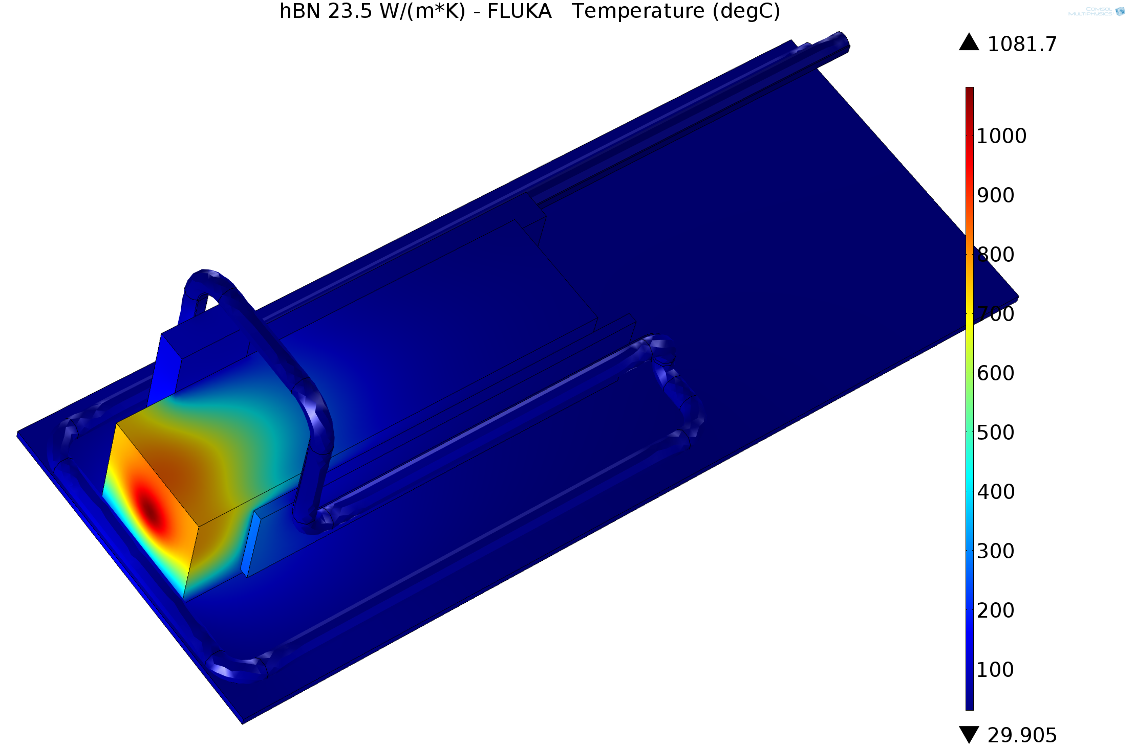
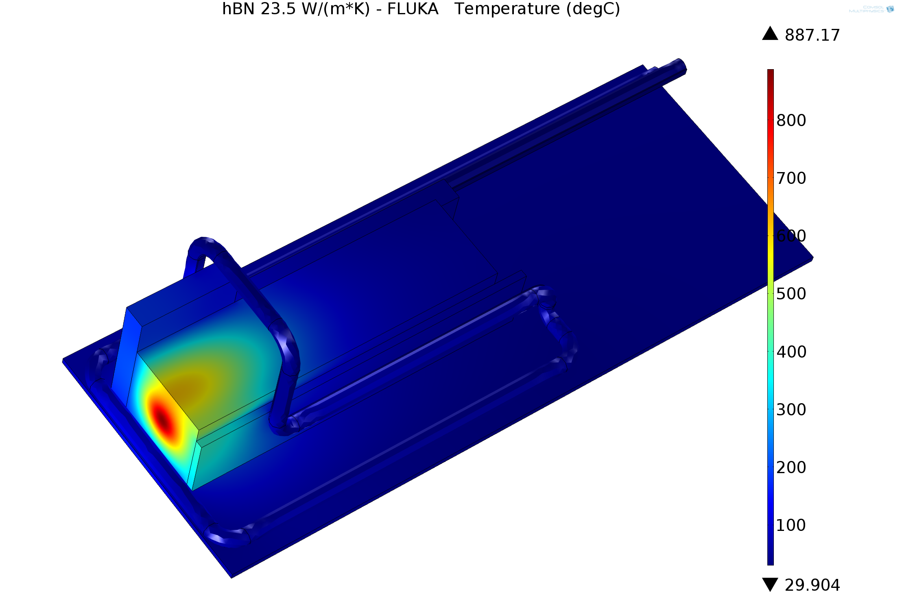
1kW THERMAL ANALYSIS FLUKA (SIDE PLATE EXTENSION)
CURRENT SIDE PLATES
EXTENDED SIDE PLATES
JOE GUBELI

Slide 5
Future Activities
Week of October 12
ERR Review for 5 kwatt irradiation
Week of October 26
Reinstall shield blocks
November 9 – 12
Re-run “Stack' arrangement using metallic Ga71 (1 hour, 100 watts)
Run solid block of graphite to validate temperatures (~20 minutes, 5 kw)
Run graphite crucible with natural occurring Gallium for 30 hours, this sample would not leave JLab - gamma spec done by RadCon to validate Fluka model
January 11 – 14
Possible “Stack” exposure w/metalic Ga71 to refine Fluka results
Run naturally occurring Gallium at 5 kw
May (Depends on CHL status)
Run new 50 kw target at 5 kw to validate design & model

