Slide 1
LERF Cryomodule Shuffle
Kevin Jordan Sep. 15, 2017

Slide 2
Scope
Secure vacuum on all three modules
Remove the three girders between FL03 & FL04
Sample beam tube from above for contamination
Remove girders as needed between FL02 & FL03 to enable move of F100 in FL02
Remove F100 (FL02), and SL21 (FL03)
Warm-up and move C50 (FL04) to FL02
Reconnect cryo & RF to C50 in FL02
Summary/Questions/Concerns/Comments

Slide 3
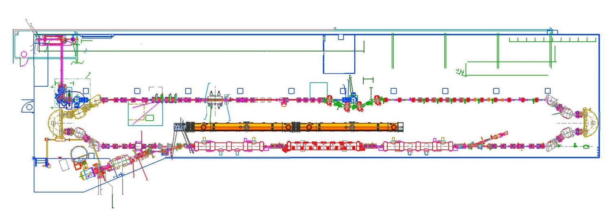
LCLS-II CM Layout in LERF – Testing 2 CMs per Cycle
CM Slot
CM Slot
CM Slot
Access
Storage
Current machine contains slots for 3 full CMs and 1 Injector CM
Shielded vault
Existing PSS including radiation and ODH monitoring
Utilities include cryo, water, electrical
Propose 2 CMs installed in middle of FEL machine

Slide 4
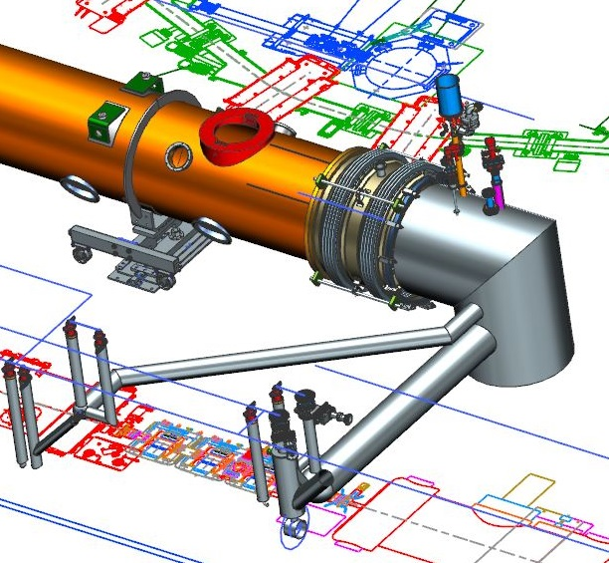
End Can & U-tubes – Conceptual Design
Interconnect Bellows with Restraints
Uses both FL03 & FL04 taps
Relief Stack, Valves and Cooldown Line Connection
Stands w/Wheels
Floor Plates
End Can, Mounted to Floor
Supply Line
Supply TL
Return Line
Return TL
Re-use existing U-tubes for cryo connection

Slide 5
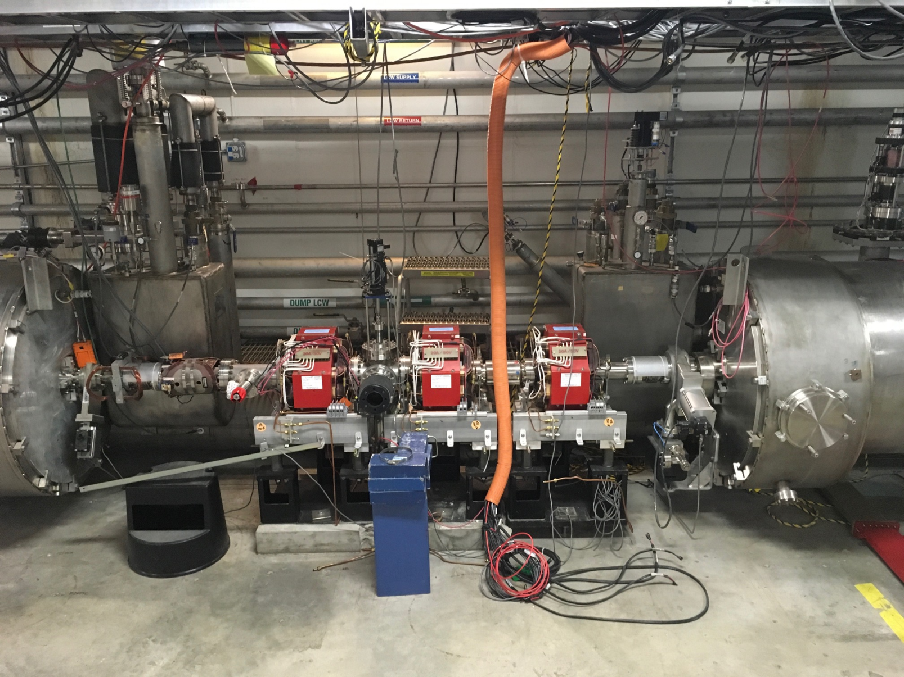
FL03/04 – clear out completely

Slide 6
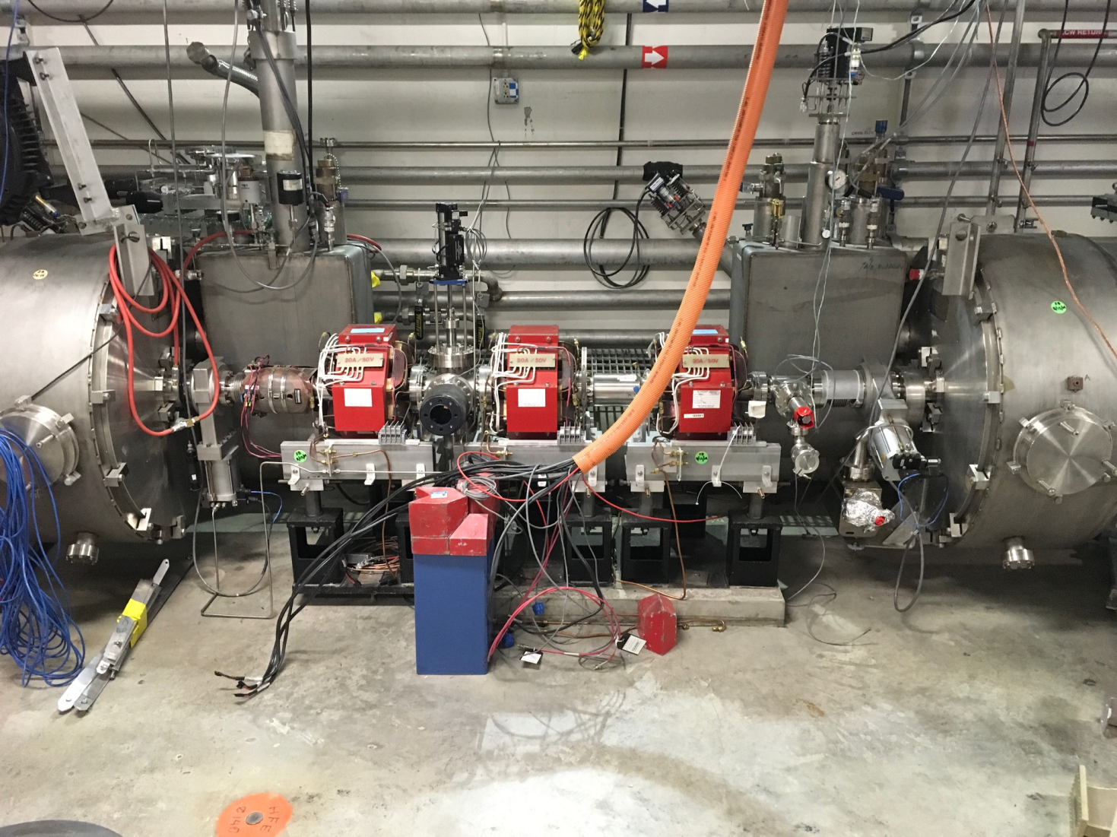
FL02/03
Remove & replace as needed to move CM FL02
Restore girder & vacuum with valve on downstream end

Slide 7
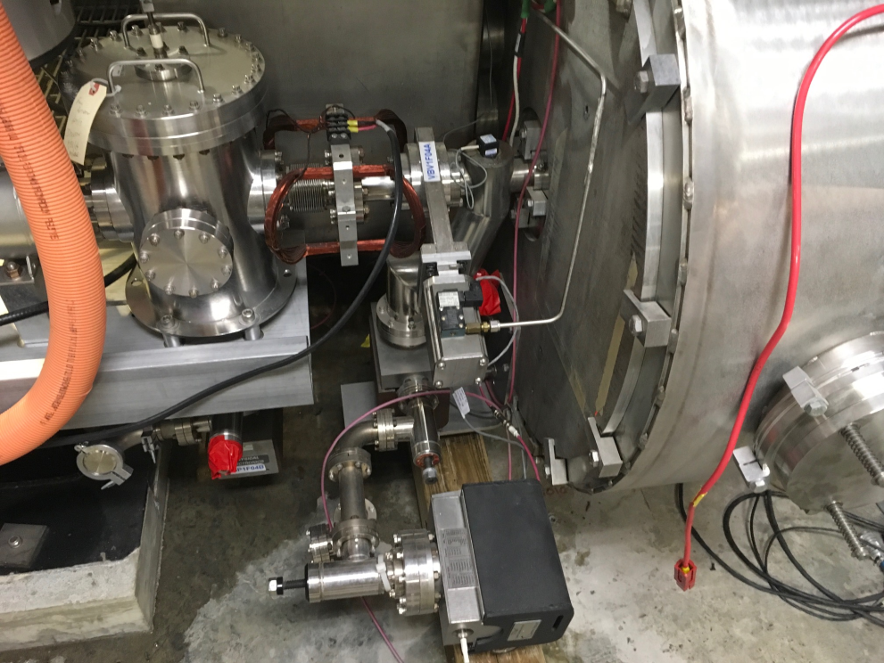
C50 – Replace Ion Pump?
Take opportunity to replace pump…

Slide 8
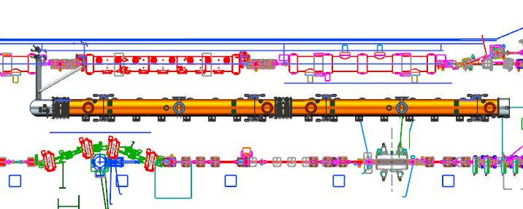
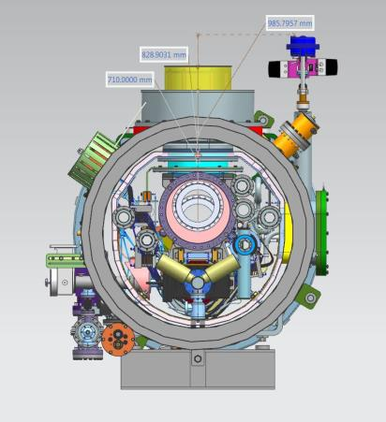
LCLS-II CM Layout in LERF – Testing 2 CMs per Cycle
End Can, New Design
End Cap, Existing Design
Interconnect w/
Beamline connection and Cryo line flanged connections
~1 m OD x 12 m Long, Handling weight 8 tons max

