Slide 1
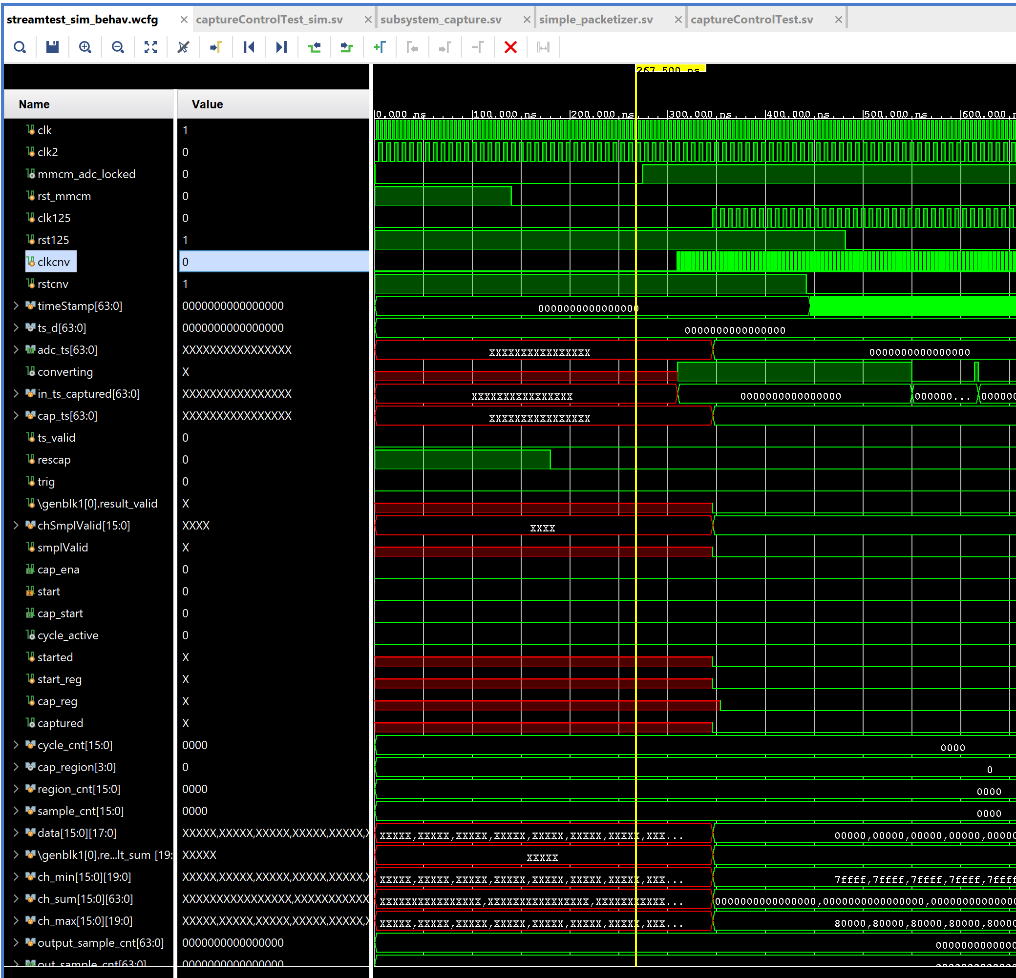
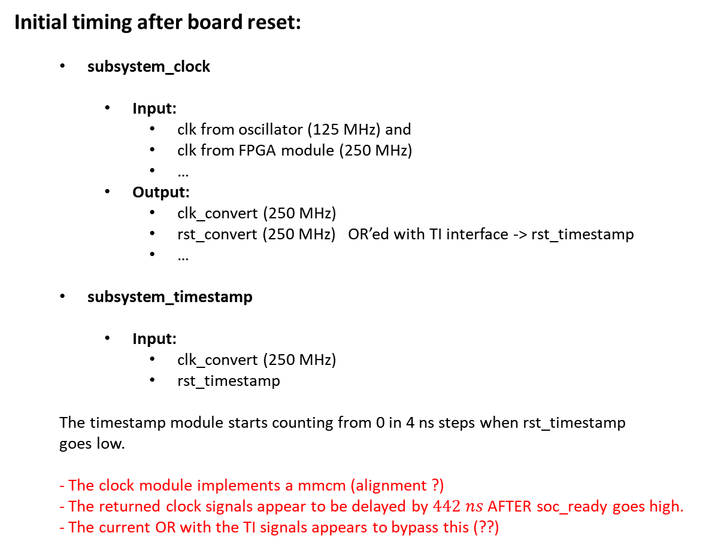
ADC Board Integration Mode Timing
Initial timing after board reset:
subsystem_clock
Input:
clk from oscillator (125 MHz) and
clk from FPGA module (250 MHz)
…
Output:
clk_convert (250 MHz)
rst_convert (250 MHz) OR’ed with TI interface -> rst_timestamp
…
subsystem_timestamp
Input:
clk_convert (250 MHz)
rst_timestamp
The timestamp module starts counting from 0 in 4 ns steps when rst_timestamp goes low.
- The clock module implements a mmcm (alignment ?)
- The returned clock signals appear to be delayed by $442 ns$ AFTER soc_ready goes high. - The current OR with the TI signals appears to bypass this (??)

Slide 2
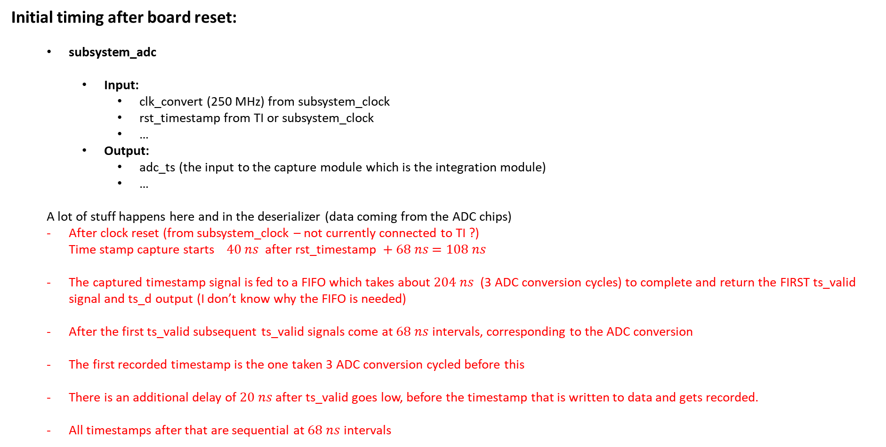
ADC Board Integration Mode Timing
Initial timing after board reset:
subsystem_adc
Input:
clk_convert (250 MHz) from subsystem_clock
rst_timestamp from TI or subsystem_clock
…
Output:
adc_ts (the input to the capture module which is the integration module)
…
A lot of stuff happens here and in the deserializer (data coming from the ADC chips)
After clock reset (from subsystem_clock – not currently connected to TI ?) Time stamp capture starts $40 ns$ after rst_timestamp $+ 68 ns$ $=108 ns$
The captured timestamp signal is fed to a FIFO which takes about $204 ns$ (3 ADC conversion cycles) to complete and return the FIRST ts_valid signal and ts_d output (I don’t know why the FIFO is needed)
After the first ts_valid subsequent ts_valid signals come at $68 ns$ intervals, corresponding to the ADC conversion
The first recorded timestamp is the one taken 3 ADC conversion cycled before this
There is an additional delay of $20 ns$ after ts_valid goes low, before the timestamp that is written to data and gets recorded.
All timestamps after that are sequential at $68 ns$ intervals

Slide 3
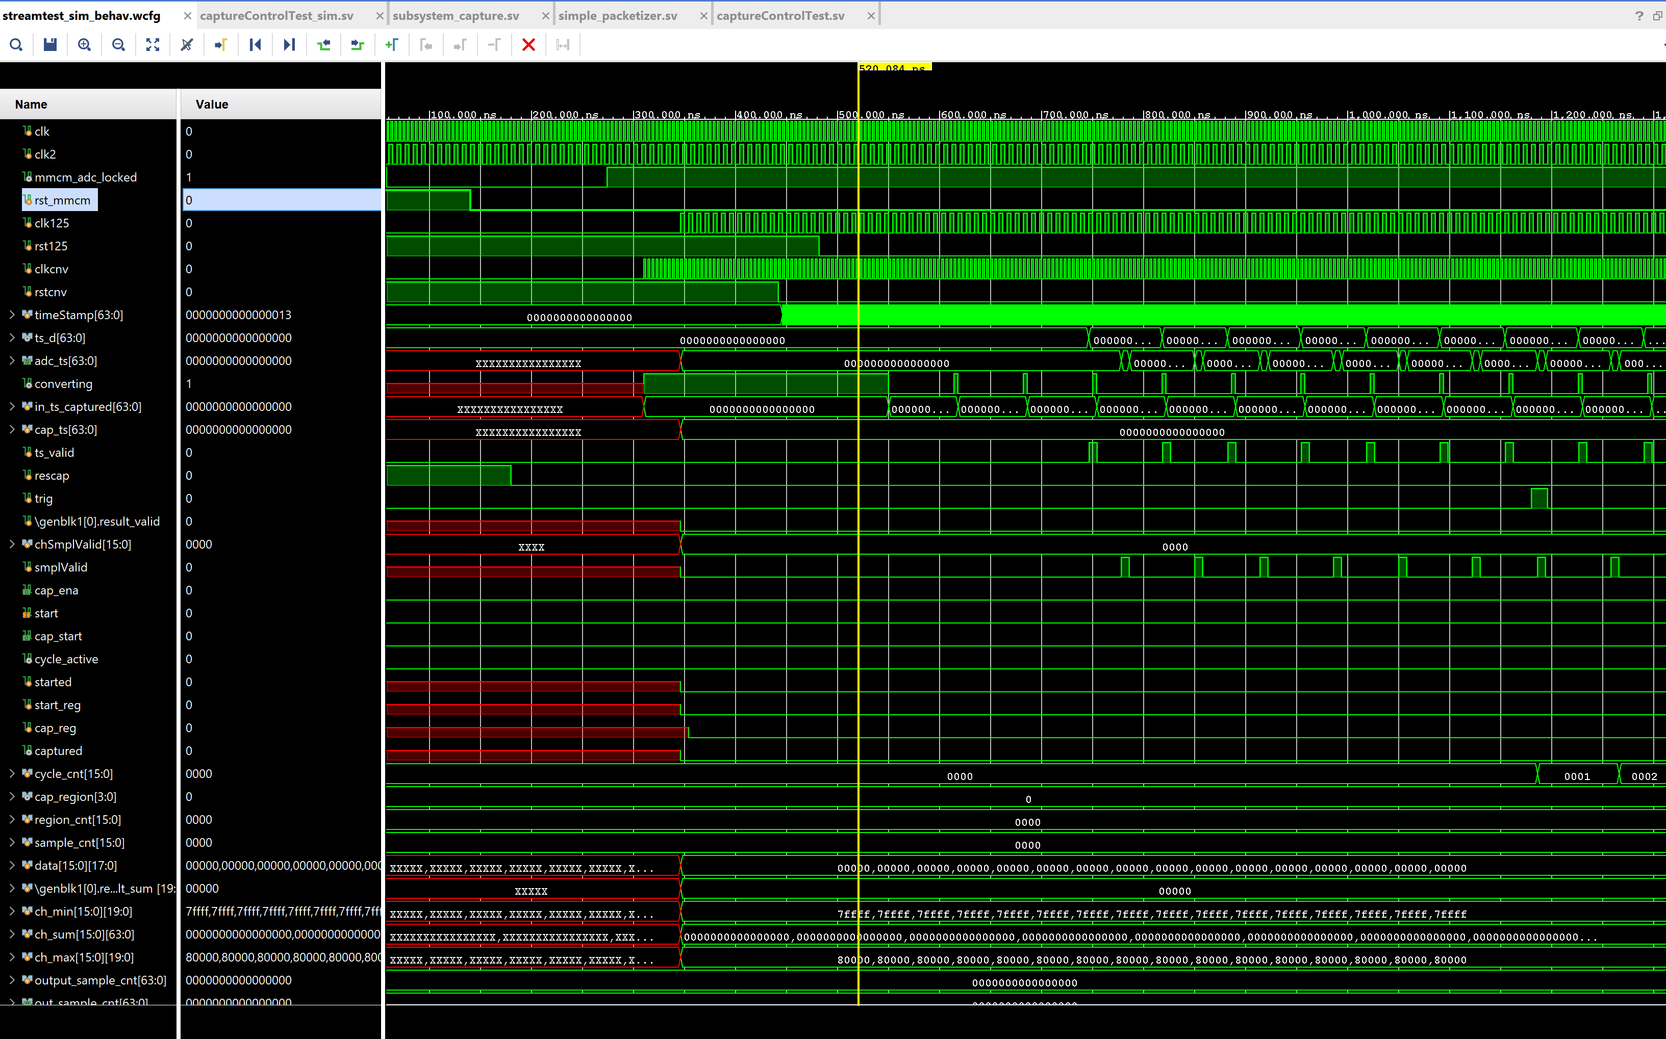

ADC Board Integration Mode Timing
Initial timing after board reset:
First recorded timestamp
TI stamp reset
Recorded timestamp
+ 20 ns
+ 108 ns
+ 204 ns
First Trigger

Slide 4
ADC Board Integration Mode Timing
Initial timing after board reset:
subsystem_capture (integration module)
Input:
adc_ts from ADC module
…
Output:
AXI data stream
Inside the capture module the adc_ts is recorded together with the rest of the data at intervals corresponding to the block size (see next slide)
The timestamps are recorded at the beginning of a block, but the running stamp number corresponds to the beginning of conversion (when the ADC started converting), which is about 3 cycles before the first recorded timestamp and 332 ns after the start of timestamp counting on the board.
The trigger input to the integration module does not currently reset the timestamp value, this can/could be implemented in the timestamp module
Any additional delay specified in the configuration script happens for each trigger and would add to the time difference between the trigger timestamp and the adc timestamp in the data stream
The current version of the code seems to require a small but non-zero delay between trigger and start of integration – I am not sure at the moment how small this can be, but I think it would be a small number of samples (currently specified as 10 ADC samples in the simulation) .
The relevant comparison for timestamps from the ADC conversion in the FW is the variable ts_run in the ADC Verilog module output.

Slide 5
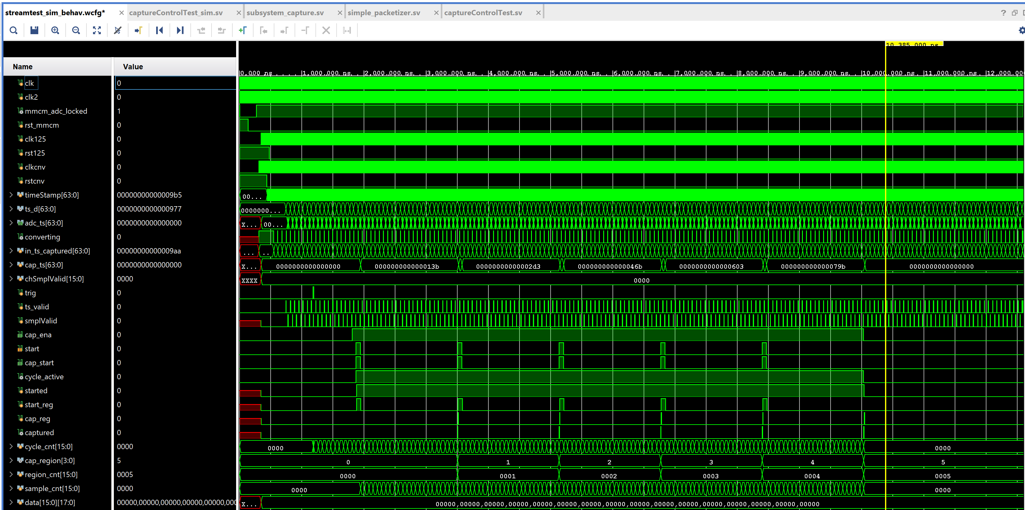
Time stamps
“Helicity block”
Trigger
Block 1
Last block readout

