Slide 1
Homework
MOLLER OPA Status Review
Jim Fast

Slide 2
SC-1 Questions re:Slide 35 of Spectrometer Presentation (Risks)
R3.23 Please add more details about the three mitigation strategies:
  Ensure tight tolerances are met – what’s a typical tolerance? Achievable by survey? Does the temperature need to be controlled to make an accurate measurement?
    Magnet only requires ~1 mm alignment tolerance per simulation
    Expect to align to within ~0.5 mm
    Will align at room temperature, but to the modelled operational displacements
  Monitor fab, make changes during fab – will Moeller provide a full-time inspector?
    We do not see a need for a full-time inspector at the vendor. We will be onsite and monitoring during prototype coil fabrication and plan for vendor visits during production.
  Adjust alignment during assy. Vendor will be moving stiff copper a few mils – is there tooling for that?
    Vendor is winding on stiff mandrels and providing potted coils with G-10 fillers
    Magnet assembly will be done at Jlab – we are designing the coil adjustment mechanisms
    Each coil (7 upstream and 28 downstream) has its own support/alignment system
R3.24/25
  Mitigation – conduct radiation damage testing. Is there a plan to initiate this?
    SOW for testing provided the SC-1
      5 sets of samples, 50, 100, ~165 MGy, one each in vacuum, other 50/100 MGy sets in inert gas
    Samples are at UC Davis for reactor irradiation starting this week
    CTD will perform shear strength testing on samples after irradiation
    Expect results by end of CY

Slide 3
SC-1 Questions re; Slide 35 of Spectrometer Presentation (Risks)
R3.26/27/28
  Mitigation – continuous QA/QC – Who pays the QA/QC persons?
    Each coil resistance will be measured before and after potting
    Vendor is responsible for continuous QA/QC during fabrication and must demonstrate compliance with the technical specification
    JLab will be spot checking compliance during production run and detailed inspection at delivery
    QA/QC at JLab is charged to project (engineering/technical staff and QA/QC lead)
  Employ sufficiently sensitive turn-to-turn testing during winding. Will temperature control of the winding be needed?
    Coil design (4 to 6 turns, upstream and downstream torus magnet 1-3) does not allow turn-to-turn testing
    DS torus magnet 4 has total of 10 turns and will have ringing test
    Hard shorts will be detectable through resistance measurements
    The small turn-to-turn voltage drop in the coil design has virtually no risk of causing operational problems
    Testing will be done at room temperature, or slightly elevated by water supply temperature

Slide 4
SC-2 Questions: Overnight homework
For the 10 am session tomorrow morning we would like to get some more information about the project plan toward CD2, e.g. how to track progress on the design, dealing with uncertainties on the budget profile, and procurement schedule/strategy. This will probably be covered in detail in the management parallel session but not everybody will be attending.
  Tracking design progress
    Design progress is tracked in part by EVMS tools through monthly reporting of progress
    Also tracked by readiness for 60% and 90% design reviews
    Each team has pretty good situational awareness of their progress at this time
    Working on more formal status sheet to provide more fidelity especially as we get to the point of preparing drawings and procurement packages
  Budget uncertainties are a fact of life so we have built flexible planning tools that allow us to do “What If’s” fairly easily – exercised quite a bit with the FY22 PBR exercise
    FY funding milestones in P6 used to move procurements between FY
    Procurements ordered by schedule float and staggered for load on procurement staff and funding
    BO profile dumped to Excel to look at contingency and carryover to build BA profile
  We are working under the assumption that we will receive only the $7M in the PBR in FY22
    Given CD-2/3 in FY22Q4 or FY23Q1, there will be a large funding need in FY23Q1 to initiate the longest lead time procurement (see next slide)

Slide 5
BA-BO Profile
Incorporates Latest Funding Guidance (incl. Presidents Budget Request for FY22)
Funding profile after PB-001
Funding profile with FY22 PBR
$9M needed in Q1FY23
$4.5M in October, balance in December

Slide 6
SC-2 Questions: Overnight homework
Other than that we would just like to mention a couple of additional technical points that would probably be best addressed during the spectrometer presentations:
  Composite samples preparation and irradiation results are needed to finalize shielding requirements. How is this accounted for in the current design?
    Engineering team analyzed available data an concluded that 85% strength is reached at 70 MGy
      Designing for 35 MGy predicted by GEANT (don’t trust GEANT for absolute number)
    PM analysis of available data concluded 50 MGy so there is concern over extrapolations
      No data between 50 and 230 MGy and all irradiated sample tests performed in LN (77 K)
  Magnetic field strength stability over 24h: can you provide some more details about main challenges from both the power supply stability and measurement accuracy standpoint
    Several vendors state they can do 25 ppm while others are saying 500 ppm and we do not want to drive procurement based on this one specification
    Deferring details of what the difficulties are to the spectrometer talk

Slide 7
Table of available CTD strength data
Engineer’s estimate was a fit across temperature and dose assuming linear strength/dose relationship between 50 MGy and 230 MGy points.
Jim’s expected is derived from:
(77K, 47 MGy)*(343K, 0 MGy)/(77K, 0 MGy)

Slide 8
Infrastructure slide these tasks to be completed before CD-2
Infrastructure slide these tasks to be completed before CD-2
  Detailed design of target and upstream torus shielding enclosures (60+% now)
  E&D of shielding wall and exit of drift tube (40+% now)
  E&D of LCW and electrical power to spectrometer magnets and power supplies
  Detector support structures and access platforms
    preliminary design in place, on hold for structural detector design
  E&D of detector cables and power supply layouts including grounding.
  Pass final design reviews
What’s the labor breakdown for each task above (in units of hours)?

Slide 9
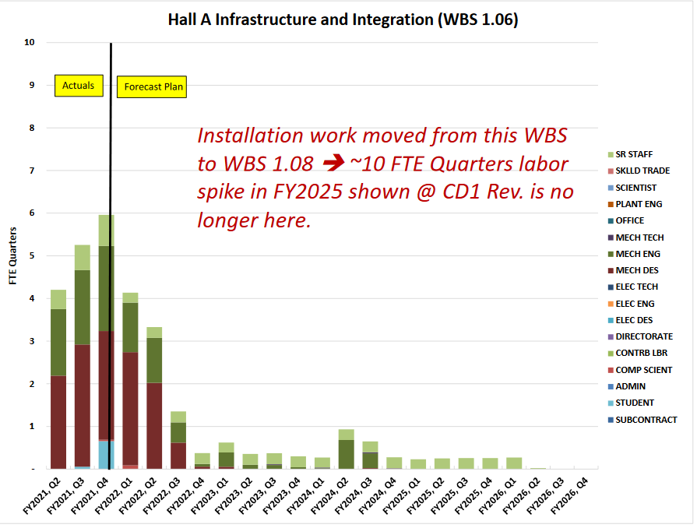
The labor profile looks like it is ramping down but there is a lot of work to be done:
What’s the total planned infrastructure labor for FY22 (in units of hours)?

Slide 10
Supply chain
For BOM lead time surveys, which items were being tagged as one-year lead-time (or longer)?
  FPGAs
  Magnet power supplies (have not received estimates for production yet, but expect >1 year)
  Beam pipes (all aluminum fabrications)
  Others on our watch list
  Magnet coils (vendor estimates 24 weeks from production order, but we remain concerned)
  Downstream toroid enclosure
  Vacuum pumps
  Process controls and instrumentation components
  DAQ/trigger boards (general chip shortage, but driven by FPGAs currently)
  Detector power supplies (HV and LV)
Have you queried suppliers about lead-times on other key materials such as quartz for detectors, PMTs, and custom chemicals (e.g optical epoxies)?
  Not recently enough, but it is also difficult to foresee what the situation will be in 12-18 months when we would start to order these in production quantities
  NSF and CFI/RM funding allow flexibility to initiate orders before CD-2/3
    We need to complete design work and interface checks sufficiently to move forward
    Need to complete assembly and test of pre-production prototypes to validate performance will be met

