Slide 1
MOLLER IPR Oct 2023
Preparation Tasks for IPR in October
We should aim to complete all actions and updates by Friday Sept 15th.
v2.00 – 08.21.23 – R. Fair
MOLLER - 2023 CD 2.3 IPR_Oct 2023 - All Documents (sharepoint.com)

Slide 2
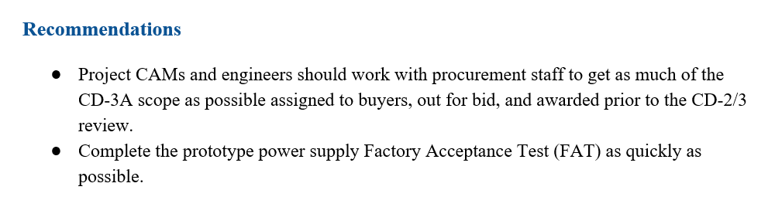
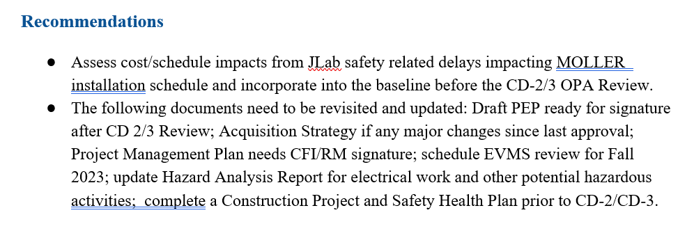
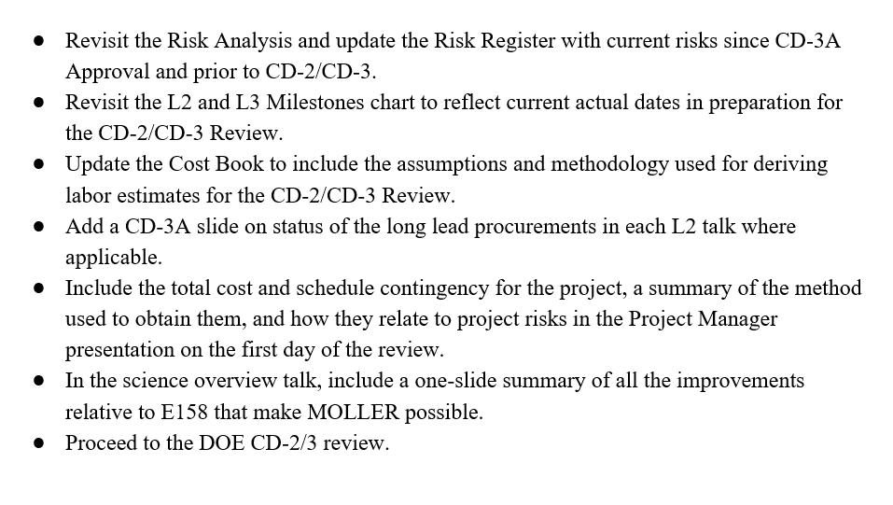
Recommendations from Director’s Review (Aug 2023)
SC-1 Target, Spectrometer, Assembly
SC-2 Detectors, Infrastructure, Trigger and DAQ
No Recommendations
SC-3 Management

Slide 3
Preparation Tasks for IPR in October
Note: We should aim to complete all actions and updates by Friday Sept 15th.
Review and address recommendations
Update all Director’s Review slides for IPR
Update Cost Books
Prepare additional slide pack for CAM Interview/Drill Down – see example from Ruben
Collect and upload all backup information to review website
Review website – don’t use sharepoint?
→ As you update your presentations and cost books, please upload them to the DRAFT folders (see link below) and let Jennifer and I know so we can start reviewing them.
MOLLER - 2023 CD 2.3 IPR_Oct 2023 - All Documents (sharepoint.com)

Slide 4
Review and address recommendations

Slide 5
2. Update all Director’s Review slides for IPR
  Title slide – Use ‘ MOLLER CD-2/3 Independent Project Review’
  Title slide – Use October 3 – 5, 2023
  If you show any graphics of the interior of the hall or of any equipment, always include an arrow to show the direction of the beam.
  Guidance for number of slides: No. of slides = talk duration / 2 (e.g. a 20 min talk should have 10 slides, assume Q&A is another 10 mins on top of the 20 min talk). Now, we may have to bend this rule for the CAM talks, for example as we have to follow a template.
  Add a slide to show CD-3A procurement awards and status for each of your systems (if applicable) – a template will be provided

Slide 6
3. Update Cost Book
  Use internal hyperlinks (bookmarks) to allow smoother transitions between main text in document and vendor estimates or other tables.
  Provide more detail In narrative to explain how costs were developed – if necessary provide additional tables showing the summation of separate cost items which clearly roll-up to any totals shown
  Have all other backup and supporting information uploaded to review website and readily accessible
  Can we develop a labor cost estimation strategy for those systems where we do not have backup info
    For example: We state that we have used the following guidelines to produce a base estimate for the various activities, then the CAM and SME adjusts the numbers to suit the complexity of the activity based on previous experience.
      EM calcs : EE = x hours, MD = y hours
      Mechanical FEA: ME = x hours, MD = y hours
      Assembly of Equip #1: ME = x hours, MT = y hours and so on
  See example from Ruben – go to the following link, look at 01_US ITER cost book…, scroll down to Appendix E. Appendix E describes a labor estimating tool that was developed by the CAMs and Technical Leads at PPPL to support their labor estimates in P6. I’m not suggesting that we produce such a sophisticated tool, but we might be able to produce some similar narrative and a simpler tool for the IPR – we should discuss further as to the best approach to take.
  MOLLER - Examples - All Documents (sharepoint.com)

Slide 7
4. Prepare additional slide pack for CAM Interview/Drill Down
  See example from Ruben – go to the link below, look at IPR Jun 2023…… this slide pack worked very well for the US ITER CD-2/3 review held in June 2023. The CAM interview/drill down took the following form:
  CAM goes through the drill down slides and goes through the example or examples shown (I suggest you prepare 2 examples)
  The CAM goes to their cost book and describes the top level or major costs and if you have vendor estimates in the appendix in your cost book, go to them and ensure that you can match the costs shown.
  The PCA brings up P6 live – with all the control accounts rolled up so the reviewer can see the overall structure of your plan.
  The CAM talks through the overall structure of the plan and un-rolls each control account in turn and describes (at a top level) the activities therein.
  The reviewer then selects a cost (usually materials or procurements) and wants to see that you have backup info that matches the direct (un-escalated and unburdened) costs shown in P6.
  You will notice that for the US ITER cost book, all vendor quotes were stored in separate documents (i.e. not included in the cost book) but also uploaded to the review website.
MOLLER - Examples - All Documents (sharepoint.com)

Slide 8
APPENDIX
Feedback from review panel
Feedback from S. Budenstein, M. Dion and C. Gal

Slide 9
Informal note from Heather Crawford, Director’s review panel member (08.16.23)
You’ve accomplished a ton - lead with that!
Given that the upcoming review is for CD-2/3 the CAM presentations could emphasize more the way the cost/schedule was developed. In particular, more discussion of the breakdown of work by estimate type (separating labor and materials would be helpful too) and defining start and finish of major constructions. Key schedule milestones should also be highlighted to help explain how the schedule was developed.
The color legend on the time-phased FTE charts shown is difficult to see (many colors appear very similar, but I think the bigger impact is that the legend squares are small and have a black outline which makes the color hard to see)
If possible, make figures consistent - from same perspective (e.g. slide 8 of KK’s WBS 1.08 talk), or with same color coding (e.g. color of barite concrete blocks in different views)
Point out and take credit for students who are engaged already on the project, even if not on the DOE scope! Consistent way of highlighting students across talks might be useful too (e.g. students are highlighted by font color)
Proof slides carefully - a few noted items were slides indicating only Jim as PM, referencing a speaker not in the review, use of the word ‘man-power’ instead of effort/personnel…
Streamline messages where you can - we don’t need to know everything you’re thinking about (e.g. the project is planning to buy all new cables, there is no need to mention possibly reusing cables, even if that’s what you end up doing)
The second talk from Robert Michaels for WBS 1.07 was very repetitive from the talk from Paul King on the first day, except for the last slide - perhaps not needed as a separate talk?
The website was a bit tricky in some aspects - the documents that the project wants the reviewers to see/consider should all be in one place. And the majority were - on https://jeffersonlab.sharepoint.com/sites/MOLLER/SitePages/MOLLER-2023%20CD-2.3%20DR.aspx. The tricky part was that we could see and access everything else on the Sharepoint site, and so potentially were looking at documents that were not correct (e.g. MOLLER assumptions document was not on the review page, but we looked at it - if we looked at the correct version?)

Slide 10
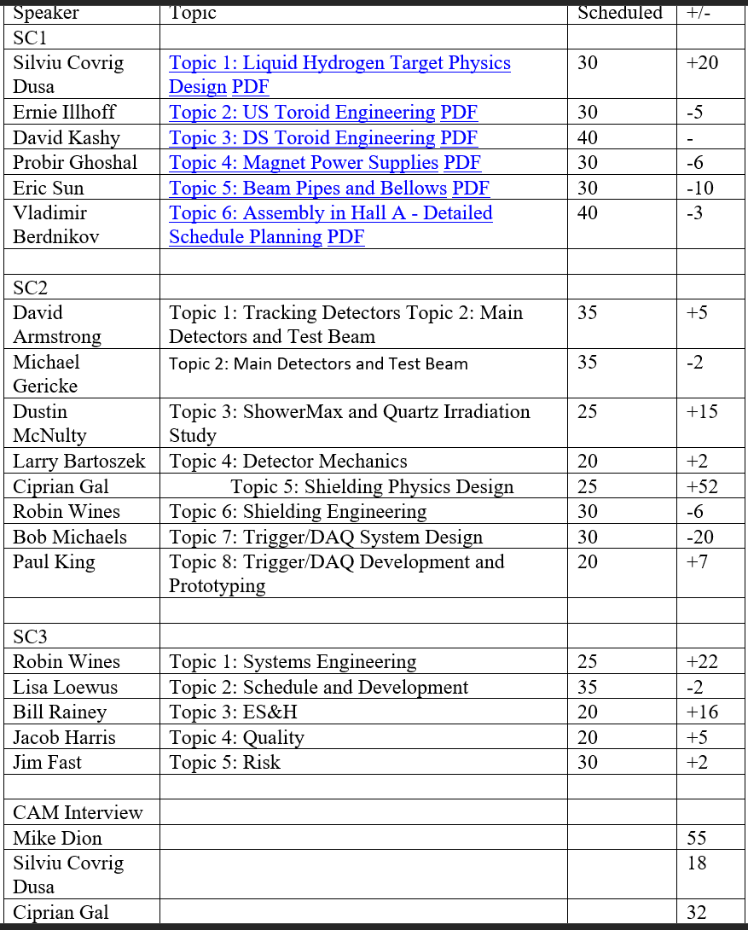
Director’s Review
(Actual timings recorded by J. McAllister – thank you!)

Slide 11
Congratulations Ruben, Jim, Lisa and to the CAMs!
Cathleen Lavelle seemed very impressed with almost all aspects of these CAM Interviews for BOE’s, CPR’s, and VAR’s, and very complimentary.
“Overall, I think everything is really good, need labor backup, work making traces easy to follow.”
WBS and CAMs reviewed –
1.03 Spectrometer Mike Dion
1.02 Target Silviu Covrig
1.06 Infra & Integration Cip Ciprian
She recommended the following –
Short CAM Presentation for BOE drilldown
Need more narrative in some cases for Estimate development (e.g., how a vendor estimate was used as base and factors added)
Have labor backup included in the Costbooks.
Include backup to justify “Experience” costs.
CAMS to ensure they can trace easily and clearly from their backup to estimate to between P6 and to Cobra.
Use tables to more clearly identify Costbook total that ties to P6 (vrs paragraph form….e.g. in WBS 1.02)
Ensure Costbook, P6, and Cobra match within rounding differences.
Practice everything in baseline management and execution.
Work on variance analysis (always a difficult process)
My Observations -
Positives
CAM’s Schedule, Estimate, and navigation knowledge, understanding, and use supporting references was good
CAM delivery of responses was good
Basis of material backup was good
Lisa’s suggestions on backup to use were all within Cathleen’s guideline (“CAMs should answer all questions”)
VAR explanations were generally good, some very good
Opportunities for Improvement
See Cathleen’s list above
Perform “SC style Black Hat” mock CAM interview
  Ensure all references are available and P6 reports ready with appropriate filters
Ensure Costbook, P6, and Cobra match within reasonable rounding errors
If possible, Fix rounding issues between P6 and Cobra (and Costbooks)
  Unfortunately
The Corrective Action string was not pulled, but MOLLER Project and CAMs should still be prepared.
Feedback from Sam Budenstein

Slide 12
All,
From what I heard and saw, I think we are in excellent shape to pass the OPA review in Oct (from the CAM perspective). I sat through Silviu’s and some of Cip’s drilldown and we sounded up to speed and comfortable with our WBS. However, there are some things that will help us.
I think Cathy did a really good job probing the BOE. If you (Sam, Lisa, Jim and Ruben) think that her drilldown will represent what the CAMs should expect at OPA, here are some comments:
We spent too much time internally with the nuisances of EVMS – terminology, canned answers etc. Generally, it is useful but that was not her focus though.
Our cost books are incomplete and require (what seems to be) a lot of detail for labor estimates. I am concerned about this for Spectrometer since I do NOT have all detailed estimate docs for labor. Jim/Lisa, I do have the doc that Lisa shared.
I know I asked prior to yesterday if I could have my laptop open to access ‘local’ files and I was told yes. However, Jim commented that everything needed to be posted. We need clarity on the rules going in but maybe this was a misunderstanding.
We need to be able to quickly access our procurement/labor activities and cross ref that to our BOE document and P6 for budgetary comparisons. It was fairly clunky when I was going through this.
We (the CAMs) need to develop a short presentation to preface the drilldown. Maybe Cathy (and others) can work to provide a template including the pertinent info. It would be nice if we could get an example presentation.
Stay out of the technical details and provide short responses.
We could use this thread as a compilation of thoughts/comments so we can ensure we check them off before OPA. I ask the other CAMs to add to the list – specifically, if you have feedback on my drilldown because it is hard to self-critique.
Feedback from Mike Dion

Slide 13
Additional feedback from Sam Budenstein
Mike,
First, I thought all CAMS performed well and have benefited from the training and experience. The CAMs knowledge, understanding, ability to use P6 and supporting references , and “comfort level” with processes and mechanics was evident with only a couple major drawbacks. This provides OPA DR team additional confidence in the MOLLER Teams’ ability to successfully complete the MOLLER project.
I believe this was a very good round of Review Team Interviews related to EVMS, albeit only a partial 20% check on CAM EVMS proficiency.
Most of my observations are in the email that Ruben forwarded.
Here’s some background and context wrt your first item on EVMS –
The CD 2/3 DR is focused on readiness for CD 2/3, which includes demonstrating compliance with EVMS prior to CD 2/3 (a DOE O 413.3 requirement).
  The CD 2/3 DR Review team has –
    complete autonomy within their Charge to ask any questions on any topic.
    performed only a partial EVMS review (based on the CAM Interviews and not knowing what reviews they did of the P6 schedule and Cobra) – considering the overlap between some aspects of the BOE review and EVMS, say 20%.
  To be clear, this Review has not performed an EVMS Surveillance Review, but did address a portion of the subjects, but not in the normal depth. So CAMS should expect much more of drilldown in an EVMS Surveillance Review.
    About 5 to 10 minutes Interview time for 3 CAMS on “pure EVMS” versus at least 1.5 hours for each CAM with a team of Reviewers covering each of 5 EVMS EIA-748 EVMS categories of guidelines.
      Significantly more document and submittal review by an EVMS Surveillance Review Team
      I was on such a Review Team last week for Fermi.
The key objective of JPMQ and ongoing EVMS training is to support he CAM responsibility for demonstrating project management including EVMS proficiency through CAM’s managing their work scopes in support of the MOLLER project and performing well at Reviews.
An effective Science CAM – PCA partnership is key in the approach for CAMs on MOLLER and EIC, and this is being demonstrated by MOLLER at this point.

Slide 14
Feedback from Ciprian Gal
Here are some other things I jotted down while you and Silviu were being interviewed:
Structure of the costbook:
  at the top under the individual L3 tables we should have basically the text Silviu has; explaining at the top level what the big items are in the WBS (one sentence per number).
  after that we have small table doing with the sum of those numbers leading to the same number as the L3 table
  after that we can have an internal word link to the appendix where we have the vendor estimates/spreasheets or whatever else supports the number from the text
  Quotes should be less than 1.5 years old (and if older we should explain why we used them and if we expect they need to be escalated)
Questions:
  Let the interviewer finish the question and if it not clear ask for a rephrase. I am not sure at point this happened but I thought a couple of times that a clarifying question would have led to less flailing and a more crisp answer. It seemed Cathy was content to let us ramble on and redirected us at the end (is filibustering the interview an option?! 😂)
  The shorter the answer the better; if they want to know more they can follow up
Once we know the room where these interviews happen it would be useful for us to play a bit with the computer to make sure we are comfortable with the mouse and the resolution. I had a hard time with the resolution being too small and. the zoom floating window being at the top (maybe we can change the zoom settings prior to the interview). Making a couple of bookmarks to the review page and the CAM notebook on the browser would definitely help with navigation.

