Slide 1
The MOLLER Project
PROCUREMENT
OVERSIGHT
Acquisition Process Meeting for TR’s, CAM’s, and PO’s
Mitchell L. Laney
Manager, Strategic Acquisitions Group
Input from: Ruben Fair

Slide 2
Outline
  Project Kickoff Meeting
  About Me
  Procurement Organization – SAG
  Moller - TJNAF Organization
  Procurement Authority
  Moller Overall Schedule
  Moller Scope for Procurement
  Procurement Authority
  Procurement Officer Technical Representatives
  Procurement Officer
  Acquisition Process/Procurement Cycle
  Advance Procurement Planning (APP)
  General Information – Strategies
  Procurement Mechanisms and terms
  Preparation for Long Lead Procurements – Long Lead Requirements
  Vendor Communications
  Summary

Slide 3
Project Kickoff Meeting
Project Kickoff/Meeting for CAM’s, TR’s and PO’s
  Initial meeting is today August 23, 2023
  Future Meetings to be held with Control Account Managers (CAMs) and Technical Representatives (TR’s) to discuss various procurement packages monthly
  All Procurement Officer Technical Representatives (TRs) are trained or will be trained.
  Need to sign up for TR class Gen 020 if you haven’t already
  Next class is November 6, 2023. (If needed I can set up others before this date)
  https://misportal.jlab.org/training/courses/326

Slide 4
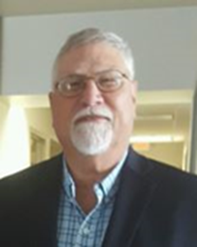
About me
Mitchell L. Laney
Strategic Acquisitions Group Manager
Relevant Experience:
    Experience spans 51 years in the DOD, DOE, DOS and commercial communities
    Thomas Jefferson National Accelerator Facility – 21 yrs.
      Strategic Acquisitions Group Manager
    Oak Ridge National Laboratory – 2 years on SNS Project
    Procurement Manager – Shaw Group – Mixed Oxide Fuel Job at Savannah River Site – 4 years
    Procurement Manager – DynCorp International – 2 years
    Procurement Officer – Delta T Corporation – 2 years
    US Air Force Contracting Squadron Commander – 20 years
    University of South Carolina (B.S 1981)

Slide 5
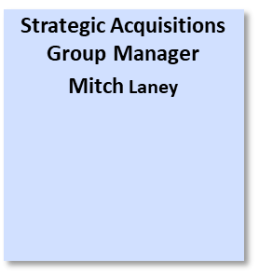





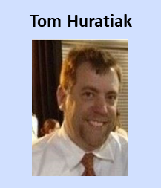


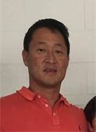


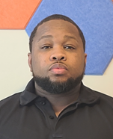

Moller Procurement Readiness – Strategic Acquisitions Group (SAG)

Slide 6
Moller Procurement Readiness: TJNAF Team - SAG
Current procurement staff and near-term increase plan
  Small but experienced staff; currently have 18 Procurement Officers (POs)
    Average time at JLab is 12.5 years
  Projecting to hire 2 new POs each year for the next 3 years based on current projected spending increases across the lab portfolio
  In Process of hiring a SA II now
Current staff has extensive recent experience supporting “Non-Normal” project procurements
  12GeV Upgrade = ~$215M over 8-10 years (completed 2018)
  LCLS-II = ~$105M over 5 years (TJNAF procurement effort completed 2020)
  LCLS-II HE = ~$15M over 4 years (TJNAF procurement effort on going)
  SNS PPU = ~$10M over 4 Years (TJNAF procurement effort on going)
Small Business Liaison Officer: Renee Carter

Slide 7
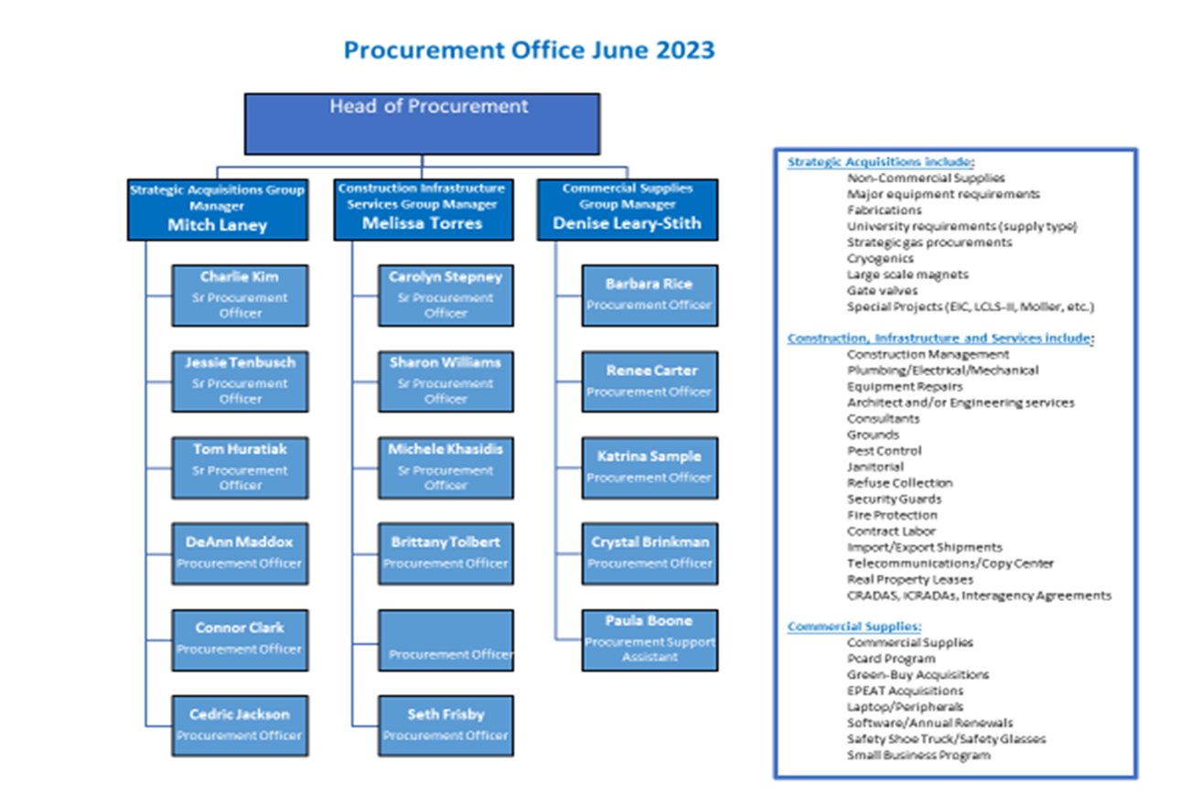
TJNAF Procurement Organization

Slide 8
Project Team
Integrated Project Team (IPT)
  Federal Program Manager (Elizabeth Bartosz; ONP)
  Federal Project Director (Bryan Foley; TJSO)
  Contracting Officer (Wayne Skinner; TJSO)
  Contractor Project Manager (Ruben Fair; JLab)
Project Management Team Responsibilities
  PM (Ruben Fair – incoming, Jim Fast emeritus)
    Delivery of project on schedule/budget
    Technical management of physics goals
    Change Control
  DPM (Klaus Demhelt – starts 9/1/23)
    Risk management
  PE (Robin Wines)
    Requirements and Interface management
    Engineering coordination and integration
  PCA (Lisa Loewus)
    Baseline management in P6
    Earned Value management
  Procurement Coordination (Mitch Laney)
  EH&S (Bill Rainey)
  Quality (Jacob Harris - acting)

Slide 9
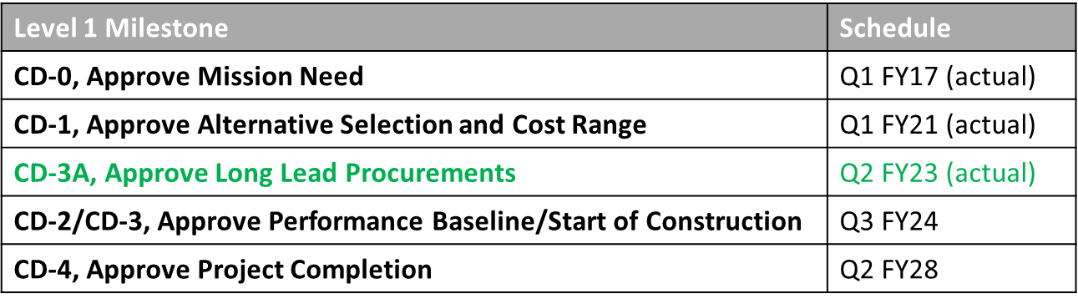
Moller Kickoff Meeting - Schedule
  CD-1 was approved in December 2020​
  CD-3A was approved in May 2023​
  CD-2/CD-3 is planned for end of CY 2023 [IPR is scheduled for October 3-5]​
  CD-4 Critical path runs through completion of SBS operations​
  Restart after recent SAD was delayed several months due to new hazardous work controls​

Slide 10
Moller Scope of Procurement
Procure all supplies and services required to support Moller scope
Follow JSA’s approved Procurement Operations Manual (POM) and Acquisition Policy Manual (APM)
  Ensures all JLab procurements adhere to our DOE-approved Purchasing System
  Basis for authority as a company and subsequently assigned individual authorities
All JLab procurements are on “JSA Paper” and only JSA has “Privity of Contract”
  Only JSA PO’s have authority to issue or change JSA contracts
  Technical collaboration will be maintained with other’s but we must ensure our vendors only get direction from the JSA Procurement Officer (PO)

Slide 11
Procurement Authority
DOE Approved Procurement System
  Approval Revised through May 31, 2024
    “Attributable to High Performance Evaluations and Balanced Scorecard Ratings…”
  Acquisition Policy Manual (APM) Establishes Policy
  Procurement Operations Manual (POM) Implements Policy
Procurement Authority Delegated by Lab Director
  Business and Finance Director $20M
  Procurement Manager (PM) $10M
Procurement Authority Delegated by Procurement Manager
  Group Managers $3M
  Procurement Officers/Buyers $50K-$1.5M

Slide 12
Technical Representative
Oversees technical aspects of the acquisition process
  Serves as PO’s technical lead to process the solicitation
  Generates all pre-solicitation technical and funding documents
    PR, Specifications, Drawings, Recommended Sources
  Assists Subcontracting Officer with Site Visit (if necessary)
  Guides technical processes through subcontract award
    TR for package serves as Technical Chairperson for Source Evaluation Team
    Selects team to assist with review (3 to 5 people)
Provides technical oversight of the subcontract
  Ensures ES&H requirements are met (e.g., ES&H 6150)
  Reviews and approves submittals and subcontractor changes
  Performs inspections and tests
  Accepts final work products and services
  PO’s and TR’s will accompany each other on vendor visits to maintain constant oversight of the subcontractors

Slide 13
Procurement Officer
JLab’s business point of contact
  Leads solicitation process and vendor negotiations
    Issues notice of subcontract award
Point of contact for subcontract business issues and changes
  Directs and Negotiates subcontract changes
  Directs and notifies subcontractor to mitigate and/or correct performance issues
  Communicates acceptance to subcontractor
  Enforces warranty and termination provisions

Slide 14
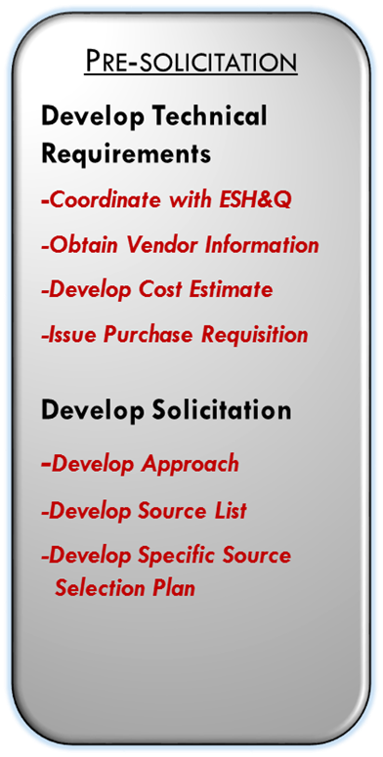
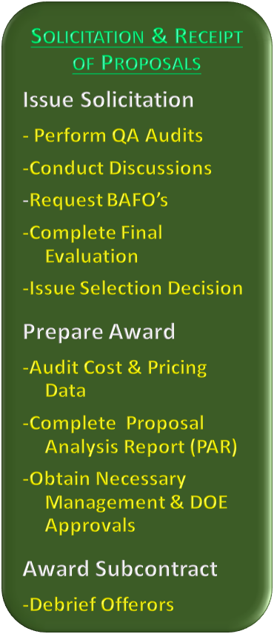
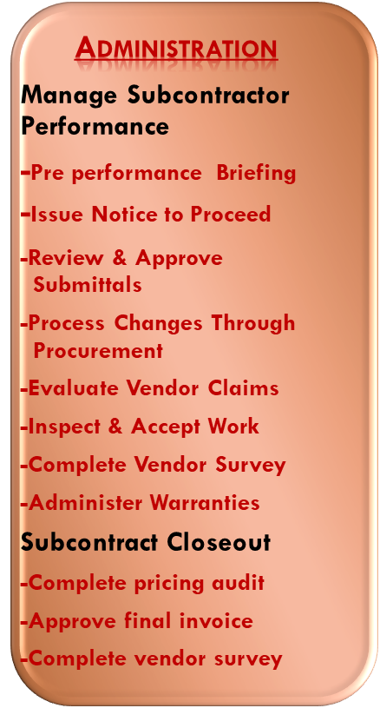

The Acquisition Process

Slide 15
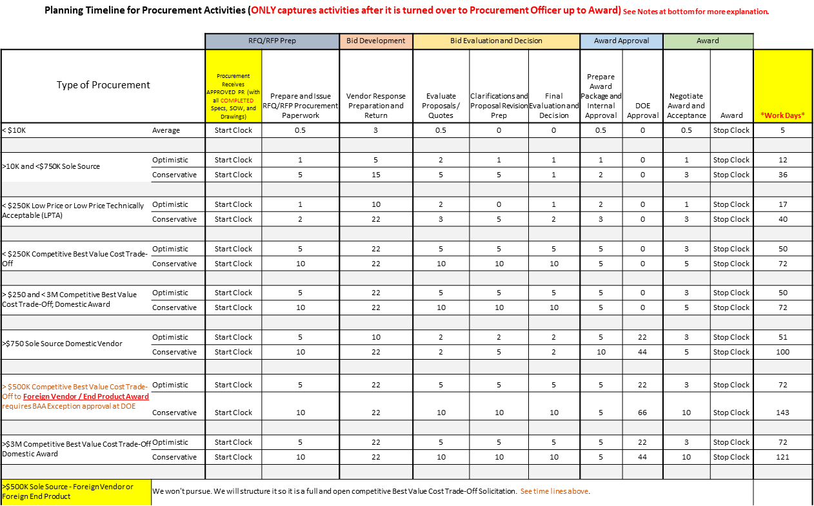
TJNAF Procurement Strings

Slide 16
Procurement Cycle – 5 Phases
Phase 1 – Planning – Advanced Procurement Planning (APP) – A Plan simply deciding what you want, when you want it, and how you will get it.
Phase 2 – Solicitation - act of going to subcontractors for pricing, business terms and schedule information, different types depending on complexity/magnitude of procurement (verbal, RFQ, RFP etc.)
Phase 3 - Evaluation and Award - determine if a meeting of the minds exist and select contractor for award of purchase order/subcontract.
Phase 4 – SubContract Administration - time where the subcontractor performs and supplies goods or services to meet subcontract requirements
Phase 5 – SubContract Closeout - point where all paperwork is completed, final payment made, and documents executed formally completing the contract.

Slide 17
Procurement Cycle – 5 Phases (cont.)
Just a few considerations how you may fit in these cycles
All of the phases have different levels of complexity and the JLab approved purchasing system defines what happens.
Understand these processes to know what role you do at each of these stages.
  Are you involved in planning and writing/reviewing specifications?
  Do you support procurement personnel answering questions from vendors during the solicitation phase?
  Are you a part of any formal technical evaluation source selection team?
  What is your plan if you are the technical person responsible for subcontractor surveillance? Acceptance criteria, site visits, inspections, certifications, approving progress invoices are just a few considerations
  What do you need to do to sign off technically on the final subcontract closeout supporting final payment, warranty considerations?

Slide 18
Advance Procurement Planning
When? Required for all procurements > $1Million up to $25 Million handled locally >$25Million goes to DOE HQ
Why needed?
    Sound business practice communicating with Project technical and business teams when things need to happen to meet schedule
    Helps entire team understand what is coming and when
    Efficient use of resources allowing capability to address real urgencies
    Without APPs, project has trouble understanding status and impacts on schedules, can focus help if necessary to mitigate delays
    Inadequate planning often causes loss of time and money
What else?
  Progress on APPs discussed at Moller
  Status Meetings

Slide 19
Advance Procurement Planning - Milestones
APP’s Include the below milestones which are reflected in the
Primavera Schedule
Complete approved Specs, drawings – (Activity)
Submission of technical package and Requisition to Procurement
Prepare RFP – (Activity)
Issue RFP - (Activity)
Vendor Proposal Effort - (90 days or more – depends on complexity)
Receive Proposal: Vendor Proposal - (Activity)
Complete technical evaluation
  Negotiations conducted and completed
Prepare Award Documents
DOE Review and Approval - (if >$3M Fixed Price or >$750K sole source or >$500K foreign vendor/item)
AWARD: Subcontract - (Activity)
Subcontract Completion Date (Established milestones by vendor)
Vendor Effort - Fabrication

Slide 20
Advance Procurement Planning - Continued
As part of planning the procurement packages are assigned in the preliminary design phases
  PO’s and TR’s will be assigned to that package to start the Procurement Process
  This allows the team to begin working on the requirement
PO’s and TR’s will accompany each other on vendor visits to maintain constant oversight of the subcontractors

Slide 21
Advance Procurement Planning - Continued
Lessons learned on previous projects guide the strategy used for procurements on Moller
  Best value – (Source Selection and Low Price Technical Acceptable) procurement methods shall be used to ensure we get the best possible outcome on the requirements.
  Options in subcontracts will be used to reduce duplication of effort at a later date for spare parts if needed while minimizing cost and unused parts
The procurement process will look to obtain domestic vendors (preferably small/large businesses) first before going to foreign sources unless it is absolutely necessary and justified, thus avoiding customs fees, exchange rate adjustments, and international shipping issues
Requirements will be posted in SAM.gov to the maximum extent possible so as to reduce issues with DOE and maximize competition

Slide 22
General Information - Strategies
Use Request for Information (RFI) Process to obtain Budgetary and Schedule information, sources,
Methods of Solicitation
Best Value – Tradeoff Process - trading off marginal differences in capability and price and when it is in best interest of Lab to award to other than the low offeror
  For Source Selection Boards
    Need to Know Who Fills These Slots:
    Source Selection Official (SSO):
    Procurement Officer (PO): Various POs
    Technical Representative (TR): Various – May involve other SME personnel
    Technical Evaluation Team (TET) Chairperson:
    TET Members:
    TET Advisors (Non-Voting Members): Mitch Laney and ?
Best Value - Technical Acceptable Low Price
  Lowest Offered Price – responsive, qualified offeror based on establishing requirements of acceptability
Awarding prototype/first articles where possible with production options benefits the project
  Eliminate multiple procurement cycles (options vs solicitations), and use resources more effectively
  Identifies/retires cost risks early in project schedule
  Allows Project to understand vendor strengths/weaknesses

Slide 23
General Information - Strategies - Continued
For all packages under the guidance of 10CFR 851 which requires all custom fabrications, piping systems, and pressure vessels to be fabricated and welded in accordance with ASME and/or AWS codes go to https://www.jlab.org/eshq/QACI for listing of approved vendors.
Each PR is a separate standing requirement and will be electronically filed—all SOW, specifications, drawings etc. required for that PR need to be added to each PR and submitted at the time the PR is submitted
If a “No Fund” PR is entered –ensure funding will be available fairly soon—as to not let the proposal/quote Bid Acceptance Period expire
Will be doing a sources sought request for Fabrication Vendors in near future.
All requirements over $250K are required to be posted on the Procurement website at https://misportal.jlab.org/ul/bus_ops/
  Requirements can be posted at SAM.gov if determined necessary by the PO if not enough sources
Weekly/Bi-Weekly/Monthly “How Goes it Meetings” will be put into place as agreed upon with Project Manager
  During those meetings Procurement will utilize a Procurement Status Sheet Report to status progress on the various Purchase Orders/Subcontracts

Slide 24
General Information - Continued
  Documents as described below are needed as indicated in red
  *All documents can be submitted either in two ways: 1 submit with PR or post at designated folder as dictated by the Project such as Sharepoint.
  What documents do we need?
    PR (Funded or Non Funded)
    Specifications (with PR)*
    Drawings (with PR)*
    Recommended Bidders based on your market research or taken from approved QA Listing (with PR)*
    Sole source justification (if sole source) (needed after discussion with PO) Over 50K PD 14 will need to be done.
    Best Value – tradeoff – will need listing of evaluators and evaluation factors (needed after discussion with PO)
    Best Value – Low price technical – will need factors that vendor will need to meet - its either a yes or no if they met (needed after discussion with PO)
    Estimate ( if you have one please provide) (with PR)*
    Budgetary Estimates (if you have received, we need to know who you received from and any emails associated with the budgetary request) (with PR)*

Slide 25
Procurement Mechanisms/Terms
Conflicts of Interests / Confidentiality Letters
  Required to be signed by all project participants
  Protects the integrity of project activities and vendor proprietary data

Slide 26
Preparation for Long Lead Procurements (LLPs)
Posting Request for Information (RFIs) for all approved Long Lead Items
  SAM.GOV.
  TJNAF Bulletin Board - https://misportal.jlab.org/ul/bus_ops/
Conduct Advanced Procurement Plan (APP) meetings for all approved procurement over $1million
Conduct Weekly Procurement Meeting with the TJNAF Moller Project Team
  Funding Updates
  Reiterate Moller Procurement Planning Process
  Provide a copy of the current Status sheet based on the P6 Schedule
  Provide updates on major acquisitions
  Identify and report the APPs in progress
Will assign a PO in advance to begin working with the TR (see list of Long Lead Requirements)

Slide 27
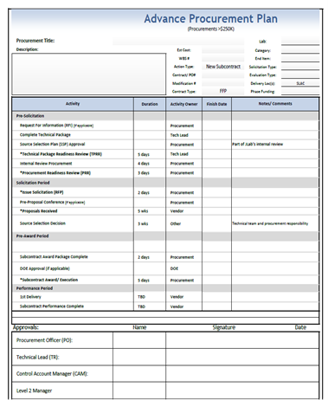
Advance Procurement Plan Example Continued
Example:
APP Document
Once a procurement is identified as an APP candidate the plan is developed and routed for coordination
Pertinent Information
  Basic Project Funding Info
  Key Procurement Milestones
  Key Stakeholder Approval Routing and Record of Approval
Moller-specific APP is being developed (for actions at or above $1,000,000.00.

Slide 28
Challenges for TJNAF
Vendor Supply Chain issues – See Vendor Survey Slides)
  Limited number of vendors
  Value Added Tax (VAT) for foreign vendors
    Germany (19%), Italy (22%), China (13%)
  Long Lead delivery times
  Bid validity time
  COVID-19 Impacts
    Supplier facility shutdown – longer than normal manufacturing schedules
  Limited Funding
    Impacts our ability to award procurement – specifically R&D
Inflation
  Price of raw materials
Phased Funding and Impacts
Procurement Lead Times
  Aligning project schedule with Procurement lead times by approval thresholds

Slide 29
Vendor Survey
Issued request to 104 Vendors (Fabrication type) on March 23, 2023. Closed responses on May 26, 2023.
Thirty One (31) responses were received.
  Machining and Fabrication – 12 received
  Magnets and Coils – 12 received
  Cryogenics – 2 received
  Fabrication and Piping – 2 received
  Magnet Steel – 1 received
  General Industrial – 1 received
  Compresor services – 1 received

Slide 30
Vendor Survey - Responses
1. What has been the greatest impact to your company in the last year? Loss of personnel? Material shortages? Loss of work? Other? 10 out of 31 – Personnel Shortages. 19 out 0f 31 – Supply Chain – raw material issues
2. Are you having difficulties obtaining certain materials and if so what are they? What are some with the longest lead-times? Copper – 3 to 8 month Leadtime, Castings and forgings – 52 week Leadtime, Aluminum, Beryllium, Steel – mill time 8 to 11 weeks, vacuum pumps, Power supplies – 6 to 12 months Leadtime,
3. Are the current supply chain issues affecting your company and if so in what way? Overseas shipment of material? Delays due to ground transportation? Reduction of work? Reduced capacity due to reduced personnel or not enough materials? Other? Volume restrictions, elevated costs of materials, Loss of personnel – new hires do not have same skills, Had to lengthen deliveries and raise prices, Increase transport costs,
4. Based on the supply chain disruptions; what is your company doing to minimize the disruptions? Add more personnel? Material alternatives? Using different carriers for shipping? Other? Looking at alternative carriers, Buying as much up front as possible, material substitutions, order parts a year ahead, look to get forecasting from customers as early as possible, expanded vendor base,
5. Do you have any sense as to whether these issues will remain for the long term or do you think they will resolve themselves over time for your company? 15 to 18 months longer, next two years, pricing will get higher due to inflation issues now, 12 to 18 months, many feel things are improving but still with issues.

Slide 31
Vendor Survey - Responses
1. What has been the greatest impact to your company in the last year? Loss of personnel? Material shortages? Loss of work? Other? 10 out of 31 – Personnel Shortages. 19 out 0f 31 – Supply Chain – raw material issues
2. Are you having difficulties obtaining certain materials and if so what are they? What are some with the longest lead-times? Copper – 3 to 8 month Leadtime, Castings and forgings – 52 week Leadtime, Aluminum, Beryllium, Steel – mill time 8 to 11 weeks, vacuum pumps, Power supplies – 6 to 12 months Leadtime,
3. Are the current supply chain issues affecting your company and if so in what way? Overseas shipment of material? Delays due to ground transportation? Reduction of work? Reduced capacity due to reduced personnel or not enough materials? Other? Volume restrictions, elevated costs of materials, Loss of personnel – new hires do not have same skills, Had to lengthen deliveries and raise prices, Increase transport costs,
4. Based on the supply chain disruptions; what is your company doing to minimize the disruptions? Add more personnel? Material alternatives? Using different carriers for shipping? Other? Looking at alternative carriers, Buying as much up front as possible, material substitutions, order parts a year ahead, look to get forecasting from customers as early as possible, expanded vendor base,
5. Do you have any sense as to whether these issues will remain for the long term or do you think they will resolve themselves over time for your company? 15 to 18 months longer, next two years, pricing will get higher due to inflation issues now, 12 to 18 months, many feel things are improving but still with issues.

Slide 32
Purchase Order/Subcontract Accruals
Go to: https://www.jlab.org/finance/procurement/tr
  Look for Technical Representative Guidelines and then Purchase Order Accrual Guide
  Accruals definition: Accounting method where expenses are recorded when a transaction liability occurs rather than when payment is made.
  Why Accruals are Needed: To record the expenses and their related liabilities which were incurred during the month, but the transactions (Invoice, receipt, etc..) had not been recorded in the Accounting books as of the end of the month.
  Delivery does not drive Accrual. The value of the work performed by the vendor, needs to be accrued monthly
  See examples in guide.
  Connie Adams will send out a request after that month is completed to have accrual back usually by the 5th.
  Call #: 757-269-5108 Email: cadams@ljab.org (Connie Adams) or mccallum@jlab.org (Shareen Mccallum) if any questions.

Slide 33

Subcontract Administration – Vendor Communication
Vendor
Collaborators
Prime Contractor (Purchaser)
Ultimate Customer
Government
Third Parties
Logistics Partners

Slide 34
Subcontract Administration – Vendor Communication
Government
Customer
Users
Partner B
Partner A
Industry Experts
Procurement Officer/TR
Vendor

Slide 35
Four (4) Guidelines for Effective Vendor Communication
  1. Maintain a single funnel/filter for all vendor communication.
  Involve the Procurement Officer & TR in every email or phone call with the vendors.
  Do not contact the vendor without guidance from the TR &/or Procurement Officer.
  2. Never argue in front of the vendor.
  If on call, ask to press "mute".
  If in person, wait for a break. If urgent, ask for a break & discuss offline.
  If you have a question that may be controversial, run it by the TR first (if technical) & the Procurement Officer (if of a business nature).
  3. Avoid using: "You should...", "You need to..", "You will..." (Unless you are the Procurement Officer or have the Procurement Officer’s concurrence).
  The direction may be considered a “directed change” and increase subcontract scope.

Slide 36
Four (4) Guidelines for Effective Vendor Communication
  4. Don’t lay all of your cards on the table.
  Do not discuss the project (P6) schedule.
If there is float, keep it to yourself or your float will soon disappear.
The vendor is accountable to the subcontract schedule, not P6.
Never agree to changes, impacts to cost or schedule without consideration.
If the vendor suggests possible cost increases, or schedule extension……ask “What is the impact?”
Take the discussion offline with Procurement Officer, CAM, STL for final decision

Slide 37
Summary
The Procurement Team is aware of current Market status with regard to Personnel, Inflation, Supply Chain Issues
The Procurement Team is aware of what requirements make up the Long Lead Items
The TJNAF procurement team are very experienced and already engaged with the Moller estimators, Engineers and Physicists
Current Procedures/processes will allow for the immediate processing of Long Lead Procurements as requirements are provided to Procurement
  Communication is paramount in a partnership to reduce vendor confusion
We are actively engaged in the process of staffing up and ready to support Moller

Slide 38
Closing
Thank You
Questions?

