Slide 1
MOLLER Spectrometer
Downstream Coil Design Down Select
- The Process
R. Fair
v1.00 – 12.02.20 – First Release
(with support from the JLab Magnet Group, J. Mammei, K. Kumar and others)

Slide 2
Introduction to the two DS coil designs
How do we use the Pugh Matrix?
Extract from the matrix for the coil down select
What happens next…….?

Slide 3
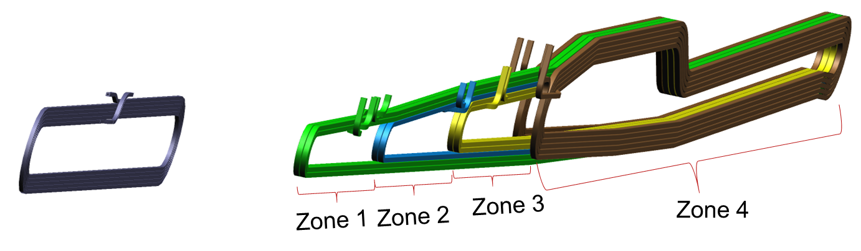
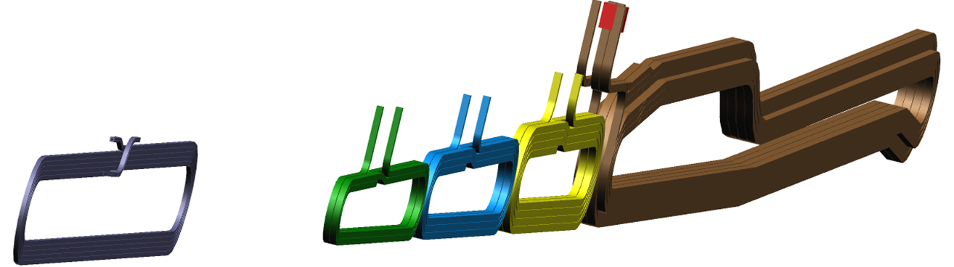
Introduction to the two DS coil designs
DS Hybrid Torus: Co-wound coils
DS Segmented Torus: Independent coils

Slide 4
Coil Engineering - Process
Choose appropriate design goals ^{[1]}
  Current density: 20 A/mm²
  Water Flow Velocity: 15 ft/sec
  Water temperature rise: 35 ºC ( note coolant supply 30 ºC)
Choose a operating differential pressure 100 psid (chosen to allow increase if needed to create flow but not limiting fitting or hose type choice)
Nominal Current (Ampere Turns) by zone provided by collaboration)
Design current is 110% of nominal value provided by the collaboration
Choose a conductor size (H x W x dia) for each coil type and create wind-able design to match collaboration requested current placement geometry and to clear particle tracks
Provide simplified (blocky model) of winding layout to collaboration for evaluation of particle tracking
[1] – Based on review of water-cooled magnets at JLab and SLAC
Magnet type | US | Zone 1 | Zone 2 | Zone 3 | Zone 4
Hybrid | 5358 | 7752 | 10602 | 16862 | 29160
Segmented (15% More than Hybrid DS coil) | 5358 | 8914 | 12192 | 19391 | 33534
Notes:
Go through bullets
Not Segmented needs 15% more current due to reduced coil straight lengths

Slide 5
What is a Pugh Matrix ?
It is a framework which formalizes decision-making
It allows us to identify the strengths and weaknesses of one solution compared to another
It also allows us to record how we made the decision
It works best when the whole team participates

Slide 6
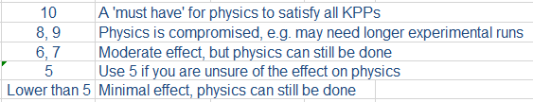
How do we use the Pugh Matrix – this MUST be a team effort
Enter Critical to Quality (CTQs) requirements
  For the Moller spectrometer, the main requirement (obviously) is being able to perform the physics
    This top level requirement can be broken down further to include the engineering requirements. We have divided it into DESIGN, FABRICATION, ASSEMBLY and OPERATION
Give each CTQ a weight – i.e. ask ourselves how important is each CTQ to satisfying the physics requirements? The weights are usually rated from 1 to 10.
Rate each alternative design as better (1), worse (-1) or the same (0) as the ‘baseline design’.
  Here we have selected the ‘baseline design’ to be the Hybrid coil design and the segmented coil design as the alternative

Slide 7
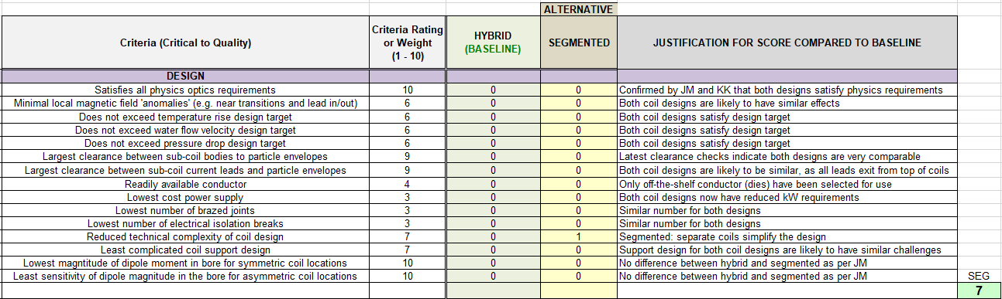
Extract from the Pugh Matrix for the coil design down select
X

Slide 8
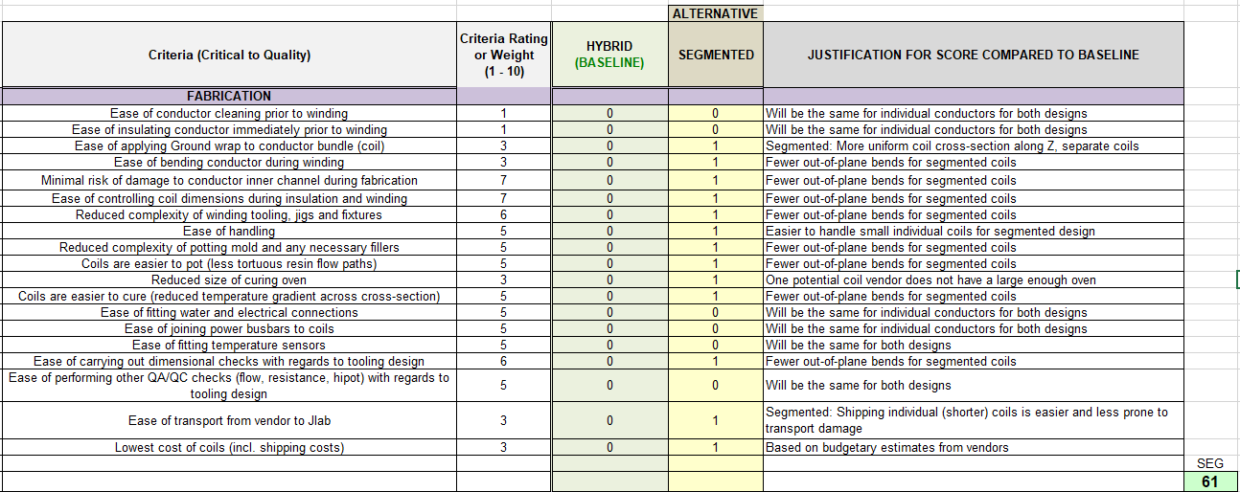
Extract from the Pugh Matrix for the coil design down select

Slide 9
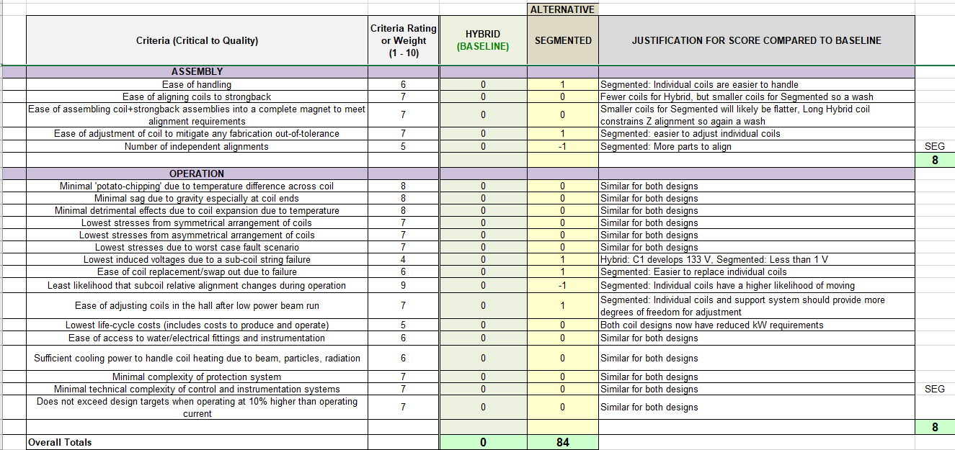
Extract from the Pugh Matrix for the coil design down select

Slide 10
What happens next…….?
All team members to review the Pugh Matrix Excel Worksheet (in particular the weights) – by Friday 4th Dec
Friday 4th Dec – detailed review of the Pugh Matrix → make the down select
Write a report summarizing the decision – Ruben, Juliette, KK
Convene the Change Control Board (by 12.15.20 ?) – Jim Fast
Present and defend the decision – Ruben, Juliette, KK
Formalize the decision – Jim Fast

Slide 11
BACKUP – SYSTEM OVERVIEW

Slide 12
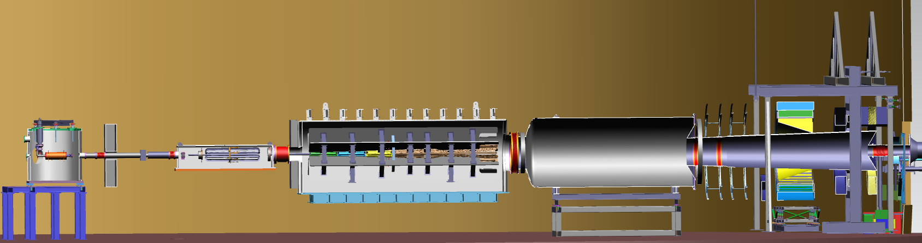
Subsystem Overview
UPSTREAM
Extent of Spectrometer Scope + beam pipes to the dump
DOWNSTREAM
Scattering Chamber and Target
(not included in Spectrometer scope)
Lead Collar
Hybrid Lead Wall
Lead Collar
Lead Collar
Primary beam window
Shield Pipes
Drift Pipe
Drift Pipe
Detector Pipe
Electron beam
Target Lead Wall
Detectors
(Not included in Spectrometer scope)
1.03.06 Blockers #6 and #7
(for calibration and background checks)
1.03.06 Collimator #4
(Secondary acceptance defining collimator)
1.03.07 Downstream Beam Pipes and Windows
1.03.06 Collimator #1
(Primary beam intercepting collimator)
1.03.03 Upstream Torus
(Pre-bending of particles)
1.03.02 Downstream Torus
(Focusing and separation of particles)
Not shown here:
1.03.04 Field measurement system
1.03.05 Water chiller
1.03.08 Shielding supports
1.03.06 Collimator #2
(Primary acceptance defining collimator)
1.03.06 Collimator #5
(Photon-blocking collimator) and Lintels
[Note: There is no Collimator #3]

Slide 13
BACKUP – KPPs

Slide 14
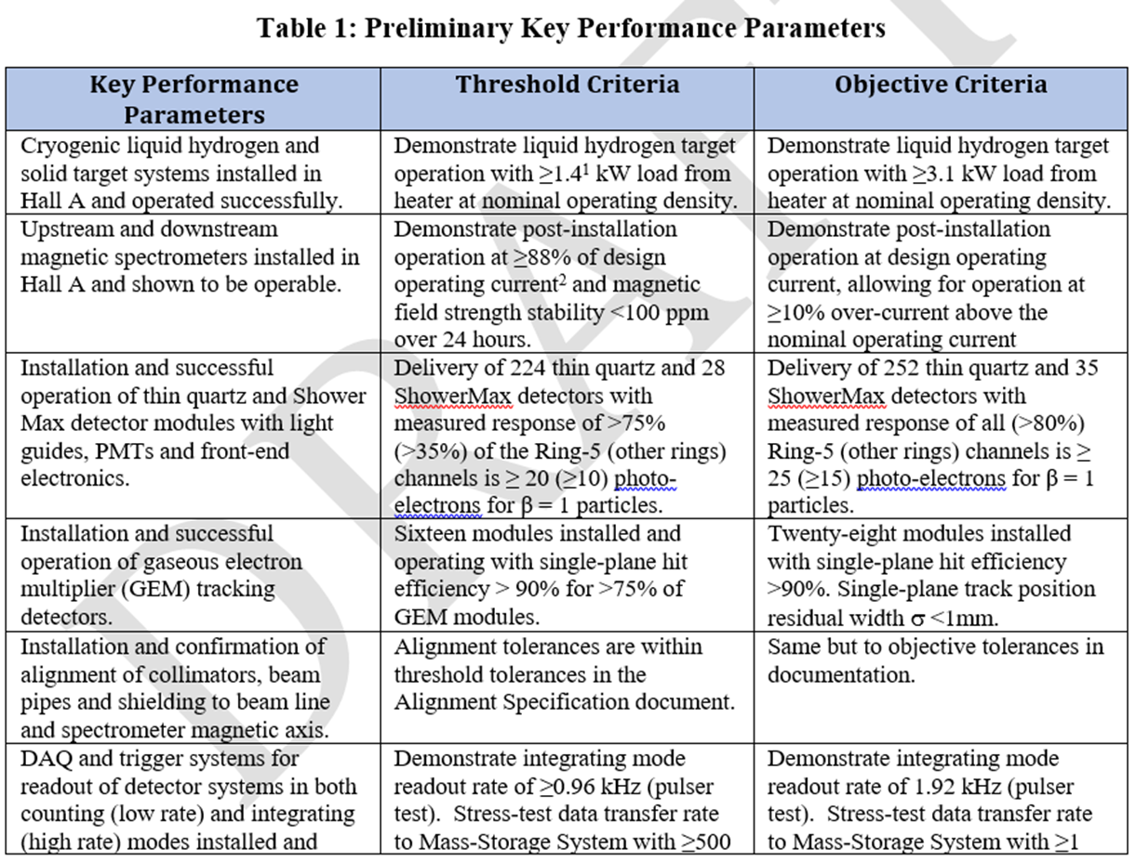

Slide 15
BACKUP – Coil Hydraulic and Electrical Design
O:\Magnet_Design_Tools\Magnet Projects\MOLLER - Hall A\6. Engineering Calculations-Analyses-Simulations\Mechanical\Coil DP calcs
Filename: CDT 110percent - Sept 2020 100psi w_KPP Seg SC 4.xls
Worksheet: Release Sheet_V2

Slide 16
UPSTREAM

Slide 17
HYBRID DS

Slide 18
HYBRID DS

Slide 19
SEGMENTED DS

Slide 20
SEGMENTED DS
5 turns per pancake
4 turns per pancake

Slide 21
BACKUP – Clearances to Particle Envelopes
O:\Magnet_Design_Tools\Magnet Projects\MOLLER - Hall A\5. Preliminary Drawings - uncontrolled\Beamline Cad\ENVELOPE CLEARANCES
Filename: COIL CLEARANCES 2_RRW_dk.xlsx
Worksheet: Nov 2020

Slide 22
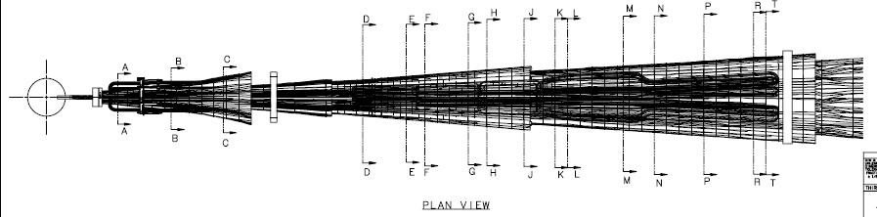
UPSTREAM TOROID
DOWNSTREAM TOROID
SC1
SC2
SC3
SC4

Slide 23
UPSTREAM

Slide 24
DOWNSTREAM – SC1

Slide 25
DOWNSTREAM – SC2

Slide 26
DOWNSTREAM – SC3

Slide 27
DOWNSTREAM – SC4

