Slide 1
JLab Cryomodule Production
J. Fischer / T. Reilly / N. Huque
04 November 2019

Slide 2
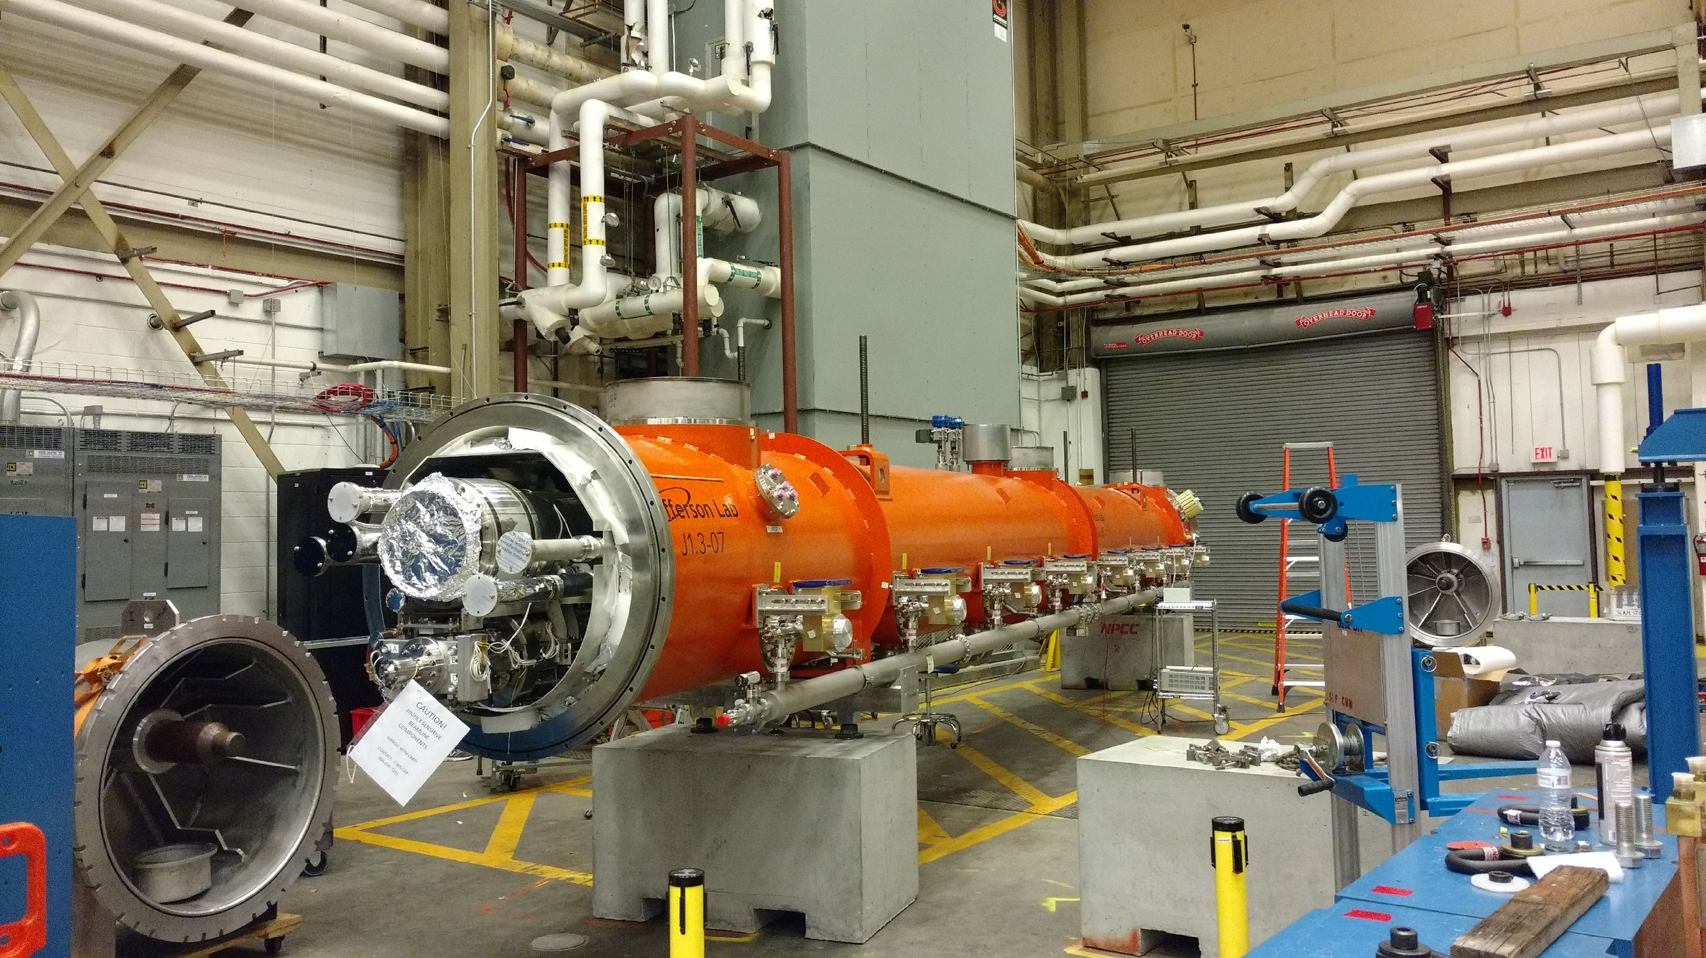
Outline
Cryomodule status
Cryomodule locations
Retrofit Work Status
CM Assy Traveler Status
3 week Outlook
J1.3-07 Shipping 11/08

Slide 3
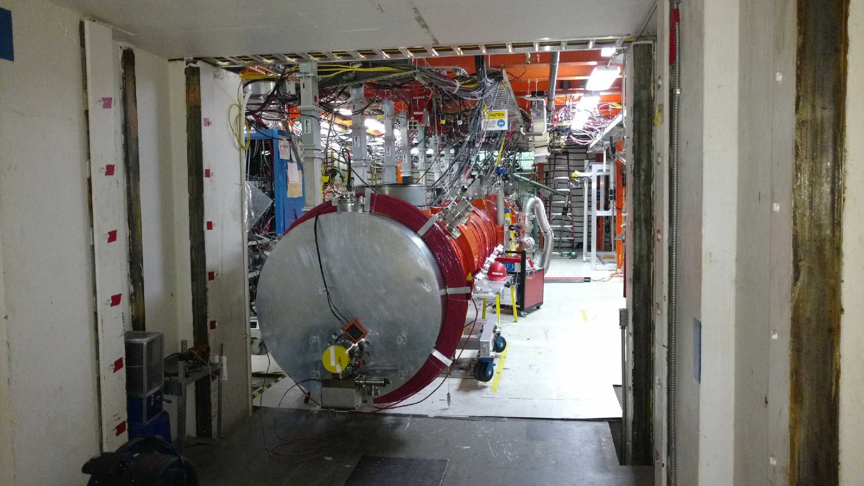
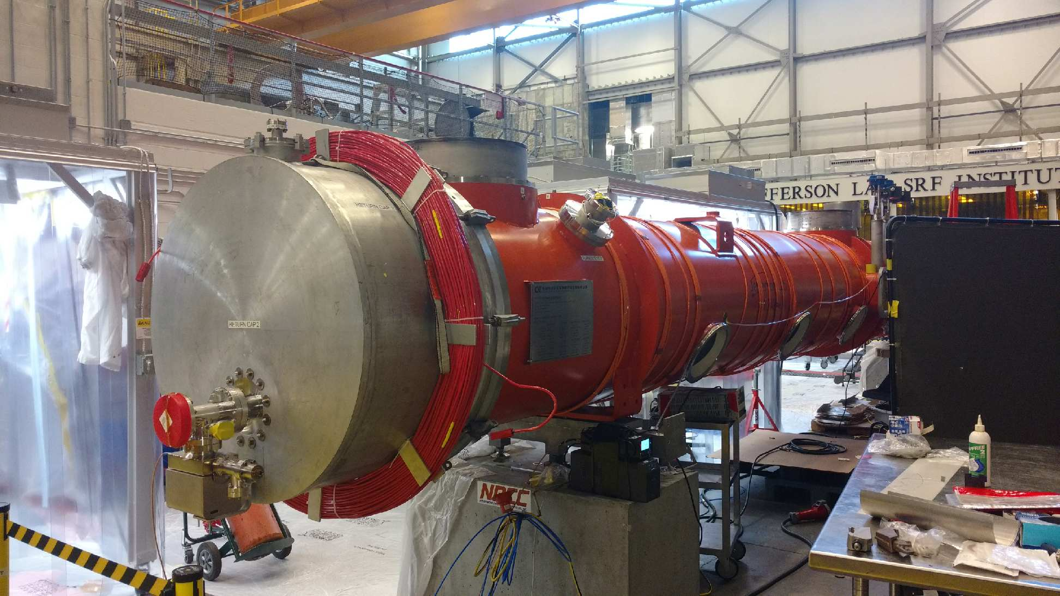
J1.3-21 through -16 Status
J1.3-21- WS4- Instrumentation, RF Cables
J1.3-20- WS5- 2 phase leak check, final checks
J1.3-19- In CMTF, Testing
J1.3-18- UITF
J1.3-16- WS5- Post test configuration
J1.3-19
J1.3-20

Slide 4
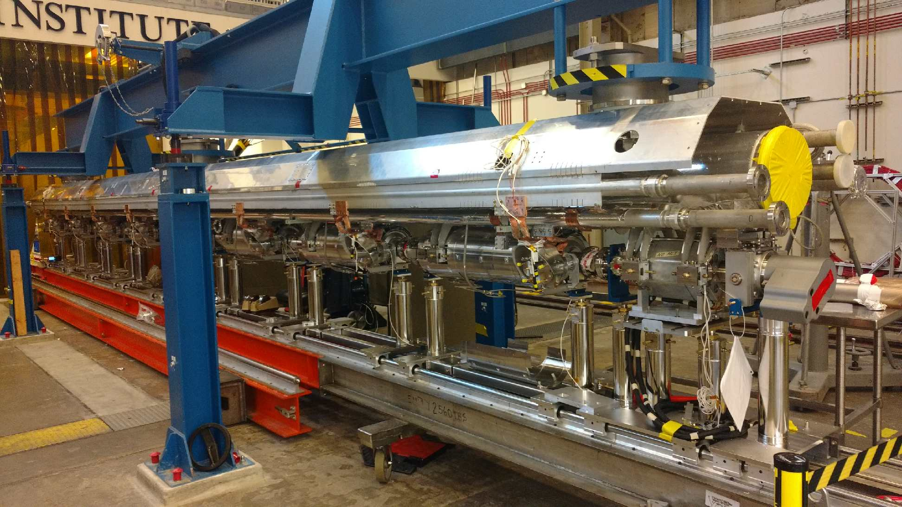
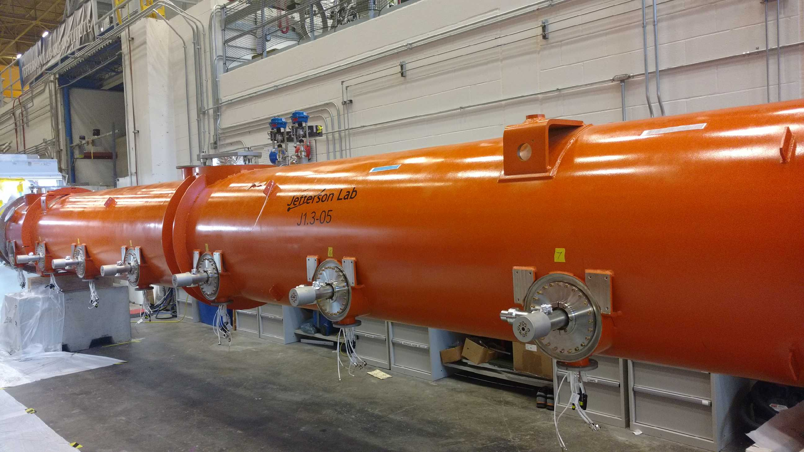
J1.3-11 through -01 Status
J1.3-11- Disassembly complete
J1.3-07- WS6- Prep for shipping 11/08
J1.3-06R- WS3- LC 2 phase piping, solder magnet leads
J1.3-05- UITF
J1.3-02- In storage offsite
J1.3-01,03,04,08,10,12,13,14,15,17@SLAC
J1.3-06R
J1.3-05

Slide 5
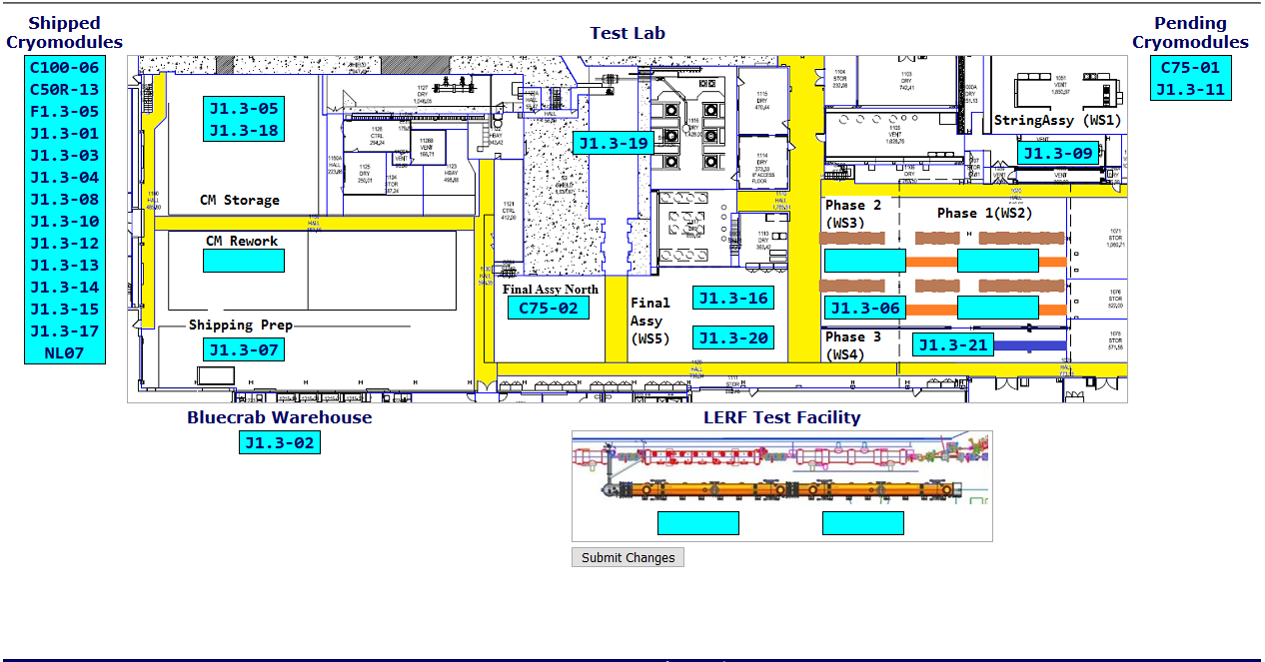
Cryomodule Locations

Slide 6
Retrofit Work by Cryomodule

Slide 7
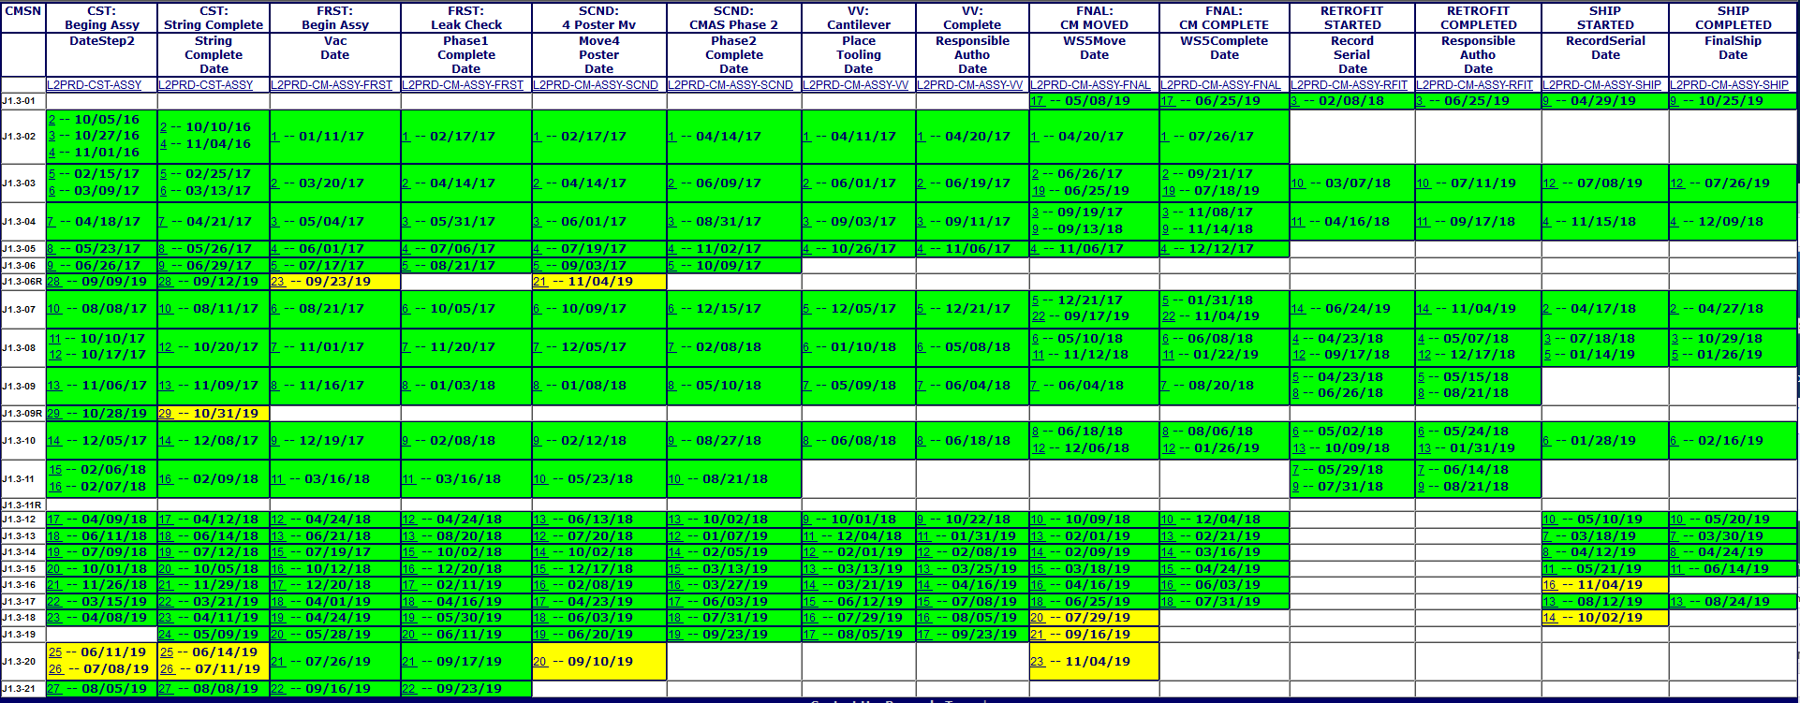
Traveler Status

Slide 8
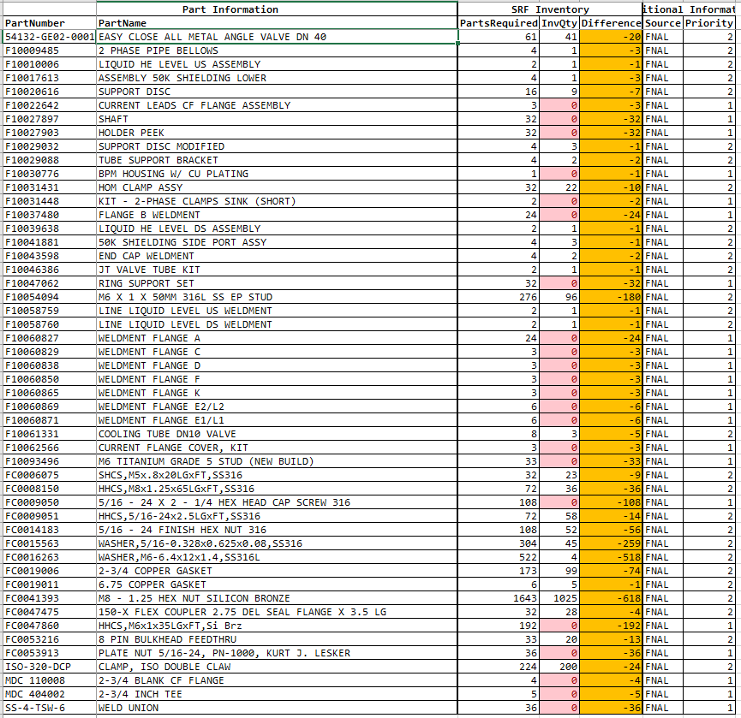
Inventory Shortage
Progress is going well.
Down to 49 Part Numbers
Recent shipment included in report.

Slide 9
CM Assy 3 Week Look Ahead
J1.3-02- Off-site Storage
J1.3-05- Storage, wait for Cantilever
J1.3-06- WS3- Tuners
J1.3-07- @ SLAC
J1.3-09- WS2- Process piping, magnet install
J1.3-16- Post test configuration
J1.3-18- Shipping Traveler
J1.3-19- Post test Configuration
J1.3-20- Move to LERF, Nov 21st
J1.3-21- WS5, Warm couplers, Beam line work
J1.3-01,03,04,07,08,10,12,13,14,15,17@ SLAC

