Slide 1
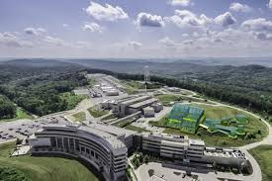
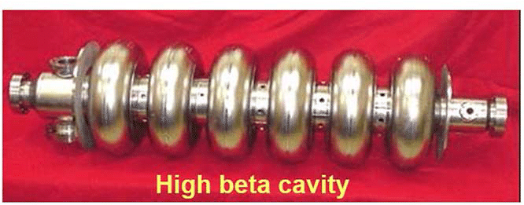
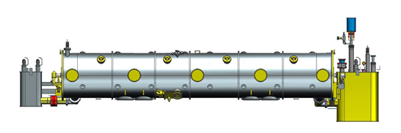
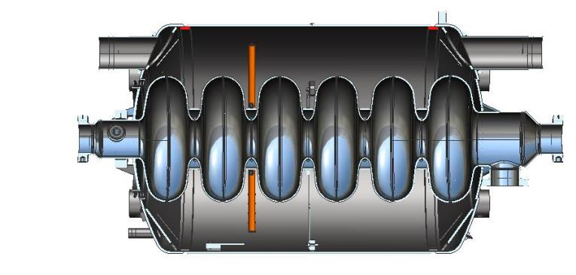
SNS-PPU Cavity/Cryomodule Construction Process
JLAB Cryomodule Construction
Spallation Neutron Source @ ORNL
Oak Ridge Tennessee
Supplier
Receiving in SRF Inventory
Mechanical Inspection CMM
Cavity /Helium Vessel Prep. & Test
Helium Vessel Weld
VTA RF Test in liquid Helium @ 2 K
 | Component | JLAB | ORNL
Cavity String Assembly | Niobium |  | X
 | Cavities |  | X
 | Helium Vessels | X
 | Cavity Feedthroughs | X
 | Cavity Flanges & Assoc. Hardware/Seals (VTS & HTS compatible) | X
 | Fundamental Power Coupler (FPC) |  | X
 | Cavity String Interconnecting Bellows | X
 | Cavity String Assembly Hardware & Seals | X
 | SC Magnet Assembly | X
 | Beam Position Monitor (BPM) | X
 | Beamline Vac. Monitoring Manifold & Gauge | X
 | Clean room Assembly Beamline Bellows | X
 | Clean room Assembly Gate Valves | X
Cryomodule | Two-phase Pipe Bellows
 | Tuner motors (Stepper) | X
 | Tuner Harmonic Drives | X
 | Tuner Frames | X
 | Thermal Shield | X
 | MLI | X
 | Magnetic Shielding | X
 | Space Frame | X
 | Vacuum Vessel | X
 | Supply & Return End Cans | X
 | Return End Can Heat Exchangers | X
 | Coupler Pumping Lines & Pumps (ion+TSP) + vacuum gauges | X
 | Instrumentation | X
 | Liquid Level Probes & JT Valve | X
 | Beamline Interconnect Parts including Aluminum Heat Shields | X
 | HOM Absorber | X
 | Shipping Frames & End Caps + Shock Log Devices | X
 | X = Lead Lab
Work Station 1- Cavity String
Assemble Cavity String -Class 100 Clean Room
Leak Test
Work Station 2 Cold Mass Assembly
Cold Mass Assembly
Thermal Shield/Space Frame Assembly
Alignment
Insertion of cold mass into the vacuum tank
Pressure & Leak Test
Test & Commissioning at ORNL
Install Cryomodules in Accelerator, cool to 2 K
Tuners - Range, Hysteresis, & Resolution/ Sensitivity
Cavities for Gradient & Dynamic Heat Load Q_{o}
Weld & certify leak tight , pressure test ,
check Controls,
Gradient & Dynamic Heat Load
Work Station 3 Final Assembly
Cold Mass Assembly
End can assembly
Top hat assembly
Pressure & Leak Test
Supply end can
Vacuum vessel (39” shell OD)
Return end can
Beam line length (6.290 m)
Overall length (7.87 m)
Work Station 4 – Test Cave
Cryomodule integrity thermal cycle & checkout @ 2 K
Cryomodule shipping to ORNL

