Slide 1

JLab SRF QA Tools
Valerie Bookwalter
JLab Pansophy
31 March 2014

Slide 2
Pansophy team
Johnny Leung (LCLS-II POC)
Steven Smith (QA/CI manager)
QA team
Valerie Bookwalter (Computer Scientist)
Mike Dickey (Programmer / Part Time)
M.I.S. Robert Lawrence and Mike Staron (Traveler Backup)
Anne McEwen (SRFPJS Team Leader)

Slide 3
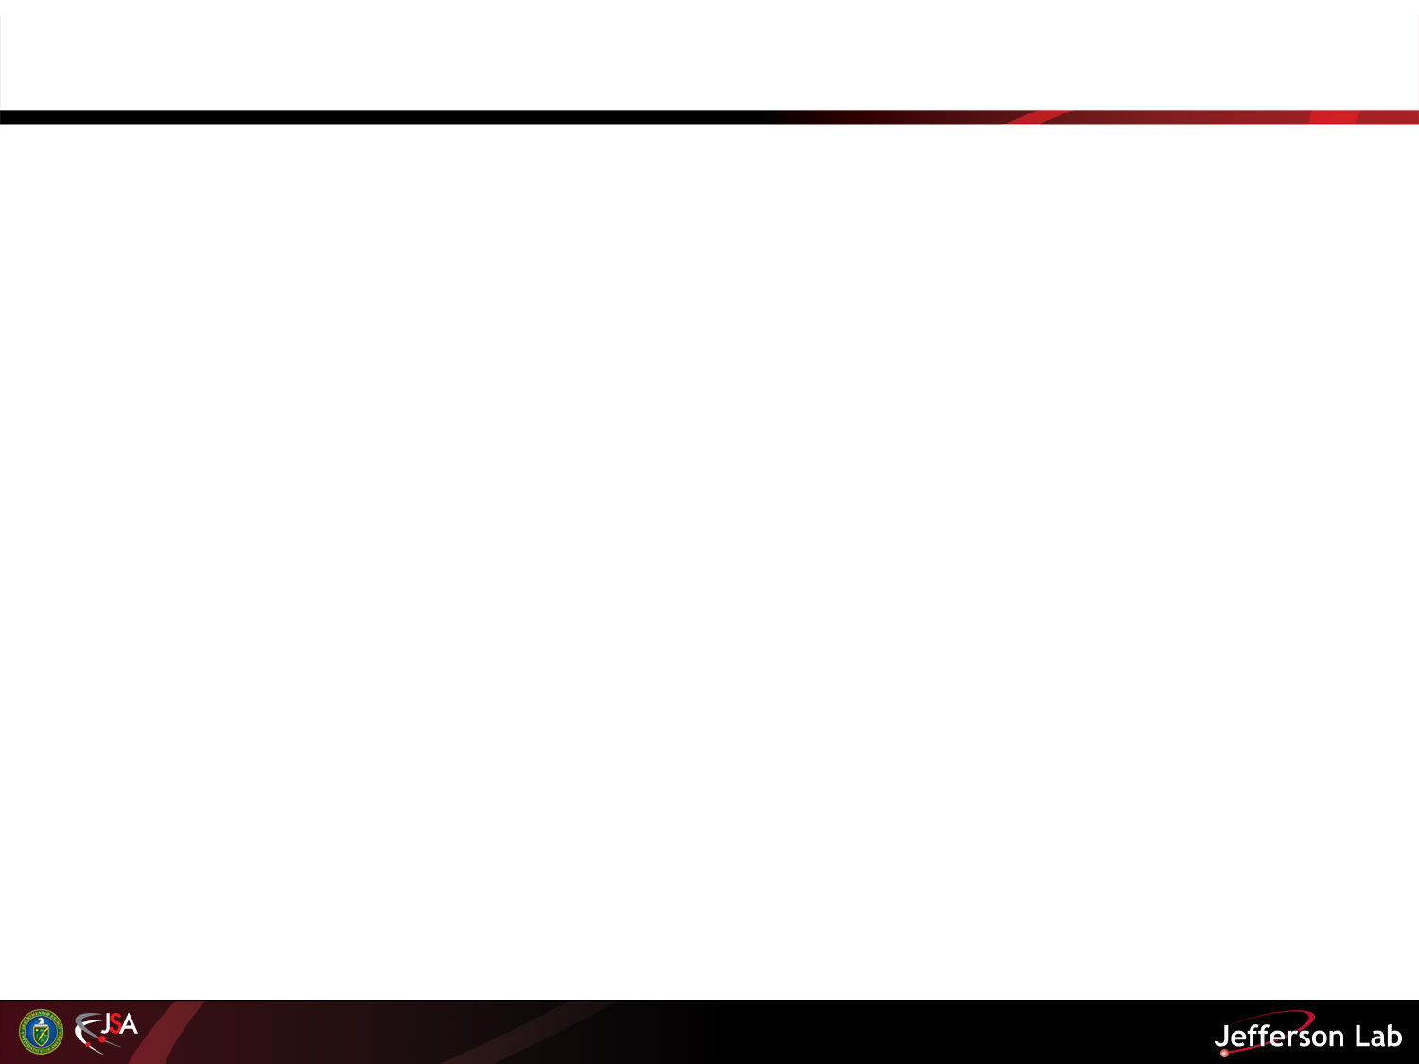
Outline
QA/QC (Johnny Leung POC)
The Pansophy QMS connection
External access / Data Sharing
Pansophy Overview
Questions

Slide 4
Jefferson Lab Quality Management
The Quality Assurance/Continuous Improvement (QA/CI) group of ESH&Q is responsible for the overarching lab quality.
The Quality Assurance Program Description (Doc # QAC-09-038 located within Quality Assurance Program Procedures) describes the Quality Assurance Program Structure for the lab.
Engineering Division, which include Cryogenics, has the Conduct of Engineering Manual as the governing divisional policy. Conduct of Engineering Manual (ENG-AD-01-001)*
SRF Quality Policy: Quality Manual QA-M-001 A “Road Map” describing the SRF Mission, the quality assurance/control systems, and mechanism to produce high quality deliverables
SRF Project Management Process (PR-P-001)
  Provides a structured methodology to manage small to medium size projects.
  Formalized process to enhance planning, organization, communication, and implementation.
* Link is to the JLab DocuShare website, requiring login access.

Slide 5
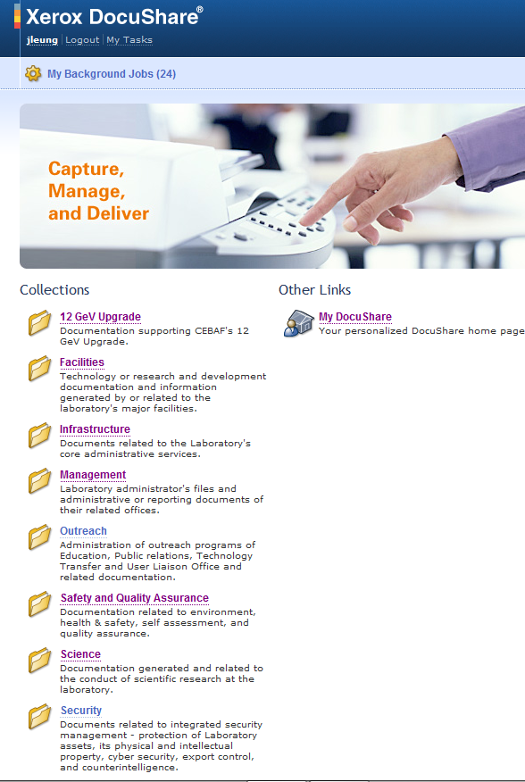
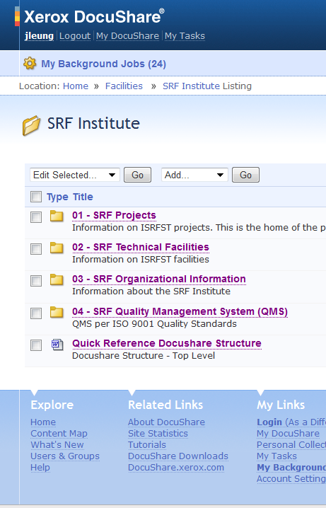
DocuShare (Xerox) – Document management system/repository
SRF Data, Document & Process Management
Web-accessible centralized file storage database (Lab-wide & SRF).
Controlled-Sharing access to site content.
Collection-Based filing structure.
Files for SRF organizational info, Quality Management System, Project Management, procedures, travelers, etc.
Plus other account and content features including security and revision control.
Johnny Leung slide

Slide 6
Outline
QA/QC
The Pansophy QMS connection
External access / Data Sharing
Pansophy Overview
Questions

Slide 7
SRF Document Control Process (QA-P-001)
An example of one of the formal processes for the creation, review, approval and filing of process documents.
Centrally stored files for common access to the latest approved document versions.
Revision control is maintained for history and records.
Johnny Leung slide

Slide 8
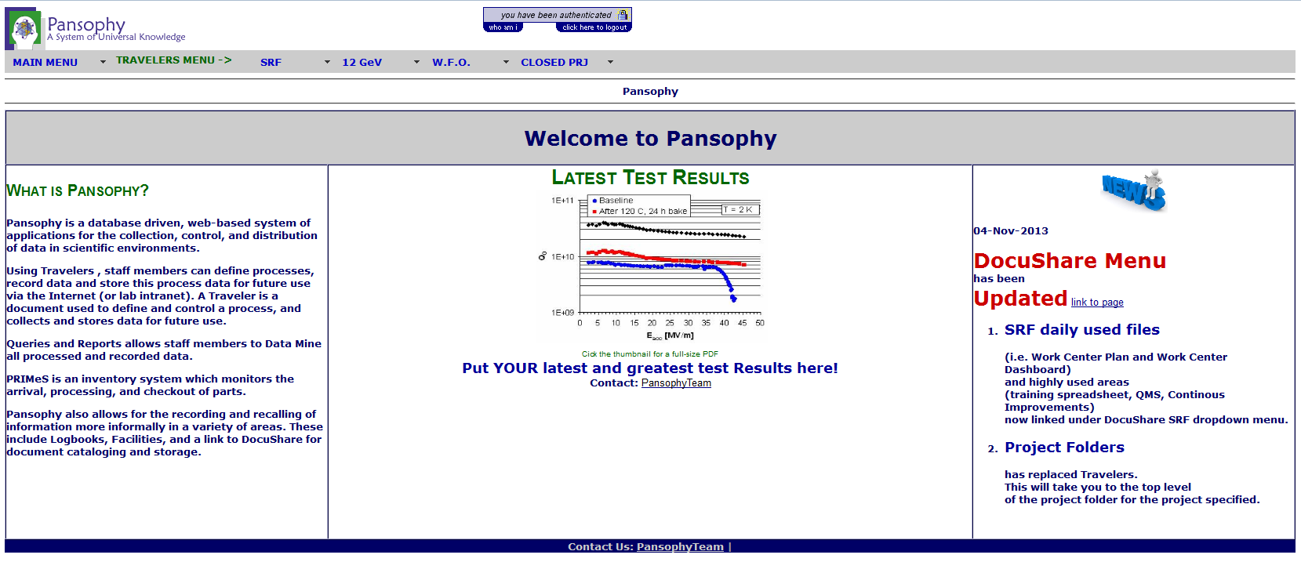
Data, Document & Process Management
PANSOPHY
A Process & Data Management Tool
Pansophy is the home for our electronic Travelers.
Other PANSOPHY Uses ….
Data Management & Storage
  subcomponent test data
  processing & testing procedures
  Inventory
  R&D and Production
Knowledge Management
  to Maximize learning from expensive prototyping and low-volume production
Utilized in both R&D and Production environments (SNS, Gev12)
Johnny Leung slide

Slide 9
Control of Non-Conforming Product (MAI-P-004)
Non-Conforming Reports (NCRs):
Formal process for identification and disposition of Non-Conforming products, when a component part or an assembly fails an inspection or test requirement.
Process Integration between quality control, inventory control, and the production Travelers.
A Supplemental Tool for capturing “Off-Normal” events that occur in the production process.
Detours, Deviations and Discrepancies (D3s):

Slide 10
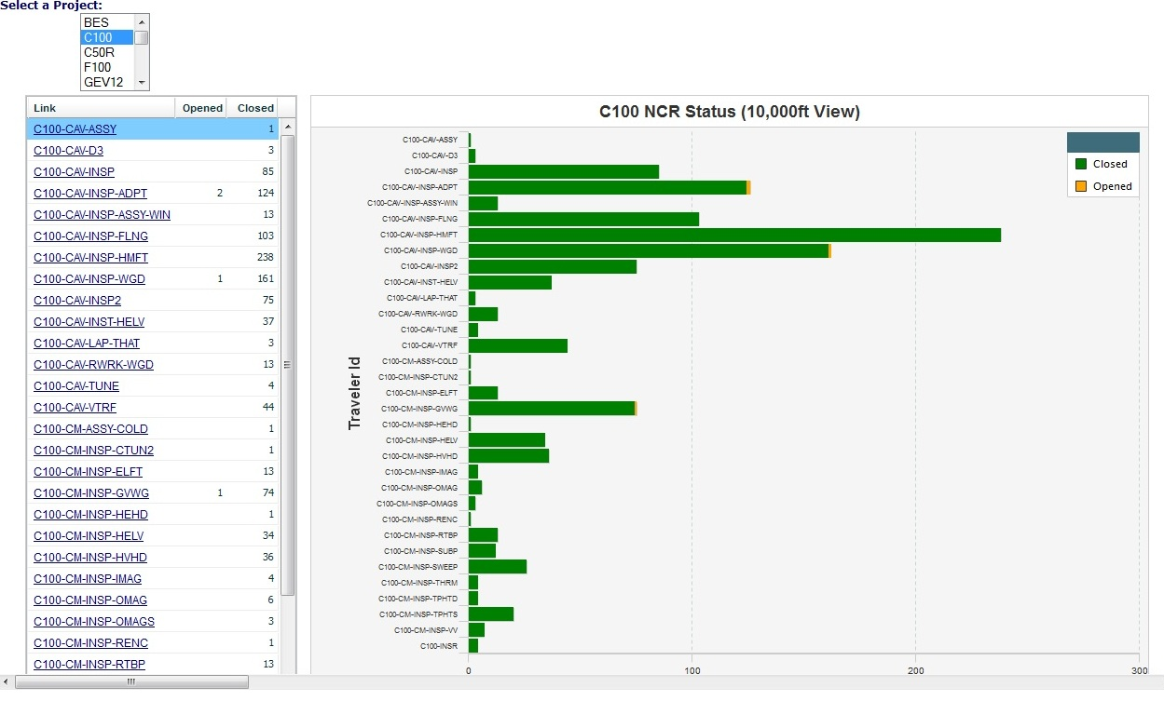
NCR Project View
Drill-down links to Traveler status Query
Visual Status of NCRs (open/close, numbers)
  Listing of NCRs by Traveler ID
Helps Prioritize Traveler/Components with the most issues

Slide 11
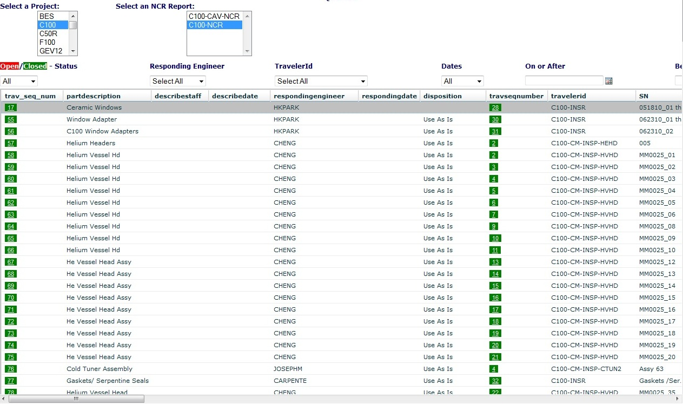
NCR Management (QA/Team Level)
Drill-down links to individual Travelers
NCRs: Non-Conformance Report
  Listing of NCRs, open/close status, related travelers
    Typically found with inspections, but any traveler can apply a NCR
  Linked to specific NCR & Traveler for “Drill Down”
Sort on Disposition, travelers, etc. to Management the NCRs

Slide 12
Outline
QA/QC
The Pansophy QMS connection
External access / Data Sharing
Pansophy Overview
Questions

Slide 13
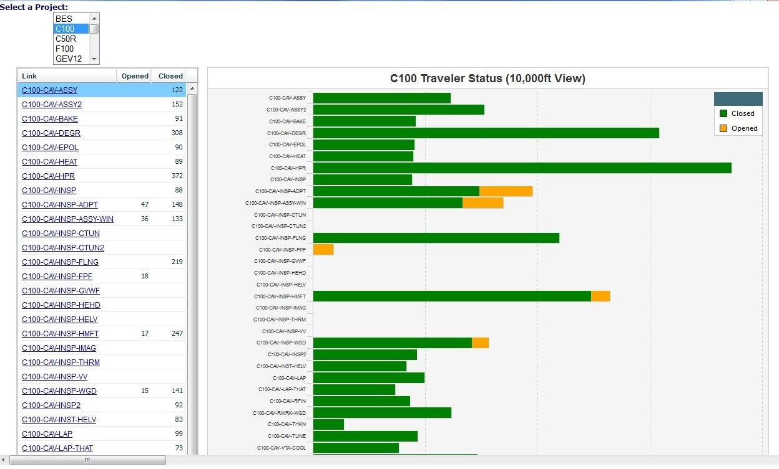
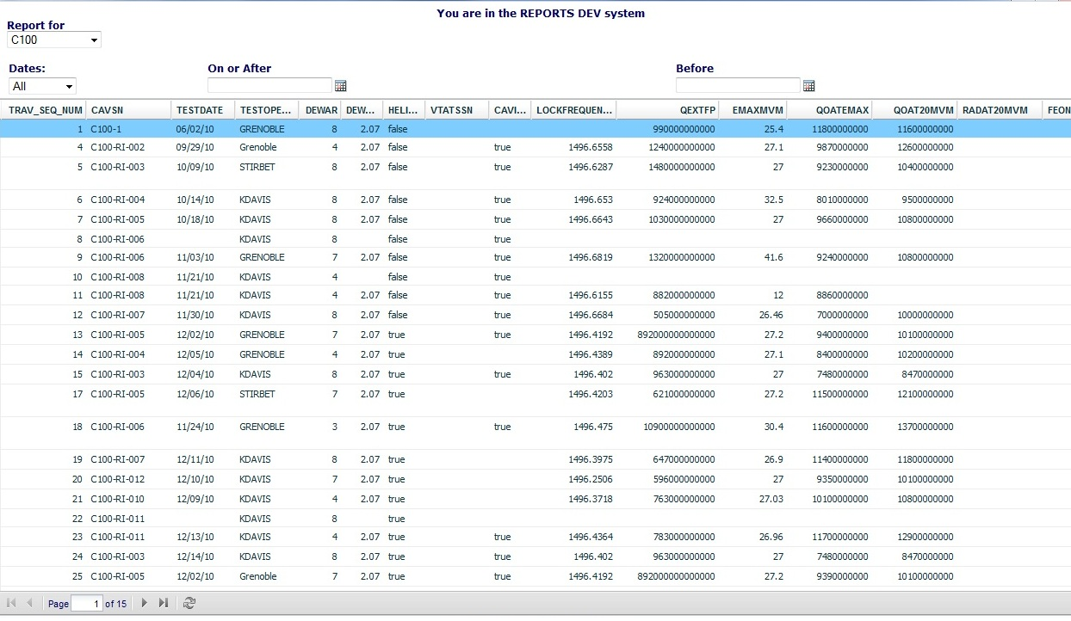
Reports Sharing
Most efficient and cost effective method
NCR Status
Cavity Performance
Traveler Status
Reports can be exported to PDF or Excel formats
Automation of Report Sharing possible

Slide 14
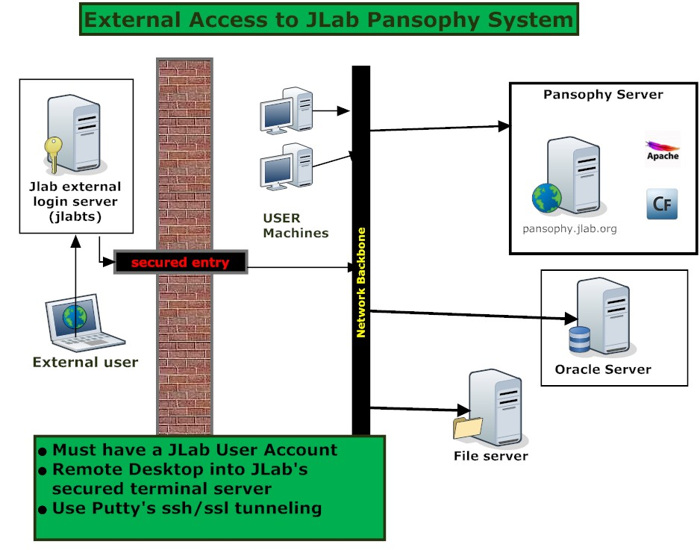
External Access and “Real Time” Reports
Also efficient and cost effective
Pansophy has an integrated security system.
Permissions can be set by areas and/or users.
Security setting upgrades in progress.
JLab: User account
Ext: PuTTY – secure shell
Ext: Remote Desktop app
JLab: Windows Terminal server
JLab: Login Pansophy

Slide 15
Outline
QA/QC
The Pansophy QMS connection
External access / Data Sharing
Pansophy Overview
Questions

Slide 16
Pansophy in use since 2002
Proven Track Record in both internal and external production environments

Slide 17
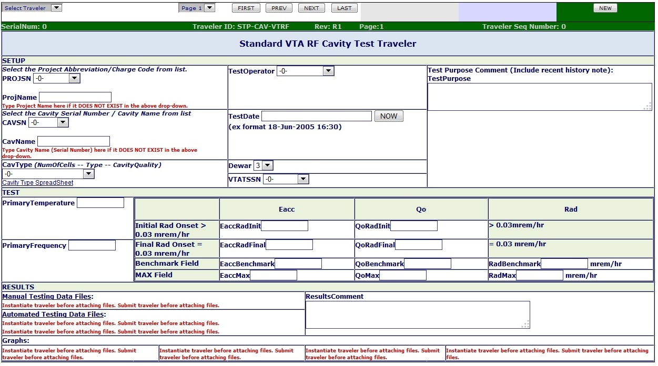
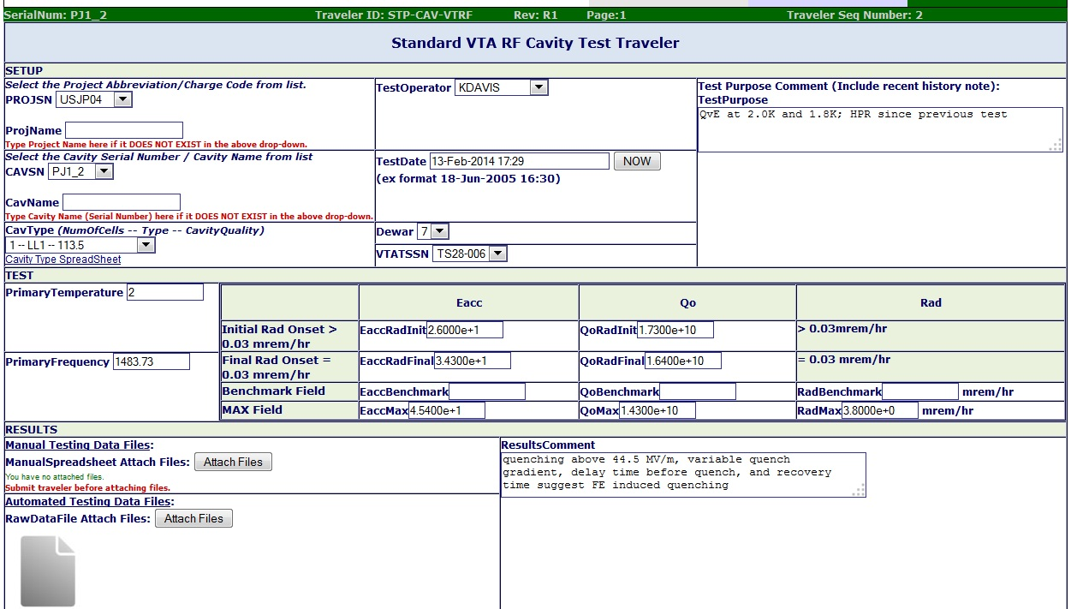
Example Pansophy Traveler
System Expert driven content
Create a copy ready for new data entry.
Unique Identifier.
Open an existing copy.
Serial Number Tracking.
Enter data & submit to database

Slide 18
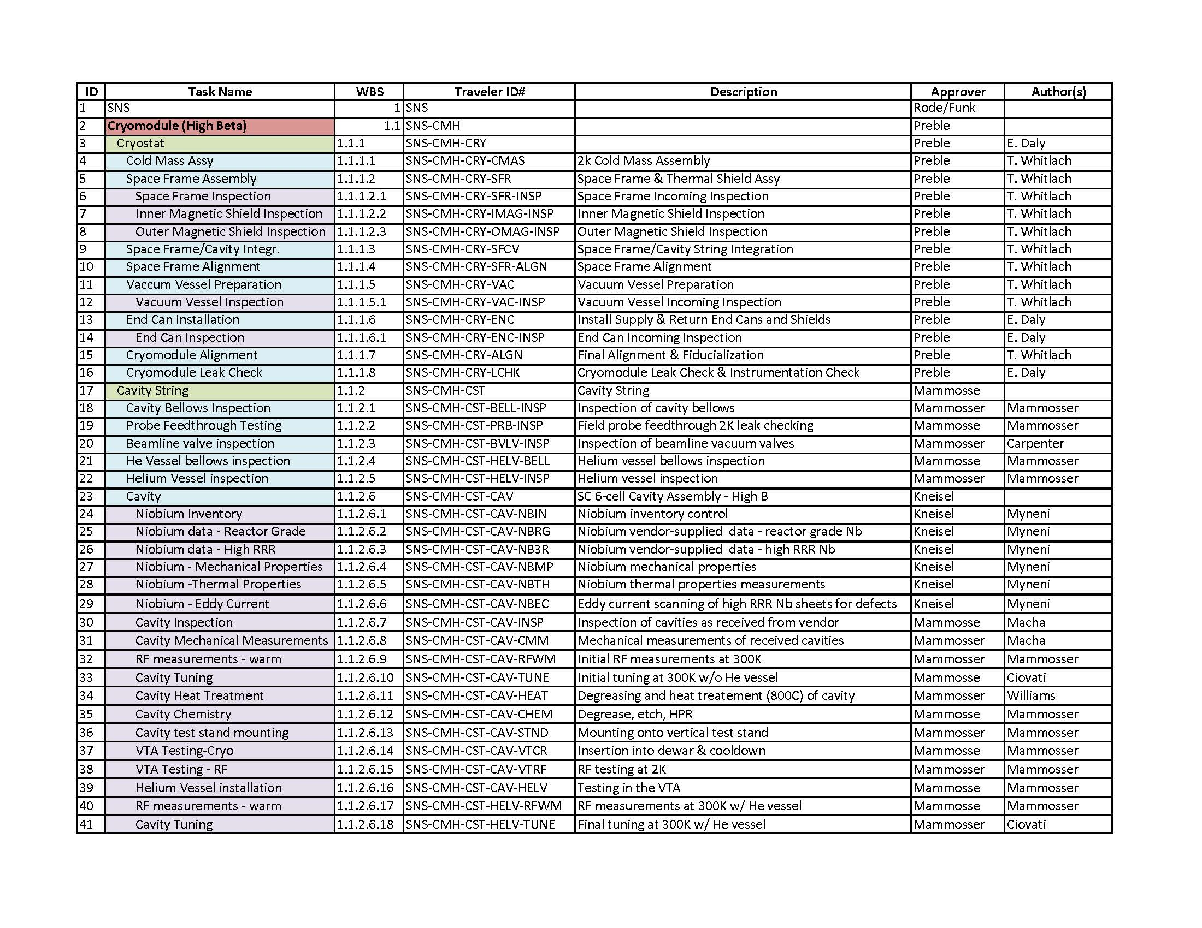
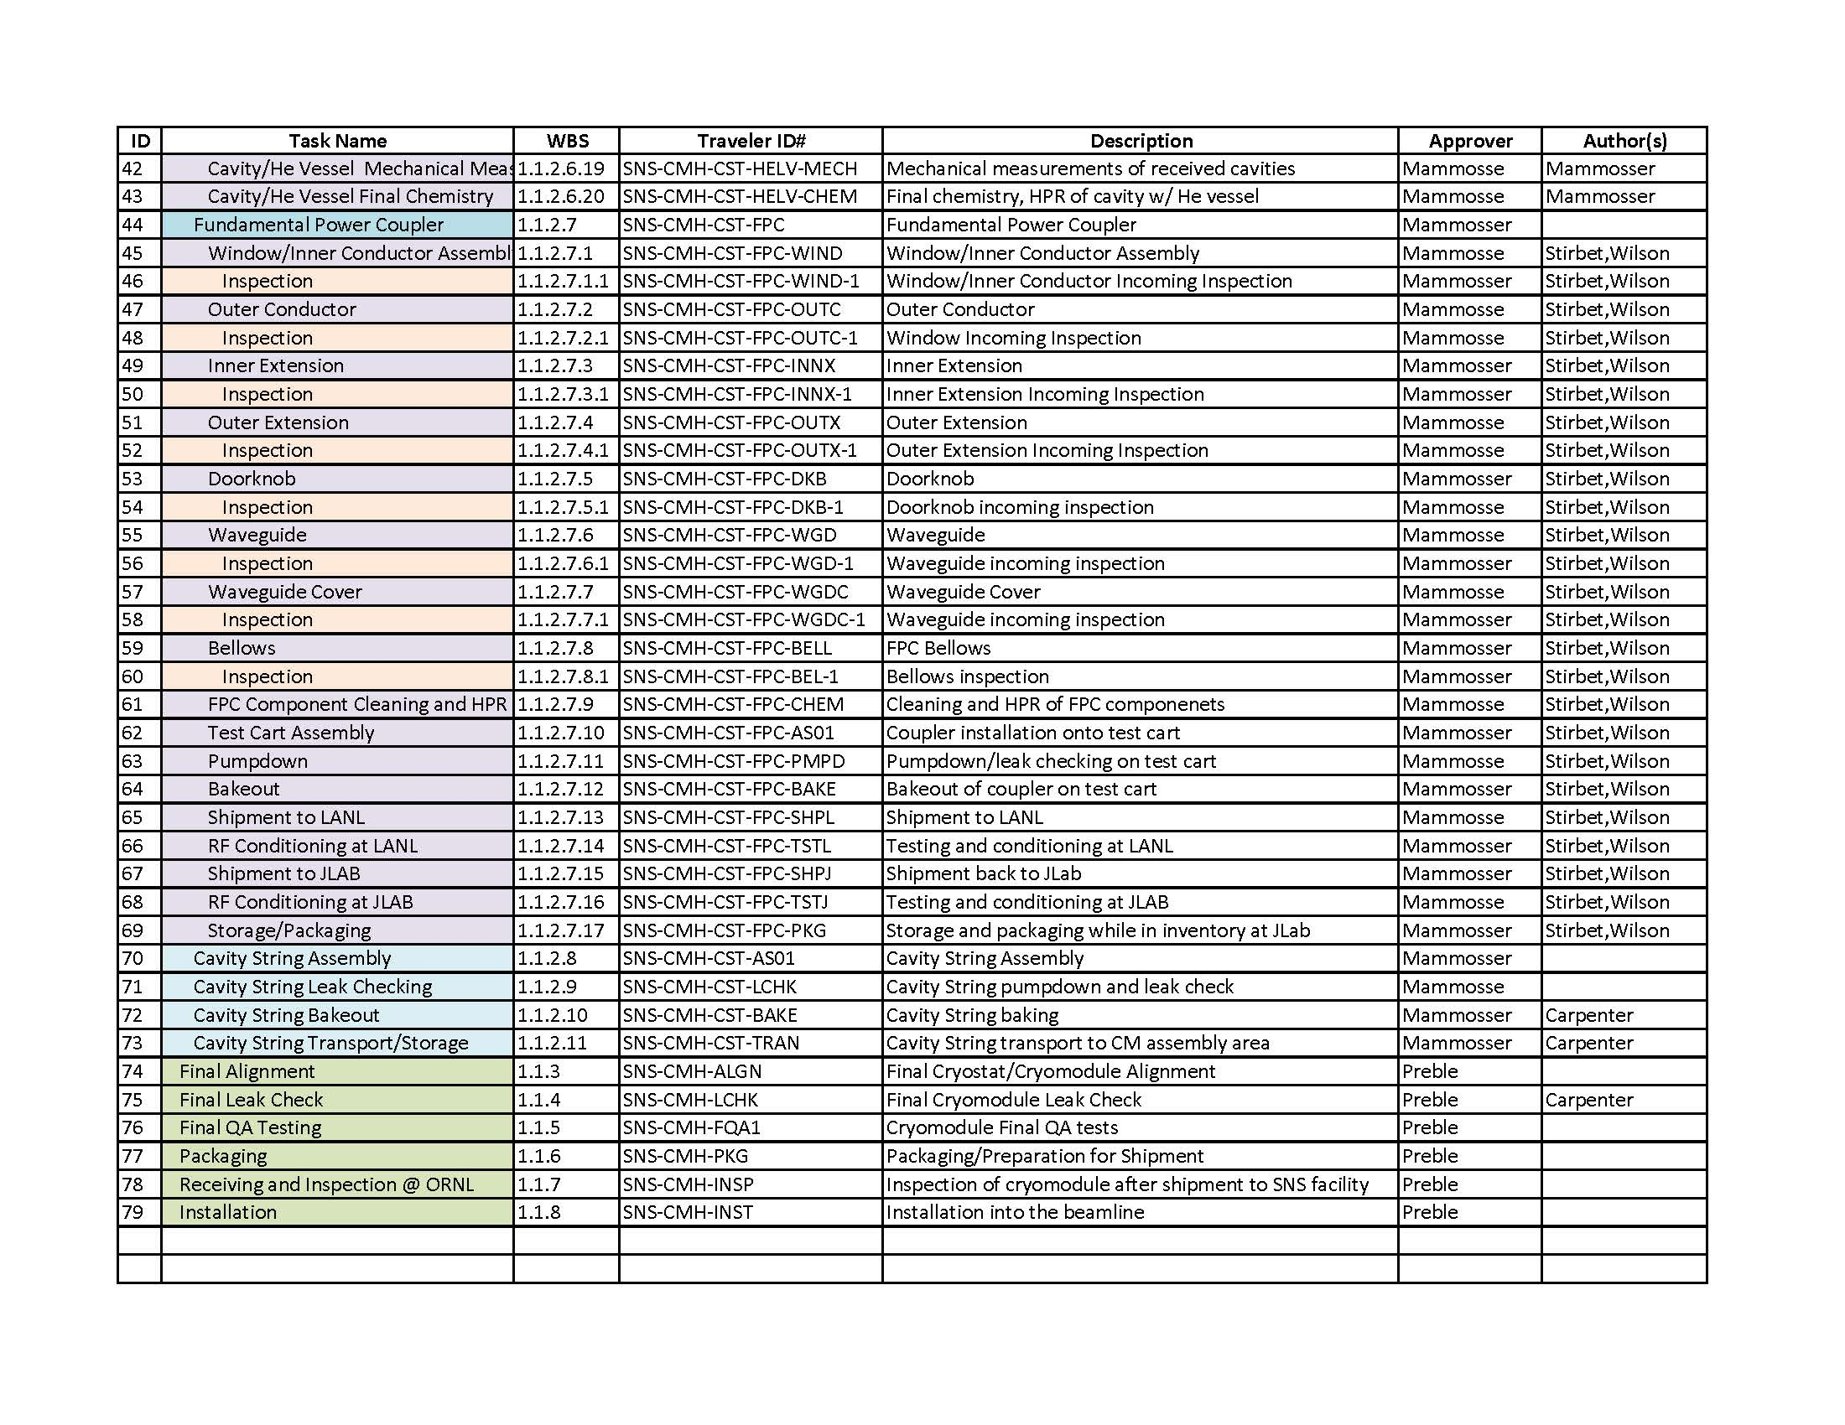
Traveler Listing
Extensive List of Cavity, String, and Cryomodule Travelers

Slide 19
Traveler Project View
Project Management : Traveler view of open/close and number of instantiations.
Drill down to Traveler Query

Slide 20
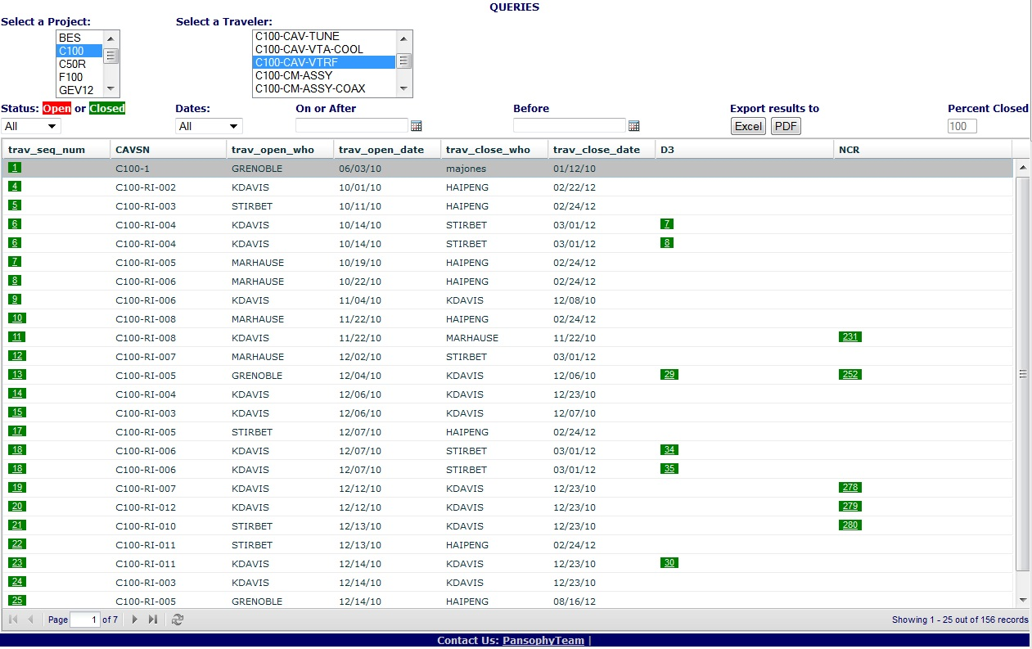
Traveler Management (QA/Team Level)
Links to Travelers/NCRs/D3s

Slide 21
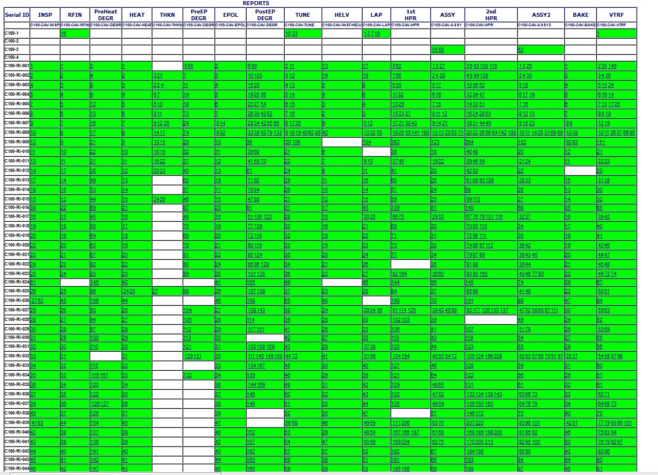
Cavity Processing Status Board
Project management view of Cavity Processing:
Cavities to be processed (Rows)
The Processes / Travelers (Columns)

Slide 22
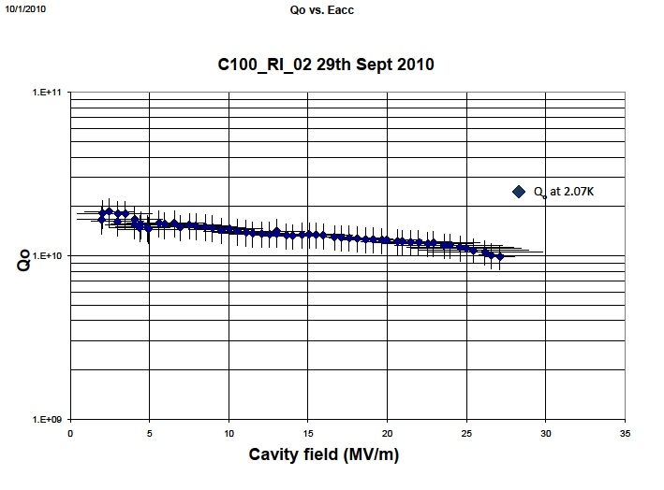
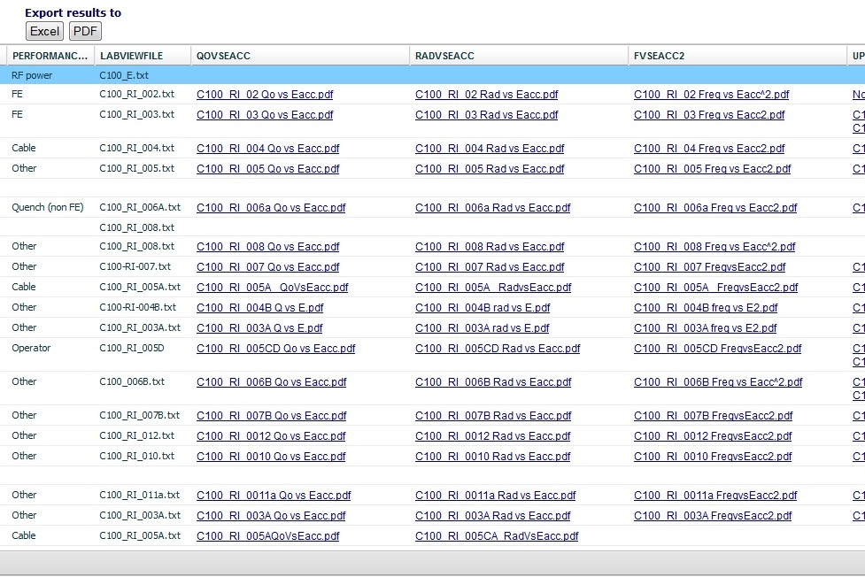
Cavity Performance Project Overview
Vertical Test Area RF Cavity Test Results
Links to uploaded files: data and graphs
Cavity Performance can be exported for analysis & graphics

Slide 23
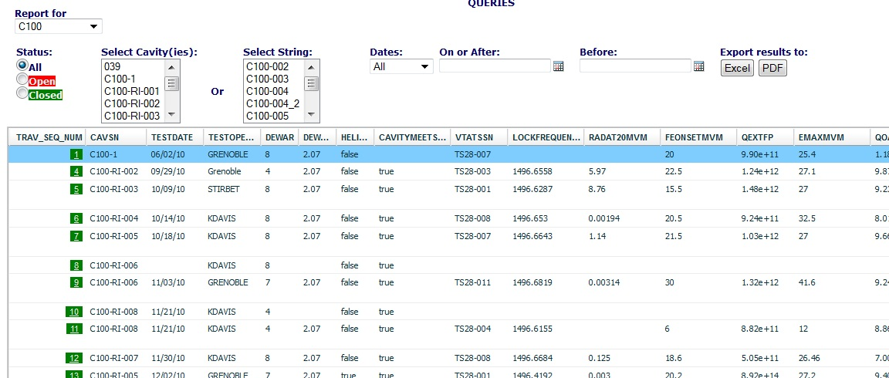
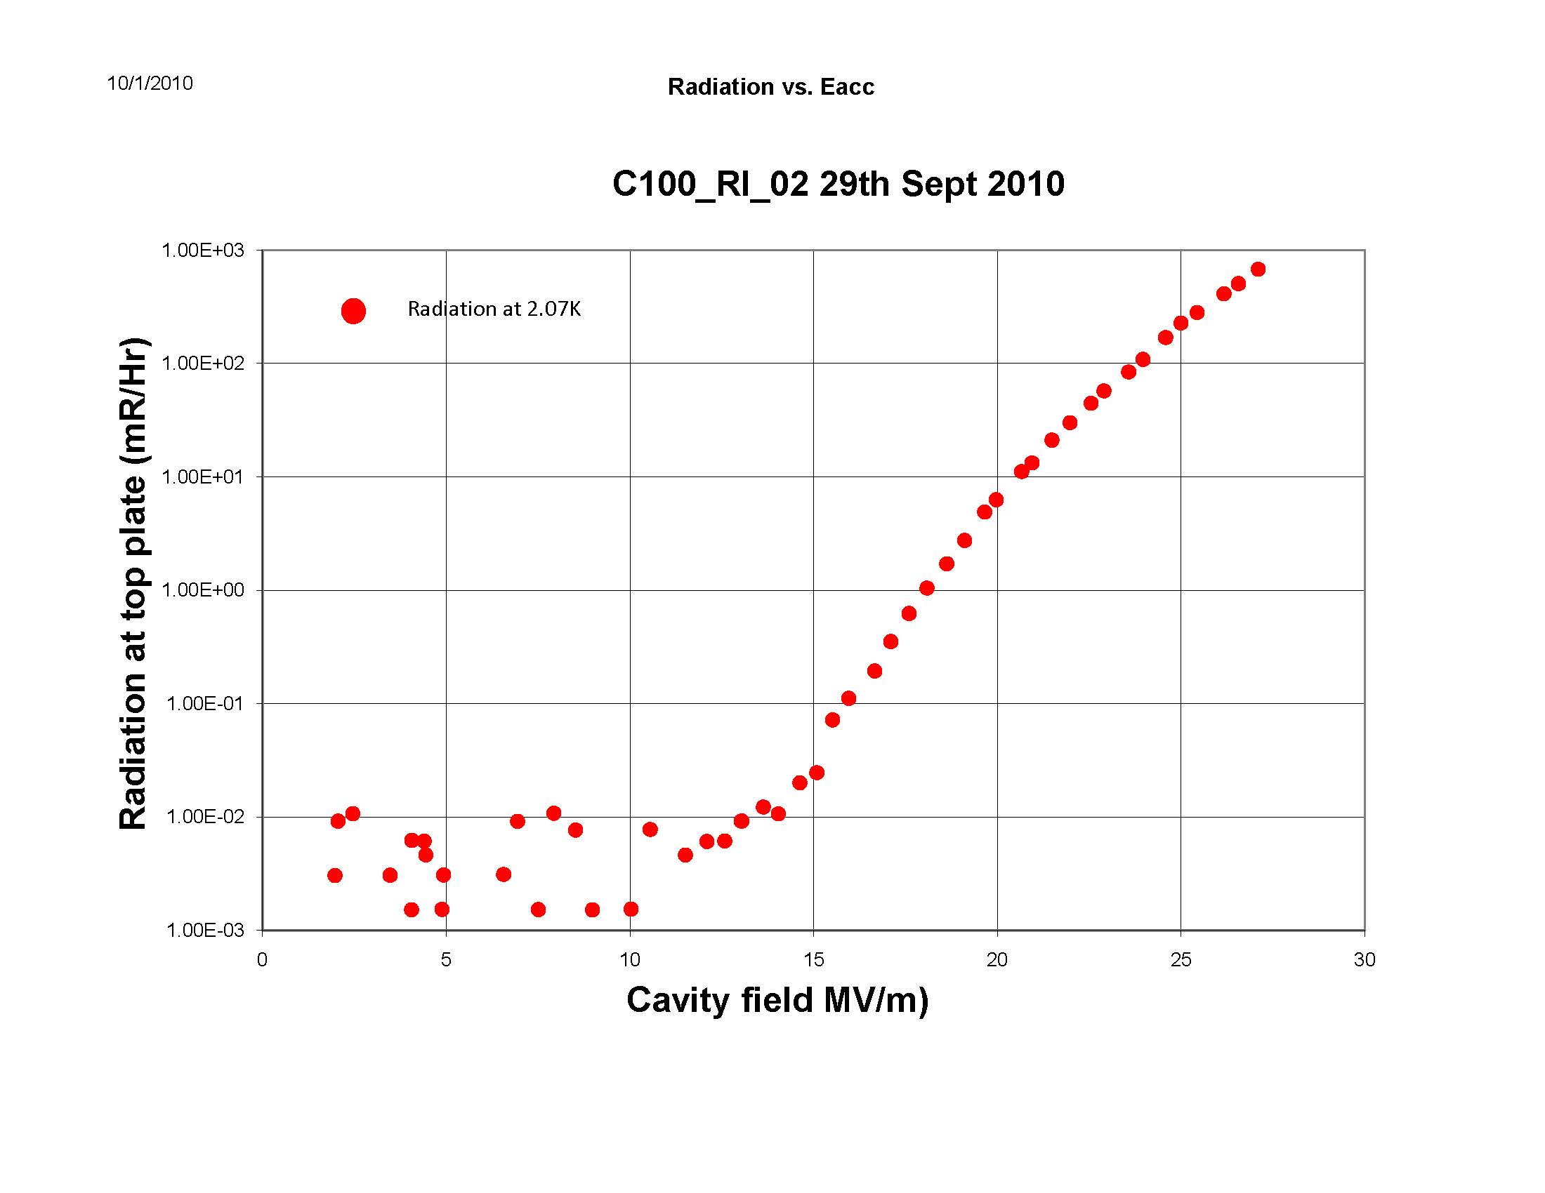
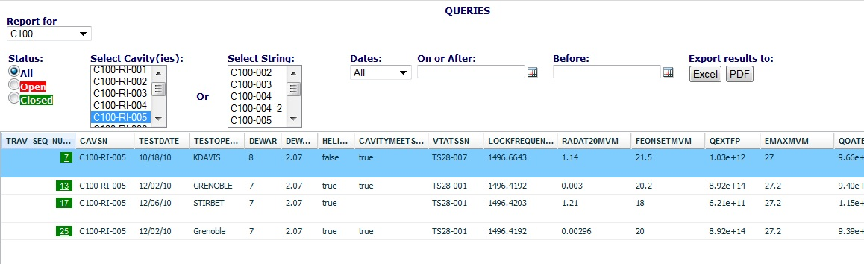
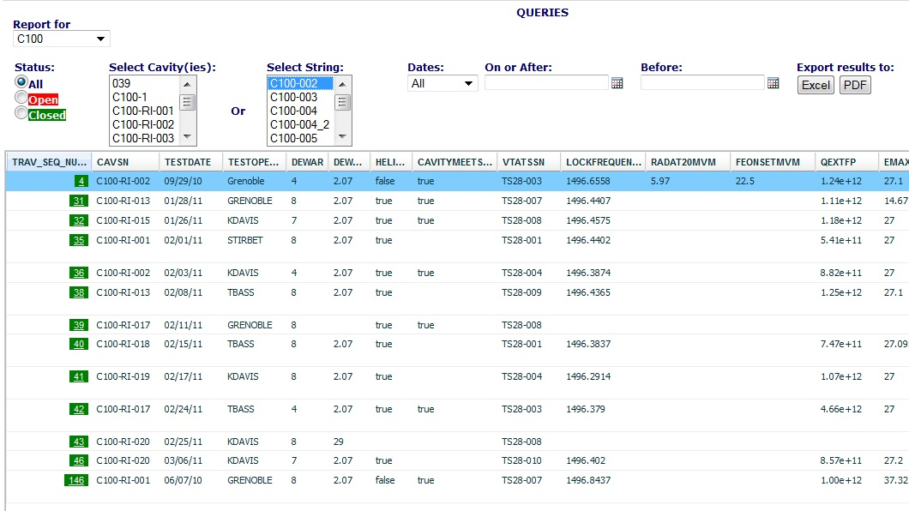
Data Mining for Cavity Performance
Select: Project ➔ Display: All VTA cavity tests for project (pre-defined columns)
Select: CAVSN(s) ➔ Display: All VTA cavity tests for selected CAVSN(s)
Select: CMSN ➔ Display: All cavities for selected CMSN and all related VTA test results

Slide 24
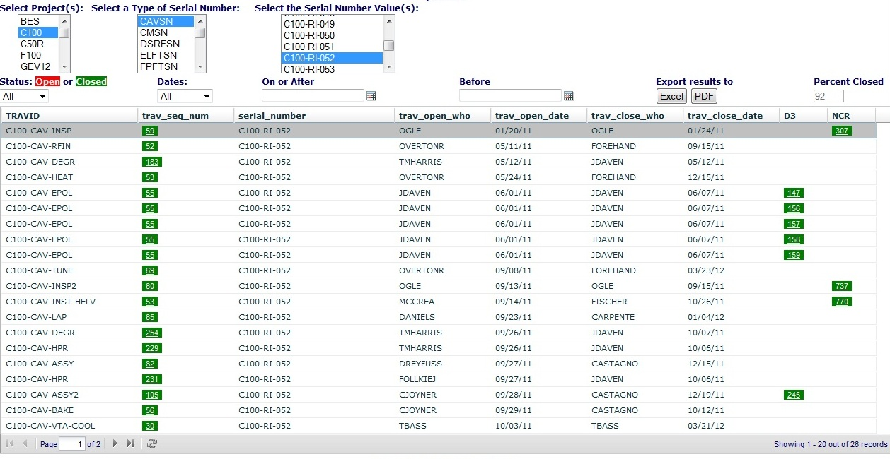
Serial Number (SN) Genealogy
  Select: Project, Serial Number type (i.e. CAVSN, CMSN),
  and Serial Number value(s) (i.e. C100-RI-002)
  Display: All travelers which contain the selected values

Slide 25
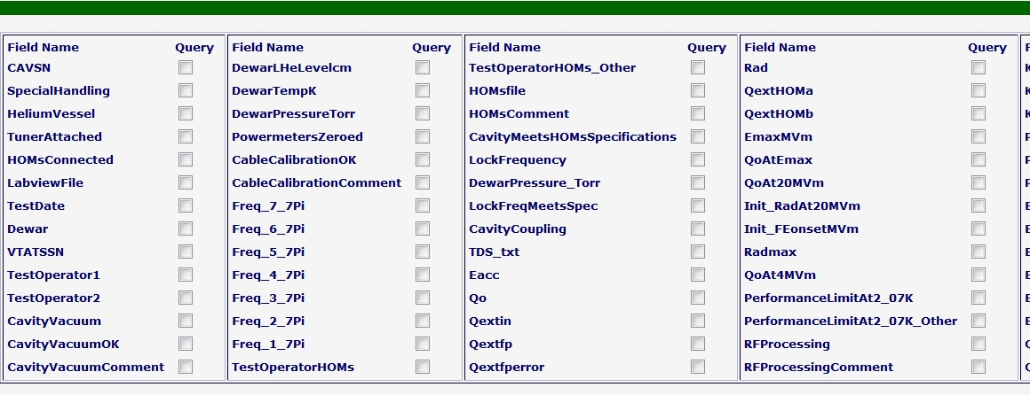
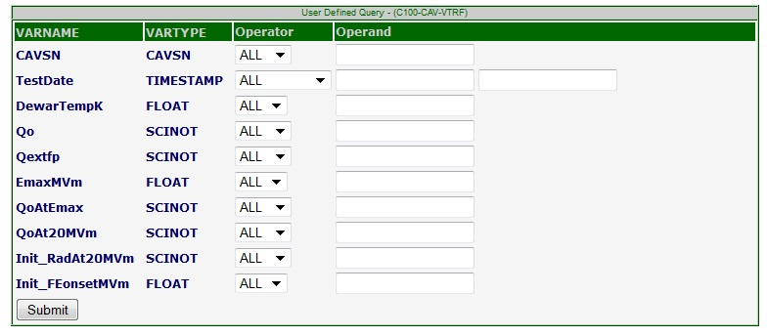
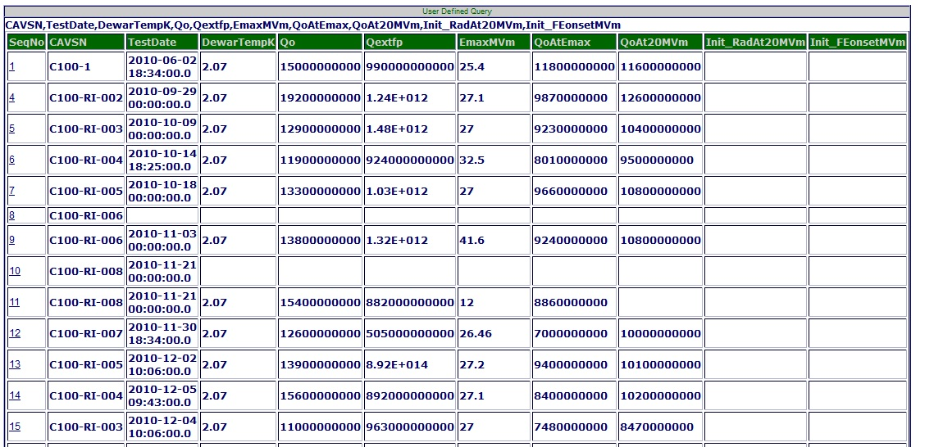
User Defined Query
  User selects Traveler
  and is presented with a list of all available data entry points.
  Upon selection the user can set operator and operands
  which will present user with a list of data fitting the resulting query.

Slide 26
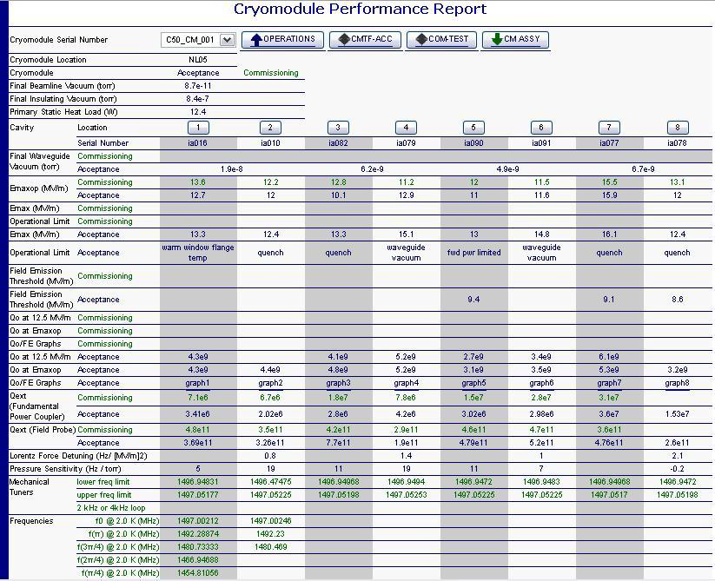
C50 Drill-Down Reports
Cryomodule Performance Report:
Acceptance and Commissioning Data

Slide 27
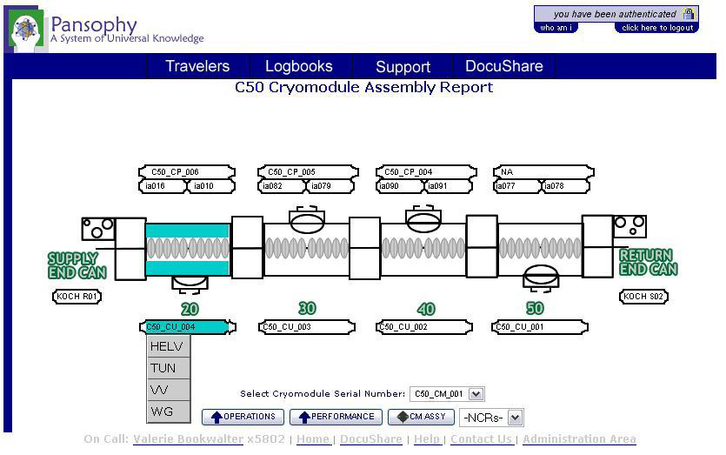
C50 Drill-Down Reports
Cryomodule Assembly Report:
Links to all travelers related to cryomodule

Slide 28
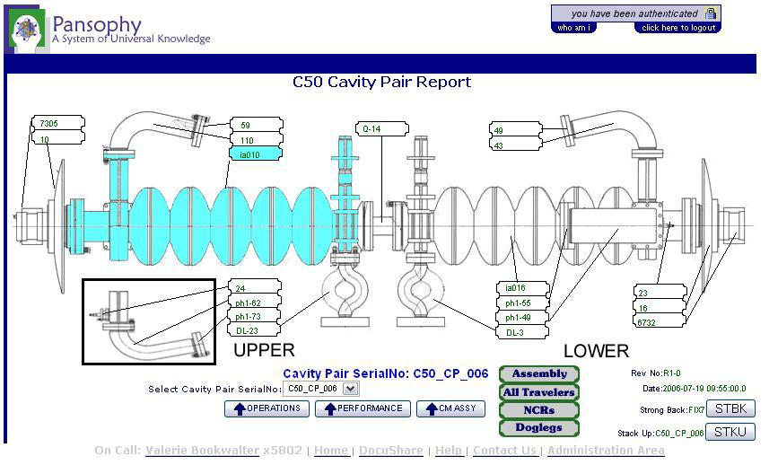
C50 Drill-Down Reports
Cavity Pair Assembly Report:
Links to all travelers related to Cavity Pair assembly

Slide 29
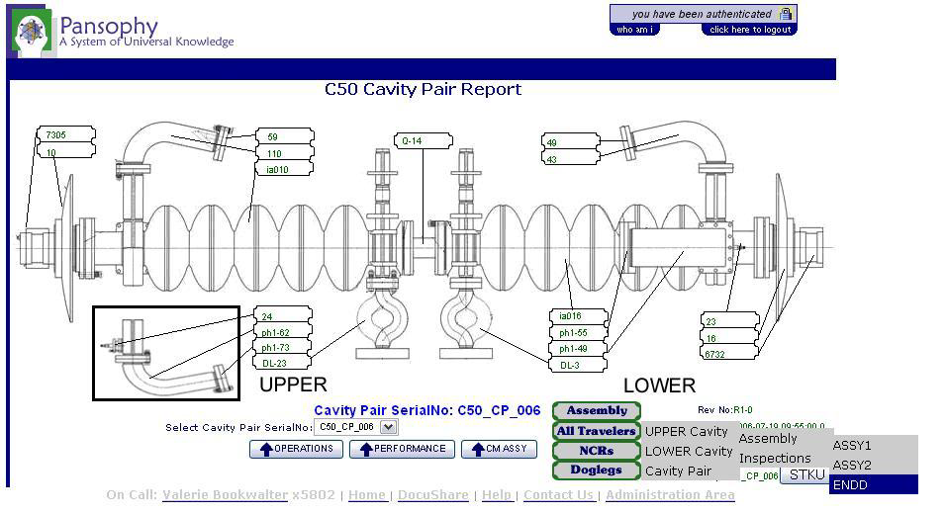
C50 Drill-Down Reports
Cavity Pair Assembly Report (cont) :
Traveler Listing includes all Cavity Processing And Inspections

Slide 30
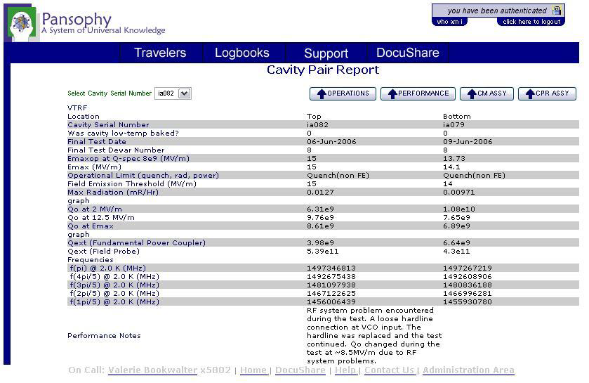
C50 Drill-Down Reports
VTA RF Cavity Testing Report:
Drill-down to Cavity data from VTA testing

Slide 31
Conclusions
The Jlab QA and Pansophy systems have proven effectiveness in data tracking and management of cryomodule/cavity processing and production.
Due to time/money/resource constraints and the current schedule the recommendation would be for each lab to utilize current systems and strengths.

Slide 32
Challenges
What are LCLS-II required capabilities for each system
Priority should be given to developing requirements for Reports and Data Sharing
  Important that there is agreement on "key Characteristics“ to be collected
  Serialization and Nomenclature
  Travelers / Procedures to be generated

Slide 33
Questions ?

Slide 34
Detailed examples of
Reports Available
Appendix A

Slide 35
Data Mining (Reports / Queries)
Queries
  Pre-defined and Used-defined
  After data retrieval permits further refinement through sort and filter functions
Reports
  Pre-Defined
  Simple output, no further refinement
Export to PDF/Excel

Slide 36
Queries
Project Independent Queries | Description
Traveler Status | OPEN / CLOSE status and relationship between Traveler/NCR/D3
NCR Status
D3 status
Serial Number (SN) genealogy | All Travelers utilized for select serial number(s)
Cavity Performance | Project level Vertical Test Area RF Cavity Performance test results
Project Dependent Queries
User Defined Traveler Specific Status Boards | User pre-defined array of traveler specific data fields results in a grid with sorting and filtering functionality
Full Variable Grid | full listing of all variables from selected traveler
User Defined Query | user selectable traveler. field names, operators and operands produces a User Defined listing of values

Slide 37
Reports
Project Independent Reports | Description
Traveler / Procedure Quality Management | (TP QM) Travelers or Procedures written or to be written for selected project
Traveler Status | Traveler completion status
Traveler Project View | Listing of all travelers for selected project and number of instantiations of each with open/close status
NCR Project View | Listing of all travelers for selected project and number of NCRs for each with open/close status
D3 Project View | Listing of all travelers for selected project and number of D3s for each with open/close status
Project Dependent Reports
Project Level Cavity Processing status Board | management status board showing progress of all cavity processing and assembly (can also be done for Cryomodule and String assembly)
VTRF | VTA cavity test results snapshot

Slide 38
Cavity Processing Status Board
Project management view of Cavity Processing:
Cavities to be processed (Rows)
The Processes / Travelers (Columns)

Slide 39
Cavity Performance Project Overview
Vertical Test Area RF Cavity Test Results
Links to uploaded files: data and graphs
Cavity Performance can be exported for analysis & graphics

Slide 40
Traveler Project View
Project Management : Traveler view of open/close and number of instantiations.
Drill down to Traveler Query

Slide 41
Traveler Management (QA/Team Level)
Links to Travelers/NCRs/D3s
    Status of Travelers includes:
    Opened/Closed
    open/close dates and users
    related NCRs and D3s

Slide 42
NCR Project View
Drill-down links to Traveler status Query
  Visual Status of NCRs (open/close, numbers)
    Listing of NCRs by Traveler ID
  Helps Prioritize Traveler/Components with the most issues
  Typically found with inspections, but any traveler can apply a NCR

Slide 43
NCR Management (QA/Team Level)
Drill-down links to individual Travelers
  Linked to specific NCR & Traveler for “Drill Down”
  Sort on Disposition, travelers, etc. to Management the NCRs
  Status of NCRs includes:
    Opened/Closed
    open/close dates and users
    related Travelers

Slide 44
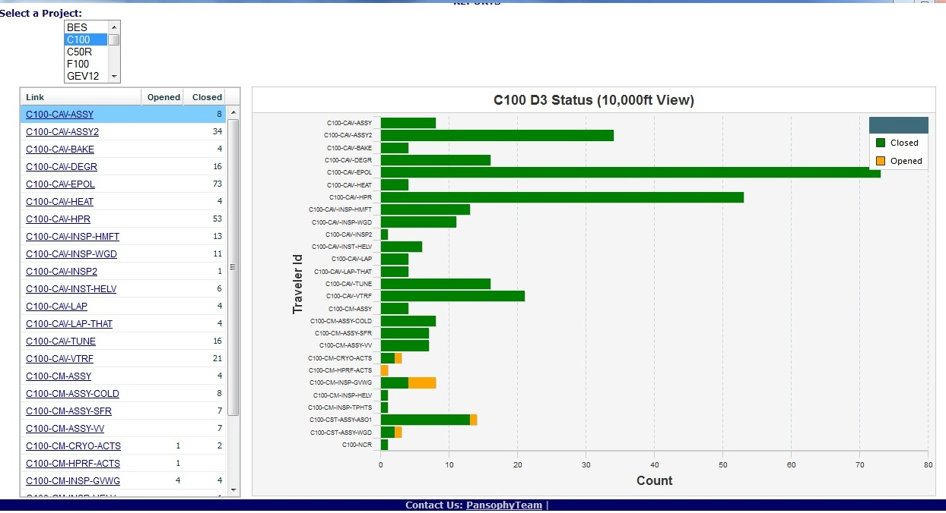
D3 Project View
Drill-down links to Traveler status
  Graphical Project Management view of D3s by Traveler
  Annotates “off-normal” events related to procedures and processing
  Linked to Traveler Status Query for “Drill Down”

Slide 45
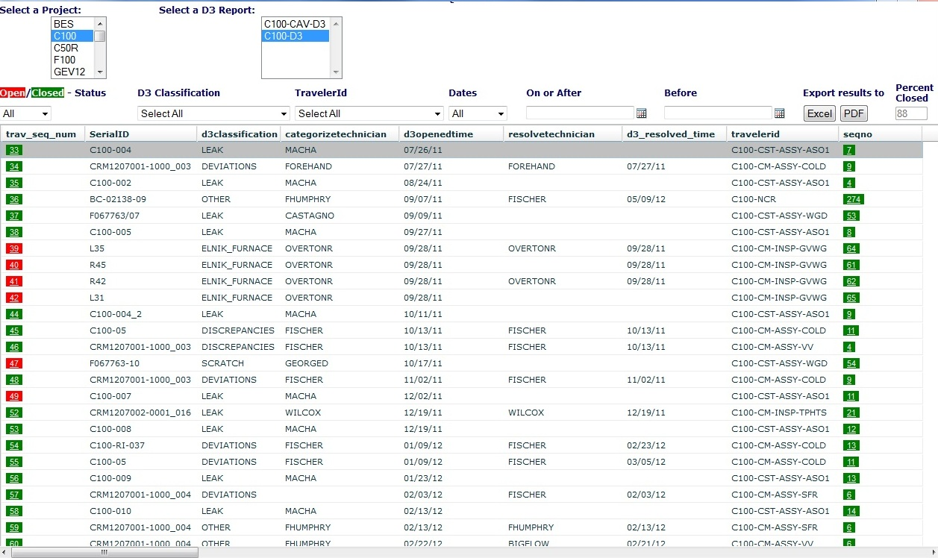
D3 Management (QA/Team Level)
Links to D3s / Travelers
Exports
    Status of D3s includes:
    Opened/Closed
    open/close dates and users
    related Travelers

Slide 46
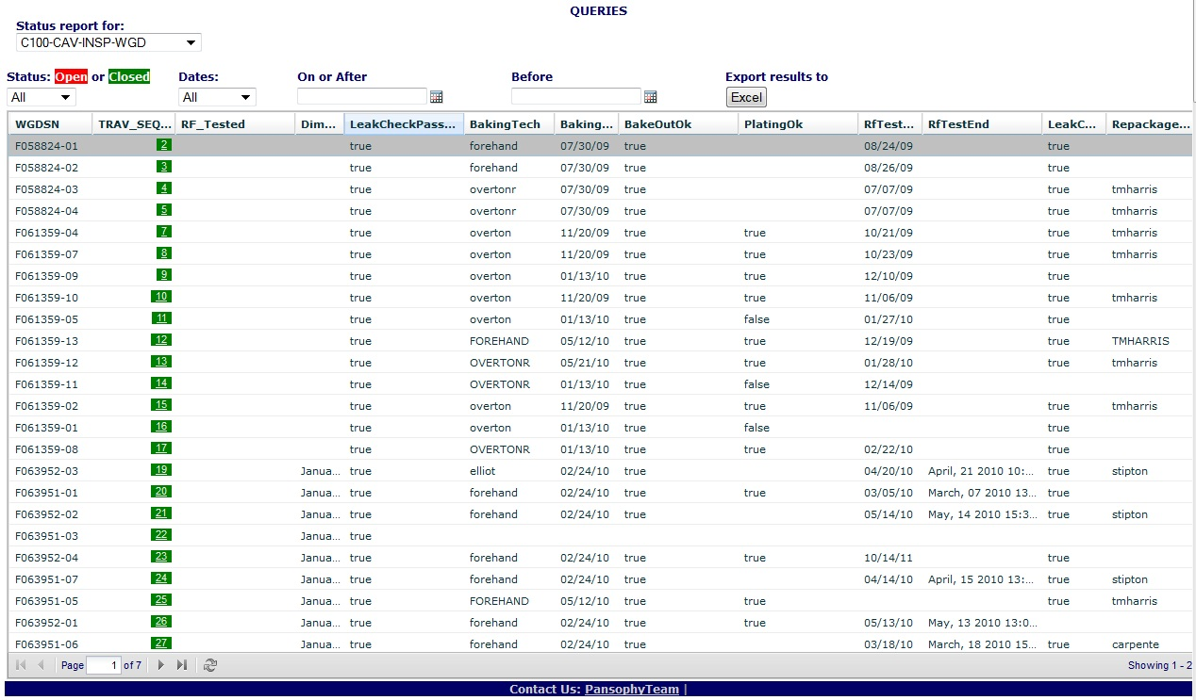
User Defined Traveler Specific Status Board
    User Defined array of pre-selected data fields resulting in a grid report.
    Filtering and sorting is available

Slide 47
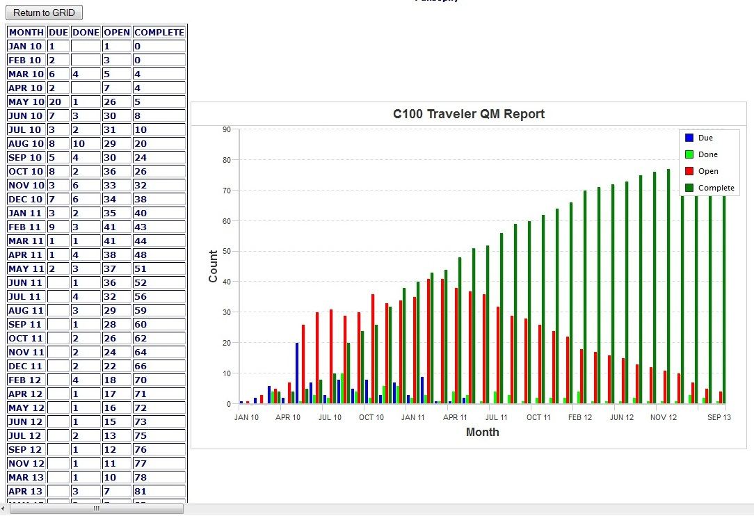
Traveler/Procedure Writing Graph
  Traveler and Procedure writing tracking graph.
  Shows how many need to be written, when and number complete

Slide 48
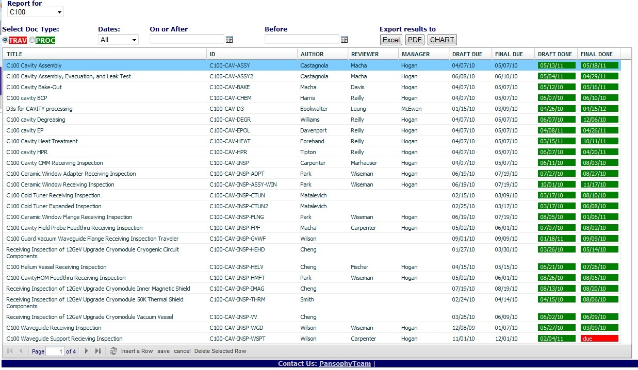
Report: Traveler/Procedure QM (TP QM)
    Detailed grid layout of Travelers/Procedure for QA tracking and management.

Slide 49
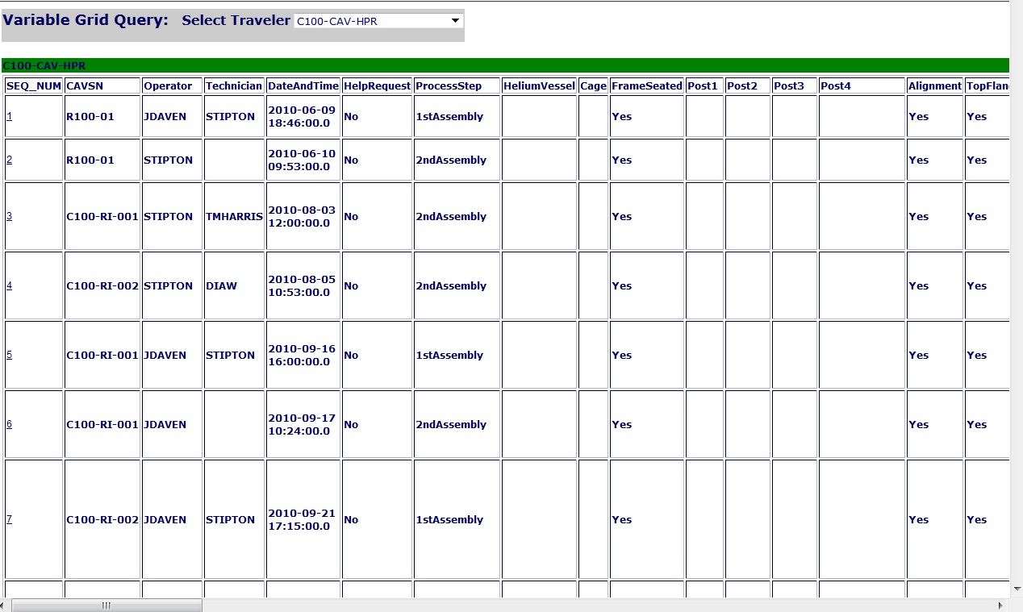
Full Variable Grid
A grid of All variables (data entry points) from a traveler
All instantiations are displayed

Slide 50
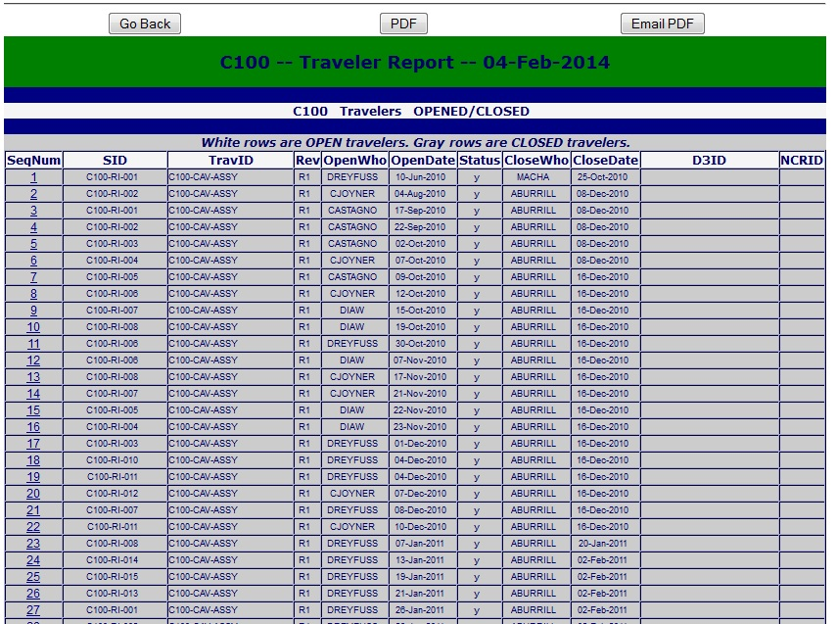
Report: Traveler
List of all Travelers from a project with open/closed status and related NCRs/D3s

Slide 51
Appendix B
Pansophy’s Traveler System
    Writing
    Conversion
    Using
    Securing data / Closing

Slide 52
Traveler Generation Process
Project-specific Travelers, Authors and Approvers are identified by the responsible project manager.
Traveler authors generate drafts of travelers using MS-Word template.
Traveler is posted in the appropriate DocuShare directory.
Traveler is converted to ColdFusion , the supporting database is constructed and the Traveler is made live in Pansophy.
Traveler is now usable from the Web on the production floor.

Slide 53
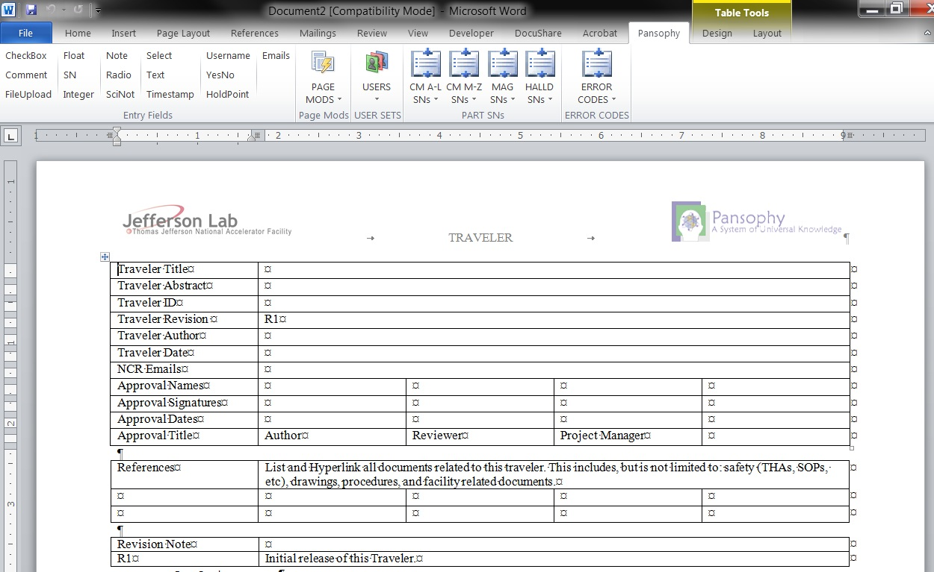
Traveler Creation
Word template, macro enabled
User/Engineer Authored
Process Steps and data Inputs defined
Version controlled
Links to Procedures, drawings and safety documentation
5/27/2020

Slide 54


Traveler Conversion (Travelerization)
Database
Table creation
& config setup
Configuration
files
Engineers/Authors
Document
Coordinator
Traveler
Conversion
MSWord Template
User writes traveler
Utilizing pre-defined
Data input fields
Coldfusion (cfm)
Web pages

Slide 55
Traveler Usage - Data In
Instantiating a traveler – starting a new copy of traveler, ready for data input
Adding data and submitting to database
Closing a traveler and securing the data

Slide 56
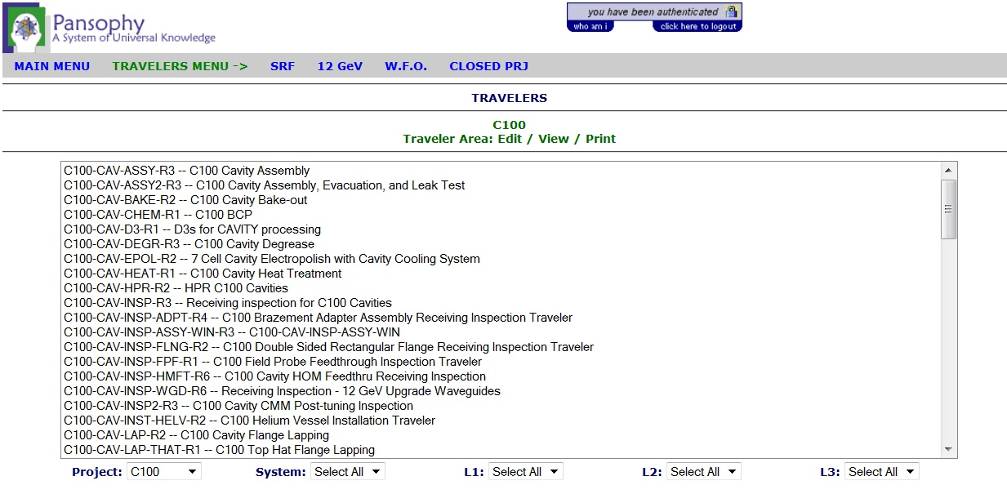
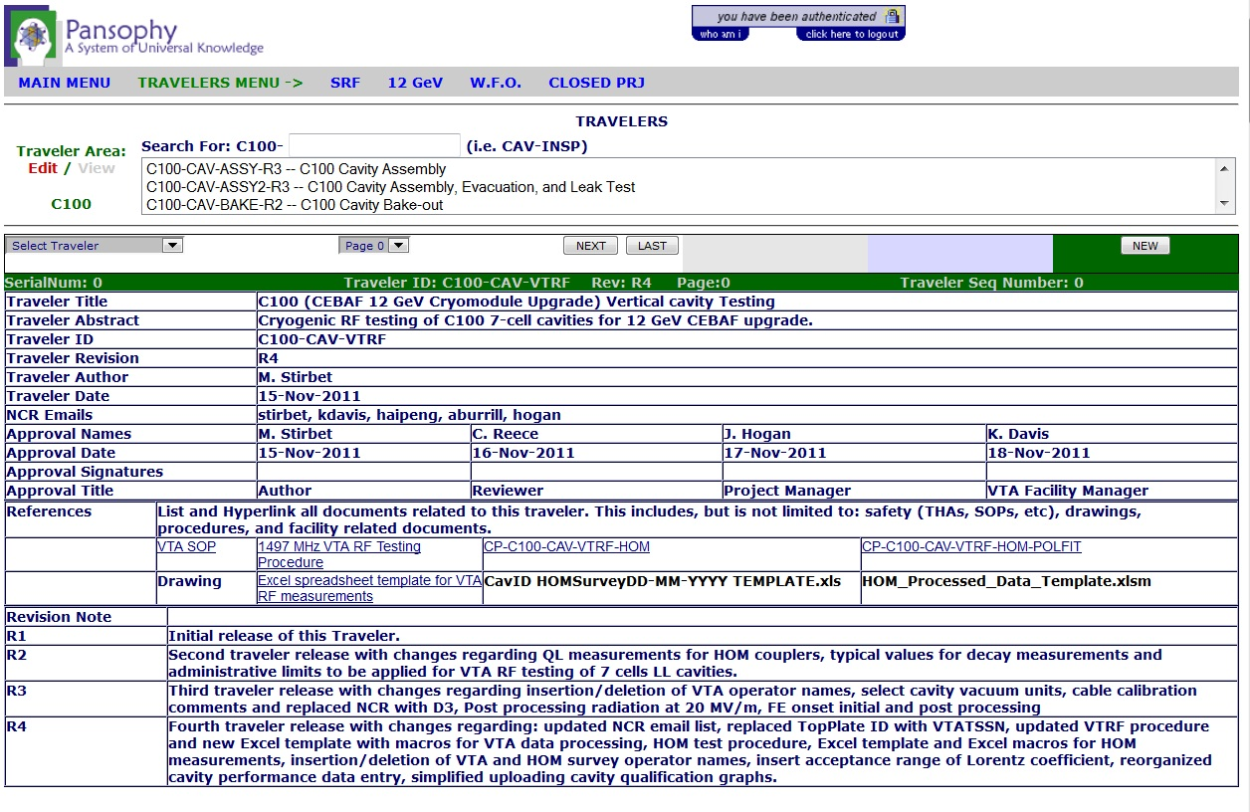
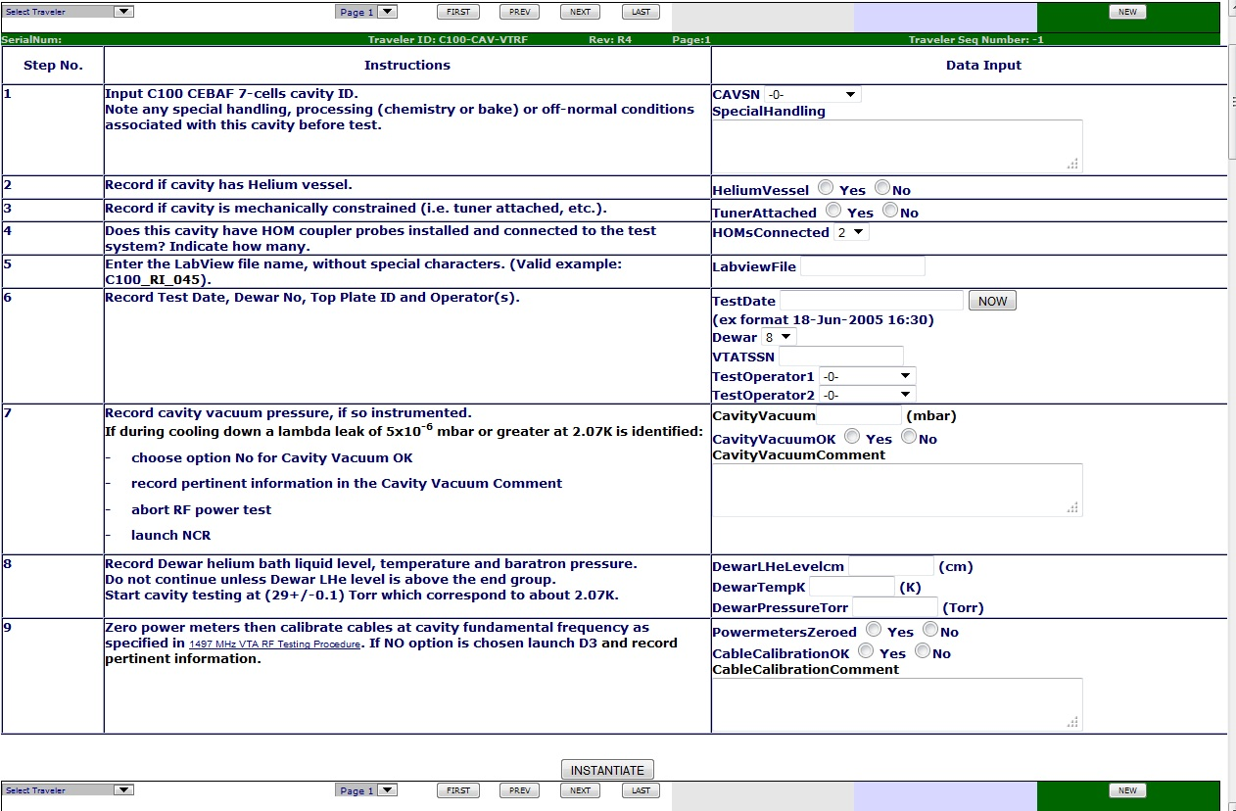
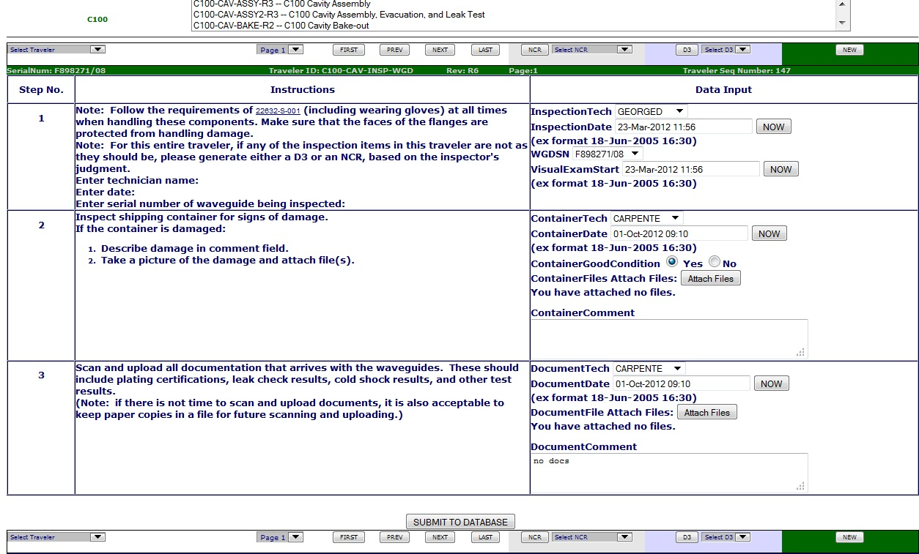
Traveler Instantiation
1. Select Traveler From list
2. Info page select NEW
3. Enter data & instantiate
4. Traveler receives a Sequence Number

Slide 57
Traveler Use
Select previously created traveler sequence number
Continue to add/update data
Submit each page !!
Page control buttons (next, prev)

Slide 58
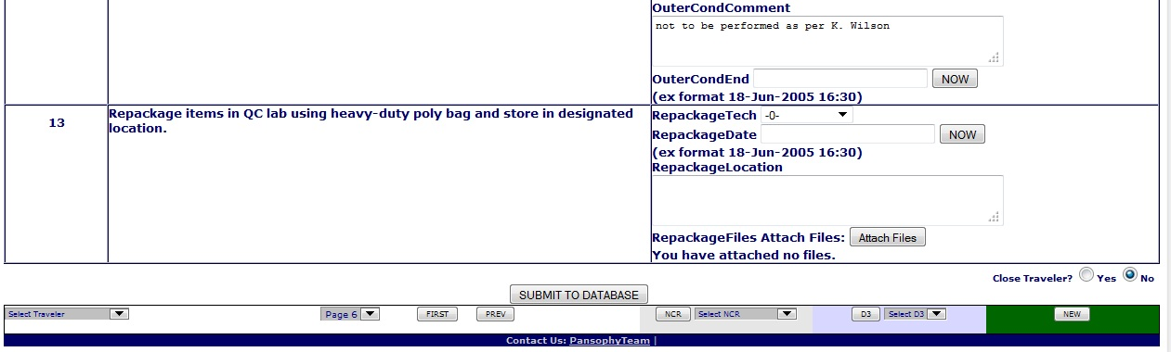
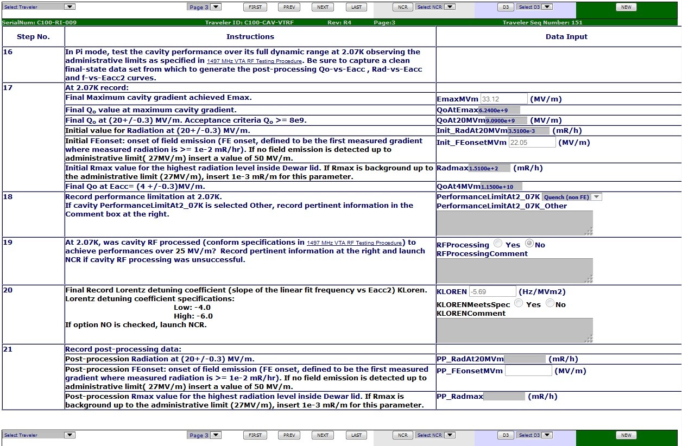
Traveler Closing
Until a traveler is CLOSED, all data can be modified and data entry can continue
Data is never deleted – history of changes are kept
Once a traveler is closed, ALL DATA is locked and no further changes can be made

Slide 59
Data Types
Data Type | Description
Checkbox | check box that indicates the answer to a question is “yes”
Comment | Allows for input of comments in a large input box
FileUploads | Allows multiple file uploads. File name must contain ONLY letters, numbers, and underscores
Float | input box that accepts numbers containing a decimal point
SN | text box that accepts serial numbers (allows both letters and numbers)
Integer | Input box that accepts whole numbers only
Note | Used to alert the programmers to special traveler requirements (calculations)
Radio | Series of Radio Buttons that the author must provide names for. Only one can be selected
SciNot | Input of numbers in scientific notation
Select | Author defined pull-down menu
Text | Input box for text entries, max 256 chars
Timestamp | Input box which accepts date and time. Also supplies a button “Now” which will automatically enter the current date and time
UserName | Input box for a username (jlab username)
YesNo | Radio buttons, yes and no
Holdpoints | A stop point in a traveler that generates an email to whomever the Author designates as a reviewer. Must be cleared before entering data on subsequent pages, or on last page prevents closing of traveler until data has been reviewed.
Email | Allow the author to email a designated user to the status of a traveler

Slide 60
Appendix C
Miscellaneous

Slide 61
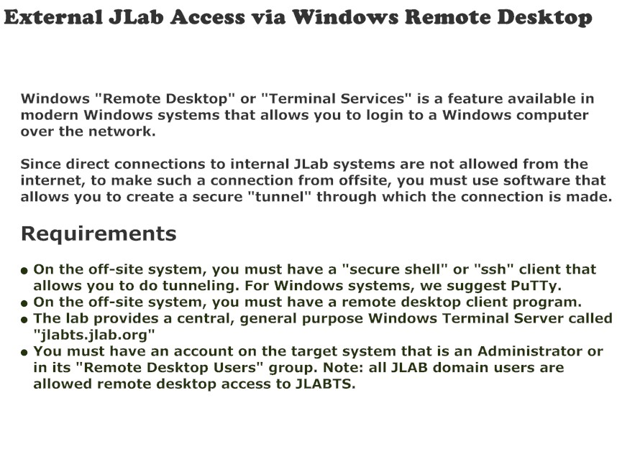
External Access Requirements

Slide 62
Where’s My Data?
Linux/VM
M:drive
pansophy.jlab.org
POC for DB Servers:
David Sheppard
Mike Staron
USER
Apache
/group/asd/www/pansophy/html/
…
pansophy(App.cfc) (PRD)
pansophyit(App.cfc) (IT)
CF
Linux
LCDS
Production Server
dbl6.jlab.org
DOC
COORD
POC for Apache Servers:
Marty Wise
PRD
adapps
11g
DEV
adappstst
11gTST
Linux/VM
Database Server
pansophydev.jlab.org
/group/asd/www/pansophydev/html/pansophydev(App.cfc)
ACCESS
FACILITY
TRAVELER
SAMTRAXS
10G
10GTST
11G
11GTST
Developer
X
Apache
CF
LCDS
Development Server
Admin

Slide 63
Options for External Partner Lab
Access & Data Sharing
Report Sharing
External Access and “Real Time” Reports
Duplication of Pansophy System on external site
Export of data base

Slide 64
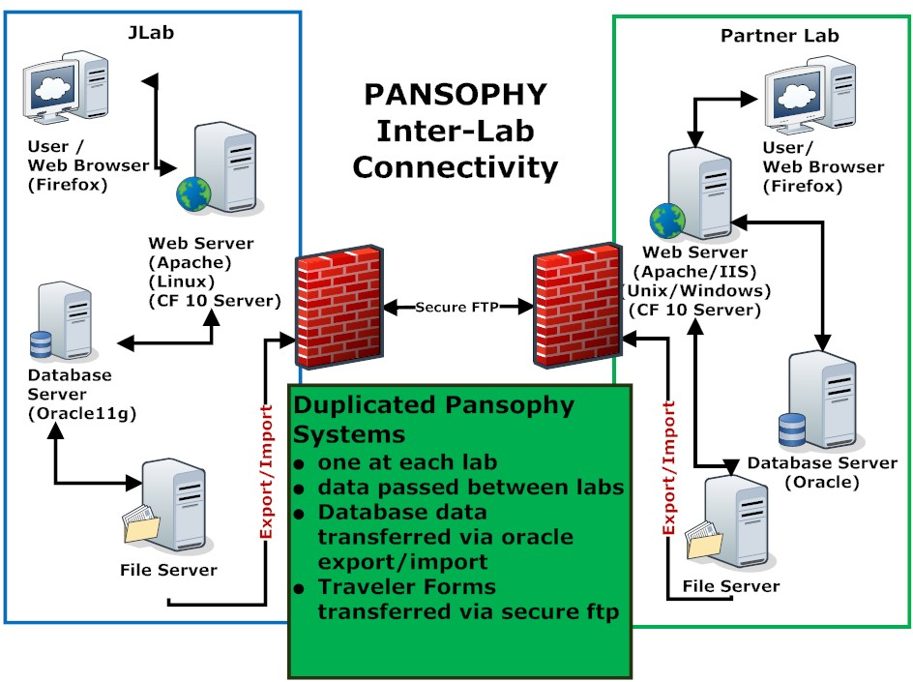
Duplication of Pansophy System

Slide 65
Database Export/Import
JLab (Oracle)
Export table schemas
Partner Lab (Oracle or other Database)
Import and setup Table schemas
Export data from selected tables (periodic)
Import data for selected tables (periodic)

Slide 66
Additional Reports
can be found
in Appendix A

Slide 67
Pansophy Traveler System and QMS Connection
Quality Management System procedures
SRF Document Control Procedure

Slide 68
QMS Documentation
QMS Documentation References
Control of Non-Conforming Product
  MAI-P-004, Control of Non-Conforming Product
Document Control Process
  QA-P-001, Document Control Process
See Johnny Leung for questions on QMS

Slide 69
SRF Quality Policy: Quality Manual QA-M-001
A “Road Map” describing the SRF Mission, the quality assurance/control systems, and mechanism to produce high quality deliverables.
Highlights:
a) Process elements are based on ISO 9001:2008 (section 1).
b) Lists a full set of quality process procedures (section 2).
c) Explains different levels of process documents (section 3).
d) Supplements lab-wide Jlab Quality Assurance Plan (section 3).
e) Describes SRF process interactions (section 4.2.2.1).
f) Captures SRF Mission Statement (section 5.3).
g) Explains SRF quality objectives (section 5.4.1).
h) …..… and the quality processes (section 5.5 to section 8.5).
Johnny Leung slide

Slide 70
SRF Project Management Process (PR-P-001)
Provides a structured methodology to manage small to medium size projects.
Formalized process to enhance planning, organization, communication, and implementation.
Johnny Leung slide

Slide 71
How we use Pansophy
Travelers
(Data In)
Inspection, Processing and Assembly Data for Cavities & Cryomodules and associated parts
Use and Management
Supports Quality Management (NCRs & D3 Reports)
Data Mining Queries – example Cavity Performance
Reports
(Data Out)
Real-Time Status reports - Dashboards
Docushare links to Procedures & Documents
Production & Project Manager Status reports
Quality & Traveler Status , level of completion,
Reports, tables & graphs, export to PDF/Excel

Slide 72





Pansophy Timeline
Beginnings
IIS web server
Windows CF server
Ingres Database
Additions
Sample tracking System (SamTraxs)
QA (NCRs/D3s)
RAM & SN tracking
Linux ColdFusion server
Data Mining Project
Grids: sortable, filterable, exportable queries
Data binding – speed
Project, Manager & Team level reports
QMS tracking Reports
Generation 2
Pansophy Released
Projects converted
VM servers
Continue CF and Oracle upgrades
Transition
Oracle
Matlab Plot
01
02
03
04
05
06
07
08
09
10
11
12
13
14
Growth
Travelers
Logbooks
Calibration
Niobium tracking
Database Restructured
Complete rework of database schemas to account for growth, simplification of queries, and speed in access
Future:
Where the next project leads and beyond …
Growth
CLOBs
Reports / Queries
Environment Data / LabView
Export (Excel/PDF)
Drilldown Genealogy Reports
CFC’s / UDQ CF upgrades
Growth
Weekly emailed reports
New Pansophy tags
Name & SN standardization
PRIMes / Inventory

Slide 73
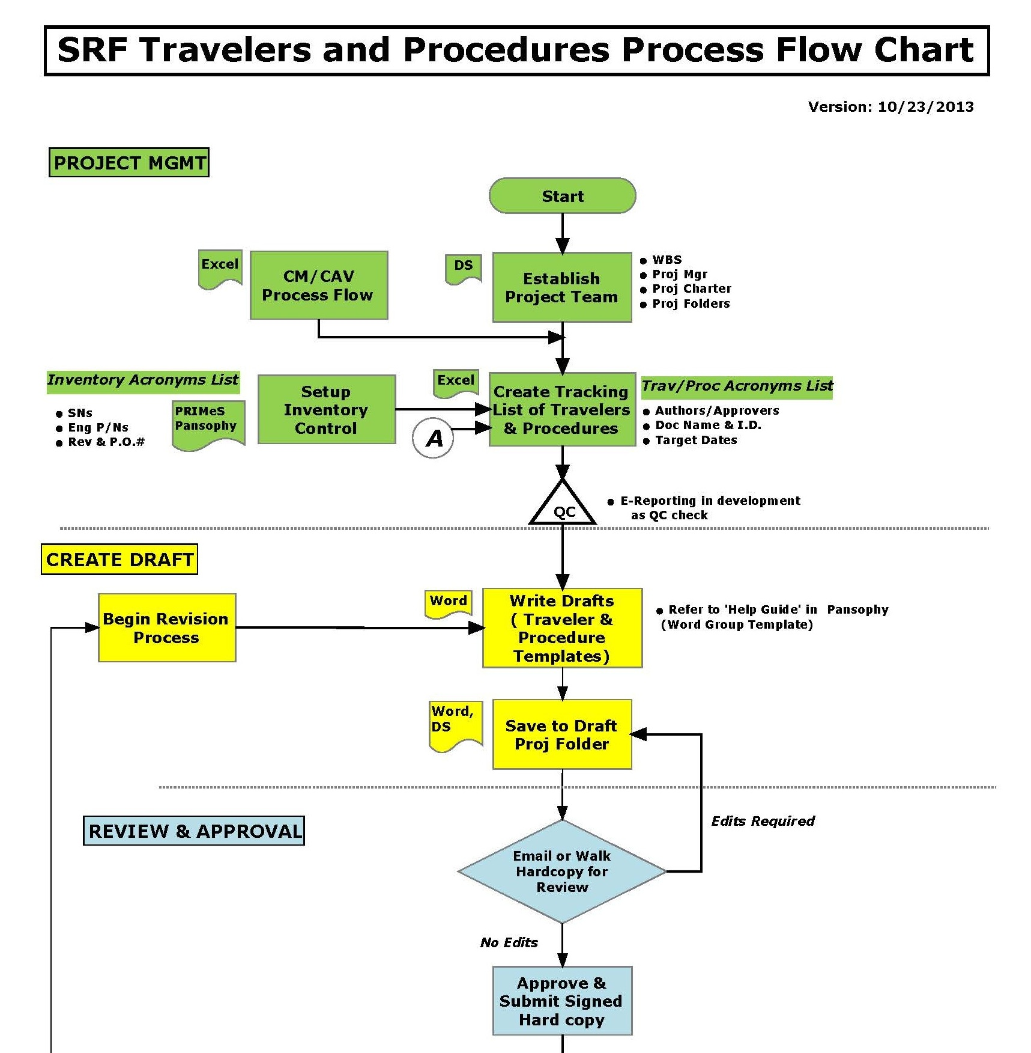
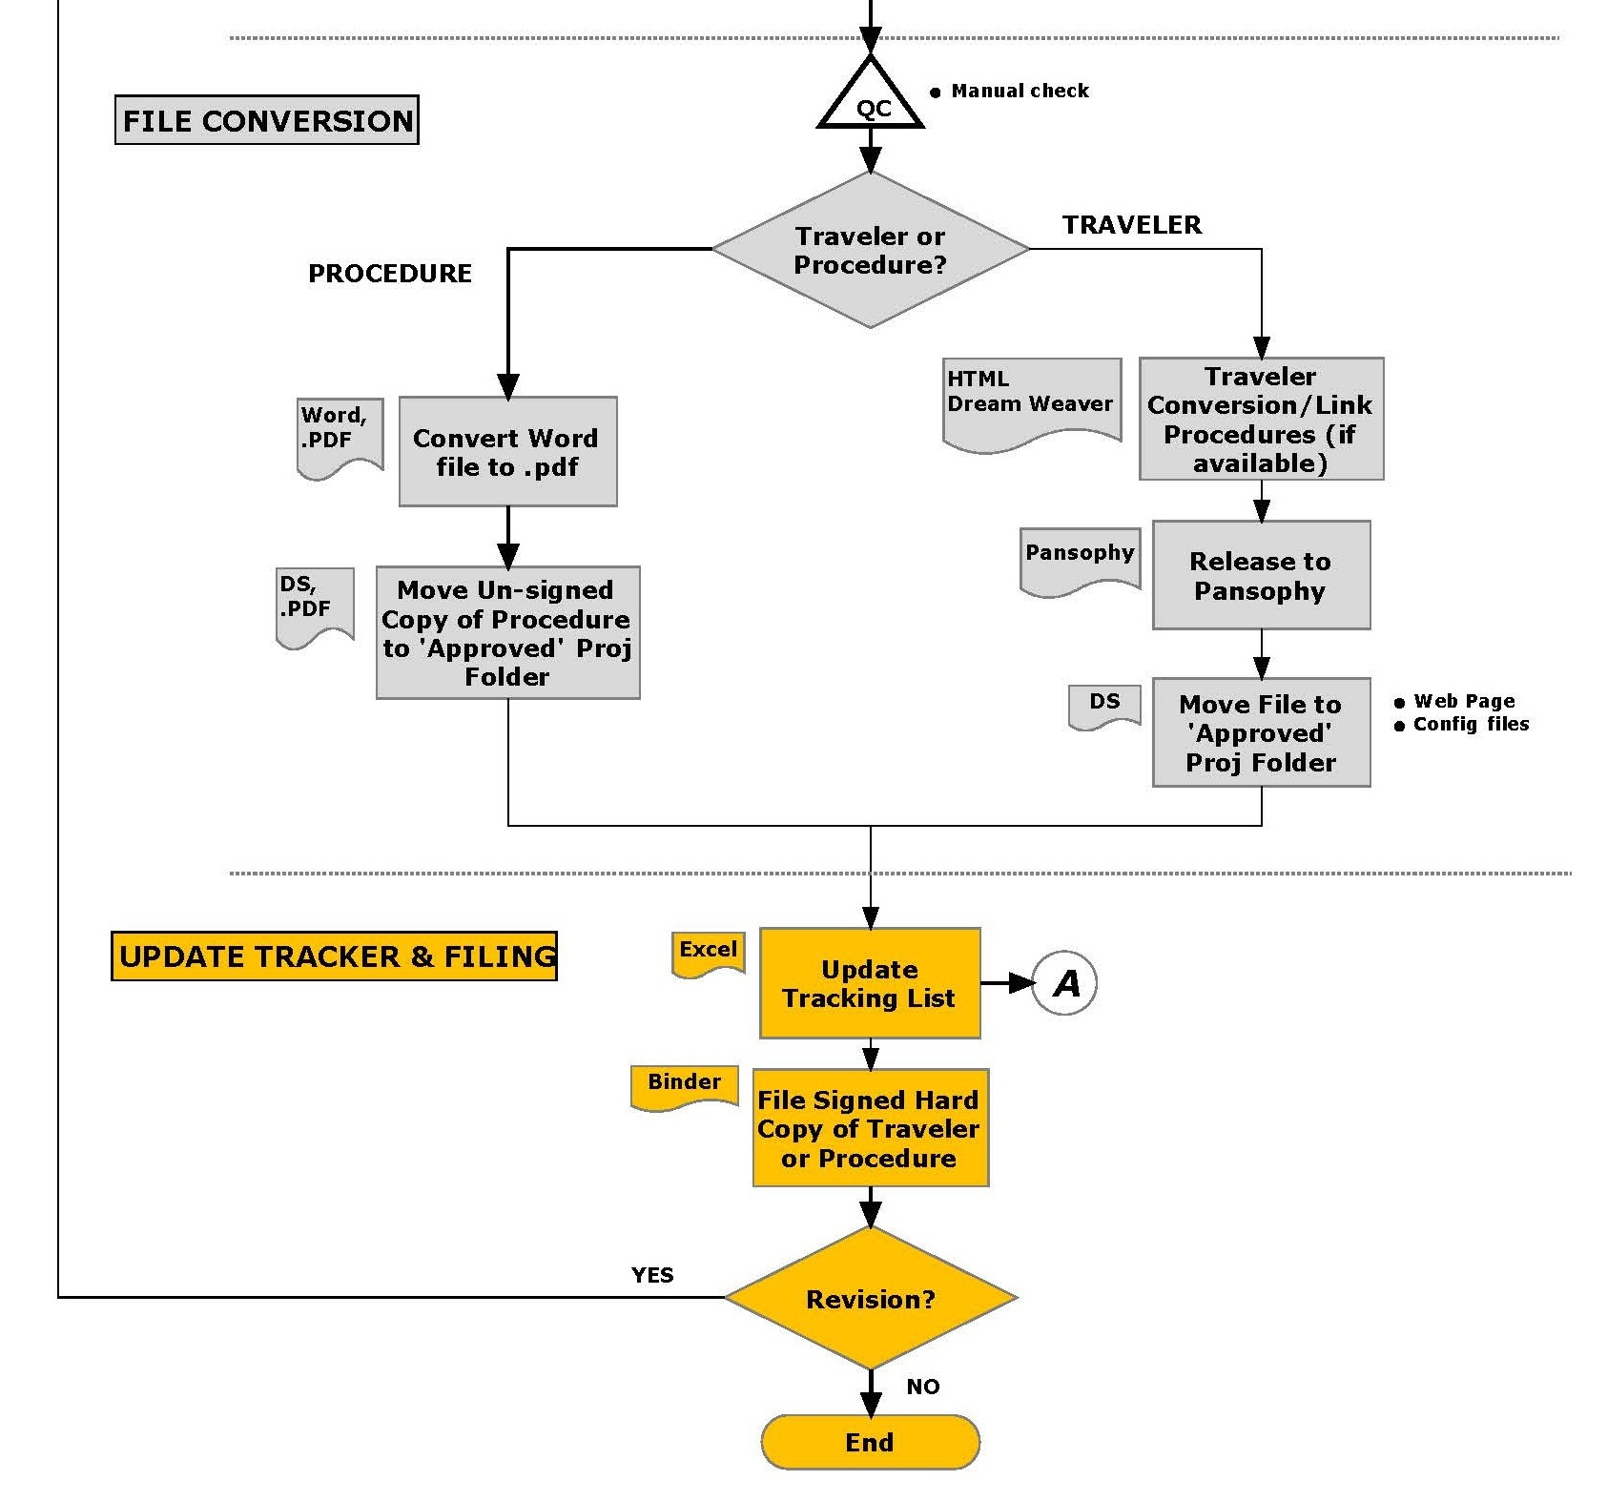
Pansophy Process Flowchart

Slide 74
Pansophy and Traveler System
Pansophy is
  Process control, data collection, and data access
  Web based data collection (Travelers) and data mining system (Reports/Queries)
  JLab customized Oracle + Cold Fusion
Local language usage: “Travelers”
  Used to define and control a process and gather data particular to the fabrication, assembly, or performance verification, of components and completed Cryomodules.
  Authored by the experts via MSWord macro template
  sequential list of required tasks
  version-controlled
  reference Drawings, SOPs, Common Procedures, or other static but readily accessible information.

Slide 75
Example Pansophy Traveler
System Expert driven content
Create a copy ready for new data entry.
Unique Identifier.
Open an existing copy.
Serial Number Tracking.
Enter data & submit to database
To INSTANTIATE a Traveler is to create a copy of the Traveler Template and make it ready to receive data.

Slide 76
Travelers (QMS)
Traveler
“Traveler – the approved documentation vehicle for both prescribing the process activities to be applied to specific components and also describing the actual process applied and associated data collected for each specific instance of traveler use. For SRF usage, the traveler content is maintained indefinitely in a robust commercial database system. Travelers are used to call out specifications required for acceptability, traceability, data collection and archival of results.”
QA-P-001, Document Control Process

Slide 77
NCRs: Non-Conformance Report (QMS)
“An NCR is initiated when a component part or an assembly fails an inspection or test requirement.”
MAI-P-004, Control of Non-Conforming Product
Non-Conforming Product – product which does not conform to requirements such as prints, specifications, or traveler callouts
Typically found with inspections, but any traveler can apply a NCR
Note: multiple NCRs can be attached to any traveler

Slide 78
D3s: Detours, Deviations, & Discrepancies (QMS)
“A D3 is used to document the difference from what is called out in the traveler. A D3 is initiated when there is a change to the prescribed process or work flow or that the process could not be completed as specified in the traveler or supporting documentation.”
MAI-P-004, Control of Non-Conforming Product
a change to the prescribed process or work flow
to note events within the fabrication process
as a data collection
tool for learning as part of the continuous improvement
Typically found with processing travelers, but any traveler can apply a D3
Note: multiple D3s can be attached to any traveler

Slide 79
Control of Non-Conforming Product (MAI-P-004)
Non-Conforming Reports (NCRs):
Formal process for identification and disposition of Non-Conforming products, when a component part or an assembly fails an inspection or test requirement.
  Examples:
  Damaged component due to shipping.
  Visual inspection failure per Traveler requirement.
  Dimensional or test failure per Traveler requirement.
Process Integration between quality control, inventory control, and the production Travelers.
Tie-ins to Pansophy for automatic Non-Conforming Reporting.
Johnny Leung slide

Slide 80
Control of Non-Conforming Product (MAI-P-004)
Detours, Deviations and Discrepancies (D3s):
A Supplemental Tool for capturing “Off-Normal” events that occur in the production process.
A D3 is used to document the difference in what is called out in the Traveler.
Generating a D3 does not imply that the part or assembly is unacceptable.
Tie-ins to Pansophy for automatic reports and search query.
  Examples:
  Electrical power interruption to Chemical EP Tool, having to repeat steps x to x.
  Outside environmental smoke fumes penetrating into High Bay area.
  Construction noises or vibrations during Micro-phonics testing.
Johnny Leung slide

Slide 81
D3 Project View
Drill-down links to Traveler status
D3s: Detours, Deviations and Discrepancies
  Listing of D3s by Traveler ID
    Annotates “off-normal” events related to procedures and processing
  Linked to Traveler Status Query for “Drill Down”

Slide 82
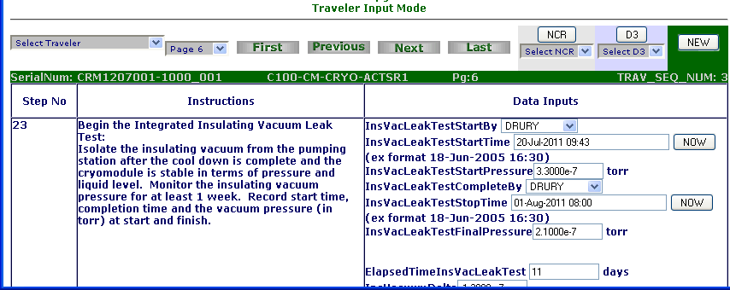
Non-Conformance Reports
An NCR button is located at the top of every page of a Traveler.
By selecting this button you “issue an NCR”.
You may issue more than one NCR from the NCR button in the traveler.
Attached NCRs can be selected from the drop-down
Refer to the Control of Non-Conforming Product (MAI-P-004) procedure for examples of when an NCR should be issued.

Slide 83
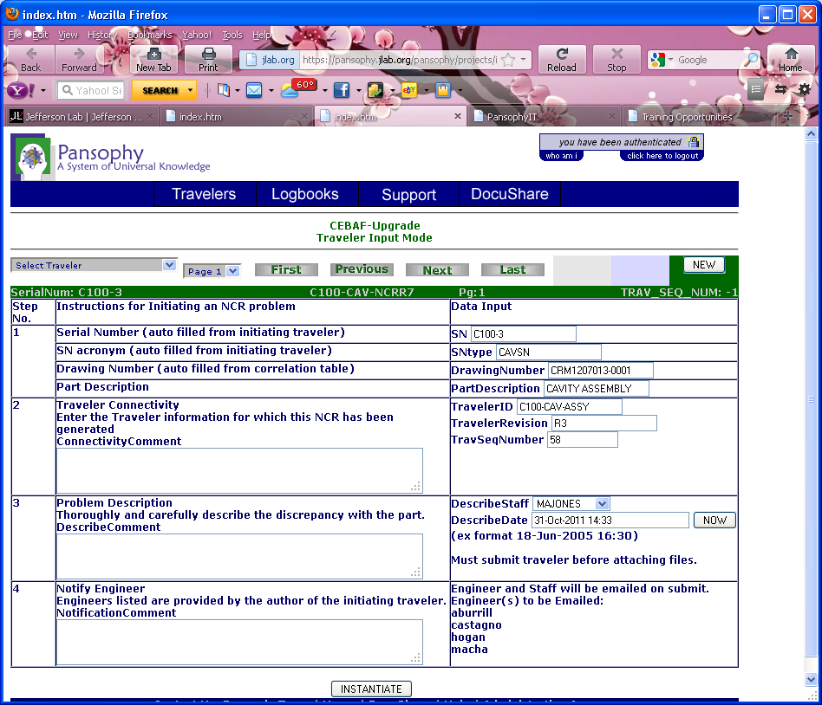
NCR Instantiation (pg. 1)
Enter as much information as possible about the non-conformance.
If the NCR was started from a traveler, then
Traveler ID
Traveler Revision
Traveler Seq Num
Serial Number
SN Type (part)
will auto-populate with the traveler information.
Engineers listed will automatically be emailed
Instantiate to create the NCR.

Slide 84

NCR Disposition (pg. 2)
Originator will automatically be emailed
The Responding Engineer field will auto-populate with the name of the person logged in.
The Engineer is responsible for analyzing the problem and selecting a disposition for the part.
Dispositions:
Use As Is, Return To Vendor, Reject, Proceed to next Work Center ➔
The NCR is automatically closed
Modify, Re-process ➔
email sent to initiating user for additional work

Slide 85

NCR Modify/Re-Process (pg. 3)
NCR is returned
to the originator for additional work
Verification of
Rework signature
obtained
Explanation of
Additional work.
Engineer will automatically be emailed

Slide 86

NCR Final Disposition (pg 4)
NCR Closed automatically
The Engineer is responsible for analyzing the rework and selecting a disposition for the part.
Dispositions:
Use As Is, Return To Vendor, Reject, Proceed to next Work Center ➔
The NCR is automatically closed
Modify, Re-process ➔
NCR is closed, all staff working on the NCR will be notified.
A new NCR can be opened to track further processing and dispositions.

Slide 87

Detour, Deviation, or Discrepancy (D3)
An D3button is located at the top of every page of a Traveler.
By selecting this button you “issue an D3”.
You may issue more than one D3from the D3 button in the traveler.
Attached D3s can be selected from the drop-down
Refer to the Control of Non-Conforming Product (MAI-P-004) procedure for examples of when a D3 should be issued.

Slide 88
D3 Traveler Specifics
D3 Classification is preset for each project, must select
Information automatically transferred from Traveler
Fill in all input areas to fully explain the D3 from problem to resolution

Slide 89

D3 classifications
Default classifications:
DETOUR
DESCREPANCY
DEVIATION

Slide 90

C50 Drill-Down Reports
Cavity Pair Assembly Report:
Links to all travelers related to Cavity Pair assembly

Slide 91

VTRF (Vertical Test Area RF Cavity Test)
Cavity Performance snapshot

Slide 92
Examples of available reports
Types of reports available from Pansophy
  NCRs -Non-Conformance Report & Status (QA)
  D3s: Detours, Deviations, & Discrepancies (QA)
  Traveler Status - Level of Completion
  Production Status – example “dashboard”
  Data Mining – example Cavity Performance
Data Mining and summary reports assist the Project Manager and QA Department in understanding the issues

