Slide 1
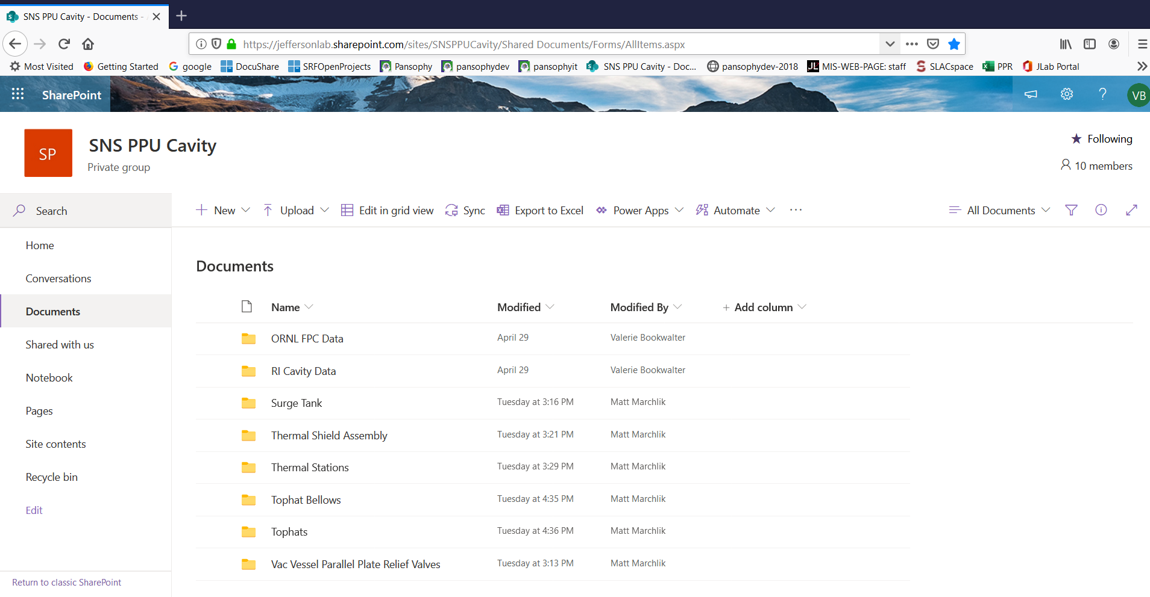
SNSPPU SharePoint Drive for Vendor Data
The Computer Center has setup a SharePoint Drive for SNSPPU Vendor Data (Note: yes the name is misleading, it is not just for cavity data)
If you have Vendor Data for a part, please let us know at pansophy@jlab.org so that we can grant you access OR you can send the email of the vendor contact and we can give them access to upload the data themselves rather than going through email.
Setup a directory for each part and subdivide if needed (Matt has setup some directories for his parts. Great job Matt!)

Slide 2
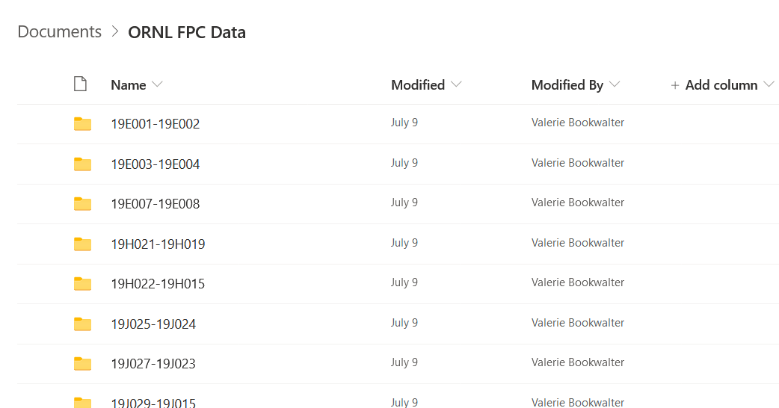
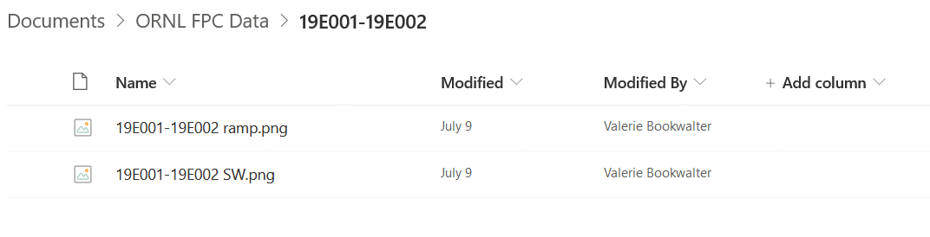
Attaching Data to a Traveler (SOTRs)
SOTRs are responsible for ensuring the Vendor Data is attached to the appropriate Traveler(s)
Inventory (shipping documents and certifications)
Inspection (Vendor data about inspections and compliance)
Example:
The ORNL FPC Data was emailed to bookwalt@jlab.org rather than directly uploaded to SharePoint.
However, this data has not yet been attached to a Traveler.
Who is the SOTR?
Is there a traveler available?
Has the SOTR attached the data to a Traveler?

Slide 3
Other Important Notes
Inventory – ALL Parts must go through Inventory! If a part can not then an email must be sent to srfinv@jlab.org with the part information (PO number, drawing number, serial number, etc.)
Acronyms – Please refer to the online acronym listing in Pansophy. If your part does not show up in the list then email pansophy@jlab.org so that an appropriate acronym can be created.
Travelers – Priorities are in a constant state of flux and Part arrivals have changed so please let us know when parts are expected to arrive and be inspected so that Travelers can be done in a reasonable time *(We can not guarantee same day turnaround!)

