Slide 1
Pansophy 102
Traveler Writing & DocuShare
Pansophy Team
pansophy@jlab.org
July 15, 2019

Slide 2
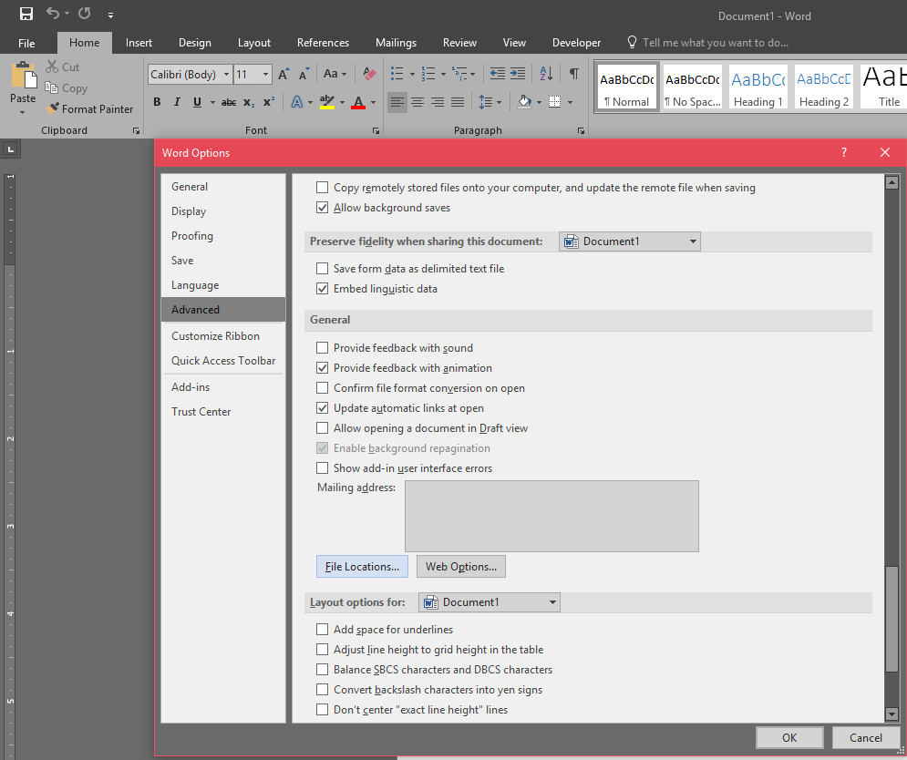
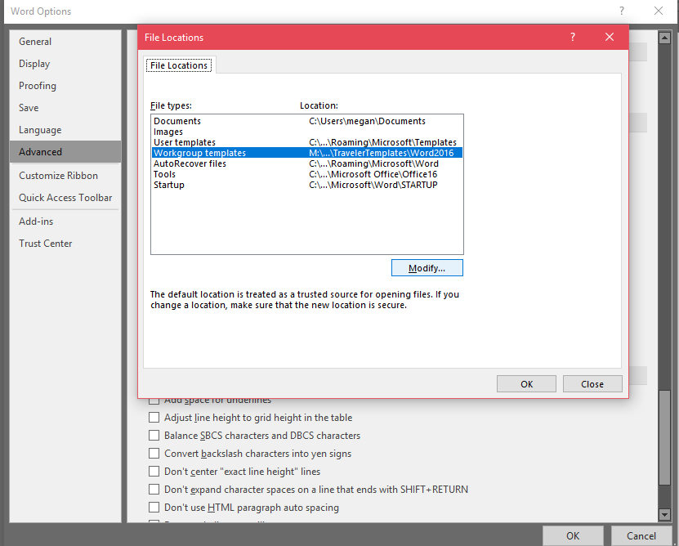
Setting up the Traveler Template
Attaching the template
Navigate to File > Options > Advanced
Scroll to General
Click “File Locations”
Highlight “Workgroup templates” and click “Modify”
Navigate to M:\asd\asddocs\TravelerTemplates\Word2016
Click “OK” on File Locations
Click “OK on Word Options
Step 3
Step 4

Slide 3
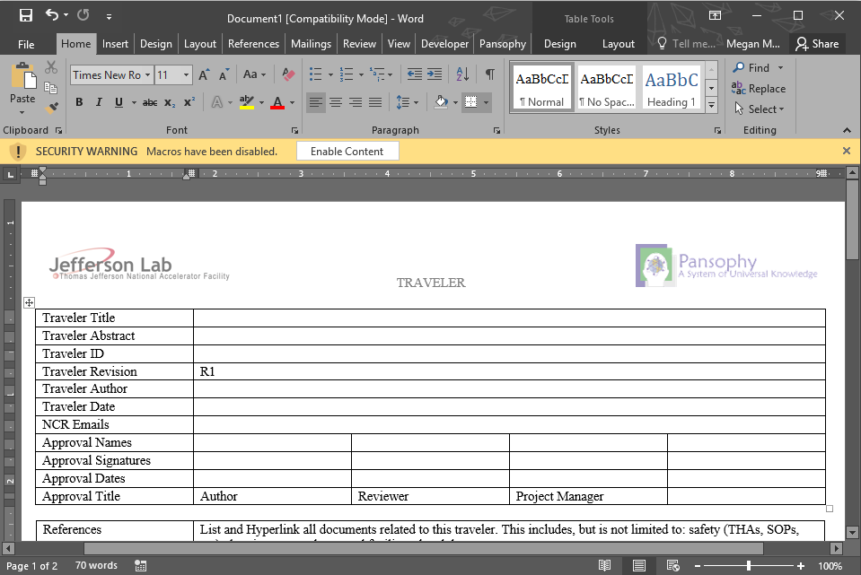
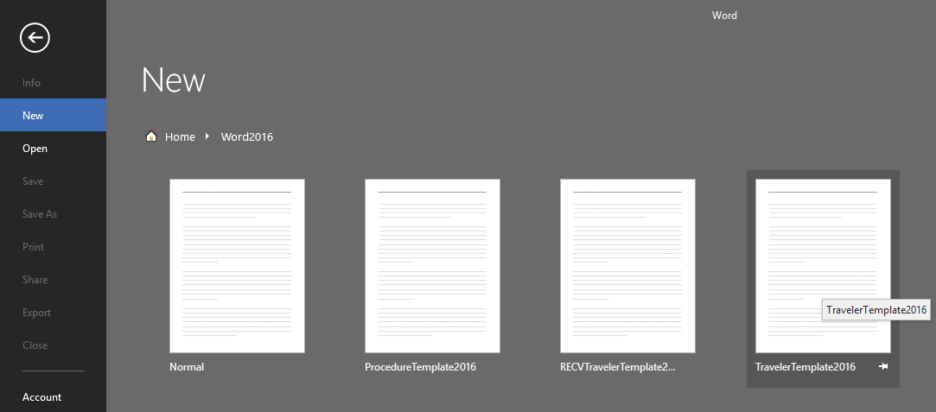
Opening a new Traveler
In Word 2016, click CUSTOM > Word2016
A new traveler will open with a SECURITY WARNING. Select “Enable Content”
Select TravelerTemplate2016

Slide 4
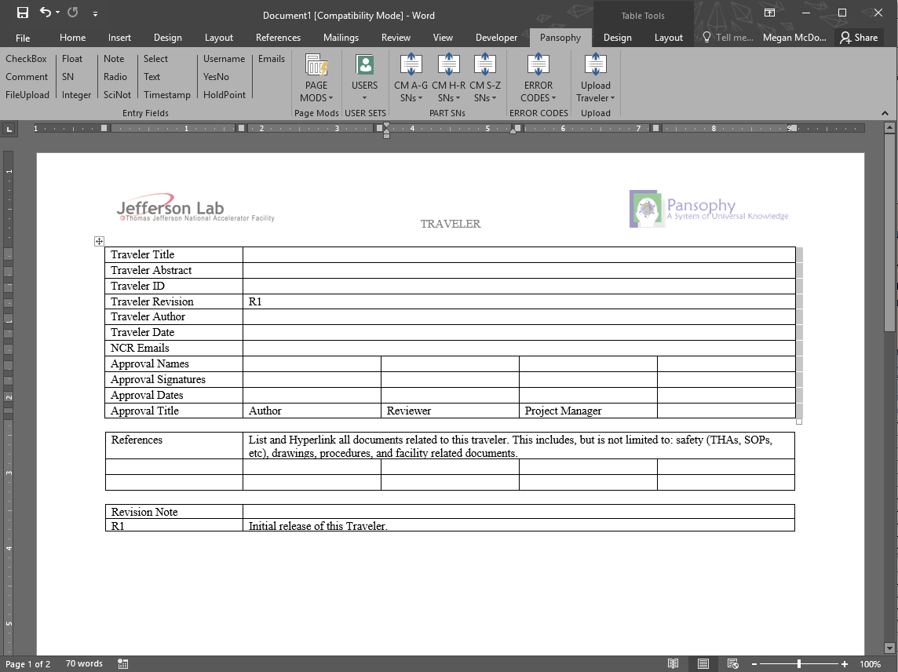
The Pansophy Ribbon
The Pansophy tab allows for access to the traveler macros for adding inputs to your traveler.

Slide 5
Traveler Header Information
Fill out the traveler head information for your activity
List and Hyperlink all documents related to this traveler. This includes, but is not limited to: safesty (THAs, SOPs, etc), drawings, procedures and facility related documents
Fill in the revision note

Slide 6
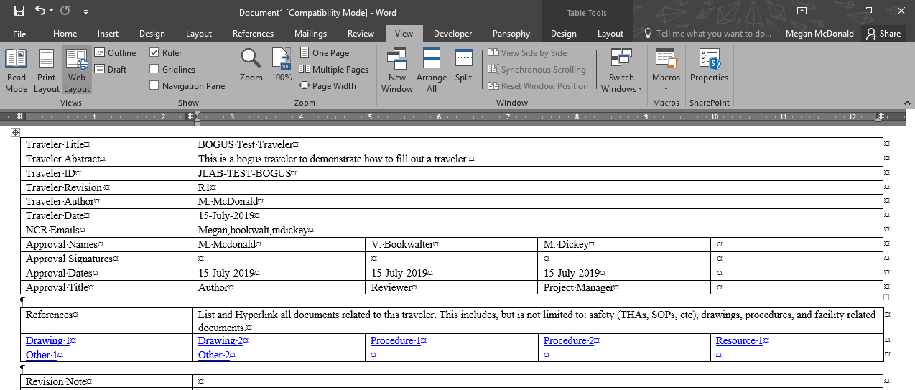
Traveler Authoring – Helpful Tips
Click on the paragraph symbol to better view the formatting of the document
Under the View tab, select “Web Layout” to view page breaks

Slide 7
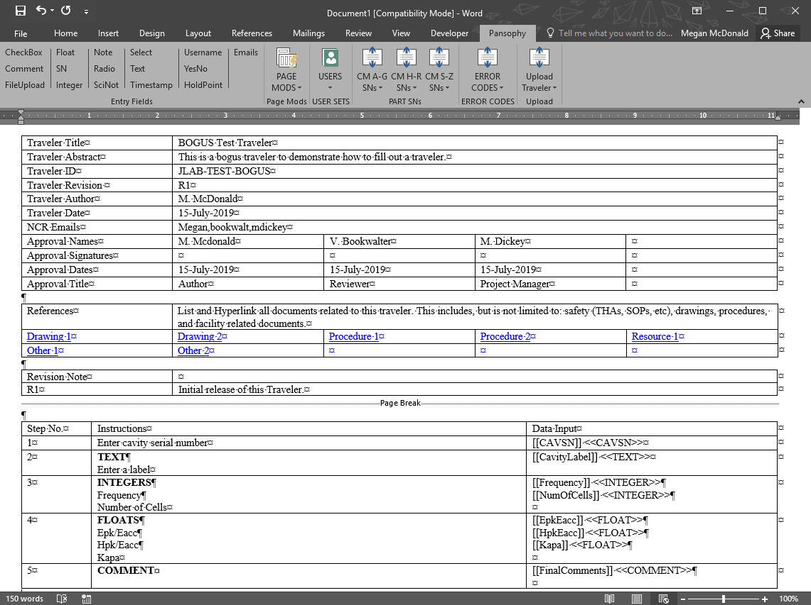
Traveler Authoring – Writing Steps
Enter step numbers and instructions

Slide 8
Traveler Template Codes
Name | Format | Definition
CheckBox | [[FieldName]] <<CHECKBOX>> | A pull-down (select) menu will be created using the user supplied choices
Comment | [[FieldName]] <<COMMENT>> | Allows for the collection of comments in a large input box
FileUpload | [[FieldName]] <<FILEUPLOAD>> | Allows any type of file to be uploaded to the server
Float | [[FieldName]] <<FLOAT>> | Creates an input box that accepts numbers containing a decimal point
SN | [[FieldName]] <<SN>> | Provides a text box that accepts serial numbers (allows for both letters and numbers)
Integer | [[FieldName]] <<INTEGER>> | Creates an input box that only accepts whole numbers
Note | [[FieldName]] <<NOTE>> | Alerts programmers to special traveler requirements (ex: calculations)
Radio | [[FieldName]] {{Choice1,Choice2,Choice3}} <<RADIO>> | Creates a series of radio buttons (only one can be selected) based on the author supplied list of choices

Slide 9
Traveler Template Codes (cont.)
Name | Format | Definition
SciNot | [[FieldName]] <<SCINOT>> | Allows for the input of numbers in scientific notation
Select | [[FieldName]] {{Choice1,Choice2,Choice3}} <<SELECT>> | Creates an author defined pull-down menu. Authors must list the input values to be placed on the pull-down menu
Text | [[FieldName]] <<TEXT>> | Creates an input box for text entries
Timestamp | [[FieldName]] <<TIMESTAMP>> | Provides an input box which accepts date and time. Also supplies a “Now” button which will automatically input the current date and time
Username | [[FieldName]] <<USERNAME>> | Provides and input box for a person’s name
YesNo | [[FieldName]] <<YESNO>> | Creates radio buttons that answer a yes/no question
HoldPoint | [[FieldName]] {{Username1,Username2,Username2}} <<HOLDPOINT>> | Creates a hold point in the traveler preventing further data entry
Emails | [[FieldName]] [[Username1,Username2,Username3}} <<EMAIL>> [[FieldName]] {{Subject Line}} <<EMAILSUBJ>> | Will email author supplied users when the traveler page is submitted

Slide 10
Traveler Template Codes (cont.) – User Sets
Name | Format | Definition
SRF | [[FieldName_SRF]] <<SRF>> | SRF User Set
SRF_CMP | [[FieldName_SRFCMP]] <<SRFCMP>> | SRF Cryomodule User Set
SRF_CVP | [[FieldName_SRFCVP]] <<SRFCVP>> | SRF Cavity User Set
SRF_FAB | [[FieldName_SRFFAB]] <<SRFFAB>> | SRF Fabrication User Set
BT | [[FieldName_BT]] <<BT>>
MACH | [[FieldName_MACH]] <<MACH>>
DCPWR | [[FieldName_DCPWR]] <<DCPWR>>
HPRF | [[FieldName_HPRF]] <<HPRF>>
LLRF | [[FieldName_LLRF]] <<LLRF>>

