Slide 1
SRF Pansophy – Document Control Travelers/Procedures and an Example of NCR
Document Control Mechanisms
Reference Procedure : QA-P-001 ( SRF Institute Document Control Process)
NCR- Non-Conformance Report
Reference Procedure : MAI-P-004 ( SRF Control of Non-Conforming Material)
16-Aug-2018

Slide 2
Pansophy Revision Control
Change to a Traveler or Procedure requires a new revision.
These revisions are kept in a draft folder in Docushare for SME’s to edit and revise.
When a signed hardcopy of a New Revision is received by the Pansophy group, then the word document is converted to an online Traveler/Procedure.
Additionally the converted documents are saved in Docushare under the FINAL area where write permissions are strictly limited and the signed hardcopies are secured in a locked cabinet.
Any documents linked from a traveler/procedure must reside in the docushare system to maintain revision control.

Slide 3
Traveler Title Page
Traveler Title Page
Revision Date
Signatures
Revision Notes
Links to Procedures, drawings, and relevant documents

Slide 4
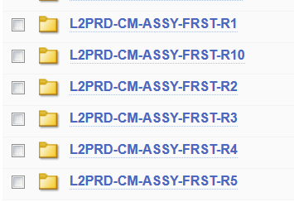
Docushare
Procedures/Travelers are stored in Docushare to ensure revision control and write/change control.
Included files, such as drawings and work plans, are kept in included files area.
Each version of a traveler is maintained.
Docushare is a Xerox Document Control System

Slide 5
Traveler Data Locking
Data can be resubmitted to a traveler UNTIL a traveler is CLOSED. Upon closure the data is locked in the database and the form no longer allows user entry as shown by the grayed out form fields.
Additionally Holdpoint(s) can be placed in a traveler which will halt data entry or traveler closure until such time an SME reviews data and signs off.

Slide 6
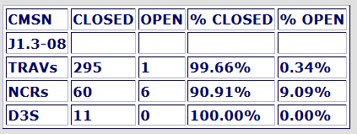
Cryomodule Review Report
Report shows a complete view of Travelers/NCRs/D3s for a selected Cryomodule. It has Open/Closed status and links. This aids in reviewing progress of CM and its associated data. As well as review of NCR status. A summary of open travelers is also provided.

Slide 7
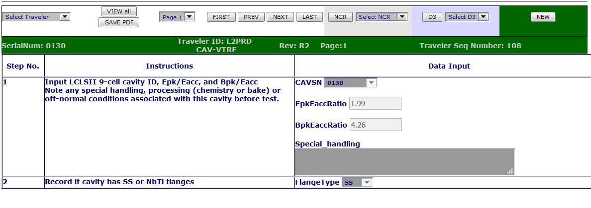
Example NCR Process (VTRF CAV0130, NCR 1495)
If a non-conformance is found, an NCR can be initiated from any traveler.
Serial Numbers, Part description and Traveler information are automatically placed into the NCR. The user then fills in the details of the non-conformance and initiates the NCR process.
SME’s are automatically emailed a link to the NCR and action requested.

Slide 8
Example NCR Process (Pg 2, First Disposition)
SME first response to NCR with action to be taken. Automatically emailed to technician

Slide 9
Example NCR Process (Pg 3, Modification/Re-measure)
Multiple interations of modifications can be tracked where needed. An SME emailed results

Slide 10
Example NCR Process (Pg 4, Final Disposition & Closure)
SME gives final disposition and NCR is closed

Slide 11
Pansophy
Questions?

