Slide 1
Pansophy 101
The Basics

Slide 2
Navigating to Pansophy
User Action
Open the firefox browser
In the URL type pansophy.jlab.org

Slide 3
Logging In
Your Username and Password are the same as your CUE
The User is NOT logged into Pansophy. Click to login

Slide 4
Pansophy Home Page
The home page is the Travelers page.

Slide 5
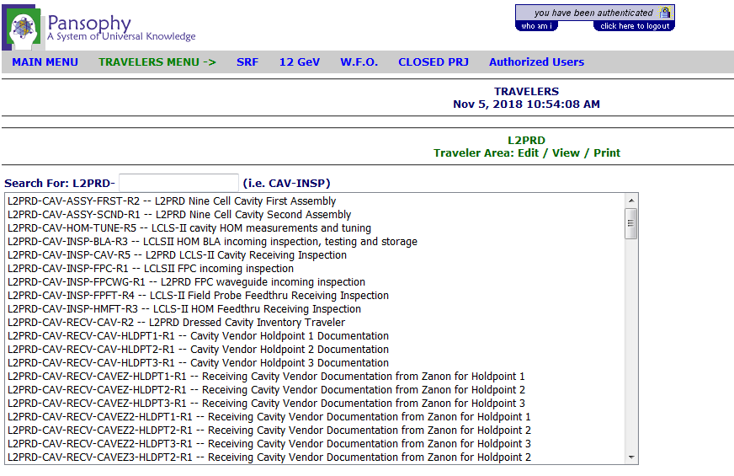
Navigating to Travelers
Hover over W.F.O. (Work for Others) and navigate to L2PRD

Slide 6
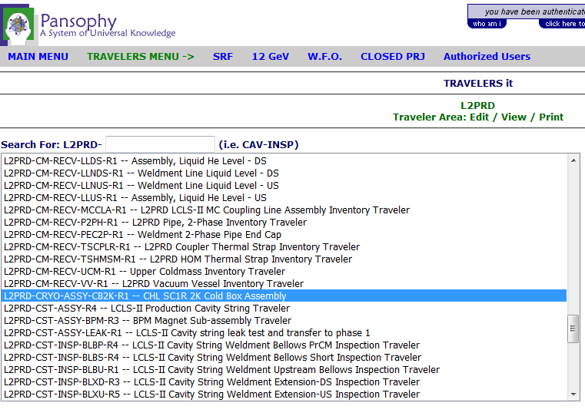
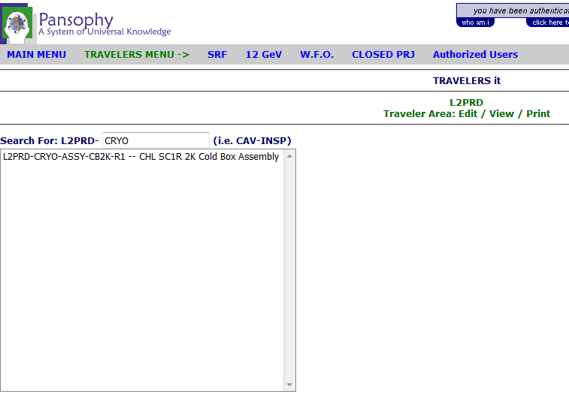
Two Ways to Navigate to your Traveler
1. Scroll until you find it
2. Use the filtering text box

Slide 7
Anatomy of a Traveler
To select previously instantiated travelers, select from this list
Page navigation
Page 0 (or first page) of traveler
A “0” denotes that no specific (old or new) traveler has been opened
Files related to the traveler

Slide 8
Instantiating a New Traveler
To select a previously instantiated traveler, select from this list
To instantiate a new traveler, click the “new” button

Slide 9
An Instantiated Traveler, Page 1
A newly instantiated traveler will have a seq number of -1. This denotes that the traveler has not yet been saved
User Action
Enter data into the form fields

Slide 10
Instantiating
User Action
Continue to enter data into the form fields
Click “Instantiate”
You must click INSTANTIATE (page 1) so that the traveler is entered into the system and assigned a sequence number
Multi-File uploads will not be available until the traveler has a sequence number

Slide 11
Traveler Sequence Number
A seq number will now appear
User Action
Click on “Attach Files”
Attach files now appears

Slide 12
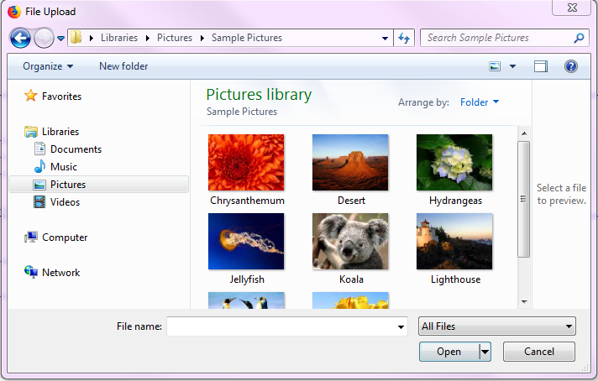
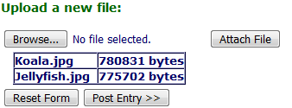
Attach Files
User Action
A new window is displayed
Click “Browse”
A pop-up window will display
Browse your file’s directory
Select the file
Click “Open”
The file browse window will close
Click “Attach File”
Repeat for each file to be uploaded
When done selecting files, click “Post Entry >>”

Slide 13
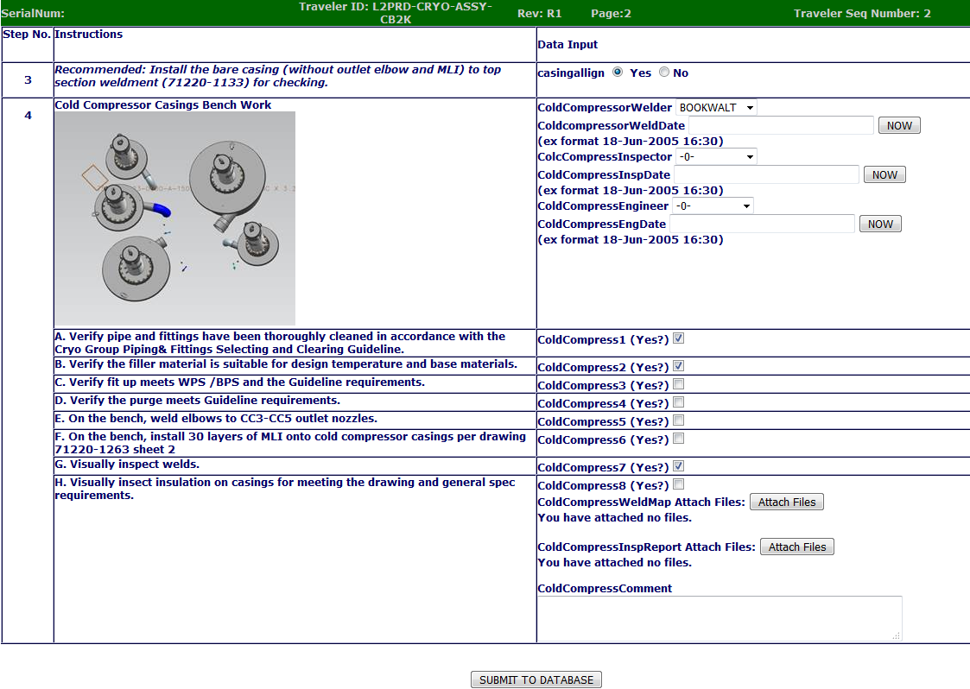
Submitting Data Pages
User Action
Click “Next” to navigate to page 2
Enter some data
Click “Submit to Database”
Repeat for each page on the traveler

Slide 14
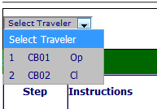
Closing a Traveler
-Closing a traveler locks the data so that it can not be edited any further.
- To close a traveler, navigate to the last page and select “Yes” at the bottom of the page and then click “Submit to Database”

Slide 15
Questions?
Megan McDonald
megan@jlab.org
X 7641
Valerie Bookwalter
bookwalt@jlab.org
X 5802
Pansophy Help Email
pansophy@jlab.org

