Slide 1
Instructions to Install Xerox DocuShare Drive
These steps are shown in the screen recordings on the next 2 slides
Navigate in File Explorer to \\jlabwin\SW_Dist\UserApps\DocushareClient
Double click the DSDriveSetup Application file to begin the installation
Click through the installation, as shown in the screen recording on the next slide
When prompted, the DocuShare URL is jlabdoc.jlab.org
Finish through the installation and click “Yes” when prompted to restart the computer
When the computer has restarted, click the up arrow in the bottom right corner, has shown in the second screen recording
Right click on the “Xerox DocuShare Drive” icon and click Map Server
The URL is https://jlabdoc.jlab.org/docushare/dsweb/HomePage
Click “Next” and use your Jlab username and password
Click “Next” and give the drive a label (I used JLab)
Click “Next” and then “Finish”. You can now access DocuShare through your File Explorer

Slide 2
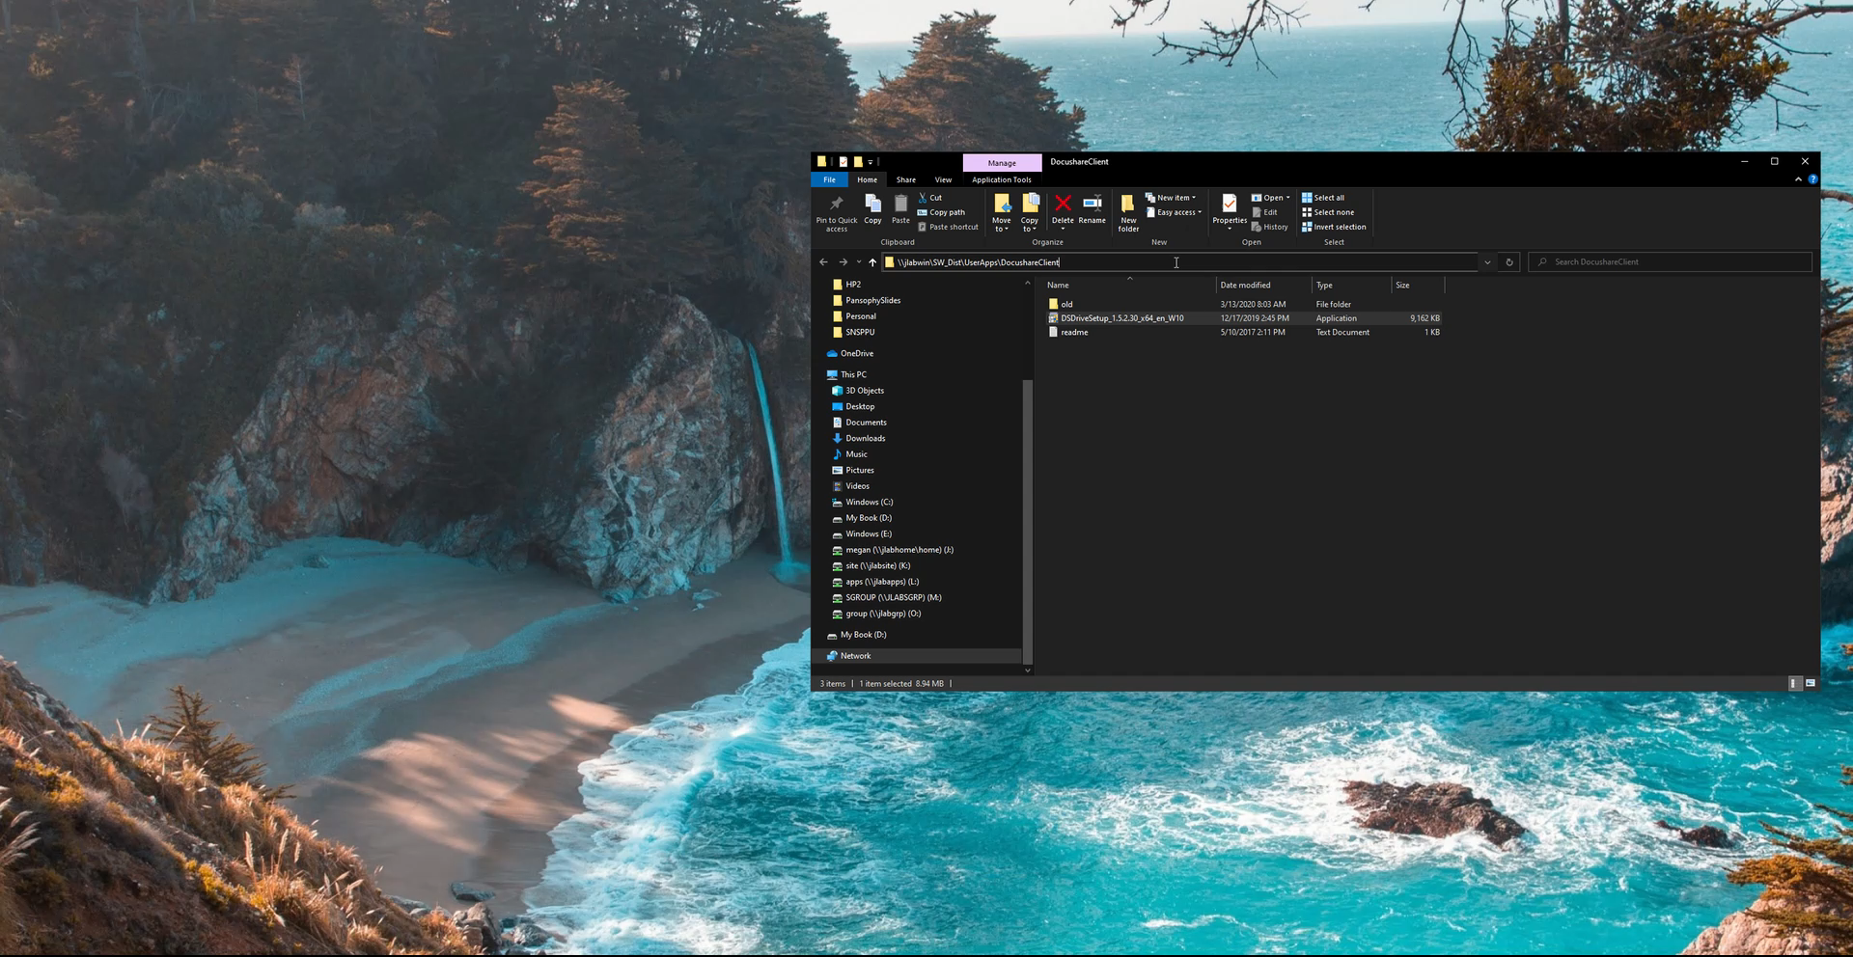
Installing DocuShare Drive Software

Slide 3
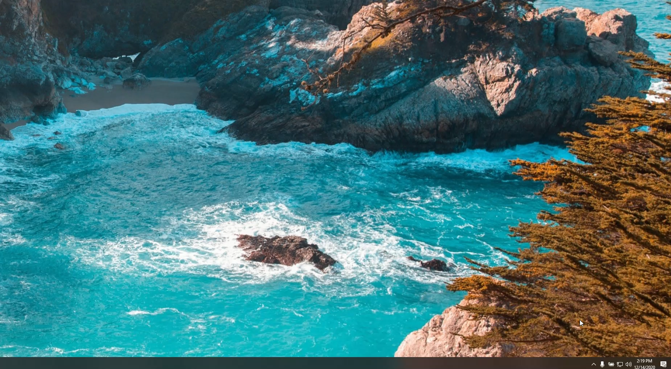
Mapping the DocuShare Drive Server

Slide 4
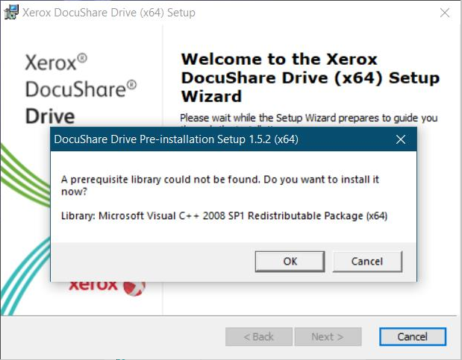
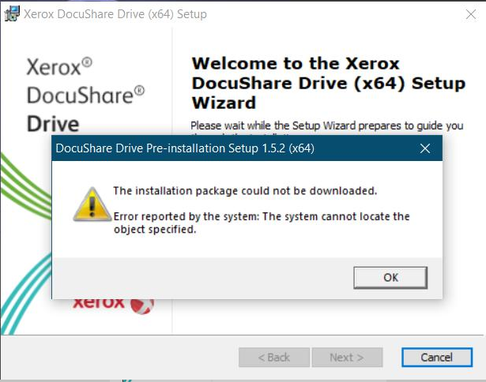
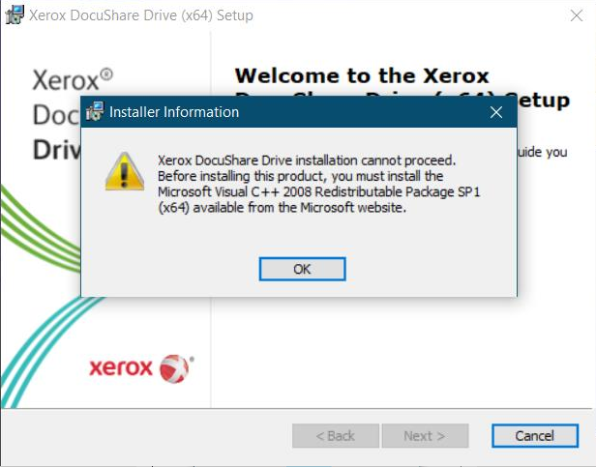

Errors?
If you encounter the above prompts, please follow the link below to install Microsft Visual C++ Redistributable Package (x64). This link was provided by Erik Werlau. If you have further questions, contact the Pansophy Team (pansophy@jlab.org)
https://www.microsoft.com/en-us/Download/confirmation.aspx?id=15336

