Slide 1
RFD Manufacturing Plan

Slide 2
Approaches
Minimum number of forming dies and weld seams
Avoid weld seams in high field area
Weld seam 2D lines as opposed to 3D lines for better ebw machine control
Avoid one sided full penetration weld as much as possible especially on sensitive area
Make all sensitive weld seams available for inspection and polish before moving forward
Critical operation should be done earlier so it has opportunity to correct and accumulated time and efforts not wasted. For example, establishing pole geometry early on so the most important cavity parameters like frequency and electric center are determined and remained throughout the manufacturing process.

Slide 3
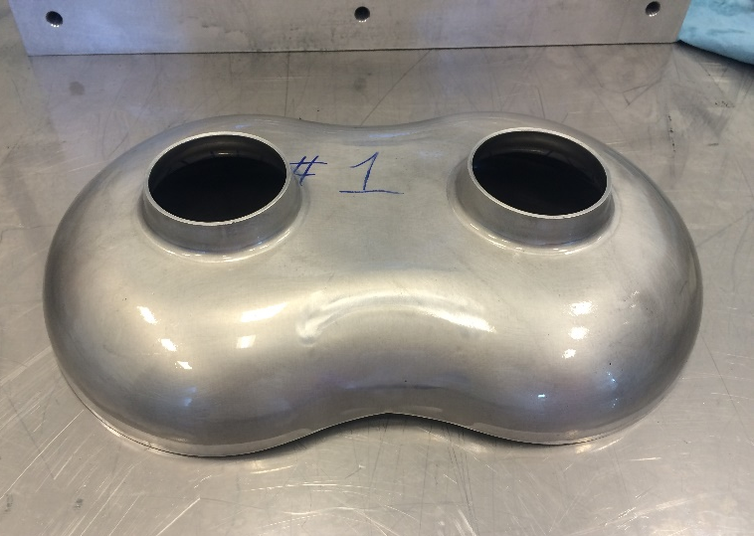
Form poles (4 mm thick) Examples (twin axis cavity)

Slide 4
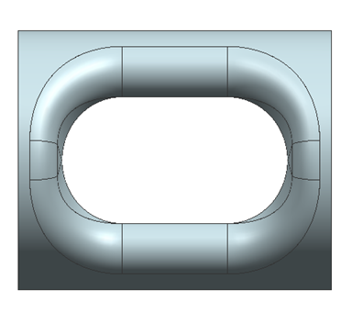
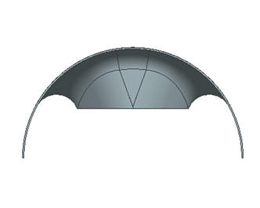
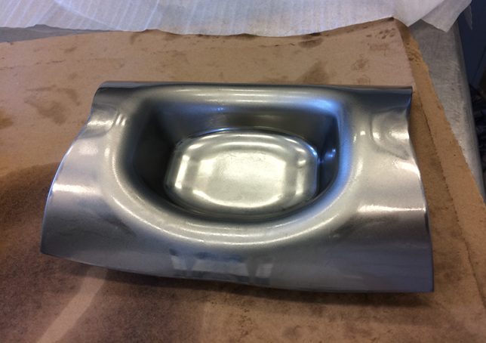
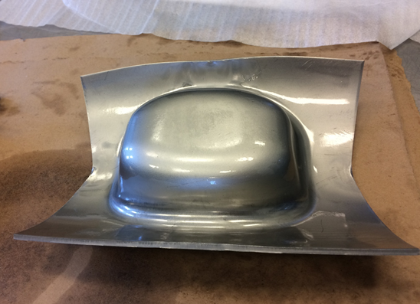
Form outer conductor (4 mm thick) Examples (JLEIC crab cavity)

Slide 5
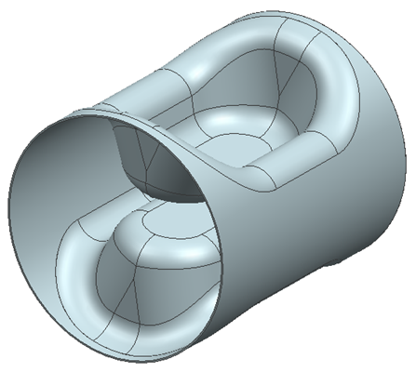
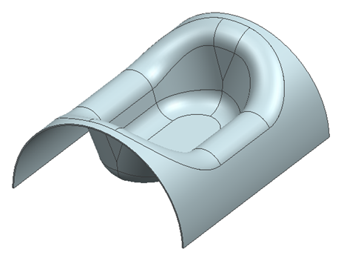
Weld pole + outer conductor Inside and outside weld for smoothness Line of sight √
X 2 =
Welded half center body Welded full center body
Stiffeners will be welded at this stage
(shown later)

Slide 6
EBW specifics EBW gun is stationary for this kind of weld and the part will have to rotate
EBW gun
High point should ensure clearance from gun proper
Weld swing ~70 cm

Slide 7
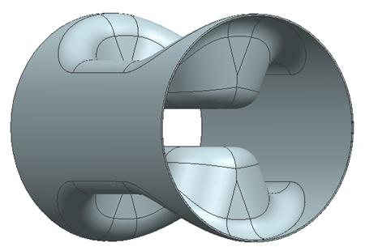
Weld half center bodies Inside and outside weld for smoothness Line of sight √ Internal surface easily accessible for weld check and polish

Slide 8
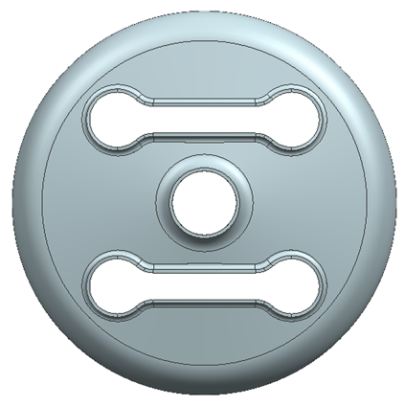
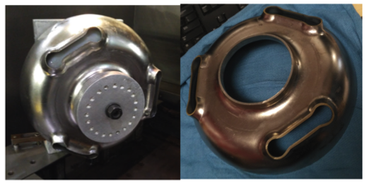
Form end caps (5 mm thick) Identical end caps for both sides Different orientation for each side Examples (On-cell damper cavity)

Slide 9
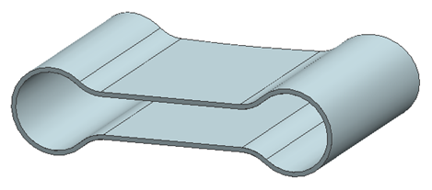
Form wave guide half (3-4 mm thick) 8 pieces to make 1 FPC stub and 3 wave guides One side full penetration (or inside and outside weld available) weld and trim
Flange will be added (weld or braze) before it is welded to the end cap
Line of sight OK for inside and outside weld for better weld quality

Slide 10
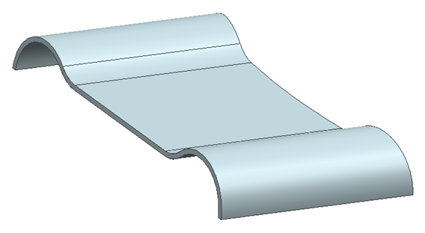
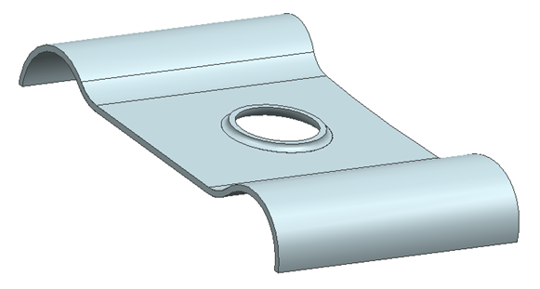
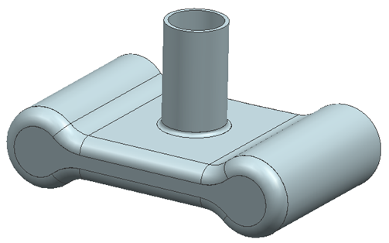
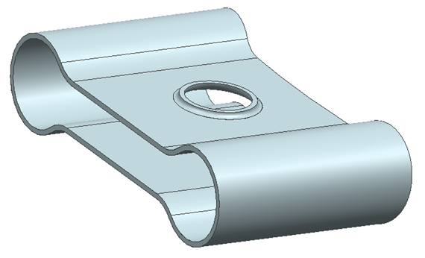
FPC stub Use same wave guide form and pull port transition (no forming die necessary)
Weld port and wave guide plug

Slide 11
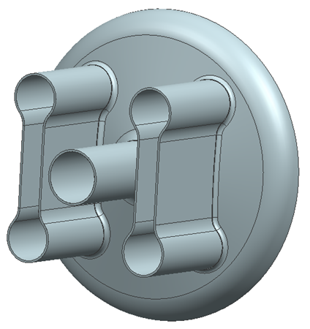
Complete end cap subassembly
Subassembly’s internal surface accessible for weld inspection and polish
Wave guide stub plug will be formed or cut from a flat sheet

Slide 12
Final weld Outside full penetration circular weld Circular weld ensures weld quality Trimming error or weld shrinkage of final weld seam affects minimally on frequency and also can be accommodated by tuning range

Slide 13
Weld cavity with stiffeners (4 mm thick reactor grade)

Slide 14
Forming Blanks
Dimensions are rounded up to truncate the decimals

Slide 15
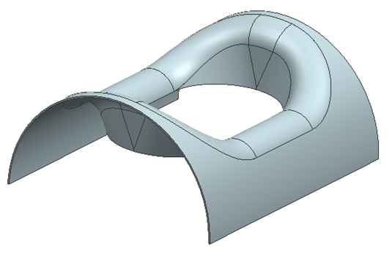
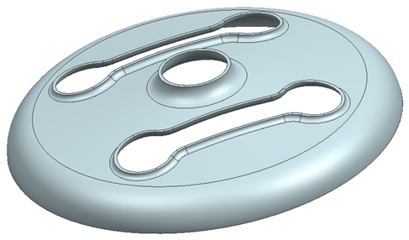
Part name | Geometry | Finished (Trimmed) size Thickness X side X side or diameter mm | Size including trimming/weld margins | Required Quantity | Note
Pole |  | 4 X 638 X 395 | 4 X 648 X 405 | 2
Outer conductor |  | 4 X 938 X 726 | 4 X 948 X 746 | 2 | Beamline direction has 10mm margin each side for frequency trimming
End cap |  | 5 X Ø 667 | 5 X Ø 677 | 2 | Enough margin to compensate outer conductor side if necessary

Slide 16
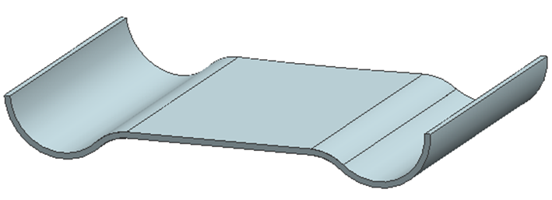
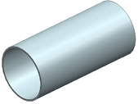
Part name | Geometry | Finished (Trimmed) size Thickness X side X side or diameter mm | Size including trimming/weld margins | Required Quantity | Note
Wave guide half |  | 4 X 431 X 204 | 4 X 436 X 209 | 8
Beam pipe |  | 4(3) X 333 X 230 | 4(3) X 333 X 235 | 2 | Beampipe blanks are cut precisely in circumference dimension
FPC port |  | 4(3) X 220 X 185 | 4(3) X 220 X 190 | 1
Wave guide plug (FPC WG stub) |  | 4 X 386 X 114 | 4 X 391 X 119 | 1 | Could be 2 if one of the HOM wave guide becomes a stub

Slide 17
Part name | Geometry | Finished (Trimmed) size Thickness X side X side or diameter mm | Size including trimming/weld margins | Required Quantity | Note
Stiffener |  | 4 X 261 X 720 | 4 X 266 X 720 | 2 | Reactor grade Nb
Stiffener |  | 4 X 261 X 280 | 4 X Ø 630 | Blanks 3 Finished shape 12 | Reactor grade Nb Round sheet makes 4 finished shape
Tuner tabs | TBD |  |  |  | Nb-Ti
Flanges | TBD |  |  |  | SS or Nb TBD

