Slide 1

Traveler Authorship
Megan McDonald
March 13, 2020

Slide 2
Location of Training Slides
SRF Institute > 01 – SRF Projects > 06 – For Reference, Additional Template and Processes

Slide 3
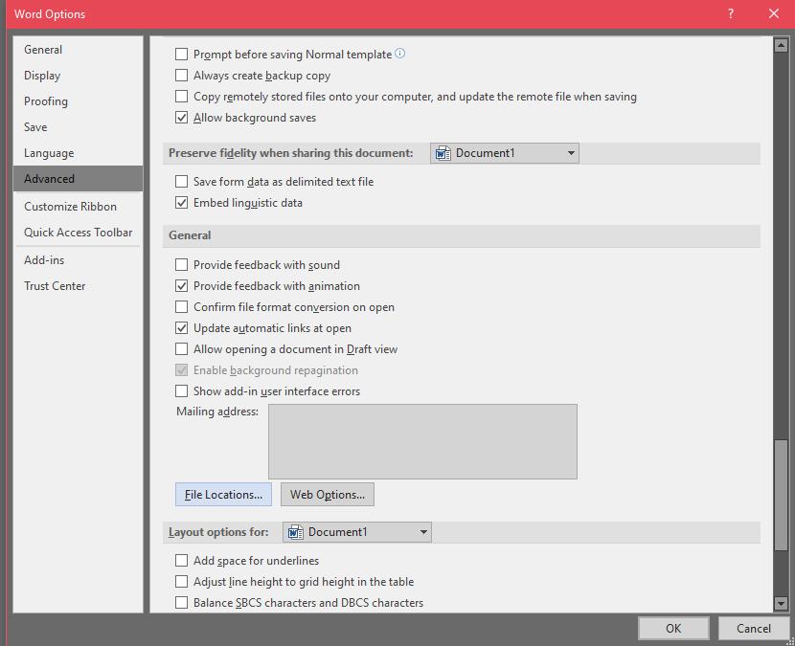
Attach the Template
Open Microsoft Word 2016
Open a Blank document
Select the File tab
Select Options
Select Advanced
Scroll down to General
Click File Locations

Slide 4
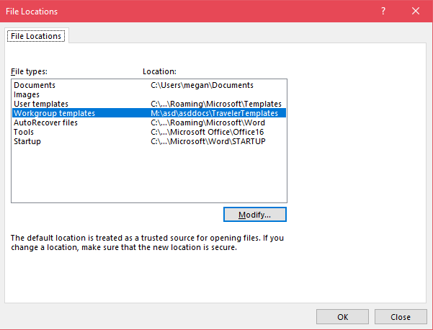
Attach the Template (cont.)
In the File Locations pop up, select Workgroup templates
Click the Modify… button
Browse to M:\asd\asddocs\TravelerTemplates
Click OK
Click OK on File Locations
Click OK on Word Options

Slide 5
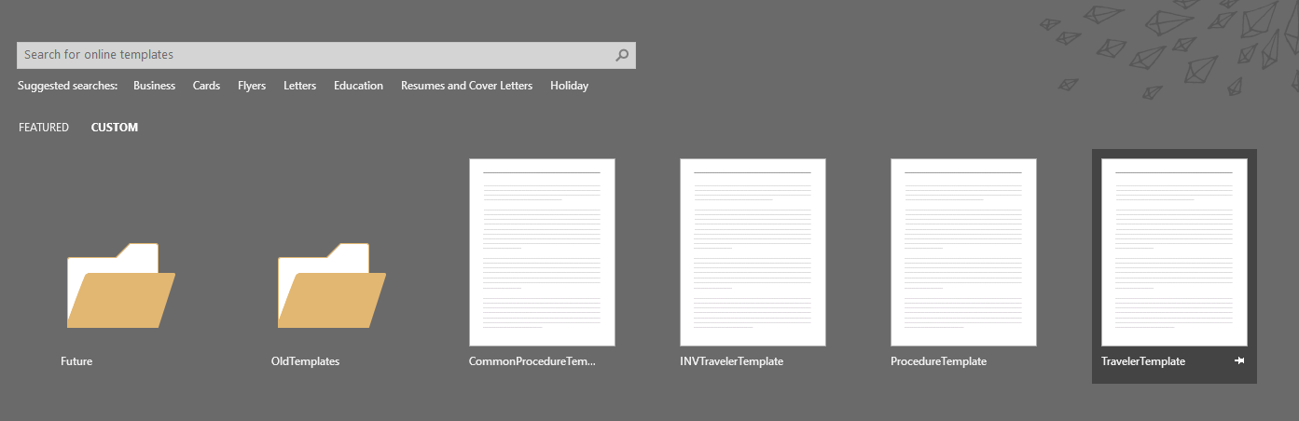
Attach the Template (cont.)
Restart Word
All templates (Traveler, Procedure and Inventory Traveler) will now be available under the CUSTOM tab when Word is first opened

Slide 6
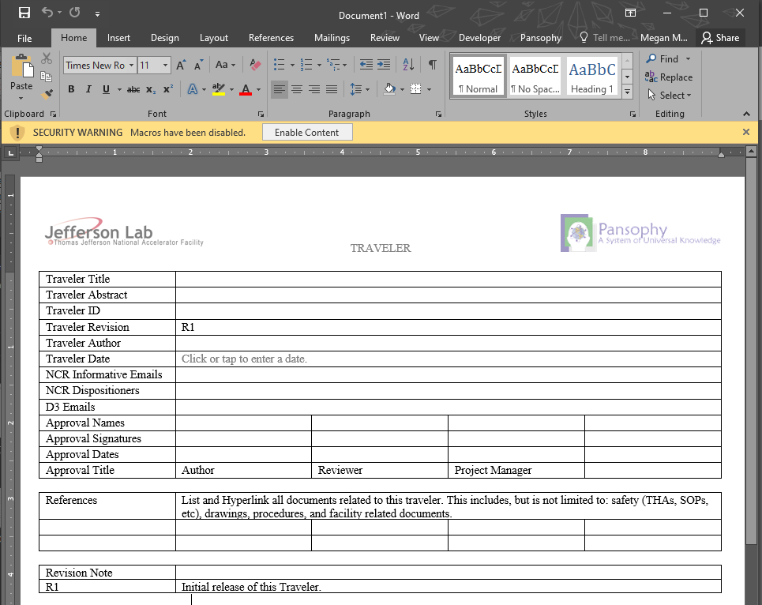
Creating a Traveler
Select TravelerTemplate from the custom templates tab
Be sure to click Enable Content to enable the Pansophy Tab

Slide 7
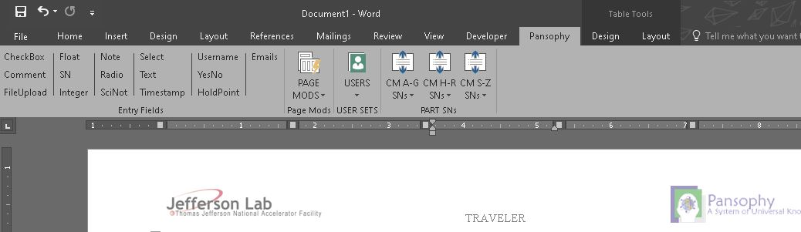
Pansophy Ribbon
1
2
3
4
1. Entry Fields
3. User Sets
2. Page Mods
4. Part SNs

Slide 8
Pansophy Ribbon – Entry Fields (cont.)
1. Entry Fields
The only valid input types for travelers
Used to collect the data to be entered in the traveler
Formats:
  [[FIELDNAME]] <<FIELDTYPE>>
  [[FIELDNAME]] {{CHOICE1,CHOICE2,…}} <<FIELDTYPE>>
[[FIELDNAME]] is the variable name used for display on the web page and the column name in the Oracle database
<<FIELDTYPE>> is the type of input
{{CHOICE1,CHOICE2,…}} is where the user types choices for a select menu or radio boxes

Slide 9

Pansophy Ribbon – Entry Fields
1. Entry Fields
Ribbon Code | Traveler Code | Definition
CheckBox | [[FieldName]] <<CHECKBOX>> | A checkbox that indicates the answer to a question is “yes”.
Comment | [[FieldName]] <<COMMENT>> | Allows you to collect comments in a large input box.
FileUpload | [[FieldName]] <<FILEUPLOAD>> | Allows you to upload any type of file to the server. File name must contain ONLY letters, numbers and underscores.
Float | [[FieldName]] <<FLOAT>> | Creates in input box that accepts numbers containing a decimal point.
SN | [[FieldName]] <<SN>> | Provides a text box that accepts serial numbers (both numbers and letters).
Integer | [[FieldName]] <<INTEGER>> | Creates an input box that accepts whole numbers only.
Note | [[FieldName]] <<NOTE>> | Use to alert programmers of special traveler requirements (ex: calculations).
Radio | [[FieldName]] {{Choice1,Choice2,Choice3}} <<RADIO>> | Creates a series of radio buttons (only one can be selected) base on the author supplied list of choices.

Slide 10
Pansophy Ribbon – Entry Fields (cont.)
1. Entry Fields
Ribbon Code | Traveler Code | Definition
SciNot | [[FieldName]] <<SCINOT>> | Allows for the numbers in scientific notation.
Select | [[FieldName]] {{Choice1,Choice2,Choice3}} <<SELECT>> | Creates an author defined pull-down menu.
Text | [FieldName]] <<TEXT>> | Creates an input box for text entries.
Timestamp | [[FieldName]] <<TIMESTAMP>> | Provides an input box which accepts date & time. Also supplies a “Now” button which will automatically enter the current date & time.
Username | [[FieldName]] <<USERNAME>> | Provides an input box for a person’s name.
YesNo | [[FieldName]] <<YESNO>> | Creates radio buttons that answer a yes/no question
Holdpoint | [[FieldName]] {{Username1,Username2}} <<HOLDPOINT>> | Creates a hold point in the traveler, preventing any further data entry.
Emails | [[FieldName]] {{Username1,Username2}} <<EMAIL>> [[FieldName]] {{Subject Line}} <<EMAILSUBJ>> | Send an email to author specified users when a page is submitted. Must use the same Field Name for both lines of Entry Fields

Slide 11
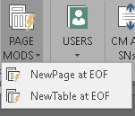
Pansophy Ribbon – Page Mods
2. Page Mods
Ribbon Code | Definition
NewPage at EOF | Inserts a page break at the end of the traveler.
NewTable at EOF | Inserts a page break and a table for steps, instructions and data input at the end of the traveler.

Slide 12
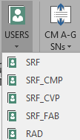
Pansophy Ribbon - User Sets
3. User Sets
Ribbon Code | Traveler Code | Definition
SRF | [[SRF_FIELDNAME]] <<SRF>> | SRF User Set
SRF_CMP | [[SRFCMP_FIELDNAME]] <<SRFCMP>> | SRF Cryomodule User Set
SRF_CVP | [[SRFCVP_FIELDNAME]] <<SRFCVP>> | SRF Cavity User Set
SRF_FAB | [[SRFFAB_FIELDNAME]] <<SRFFAB>> | SRF Fabrication User Set
RAD | [[RAD_FIELDNAME]] <<RAD>> | Radcon User Set

Slide 13
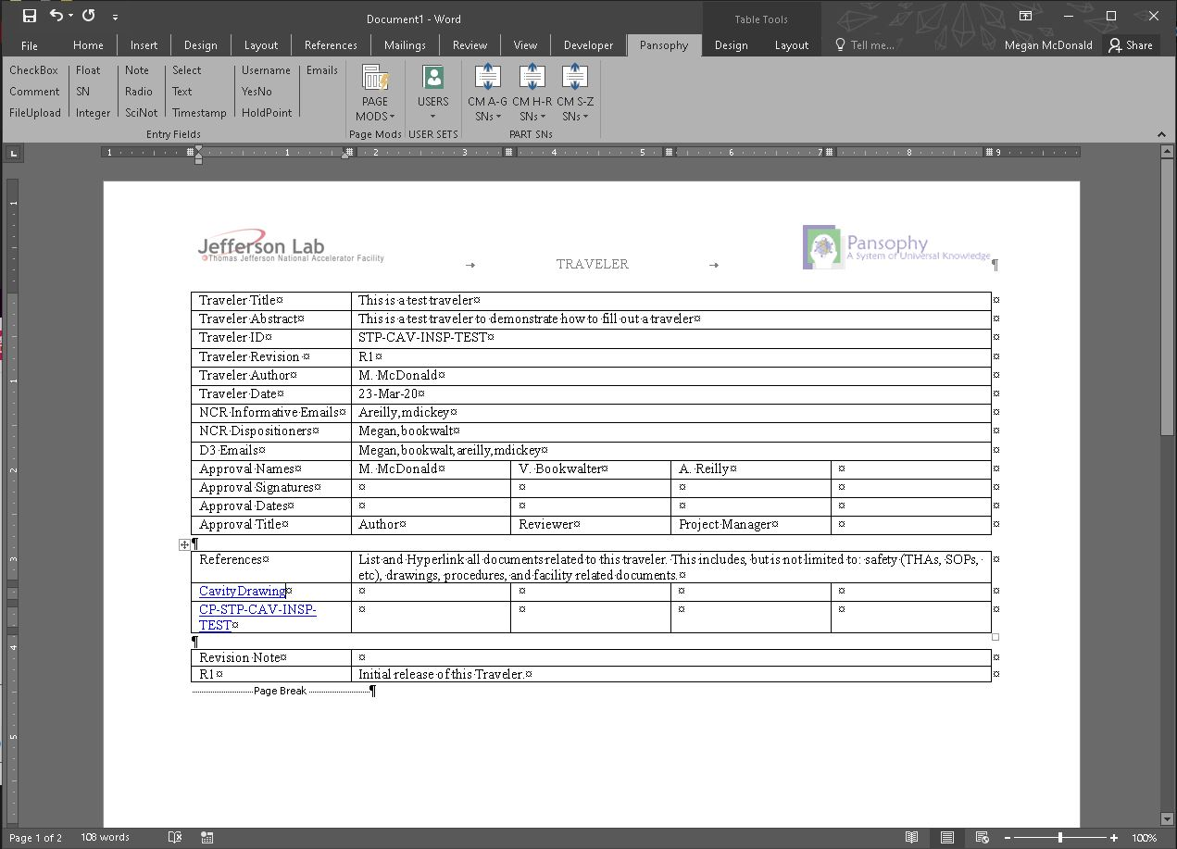
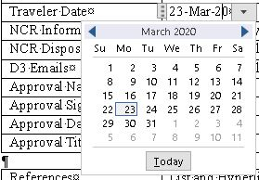
Filling Out a Traveler – Header Page
Author and Reviewer name format:
First Initial & Last Name
F. Lastname
Traveler ID format:
Up to 5 levels
PRJ-SYS-WCA-COMP[-COMP]
Level 1: Project Acronym (STP)
Level 2: System Acronym (CAV)
Level 3: Work Center/Activity (INSP)
Level 4 & 5: Component (TEST)
Date Selection
Hyperlinks to any reference files the author deems necessary for the traveler
NCR & D3 Names format:
username1,username2,etc…
NO SPACES
Revision Notes:
Add lines after R1 when a new revision is created to detail what changes were made

Slide 14
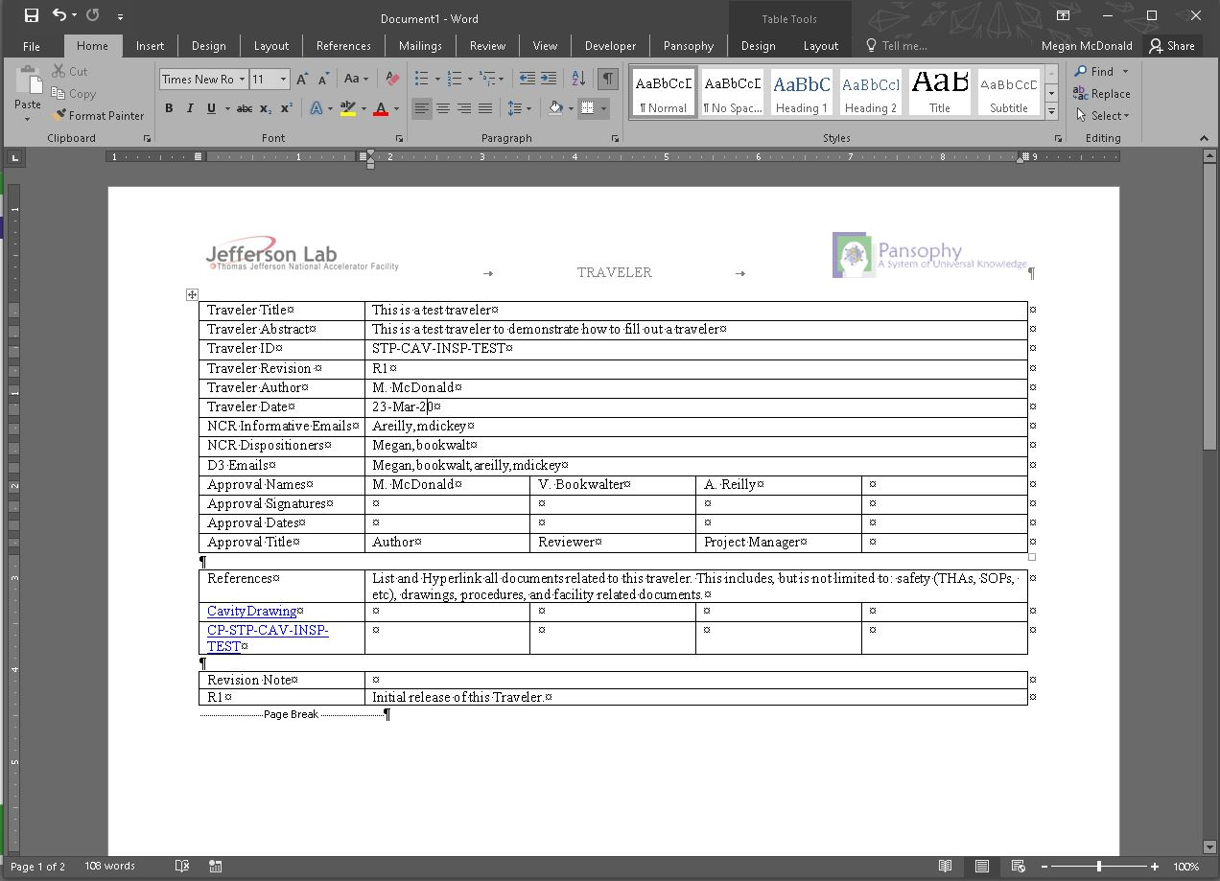
Filling Out a Traveler – Useful Tips
Ensure that there is a page break at the end of each page. The page mods drop down on the Pansophy tab adds page breaks
Turn on the Show Paragraph feature on the home tab to show any spaces and all page breaks

Slide 15
Filling Out a Traveler – Field Names
FieldNames (or VarNames)
[[FieldNames]] found in entry codes will become the “display” name and the “database” name for the variable
Must be unique within the traveler
  Ex: If you need to record more than 1 cavity serial number, add numbers to the end. CAVSN1, CAVSN2, …
Letters, numbers and underscores ONLY.
  Camel Case is preferred [[ThisIsACamelCase]]
Be specific
Be descriptive! [[Technician1]] does not explain what step is being completed. [[VacuumTech]] is more descriptive

