Slide 1
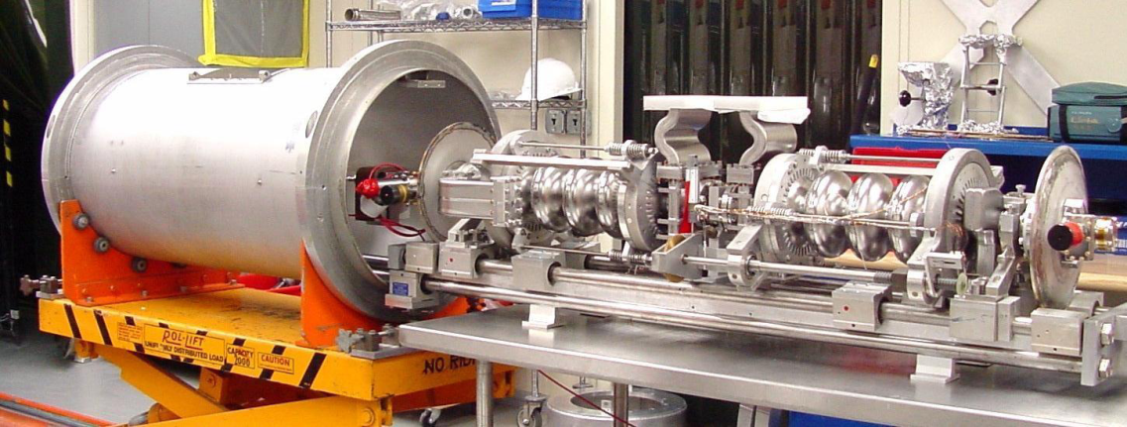
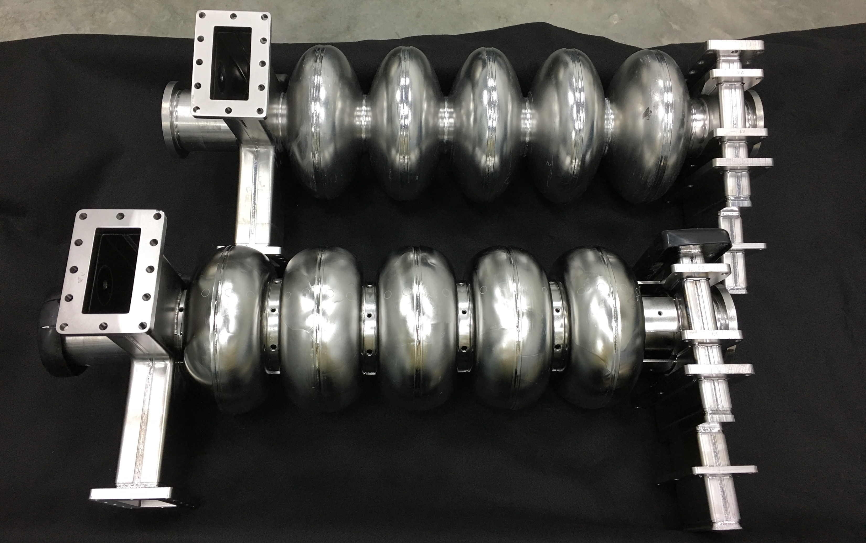
CEBAF Gradient Improvement Program
Supports CEBAF
Original CEBAF (OC)
CEBAF Cryo-unit
C20 Refurbishment Program
C50-13 (7b) delivered Aug. 2017
C75-01 planned for FY20/21
C75 Cavity (HC- High Current )
made from Ingot Niobium
Courtesy Gigi Ciovati & Bob Rimmer Jun2017

