Slide 1
Pansophy Tuesday Tidbits
Traveler Cover Page – Commonly Found Errors
Notes:
The following traveler was borrowed and heavily modified to provide error examples. It does not in any way reflect the version given to us by the Author.

Slide 2
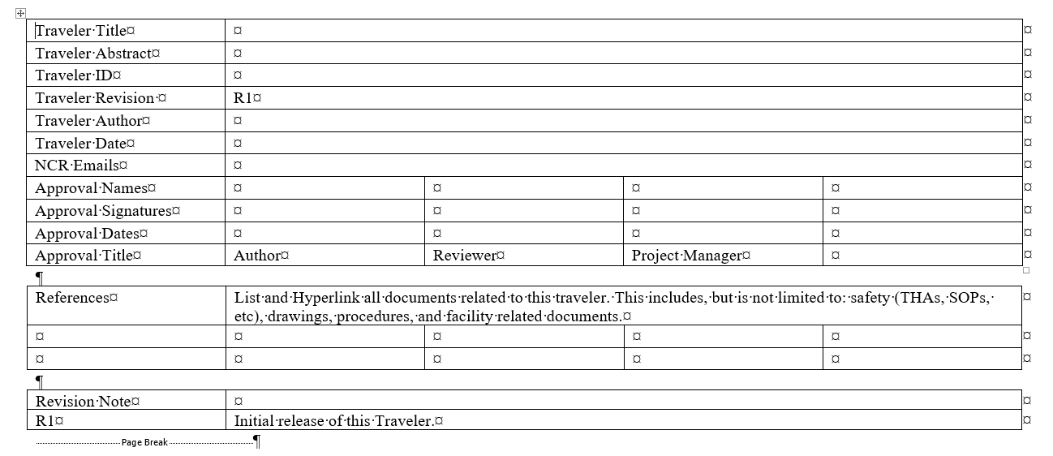
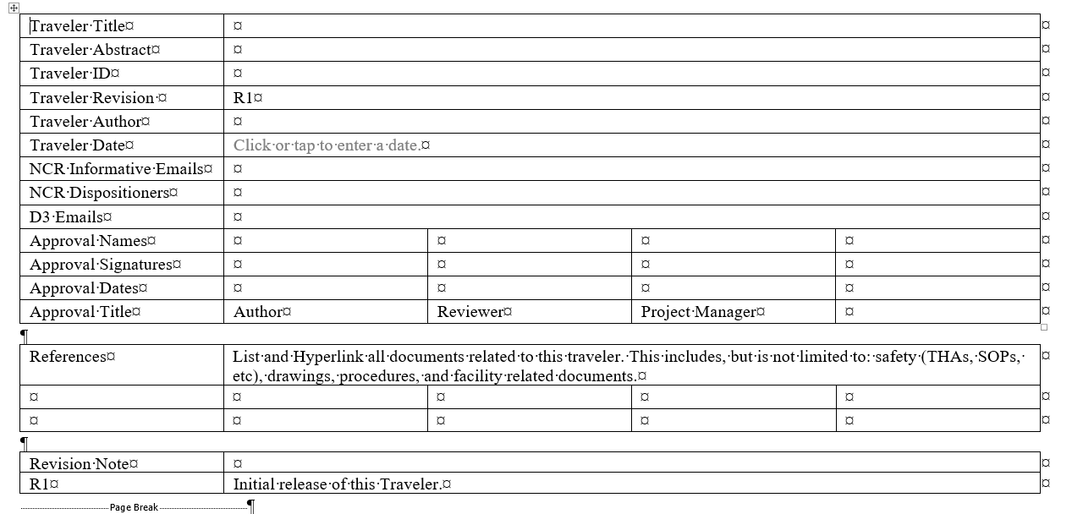
Old Traveler Template
Old
New
If Traveler Cover Page has only NCR Emails, Traveler must be remade in new template

Slide 3

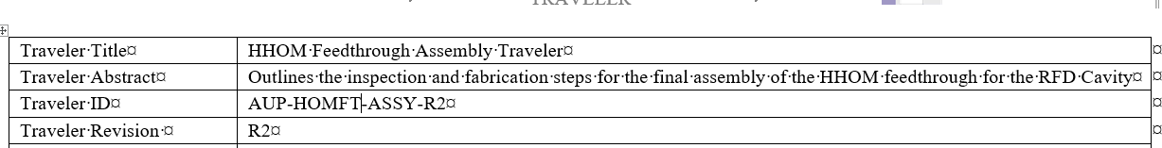
Traveler IDs
Traveler ID and Document Title MUST match
  The only difference is the inclusion of the Traveler Revision Number
NO Revision number in Traveler ID
HOMFT isn’t a real acronym.
  A list of valid acronyms can be found on the pansophy menu ribbon TRAVELERS -> USER TOOLS -> TRAVELER TOOLS
ID is out of order. PROJ-WCA-COMP-ACTION

Slide 4
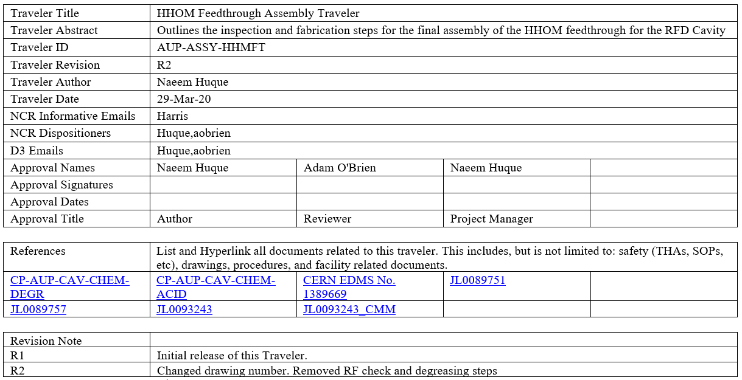
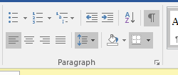
Special Characters
NO Special Characters (apostrophes and quotation marks are NOT allowed)
  Letters, numbers, punctuation, dashes, and underscores only.
NO formatting (ex: bold, font color, highlighting)
  Exception is with radcon notifications
Turn on the show/hide button to help find space, paragraphs, and formatting marks

Slide 5
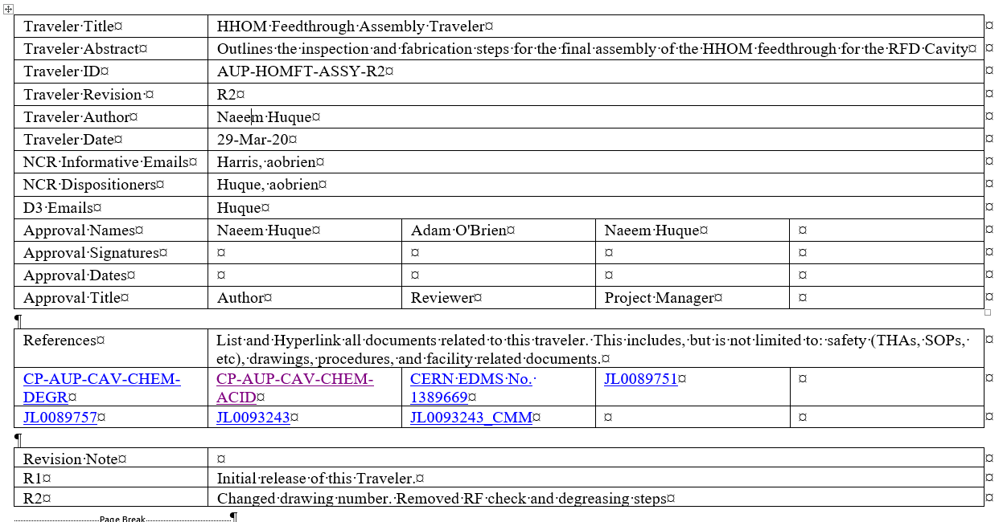
NCRs and D3s
NCR and D3 Emails must be properly formatted:​
  NO spaces between email names​
  Everything before the @ sign​
  Valid JLab usernames (harris is not valid, should be jharris)​
NO duplicate emails between NCR Informative and Dispositioners​
Turn on the show/hide button to help find space, paragraphs, and formatting marks

Slide 6
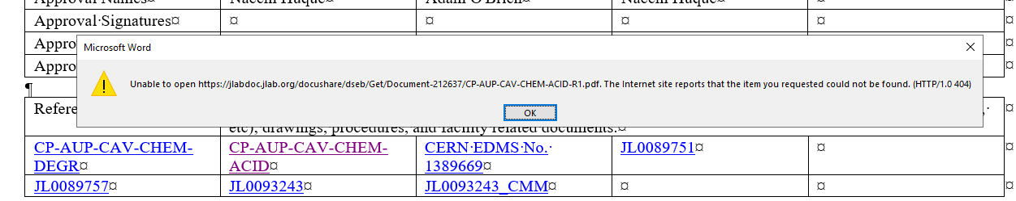
References
Reference links MUST go to a document in Docushare
Link preferably opens the document itself

Slide 7
Revision Notes
Each revision MUST have a revision note

Slide 8
Questions?

