Slide 1
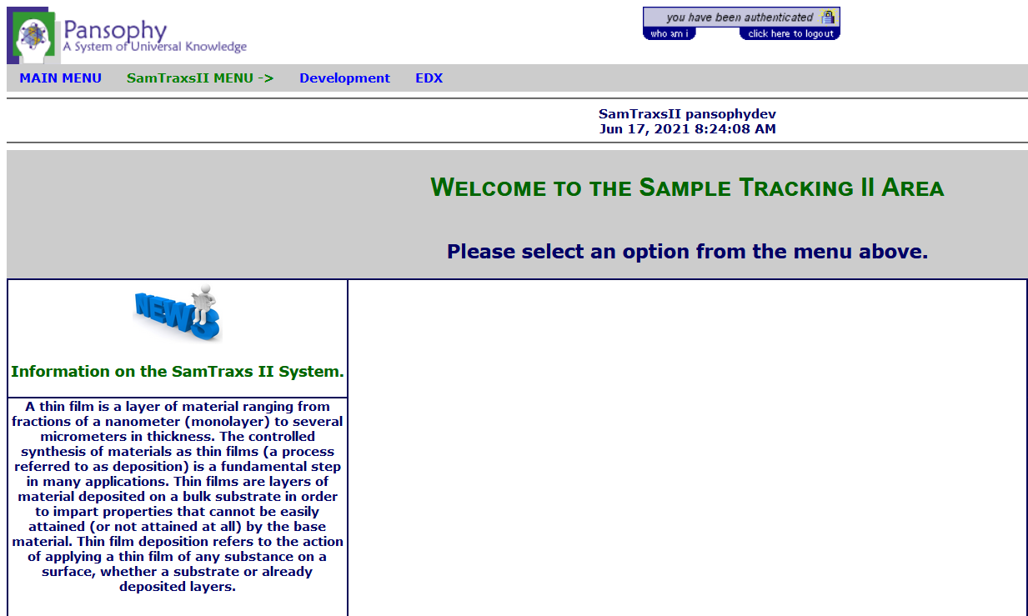
SamTraxs II Part of the SRF Pansophy Software System
Mentor: Valerie Bookwalter
Mentee: An Nguyen
Summer 2021

Slide 2
PMA sample tracking system – research workflow demo
Timeline
PMA Sample Tracking Interface 1: History of Sample(s)
Pristine material (info: from Jlab, Cu, size..)
Sample X
Sample Cu
Event 1 (electropolish, or EP)
EP
EP
MM-DD-YY
EP will modify surface (info: time, who, EP chemical, process parameters, locations…)
Hyber-link Navigation bar which redirect to data report window
XPS
EBSD
SEM/EDX
ECR Thin-Film deposition
Event 2 (EBSD)
EBSD
Each tab is an event located on timeline
MM-DD-YY
EBSD will inspect sample surface and generate experimental data (info: time, who, lab location, jpg, report …)
SIMS
Event 3 (ECR thin film deposition)
EBSD
TEM
MM-DD-YY
ECR TH deposition will grow a layer of thin film on pristine material (info: time, who, lab loc., thickness, jpg, deposition report …)
RRR
RRR
Tc
Event 4 (EBSD)
FEViewer
SIC
MM-DD-YY
EBSD will inspect sample surface and generate experimental data (info: time, who, lab location, jpg, report …)
SFEM
……….
……….
……….
……….
Processing XXX
Event N (XXX)
Action in Event N will … (info: time, lab, jpg, movie report …)
FEViewer

Slide 3
SamTraxs Event Process List
Order | ShortName | Name | Category | User Contact
1 | PSD | Power Spectral Density (AFM/PROF) | Analysis (Matlab) | HT
2 | DCMS | DC Magnetron Sputtering | Coating | AMVF
3 | ECRCavity | Electron Cyclotron Resonance | Coating | AMVF
4 | ECRSample | Electron Cyclotron Resonance | Coating | AMVF
5 | ReacMS | Reactive Magnetron Sputtering | Coating | AMVF
6 | RFID | RF Ion Deposition | Coating | AMVF
7 | RFMS | RF Magnetron Sputtering | Coating | AMVF
8 | AFM | Atomic Force Microscope | MaterialAnalysis | HT
9 | EBSD | Electron Backscatter Diffraction (SEM) | MaterialAnalysis | XZ
10 | EDX | Energy Dispersive X-Ray Spectroscopy | MaterialAnalysis | AW
11 | FEV | Field Emission Viewer | MaterialAnalysis | AMVF
12 | FIB | Focused Ion Beam | MaterialAnalysis | AMVF
13 | HDOM | Hyrox Digital Optical Microscope | MaterialAnalysis | WS
14 | HRTEM | High Resolution TEM | MaterialAnalysis | AW
15 | MOM | Metallographic Optical Microscope | MaterialAnalysis | AW
16 | Prof | Surface Profilometry System | MaterialAnalysis | AW
17 | SAM | Scanning Auger Microscope | MaterialAnalysis | AW
18 | SCPROP | Superconducting Properties Measurement | MaterialAnalysis | JM
19 | SEM | Scanning Electron Microscopy | MaterialAnalysis | AW
20 | SFEM | Scanning Field Emission Microscopy | MaterialAnalysis | AW
21 | SIMS | Secondary Ion Mass Spectrometry | MaterialAnalysis | AW
22 | TEO11 | TEO11 Measurement | MaterialAnalysis | GC/JM
23 | XPS | X-ray Photoelectron Spectroscopy | MaterialAnalysis | HT
24 | XRD | X-ray Diffraction | MaterialAnalysis | XZ
25 | RRRMeas | Residual Resistivity Ratio | RF/SC Measurement | XZ
26 | SIC | SIC Cavity TEO11 Surface Impedence | RF/SC Measurement | BX
27 | TcMeas | Transition Temperature Measurement | RF/SC Measurement | XZ
28 | ANN | Annealing | Surface Preparations | AMVF
29 | BCP | Buffered Chemical Polish | Surface Preparations | AMVF
30 | CP | Copper Chemical Polish | Surface Preparations | AMVF
31 | CuEP | Copper ElectroPolish | Surface Preparations | AMVF
32 | EIS | ElectroChemical Impedance Spectroscopy | Surface Preparations | HT
33 | EP | ElectroPolish | Surface Preparations | HT
34 | MP | Buehler Minimet 1000 Polisher/Grinder | Surface Preparations | AW
35 | PLETCH | Plasma Etching | Surface Preparations | MR

