Slide 1
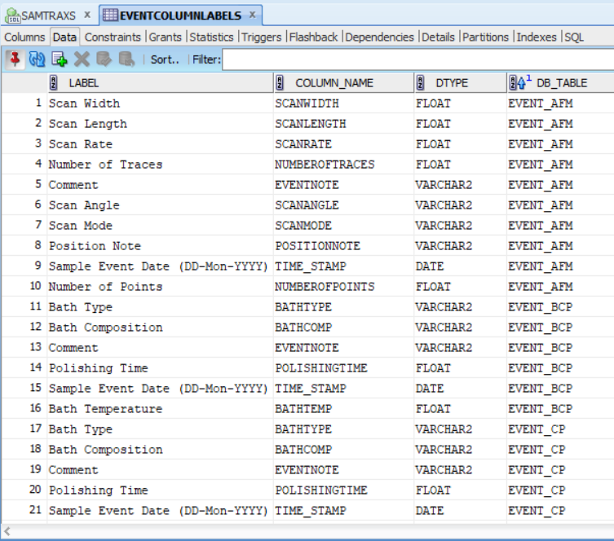
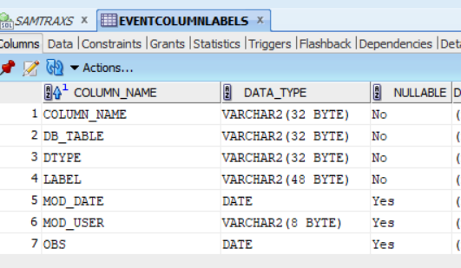
EVENTCOLUMNLABELS

Slide 2
PMA sample tracking system – research workflow demo
Timeline
PMA Sample Tracking Interface 1: History of Sample(s)
Pristine material (info: from Jlab, Cu, size..)
Sample X
Sample Cu
Event 1 (electropolish, or EP)
EP
EP
MM-DD-YY
EP will modify surface (info: time, who, EP chemical, process parameters, locations…)
Hyber-link Navigation bar which redirect to data report window
XPS
EBSD
SEM/EDX
ECR Thin-Film deposition
Event 2 (EBSD)
EBSD
Each tab is an event located on timeline
MM-DD-YY
EBSD will inspect sample surface and generate experimental data (info: time, who, lab location, jpg, report …)
SIMS
Event 3 (ECR thin film deposition)
EBSD
TEM
MM-DD-YY
ECR TH deposition will grow a layer of thin film on pristine material (info: time, who, lab loc., thickness, jpg, deposition report …)
RRR
RRR
Tc
Event 4 (EBSD)
FEViewer
SIC
MM-DD-YY
EBSD will inspect sample surface and generate experimental data (info: time, who, lab location, jpg, report …)
SFEM
……….
……….
……….
……….
Processing XXX
Event N (XXX)
Action in Event N will … (info: time, lab, jpg, movie report …)
FEViewer

Slide 3
SamTraxs Event Process List
Order | ShortName | Name | Category | User Contact
1 | PSD | Power Spectral Density (AFM/PROF) | Analysis (Matlab) | HT
2 | DCMS | DC Magnetron Sputtering | Coating | AMVF
3 | ECRCavity | Electron Cyclotron Resonance | Coating | AMVF
4 | ECRSample | Electron Cyclotron Resonance | Coating | AMVF
5 | ReacMS | Reactive Magnetron Sputtering | Coating | AMVF
6 | RFID | RF Ion Deposition | Coating | AMVF
7 | RFMS | RF Magnetron Sputtering | Coating | AMVF
8 | AFM | Atomic Force Microscope | MaterialAnalysis | HT
9 | EBSD | Electron Backscatter Diffraction (SEM) | MaterialAnalysis | XZ
10 | EDX | Energy Dispersive X-Ray Spectroscopy | MaterialAnalysis | AW
11 | FEV | Field Emission Viewer | MaterialAnalysis | AMVF
12 | FIB | Focused Ion Beam | MaterialAnalysis | AMVF
13 | HDOM | Hyrox Digital Optical Microscope | MaterialAnalysis | WS
14 | HRTEM | High Resolution TEM | MaterialAnalysis | AW
15 | MOM | Metallographic Optical Microscope | MaterialAnalysis | AW
16 | Prof | Surface Profilometry System | MaterialAnalysis | AW
17 | SAM | Scanning Auger Microscope | MaterialAnalysis | AW
18 | SCPROP | Superconducting Properties Measurement | MaterialAnalysis | JM
19 | SEM | Scanning Electron Microscopy | MaterialAnalysis | AW
20 | SFEM | Scanning Field Emission Microscopy | MaterialAnalysis | AW
21 | SIMS | Secondary Ion Mass Spectrometry | MaterialAnalysis | AW
22 | TEO11 | TEO11 Measurement | MaterialAnalysis | GC/JM
23 | XPS | X-ray Photoelectron Spectroscopy | MaterialAnalysis | HT
24 | XRD | X-ray Diffraction | MaterialAnalysis | XZ
25 | RRRMeas | Residual Resistivity Ratio | RF/SC Measurement | XZ
26 | SIC | SIC Cavity TEO11 Surface Impedence | RF/SC Measurement | BX
27 | TcMeas | Transition Temperature Measurement | RF/SC Measurement | XZ
28 | ANN | Annealing | Surface Preparations | AMVF
29 | BCP | Buffered Chemical Polish | Surface Preparations | AMVF
30 | CP | Copper Chemical Polish | Surface Preparations | AMVF
31 | CuEP | Copper ElectroPolish | Surface Preparations | AMVF
32 | EIS | ElectroChemical Impedance Spectroscopy | Surface Preparations | HT
33 | EP | ElectroPolish | Surface Preparations | HT
34 | MP | Buehler Minimet 1000 Polisher/Grinder | Surface Preparations | AW
35 | PLETCH | Plasma Etching | Surface Preparations | MR

Slide 4
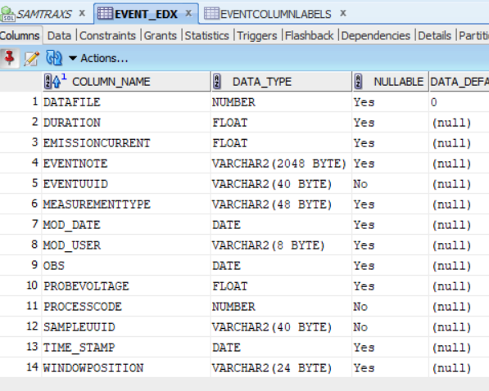
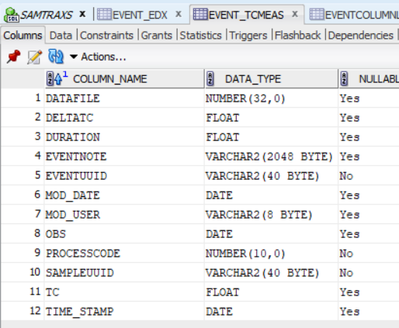

Slide 5
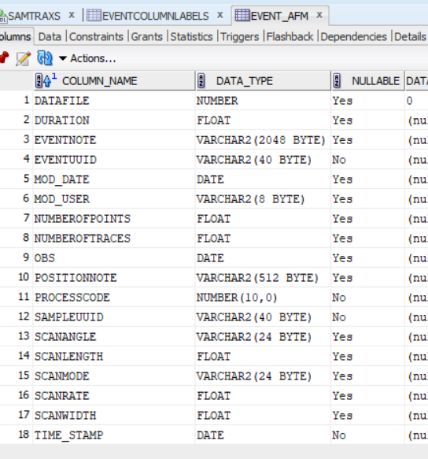
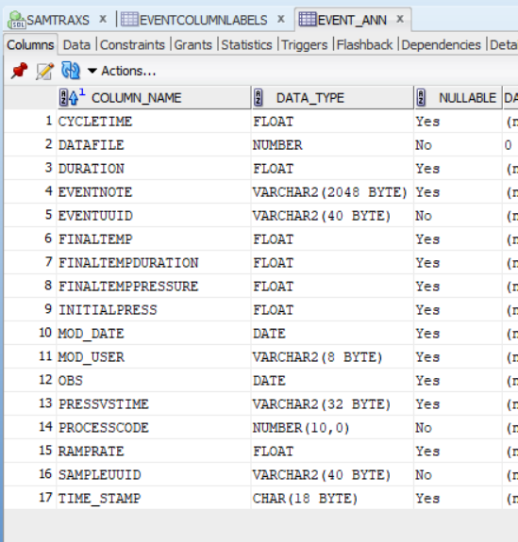

Slide 6
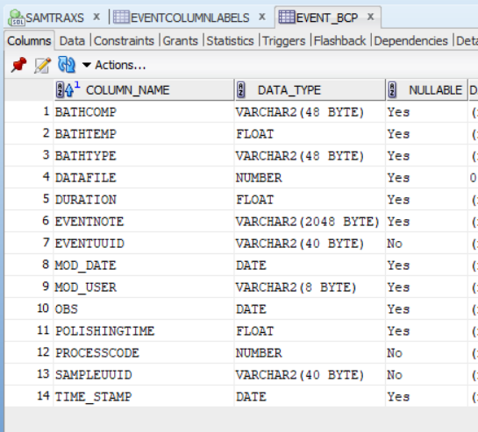
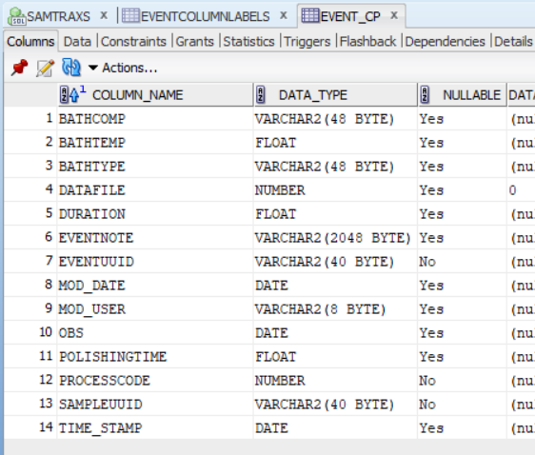

Slide 7
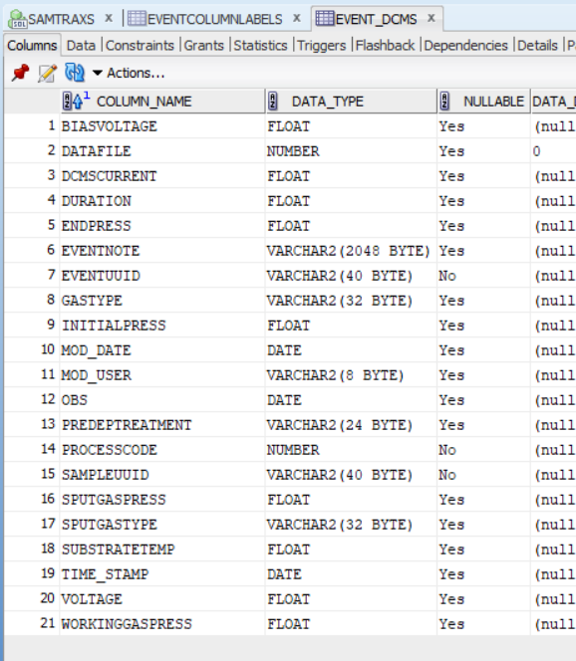
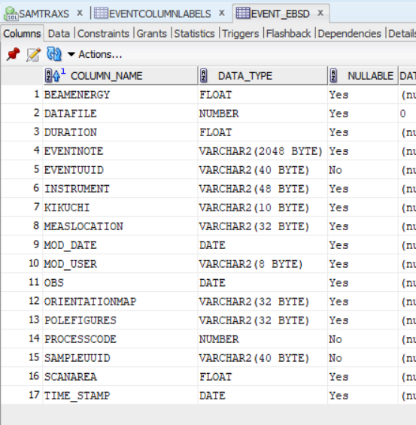

Slide 8
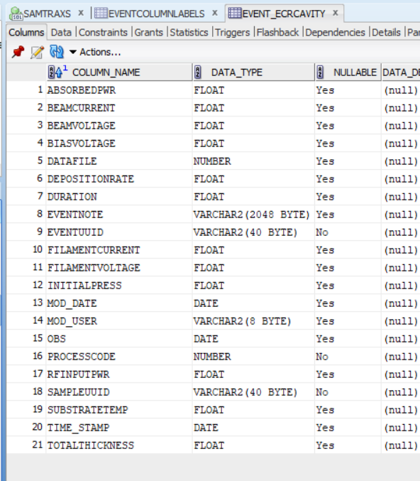
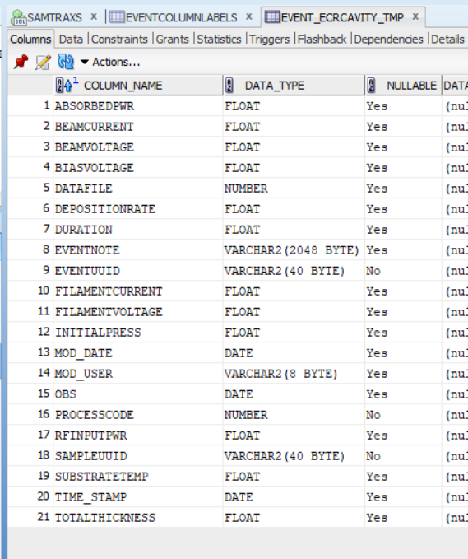

Slide 9
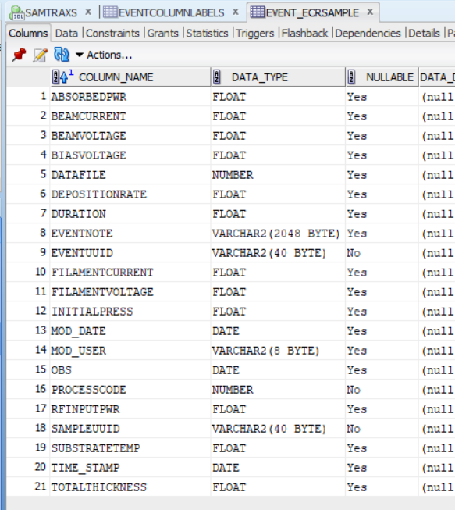
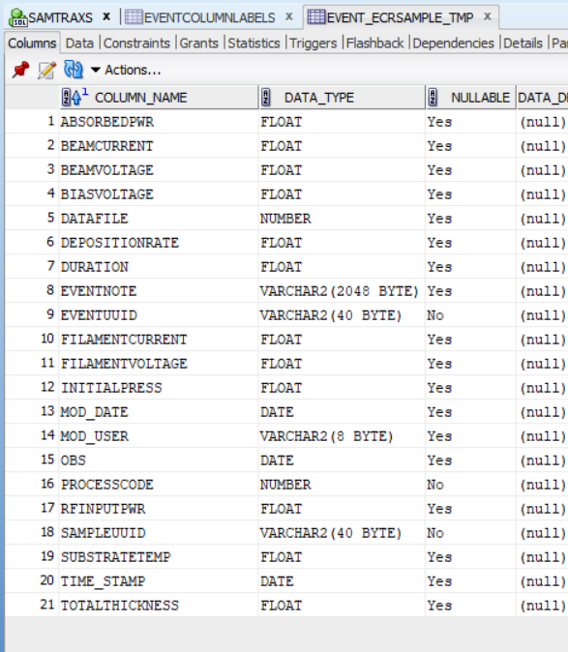

Slide 10
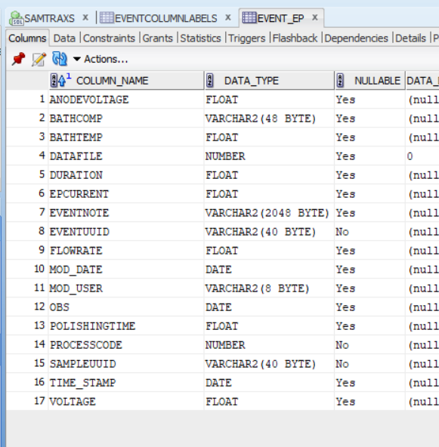
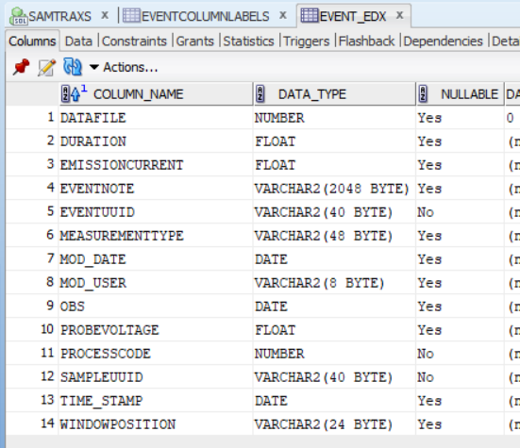

Slide 11
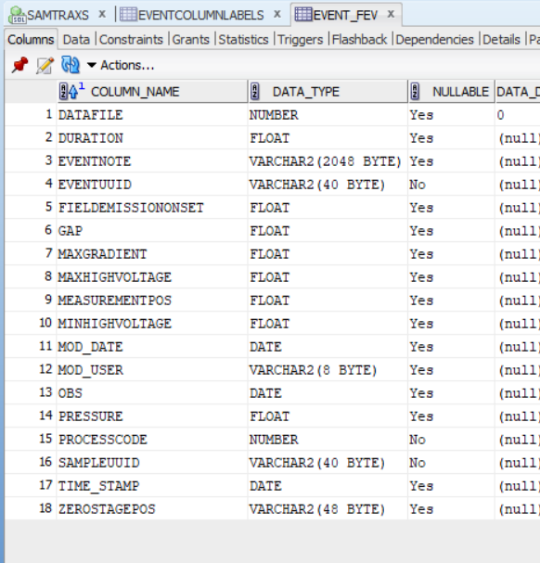
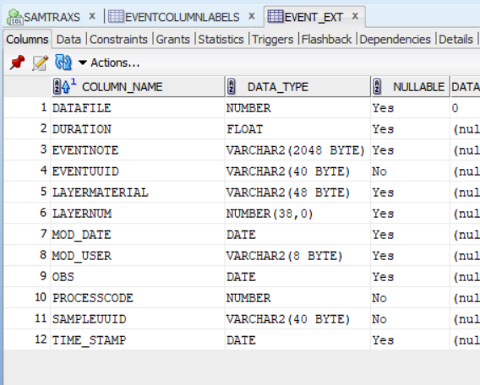

Slide 12
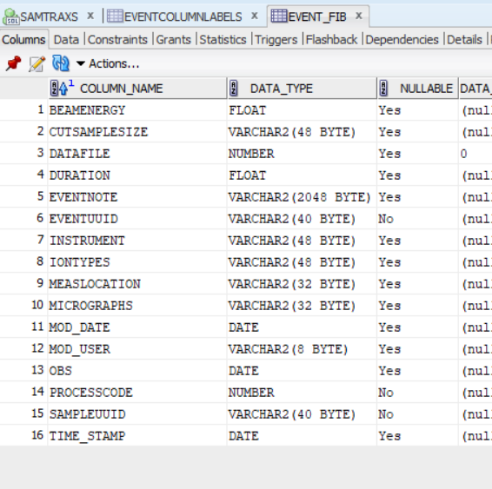
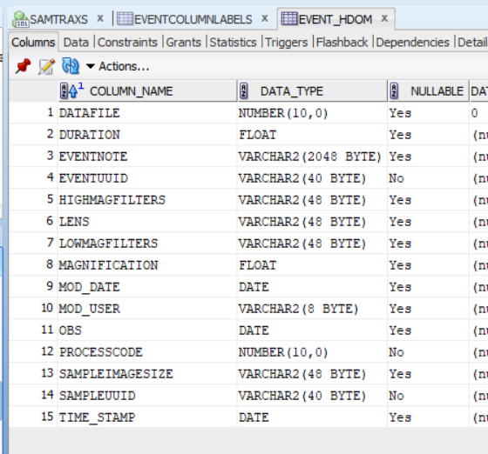

Slide 13
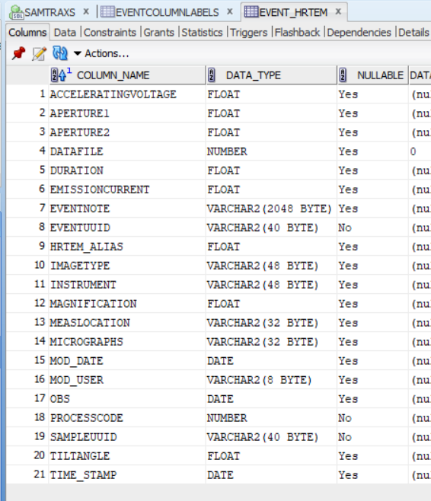
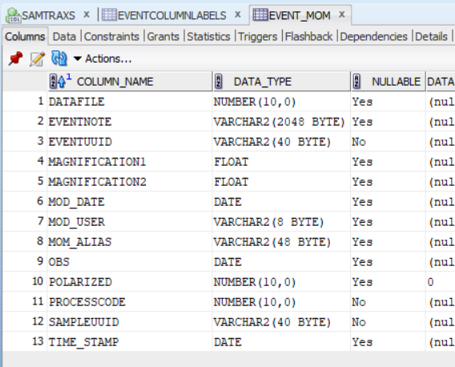

Slide 14
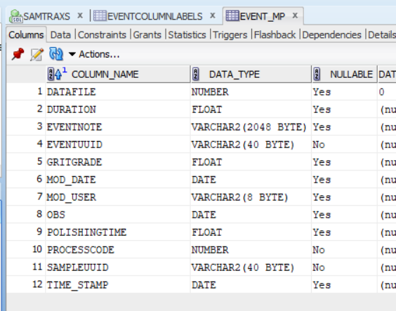
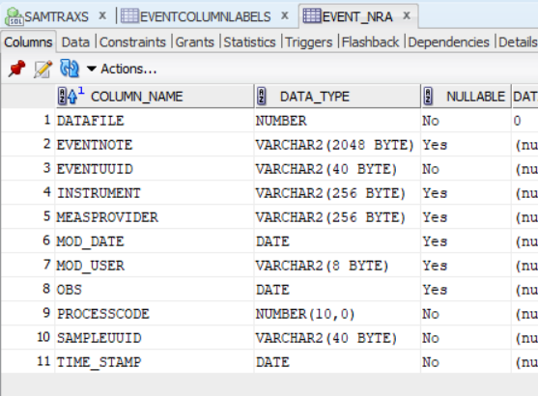

Slide 15
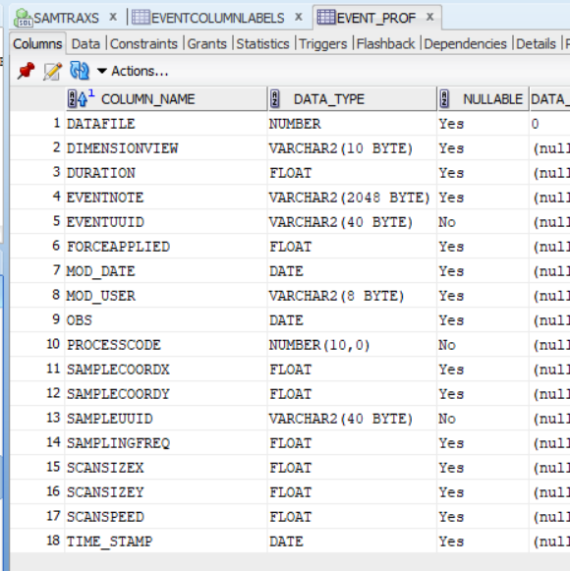
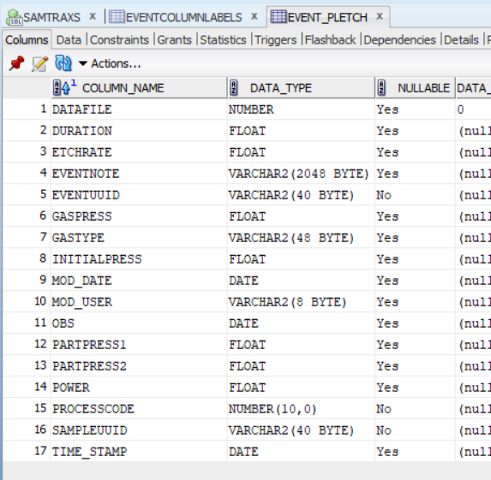

Slide 16
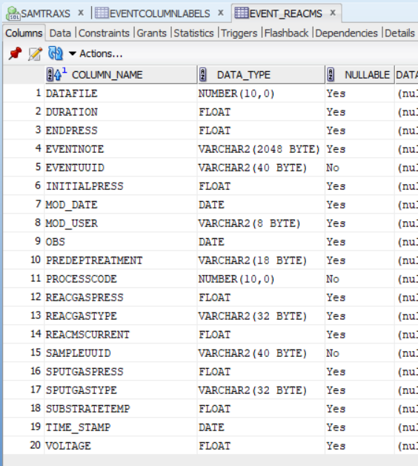
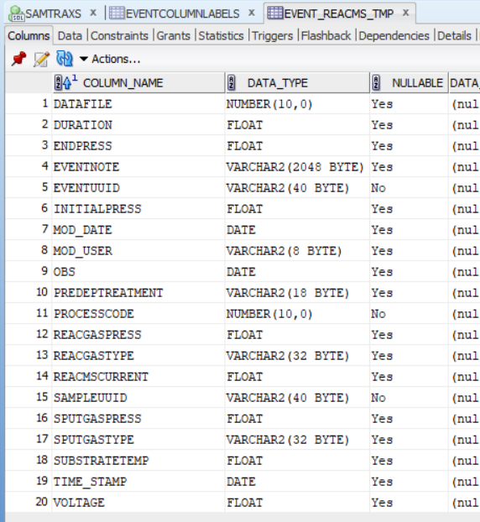

Slide 17
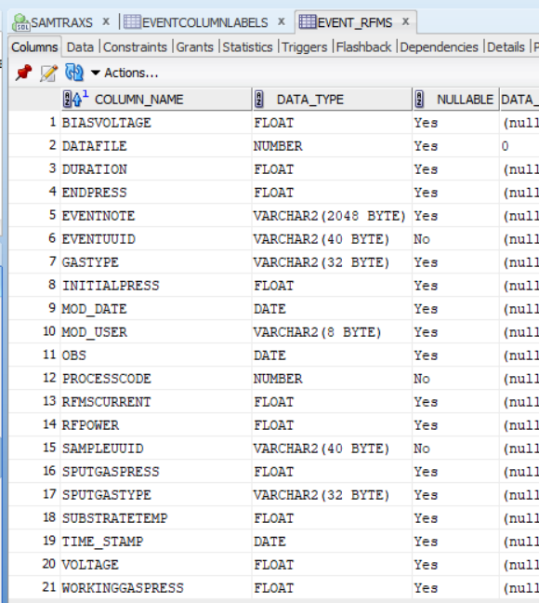
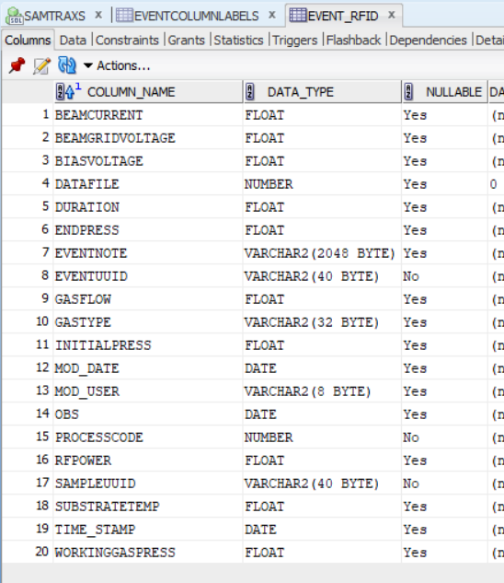

Slide 18
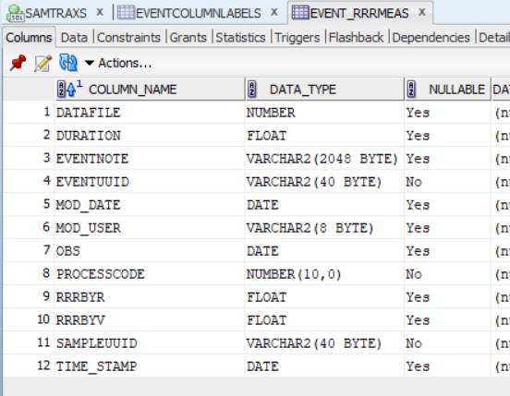
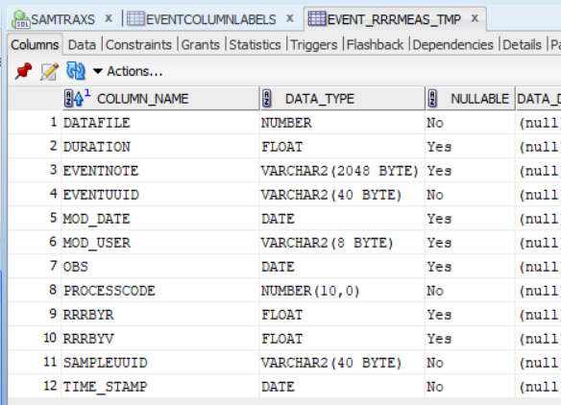

Slide 19
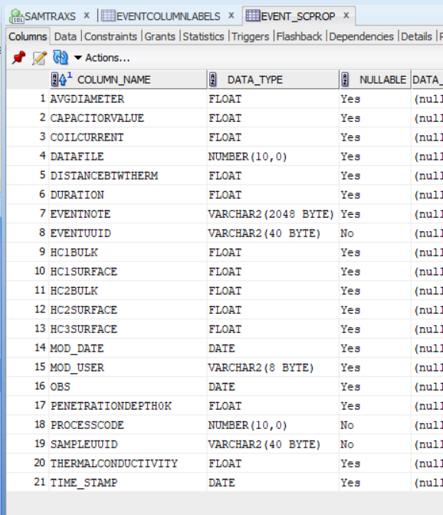
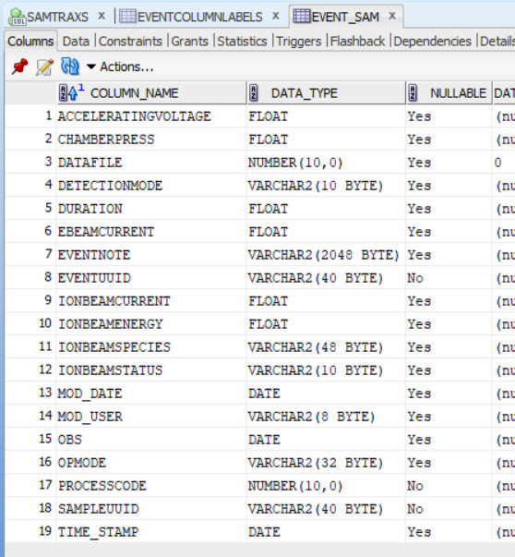

Slide 20
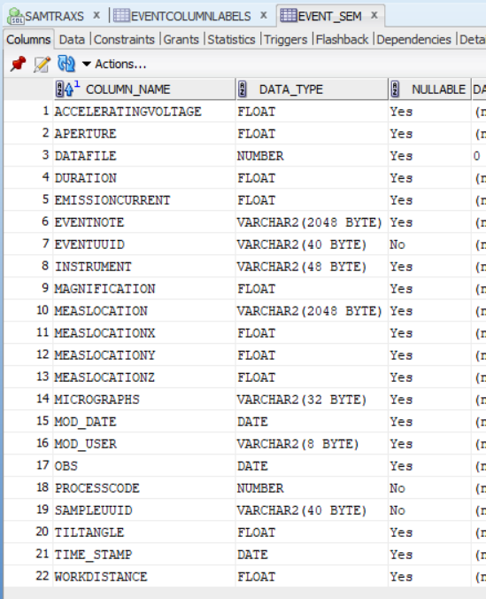
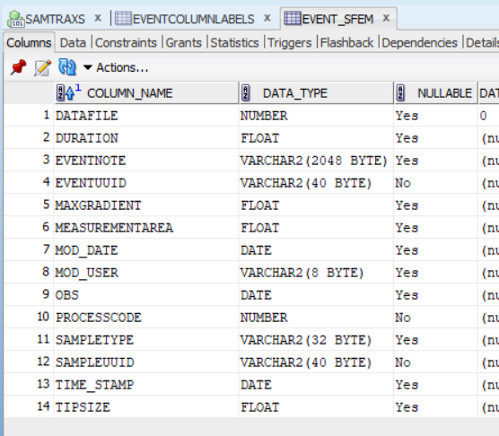

Slide 21
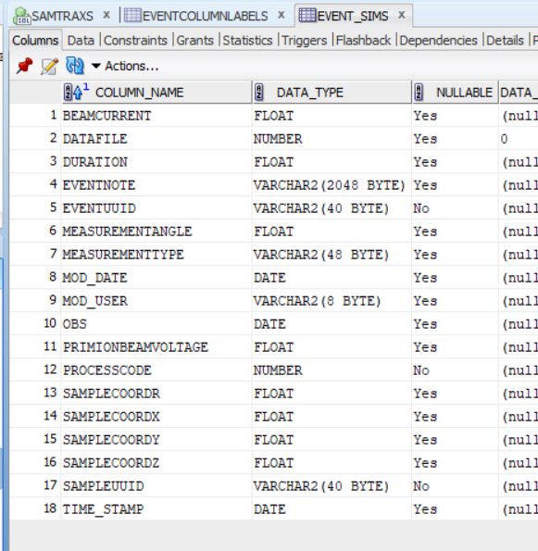
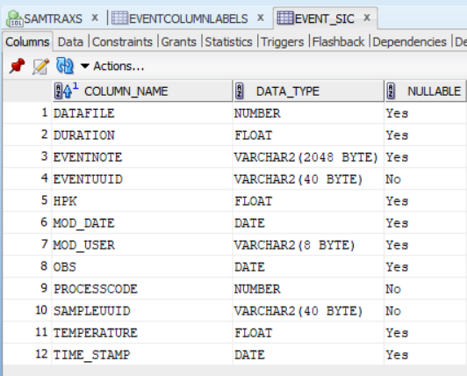

Slide 22
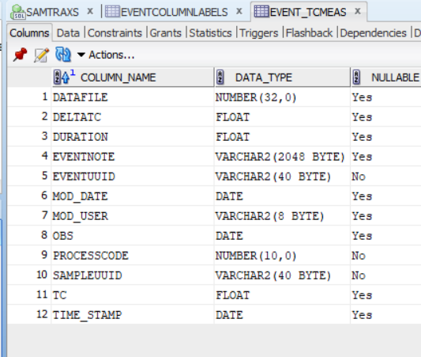
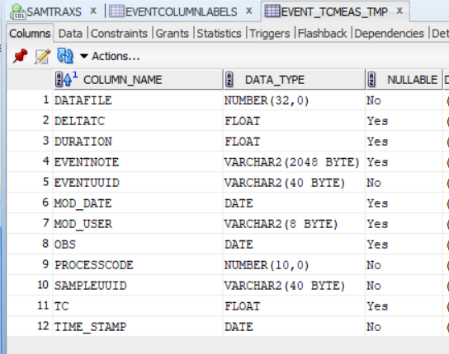

Slide 23
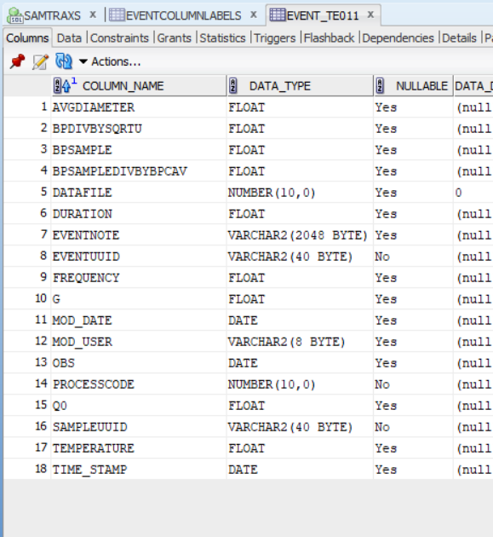
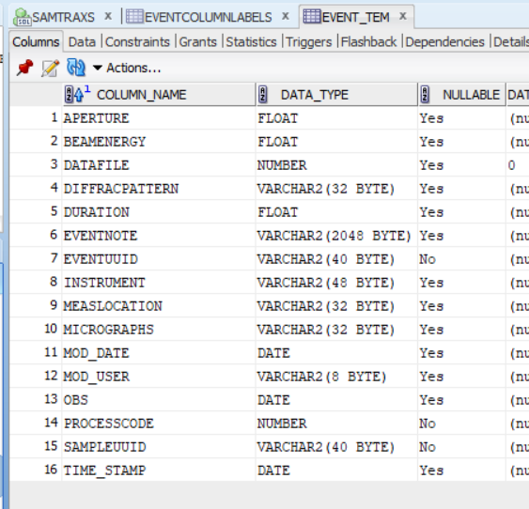

Slide 24
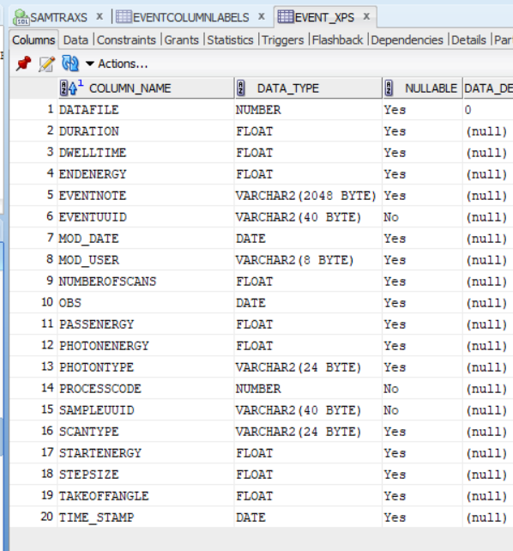
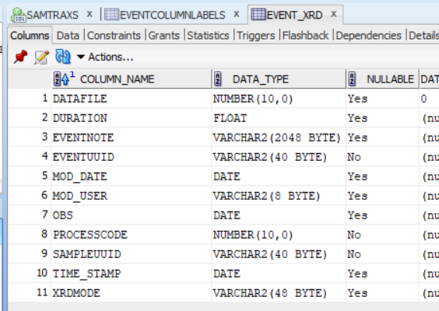

Slide 25
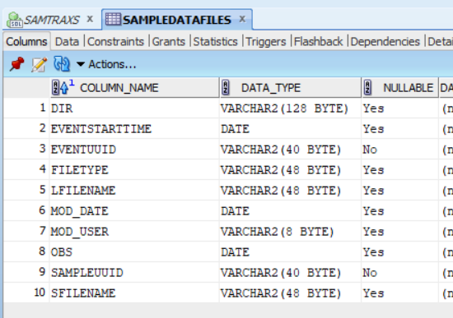
SAMPLEDATAFILES

Slide 26
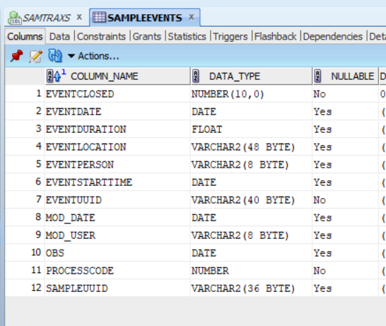
SAMPLEEVENTS

Slide 27
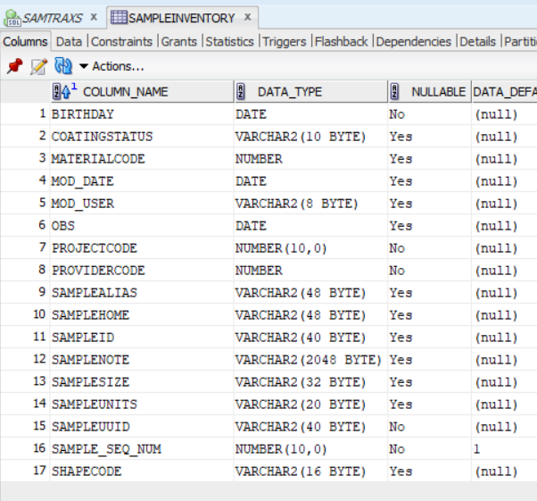
SAMPLEINVENTORY

Slide 28
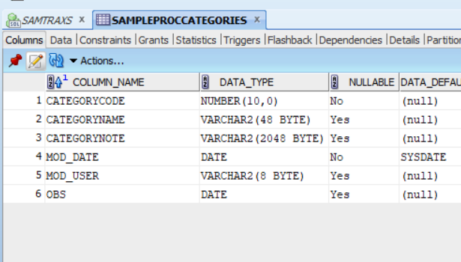
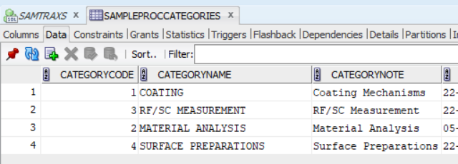
SAMPLEPROCCATEGORIES

Slide 29
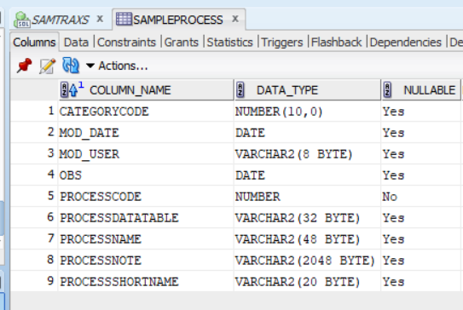
SAMPLEPROCESS

Slide 30
SAMPLEPROJECTS

Slide 31
SAMPLEPROVIDERS

Slide 32
SAMPLESHAPES

Slide 33
SUBSTRATEMATERIALS

