Slide 1
Pansophy Tuesday Tidbits
Traveler Data Pages – Fieldnames
Notes:
The following traveler was borrowed and heavily modified to provide error examples. It does not in any way reflect the version given to us by the Author.

Slide 2
No Fields on the First Work Page
First work page (P0) needs at minimum a Part SN and a timestamp

Slide 3
Duplicate Fieldnames
NO duplicate fieldnames
Fieldnames need to be unique and descriptive

Slide 4
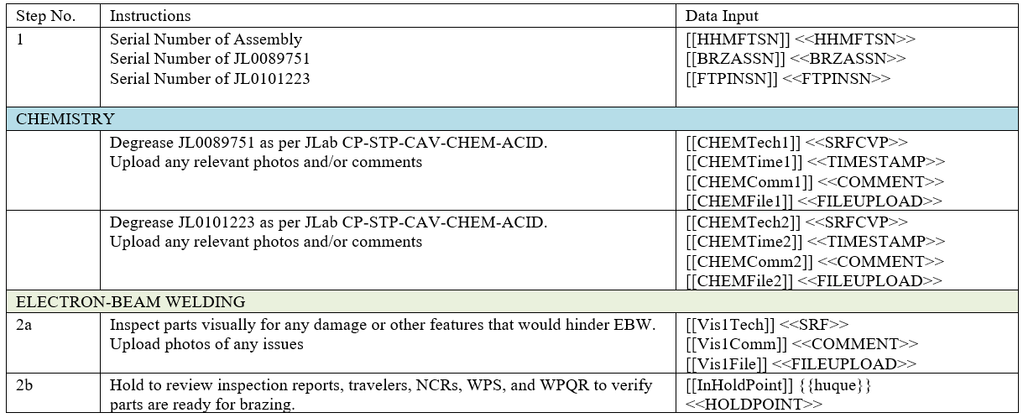
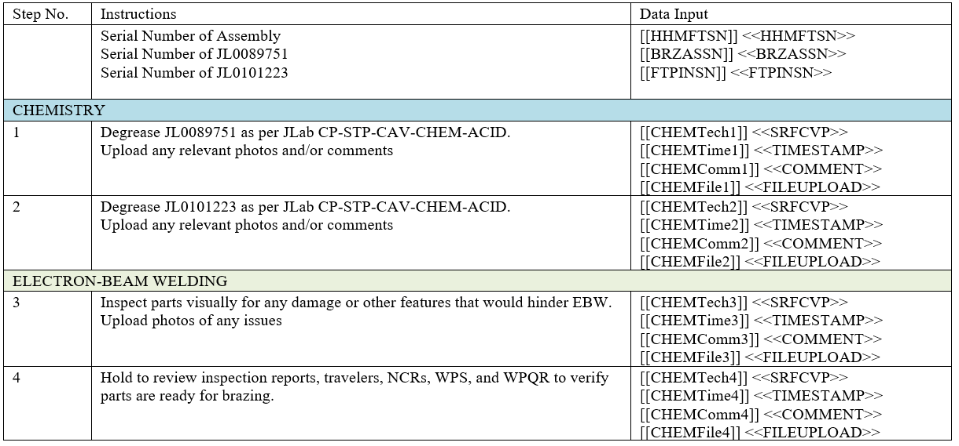
Sequential Fieldname
Okay
Not Okay
Can be used within the same step
Can NOT be used between steps

Slide 5
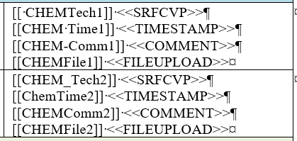
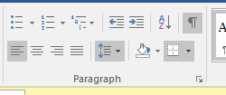
Bad Fields and Fieldnames
Spaces and dashes Can NOT be in the field or fieldname
Use underscores instead of spaces or dashes
CamelCase is also acceptable
Turn on the show/hide button to help find space, paragraphs, and formatting marks

Slide 6
Questions?

