Slide 1
Pansophy Tuesday Tidbits
Traveler Data Pages– Other Errors
Notes:
The following traveler was borrowed and heavily modified to provide error examples. It does not in any way reflect the version given to us by the Author.

Slide 2
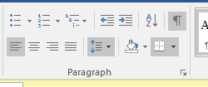
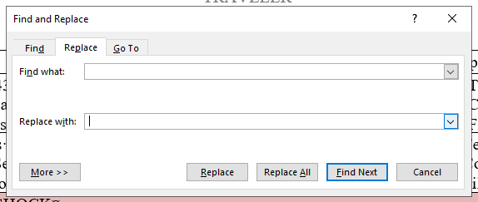
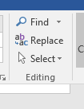
Double Spaces
Double spaces create special characters
Turn on the show/hide button to help find space, paragraphs, and formatting marks
To Remove
Open find and replace
Find double spaces
Replace with a single space

Slide 3
Positive/Negative Symbol
❌
✔

Slide 4
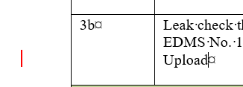
Track Changes Left On
What You See
What the Computer Sees
The upload program will still see the changes and try to put them into the traveler
Turn off Track changes AND accept all changes

Slide 5
Comments
If the comment box is closed, comments can be difficult to notice.
Delete your comments

Slide 6
Questions?

