Slide 1
Safety Minute Courtesy NSC Driving at Night - National Safety Council (nsc.org)
04-Nov-2021 – R1

Slide 2
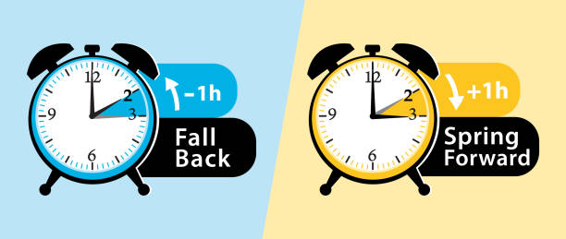
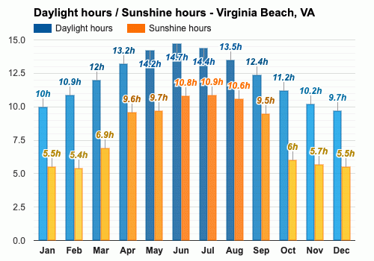
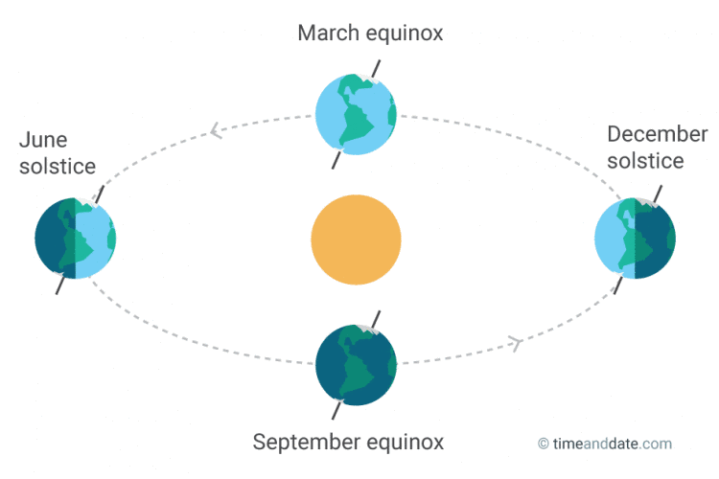
As the daylight hours get shorter ………..
Daylight Savings time ends Sunday Nov 7th 2021
Shortest day of the year – Tuesday December 21, 2021

Slide 3

As we 'Fall Back' and the days get shorter ………Take Extra Care on the Road
Shorter days, fatigue, compromised night vision, rush hour and impaired drivers are some of the risks we face when driving at night.
These risks become especially pronounced moving into the weekend
Daylight Saving Time ends 2AM Sun. November 7th
many people will find themselves spending more time driving in the dark.
Depth perception, color recognition and peripheral vision can be compromised in the dark
the glare of headlights from an oncoming vehicle can temporarily blind a driver.

Slide 4
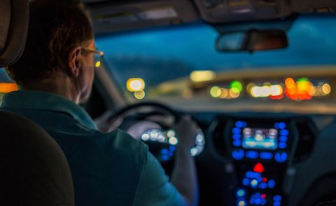
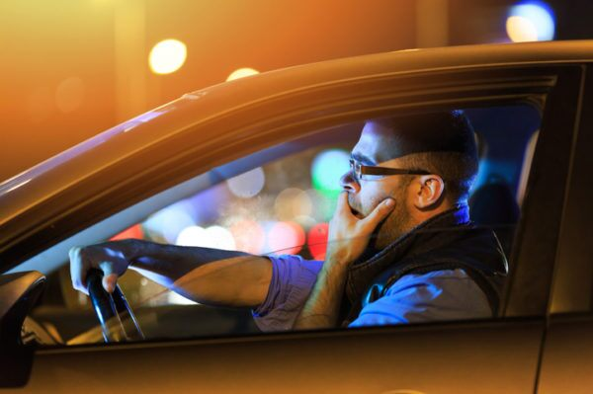
Some considerations
Compromised night vision :
As we age, we have greater difficulty seeing at night.
A 50-year-old driver may need twice as much light to see as well as a 30-year-old
Fatigue & drowsiness
Losing two hours of sleep has the same effect on driving as having three beers, and tired drivers are three times more likely to be in a car crash if they are fatigued.
Rush hour (peaks between 5-7PM)
In winter, it's dark during rush hour, compounding an already dangerous driving situation.
Impaired drivers
Impaired drivers are most frequently on the road after dark – particularly between the hours of midnight and 3 a.m. on weekends.

Slide 5

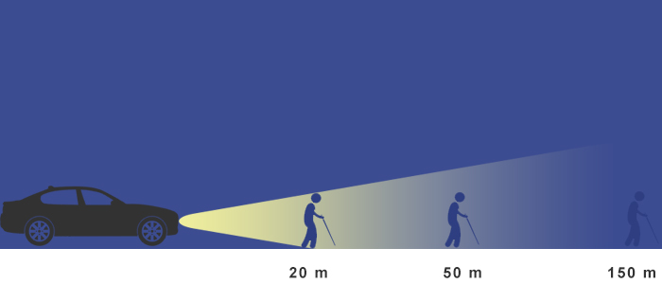
As a Driver : how to combat darkness ?
To help compensate for reduced visibility :
Aim your headlights correctly
Dim your dashboard
Look away from oncoming lights
If you wear glasses, consider anti-reflective
Clean the windshield to eliminate streaks
Slow down to compensate for limited visibility and reduced stopping time
Even with high-beam headlights on, visibility is limited to about 500 feet (250 feet for normal headlights) creating less time to react to something in the road

Slide 6
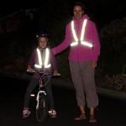
As a Pedestrian : Tips for walking safely at night
Act Defensively : Be proactive and remember that you are an unexpected object for drivers at night.
Make sure drivers are aware of your presence in crosswalks and driveways by making eye contact before crossing in front Use sidewalks or paths separated from roads when possible.
If there is no sidewalk, walk on the side of the road facing traffic so you can see oncoming vehicles. Remain aware and ready to move off the road if needed.
Consider reflective clothing & and carrying a light
More than 5,000 pedestrians are killed by vehicles each year, a large percentage of fatalities occurring on neighborhood streets. Don't become a statistic !

Slide 7
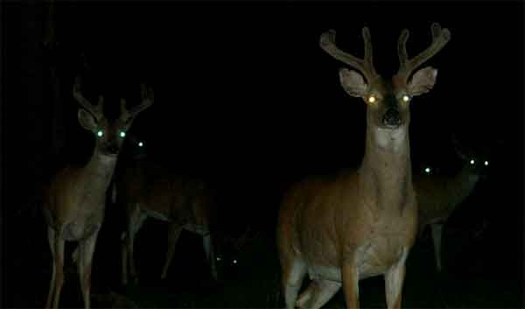
Stay Alert, Stay Alive
While we do only one quarter of our driving at night, 50% of traffic deaths happen at night. It doesn't matter whether the road is familiar or not, driving at night is always more dangerous.
By taking some extra precautions, we can all contribute to reducing Accident Statistics !
Courtesy NSC
Driving at Night - National Safety Council (nsc.org)

Slide 8

Remember to Turn back your clocks on Sunday Nov 7th
Thank you for your attention

