Slide 1
Pansophy Tuesday Tidbits
Smart Characters– Commonly Found Errors
Notes:
The following traveler was borrowed and heavily modified to provide error examples. It does not in any way reflect the version given to us by the Author.

Slide 2
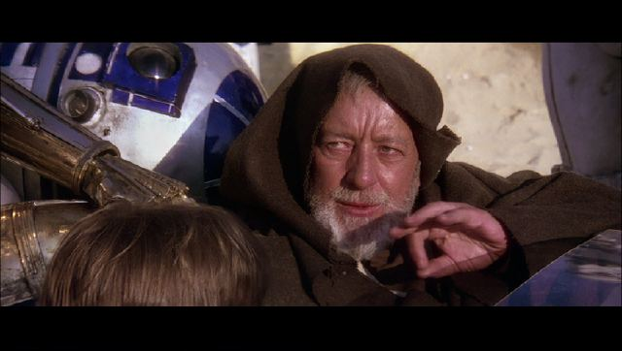

Smart Characters
Smart ❌
Not Smart ✔
“These are the ‘Smart Quotes’ you’re looking for”
The dash – is a hyphen (-) with two spaces in the middle
This is a smart fraction ¼
"These are the 'straight Quotes' you're looking for"
This is a regular fraction 1/4
These and other characters are replaced with an error symbol

Slide 3
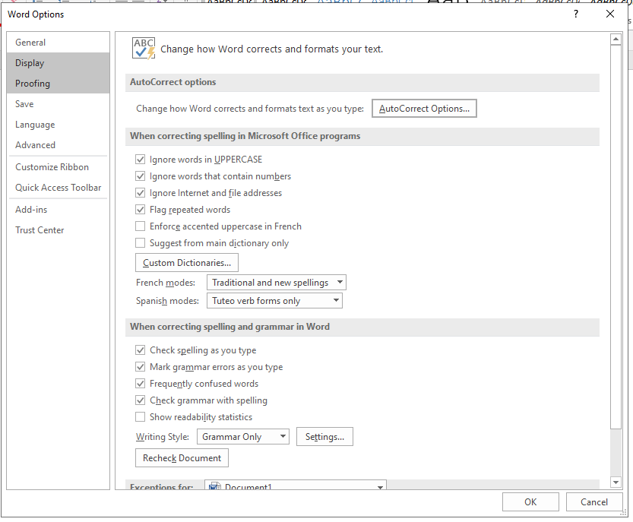
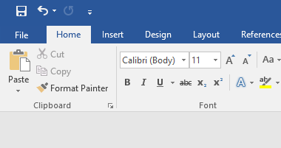
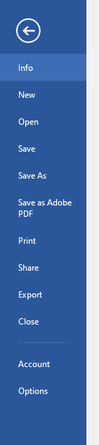
Turning off Smart Characters

Slide 4
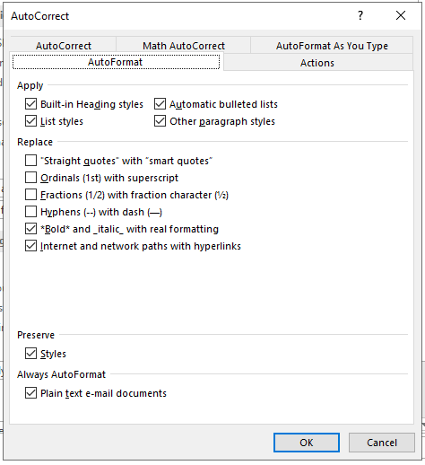
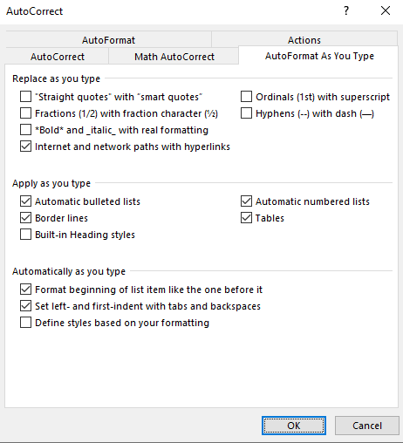
Turning off Smart Characters (cont)

Slide 5
Questions?

