Slide 1
Beginner Traveler Authorship

Slide 2
Reference Material
Sign in to Pansophy and Docushare
Docushare Directory of Training Slides and Referenced Material
SRF Institute > 01 - SRF Projects > 06- For Reference, Additional Template and Processes
Training Slides:
SRF Institute > 01 - SRF Projects > 06- For Reference, Additional Template and Processes > Pansophy Related Training

Slide 3
Pansophy Training

Slide 4
What is a Traveler?
Jefferson Lab Work Control Document (WCD)
Used to document work on parts and assemblies.
Outlines steps and collects data from the users
Allows for later reference and datamine

Slide 5
Homepage Rundown

Slide 6
Homepage Rundown- URL and Login
Users must log in to access Pansophy using their Jlab username and password
Pansophy Homepage URL

Slide 7
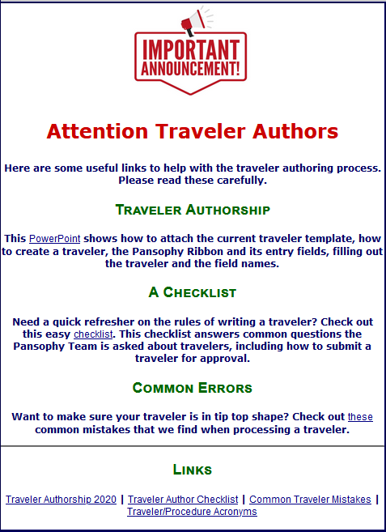
Homepage Rundown- Traveler Guides

Slide 8
Homepage Rundown- Main Menu
Hovering over the different options creates new drop downs

Slide 9
Main Menu Options
Travelers: Links on information and guides for using the Travelers in Pansophy
Datamine: Menu for accessing the datamining
Training: Menu for training on travelers
Logbooks: Menu for accessing the pansophy logbook links
Docushare: All the links for the different docushare sections
PRIMeS: The SRF Project Inventory Management System home page
Facilities: Map of the JLab facilities, and address book
Projects: Project Configuration area for SNSPPU, LPRD, and L2HE
Admin: Menu for editing Traveler information
SamTraxsII: Menu for editing and viewing the Sample Tracking II data
Help: Menu for additional help and guides

Slide 10
Pansophy Help
Links to User Guides, Pansophy Help, and Training Slides
Found under the Main Menu drop-down

Slide 11
Data In
Putting data into Travelers

Slide 12
Traveler Menu
Select project from drop down menu to display open travelers
Search for Travelers
The list updates automatically
Do not press enter: this will give an error

Slide 13
Traveler Example - Traveler Cover Page (P0)
Header Page of Travelers
Displays Traveler ID, Descriptions, and linked reference material

Slide 14
Traveler Example- P1
Contact Pansophy@jlab.org for help when needed

Slide 15
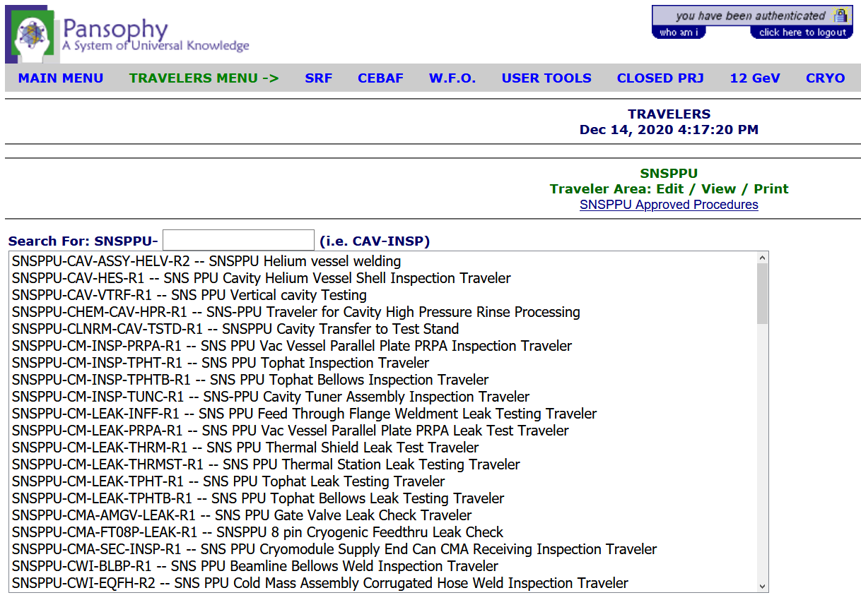
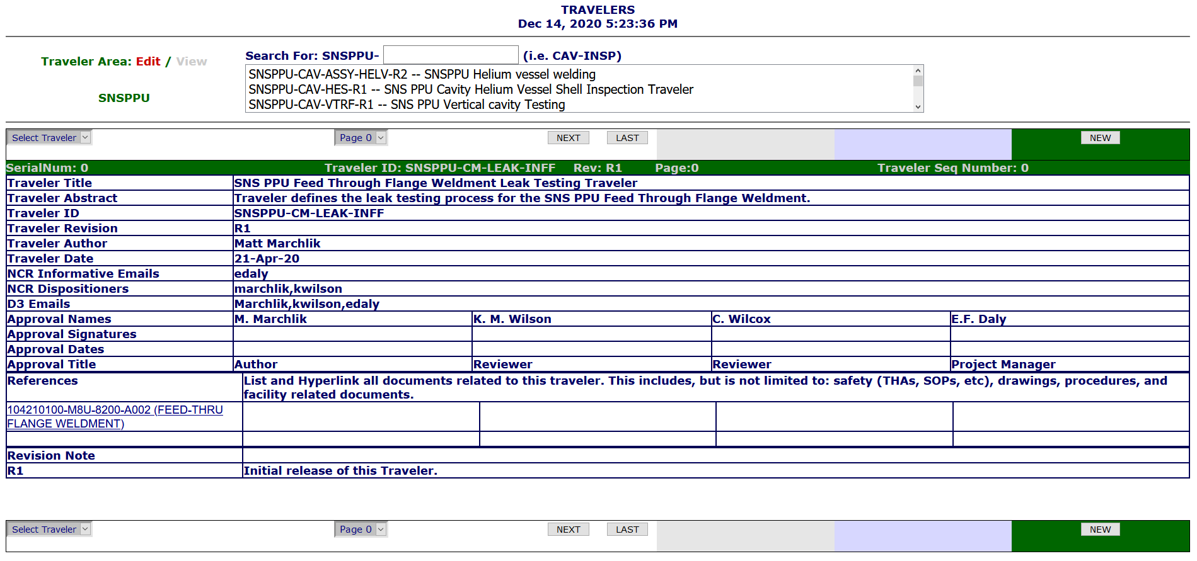
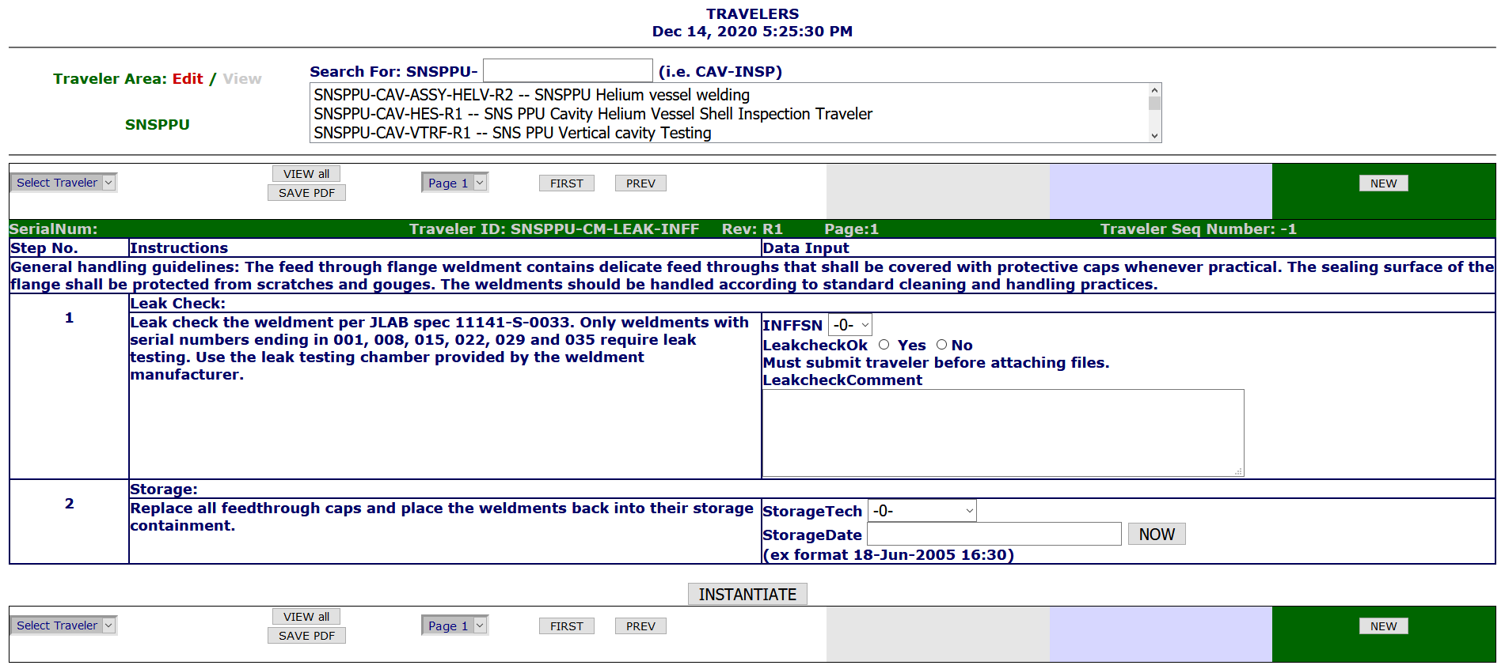
Instantiating Travelers
1. Select Traveler
2. Select New
3. Instantiate The New Traveler
4. Traveler Receives a Sequence Number after instantiation

Slide 16
Entering Data
Select previously created traveler
Page Control Buttons
Continue to Add/Update Data
SUBMIT
EACH
PAGE

Slide 17
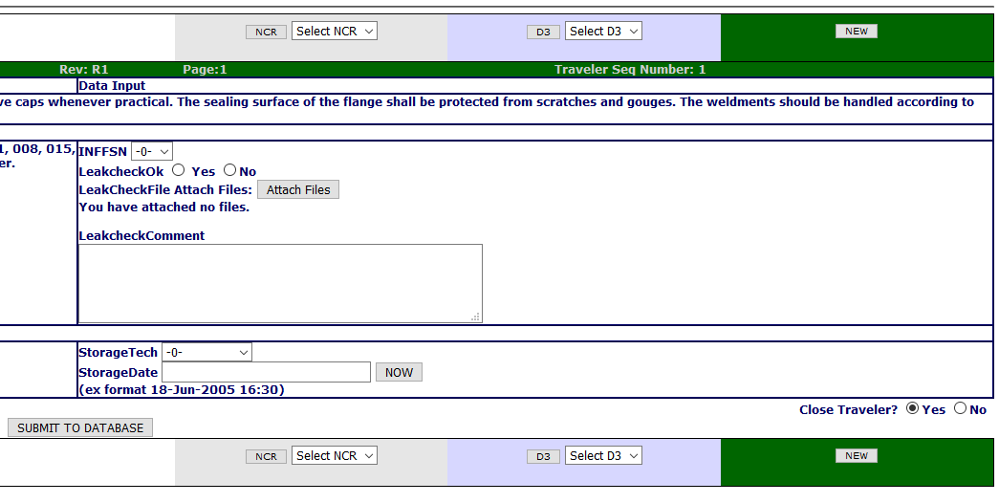
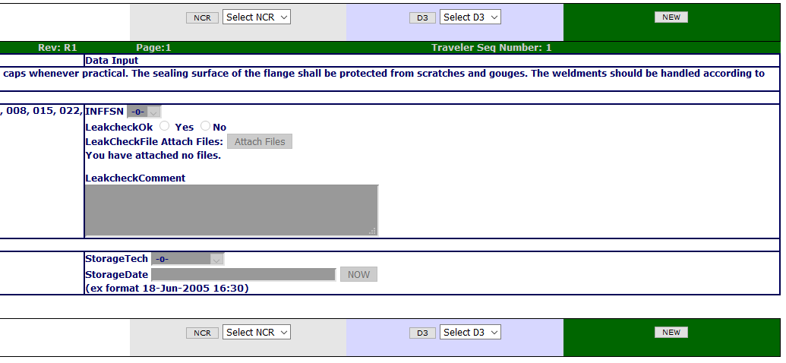
Securing Data
Until a Traveler is closed, data can be entered and edited
2
1
Once closed, ALL DATA is locked and cannot be changed
Data is never deleted, a history of all changes is kept

Slide 18
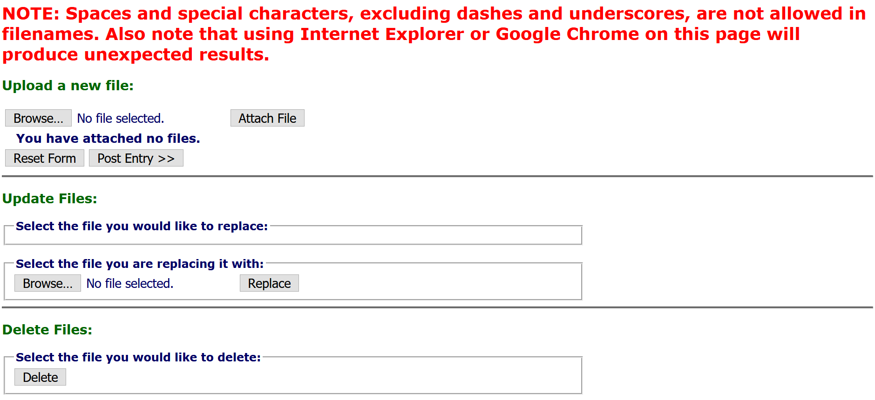
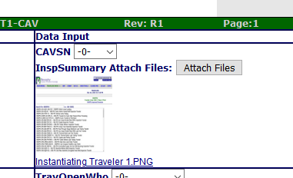
Uploading Files
IMPORTANT
Traveler MUST be instantiated before uploading files
Click Browse
In the pop-up, open the file you wish to upload
1
Clicking the Attach Files button will open another tab
2
Click Attach File, then Post Entry
3
4
File will be displayed next to Attach Files button
5

Slide 19
Hold Points (Not Signer)
Hold Points can only be cleared by the designated person(s)
Until the hold point is cleared, data cannot be added to subsequent pages

Slide 20
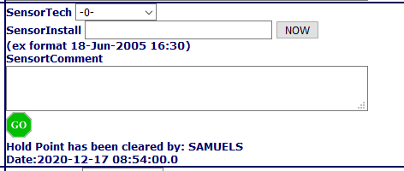
Hold Points (Signer)
This means a designated “signer” is logged in
Click the Stop Sign, then click your decision in the pop-up
This means the hold point is cleared

Slide 21
Hold Points on the Last Page
If Hold Points are on the last page, traveler cannot be closed until Hold Point is cleared

Slide 22
Opening an NCR or D3
NCR: Non Conformance Report
should be issued for any part that does NOT meet the specified requirements
D3s: Detours Deviations Discrepancies
should be issued for any process that cannot be completed as specified in the traveler or supporting documentation.
After Instantiating a traveler, the buttons to open an NCR or D3, or view a previously opened one, appear
Submit the page data to the database before opening either

Slide 23
Questions?
Contact pansophy@jlab.org

