Slide 1
Welcome To Pansophy
Pansophy Team
Valerie Bookwalter, Megan McDonald, Mike Dickey, Allen Samuels, David Parham
Contact us at Pansophy@jlab.org

Slide 2
Reference Material
Sign in to Pansophy and DocuShare
  DocuShare link
  Pansophy link
DocuShare Directory of Training Slides and Referenced Material
  SRF Institute > 01 - SRF Projects > 06- For Reference, Additional Template and Processes
Training Slides:
  SRF Institute > 01 - SRF Projects > 06- For Reference, Additional Template and Processes > Pansophy Related Training

Slide 3
What is a Traveler?
Jefferson Lab Work Control Document (WCD)
Used to document work on parts and assemblies.
Outlines steps and collects data from the users
  Allows for later reference, data mining, reports and quality control

Slide 4
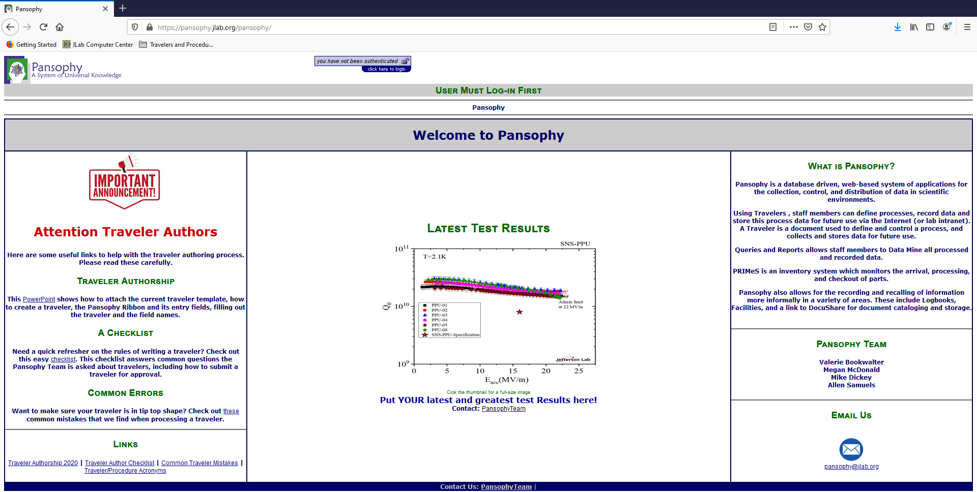
Homepage Rundown

Slide 5
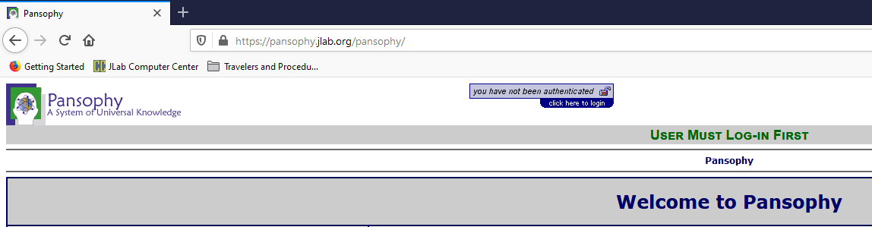
Homepage Rundown- URL and Login
Users must log in to access Pansophy using their Jlab username and password
Pansophy Homepage URL

Slide 6
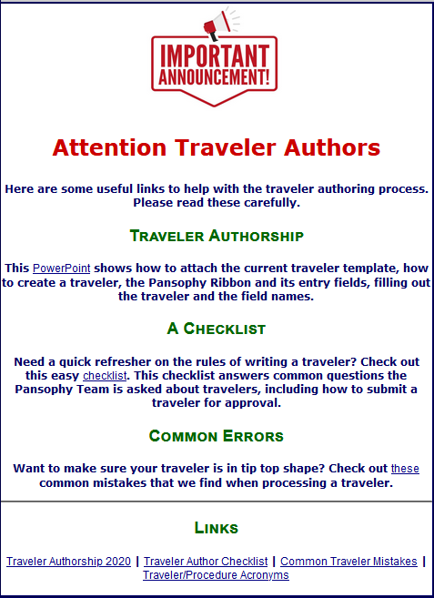
Homepage Rundown- Traveler Guides

Slide 7
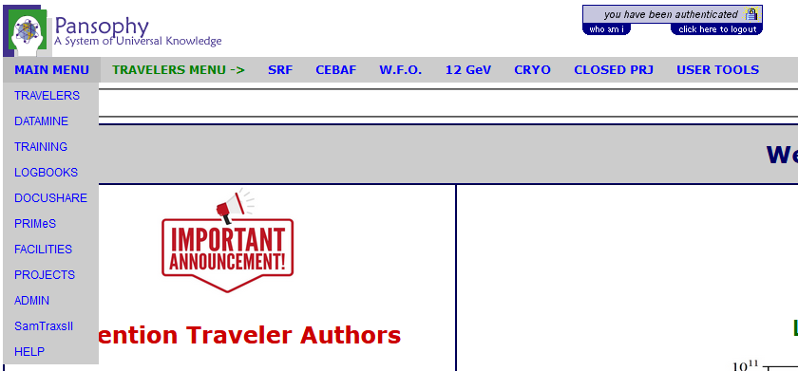
Homepage Rundown- Main Menu
Hovering over the different options creates new drop downs

Slide 8
Main Menu Options
Travelers: Links to Travelers for Active and Closed Projects, User Tools
Datamine: Menu for accessing the datamining
Training: Competence Menu (Still under development)
Logbooks: Menu for accessing the pansophy logbook and link to e-logbook (Accelerator)
DocuShare: Links to Project Areas and useful SRFOPS areas
PRIMeS: The SRF Project Inventory Management System home page
Facilities: Map of the SRFOPS production floor and Calibration system (still under development)
Projects: Project Report area for Multi-Lab Projects (MLP) like SNSPPU and LCLS-II HE
Admin: Pansophy administrative menu (restricted access)
SamTraxsII: Menu for editing and viewing the Sample Tracking II thin films and particulate research data
Help: Menu for additional help and guides

Slide 9
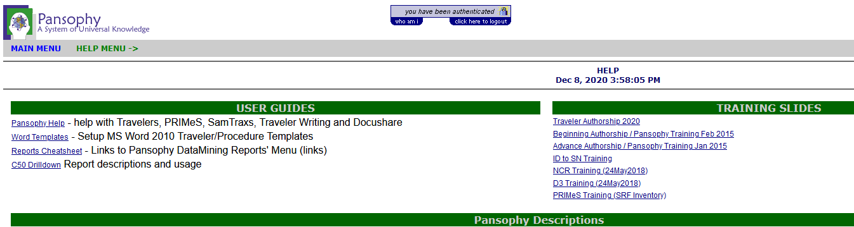
Pansophy Help
Links to User Guides, Pansophy Help, and Training Slides
Found under the Main Menu drop-down

Slide 10
Data In
Putting data into Travelers

Slide 11
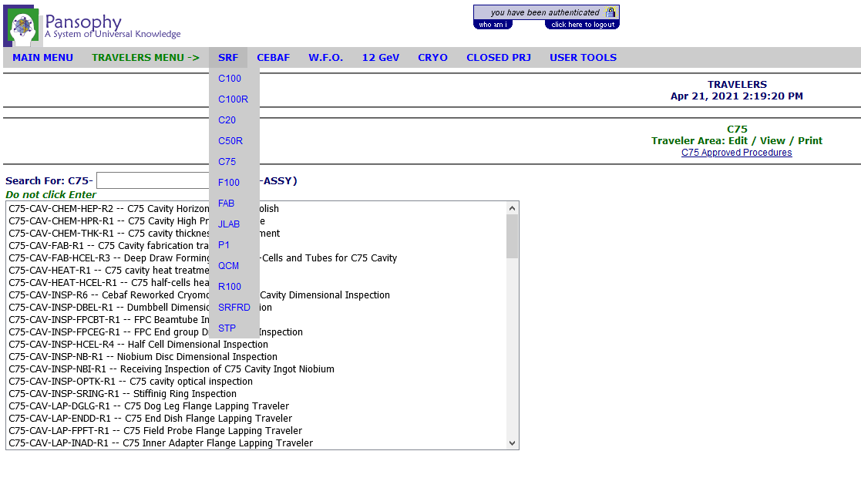
Traveler Menu
Select project from drop down menu to display open travelers
TRAVELER Main SUB-Menus
SRF: Operations and R&D
CEBAF: WarmGirder
W.F.O.: External Projects
12 GeV: CEBAF upgrade
CRYO: Cold Box
CLOSED PRJ: Closed Projects
USER TOOLS: Useful utilities for users
Search for Travelers
The list updates automatically
Do not press enter: this will give an error

Slide 12
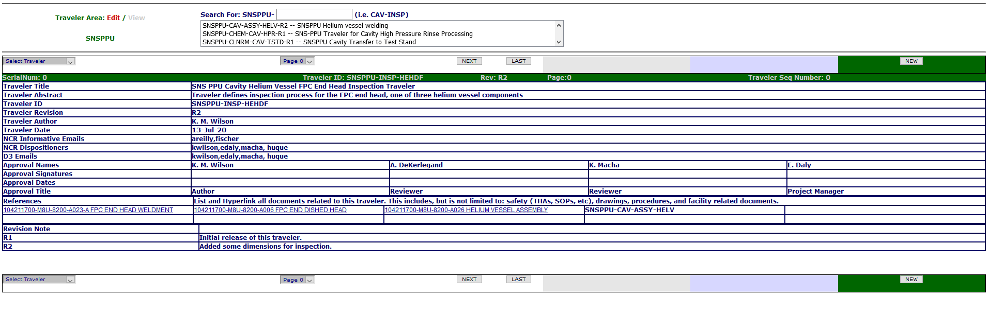
Traveler Example - Traveler Cover Page (P0)
Header Page of Travelers
Displays Traveler ID, Descriptions, and linked reference material

Slide 13
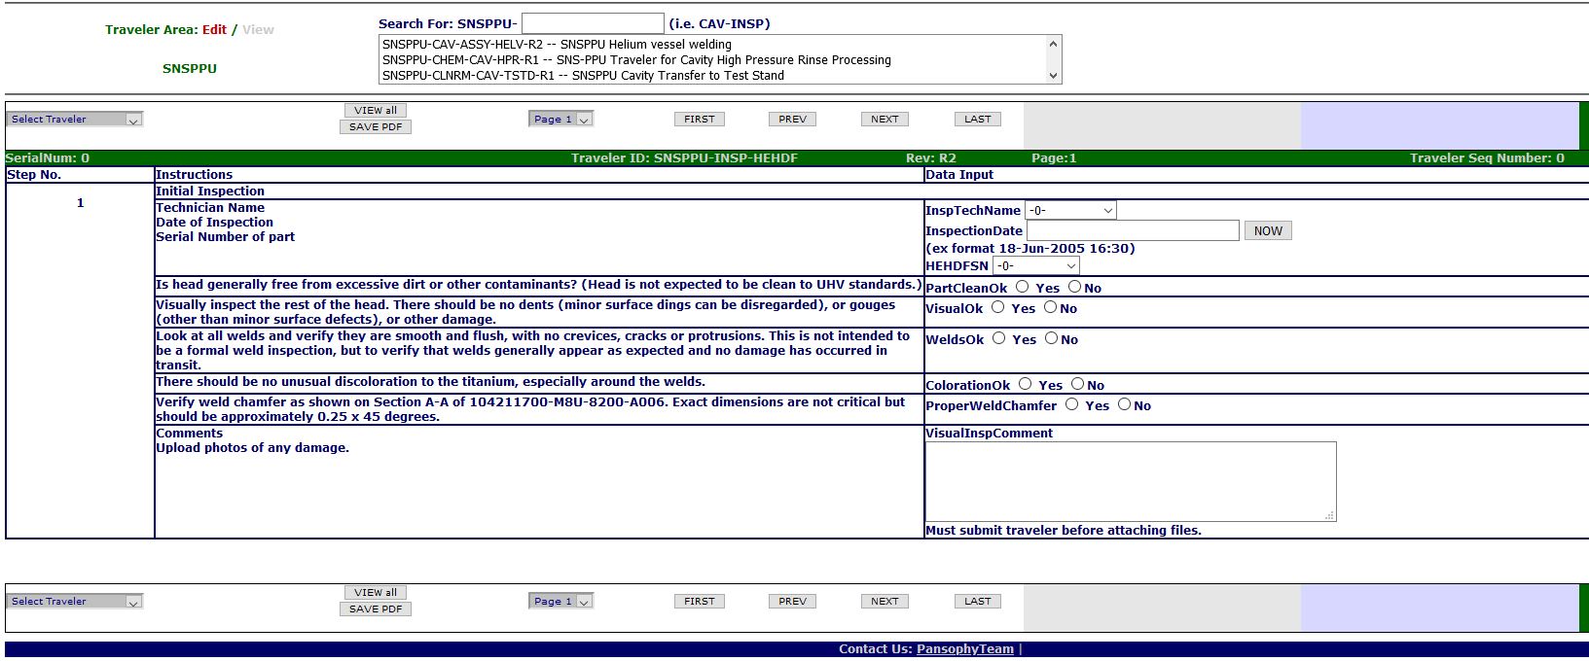
Traveler Example- P1
Contact Pansophy@jlab.org for help when needed

Slide 14
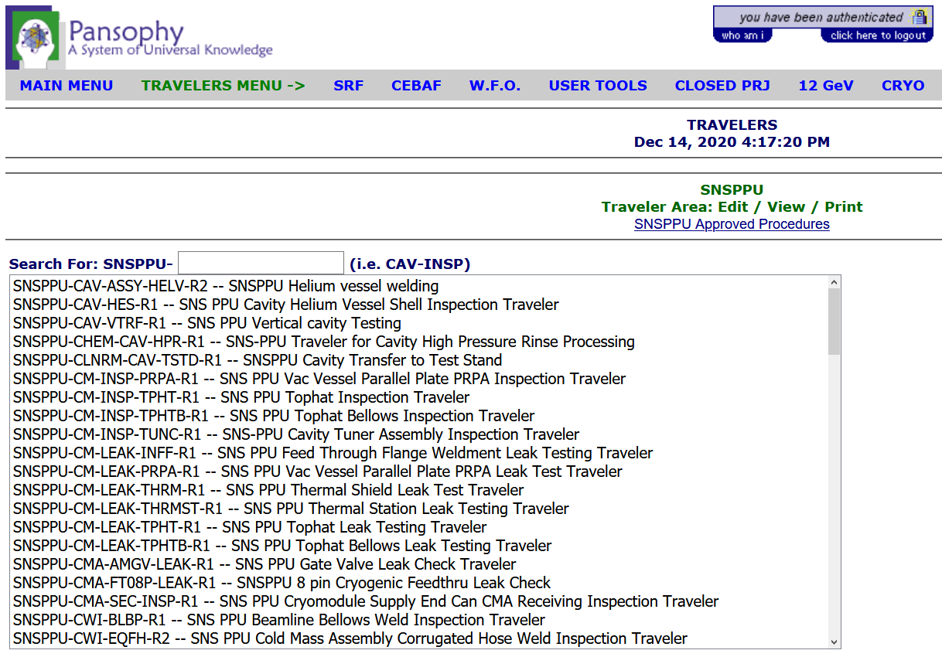
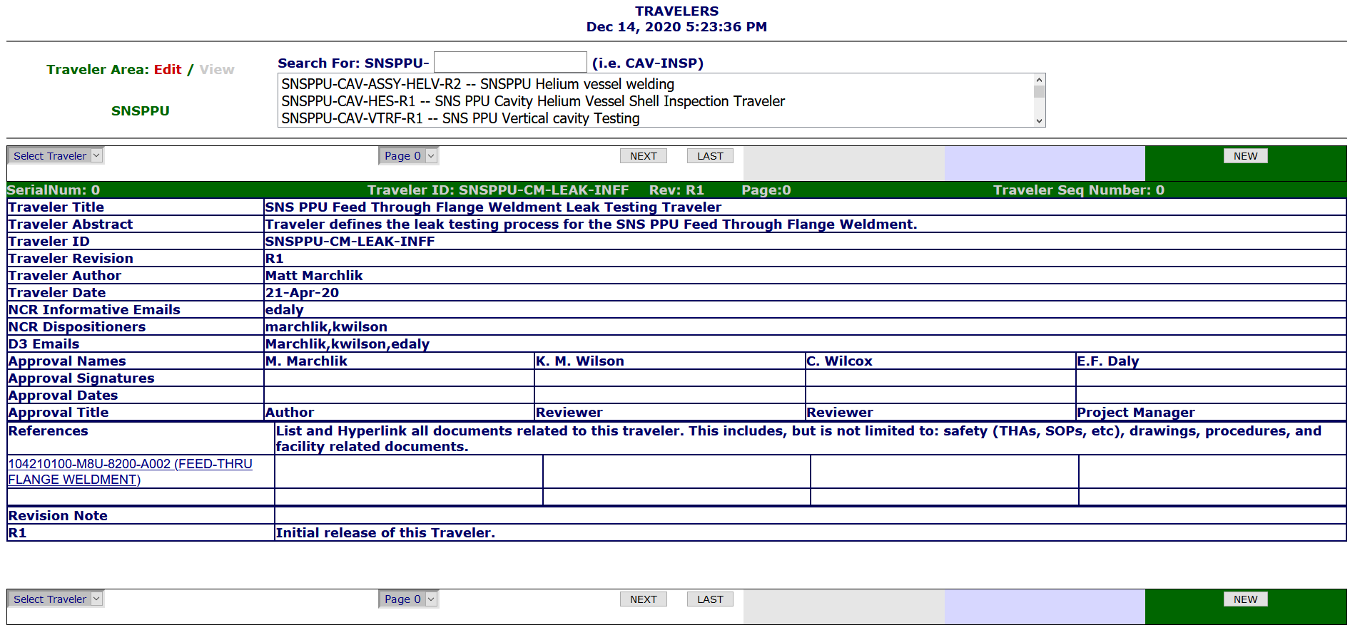
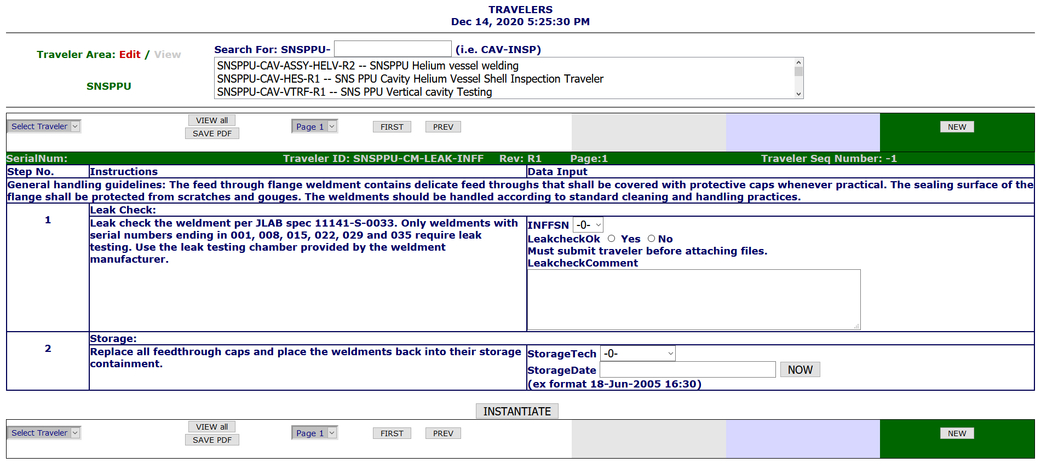
Instantiating Travelers
1. Select Traveler
2. Select New
3. Instantiate The New Traveler
4. Traveler Receives a Sequence Number after instantiation

Slide 15
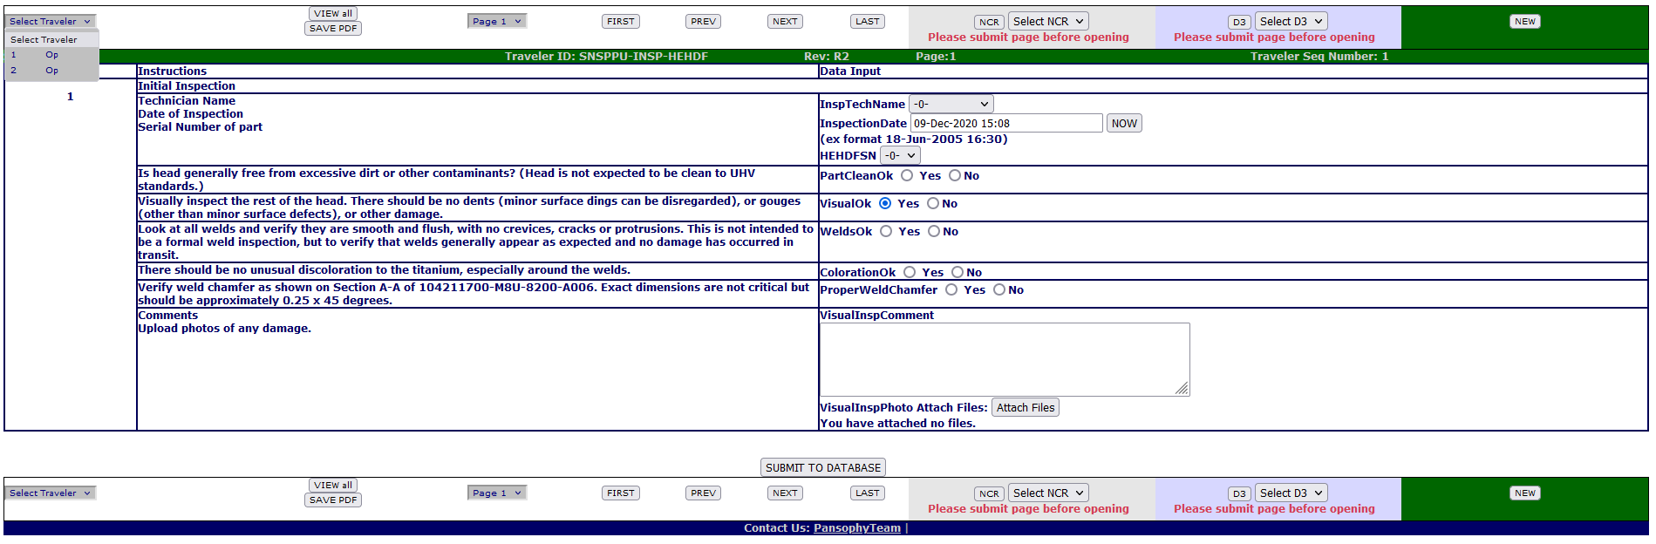
Entering Data
Select previously created traveler
Page Control Buttons
Continue to Add/Update Data
SUBMIT
EACH
PAGE

Slide 16
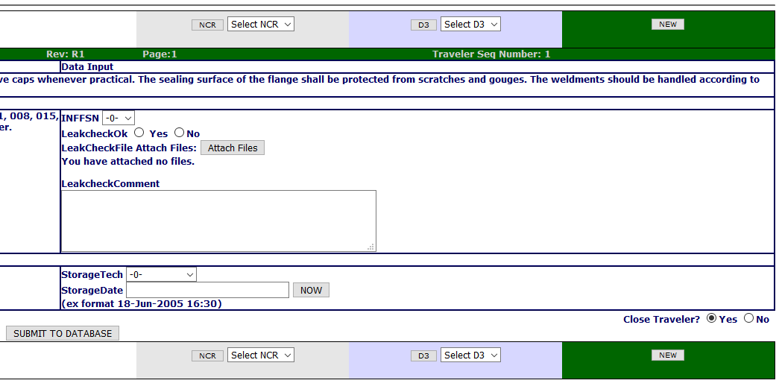
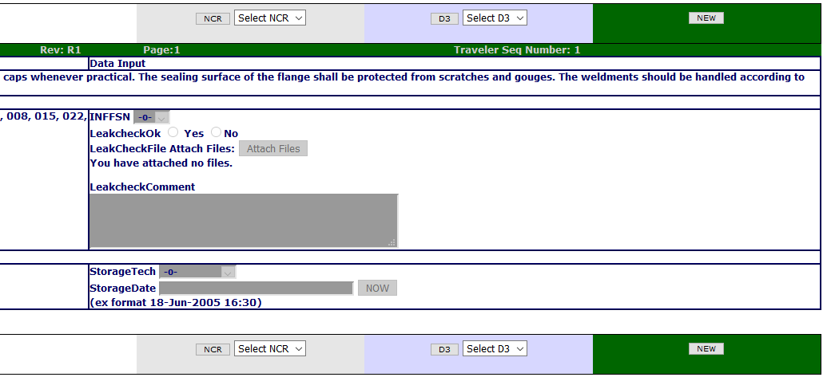
Securing Data
1. Until a Traveler is closed, data can be entered and edited
2
1
2. Once closed, ALL DATA is locked and cannot be changed
3. Data is never deleted, a history of all changes is kept
3

Slide 17
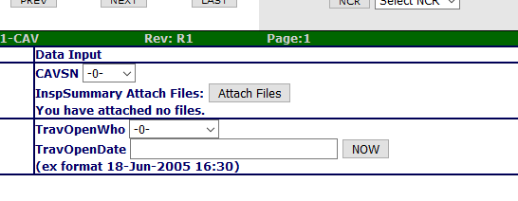
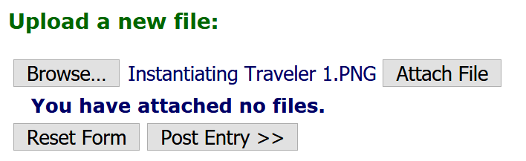
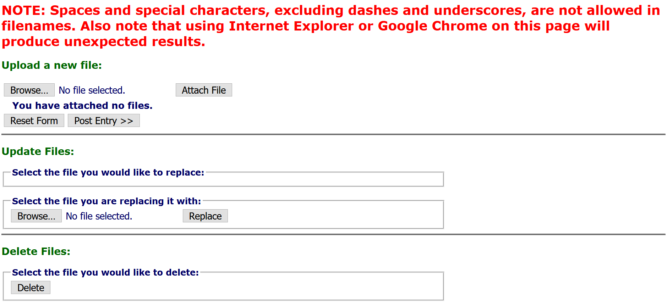
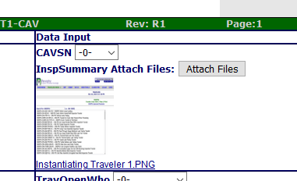
Uploading Files
IMPORTANT
Traveler MUST be instantiated before uploading files
Click Attach File, then Post Entry
3
Clicking the Attach Files button will open another tab
1
4
Click Browse
In the pop-up, open the file you wish to upload
File will be displayed next to Attach Files button
2
5

Slide 18
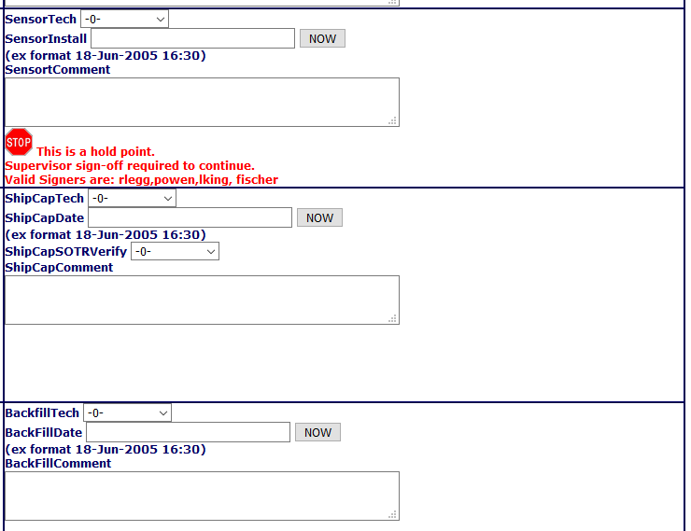
Hold Points (Not Signer)
Hold Points can only be cleared by the designated person(s)
Until the hold point is cleared, data cannot be added to subsequent pages (No ‘Submit to Database’ button)
No Submit Button

Slide 19
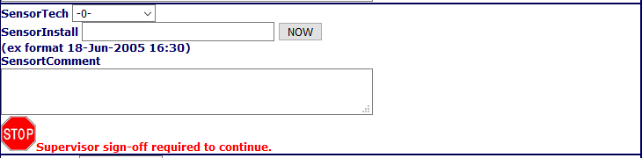
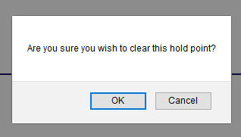
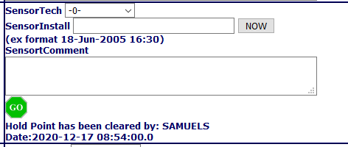
Hold Points (Signer)
This means a designated “signer” is logged in
Click the Stop Sign, then click your decision in the pop-up
This means the hold point is cleared

Slide 20
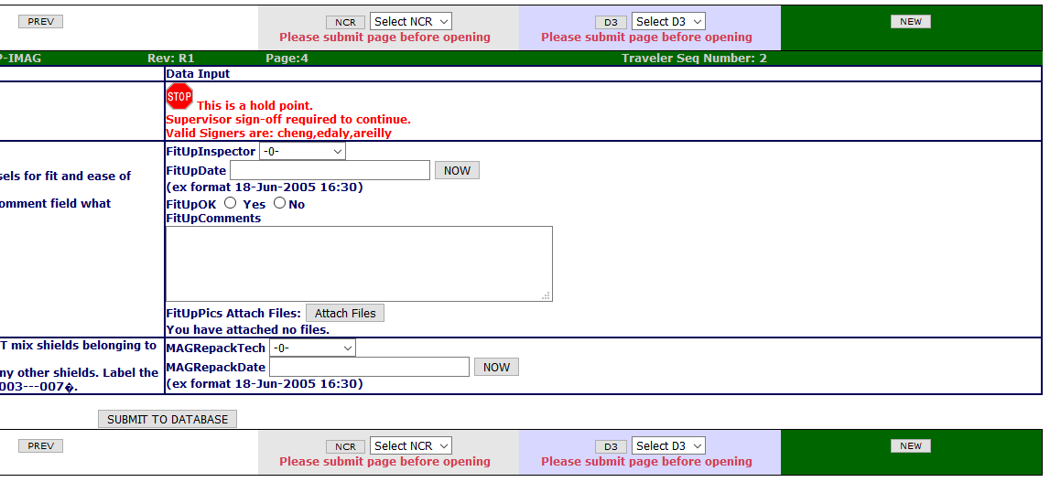
Hold Points on the Last Page
If Hold Points are on the last page, traveler cannot be closed until Hold Point is cleared
No Close Button

Slide 21
Opening an NCR or D3
NCR: Non Conformance Report
  should be issued for any part that does NOT meet the specified requirements
D3s: Detours Deviations Discrepancies
  should be issued for any process that cannot be completed as specified in the traveler or supporting documentation.
After Instantiating a traveler, the buttons to open an NCR or D3, or view a previously opened one, appear
Submit the page data to the database before opening either

