Slide 1
Pansophy Menu Upgrade
Proposed new menu breakdown structure for pansophy
2 may 2022
Pansophy Team

Slide 2
MAIN MENU
TRAVELERS – data entry; travelers for open SRF PRD/S&T and closed projects
PRODUCTION – for SRF Operations Production Floor use
PROJECTS – External Portal area for MLP projects
DATAMINE – specialized Queries and Reports for analyzing Traveler Data
QCREPORTS – Reports for Travelers/NCRs/D3s typically used for Quality Control
PRIMES – Inventory system (MOVE/STATUS/ISSUE components)
FACILITIES – facility related: including CM Locations, Shipping Form and Calibration
DOCUSHARE – links to often used DocuShare areas
LOGBOOKS – link to e-log maintained by ACCEL OPS dept.
HELP – Pansophy help area with training, FAQs, slide sets, etc.
ADMIN – P-Team area for administration of Pansophy security

Slide 3
TRAVELERS MENU
TRAVELER TOOLS
TP ACRONYMS
HEADER
HEADERS
CONFIGS
OWNERS
NCR NAMES
NCR NAMES by Trav
D3 NAMES
SN LIST
USER LIST
VAR NAMES
SN VAR NAMES
PROJECT WCA
SRF OPS
AUP
C20
SRF S&T
SRFRD
CLOSED PRJ
C50R
C75
WMGRDR
CEBAF
WFO
PANS1
USER TOOLS
BATCH NCR EDITS
BATCH TRAVELER CLOSING
L2PRD RI HOLDPOINTS
L2PRD EZ HOLDPOINT
SNSPPU RI HOLDPOINTS
RETRIEVE ALL FILES
TRAVELERS TOOLS
L2HE
NB3SN
SNSPPU
STP
C100R
ER5C
Notes:
I recommend removing the Batch NCR and Batch Traveler features. If travelers/NCRs are kept up to date, then there is no reason for batch edits. Also, if the links work in the OP/CL reports for NCRS, D3s, and Travelers, then it’s not hard to filter the list then edit several in a few minutes.
Traveler Tools and Retrieve All Files seem like they are for admins. Suggest moving to Admin Menu.

Slide 4
PRODUCTION MENU
SERIAL NUMBER SEARCH
OPEN/CLOSE STATUS
TRAVELERS (OP/CL)
NCRs (OP/CL)
CEBAF STATUS BOARDS
MLP STATUS BOARDS
DRILLDOWN
SRFOPS WCD
D3s (OP/CL)
C100 CAVITY
F100 CAVITY
C75
CAV STATUS
CPR STATUS
SNSPPU
CAV STATUS
CST STATUS
CM STATUS
CAV SPECS
L2HE
CAV STATUS
CAV SPECS
L2PRD-L2PRO
CAV STATUS
CAVEZ STATUS
CM STATUS
CAV SPECS
CAV VENDOR
L2PRO CAV STATUS
L2PRO CST STATUS
C50R
CM ASSEMBLY
CRYOUNIT ASSY
CAVITY PAIR ASSY
CAVITY ASSY
C50
CM OPERATIONS
CM PERFORMANCE
CM ASSEMBLY
CPR ASSEMBLY
CPR VTRF
C100
ACTS/COMM
CRYOMODULE
CAVITY STRING
CAVITY
TRAVELER/PROCEDURE QC
Notes:
Why is L2PRD listed?
CEBAF should look like the MLPs. Suggest consolidating into one top level menu called “Status Boards” and identify/create a common set of Status Boards for all projects (e.g. CAV, CST, CM, CAV SPEC… then add others if requested).
What happens when a project ends? Is there any reason someone might want to use these reports on a closed project?
Will “Drilldown” include MLP drilldowns?

Slide 5
PROJECTS PORTAL MENU
SNSPPU
INDEX
B.O.M.
L2PRD
INDEX
L2HE
CAVITY PERFORMANCE
CAV PERF GRID
KPI DRILLDOWNS
DRILLDOWNS
INDEX
CAVITY PERFORMANCE
CAVITY PERF GRID
DRILDOWNS
TRAVELERS BY CM
SLAC REPORT
Notes:
Why is L2PRD listed?
Delete “KPI” in “KPI Drilldowns”.

Slide 6
DATAMINE MENU
QUERIES
SERIAL NUMBER SEARCH
USER DEFINED
CAVITY PERFORMANCE
CAVITY PERF
C50R
ARCHIVED REPORTS
CLOSED PRJ AREA
VARGRID
C100
F100
R100
COMPONENT REPORTS
P1 QUERY MENU
TRAVELERS (<2010)
NCR (<2010)
D3 (<2010)
SRF REPORTS
12 GEV REPORTS
Notes:
Why no MLP projects?
The Cavity Performance reports see very similar to the status boards and drilldowns in the Production Menu. Can they be consolidated?

Slide 7
QCREPORTS MENU
TRAVELER REPORTS
TRAVELERs (OP/CL)
NCR REPORTS
NCRs (OP/CL)
D3 REPORTS
PROJECT REPORTS
TRAVELERs BY PROJECT (OP/CL)
TRAVELERs BY PROJECT ALL
TRAVELERs BY WORKCENTER
TRAVELER OPEN/CLOSED BY MONTH
NCR BY PROJEC
NCRs BY WORKCENTERS
NCR CLASSIFCATION (TRAV)
NCR CLASSIFICATION (PRJ)
NCR CLOSURE PERIODS
NCR INITIAL V FINAL
NCR STACKED DISPOSITION
NCR OP/CL BY MONTH
NCRs BY ENGR
NCR DISPOSITION (TRAV)
OPEN NCR AGE
D3s (OP/CL)
D3 BY PROJ
D3 BY WORKCENTERS
D3 CLASSIFICATIONS (TRAV)
D3 CLASSIFICATIONS (PRJ)
D3 OP/CL BY MONTH
PROJECT OVERVIEW
PROJECT METRICS
QC NCR LISTING
Notes:
Someday I would like to merge the NCRs (OP/CL) report with the QC NCR Listing report.

Slide 8
PRIMES MENU
Inventory Data Mining
Current Inventory
Inventory History
Inventory Management
Receive Parts
Move Parts & Change Status
Production Kits
Admin Tools
Management Reports
Drawings
Parts
Purchase Orders
Unit Costs
Project Names
Locations
Status Codes
Transaction Types
TID Search
Issue Parts
Kit Builder
Kit Order Form
Kit Issue Form
Add Drawing
Add parts
New Purchase Order
Add Unit Cost
New Kit Name
Add Parts To Kit List
New Project Name
New Site
New Building
New Location
New Status Code
New Transaction Type
Set Label Printer
Inventory Activity
Off-Site Storage
Inspection & Use Status
Kit Status Board

Slide 9
FACILITIES MENU
CALIBRATION
CM LOCATIONS
SHIPPING FORM

Slide 10
DOCUSHARE MENU
SRF
SRF MAIN MENU
WORK CENTER PLAN
OPEN SRF PROJECTS
C100R
CLOSED SRF PROJECTS
GROUPS
CM PRODUCTION
PROCESSES MATERIALS
PANSOPHY
SPECIAL PROJECTS
CAV
CM
EP
C20
ANL CRAB
ETC.
BES
ETC.
PROCESS DEV
MATERIAL CHAR
WORK CENTER DASHBOARD
REF MATERIALS
QMS
CONT IMPR PRJ
SFTW PRJ
METIRCS
Notes:
SRF Projects means all projects done by SRF. There isn’t a distinction made anywhere else – they are just called projects.

Slide 11
LOGBOOKS
JLAB E-LOGBOOK
SRFLOG
SRFRDLOG

Slide 12
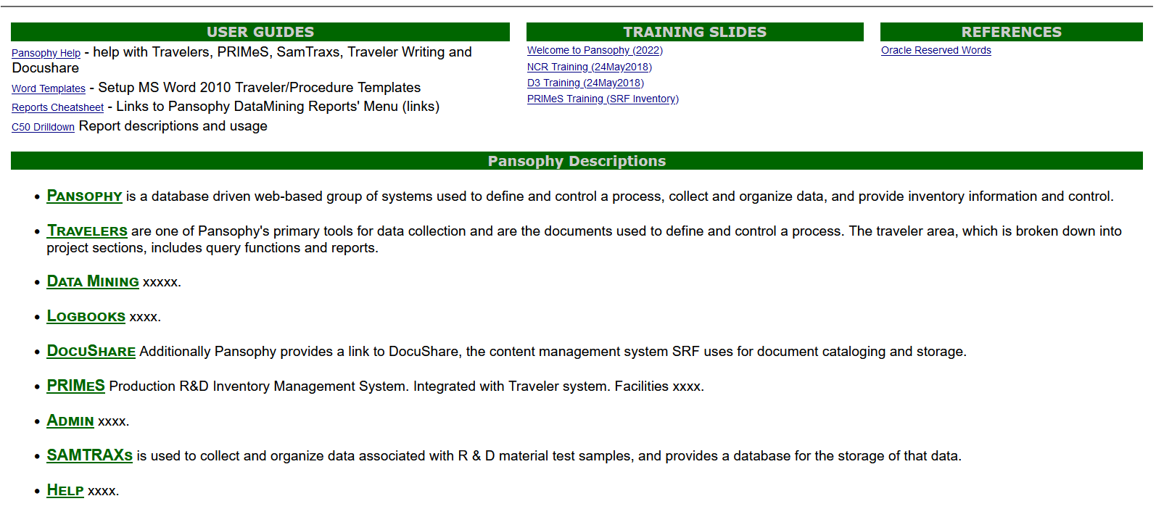
HELP

Slide 13
ADMIN MENU
CAVITY TYPE LIST
VIEW
EDIT TRAVELERS
HEADERS
SECURITY
CANNED REPORT EDITOR
AUTO CONVERTER
EDIT
ADD
CONFIS
OWNERS
NCR NAMES
HLDPT NAMES
USER LISTS
DE CATEGORIES
TP ACRONYMS
D3 NAMES
SN LIST
PROJECT WCA
ACRONYM LIST
KEYS
ADMIN OPTS
DUMP CACHED QUERIES
WEB STATS
PAGE USAGE
EDIT OUTSIDE USERS
EDIT PANSOPHY USERS
This area is RESTRICTED to Pansophy Team only!

Slide 14
The End
Questions?

Slide 15
MAIN MENU DEVELOPEMENT
TRAVELERS – data entry; travelers for open SRF PRD/S&T and closed projects
PRODUCTION – for SRF Operations Production Floor use
PROJECTS – External Portal area for MLP projects
DATAMINE – specialized Queries and Reports for analyzing Traveler Data
QCREPORTS – Reports for Travelers/NCRs/D3s typically used for Quality Control
PRIMES – Inventory system (MOVE/STATUS/ISSUE components)
FACILITIES – facility related: including CM Locations, Shipping Form and Calibration
DOCUSHARE – links to often used DocuShare areas
LOGBOOKS – link to e-log maintained by ACCEL OPS dept.
HELP – Pansophy help area with training, FAQs, slide sets, etc.
ADMIN – P-Team area for administration of Pansophy security
COMPETENCE – (DEV only) ON HOLD waiting for requirements
SAMTRAXSII – (DEV only) ON HOLD waiting for requirements
TESTAREA – (DEV only) testing area for P-Team building new software

Slide 16
MAIN MENU CHEATSHEET
1000 TRAVELERS – data entry; travelers for open SRF/WFO and closed projects
30000 PRODUCTION – for SRF Operations Production Floor use
8000 PROJECTS – External Portal area for MLP projects
2000(obs)/20000 DATAMINE – specialized Queries and Reports for analyzing Traveler Data
3000(obs)/40000 QCREPORTS – Reports for Travs/NCRs/D3s typically used for QC
6000 PRIMES – Inventory system (MOVE/STATUS/ISSUE components)
7000 FACILITIES – facility related: including CM Locations, Shipping Form and Calibration
5100 DOCUSHARE – links to often used DocuShare areas
4000 LOGBOOKS – link to e-log maintained by ACCEL OPS dept.
11000 HELP – Pansophy help area with training, FAQs, slide sets, etc.
9000 ADMIN – P-Team area for administration of Pansophy security
13001 COMPETENCE – (DEV only) ON HOLD waiting for requirements
10001 SAMTRAXSII – (DEV only) ON HOLD waiting for requirements
12000 TESTAREA – (DEV only) testing area for P-Team building new software

Slide 17
COMPETENCE
ROLES
GROUPS
JOBTITLES
EVALUATORS
PERSONS
COMPETENCIES
MATRIX
This area is only in DEVelopment.
It was started for Fischer’s Competence.
It is currently on hold awaiting requirements.

Slide 18
SAMTRAXSII MENU
VIEW BASE TABLES
Provider Contacts
Sample Inventory
EDIT BASE TABLES
Events
Categories
EDX
ADD EVENT
ADD SAMPLE
Materials
Sub-Materials
Processes-Events
Projects
Providers
Provider Contacts
Shapes
Sample Inventory
EDX LOCATIONS
EDX RUN IDS
EDX RUN DATA
EDX RUN CNT
EDX DATA UPLOAD
This area is only in DEVelopment.
It is still under development.
It is currently on hold awaiting requirements from R&D

Slide 19
TESTAREA
Development Pages (SRF)
 | Kit Builder
 | Drawings
 | Drill Down Test
 | Traveler Report Grid 2
 | Inspection Status
 | X-Project Inspection Status
 | CM Locations
Demo Pages (WEB)
 | Employee Demo
 | City_State
 | Places
 | CFSpreadsheet
 | Transitions
 | CFFormGroupExample
 | Grid Export
New Reports
 | Traveler Report Grid 3
 | T/P QA Report
 | T/P QA Report Edit
 | T/P QA Report Grid
This area is only in DEVelopment.
It is used by the Pansophy Team to develop and test new software.

