Slide 1
Pansophy Menu Upgrade
Proposed new menu breakdown structure for pansophy
02 JUNE 2022
Pansophy Team

Slide 2
Purpose And Benefits
Categorizes pages by Work/Use Areas
  Examples: Production Floor Work, Quality Control Reports, Scientific Data Mining
  Minimizing the need to “hop” between Main Menu Areas
  Reduces number of “clicks” to information.
Archives
  Unused / no longer needed Reports
  Closed Projects
Maximizes Visibility and Priorities of Areas
Updates the flow in Preparation for SRF’s growing needs

Slide 3
MAIN MENU
TRAVELERS – data entry; travelers for open SRF PRD/S&T and closed projects
PRODUCTION – for SRF Operations Production Floor use
PROJECTS – External Portal area for MLP projects
DATAMINE – specialized Queries and Reports for analyzing Traveler Data
QCREPORTS – Reports for Travelers/NCRs/D3s typically used for Quality Control
PRIMES – Inventory system (MOVE/STATUS/ISSUE components)
FACILITIES – facility related information
DOCUSHARE – links to often used DocuShare areas
LOGBOOKS – links to e-log maintained by ACCEL OPS dept.
HELP – Pansophy help area with training, FAQs, slide sets, etc.
ADMIN – Pansophy Team area for administration of Pansophy security

Slide 4
TRAVELERS MENU
SRF OPS
AUP
C20
SRF S&T
SRFRD
CLOSED PRJ
C50R
C75
WMGRDR
USER TOOLS
BATCH NCR EDITS
BATCH TRAVELER CLOSING
L2PRD RI HOLDPOINTS
L2PRD EZ HOLDPOINT
SNSPPU RI HOLDPOINTS
RETRIEVE ALL FILES
L2HE
NB3SN
SNSPPU
STP
C100R
ER5C (future)
TRAVELER TOOLS
TP ACRONYMS
HEADER
HEADERS
CONFIGS
OWNERS
NCR NAMES
NCR NAMES by Trav
D3 NAMES
SN LIST
USER LIST
VAR NAMES
SN VAR NAMES
PROJECT WCA
CEBAF
12GeV
C100
F100
R100
Etc.
WFO
BES
ILC
L2PRD
SNS
Etc.
PANS1
C50
C70
5CELL
Etc.
All Traveler Data Entry for Open Projects.
Access to Closed Project Travelers.
A set of tools for Users to access Traveler/Pansophy related information.

Slide 5
PRODUCTION MENU
SERIAL NUMBER SEARCH
OPEN/CLOSE STATUS
TRAVELERS (OP/CL)
NCRs (OP/CL)
STATUS BOARDS
DRILLDOWN
SRFOPS WCD
D3s (OP/CL)
C100 CAVITY
F100 CAVITY
C75
CAV STATUS
CPR STATUS
SNSPPU
CAV STATUS
CST STATUS
CM STATUS
CAV SPECS
C50R
CM ASSEMBLY
CRYOUNIT ASSY
CAVITY PAIR ASSY
CAVITY ASSY
C50
CM OPERATIONS
CM PERFORMANCE
CM ASSEMBLY
CPR ASSEMBLY
CPR VTRF
C100
ACTS/COMM
CRYOMODULE
CAVITY STRING
CAVITY
TRAVELER / PROCEDURE QC
L2HE
CAV STATUS
CAV SPECS
L2PRD-L2PRO
CAV STATUS
CAVEZ STATUS
CM STATUS
CAV SPECS
CAV VENDOR
L2PRO CAV STATUS
L2PRO CST STATUS
An area focused on SRF Operations Production Floor activities.
Component Status Boards
Production Flow
Work Control Documents (Travelers/Procedures)

Slide 6
PROJECTS PORTAL MENU
SNSPPU
INDEX
B.O.M.
L2PRD
INDEX
L2HE
CAVITY PERFORMANCE
CAV PERF GRID
KPI DRILLDOWNS
DRILLDOWNS
INDEX
CAVITY PERFORMANCE
CAVITY PERF GRID
KPI DRILLDOWNS
TRAVELERS BY CM
SLAC REPORT
Area for External MLP Customers where they may view data points and KPIs.

Slide 7
DATAMINE MENU
QUERIES
SERIAL NUMBER SEARCH
USER DEFINED
CAVITY PERFORMANCE
CAVITY PERF
C50R
ARCHIVED REPORTS
CLOSED PRJ AREA
VARGRID
C100
F100
R100
COMPONENT REPORTS
P1 QUERY MENU
TRAVELERS (<2010)
NCR (<2010)
D3 (<2010)
SRF REPORTS
12 GEV REPORTS
Area for Specialized Queries and Reports for analyzing Traveler Data

Slide 8
QCREPORTS MENU
TRAVELER REPORTS
TRAVELERs (OP/CL)
NCR REPORTS
NCRs (OP/CL)
D3 REPORTS
PROJECT REPORTS
TRAVELERs BY PROJECT (OP/CL)
TRAVELERs BY PROJECT ALL
TRAVELERs BY WORKCENTER
TRAVELER OPEN/CLOSED BY MONTH
NCR BY PROJEC
NCRs BY WORKCENTERS
NCR CLASSIFCATION (TRAV)
NCR CLASSIFICATION (PRJ)
NCR CLOSURE PERIODS
NCR INITIAL V FINAL
NCR STACKED DISPOSITION
NCR OP/CL BY MONTH
NCRs BY ENGR
NCR DISPOSITION (TRAV)
OPEN NCR AGE
D3s (OP/CL)
D3 BY PROJ
D3 BY WORKCENTERS
D3 CLASSIFICATIONS (TRAV)
D3 CLASSIFICATIONS (PRJ)
D3 OP/CL BY MONTH
PROJECT OVERVIEW
PROJECT METRICS
QC NCR LISTING
Reports for Travelers/NCRs/D3s typically used for Quality Control.
Quality Reports
Project Overview Reports

Slide 9
PRIMES MENU
Inventory Data Mining
Current Inventory
Inventory History
Inventory Management
Receive Parts
Move Parts & Change Status
Production Kits
Admin Tools
Management Reports
Drawings
Parts
Purchase Orders
Unit Costs
Project Names
Locations
Status Codes
Transaction Types
TID Search
Issue Parts
Kit Builder
Kit Order Form
Kit Issue Form
Add Drawing
Add parts
New Purchase Order
Add Unit Cost
New Kit Name
Add Parts To Kit List
New Project Name
New Site
New Building
New Location
New Status Code
New Transaction Type
Set Label Printer
Inventory Activity
Off-Site Storage
Inspection & Use Status
Kit Status Board
Inventory system (MOVE/STATUS/ISSUE components)

Slide 10
FACILITIES MENU
CALIBRATION (still under development)
CM LOCATIONS
SHIPPING FORM (still under development)
Facility Related Information: including CM Locations, Shipping Form and Calibration

Slide 11
DOCUSHARE MENU
SRF OPERATIONS
SRF MAIN MENU
WORK CENTER PLAN
OPEN PROJECTS
C100R
CLOSED PROJECTS
GROUPS
CM PRODUCTION
PROCESSES MATERIALS
PANSOPHY
SPECIAL PROJECTS
Cavity
Cryomodule
EP
C20
ETC.
PROCESS DEV
MATERIAL CHAR
WORK CENTER DASHBOARD
REF MATERIALS
QMS
METRICS
Links to often used DocuShare areas

Slide 12
LOGBOOKS
JLAB E-LOGBOOK
SRFLOG
SRFRDLOG
Links to e-log maintained by ACCEL OPS dept.

Slide 13
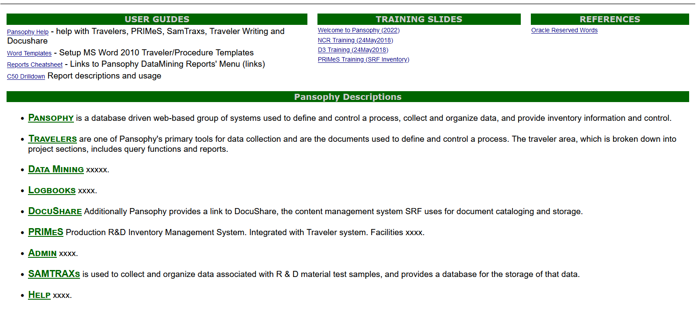
HELP
Pansophy help area with training, FAQs, slide sets, etc.

Slide 14
ADMIN MENU
CAVITY TYPE LIST
VIEW
EDIT TRAVELERS
HEADERS
SECURITY
CANNED REPORT EDITOR
AUTO CONVERTER
EDIT
ADD
CONFIGS
OWNERS
NCR NAMES
HLDPT NAMES
USER LISTS
D3 CATEGORIES
TP ACRONYMS
D3 NAMES
SN LIST
PROJECT WCA
ACRONYM LIST
KEYS
ADMIN OPTS
DUMP CACHED QUERIES
WEB STATS
PAGE USAGE
EDIT OUTSIDE USERS
EDIT PANSOPHY USERS
This area is RESTRICTED to Pansophy Team only!
Pansophy Team area for administration of Pansophy and security/

Slide 15
The End
Questions?

