Slide 1
SRFTERM Login

Slide 2
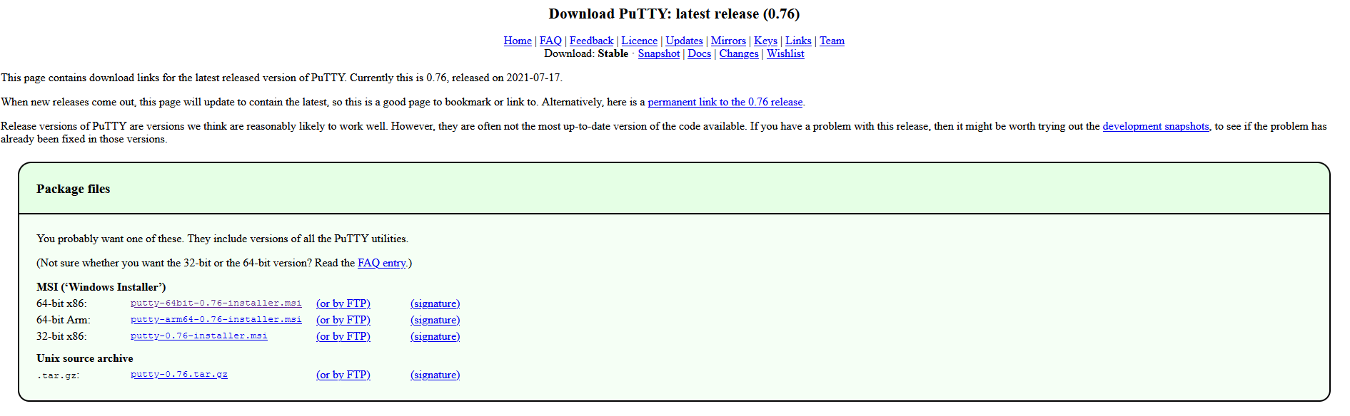
Install PuTTY
Go to the PuTTY page and download the 64-bit x86 package
Run the install program

Slide 3
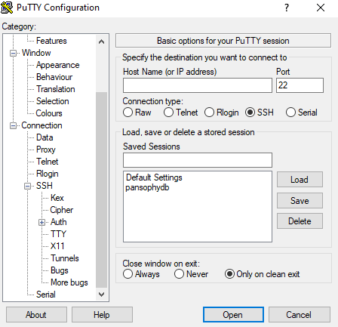
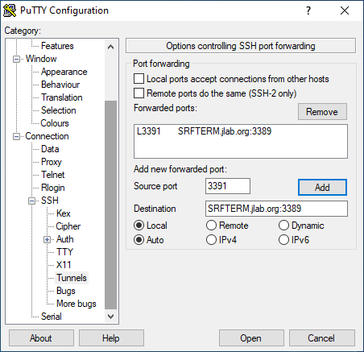
Setting up the Tunnel
Open Putty. In the category section on the left, expand SSH and select Tunnels
Fill the tunnel out
  Under Source Port, type “3391”
  Under Destination, type “SRFTERM.jlab.org:3389”
    Destination is NOT case sensitive
  Click Add
  The tunnel will appear under Forwarded Ports

Slide 4
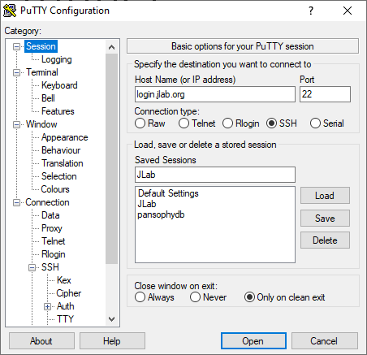
Creating a Session from the Tunnel
Under category, scroll up and select Session
On the right under the “Host Name (or IP address)” section, type login.jlab.org
Under Saved Sessions, give the session a name
  Recommend to use JLab, or SRFTERM
Click Save, and the session will appear in the list below Saved Sessions
  You can double check the tunnel by clicking Load after selecting your tunnel, and going back to the tunnel setup.

Slide 5
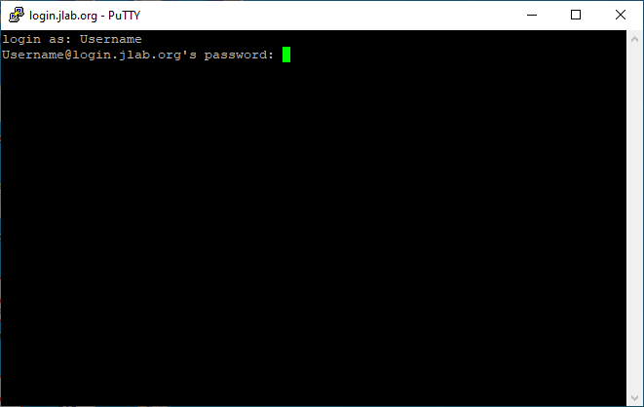
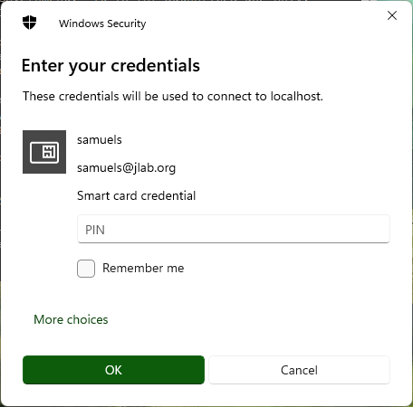
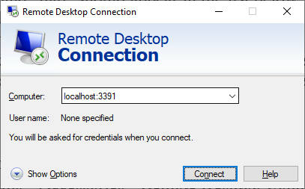
Logging in
Double Click the session, or single click and select Open
In the command window, input your JLab username and password
Open the start menu, search for and open the remote desktop
Under Computer, put localhost:3391.
  You can save the connection by selecting the Show Options dropdown and hitting save
When cautioned about the remote computer’s identity, select Yes
Enter smartcard code and login

Slide 6
Additional references
For more information, or to add additional tunnels, refer to the JLab Computer Center’s page on remote desktop and PuTTY.

