Slide 1
Traveler Authorship
Allen Samuels
July 2022

Slide 2
Location of Training Slides
Pansophy > Main Menu > Help

Slide 3
Attach the Template
Open Microsoft Word
Open a Blank document
Select the File tab
Select Options
Select Advanced
Scroll down to General
Click File Locations

Slide 4
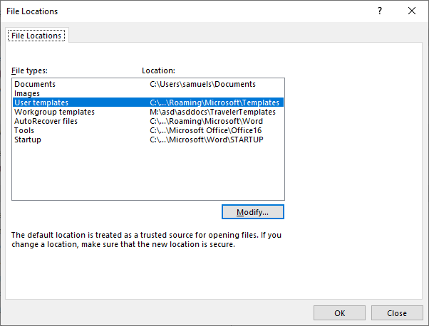
Attach the Template Cont.
In the File Locations pop up, select Workgroup templates
Click the Modify… button
Browse to M:\asd\asddocs\TravelerTemplates
Click OK
Click OK on File Locations
Click OK on Word Options

Slide 5
Attach the Template Cont.
Restart Word
All templates (Traveler, Procedure and Inventory Traveler) will now be available under the TEMPLATE area when Word is first opened

Slide 6
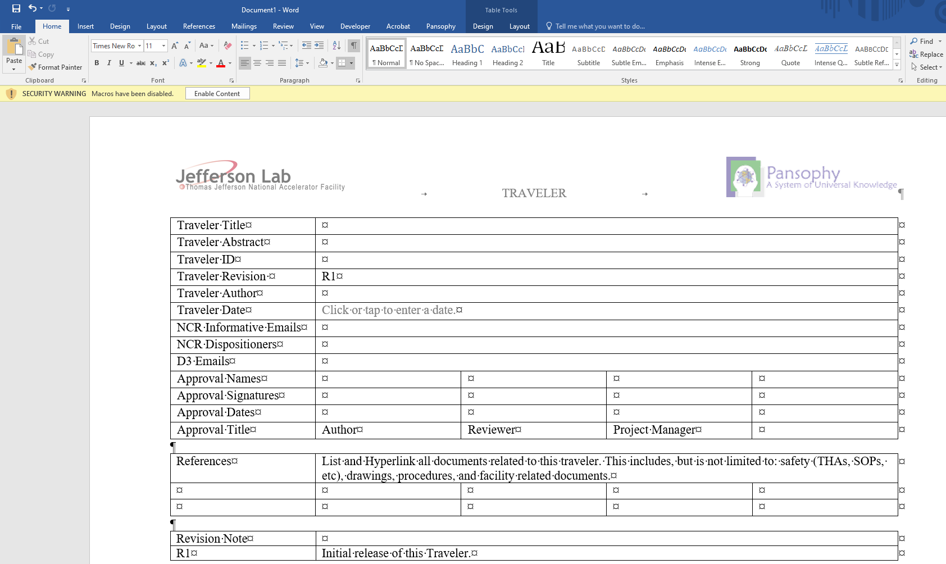
Creating a Traveler
Select Traveler Template 2022 from the templates
Be sure to click Enable Content to access the Pansophy Tab

Slide 7
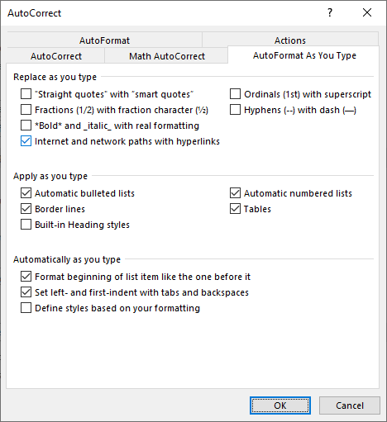
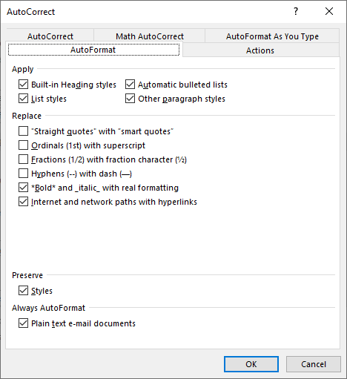
Before you Begin
Turn on Paragraph Marks
Will assist in editing by displaying hidden symbols
Turn off Smart Tags
File > Options > Proofing > Autocorrect Options
Deselect the following checkboxes
Smart characters create error symbols in pansophy

Slide 8
Pansophy Ribbon

Slide 9
Pansophy Ribbon
2
3
1
4
Entry Fields
Page Mods
User Sets
Part SN

Slide 10
Pansophy Ribbon: Entry Fields
Entry Fields are the ONLY valid data inputs for travelers
Collects entered data for the traveler
Formats:
[[FIELDNAME]] <<FIELDTYPE>>
[[FIELDNAME]] {{CHOICE1,CHOICE2,…}} <<FIELDTYPE>>
Fieldname is the title for the entry field
Displayed in the traveler and labels the field in the database
Fieldtype is the type of input
{{CHOICE1,CHOICE2,…}} is for fields that have multiple selection options

Slide 11
Pansophy Ribbon: Entry Fields Dictionary
Ribbon Code | Traveler Code | Definition
CheckBox | [[FieldName]] <<CHECKBOX>> | A checkbox that indicates the answer to a question is “yes”.
Comment | [[FieldName]] <<COMMENT>> | Allows you to collect comments in a large input box.
FileUpload | [[FieldName]] <<FILEUPLOAD>> | Allows you to upload any type of file to the server. File name must contain ONLY letters, numbers and underscores.
Float | [[FieldName]] <<FLOAT>> | Creates in input box that accepts numbers containing a decimal point.
SN | [[FieldName]] <<SN>> | Provides a text box that accepts serial numbers (both numbers and letters). A Part SN is preferred over an SN Field.
Integer | [[FieldName]] <<INTEGER>> | Creates an input box that accepts whole numbers only.
Note | [[FieldName]] <<NOTE>> | Use to alert programmers of special traveler requirements (ex: calculations).
Radio | [[FieldName]] {{Choice1,Choice2,Choice3}} <<RADIO>> | Creates a series of radio buttons (only one can be selected) base on the author supplied list of choices.

Slide 12
Pansophy Ribbon: Entry Fields Dictionary Cont.
Ribbon Code | Traveler Code | Definition
SciNot | [[FieldName]] <<SCINOT>> | Allows for the numbers in scientific notation.
Select | [[FieldName]] {{Choice1,Choice2,Choice3}} <<SELECT>> | Creates an author defined pull-down menu.
Text | [FieldName]] <<TEXT>> | Creates a input box for text entries. Smaller than a Comment box, just one line.
Timestamp | [[FieldName]] <<TIMESTAMP>> | Provides an input box which accepts date & time. Also supplies a “Now” button which will automatically enter the current date & time.
YesNo | [[FieldName]] <<YESNO>> | Creates radio buttons that answer a yes/no question
Holdpoint | [[FieldName]] {{Username1,Username2}} <<HOLDPOINT>> | Creates a hold point in the traveler, preventing any further data entry.
Emails | [[FieldName]] {{Username1,Username2}} <<EMAIL>> [[FieldName]] {{Subject Line}} <<EMAILSUBJ>> | Send an email to author specified users when a page is submitted. Must use the same Field Name for both lines of Entry Fields

Slide 13
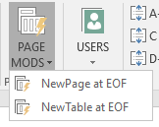
Pansophy Ribbon: Page Mods
Ribbon Code | Definition
NewPage at EOF | Inserts a page break at the end of the traveler.
NewTable at EOF | Inserts a page break and a table for steps, instructions and data input at the end of the traveler.

Slide 14
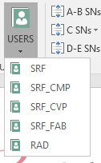
Pansophy Ribbon: User Sets
Ribbon Code | Traveler Code | Definition
SRF | [[SRF_FIELDNAME]] <<SRF>> | SRF User Set
SRF_CMP | [[SRFCMP_FIELDNAME]] <<SRFCMP>> | SRF Cryomodule User Set
SRF_CVP | [[SRFCVP_FIELDNAME]] <<SRFCVP>> | SRF Cavity User Set
SRF_FAB | [[SRFFAB_FIELDNAME]] <<SRFFAB>> | SRF Fabrication User Set
RAD | [[RAD_FIELDNAME]] <<RAD>> | Radcon User Set

Slide 15
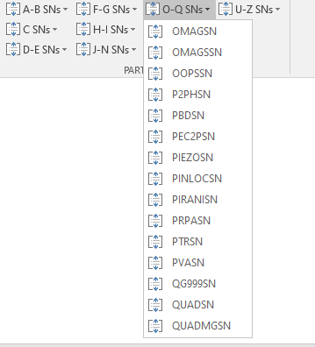
Pansophy Ribbon: Part SNs
Each dropdown lists the different Part SNs available for use in alphabetic order
E.G. [[OMAGSN]] <<OMAGSN>>
A <<SN>> field may be used if no acronym is
available yet.

Slide 16
Filling out a Traveler

Slide 17
Using an Old Traveler
Older travelers can be used as starting points for new revisions or new versions in different projects.
All files for in production travelers can be found in a project's Approved Travelers folder

Slide 18
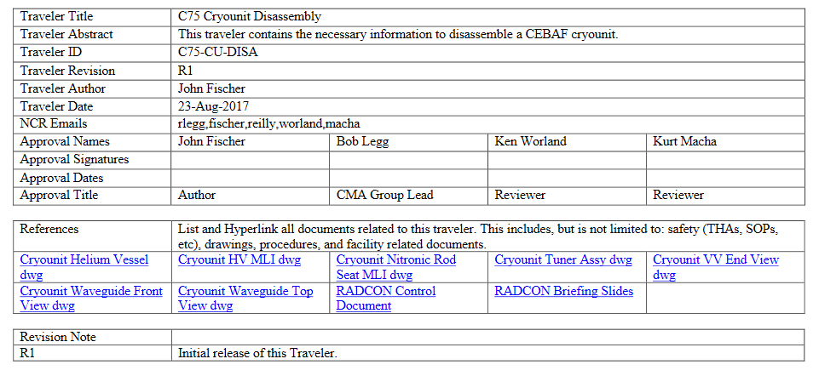
Using an Old Traveler Cont.
Ensure that the traveler is in the current template
If the first page is missing the NCR informative and D3 emails rows, it is in the old template
If this happens, create a new traveler in the current template and import the information

Slide 19
Filling Out a Traveler: Header Page
Traveler title is different from Traveler ID
Traveler ID format: Project-Work Center Area-Component-Action
NCR/D3 format: username1,username2,username3,etc
No spaces, between emails
No duplicates usernames between NCR categories

Slide 20
Filling Out a Traveler: Header Page Cont.
Hyperlink any files the author deems necessary
Ensure the links work and go to in production references
Once a traveler is in pansophy, a new revision is needed
Update the revision number and add a description of changes
Make sure the revision numbers match
Be sure a page break is at the end of the header page

Slide 21
Filling out a Traveler: Entry Fields Rules
Fieldnames must be unique and descriptive
Travelers with duplicate fieldnames names will result in errors during upload
[[Technician]] does not describe what is being done. [[VacuumTech]] or [[VacTech]] is more descriptive
Fieldnames must be nonsequential (E.G. [[FieldName1]], [[FieldName2]], etc.)
The exception is within an individual step and with Part SNs
Don't label them based on the step (E.G. [[FIELDNAME4 in step 4]])
Camel Case is preferred (E.G. [[CamelCase]], [[SRFCamelCase]])
Fieldname character limit is 48 characters
Fieldnames cannot start with a number
No spaces or special characters in fieldname except for underscore _
1 field and fieldname per line.
No more than 1 holdpoint per page

Slide 22
Traveler Page Example

Slide 23
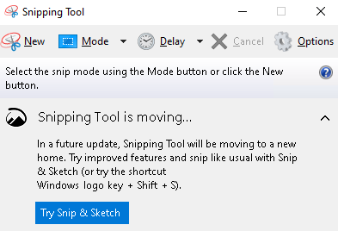
Images in a Traveler
Travelers can have images
Arrows and other symbols must be part of the image, and cannot be in the word document
To add, edit an image in word and screenshot using the snipping tool, then replace image and symbols with new image
Alternatively use Powerpoint to the same effect.

Slide 24
Extra Lines
Using extra lines to line up instructions and fields does not work
If needed, split the steps up into different cells
X
X

Slide 25
Approvals

Slide 26
When a traveler is ready for approval
Before a traveler is put out for approval, make sure it is ready to go into pansophy AS IS to the best of your ability
Pansophy may make small edits and reserves the right to send travelers back for revision
If at any time a traveler needs to be sent back for major revision, the approval process is restarted

Slide 27
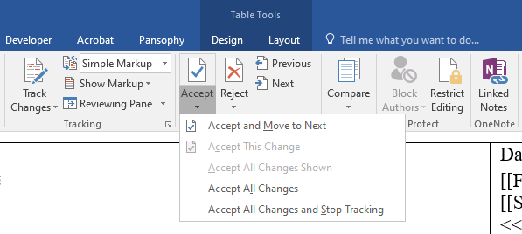
Traveler cleanup
If it was used, turn off track changes and accept all revisions
Delete comments and remove highlights
Remove double spaces
Ctrl + h, or open find and replace. Search for double spaces, replace with single. Run until zero results
If creating a new traveler from an older one, errors might carry over
Keep an eye out for smart quotes and apostrophes, or use find and replace to root them out

Slide 28
Putting a traveler out for approval
Up until this point, in progress travelers remain in the project draft folder in docushare.
When it is ready, upload to ready for approvals

Slide 29
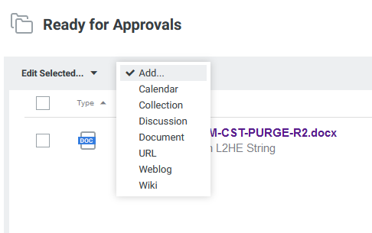
Putting a traveler out for approval: Uploading
Open ready for approvals, open the Add dropdown, and select Document

Slide 30
Putting a traveler out for approval: Uploading Cont.
Browse to select a document to upload
Document title is automatically created from the filename
Use the traveler title for the document summary

Slide 31
Approval Email
After the Document Coordinator routes a traveler for approval, the approvers will receive an email and link

Slide 32
Approving a Document
Clicking the approval link will take you to this page
You can download and view the routed document from here
Comments on the document go here
Click to save your comment
Approve or disapprove the traveler

Slide 33
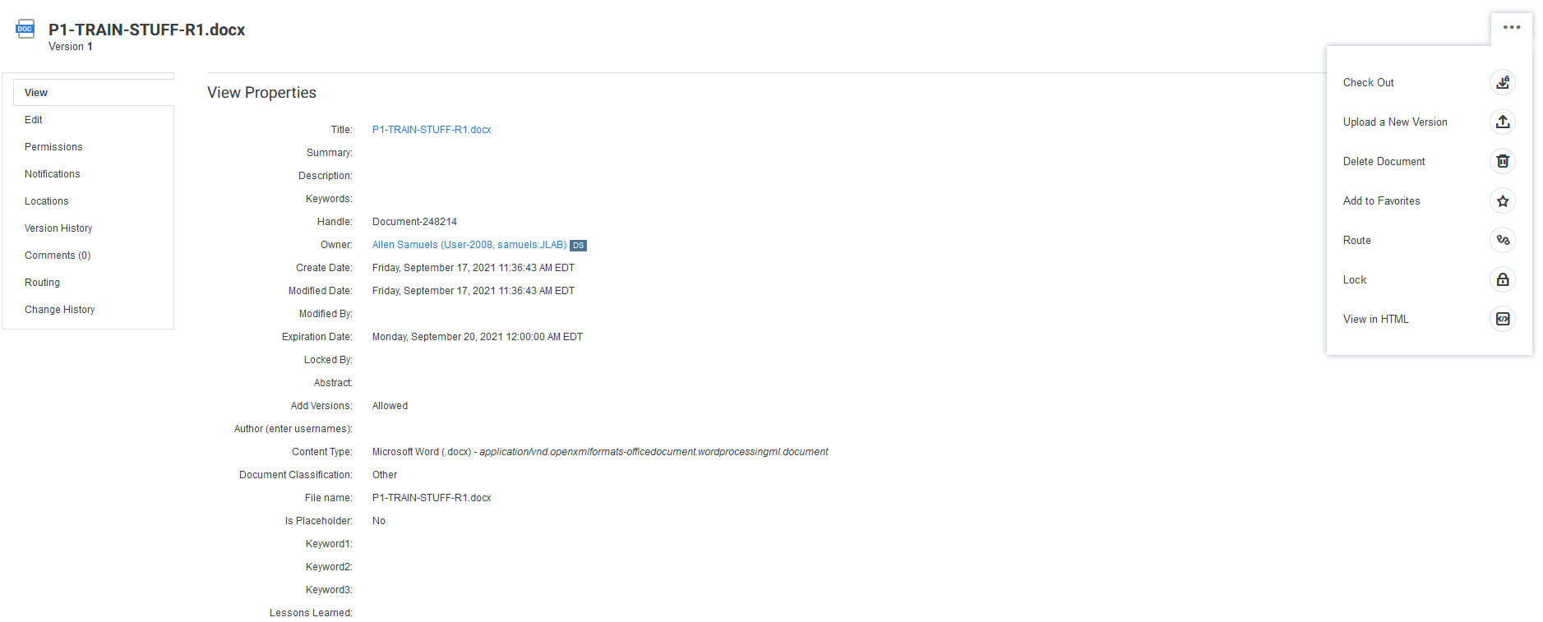
Check Approval Status
Status routing can be checked in docushare.
Open the properties, then go to routing.

Slide 34
Check Approval Status Cont.
Open the link to check who has approved or disapproved and who has not.

Slide 35
Overdue Documents and What Happens
When a Traveler or Procedure is overdue, an email will be sent to the approvers and routers.

Slide 36
Thank You For Listening
Questions?
Additional questions or concerns can be directed to pansophy@jlab.org

