Slide 1
SRFTERM Login With a Mac

Slide 2
Remote Desktop Software
Go to JLab Mac Systems, login, and open MAC Remote Access
Download the following packages at the bottom
JLab's Remote Desktop Build
The Tokend of your MAC's OS build
Reboot your mac to finish the update

Slide 3
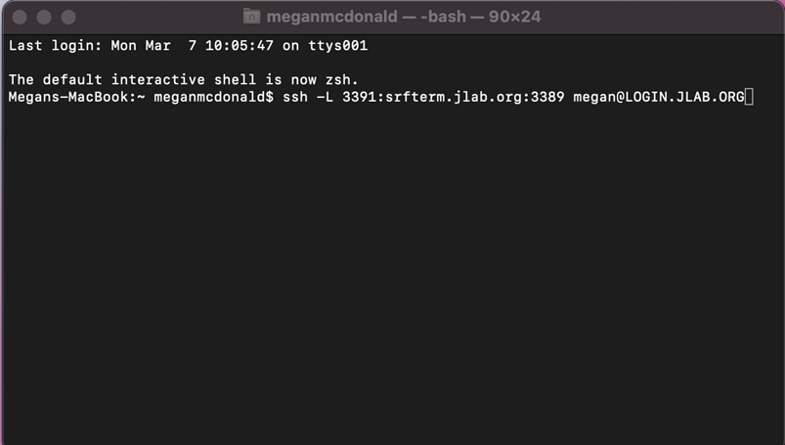
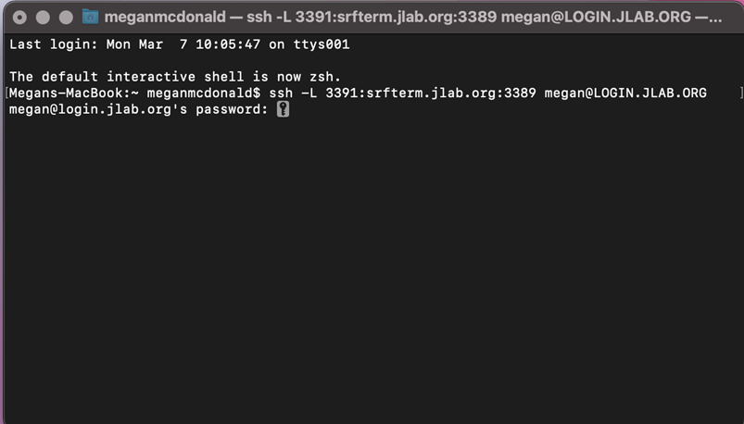
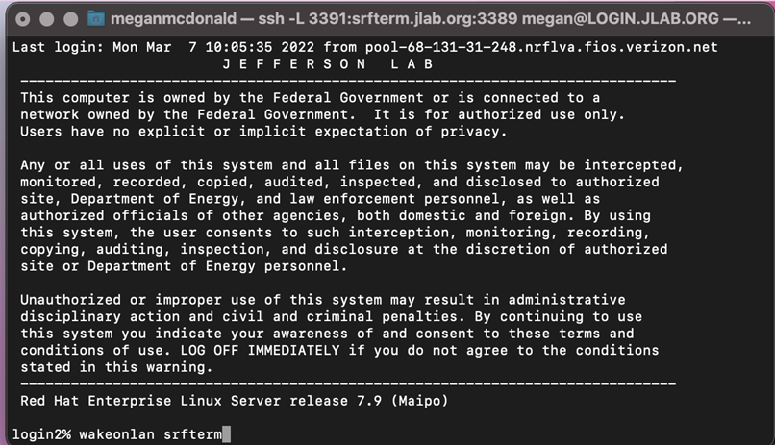
Open the Terminal
Open Terminal and type in "ssh –L 3391:srfterm.jlab.org:3389 yourusername@login.jlab.org"
Substitute yourusername with your JLab username
When prompted, type in your CUE password
IMPORTANT: Inputting an incorrect password 3 times in a row will lock you out of SRFTERM and will require your password to be reset.

Slide 4
Wake-on-Lan
Ensure SRFTerm is online by inputing the command
"wakeonlan SRFTERM"

Slide 5
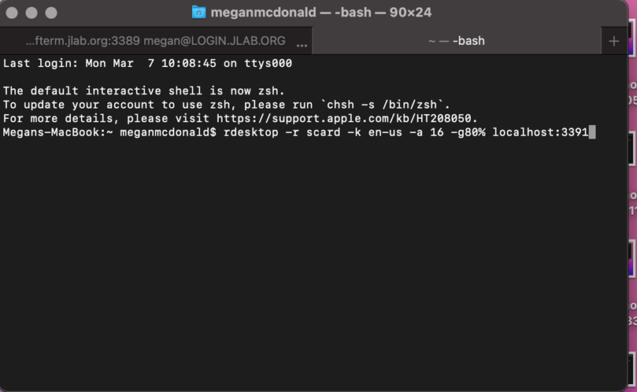
Opening The Remote Desktop
Open a new tab or window in terminal
In the new terminal, type the command
"rdesktop -r scard -k en-us -a 16 -g80% localhost:3391"

Slide 6
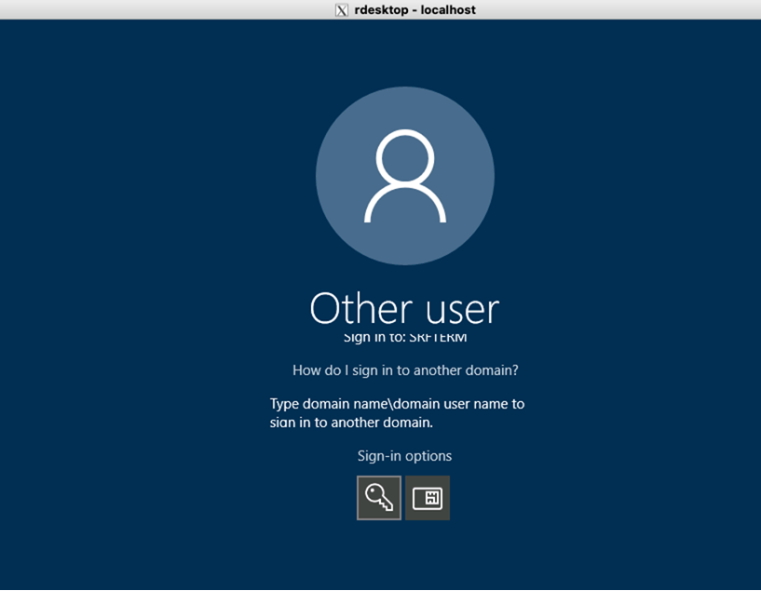
Logging in to Remote Desktop
The terminal command should open a new X11 Window to the SRFTERM computer login screen. Use the option to log in with your smartcard and passcode.

