Slide 1
Welcome To Pansophy
Pansophy Team
Valerie Bookwalter, Megan McDonald, Mike Dickey, Allen Samuels, David Parham
Contact us at Pansophy@jlab.org

Slide 2
Reference Material
Sign in to Pansophy and DocuShare
DocuShare link
Pansophy link
DocuShare Directory of Training Slides and Referenced Material
SRF Institute > 01 - SRF Projects > 06- For Reference, Additional Template and Processes
Training Slides:
SRF Institute > 01 - SRF Projects > 06- For Reference, Additional Template and Processes > Pansophy Related Training
Pansophy Help
Pansophy Home > Main Menu dropdown > Help
QMS Documents Users

Slide 3
What is a Traveler?
Jefferson Lab Work Control Document (WCD)
Used to document work on parts and assemblies.
Outlines steps and collects data from the users
Allows for later reference, data mining, reports and quality control

Slide 4
Homepage Rundown

Slide 5
Homepage Rundown- URL and Login
Users must log in to access Pansophy using their Jlab username and password
Pansophy Homepage URL

Slide 6
Homepage Rundown- Traveler Guides

Slide 7
Homepage Rundown- Main Menu
Hovering over the different options creates new drop downs
TRAVELER Main SUB-Menus
SRF OPS: Operations
SRF S&T: Science and Technology (formerly R&D)
CLOSED PRJ: Closed Projects
User TOOLS: Batch edits and file retrieval
Traveler TOOLS: Useful utilities for users

Slide 8
Main Menu Options
Travelers: Links to Travelers for Active and Closed Projects, User Tools
Production: Serial Number search, statuses, drilldowns, and SRFOPS Work Control Documents (WCD)
Projects: Project Report area for Multi-Lab Projects (MLP) like SNSPPU and LCLS-II HE
Datamine: Menu for accessing the datamining
QC Reports: Quality Control Reports board
PRIMeS: The SRF Project Inventory Management System home page
Facilities: Map of the SRFOPS production floor and Calibration system (still under development)
DocuShare: Links to Project Areas and useful SRFOPS areas
Logbooks: Menu for accessing the pansophy logbook and link to e-logbook (Accelerator)
Help: Menu for additional help and guides
Admin: Pansophy administrative menu (restricted access)
Competence: (Still under development)
SamTraxsII: Menu for editing and viewing the Sample Tracking II thin films and particulate research data
TestArea: Development Test Area for testing pages within the application environment.

Slide 9
Pansophy Help
Links to User Guides, Pansophy Training, and Traveler Authorship.
Words restricted in use for fieldnames in travelers
Found under the Main Menu drop-down

Slide 10
Data In
Putting data into Travelers

Slide 11
Traveler Menu
Select project from drop down menu to display open travelers
Search for Travelers
DO NOT HIT ENTER WHEN SEARCHING
WILL RESULT IN ERROR MESSAGE

Slide 12
Decoding Traveler IDs
Current Traveler ID naming convention: Project-Work Center Activity (WCA)-Component-Action
May experience previous naming convention in older projects (e.g. C100, C50, L2PRD)
Previous naming convention was Project-Area-Action-Component
Acronym list for traveler IDs can be found on the Pansophy homepage > User Tools > Traveler Tools > TP Acronyms

Slide 13
Traveler Example - Traveler Cover Page (P0)
Header Page of Travelers
Displays Traveler ID, Descriptions, and linked reference material

Slide 14
Traveler Example- P1

Slide 15
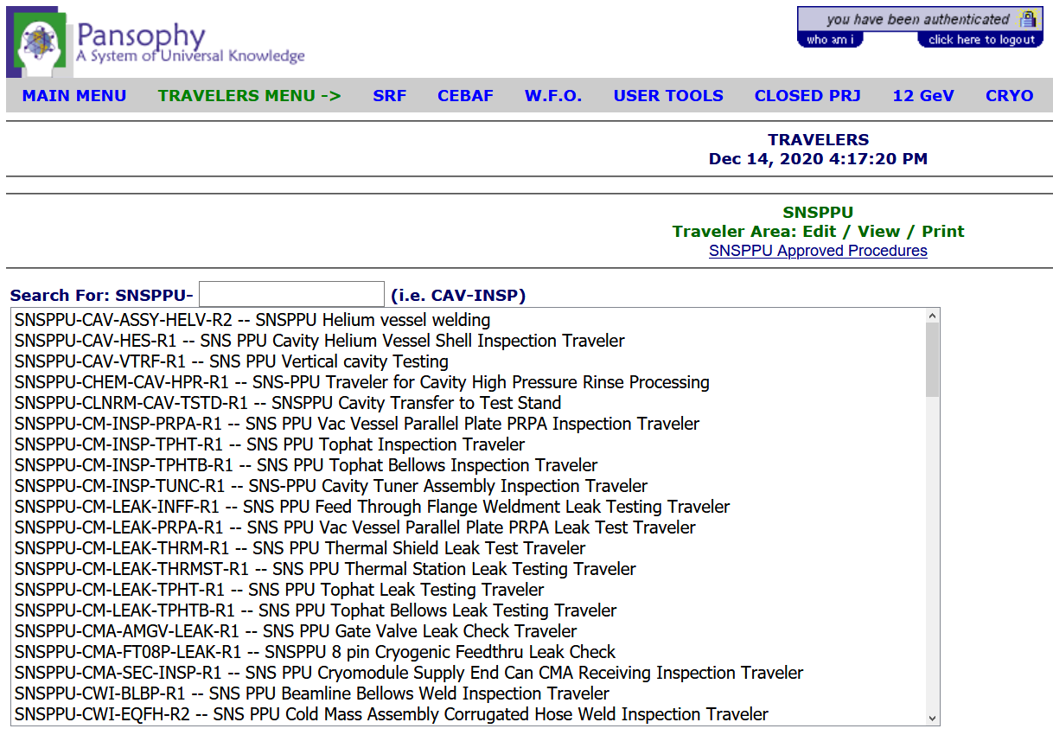
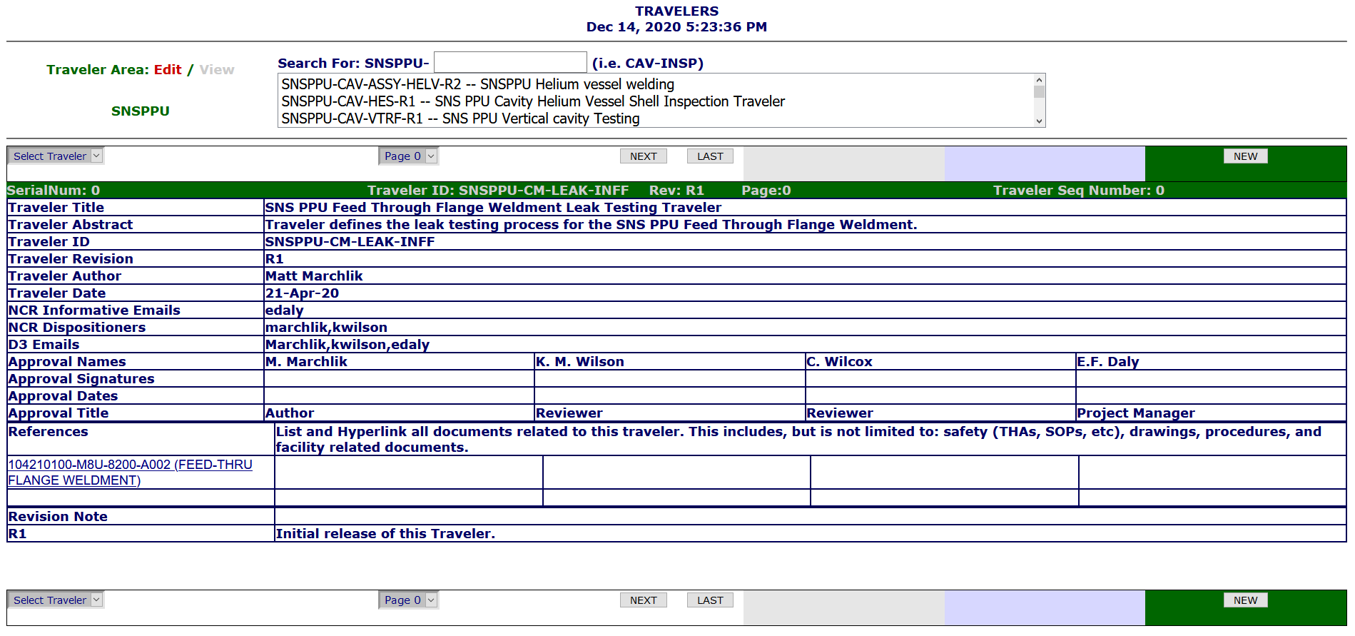
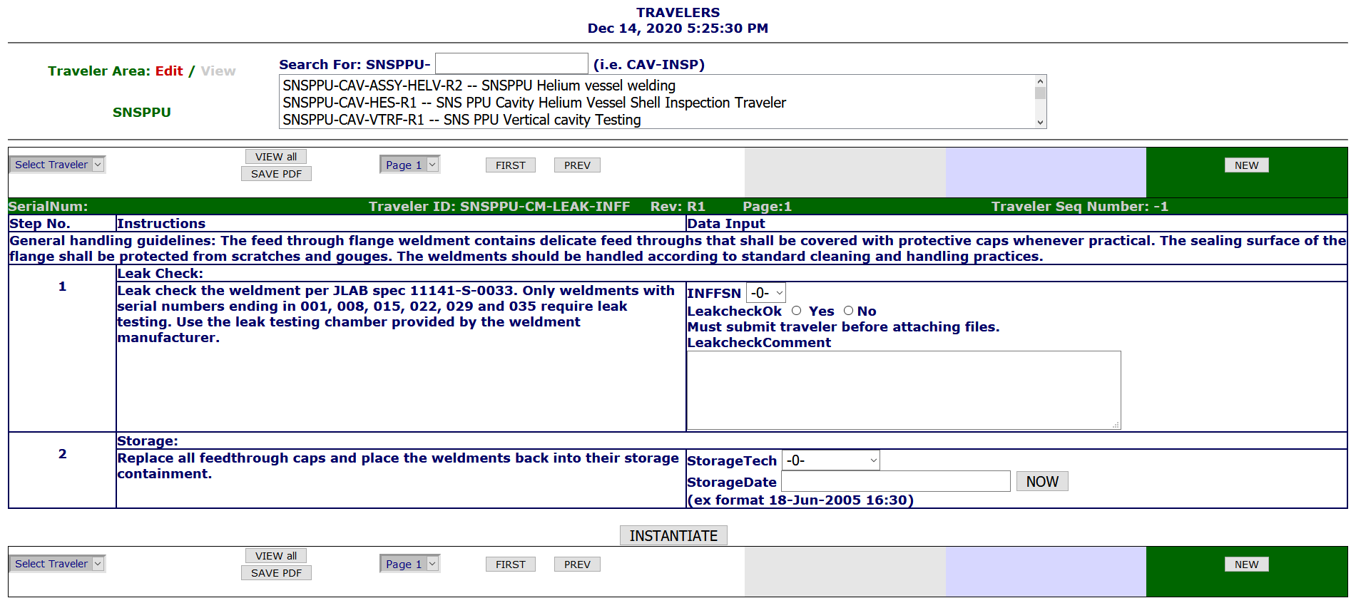
Instantiating Travelers
1. Select Traveler
2. Select New
3. Instantiate The New Traveler
4. Traveler Receives a Sequence Number after instantiation

Slide 16
Entering Data
Select previously created traveler
Page Control Buttons
Add/Update Data
SUBMIT
EACH
PAGE

Slide 17
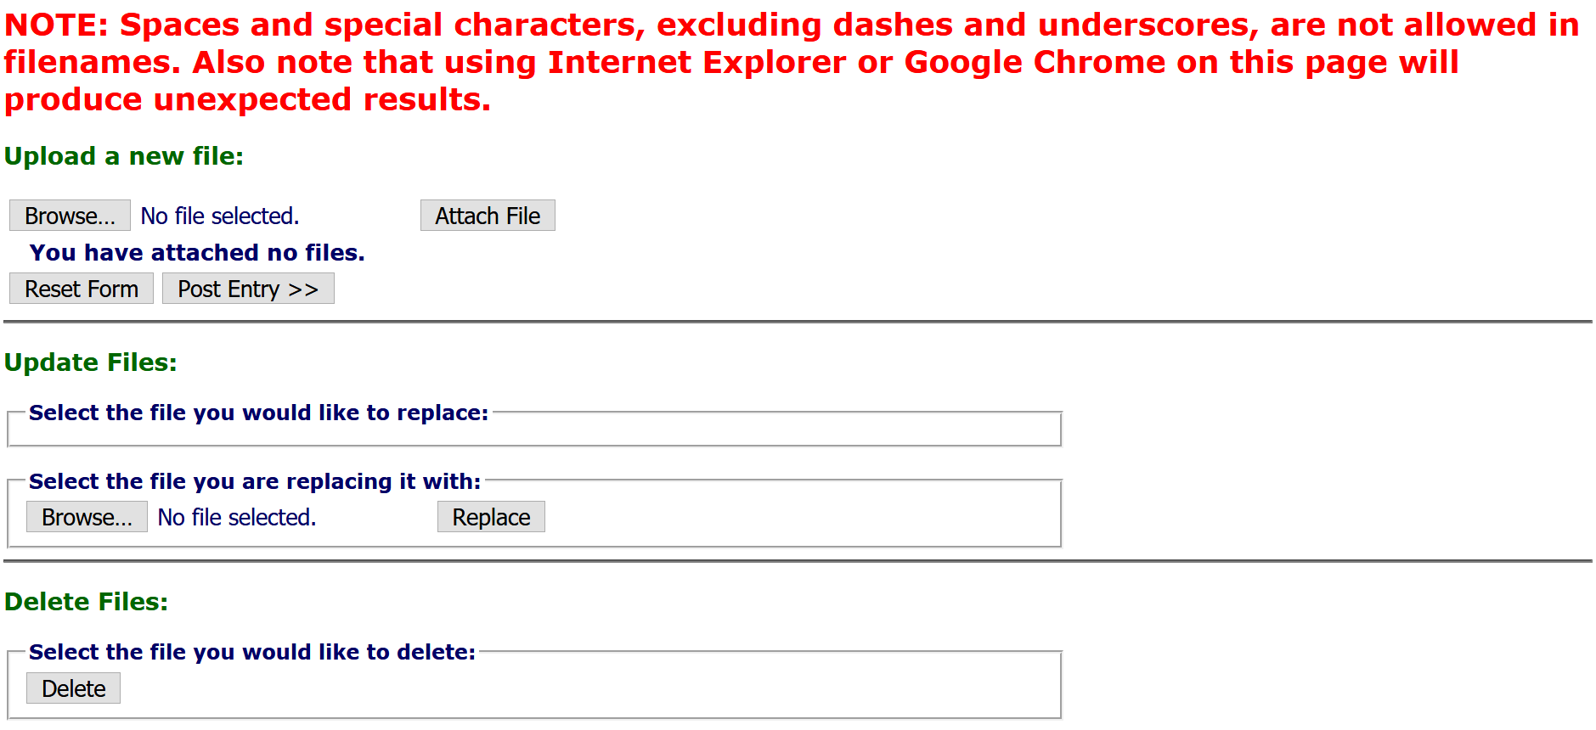
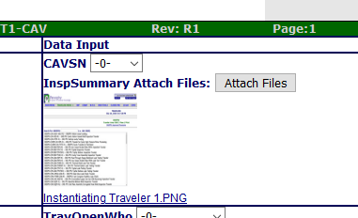
Uploading Files
IMPORTANT
Traveler MUST be instantiated before uploading files
Click Attach File, then Post Entry
3
Clicking the Attach Files button will open another tab
1
4
Click Browse
In the pop-up, open the file you wish to upload
Ensure filenames are UNIX compliant
File will be displayed next to Attach Files button
2
5

Slide 18
Hold Points (Not Signer)
Hold Points can only be cleared by the designated person(s)
Until the hold point is cleared, data cannot be added to subsequent pages (No ‘Submit to Database’ button)
No Submit Button

Slide 19
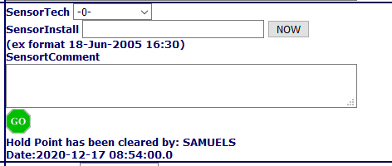
Hold Points (Signer)
This means a designated “signer” is logged in
Click the Stop Sign, then click your decision in the pop-up
This means the hold point is cleared

Slide 20
Hold Points on the Last Page
If Hold Points are on the last page, traveler cannot be closed until Hold Point is cleared
No Close Button

Slide 21
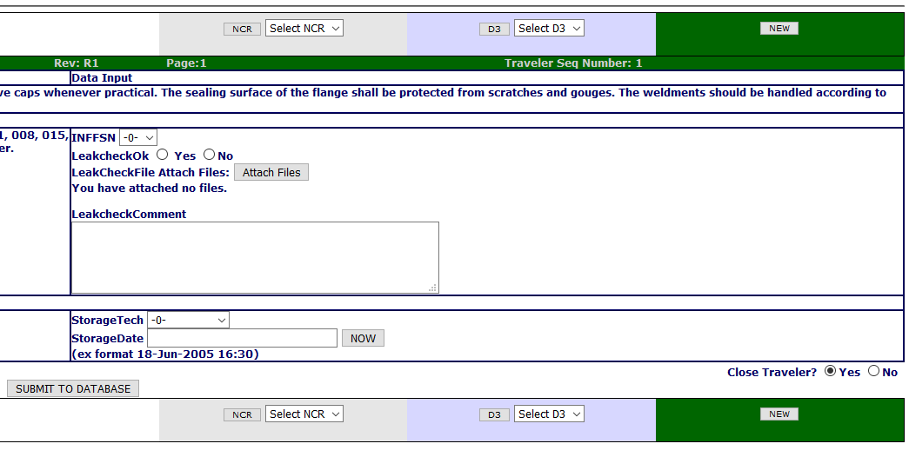
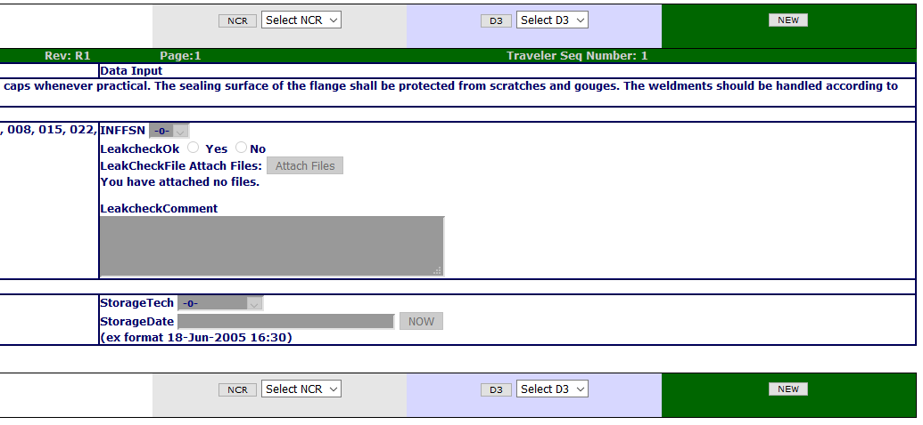
Securing Data
1. Until a Traveler is closed, data can be entered and edited
2
1
2. Once closed, ALL DATA is locked and cannot be changed
3. Data is never deleted, a history of all changes is kept
3

Slide 22
Opening an NCR or D3
NCR: Non Conformance Report
should be issued for any part that does NOT meet the specified requirements
D3s: Detours Deviations Discrepancies
should be issued for any process that cannot be completed as specified in the traveler or supporting documentation.
After Instantiating a traveler, the buttons to open an NCR or D3, or view a previously opened one, appear
Submit the page data to the database before opening either

Slide 23
Common Issues
Be sure to Instantiate a traveler before entering data
Press "Submit to Database" on every page
Ensure filenames are UNIX compliant (alphanumeric, underscores, and hyphens are all that's allowed)
Close travelers when data entry is complete and validated
Required fields are fields that must have data before submitting. Will result in an error message if left blank
Floats and Scientific Notation must have data entered in the correct format.
Ex: 1.2 for float, 1e-2 for Scientific Notation

Slide 24
Thank You For Listening
Questions?
Additional questions or concerns can be directed to pansophy@jlab.org

