Slide 1
Docushare

Slide 2
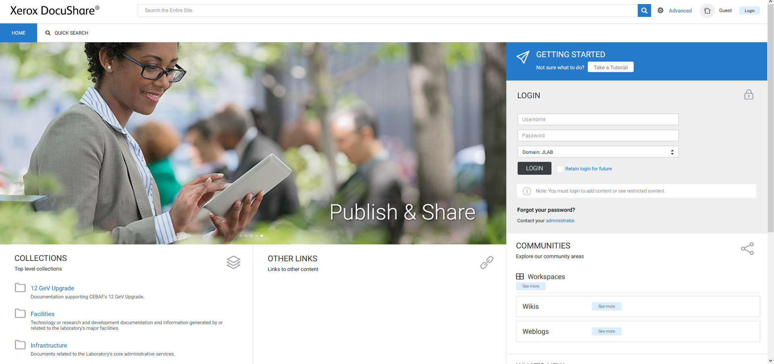
Log-In and Main Menu
Login using your Jlab Username and Password

Slide 3
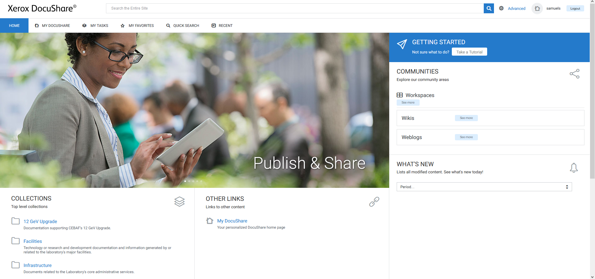
Main Menu After Login
List of documents and collections on your network
List of documents routed by you or to you
List of documents favorited by you
Additional search options
Recently edited documents

Slide 4
Document Upload and Editing

Slide 5
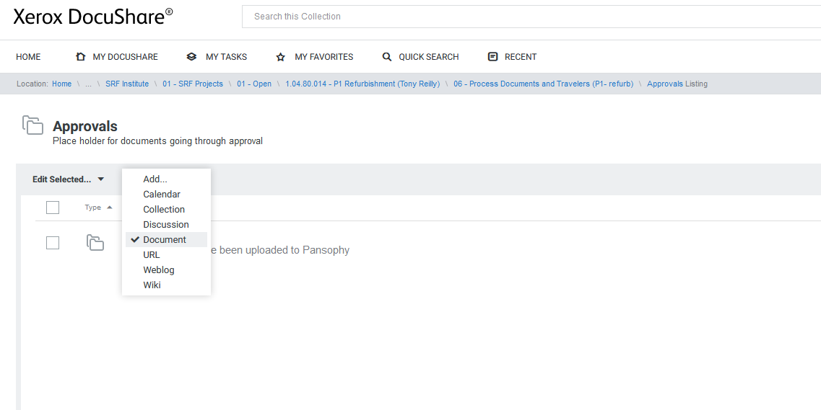
Document Upload
Go to the collection the document is meant for
Use the Drop Down under “Add” and select “Document”

Slide 6
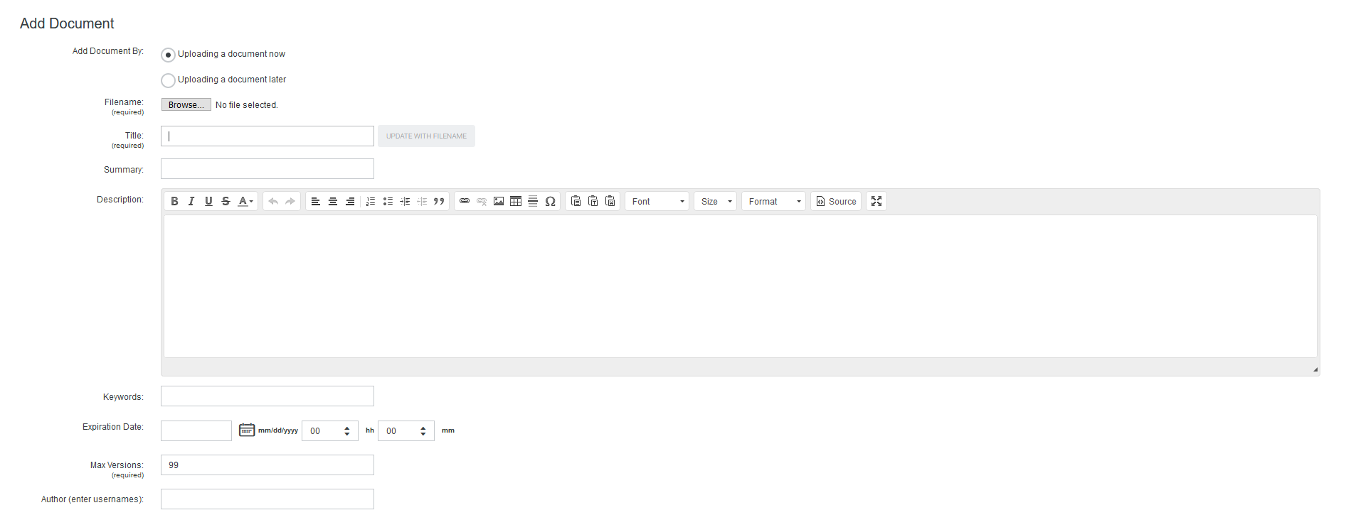
Document Upload Cont.
Browse to select a document to upload
Document title automatically created from filename
Use Traveler/Procedure title for the Document Summary

Slide 7
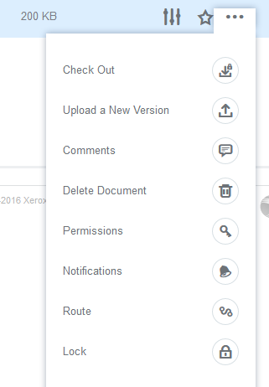
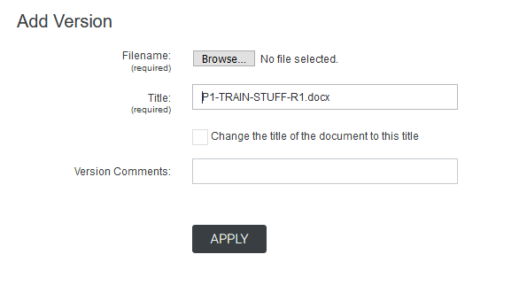
Upload a New Version
From the More Actions Section, select Upload a New Version
Add comments on the new version, if applicable

Slide 8
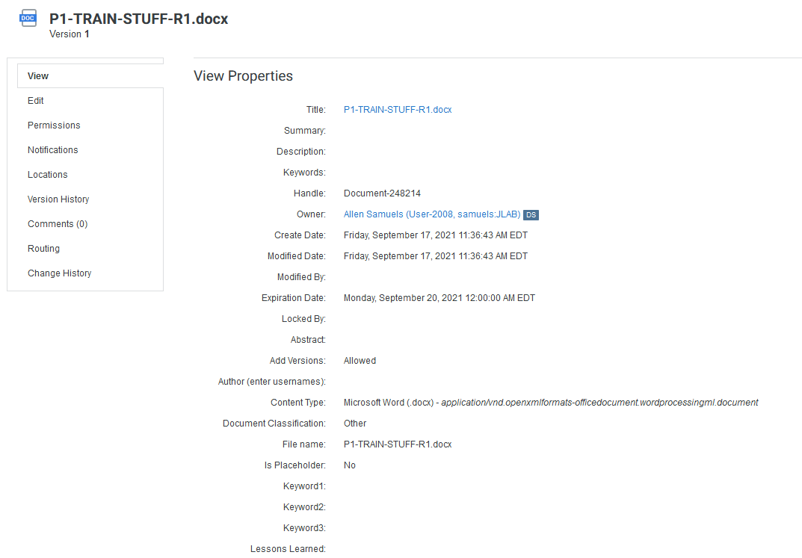
Document Properties
Select Properties to view Document Information
View the document details
Edit document details
Edit permissions to view and edit document
Add or remove notifications for documents
Locations?
Version history
Document comments
View routing status
View and change document history

Slide 9
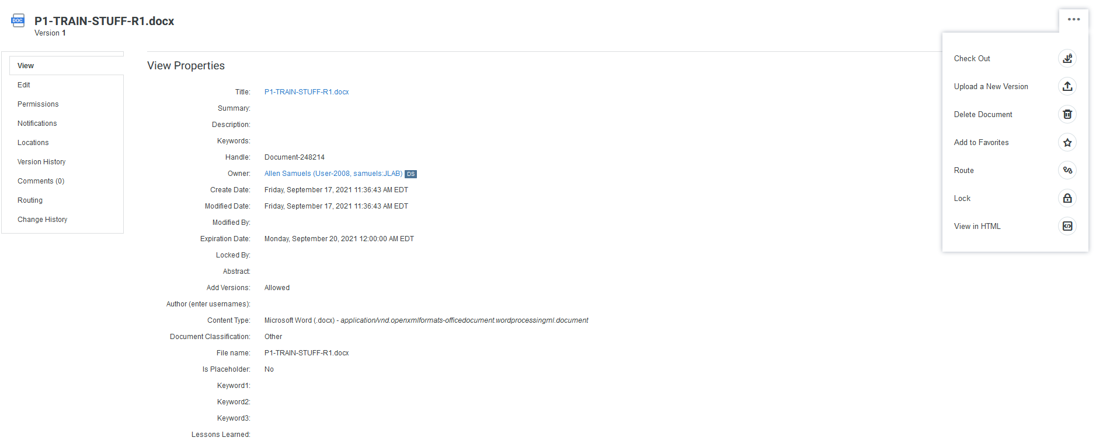
Document Actions
Temporarily lock document from edits until you check a new version back in
Uploading does not overwrite old version. A record is kept
Locks the document from others using it (not necessary to select when checking out)

Slide 10
Routing a Document

Slide 11
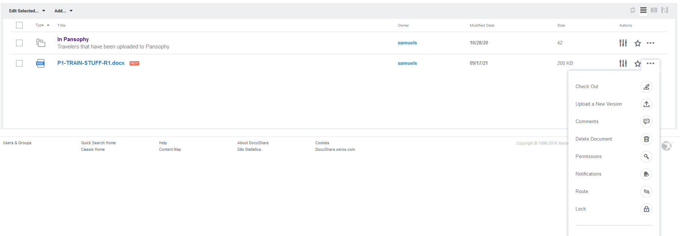
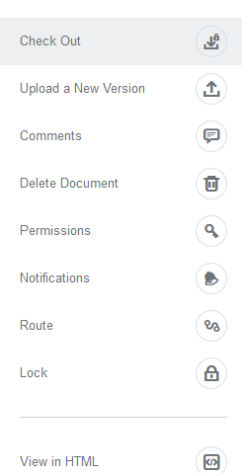
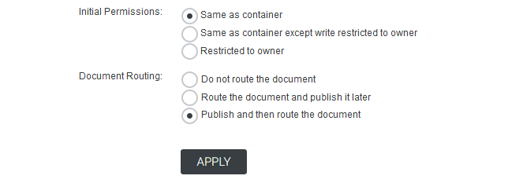
Routing
Documents can be routed at the bottom of the upload page
Documents can also be routed after publishing

Slide 12
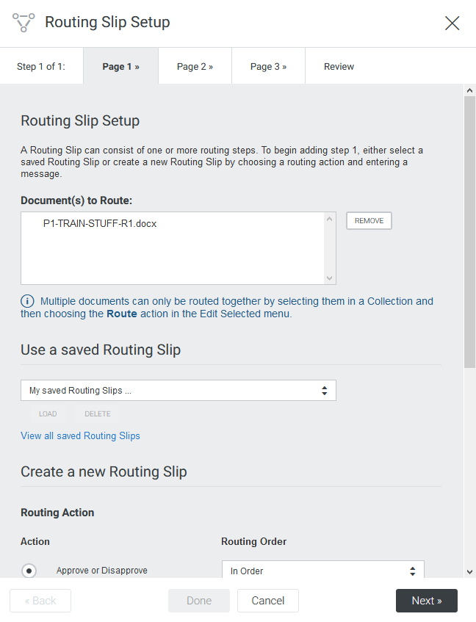
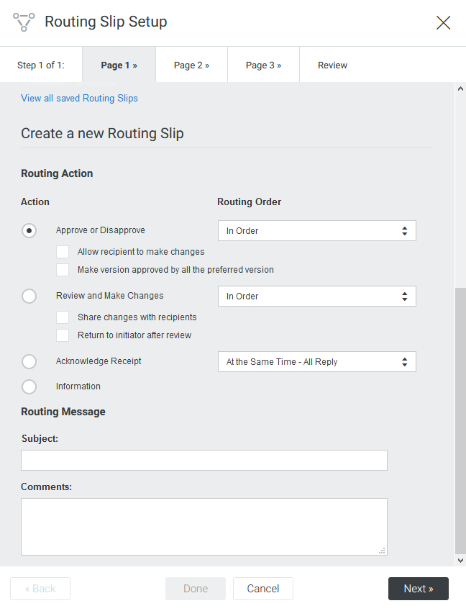
Routing Page 1
Scroll down to the bottom of Page 1
Allows you to edit the subject and message sent to the approvers
  Note: the subject is by default the document name

Slide 13
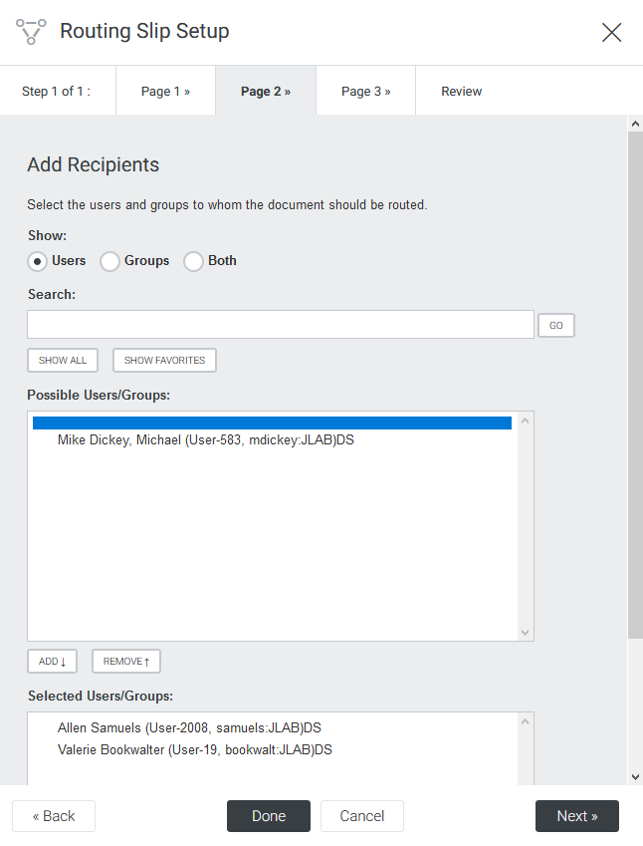
Routing Page 2
Search for user emails
Select the result you want to add
Click add to add to the approvers list
Approver names will appear here
  To remove a name, select it and click remove

Slide 14
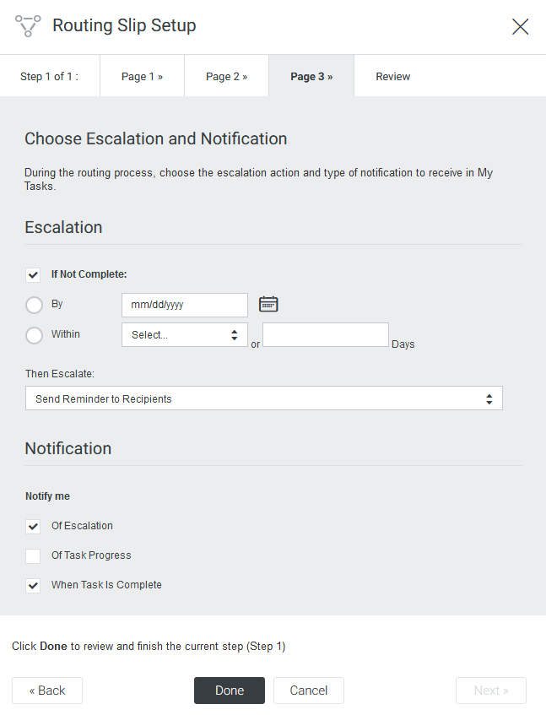
Routing Page 3
For Travelers and Procedures, use the settings shown
Set the “if not complete” date as two business days later
When active, if the approvers do not approve within a selected time, the approval becomes overdue
Defines the escalation step
Selected notifications will send emails to router when they occur

Slide 15
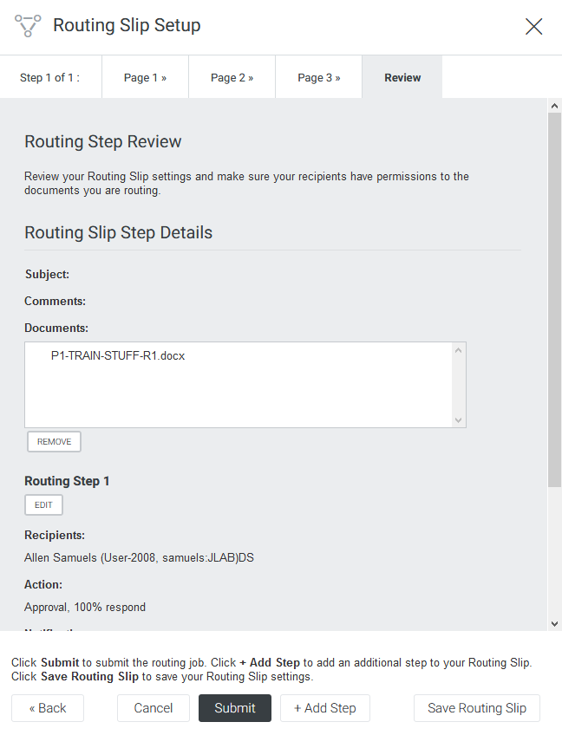
Routing Page 4
Final review page for the routing
Click Submit to route the document

Slide 16
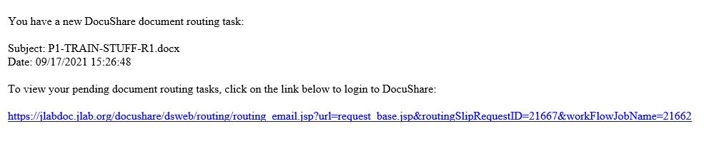
Approval Email
If a Document is sent to you for approval, you will receive an email
Link to the approval

Slide 17
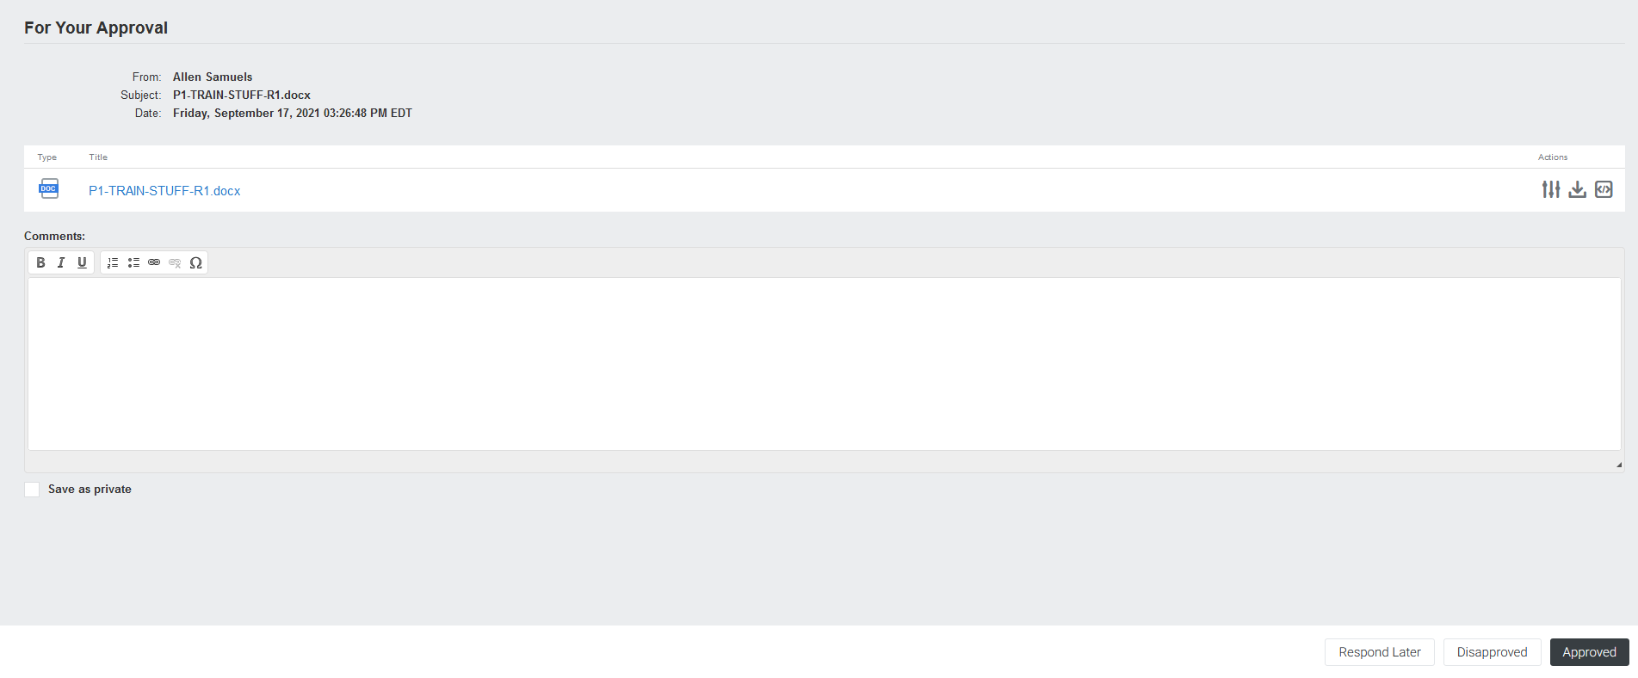
Approving a Document
Download and view routed documents
Comments on the document go here
Save comments
Approve or Disapprove

Slide 18
View Traveler
Select Properties to view Document Information
Temporarily lock document from edits until you check a new version back in
Uploading does not overwrite old version. A record is kept
Locks the document from others using it (not necessary to select when checking out)
View/Terminate Routing

Slide 19
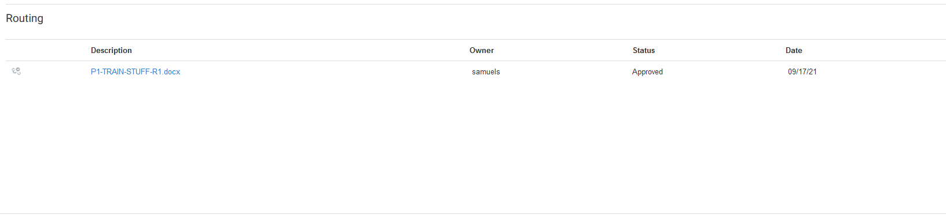
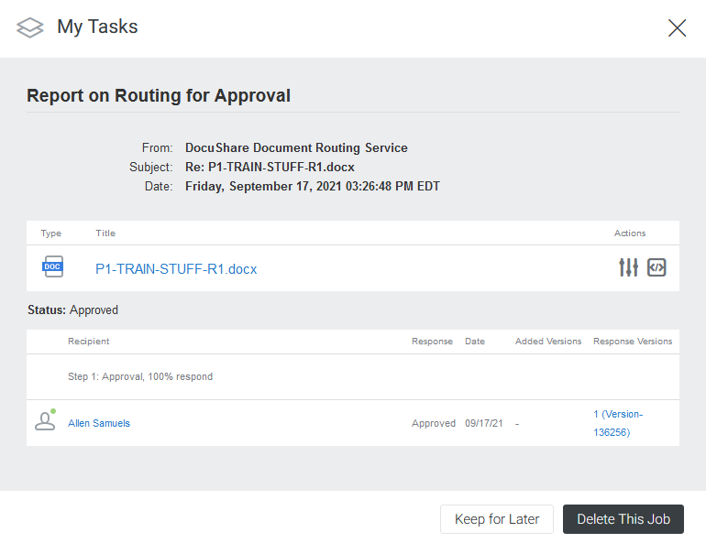
View/Terminate Routing
General Routing Status
Date of last action on routing
View detailed routing status
Response and response date
Approver
Delete/terminate routing

Slide 20
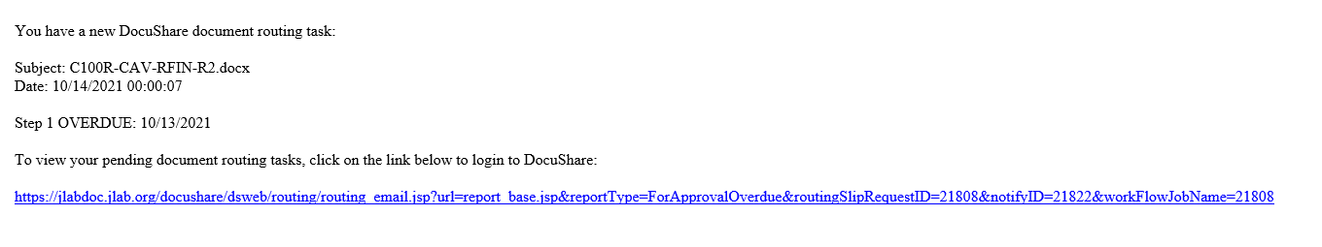
Overdue Documents and What Happens
When a Traveler or Procedure is overdue, an email will be sent to the approvers and routers if the options are selected.

Slide 21
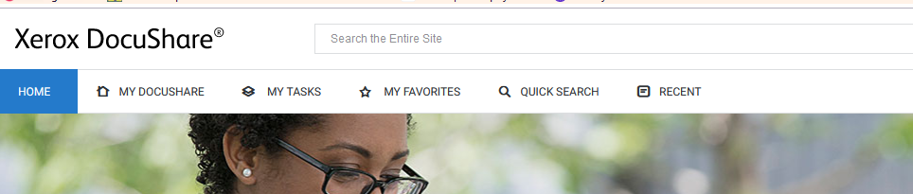
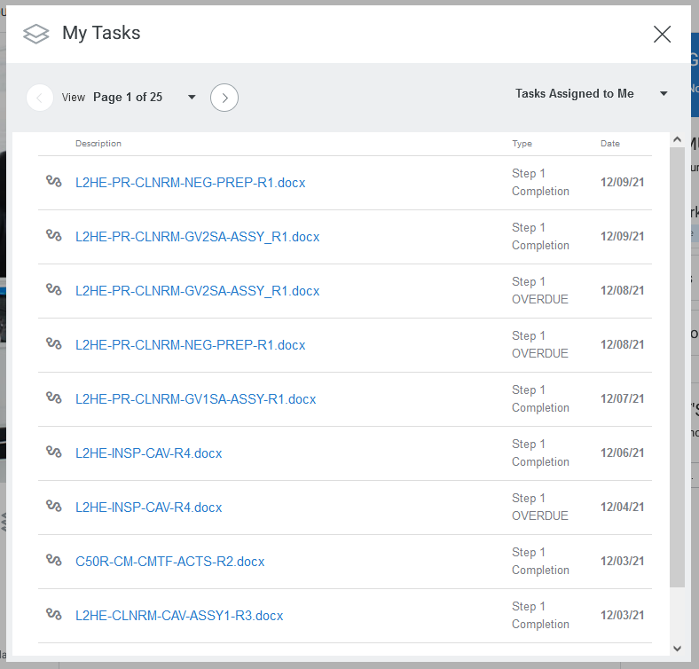
My Tasks
Date modified and status
Name of documents routed

