Slide 1
Traveler Authorship
Pansophy Team
Valerie Bookwalter, Megan McDonald, Mike Dickey, Allen Samuels, David Parham
Contact us at Pansophy@jlab.org

Slide 2
Reference Material
Sign in to Pansophy and DocuShare
  DocuShare link
  Pansophy link
DocuShare Directory of Training Slides and Referenced Material
  SRF Institute > 01 - SRF Projects > 06- For Reference, Additional Template and Processes
Training Slides:
  SRF Institute > 01 - SRF Projects > 06- For Reference, Additional Template and Processes > Pansophy Related Training
Pansophy Help
  Pansophy Home > Main Menu dropdown > Help
QMS Documents Users

Slide 3
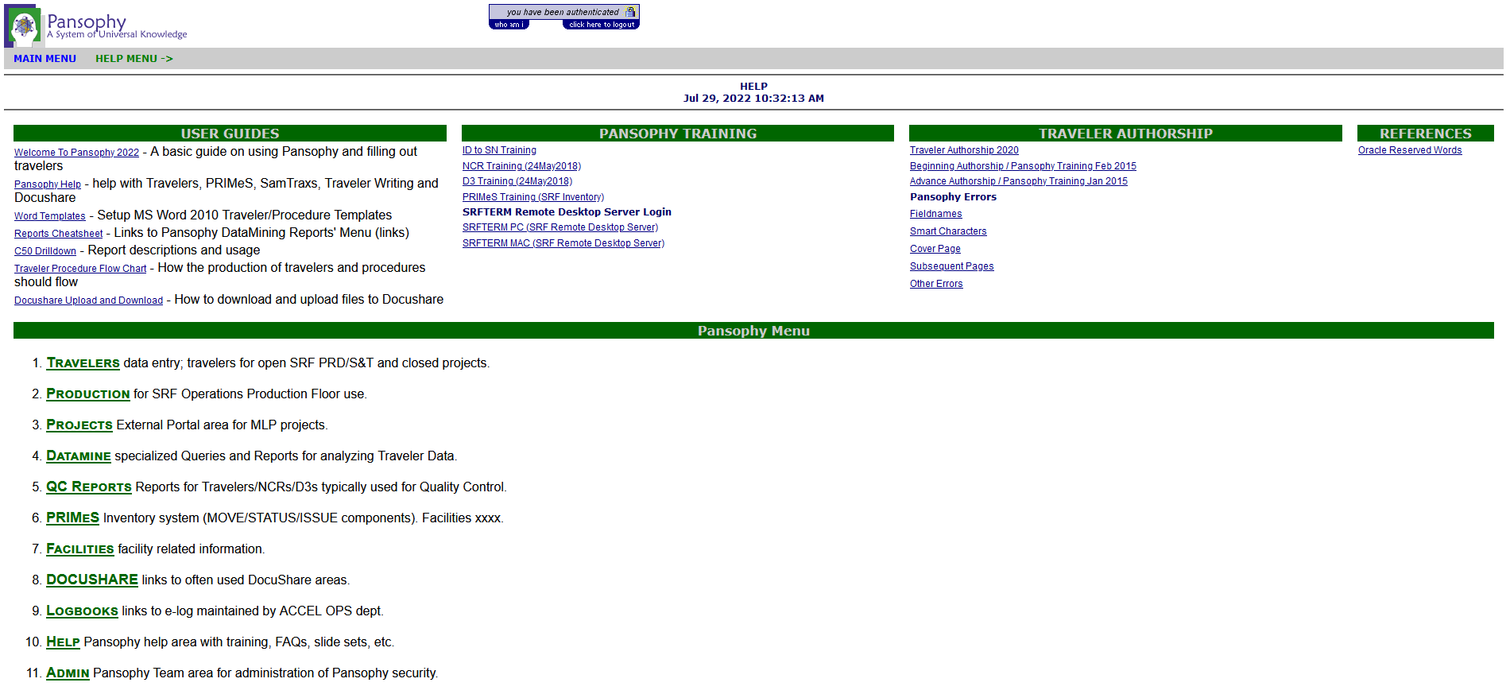
Location of Training Slides
Pansophy > Main Menu > Help

Slide 4
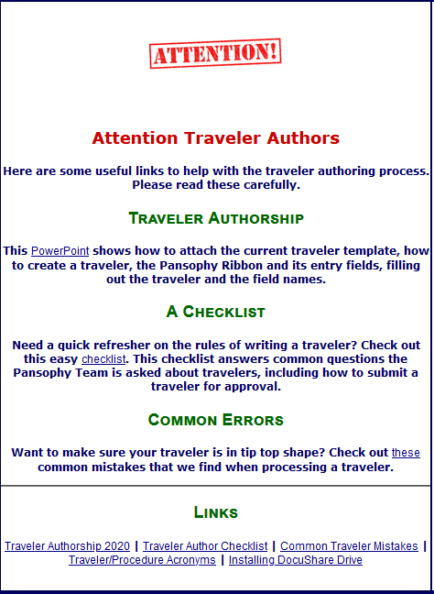
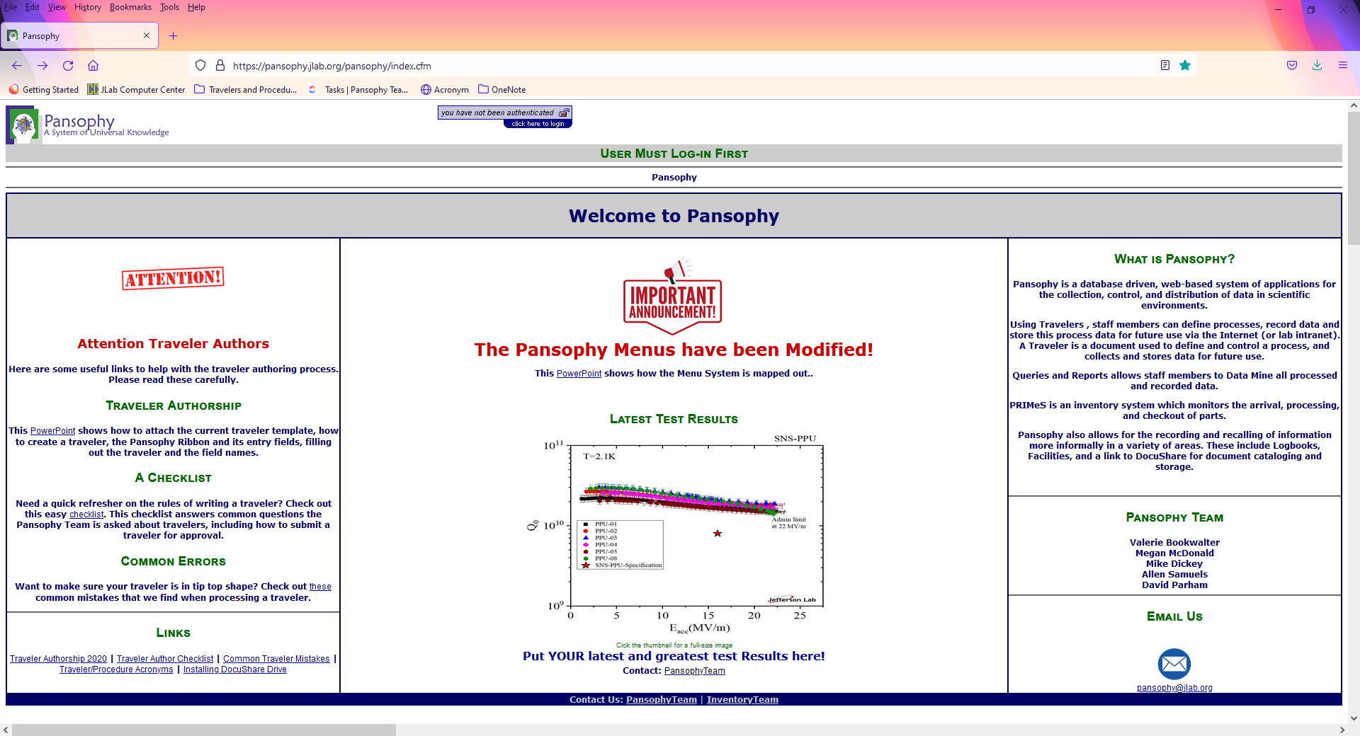
Homepage Rundown- Traveler Guides

Slide 5
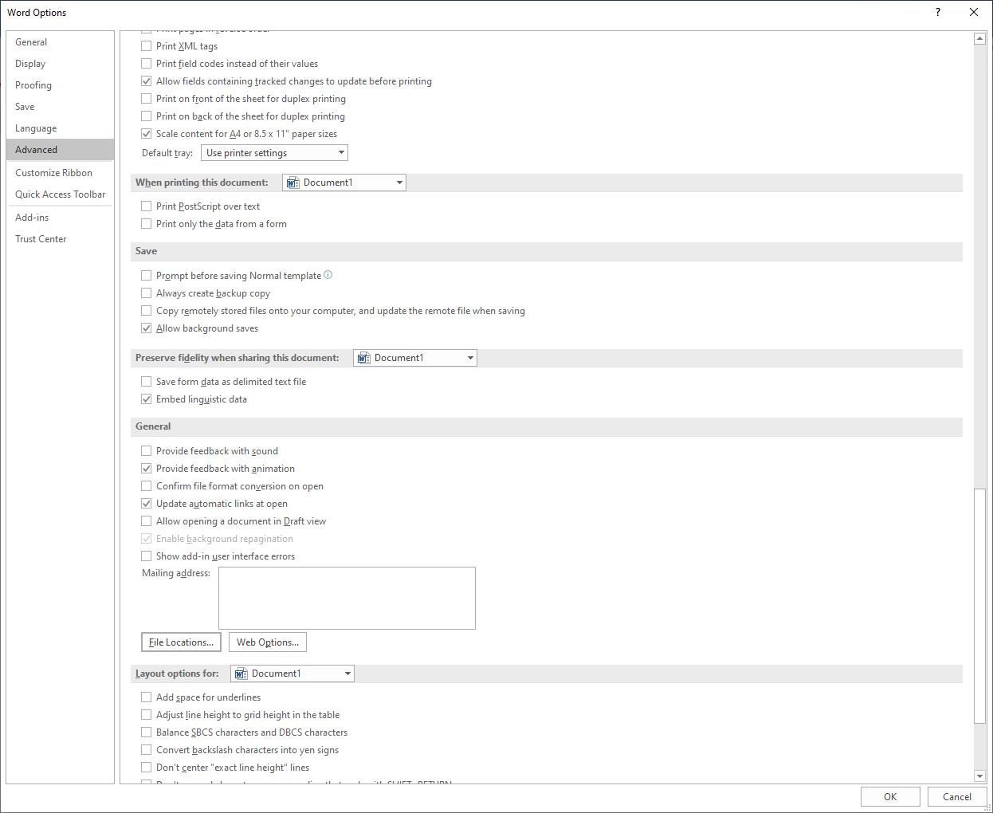
Attach the Template
Open Microsoft Word
Open a Blank document
Select the File tab
Select Options
Select Advanced
Scroll down to General
Click File Locations

Slide 6
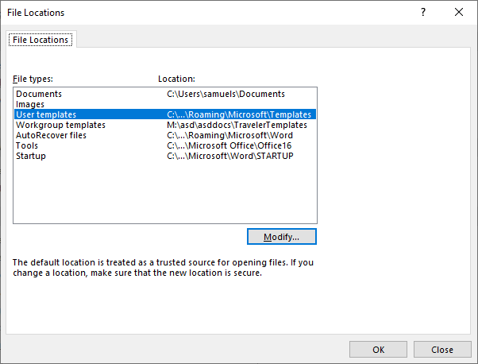
Attach the Template Cont.
In the File Locations pop up, select Workgroup templates
Click the Modify… button
Browse to M:\asd\asddocs\TravelerTemplates
Click OK
Click OK on File Locations
Click OK on Word Options

Slide 7
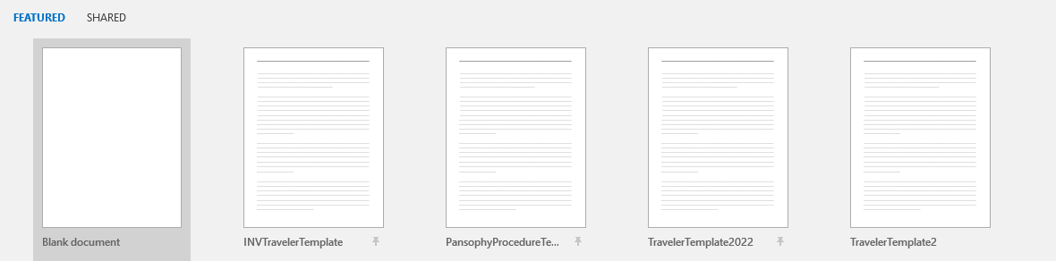
Attach the Template Cont.
Restart Word
All templates (Traveler, Procedure and Inventory Traveler) will now be available under the TEMPLATE area when Word is first opened

Slide 8
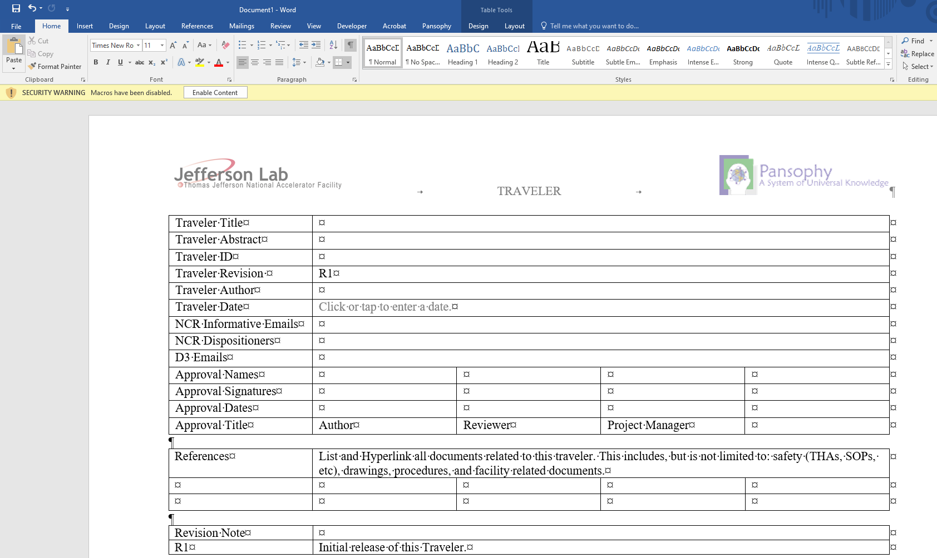
Creating a Traveler
Select TravelerTemplate2022 from the templates
  You should now see the pansophy tab in the ribbon
Be sure to click Enable Content to access the Pansophy Tab

Slide 9
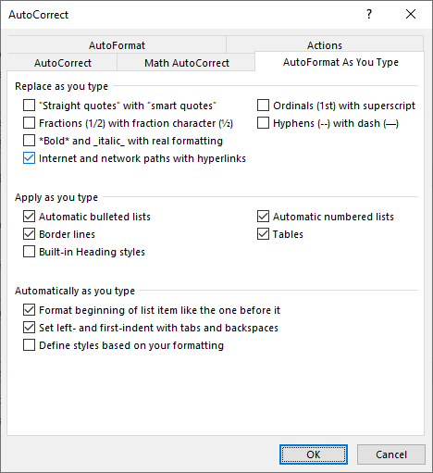

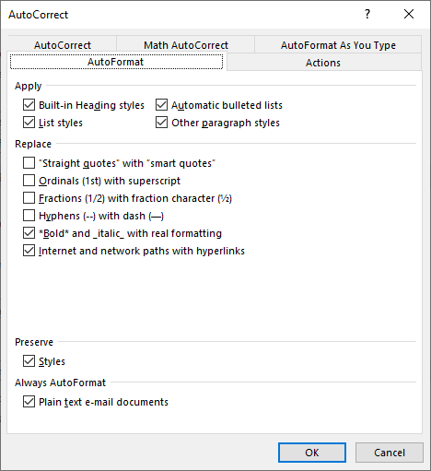
Before you Begin
Turn on Paragraph Marks
  Will assist in editing by displaying hidden symbols
Turn off Smart Tags
  File > Options > Proofing > Autocorrect Options
  Deselect the following checkboxes
  Smart characters create error symbols in pansophy

Slide 10
Pansophy Ribbon

Slide 11
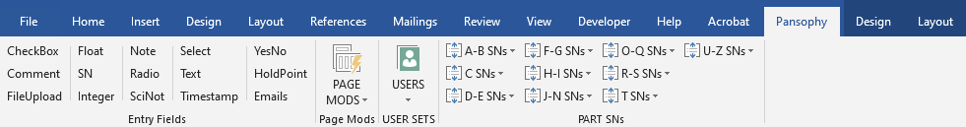
Pansophy Ribbon
2
3
1
4
Entry Fields
Page Mods
User Sets
Part SN

Slide 12

Pansophy Ribbon: Entry Fields
Entry Fields are the ONLY valid data inputs for travelers
  Collects entered data for the traveler
Formats:
  [[FieldName]] <<FIELDTYPE>>
  [[FieldName]] {{CHOICE1,CHOICE2,…}} <<FIELDTYPE>>
FieldName is the variable name for the entry field
  Displayed in the traveler and labels the field in the database
FieldType is the type of input
{{CHOICE1,CHOICE2,…}} is for fields that have multiple selection options

Slide 13
Pansophy Ribbon: Entry Fields Dictionary
Ribbon Code | Traveler Code | Definition
CheckBox | [[FieldName]] <<CHECKBOX>> | A checkbox that indicates the answer to a question is “yes”.
Comment | [[FieldName]] <<COMMENT>> | Allows you to collect comments in a large input box.
FileUpload | [[FieldName]] <<FILEUPLOAD>> | Allows you to upload any type of file to the server. File name must contain ONLY letters, numbers and underscores.
Float | [[FieldName]] <<FLOAT>> | Creates in input box that accepts numbers containing a decimal point.
SN | [[FieldName]] <<SN>> | Provides a text box that accepts serial numbers (both numbers and letters). A Part SN is preferred over an SN Field.
Integer | [[FieldName]] <<INTEGER>> | Creates an input box that accepts whole numbers only.
Note | [[FieldName]] <<NOTE>> | Use to alert programmers of special traveler requirements (ex: calculations).
Radio | [[FieldName]] {{Choice1,Choice2,Choice3}} <<RADIO>> | Creates a series of radio buttons (only one can be selected) base on the author supplied list of choices.

Slide 14
Pansophy Ribbon: Entry Fields Dictionary Cont.
Ribbon Code | Traveler Code | Definition
SciNot | [[FieldName]] <<SCINOT>> | Allows for the numbers in scientific notation.
Select | [[FieldName]] {{Choice1,Choice2,Choice3}} <<SELECT>> | Creates an author defined pull-down menu.
Text | [FieldName]] <<TEXT>> | Creates a input box for text entries. Smaller than a Comment box, just one line.
Timestamp | [[FieldName]] <<TIMESTAMP>> | Provides an input box which accepts date & time. Also supplies a “Now” button which will automatically enter the current date & time.
YesNo | [[FieldName]] <<YESNO>> | Creates radio buttons that answer a yes/no question
Holdpoint | [[FieldName]] {{Username1,Username2}} <<HOLDPOINT>> | Creates a hold point in the traveler, preventing any further data entry.
Emails | [[FieldName]] {{Username1,Username2}} <<EMAIL>> [[FieldName]] {{Subject Line}} <<EMAILSUBJ>> | Send an email to author specified users when a page is submitted. Must use the same Field Name for both lines of Entry Fields

Slide 15
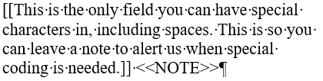
Pansophy Ribbon: Special Fields
Sometimes a traveler will require special coding beyond what entry fields offer
  If this is required, use the <<NOTE>> field
A <<HOLDPOINT>> is used to pause the traveler process until cleared by an authorized person
  Data can be submitted on the page as the holdpoint, but not subsequent pages until cleared.
  If the holdpoint is on the last page, it prevents the traveler from being closed until cleared
  IMPORTANT: Only one holdpoint per traveler page
<<EMAIL>> and <<EMAILSUBJ>> sends an email to traveler author specified users
  Must use the same Field Name for both lines of Entry Fields
    Can use spaces in the subject line, no other special characters

Slide 16
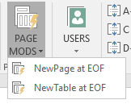
Pansophy Ribbon: Page Mods
Ribbon Code | Definition
NewPage at EOF | Inserts a page break at the End Of the File
NewTable at EOF | Inserts a page break and a table for steps, instructions and data input at the End Of the File

Slide 17
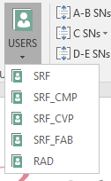
Pansophy Ribbon: User Sets
Ribbon Code | Traveler Code | Definition
SRF | [[SRF_FIELDNAME]] <<SRF>> | SRF User Set
SRF_CMP | [[SRFCMP_FIELDNAME]] <<SRFCMP>> | SRF Cryomodule User Set
SRF_CVP | [[SRFCVP_FIELDNAME]] <<SRFCVP>> | SRF Cavity User Set
SRF_FAB | [[SRFFAB_FIELDNAME]] <<SRFFAB>> | SRF Fabrication User Set
RAD | [[RAD_FIELDNAME]] <<RAD>> | Radcon User Set
If a username does not appear online, contact pansophy to add them in.

Slide 18

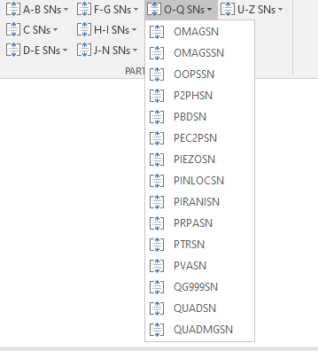
Pansophy Ribbon: Part SNs
Each dropdown lists the different Part SNs available for use in alphabetic order
E.G. [[OMAGSN]] <<OMAGSN>>
A <<SN>> field may be used if no acronym is
available yet.

Slide 19
Authoring a Traveler

Slide 20
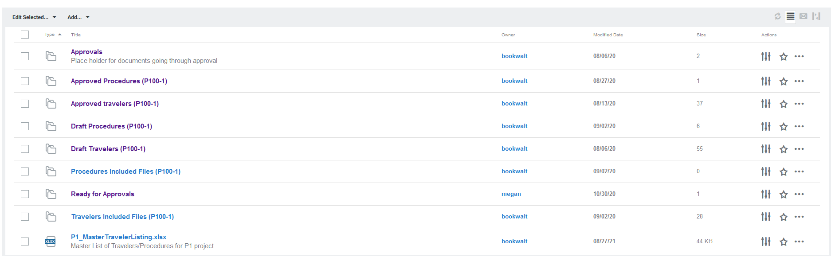
Using an Old Traveler
Older travelers can be used as starting points for new revisions or new versions in different projects.
All files for in production travelers can be found in a project's Approved Travelers folder

Slide 21
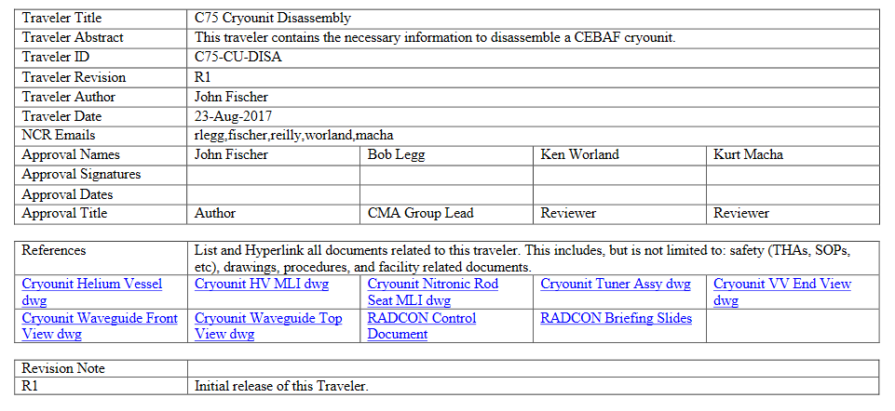
Using an Old Traveler Cont.
Ensure that the traveler is in the current template
  If the first page is missing the NCR informative and D3 emails rows, it is in the old template
  If this happens, create a new traveler in the current template and transfer the information

Slide 22
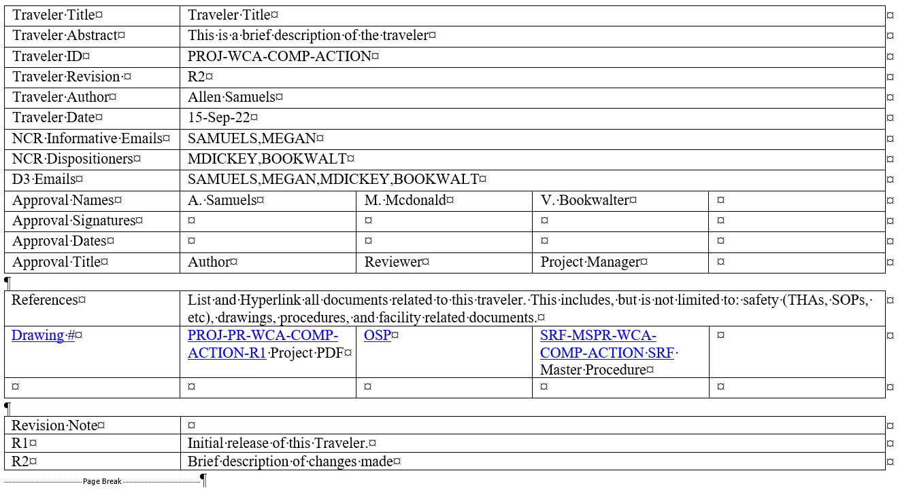
Filling Out a Traveler: Header Page
Traveler title is different from Traveler ID
Traveler ID format: Project-Work Center Area-Component-Action
  This will be the filename, along with the revision number
  Discuss Traveler ID with Project Coordinator
  Ensure Traveler ID is listed in the Work Control Document (WCD) register
  Acronyms can be found on the pansophy website > Traveler Tools > TP Acronyms
NCR/D3 format: USERNAME1,USERNAME2,USERNAME3,etc
  No spaces, between emails
  No duplicates usernames between NCR categories
    NCR Informative get email alerts about NCRs. NCR Dispositioners can go in and address them.

Slide 23
Filling Out a Traveler: Header Page Cont.
Hyperlink any files the author deems necessary
  Ensure the links work and go to in production references
Once a traveler is in production, a new revision is needed for any modifications
  Update the revision number and add a description of changes
  Make sure the revision numbers match
Be sure a page break is at the end of the header page

Slide 24
Filling out a Traveler: Entry Fields Rules
Fieldnames must be unique and descriptive
  Travelers with duplicate fieldnames names will result in errors during upload
  [[Technician]] does not describe what is being done. [[VacuumTech]] or [[VacTech]] is more descriptive
Fieldnames must be nonsequential (E.G. [[FieldName1]], [[FieldName2]], etc. is not preferred)
  The exception is within an individual step and with Part SNs
  Don't label them based on the step (E.G. [[FIELDNAME4 in step 4]])
Camel Case is preferred (E.G. [[CamelCase]], [[SRFCamelCase]])
Fieldname character limit is 40 characters
Fieldnames cannot start with a number
No spaces or special characters in fieldname except for underscore _
1 field and fieldname per line.
No more than 1 holdpoint per page

Slide 25
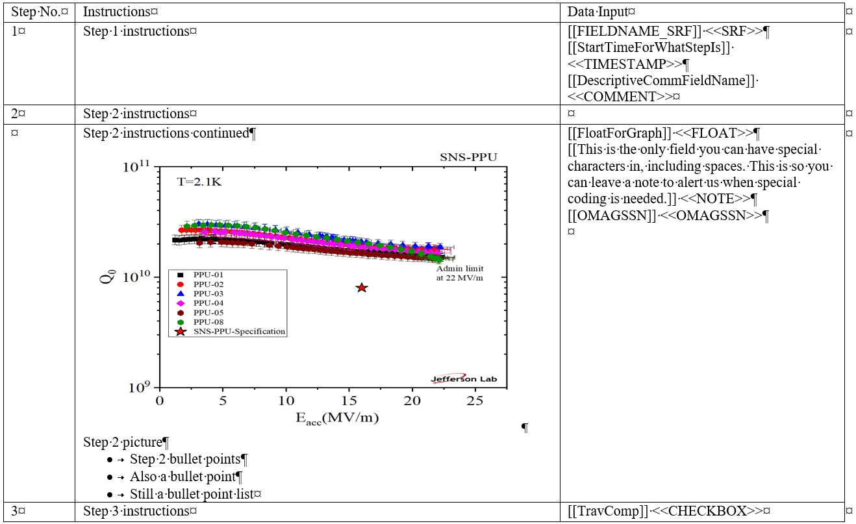
Traveler Page Example
The first work page (P1) needs at minimum:
  Part SN
  SRF User Group
  Comment
  Timestamp
Valid SNs can be found under the Pansophy tab > Part SNs
If your component is not listed, verify on the pansophy webpage > Traveler Tools > SN List

Slide 26
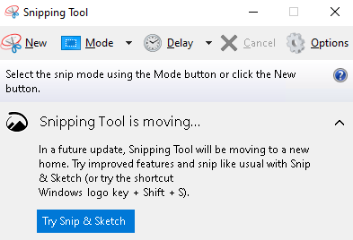
Images in a Traveler
Travelers can have images
Arrows and other symbols must be part of the image, and cannot be in the word document
  To add, edit an image in word and screenshot using the snipping tool, then replace image and symbols with new image
  Alternatively use PowerPoint to the same effect.

Slide 27
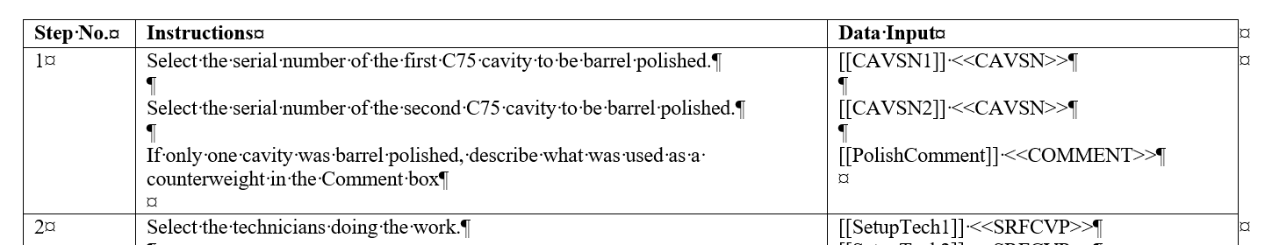
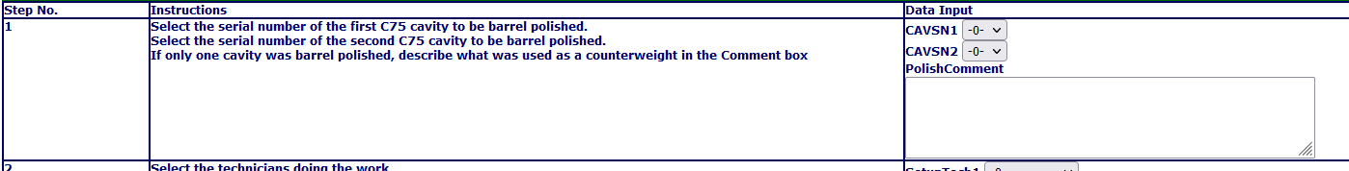
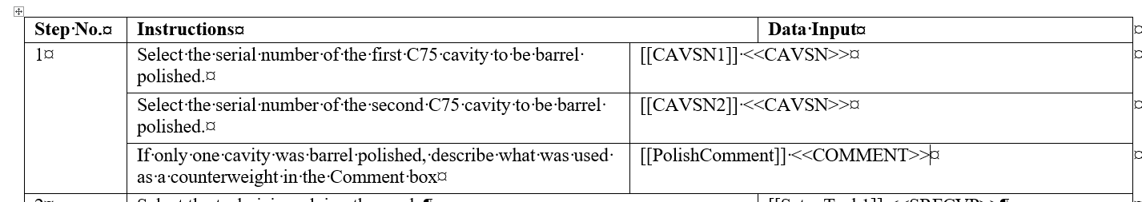
Extra Lines
Using extra lines to line up instructions and fields does not work
If needed, split the steps up into different cells
X
X

Slide 28
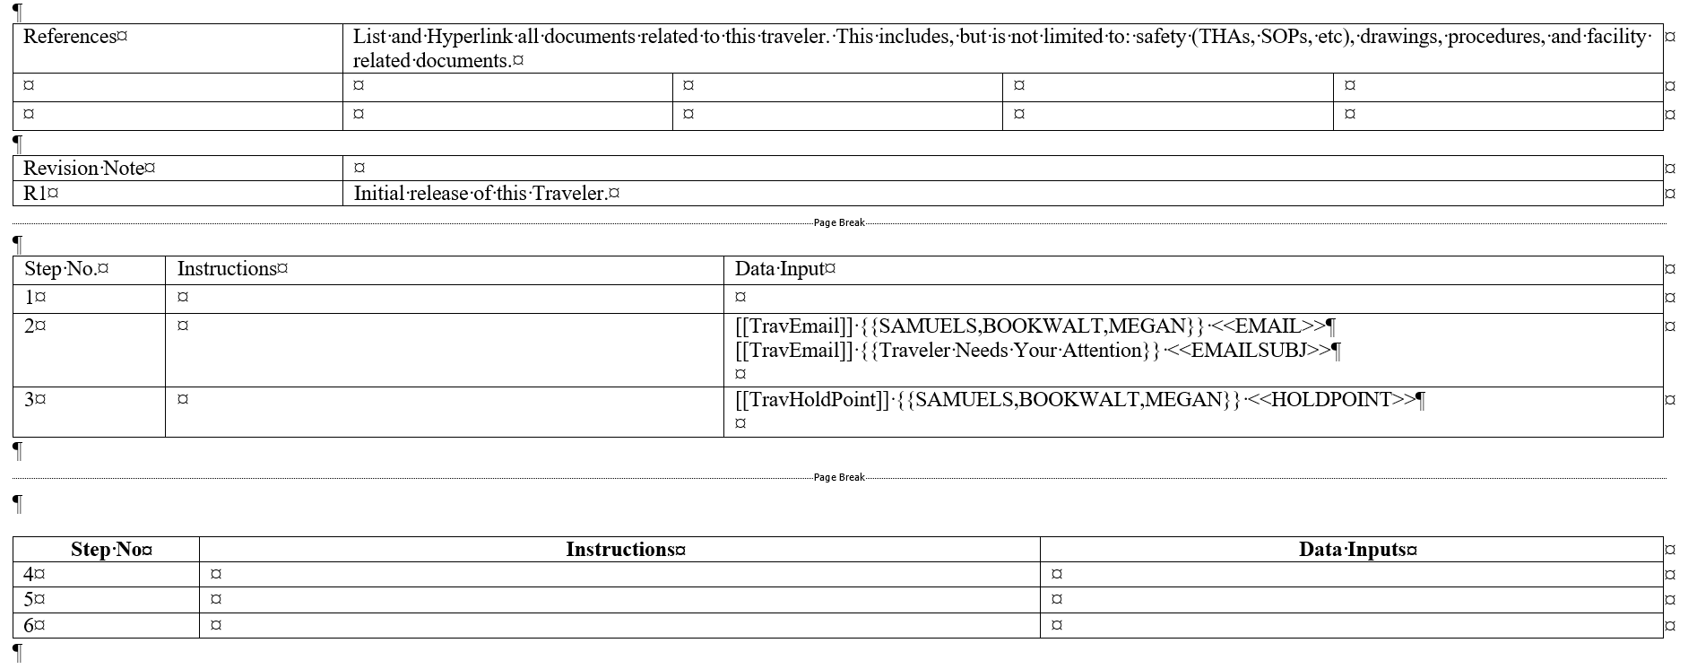
Page Breaks
Travelers are preferred to be on multiple pages
Page breaks create new pages on the web
Use Pansophy Tab > Page Mods > New Table at EOF to insert a page break and new table at the end of the document
If a table needs to be broken up, go to the layout tab and use the split table tool

Slide 29
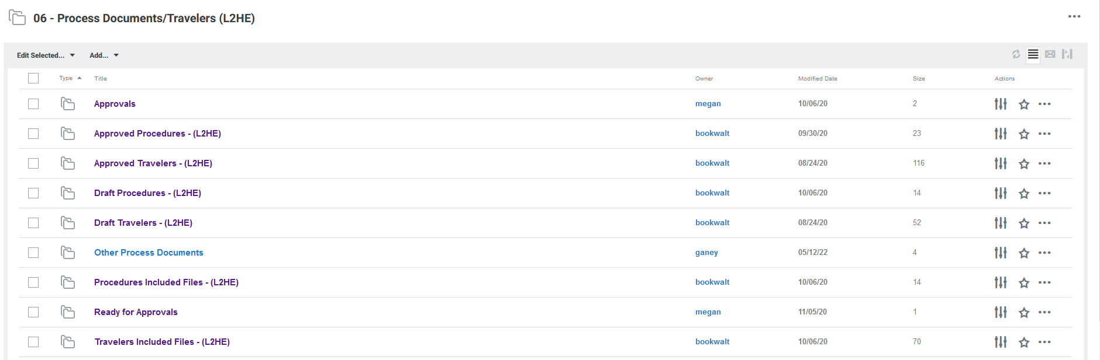
Draft Travelers Folder
Each Docushare project area has a draft travelers folder
  This folder is for authors to upload a copy of their draft traveler while in the editing process
  Also used for preliminary review between approvers before being sent out for official approvals

Slide 30
Approvals

Slide 31
When a traveler is ready for approval
Before a traveler is put out for approval, make sure it is ready to go into pansophy AS IS to the best of your ability
  Pansophy may make small edits and reserves the right to send travelers back for revision
  If at any time a traveler needs to be sent back for major revision, the approval process is restarted

Slide 32
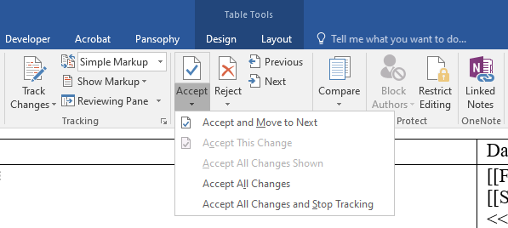
Traveler cleanup
If it was used, turn off track changes and accept all revisions
Delete comments and remove highlights
Remove double spaces
  Ctrl + h, or open find and replace. Search for double spaces, replace with single. Run until zero results
If creating a new traveler from an older one, errors might carry over
  Keep an eye out for smart quotes and apostrophes, or use find and replace to root them out

Slide 33
Putting a traveler out for approval
Up until this point, in progress travelers remain in the project draft folder in Docushare.
When it is ready, upload the traveler word document to the Ready for Approvals folder.
  Pansophy does not accept travelers via email.

Slide 34
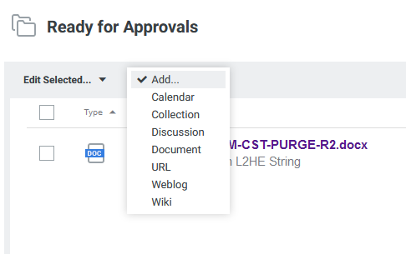
Putting a traveler out for approval: Uploading
Open ready for approvals, click the "Add" dropdown, and select Document

Slide 35
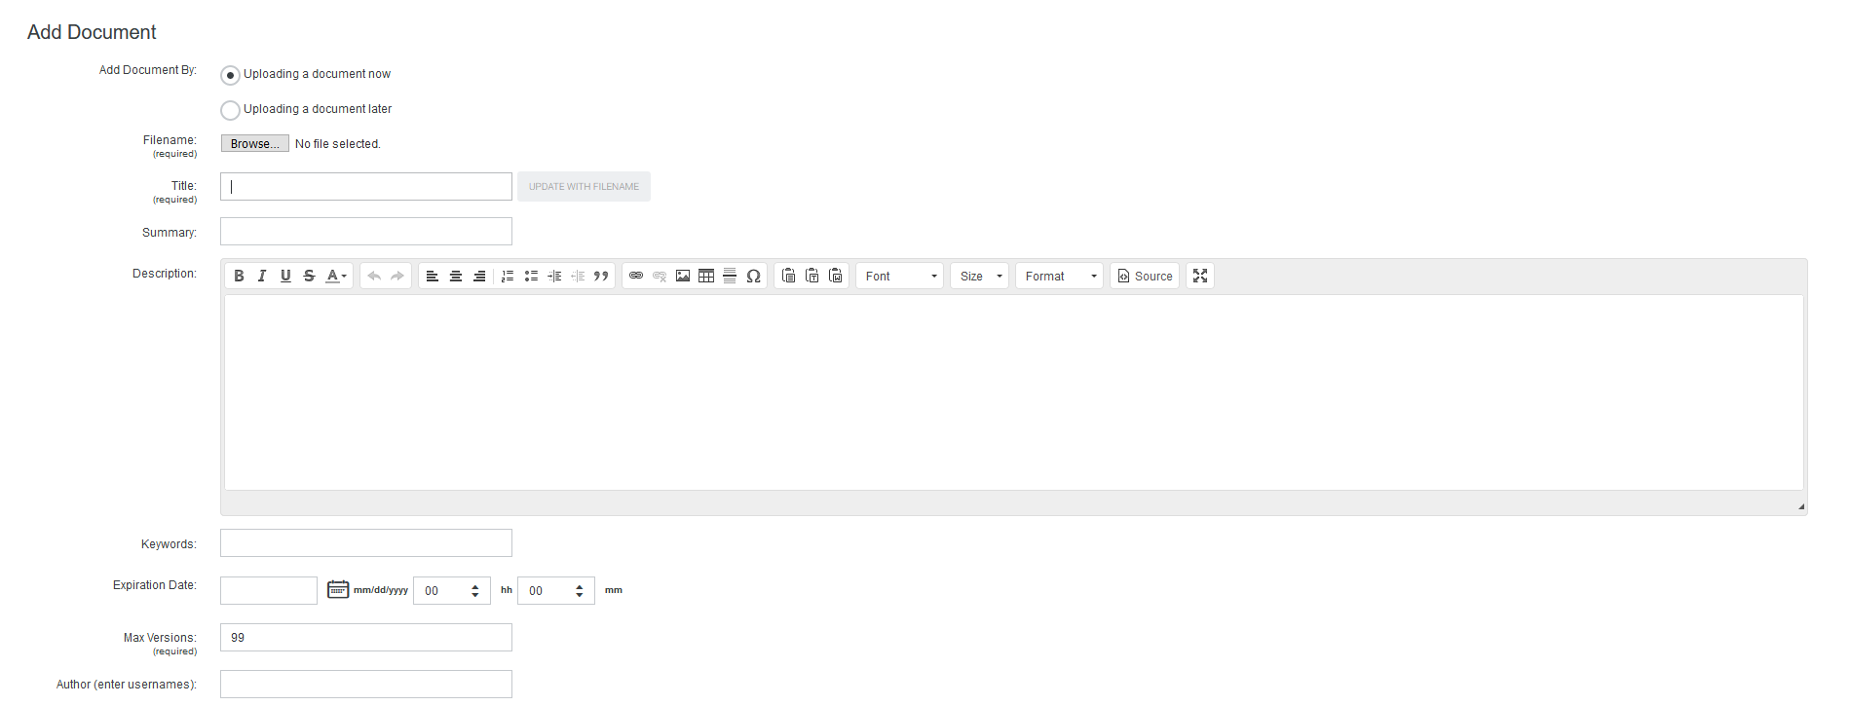
Putting a traveler out for approval: Uploading Cont.
Browse to select the traveler word document to upload
Document title is automatically created from the filename
Use the traveler title for the document summary
When finished, scroll down to the bottom and hit "Apply"

Slide 36
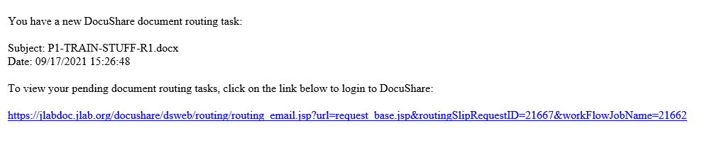
Approval Email
After the Document Coordinator routes a traveler for approval, the approvers will receive an email and link

Slide 37
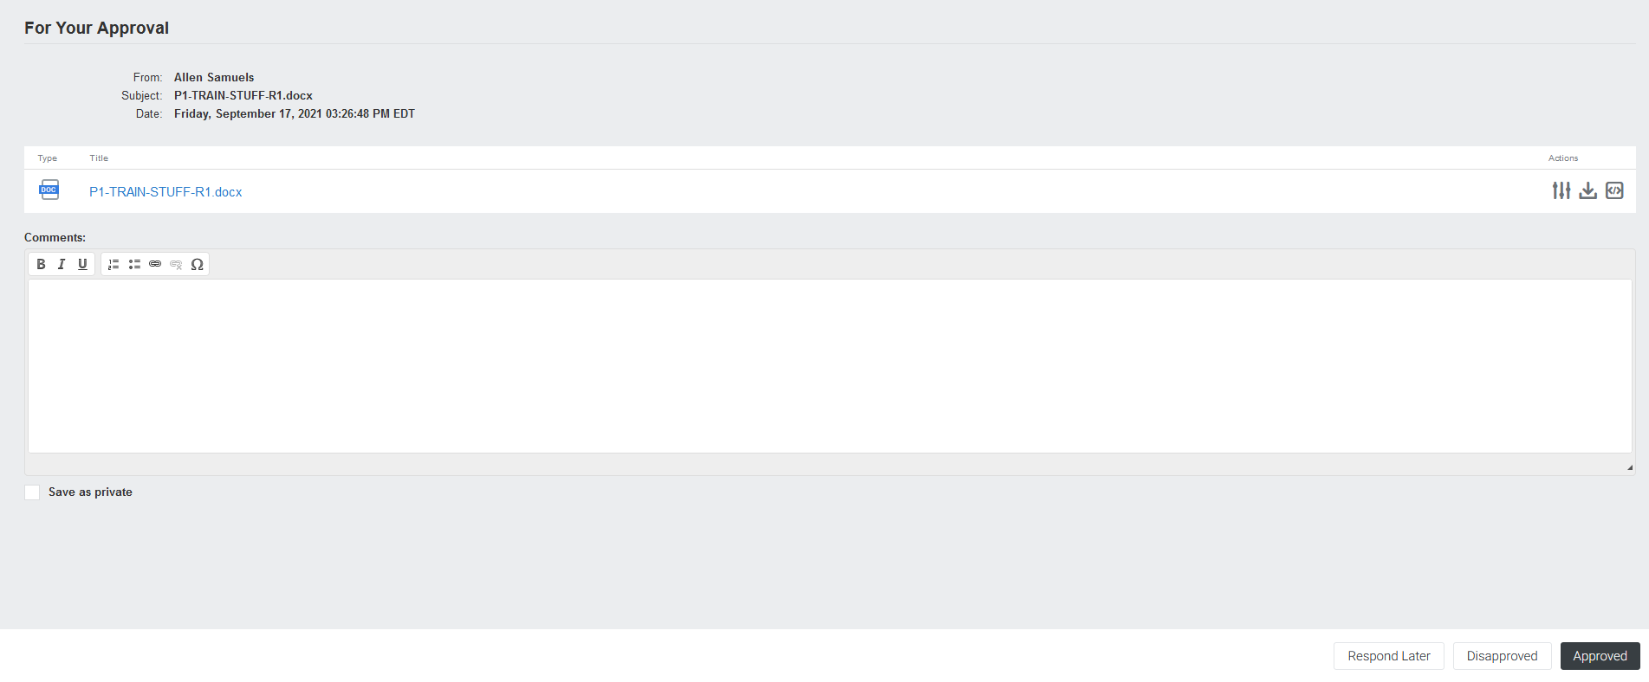
Approving a Document
Clicking the approval link will take you to this page
You can download and view the routed document from here
Must be logged in to Docushare to approve
Comments on the document go here
Click to save your comment
Approve or disapprove the traveler

Slide 38
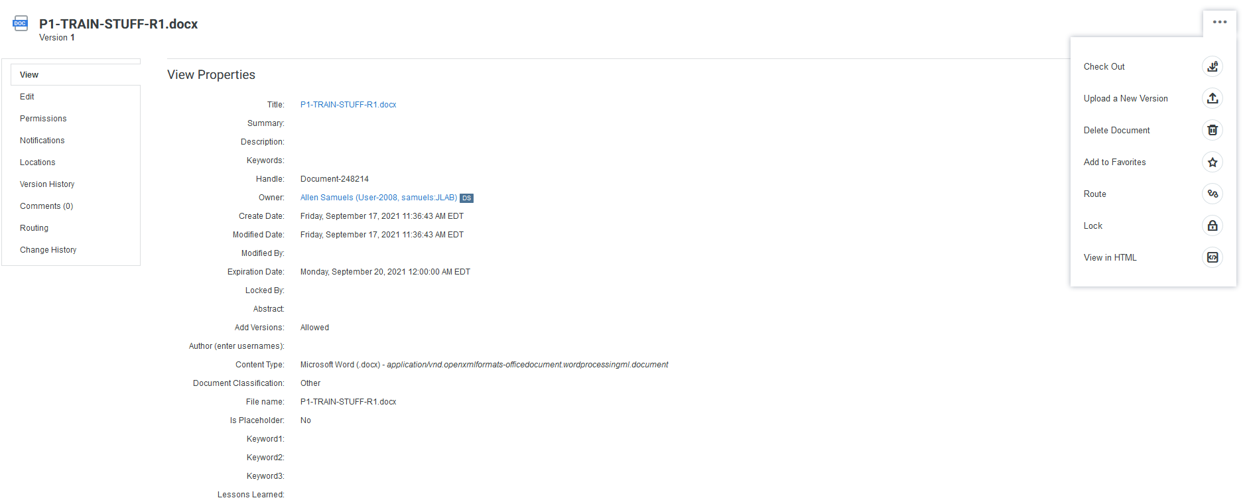
Check Approval Status
Status routing can be checked in Docushare.
  Travelers under approval are found in the project's Approvals folder
Open the properties, then go to routing.
1
2

Slide 39
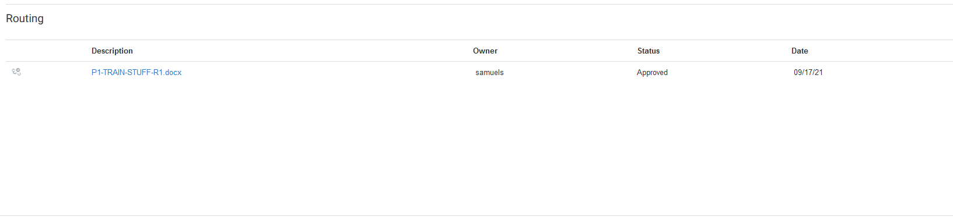
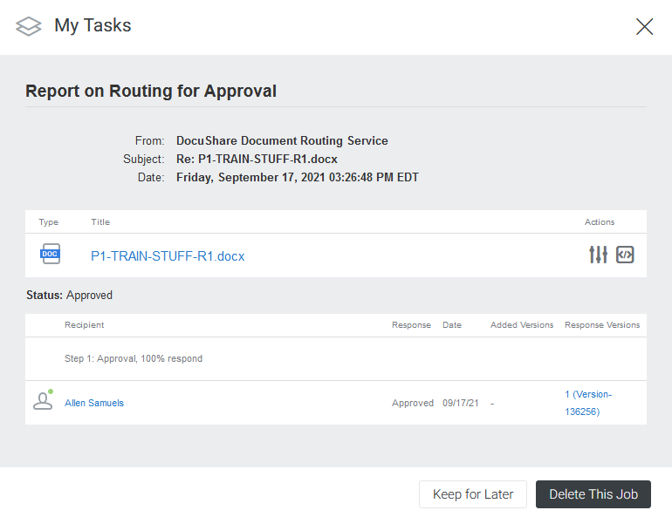
Check Approval Status Cont.
Open the link to check who has approved or disapproved and who has not.
3

Slide 40
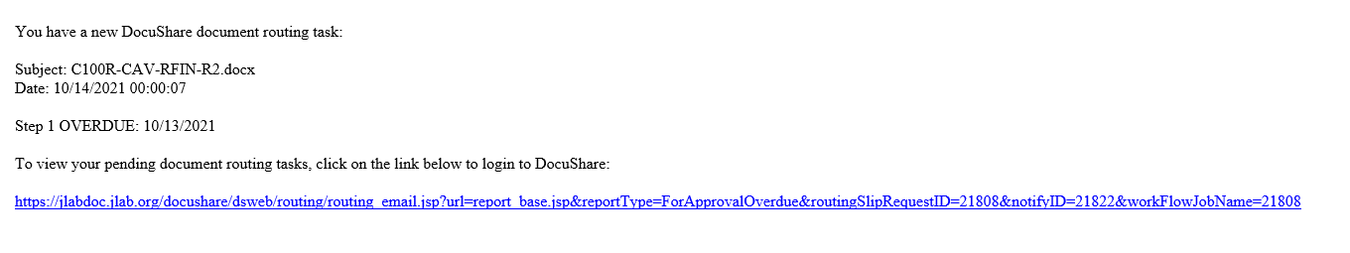
Overdue Documents and What Happens
When a Traveler or Procedure is overdue, an email will be sent to the approvers
  The Project Coordinator will be notified by the Document Coordinator if necessary

Slide 41
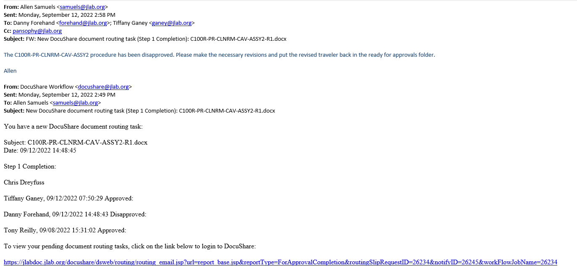
Disapproved Travelers
If a traveler is disapproved, an email will be sent out to the approvers
Once corrections are made, the approval process will be restarted
Use the version routed to the approvers when making revisions

Slide 42
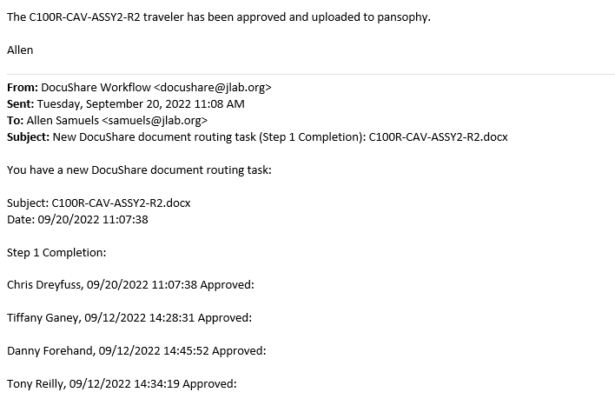
Approved and Uploaded to Pansophy
When a traveler is approved and in pansophy, an email will be sent out to the approvers
Traveler files are uploaded to the project's Approved Travelers folder for review and use for new revisions

Slide 43
Thank You For Listening
Questions?
Additional questions or concerns can be directed to pansophy@jlab.org

