Slide 2
Introduction
EIC will produce 5 different types of cavities/cryomodules
The prototype phase will involve only fabricating cavities (ellipticals and crabs)
First articles will include at least 4 types of cavities for possible use in cryomodules
Production runs will follow
Project spaces for at least the prototypes are required ASAP
Available spaces for first articles will also facilitate an early start on WCDs

Slide 3
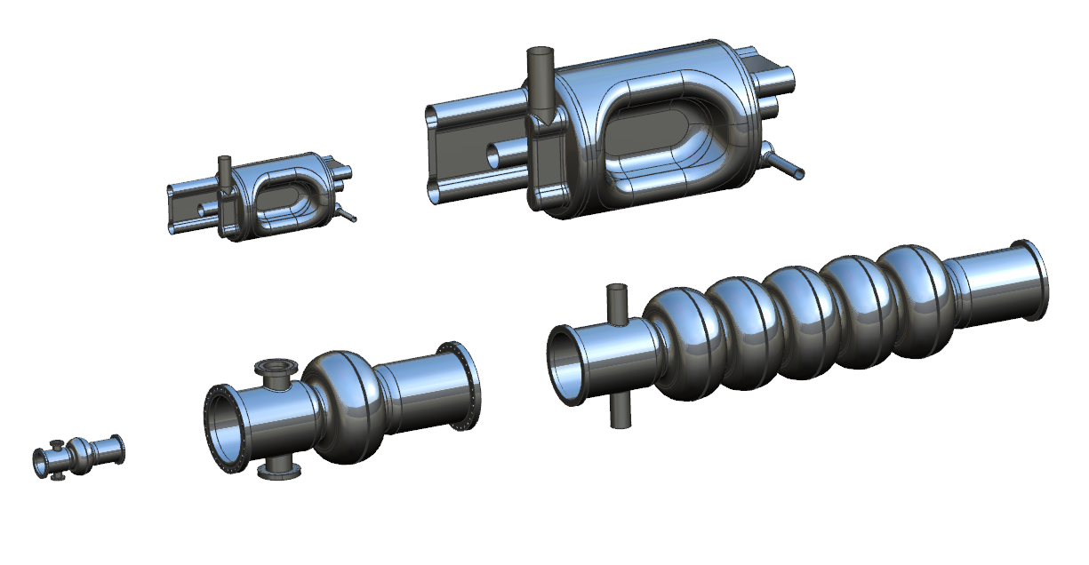
JL0117458 EIC CAVITY ASSY 20JUL2021
197_MHz_RFD_Cav_06112021 COLD
JL0103004 EIC CRAB CRYOSTAT 28SEP2020
(“old” cavity)
First Article +3 Cryomodules
JL0117457 EIC CRAB CAVITY 394 MHz 20JUL2021
(scaled 197, no cryomodule
6 Cryomodules
[100 mm beam pipe so simple scale doesn’t work]
2059.3 mm
Jl0117453 1772 MHz CAVITY ASSY 20JUL2021
(scaled 591.1, no cryomodule
3 Cryomodules
[5 cell? With waveguide FPC?]
JL0109130 591.1 MHz SINGLE CELL CAVITY DETAIL
JL0111817 591.1 MHz SINGEL CELL CRYOMODULE FOR bnl 29FEB2021
First Article + 16 Cryomodules
JL0109174 5 CELL CAVITY DETAIL
JL0112622 591.1 MHz 5 CELL for BNL 16mar2021
14 Cryomodules
LHC Crab Cavity CM Designs

Slide 4
1773 MHZ 3rd Harmonic Cavity, 3 CMs (not shown), Electron Cooler
Focus on SRF
Baseline
1 Cavity per Cryomodule for all but the 197 MHz Crab Cavities
RHIC Tunnel
3.834 km circumference
2 CMs, IR10
8 CMs, Electron Cooler
17 CMs, IR10
3 CMs, IR10
Crab Cavities (per IR) | HSR (Cavities/CMs) | ESR (Cavities/CMs)
197 MHz | 8 / 4 | -
394 MHz | 4 / 4 | 2 / 2
“Design and Impedance of RF Systems”, B. Rimmer, 9/22/21

Slide 5
EIC SRF CM and Cavity Quantities 8MAR2023
ERL has the most uncertainty in CM and Cavity Types
591 5-cell has three locations (RCS, HSR, ERL) – on-going analysis may prompt a change

Slide 6
Initial Proposal - Prototypes
Pansophy/PRIMeS Areas:
EICCPR - EIC Crab Cavity Prototypes
EICEPR - EIC Elliptical Cavity Prototypes
EIC prototype cavities will have their own section
Similar to L2PRO and L2PRD used in the past
It is intended that the prototype sections will be closed when work is complete

Slide 7
Initial Proposal – First Articles
EIC197FA: EIC 197MHz Cryomodule First Article
EIC591SCFA: EIC 591MHz Single Cell Cryomodule First Article
EIC394FA: EIC 394MHz Cryomodule First Article
EIC5915CFA: EIC 591MHz 5-Cell Cryomodule First Article
Additional CMs will have separate areas as required

Slide 8
Current Needs
Raw material for the prototype cavities have been arriving at JLab – more is incoming
There is currently no way to track the available material
The first parts will be fabricated in ~1-2 months
A space for preliminary WCDs would be good
Raw material quantities are going to be a significant factor in cavity production
Similar to the need for CM components during CM production
Nb is tracked through the Nb Inventory, which isn’t transparent to production team
Suggest treating other materials (Al, Cu, SS) as parts in PRIMeS. This is a conversation for another meeting.

