Slide 1
Bellows Defect Guidance
James Maniscalco, SLAC SRF Engineer
LCLS-II-HE
June 1, 2022 – Updated February 10, 2023

Slide 2
Bellows Defects on LCLS-II-HE Cavities
SLAC was notified that the bellows for the next ~100 HE cavities have marks/defects that look like damage
  Line-like in appearance – see photos on next slides
After investigation, we determined that these specific defects were caused by a manufacturing error, not impact
Based on the dimensions of the defects (depth, sharpness, etc.) and guidance from ASME BPVC, the SLAC/partner lab project team determined that these are usable as-is. See document LCLSII-HE-1.2-PM-0620 for more info
People performing incoming inspections of cavities/bellows should expect to see these defects, but also stay vigilant for any other defects or damage not covered by this investigation.

Slide 3
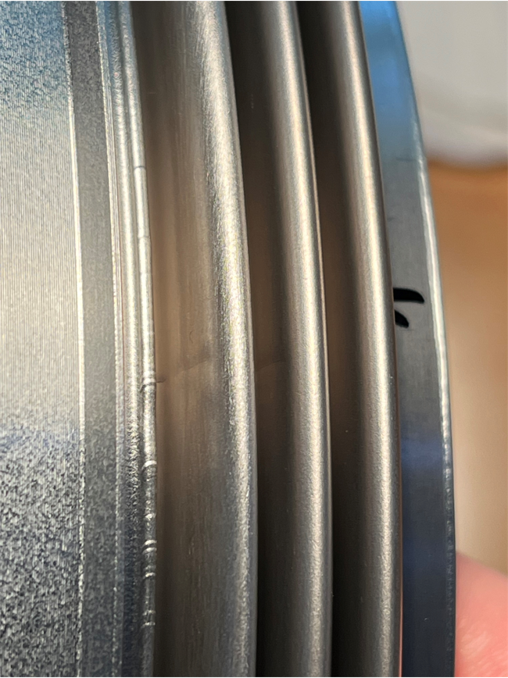
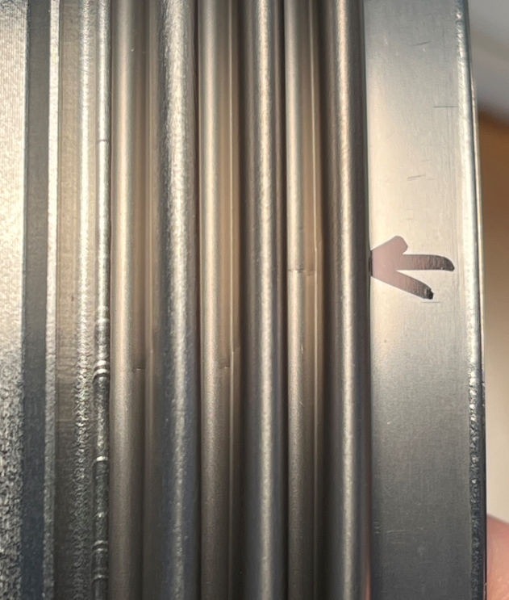
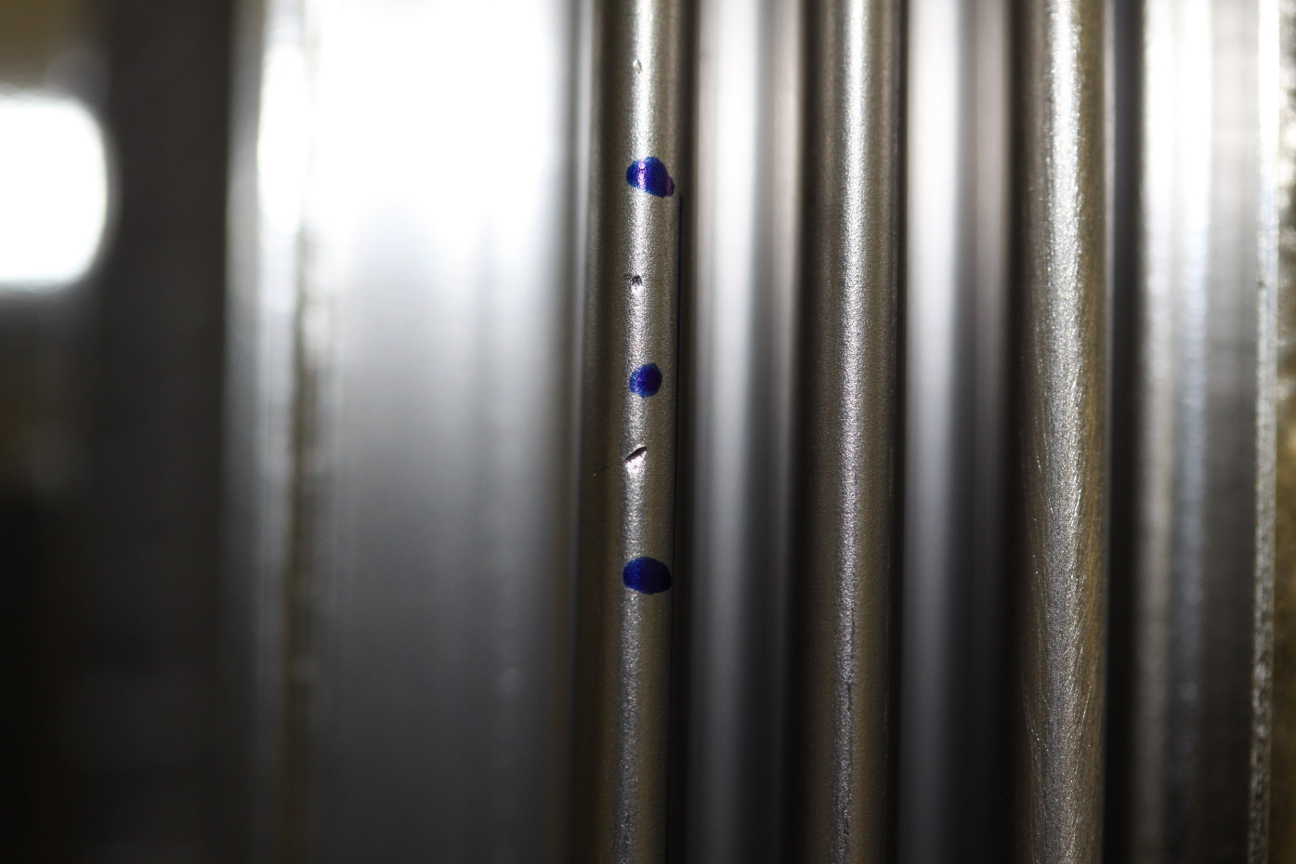
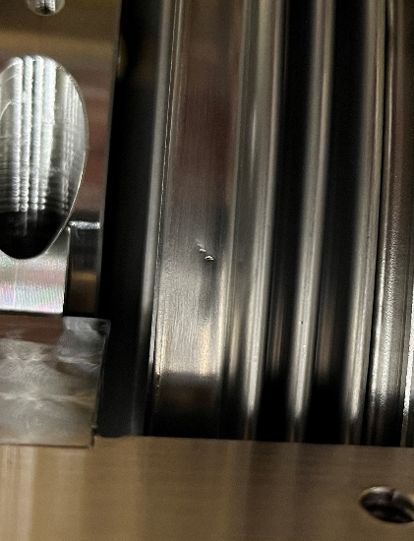
Bellows Defects – What to Expect & Do
Acceptable
Acceptable
Not Acceptable
Not Acceptable
Line-like appearance on bottom (valley) or side of bellows convolutions
Front-to-back orientation, along length of cavity
May extend across all three convolutions
May be in several locations around bellows
Please continue to document these defects in the traveler with photos
Any other visible defects/damage are still subject to normal acceptance/rejection criteria
If in doubt, notify cavity SOTR

Slide 4
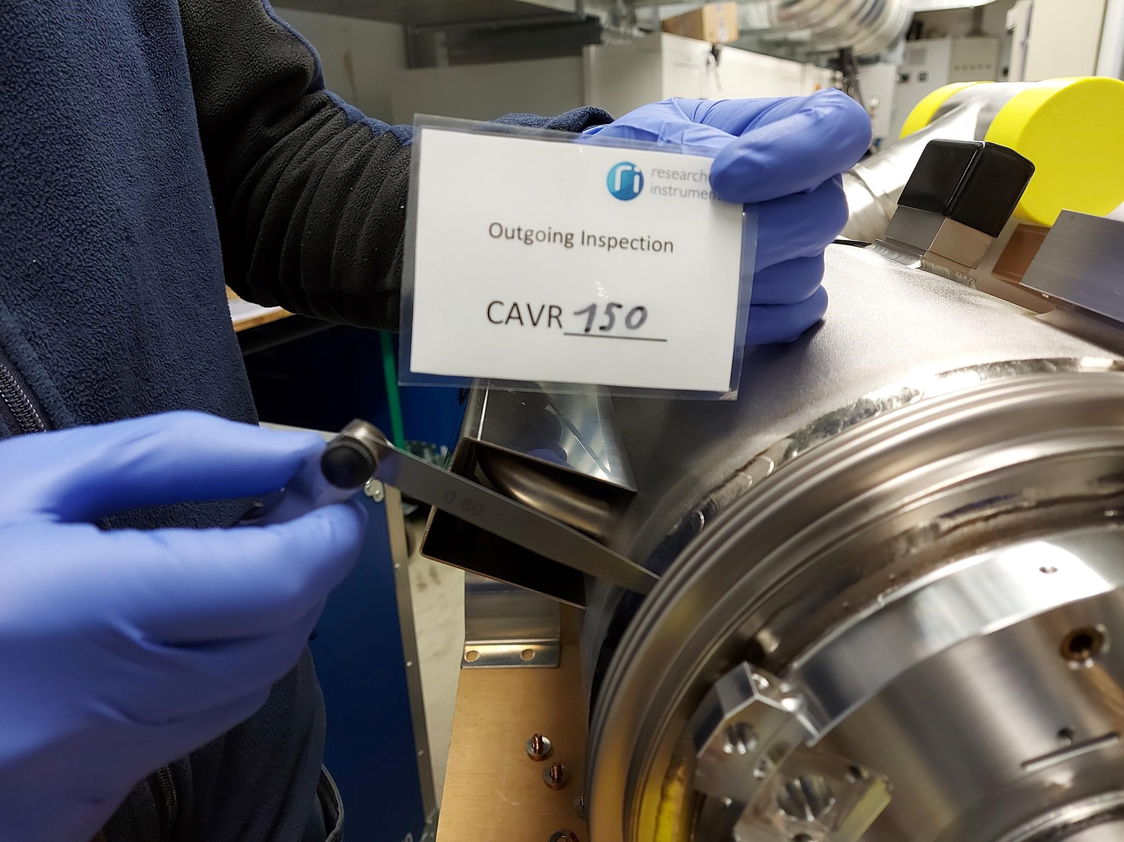
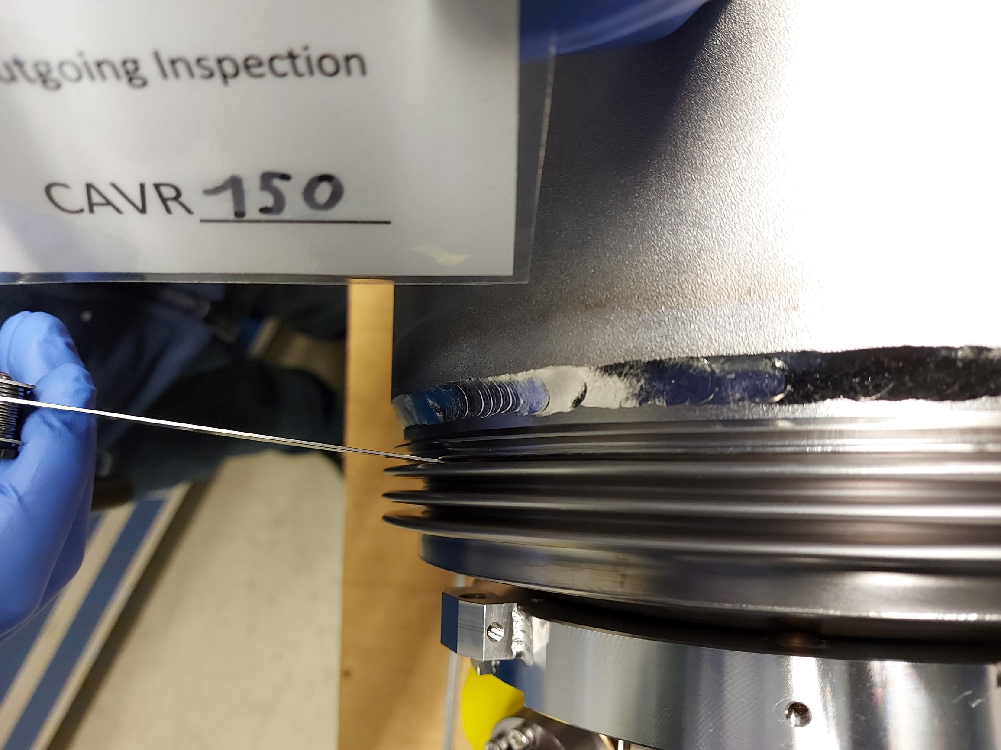
Bellows Defects – What to Expect & Do
Use a feeler gauge to measure the gap between the third bellows convolution and the collar ring. Measure at the smallest point.
Take care not to scratch or dent the bellows with the gauge.
The gap must be more than 0.5 mm wide. If smaller, notify cavity SOTR.

