Slide 1

Pansophy Upgrade Proposals
Proposals located in DocuShare here
Valerie Bookwalter
Pansophy Team
Megan McDonald, Allen Samuels, Mike Dickey,
(students) An Nguyen, Enqian Zheng, Cole Mathes
15 October 2020

Slide 2
Initial Proposals (September 2019)
Pansophy Project Configuration (In Progress)
Traveler Updates (In Progress)
Travelerization Updates (In Progress)
NCR vs D3 (In Progress)
Inventory Requirements (In Progress)
Data Mining Updates (In Progress)
Quality Updates (In Progress)
Drawing Configuration Control (No Progress)

Slide 3
Pansophy Project Configuration
Pansophy requires configuration information at the start of a new project in order to establish a configuration controllable environment for the project within Pansophy.
  milestone dates of project (receiving of parts, start of assemblies)
  parts to be received, inspected and tracked
  drawings
  process flow of parts
  travelers to be written
  procedures required
  SOTRs/ENGRs
  Key Performance Indicators (KPIs)
A Project Configuration Spreadsheet Template will be provided to Project Management upon start of a new project. This is part of the Master Traveler List.

Slide 4
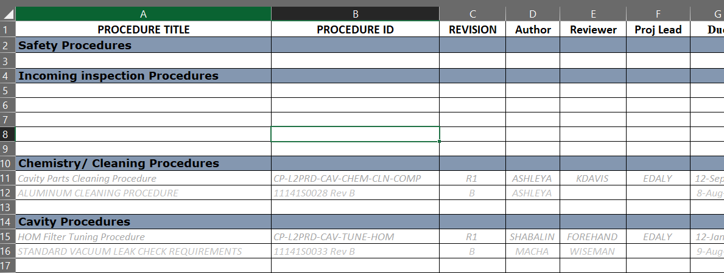
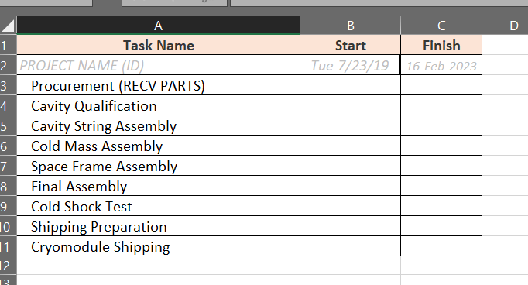
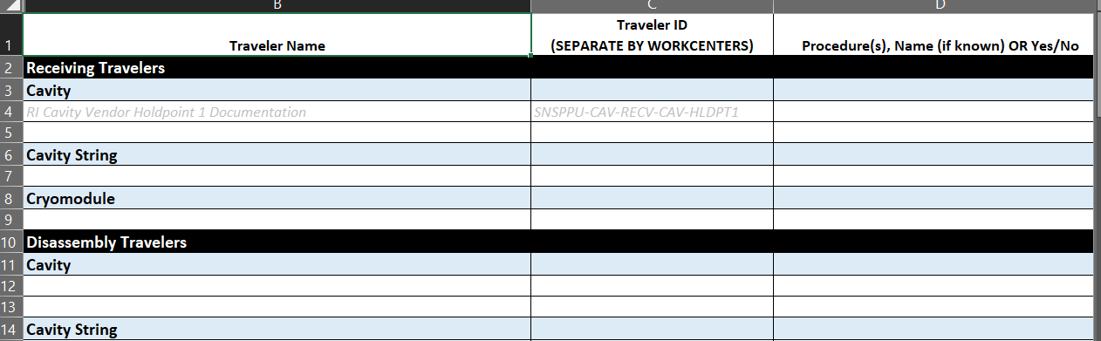
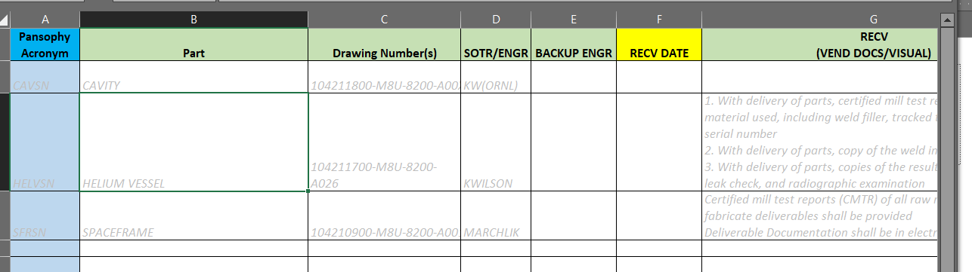
Project Template
Procedures
Timeline
Travelers
Parts

Slide 5
Traveler Updates
Travelers by Work Center – travelers will be broken down by work centers.
  Ex. An inspection traveler which previously contained visual, CMM, leak test and heat treatment, will now become three travelers: a CMM/Metrology Traveler, a Leak Test Traveler, and a Heat Treatment Traveler.
This will allow for
  Better traceability of not only individual parts but also of the assembly and rework processes.
  Clearly identifiable NCR connection to areas of concern in vendor quality and discovery of non-conformance.
  Easier administrative control of work center area travelers and NCRs.
  Efficient data entry and accurate date entry.
  Data completeness can be identified by work center, therefore responsibilities are more clearly defined.

Slide 6
Traveler Updates (Work Centers Area *WCA*)
PROPOSED WORKCENTER BREAKDOWN
CMM/METROLOGY (INSP)
INVENTORY (INV)
SPECIALTY FABRICATION (FAB)
RFIN (RF INSPECTION & TUNING) (TUNE)
HEAT TREATMENT (FURN)
CHEMISTRY (CHEM)
CLEAN ROOM ASSY (CAV & CST) (CLNRM)
CM ASSY (Includes component leak check) (CMA)
Certified Weld Inspector (CWI)
Vertical Test Area (Includes VTA COOL) (VTA)
CM Test Facility (Includes VTA COOL) (CMTF)
CEBAF (Warm Girders, Magnets, CHL)
Work Centers Area can be customized if Project requires and SRF Operations agree.
Better part traceability (issued and received by Inventory)
Travelers are not left open (data completeness & responsibilities defined)
Better interface with the Inventory system
Accurate attachment of NCRs
Better Reporting
Functional VS Physical

Slide 7
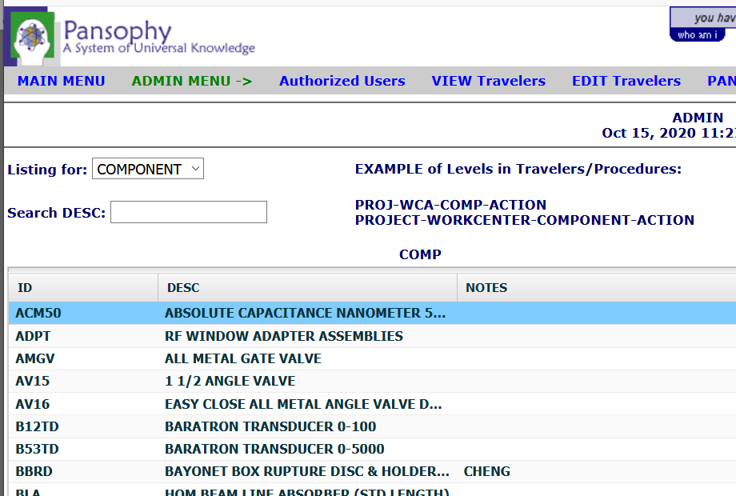
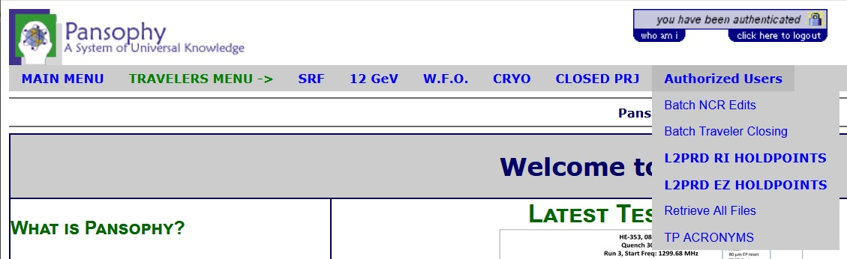
Traveler Updates (Acronyms)
Acronym configuration
  Upgrade acronym table (Done)
  Utilize table to ensure proper acronyms are used (Travelerization)
  Give complete definitions (In Progress)
  Create a user interface to locate acronyms (Old interface upgraded – Done)

Slide 8
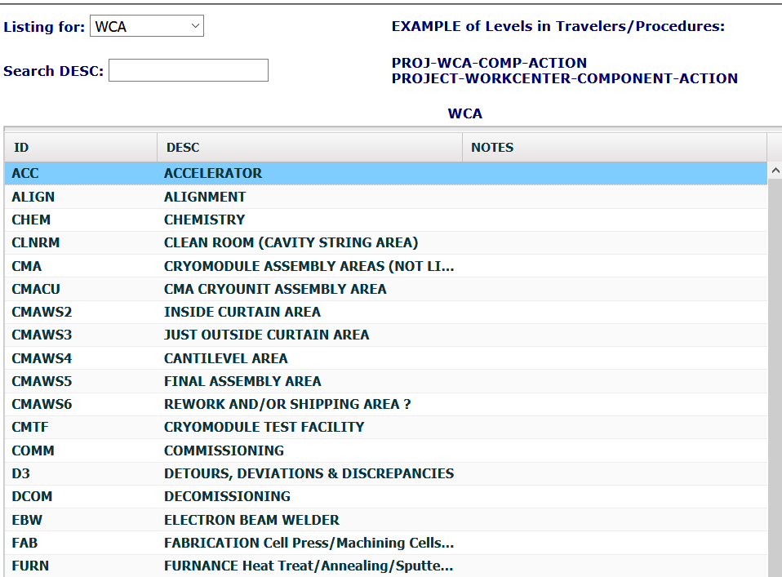
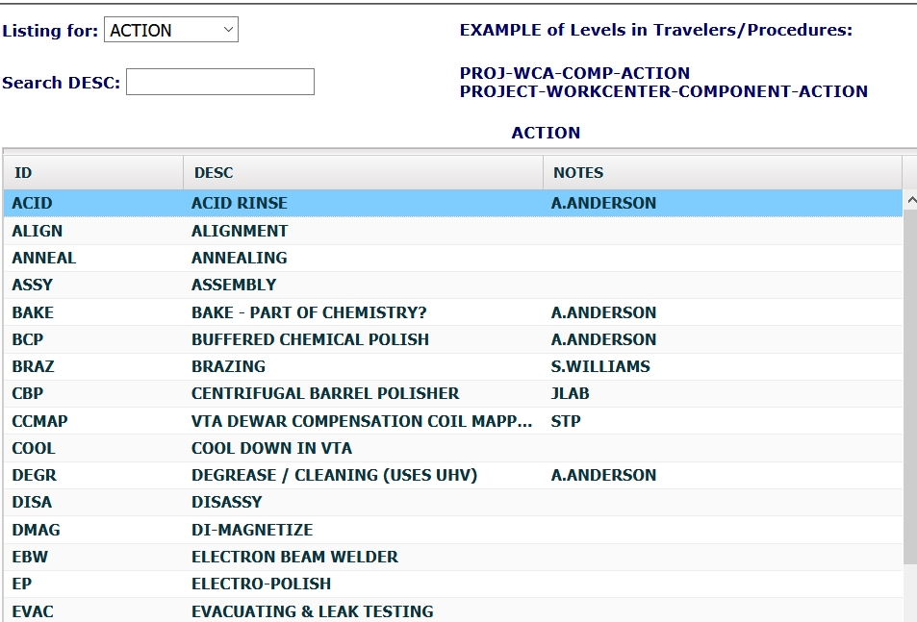
Traveler Updates (Traveler Names)
Naming Configuration
  OLD (PROJ-SYSTEM-WCA-COMP-SUBCOMP)
  NEW (PROJ-WCA-COMP-ACTION)
PROJECT – WORK CENTER AREA – COMPONENT - ACTION
WCAs
Actions

Slide 9
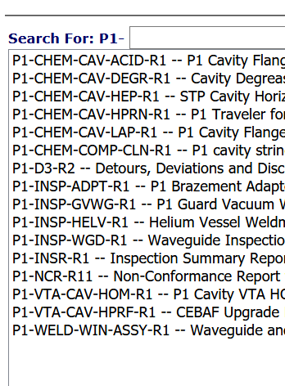
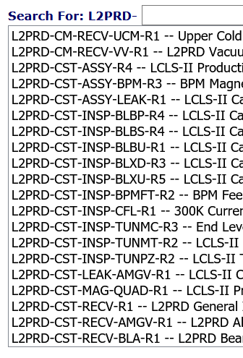
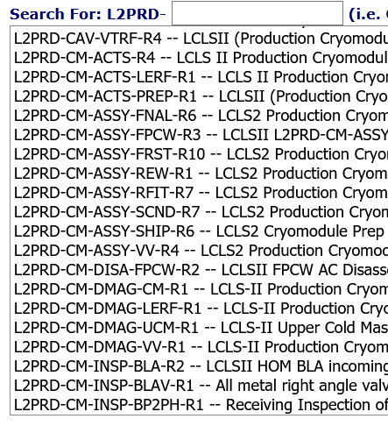
Traveler Updates (Traveler Names cont.)
Example Old List (L2PRD)
Example New List (P1)
This also helps in the Data Mining and reporting done for QA Board, Projects and Work Center Leads. The “buckets” are more clearly defined and consistent
Grouping by WCA simplifies the listing and speeds up the process for work areas to find their travelers.

Slide 10
Travelerization Updates
NCR Updates (In Progress – Jacob working on NCR Categories)
  NCR Emails
    NCR emails will only notify the specified people that an NCR has been instantiated
    People specified in NCR emails will no longer be able to disposition NCRs
  NCR Dispositioners
    NCR dispositioners will be notified when an NCR has been instantiated
    People specified as NCR dispositioners will be the only people able to disposition an NCR
  Reformatting
    Revise the Categories to better exemplify the NCR process
D3 Updates (Complete – Unless category changes are still needed)
  D3 Emails
    Like NCR emails, the specified people for D3 emails will be notified when a D3 is instantiated
  Reformatting
    The layout of the D3 has been updated to make it more easily navigable
    Revise the D3 classifications to better differentiate against the NCR process

Slide 11
Template Updates (Complete)
D3 emails line
NCR dispositioners line
Drop down in the date field (calendar select)
User choice email selection (add form field)
POP-UP help
USERNAME checking
Electronic signatures (Utilizing DocuShare Routing)
There is a NEW TRAVELER MSWord Template.

Slide 12
NCR vs D3
(more questions than answers)
ADJUST CATEGORIES (NCR/D3)
SRF-wide common tags: TAG SYSTEM MODS (3 TAGS ONLY)
Use of NCR in assembly travelers (used in TEST and INSP)
D3S LOOK DIFFERENT / D3S LOGBOOK STYLE?
D3 AUTO EMAILS (Done)
PROCEDURES UPDATED FOR NCRS AND D3S (Done)
REPORT OF NCRS/D3S TO QA BOARD AND TO SOTR'S

Slide 13
Inventory Requirements
(srfinv@jlab.org)
Input to PRIMeS
  Drawing number and revision for each part to be received
  Listing of vendor documents and format (paper / electronic)
  Number of parts to be received
  Expected delivery of part (first pkg)
  Shipping documentation must include: PO#, Drawing# Rev, etc…
  Development of “kit lists”
  Order of assembly/work centers
  Use of BOMs and/or Drawing REVs
primes requirements
  In order for primes to maintain an accurate status of parts, the tag system must be utilized and NCRs need to be dispositioned and closed in a timely fashion
  Tag system MUST be used – Tags need to go in more areas than just CMM
  Are the WCAs going to utilize "move Parts" in primes? Scanners? Printed Labels? Printed NCRs?
  Acronym control (This is our link between PRIMeS and TRAVELERS)
All Parts must go through Inventory (physically or via email to srfinv@jlab.org)

Slide 14
Data Mining Updates
(what’s required to build)
part status boards
  Projects urged to utilize more fully
  Can be built on 1 travelers or N travelers.
  Automatically generate process flow status boards for parts being inspected and processed?
assembly status boards
  Projects urged to utilize more fully
  Can be built on 1 travelers or N travelers.
  Automatically generate process flow status boards for parts being assembled?
Project drilldowns
  Requires consistency of Acronyms, Traveler Names, NCRs and Inventory
  Standardized naming convention between Projects.
  Grouping by work center areas
  Completion of travelers (data entry)
Status by cryomodule
  Traffic Light Boards
  Requires consistency of Acronyms, Traveler Names, NCRs and Inventory

Slide 15
Quality Updates
PRAMs/TRAMs – Procedure and Traveler Administrative Managements system
  Format an Excel spreadsheet template for projects (In Progress)
  Initial import from Excel spreadsheet (Master Traveler List)
  Editable grid with security (In Progress)
  Auto fill grid with completion dates from trav_config
  Auto email reminders to authors
  Upgrade Graphing
  Add Statistics
Request requirements from Quality Board / Steering Committee
  What metrics should be monitored
  VTA and CMTF data
  How often to be reported
  Monthly comparison
  What statistics should be calculated
  Create new tables to hold quality metrics (monthly / weekly) snapshots
Projects will utilize this online system to monitor Traveler/Procedure Progress

Slide 16
Drawing Configuration Control (No Progress)
DOCUMENT REPOSITORY
  AUTO EMAIL ON REV CHANGE
  MULTI-DRAWING RETRIEVAL
  LINK TO DIRECTORY (this is already possible)
BOM'S
  Depth (no requirements)
CONFIGURATION CONTROL (SOTR/SO/VENDOR)
  LOGGING VERBAL / EMAIL CHANGES
  DRAWING REVS

