Slide 1
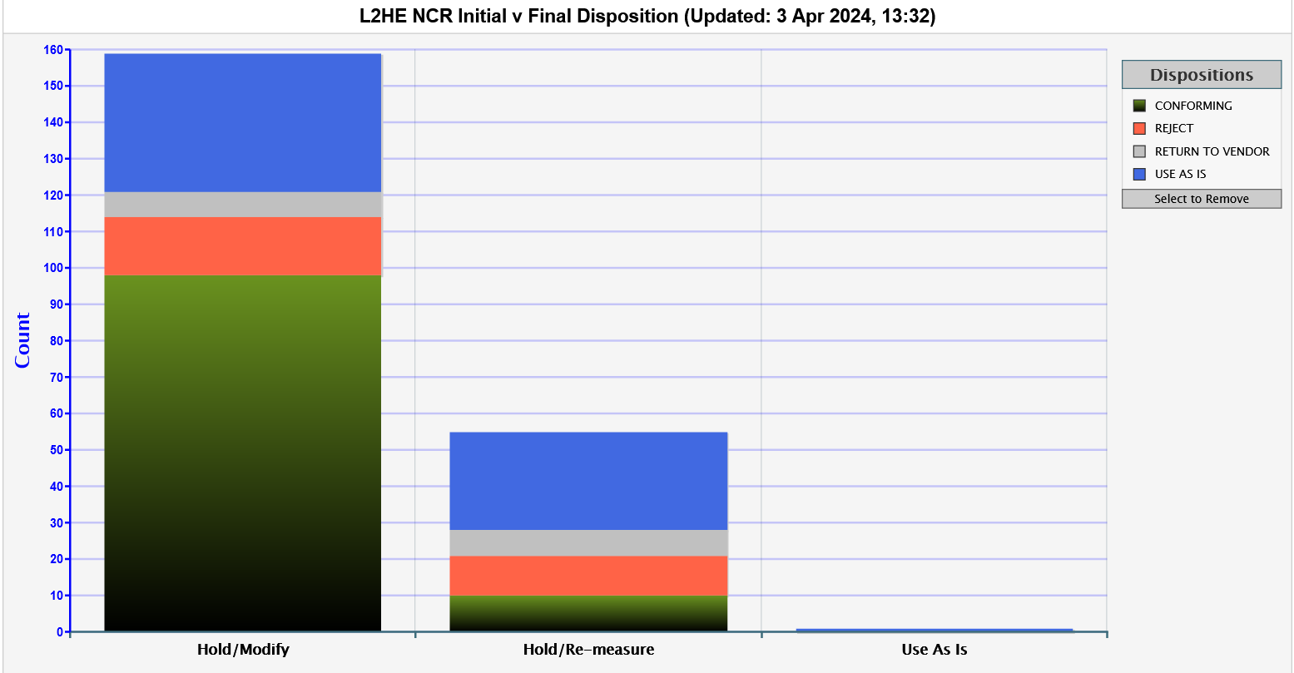
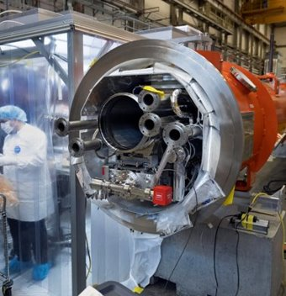
Hong’s request (delete slide)
Could you please help to contribute 2-3 slides on Non-conformance issues at each Lab to the QA presentation for CD-2/3 Director Review by Tuesday 4/2?
Suggestions:
Status: total, open, closed? What components/subsystems? Category (material, method, etc.)?
A list of top 5 major NCRs, impacts (cost & schedule), along with root cause analysis and corrective actions
Any other highlights that you like to include are welcome.
Added 4/2/24:
Ashley, could you please provide Status: total, open, closed? What components/subsystems? Category (material, method, etc.)?
Added slide 4 in response to this, tried to match Fermi’s
For all Labs, could you please prepare for how the numbers and nature (characteristics) of HE NCRs are compared to LCLS-II and explanation the differences in case this question is asked?
J1.3-22 Beamline leak (CAPA-051)
J1.3-23 coupler out of tune (CAPA-052)
Upstream bellows (CAPA-022)
Chipped FPCs (CAPA-013)
Cavity bellows damage (CAPA-038)

Slide 2
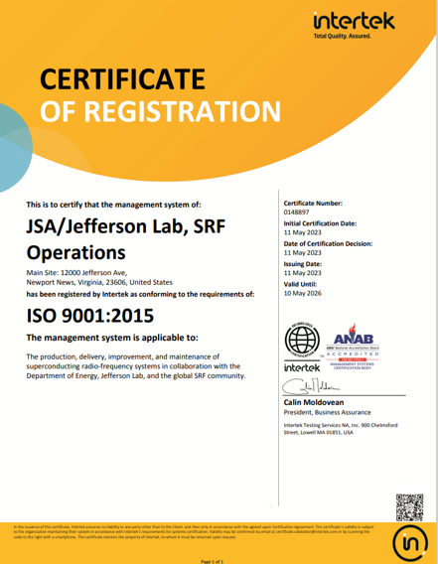
JLab SRF Operations Quality Management System (QMS)
SRF Ops has enhanced the Quality Program at JLab with a QMS modelled after the ISO 9001 Standard that includes:
4 Core Business Processes and 10 Support Processes:
Project Execution, Vendor Management, Inventory & Traceability, Production
Leadership, Calibration, Organizational Knowledge, Competence, Infrastructure, Records Management,
Document Management, Nonconforming Products, Internal Audit, Corrective Action
NCR – Nonconforming Product Report
Ensures nonconforming products are identified, segregated, evaluated, and appropriately dispositioned
Pansophy software used to manage our NCRs and Work Control Documents
CAPA – Corrective and Preventative Action Report
Used to identify, investigate root causes, and track actions to resolve quality issues
DocuShare software used for control of records and procedures
SRF Ops was ISO 9001:2015 Certified in May 2023
SRF Operations Quality Policy
Quality is our commitment to deliver world-class SRF products and services that are worthy of our customers trust by
Enabling and empowering our people to build safety, reliability, quality, and compliance into our products, technologies, and services
Delivering products to plan that support system reliability, availability, and that yield a great customer experience
Measuring our quality objectives and driving systemic continual improvement
Proactively and transparently engaging our customers

Slide 3
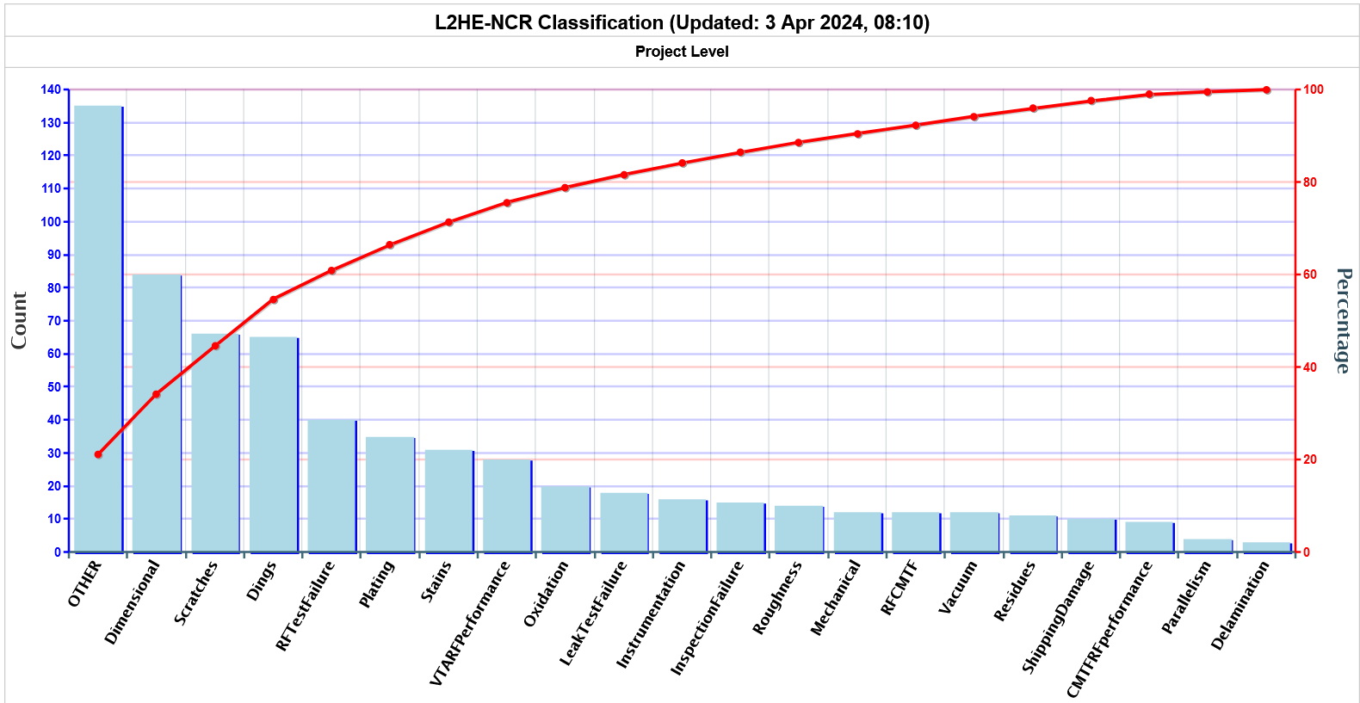
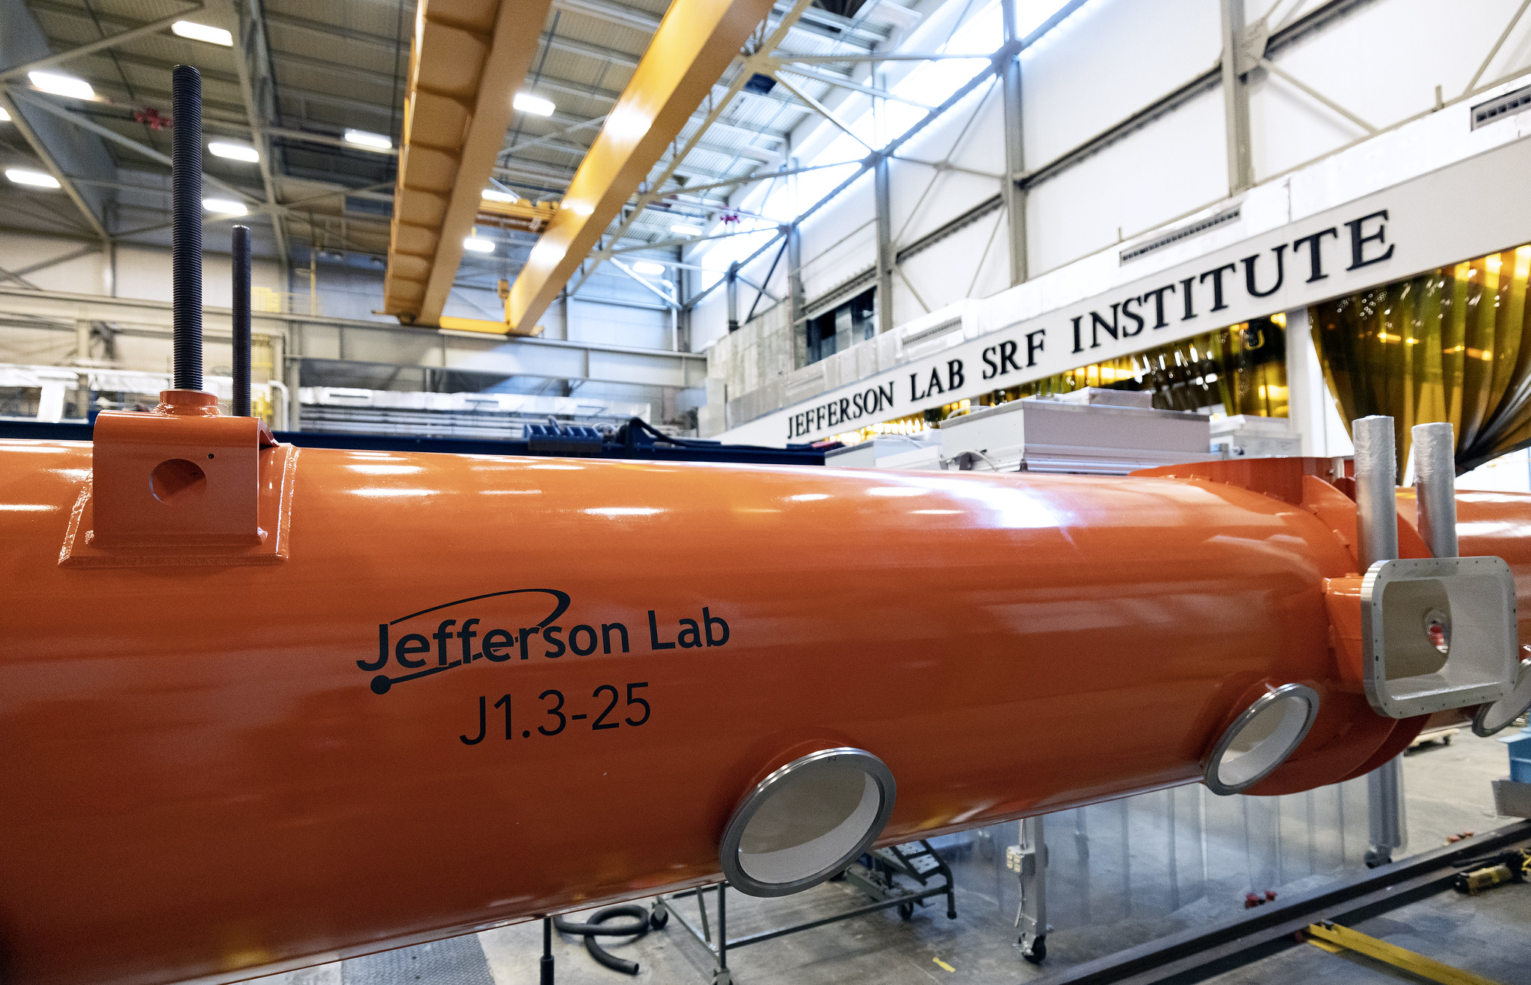
JLab LCLS-II HE Nonconformity Report (NCR) Counts
Data retrieved 3-Apr-2024
NCR Open/Closed Status L2HE NCR Report Summary
Area | Open | Closed | Total
INSP | 1 | 264 | 265
VTA | 4 | 105 | 109
CLNRM | 1 | 73 | 74
CMA | 4 | 59 | 63
INV | 0 | 30 | 30
LERF | 4 | 13 | 17
CHEM | 0 | 9 | 9
CWI | 0 | 5 | 5
TUNE | 0 | 2 | 2
Total | 14 | 560 | 574
* OTHER NCR Classification has been analyzed and is being utilized appropriately.
NCRs are generated, dispositioned, and communicated to SLAC & PL
Risks are assessed through multiple channels, including CTB, quality meetings with SLAC, Jlab staff, and PLs
CAPAs are generated for programmatic and systemic nonconformities

Slide 4
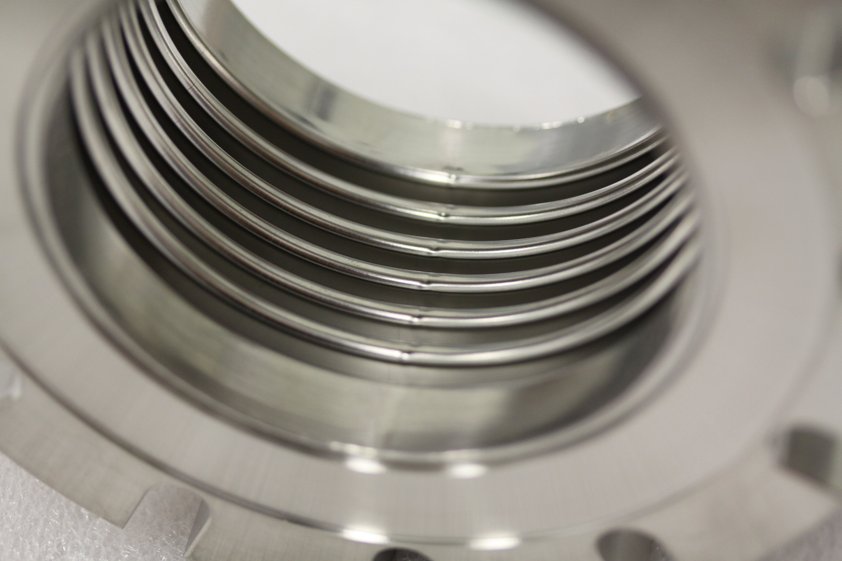
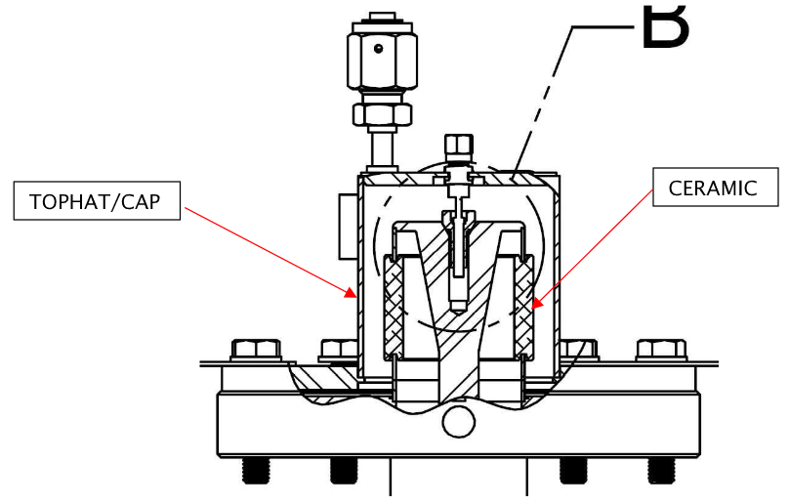
JLab LCLS-II HE High Impact NCRs
J1.3-23 coupler out of tune
Impact: ~$1k, ~3 weeks delay
Causal Analysis: Potentially insulating vacuum, issue has not reoccurred
Corrective Action: Procedure in development with SMEs for adjusting tuning while warm
Upstream bellows
Impact: ~$15k, ~2-day delay to production
Causal Analysis: Vendor tooling
Corrective Action: Update to inspection travelers and SOW to vendor, replacement bellows ordered
Chipped FPCs
Impact: ~$12k per FPC, ~1 month delay
Causal Analysis: Material weakness or material handling suspected due to tight tolerances between top hat and delicate ceramic
Corrective Action: Returned damaged FPCs to vendor for repair, fabricated tooling, increased inspection activities

Slide 5
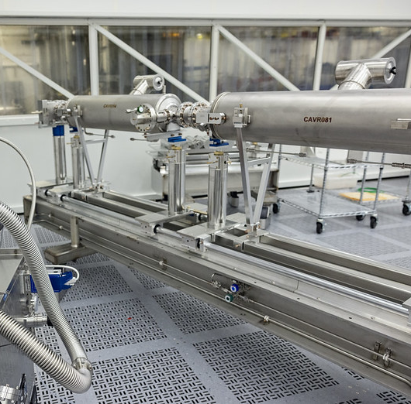
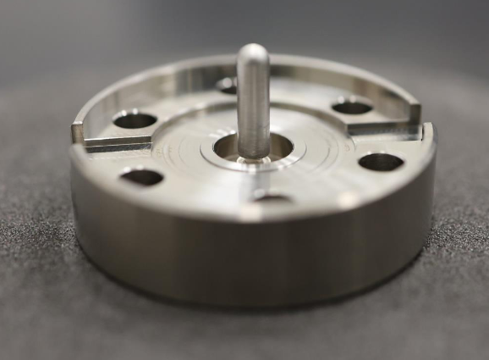
JLab LCLS-II HE High Impact NCRs
J1.3-22 Beamline leak
Impact: ~$1M, ~2-3-month production extension,
Causal Analysis: Component failure - feedthrough leaked, investigation with vendor ongoing
Corrective Action: Rebuild J1.3-22, component actions TBD after further analysis
Cavity bellows damage
Impact: ~$30k per cavity, ~1 month delay
Causal Analysis: Handling during processing suspected
Corrective Action: Bellows covers re-designed to be compatible with chemistry activities and tooling in order to remain in place throughout processing, testing, and string build
We are leveraging our QMS to continuously learn and improve

Slide 6
JLab LCLS-II vs L2HE NCRs – Overall counts less for HE
Data retrieved 3-Apr-2024
Note: NCR Classifications with a value of “0” have been removed for clarity.

