Slide 1
VTA Service Request (Beta Testing)
By: Matthew Menia
Contact us at Pansophy@jlab.org
Revised 5/9/2024

Slide 2
Purpose
Provide documentation to support multiple work center’s coordination, ensure accuracy, completeness, consistency, and validity of tests.
Will provide documents with an expiration date. Each plan will be valid for a year following final approval.

Slide 3
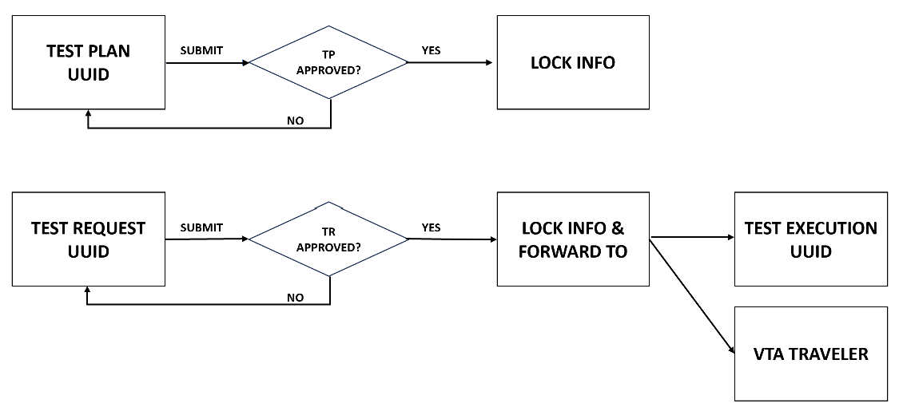
Scope

Slide 4
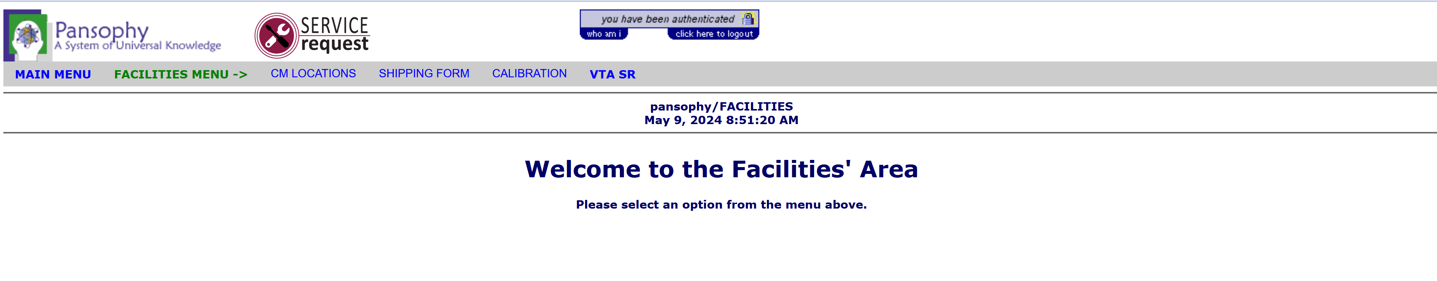
Location
Test Plan Form (Based on SRFOPS-VTA-CAV-TSTP-R1-PO)
Test Requirements Form (Based on SRFOPS-VTA-CAV-TSTR-R1-PO)
Test Activation Form (Based on SRFOPS-VTA-CAV-TSTX-R1-PO)
VTA Approval

Slide 5
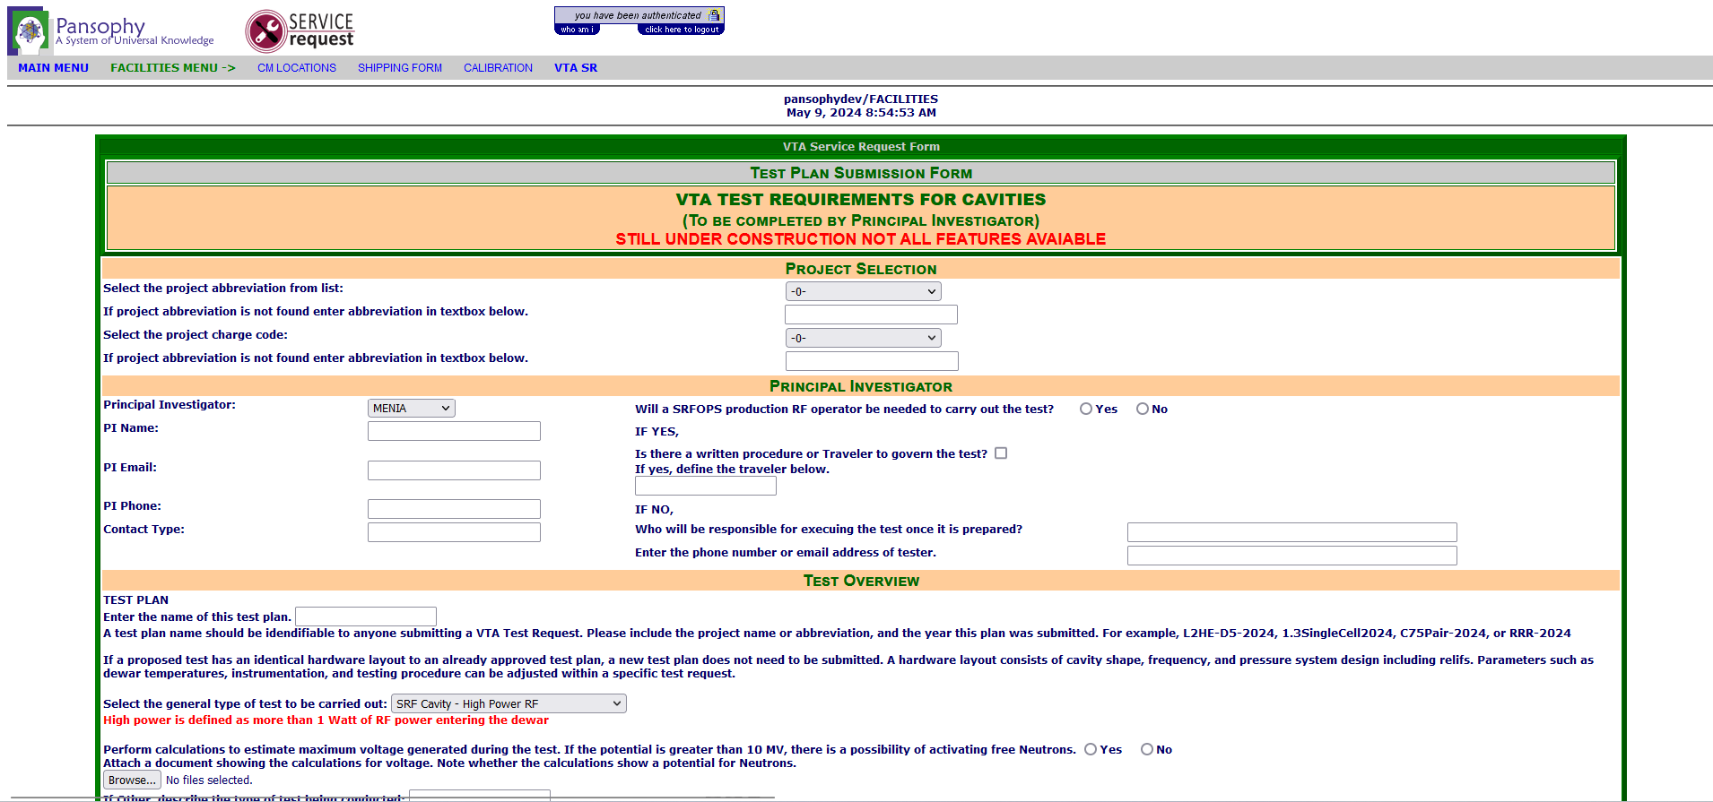
Test Plan
Reviews hardware layout, relief valve verification, test stand instrumentation, VSA sensor templates, test schedule, test parameters, and additional measurements.

Slide 6
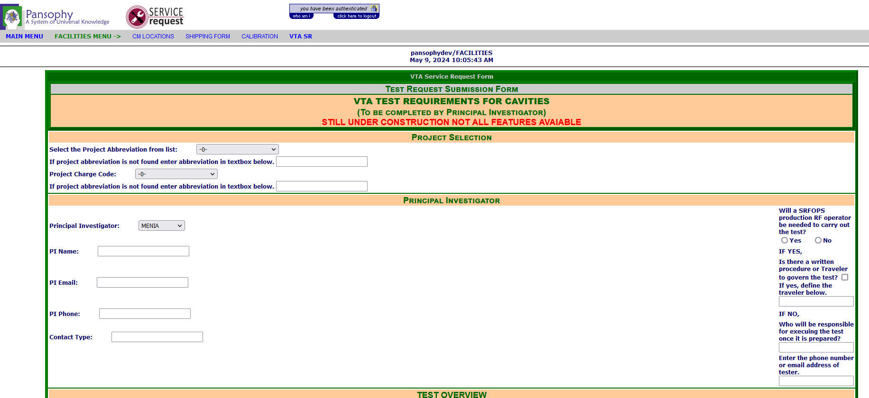
Test Request
Used to alert users an approved plan would like to test. Once approved can be scheduled with consideration to schedule, facility, availability, and division priorities.

Slide 7
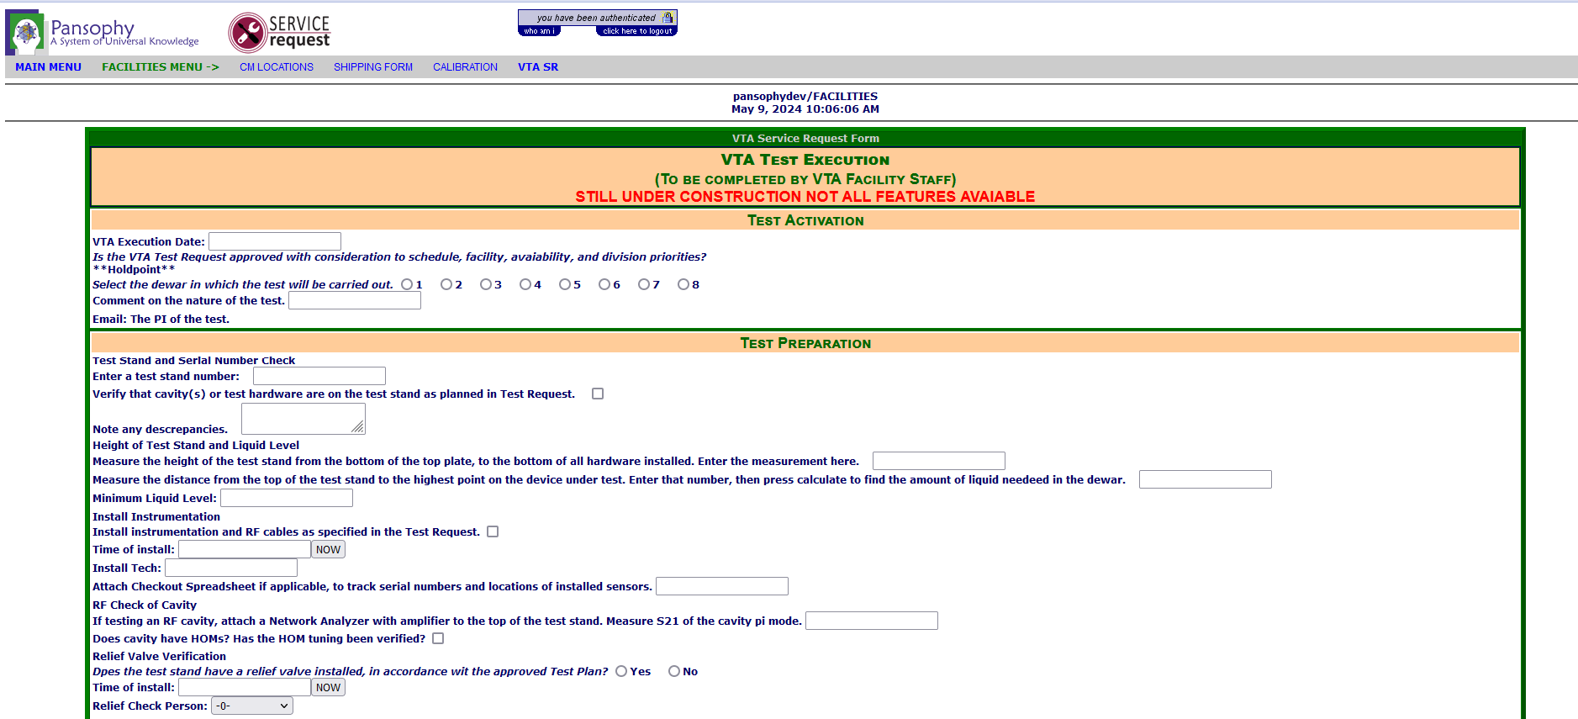
Test Activation
Reviews test stand and serial numbers, provides documentation for any discrepancies, crane operations.
Documents post testing results and will send emails if neutron generation occurs.

Slide 8
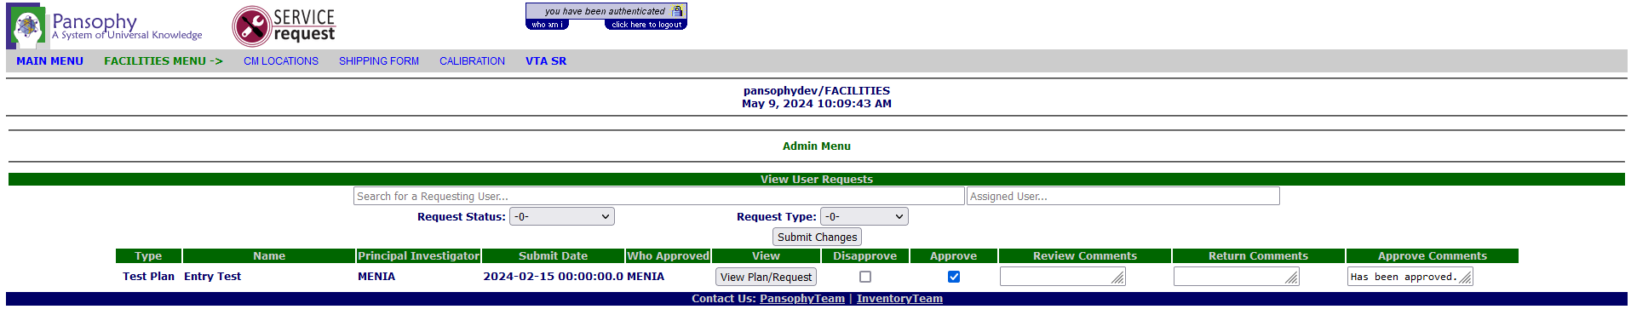
Test Approval
Users will have the ability to view all queued plans.
Multiple comment fields to track changes.
View approvers
Can approve and comment multiple plans at once.

Slide 9
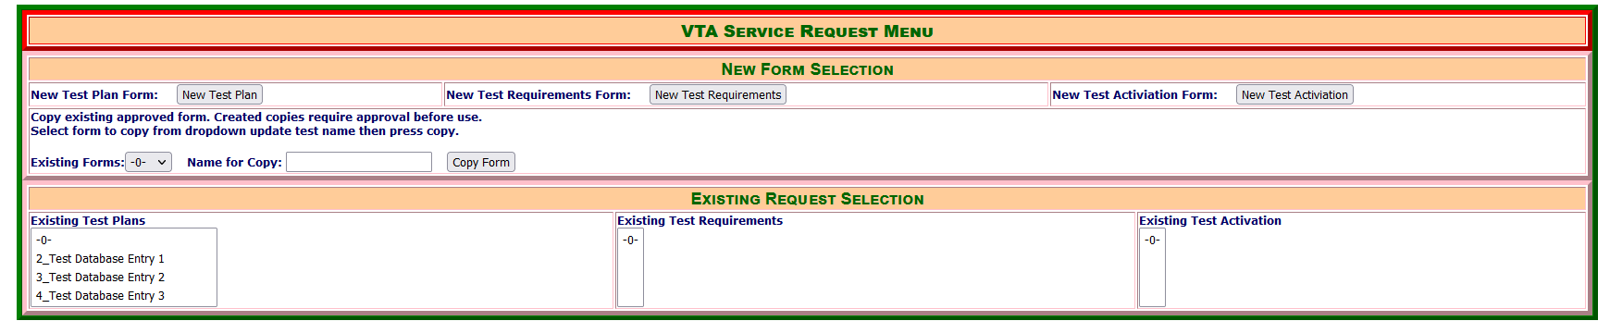
Future Updates
Automated field completion.
Dynamic page display. (Fields will change depending on selections)
Save current progress.
Copy previously approved forms.
Link to VTA travelers (will need to include <<NOTE>> in traveler)
Automated expiration emails.
Uploaded file preview in form.
Menu display to better utilize/organize features.
Image: Wireframe illustrating features menu.

Slide 10
Thank You For Listening
Questions?
Additional questions or concerns can be directed to pansophy@jlab.org

