Slide 1
Welcome To Pansophy
Pansophy Team
Valerie Bookwalter, Megan McDonald, Mike Dickey, Allen Samuels, Matthew Menia
Contact us at Pansophy@jlab.org
Revised 07/11/2024

Slide 2
Reference Material
Sign in to Pansophy and DocuShare
  DocuShare link
  Pansophy link
DocuShare Directory of Training Slides and Referenced Material
  SRF Institute > 01 - SRF Projects > 06- For Reference, Additional Template and Processes
Training Slides:
  SRF Institute > 01 - SRF Projects > 06- For Reference, Additional Template and Processes > Pansophy Related Training
Pansophy Help
  Pansophy Home > Main Menu dropdown > Help
QMS Documents Users

Slide 3
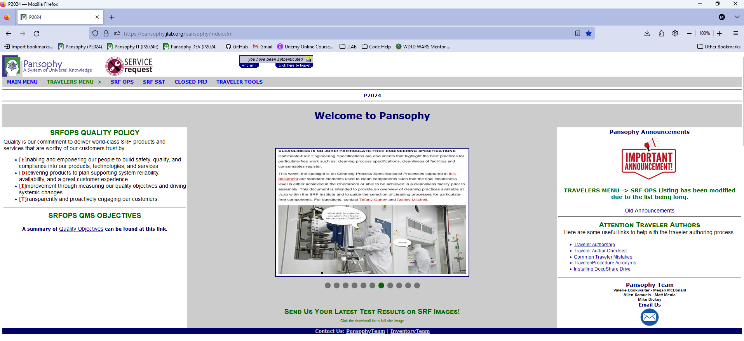
Homepage Rundown

Slide 4
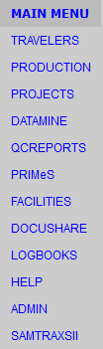
Main Menu Options
Travelers: Links to Travelers for Active and Closed Projects, User Tools
Production: Serial Number search, statuses, drilldowns, and SRFOPS Work Control Documents (WCD)
Projects: Project Report area for Multi-Lab Projects (MLP) like SNSPPU and LCLS-II HE
Datamine: Menu for accessing the datamining
QC Reports: Quality Control Reports board
PRIMeS: The SRF Project Inventory Management System home page
Facilities: Map of the SRFOPS production floor and Calibration system (still under development)
DocuShare: Links to Project Areas and useful SRFOPS areas
Logbooks: Menu for accessing the pansophy logbook and link to e-logbook (Accelerator)
Help: Menu for additional help and guides
Admin: Pansophy administrative menu (restricted access)
SamTraxsII: Menu for editing and viewing the Sample Tracking II thin films and particulate research data

Slide 5
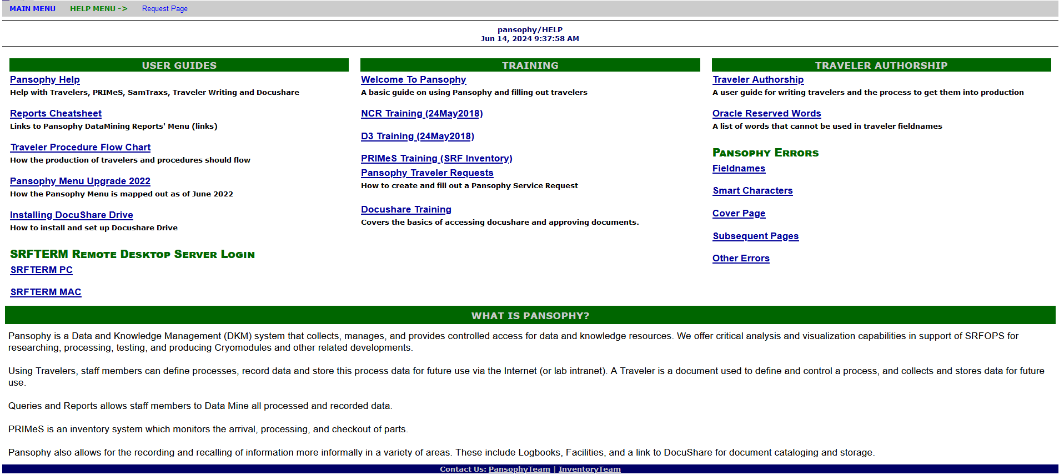
Pansophy Help

Slide 6

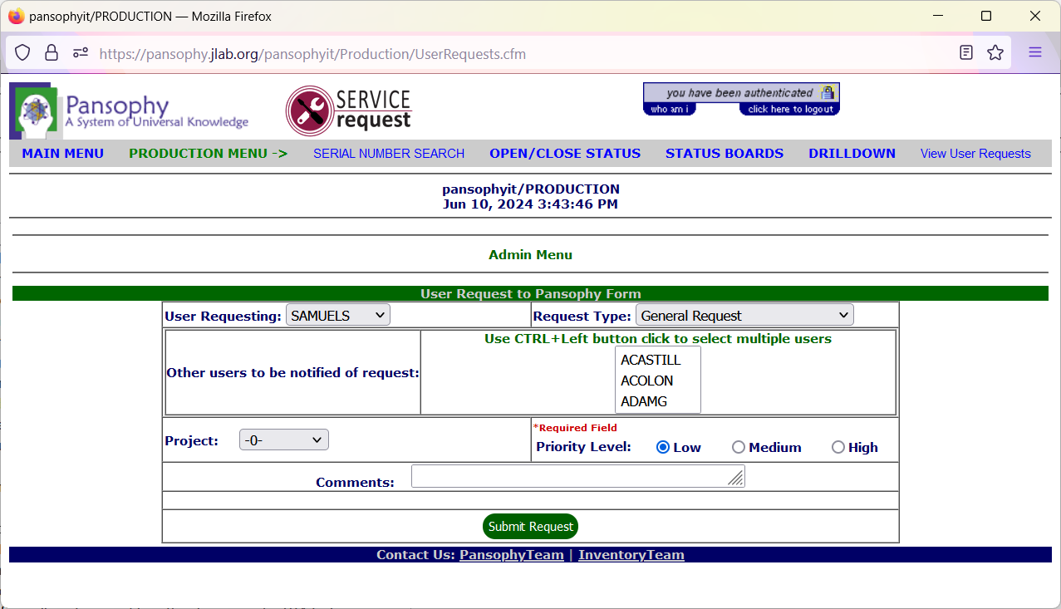
Service Requests
Users can submit requests for support with all aspects of pansophy.
Preferred method to request additional permissions, record traveler concerns, or report errors

Slide 7
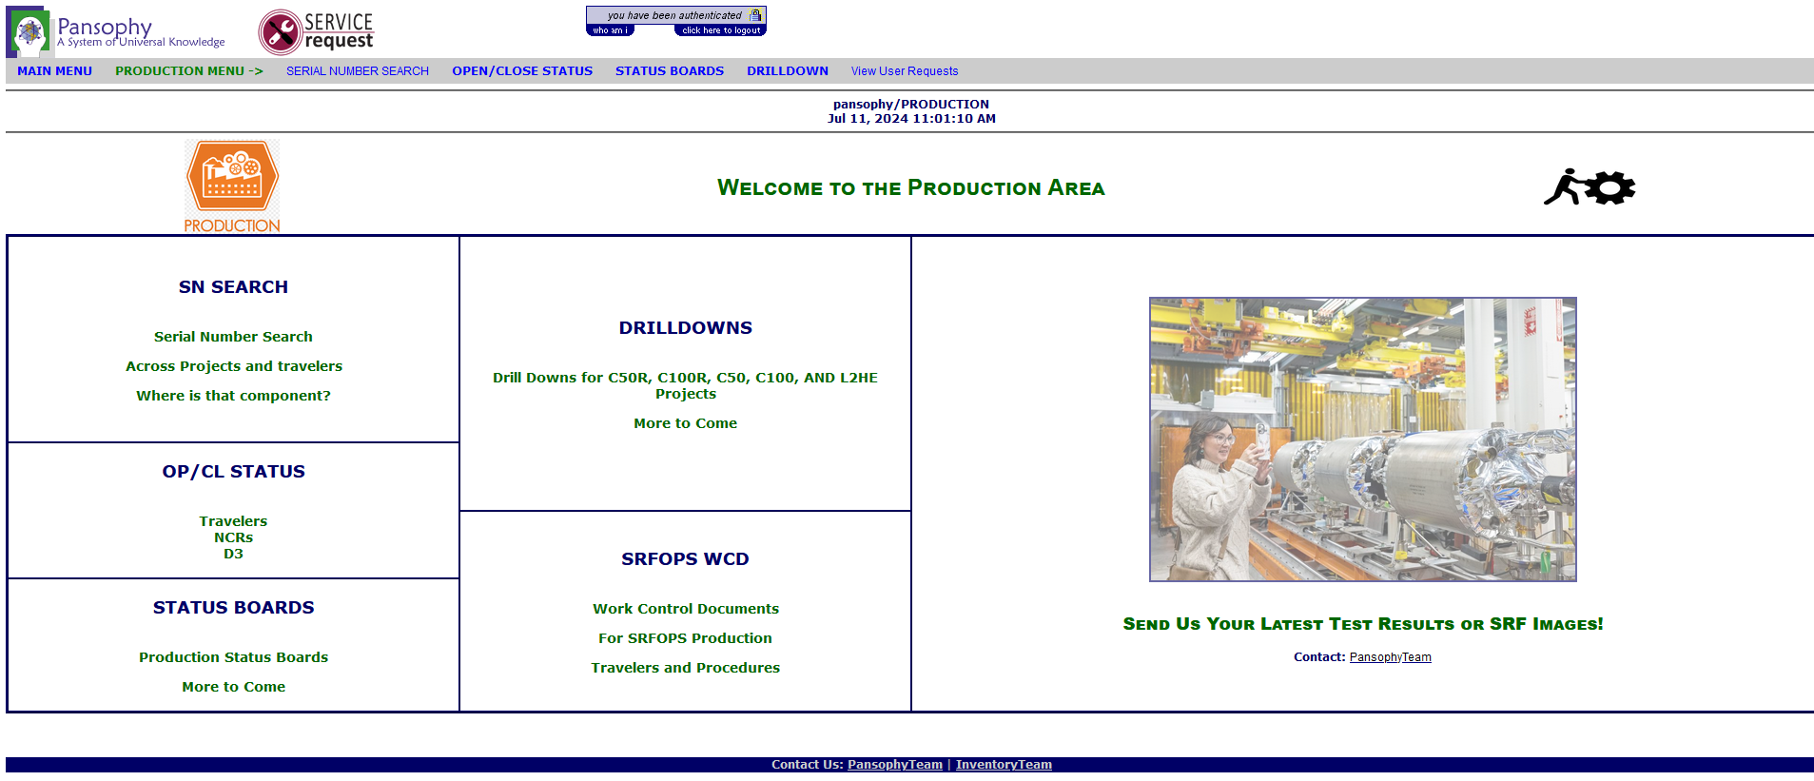
Production Area
An area focused on SRF operations production floor activities.
  Component status boards
  Production flow
  Work control documents (Travelers/D3s/NCRs/Procedures)
Limited to single projects.

Slide 8
Production Menu
SERIAL NUMBER SEARCH
OPEN/CLOSE STATUS
TRAVELERS (OP/CL)
NCRs (OP/CL)
STATUS BOARDS
DRILLDOWN
SRFOPS WCD
D3s (OP/CL)
C100 CAVITY
F100 CAVITY
C75
CAV STATUS
CPR STATUS
SNSPPU
CAV STATUS
CST STATUS
CM STATUS
CAV SPECS
C50R
CM ASSEMBLY
CRYOUNIT ASSY
CAVITY PAIR ASSY
CAVITY ASSY
C50
CM OPERATIONS
CM PERFORMANCE
CM ASSEMBLY
CPR ASSEMBLY
CPR VTRF
C100
ACTS/COMM
CRYOMODULE
CAVITY STRING
CAVITY
TRAVELER / PROCEDURE QC
L2HE
CAV STATUS
CAV SPECS
L2PRD-L2PRO
CAV STATUS
CAVEZ STATUS
CM STATUS
CAV SPECS
CAV VENDOR
L2PRO CAV STATUS
L2PRO CST STATUS
Serial Number Search – Find which travelers a specific SN has been used in. Sequence numbers hyperlink to form instance.
Open/Close Status – Listing of all open/closed instances for selected document. Different variations: OP/CL Travelers, OP/CL D3s, OP/CL NCRs, OP/CL WCA
Status Boards – Provides users a holistic approach to a process flow
Drilldowns – Captures SN, traveler statuses, and KPIs on a single display. Shows production from single cavity through to completed cryomodule, acceptance testing and commissioning

Slide 9
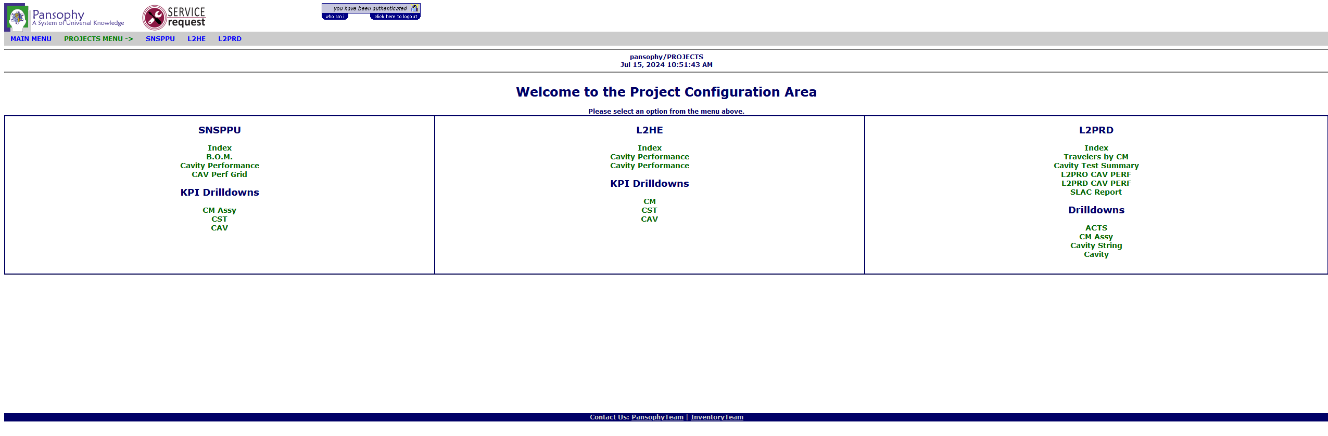
Projects Area
This area consists of status boards and reports as necessary for the dissemination of data to SRFOPS’ Project Customers.
External portal area for MLP projects view data collected by the SRFOPS Production Group.

Slide 10
Projects Menu
SNSPPU
INDEX
B.O.M.
L2PRD
INDEX
L2HE
CAVITY PERFORMANCE
CAV PERF GRID
KPI DRILLDOWNS
DRILLDOWNS
INDEX
CAVITY PERFORMANCE
CAVITY PERF GRID
KPI DRILLDOWNS
TRAVELERS BY CM
SLAC REPORT
Drilldowns - Captures SN, traveler statuses, and KPIs on a single display. Links are not active and only KPIs are displayed due to external user restrictions.
SLAC Report – Users can select a cryomodule and view or generate a SLAC report in excel. Report contains information about parts performance
Cavity Test Summary – Users can select a cryomodule to view which cavities are installed. Users can also view linked VTRF traveler and comments made.

Slide 11
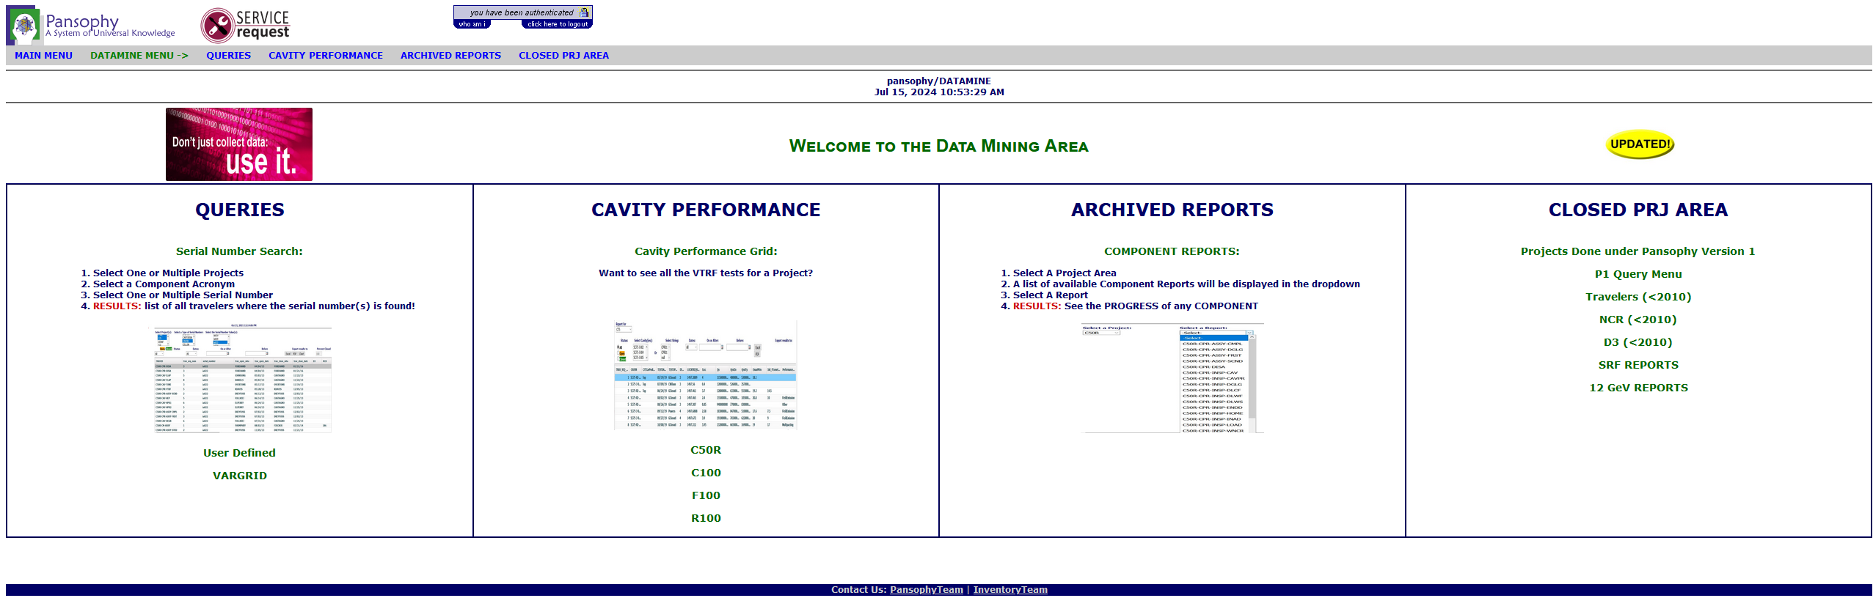
Datamining
Area for specialized queries and reports for analyzing traveler data.

Slide 12
Datamining Menu
Serial Number Search - Find which travelers a specific SN has been used in. Sequence numbers hyperlink to form instance.
User Defined Queries – allows users to generate custom queries that are traveler specific
VARGRID – allows users to view all data for a traveler stored in the database
Cavity performance – allows users to display a pre-defined list of variable values for cavities from VTRF test traveler. (often considered KPIs for the project)
Component Reports – users can select a project and traveler to view a predefined list of component data fields
Closed project area – contains status boards and reports used in past projects along with backwards compatibility for projects prior to 2010. Of note in this area is 12GeV status boards to support magnet group and LLRF group work.
QUERIES
SERIAL NUMBER SEARCH
USER DEFINED
CAVITY PERFORMANCE
CAVITY PERF
C50R
ARCHIVED REPORTS
CLOSED PRJ AREA
VARGRID
C100
F100
R100
COMPONENT REPORTS
P1 QUERY MENU
TRAVELERS (<2010)
NCR (<2010)
D3 (<2010)
SRF REPORTS
12 GEV REPORTS

Slide 13
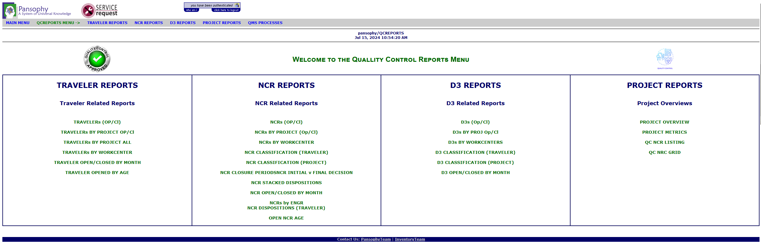
QC Reports
This area contains reports commonly used to monitor the quality of SRFOPS production for all projects.
Most reports are single project display. Charting and Graphing are used where appropriate
  Reports for Travelers/NCRs/D3s typically used for quality control.
  Quality reports
  Project overview reports

Slide 14
Reports
Traveler Reports – These reports allow users to view open and closed travelers by different metrics.
NCR Reports - These reports allow users to view open and closed NCRs by different metrics including project, work centers, classification, dispositions, and age
D3 Reports - These reports allow users to view open and closed D3 reports by different metrics including project, work center, and classifications.
Project Reports - Includes different reports that allow users to view traveler, NCR, and D3 metrics on the same page. Different filters are available with different reports.
TRAVELER REPORTS
TRAVELERs (OP/CL)
NCR REPORTS
NCRs (OP/CL)
D3 REPORTS
PROJECT REPORTS
TRAVELERs BY PROJECT (OP/CL)
TRAVELERs BY PROJECT ALL
TRAVELERs BY WORKCENTER
TRAVELER OPEN/CLOSED BY MONTH
NCR BY PROJEC
NCRs BY WORKCENTERS
NCR CLASSIFCATION (TRAV)
NCR CLASSIFICATION (PRJ)
NCR CLOSURE PERIODS
NCR INITIAL V FINAL
NCR STACKED DISPOSITION
NCR OP/CL BY MONTH
NCRs BY ENGR
NCR DISPOSITION (TRAV)
OPEN NCR AGE
D3s (OP/CL)
D3 BY PROJ
D3 BY WORKCENTERS
D3 CLASSIFICATIONS (TRAV)
D3 CLASSIFICATIONS (PRJ)
D3 OP/CL BY MONTH
PROJECT OVERVIEW
PROJECT METRICS
QC NCR LISTING

Slide 15
Writing Data to Travelers

Slide 16
What is a Traveler?
Jefferson Lab Work Control Document (WCD) used to document work on parts and assemblies.
  Outlines steps and collects data from the users
  Allows for later reference, data mining, reports and quality control
Current Traveler ID naming convention: Project-Work Center Activity (WCA)-Component-Action
  Acronym list for Traveler and Procedure IDs can be found on the right side of the Pansophy homepage

Slide 17
Data Entry Fields
Ribbon Code | Traveler Code | Definition
Checkbox | [[FieldName]]<<CHECKBOX>> | Checkbox indicates the answer to a question is “yes”.
Comment | [[FieldName]]<<COMMENT>> | Allows user to collect comments in a large input box.
File Upload | [[FieldName]]<<FILEUPLOAD>> | Allows user to upload any type of file to the server. Files name must be UNIX compliant.
Float | [[FieldName]]<<FLOAT>> | Creates input box that accepts numbers containing a decimal point.
SN | [[FieldName]]<<SN>> | Provides a textbox that accepts serial numbers (numbers and letters). A part SN is preferred over an SN field.
Integer | [[FieldName]] <<INTEGER>> | Creates an input box that accepts whole numbers only.
Note | [[FieldName]] <<NOTE>> | Use to alert programmers of special traveler requirements (ex: calculations).
Radio | [[FieldName]] {{Choice1,Choice2,Choice3}} <<RADIO>> | Creates a series of radio buttons (only one can be selected) base on the author supplied list of choices.
SciNot | [[FieldName]] <<SCINOT>> | Allows for the numbers in scientific notation.
Select | [[FieldName]] {{Choice1,Choice2,Choice3}} <<SELECT>> | Creates an author defined pull-down menu.
Text | [FieldName]] <<TEXT>> | Creates an input box for text entries. Smaller than a Comment box, just one line.
Timestamp | [[FieldName]] <<TIMESTAMP>> | Provides an input box which accepts date & time. Also supplies a “Now” button which will automatically enter the current date & time.
YesNo | [[FieldName]] <<YESNO>> | Creates radio buttons that answer a yes/no question
Holdpoint | [[FieldName]] {{Username1,Username2}} <<HOLDPOINT>> | Creates a hold point in the traveler, preventing any further data entry.
Emails | [[FieldName]] {{Username1,Username2}} <<EMAIL>> [[FieldName]] {{Subject Line}} <<EMAILSUBJ>> | Send an email to author specified users when a page is submitted. Must use the same Field Name for both lines of Entry Fields

Slide 18
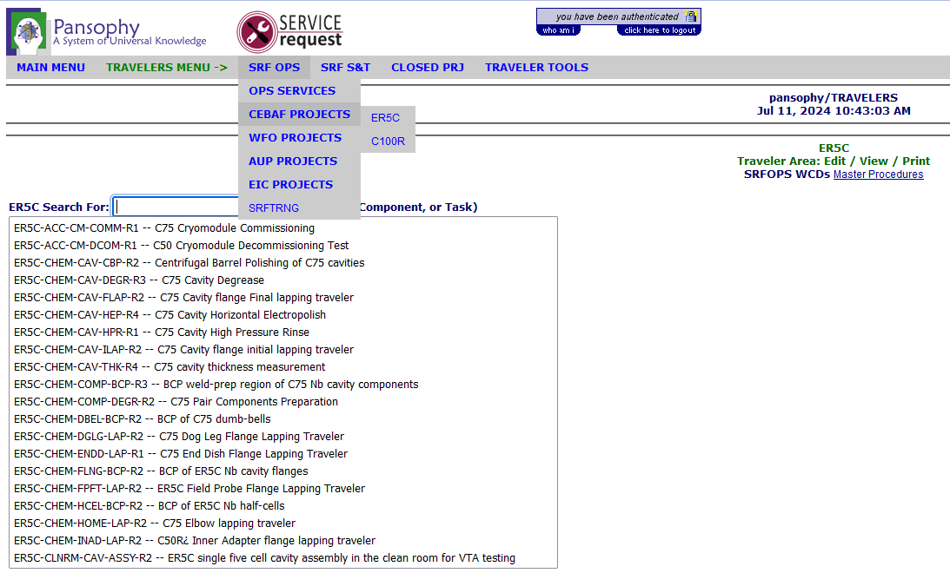
Traveler Menu
Select a project and traveler

Slide 19
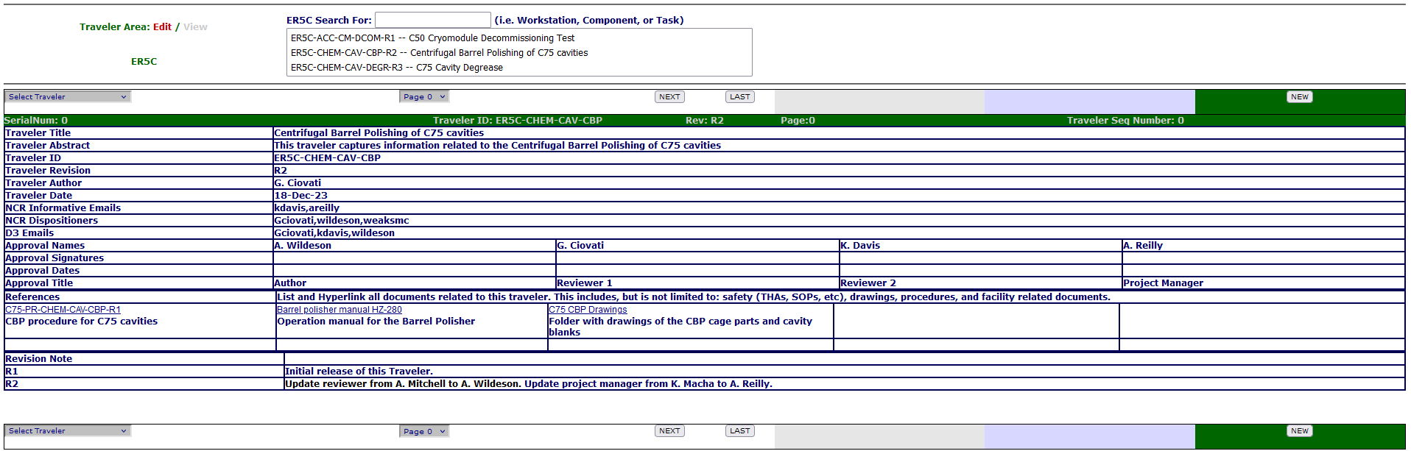
Traveler Example - Traveler Cover Page (P0)
Once on P0 select the ‘new’ button to create a traveler

Slide 20
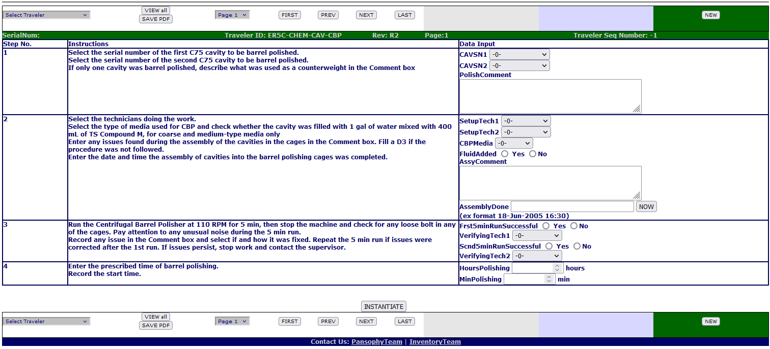
Traveler Example- P1
Press ‘instantiate’ button to assign a sequence number before entering data

Slide 21
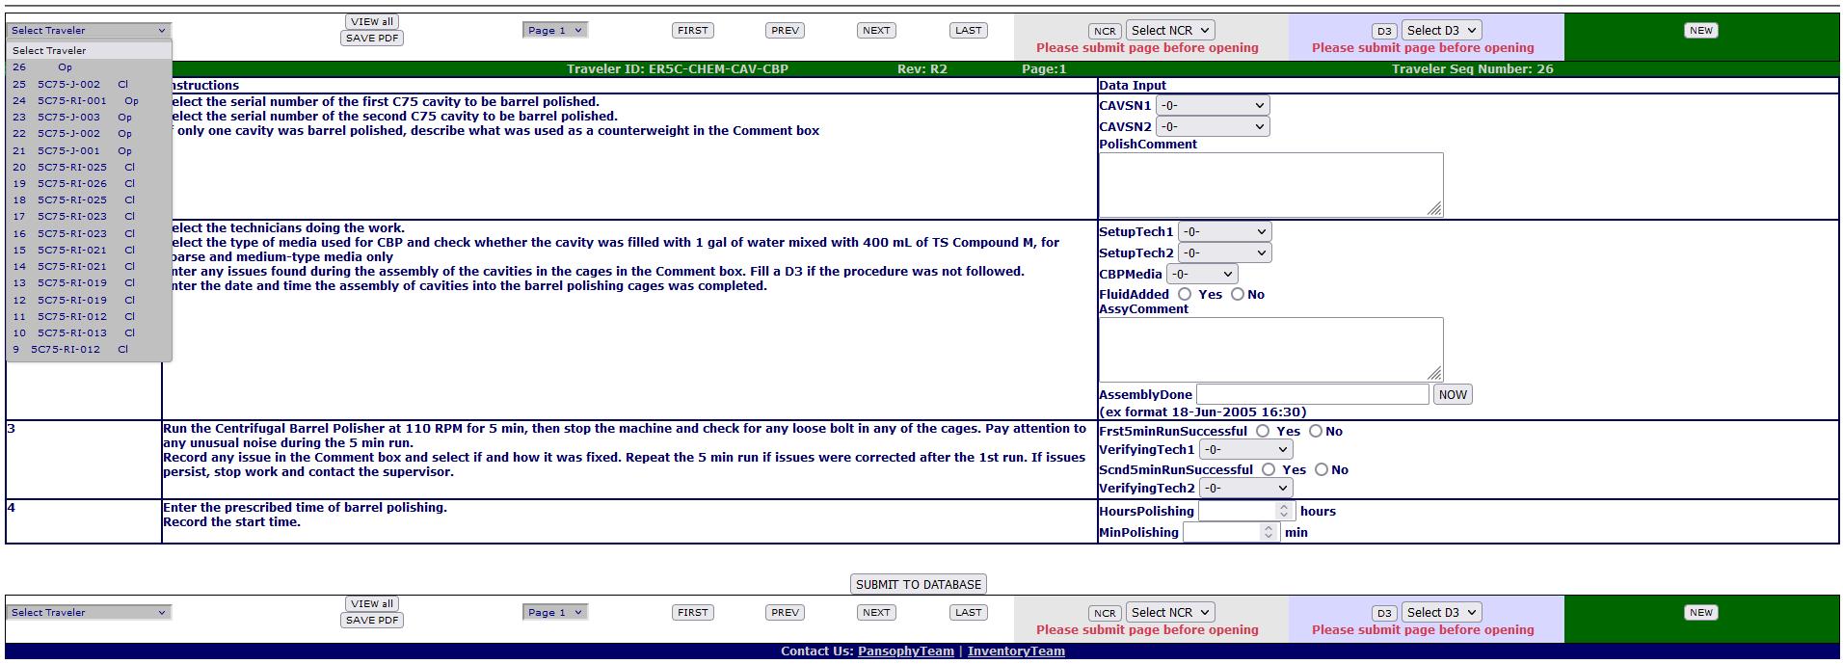
Entering Data
Select previously created traveler
SUBMIT
EACH
PAGE

Slide 22
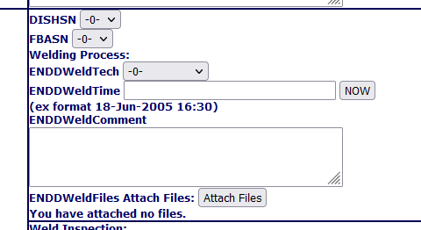
Uploading Files
IMPORTANT
Traveler MUST be instantiated before uploading files
1. Clicking the Attach Files button will open another tab
Note: Uploading files will refresh the page and remove unsaved data. Submit first or upload files before entering data

Slide 23
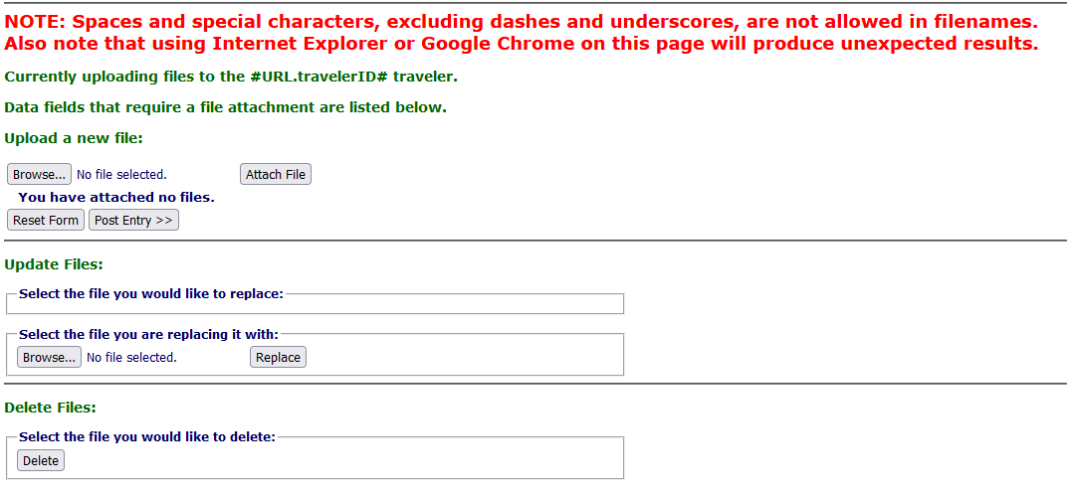
Upload Files Page
2. Click Browse
and select the file you wish to upload.
Ensure filenames are UNIX compliant
3. Click Attach File
4. Click Post Entry

Slide 24
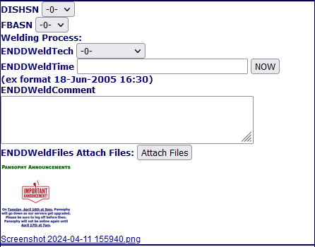
File Viewing on Traveler
5. File will be displayed next to Attach Files button

Slide 25
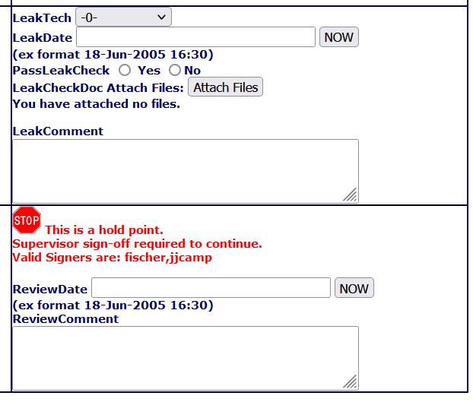
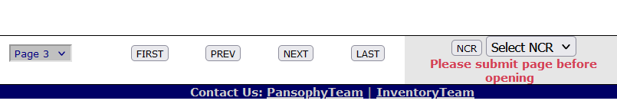
Hold Points (Not Signer)
Hold Points can only be cleared by the designated person(s)
Until the hold point is cleared, data cannot be added to subsequent pages (No ‘Submit to Database’ button)
No Submit Button

Slide 26
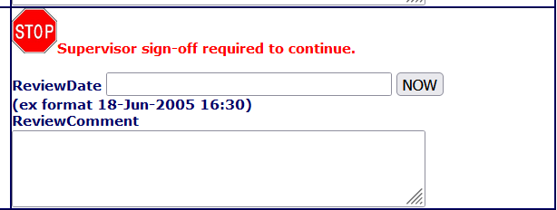
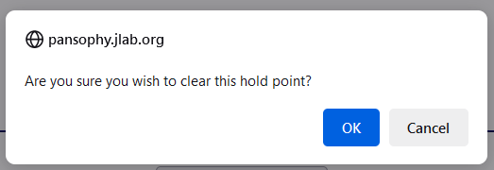
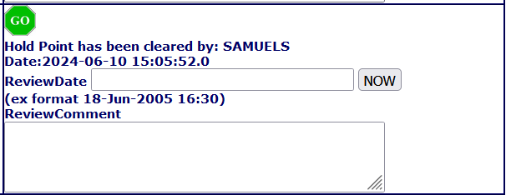
Hold Points (Signer)
This means a designated “signer” is logged in
Click the Stop Sign, then click your decision in the pop-up
This means the hold point is cleared

Slide 27
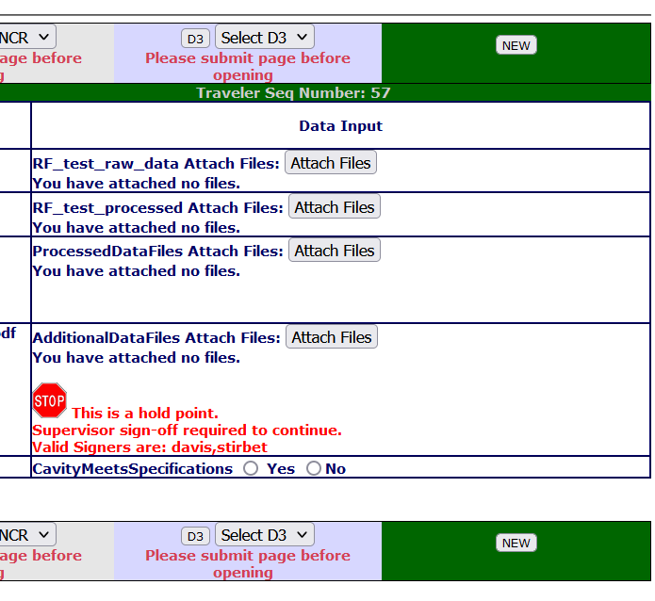
Hold Points on the Last Page
If Hold Points are on the last page, traveler cannot be closed until Hold Point is cleared
No Close Button

Slide 28
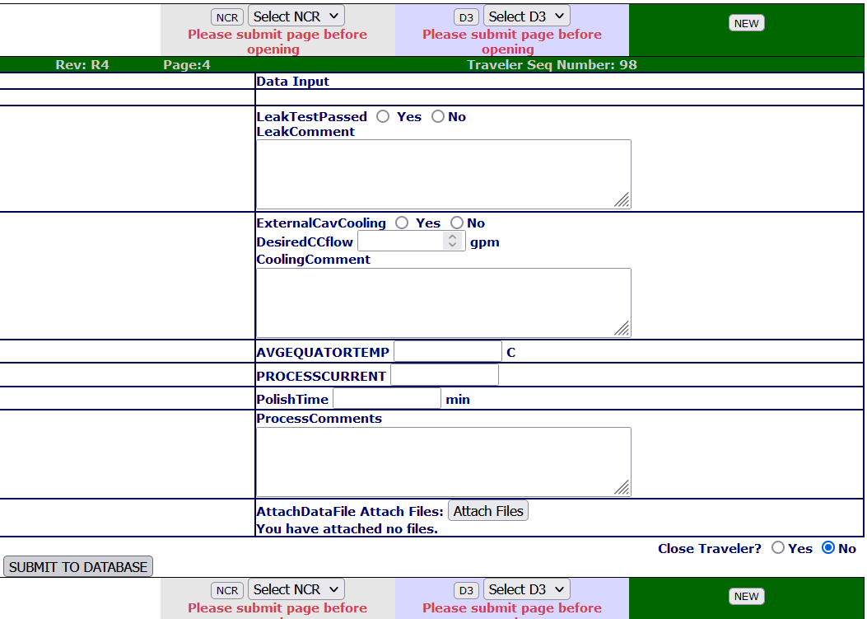
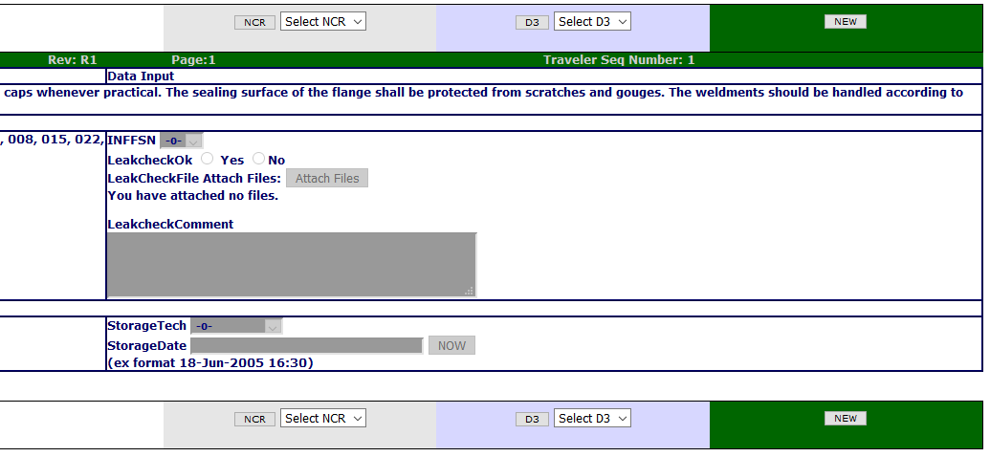
Securing Data
1. Until a Traveler is closed, data can be entered and edited
2. Once closed, ALL DATA is locked and cannot be changed without a service request
2
1
3. Data is never deleted, a history of all changes is kept
3

Slide 29
Opening an NCR or D3
NCR: Non Conformance Report
  should be issued for any part that does NOT meet the specified requirements
D3s: Detours Deviations Discrepancies
  should be issued for any process that cannot be completed as specified in the traveler or supporting documentation.
After Instantiating a traveler, the buttons to open an NCR or D3, or view a previously opened one, appear
Submit the page data to the database before opening either

Slide 30
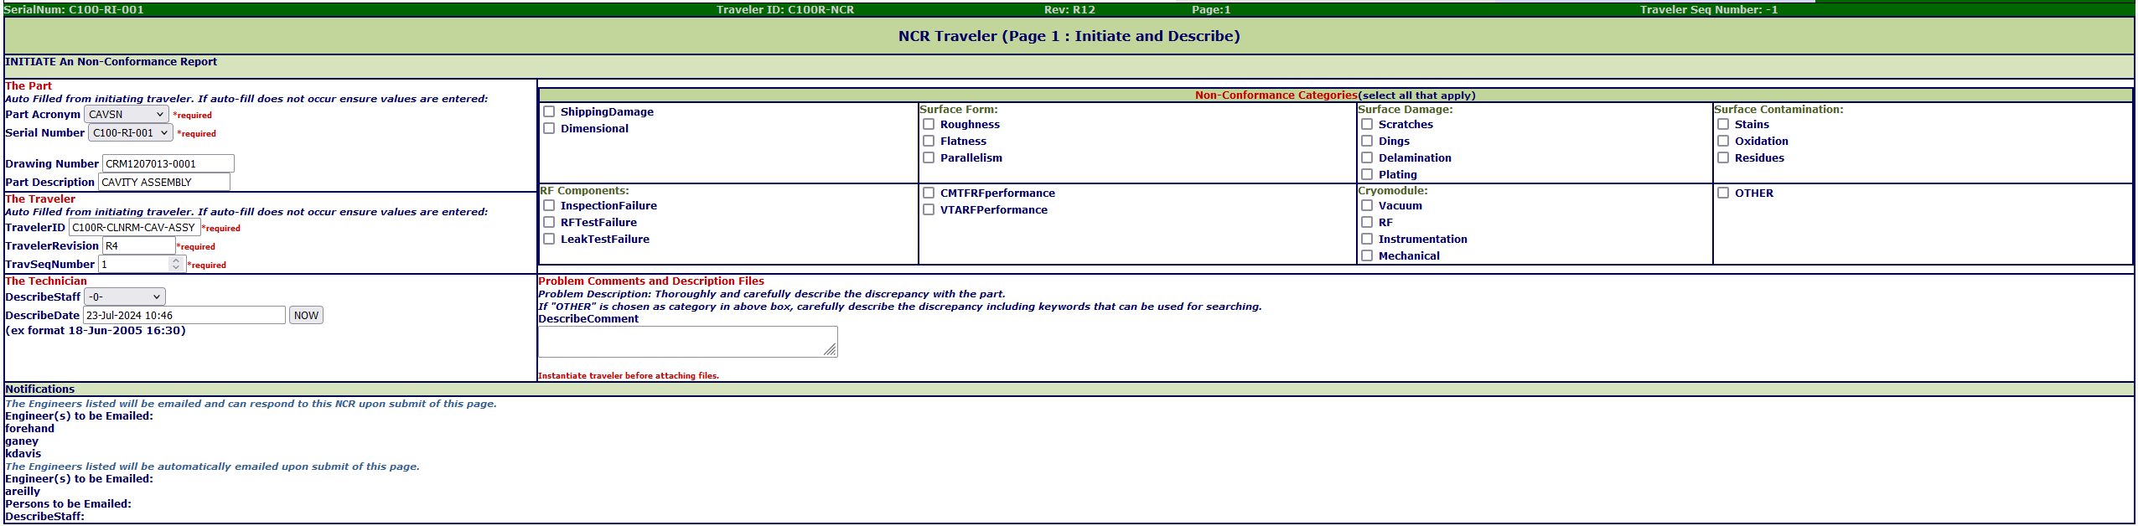
NCR Instantiation
When filling out an NCR only select one non-conformance category. If a part has more than one non-conformance then multiple NCRs will need to be opened.
Select all reasons for the noncompliance report being opened and provide an explanation of issue along with attaching any files or pictures needed for documentation.

Slide 31
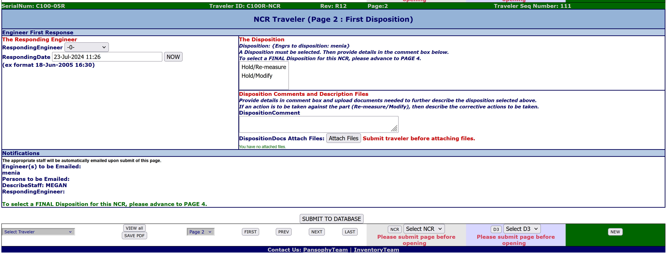
NCR Initial Disposition
Select an initial disposition. Provide description and attach any files or pictures needed for documentation.
Initial dispositions are not always needed.

Slide 32
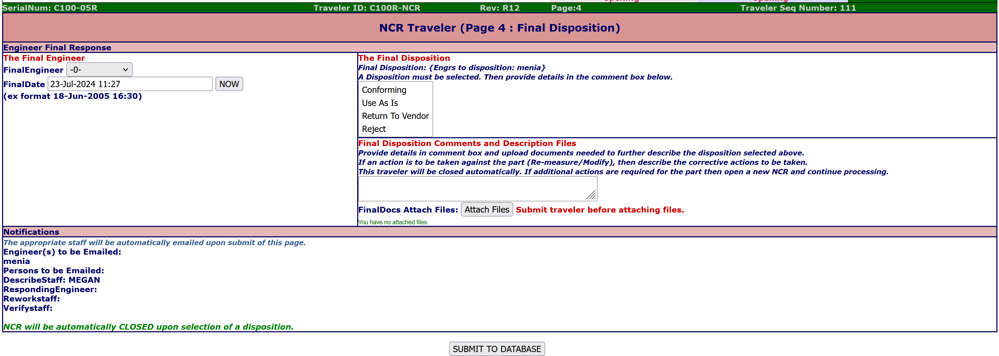
NCR Final Disposition
Select the final disposition. Provide description and attach any files or pictures needed for documentation.

Slide 33
NCR Dispositions
 | Initial Disposition | Final Disposition | Description of Disposition Pathway
1 | N/A | Conforming | Conforming. Allowed by SRF and customer. Use for production.
2 | Hold/Re-measure | Conforming | Re-measured. Verified. Conforming. Use for production.
3 | Hold/Modify | Conforming | Modified. Verified. Conforming. Use for production.
4 | N/A | Use as is | Nonconforming. Justified for use by SRF and the customer. Use for production.
5 | Hold/Re-measure | Use as is | Re-measured. Nonconforming. Justified for use by SRF and the customer. Use for production.
6 | Hold/Modify | Use as is | Modified. Nonconforming. Justified for use by SRF and the customer. Use for production.
7 | N/A | Return to Vendor | Nonconforming. Return to vendor.
8 | Hold/Re-measure | Return to Vendor | Re-measured. Nonconforming. Return to vendor.
9 | Hold/Modify | Return to Vendor | Modified. Nonconforming. Return to vendor.
10 | N/A | Reject | Nonconforming. Segregate.
11 | Hold/Re-measure | Reject | Re-measured. Nonconforming. Segregate.
12 | Hold/Modify | Reject | Modified. Segregate.
For more information on NCRs and dispositions please reference the procedure below
https://jlabdoc.jlab.org/docushare/dsweb/Get/Document-247643/SRF-12-PR-001%20Nonconforming%20Product.pdf

Slide 34
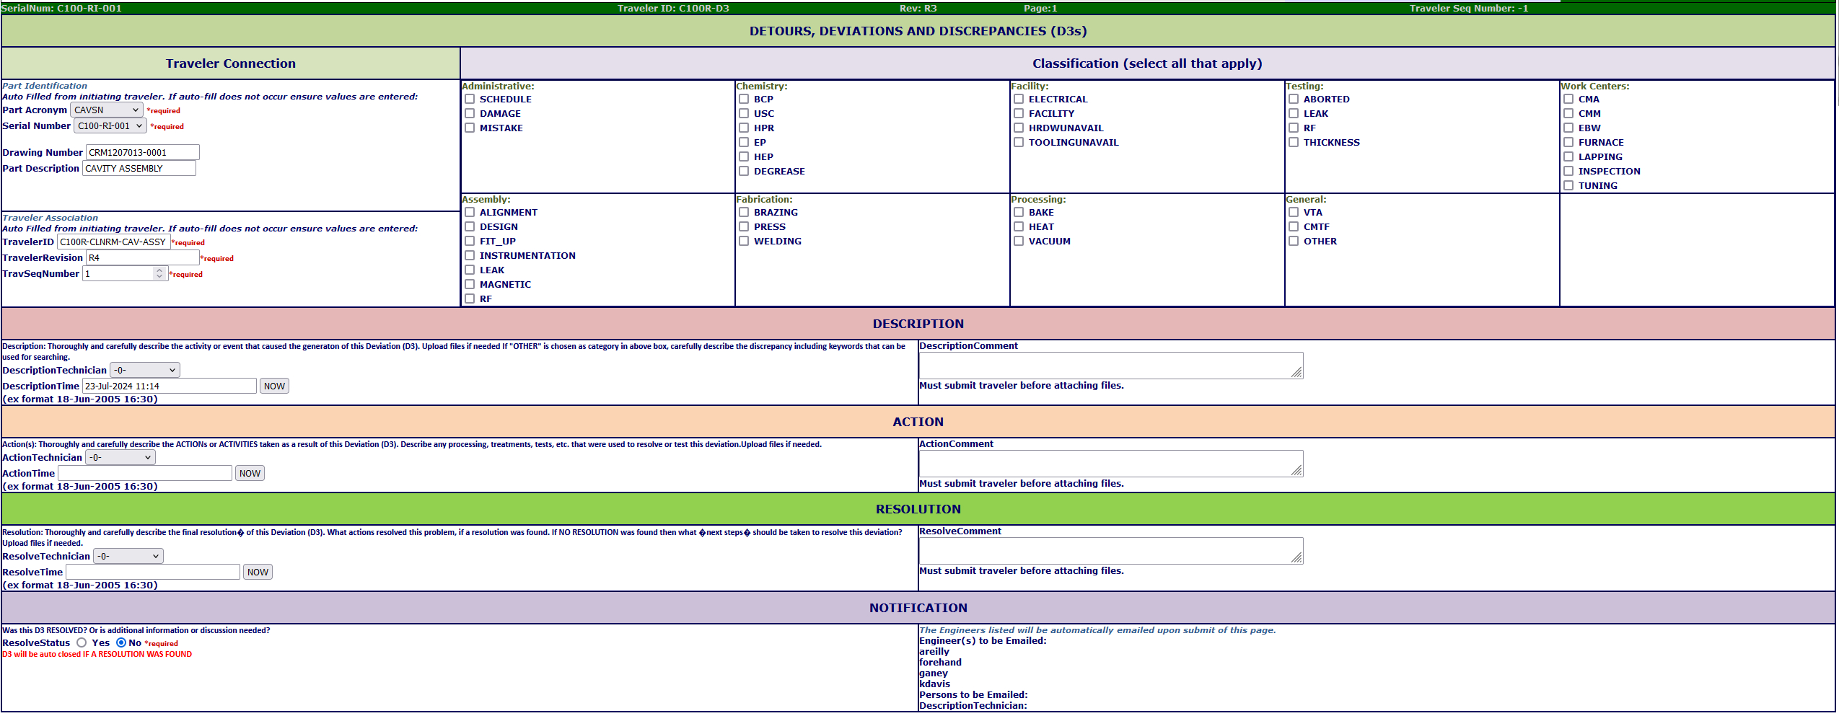
D3 Instantiation
Select all reasons for the D3 being opened and provide an explanation of issue along with attaching any files or pictures needed for documentation. Provide explanation of actions taken and what was done to resolve the issue.

Slide 35
Common Issues
Be sure to Instantiate a traveler before entering data
Press "Submit to Database" on every page
Ensure filenames are UNIX compliant (alphanumeric, underscores, and hyphens are all that's allowed)
Close travelers when data entry is complete and validated
Required fields are fields that must have data before submitting. Will result in an error message if left blank
Floats and Scientific Notation must have data entered in the correct format.
  Ex: 1.2 for float, 3.21e10 for Scientific Notation

Slide 36
Thank You For Listening
Questions?
Additional questions or concerns can be directed to pansophy@jlab.org

Slide 37
Training Release, Revision History, and Approvals
Rev # | Major Changes | Effective Date:
1 | Initial version | 23 JULY 2024
Approved by: | Name: | Signature: | Date:
Document Owner | Matthew Menia
Reviewer 1 | Megan McDonald
Reviewer 2 | Allen Samuels
Project Lead | Valerie Bookwalter

