Slide 1
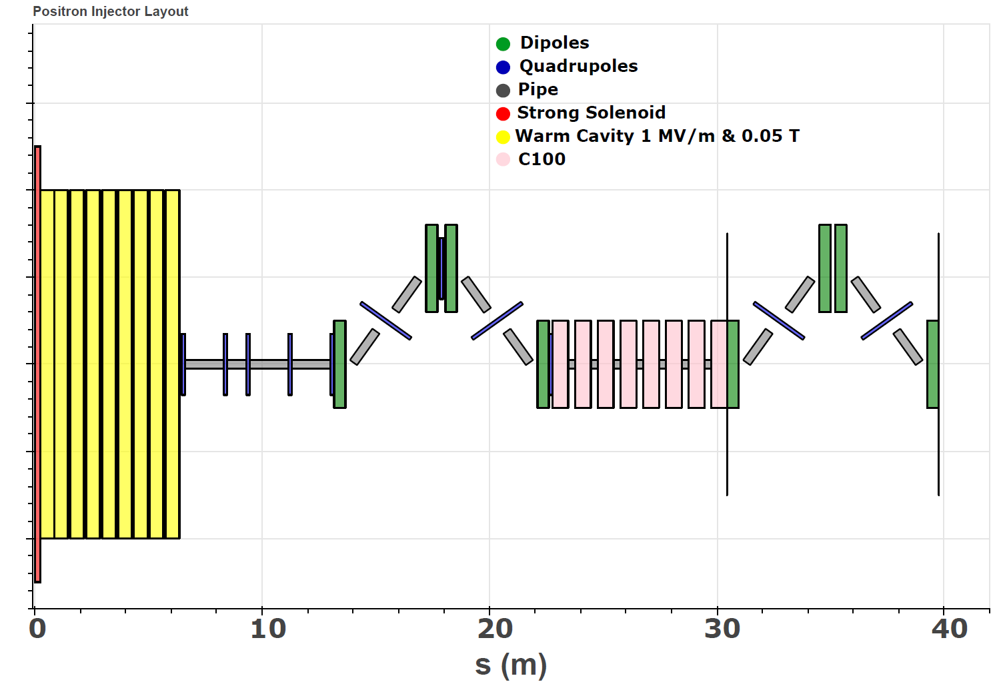
Positron Collection Scheme for Ce+BAF
Beam Dynamics: Design and optimization
Sami Habet

Slide 2
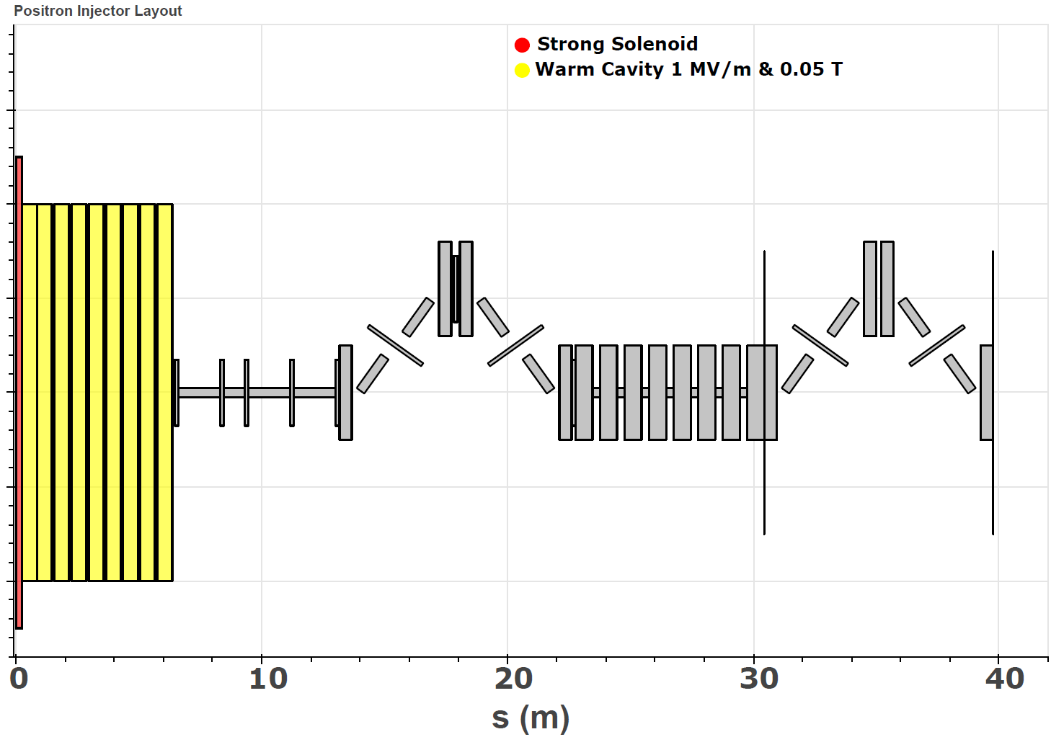
Positron Collection Scheme for Ce+BAF
Beam Dynamics: Design and optimization
Positron charcterization
e+ Collection system: QWT
Sami Habet

Slide 3
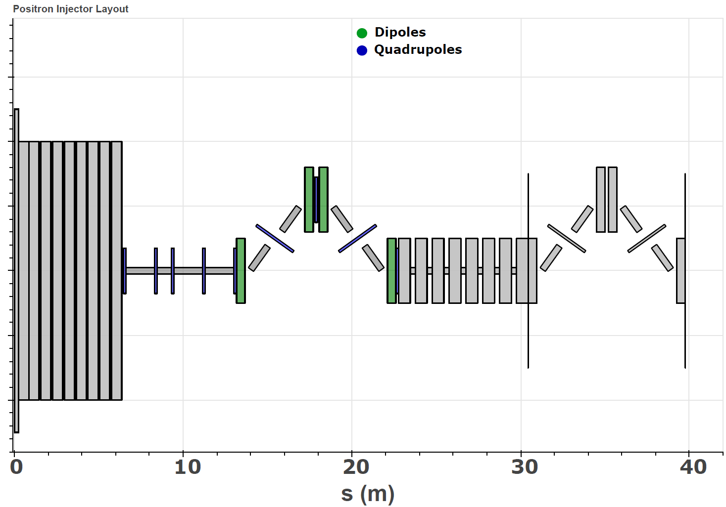
Positron Collection Scheme for Ce+BAF
Beam Dynamics: Design and optimization
Target optimization
e+ Collection system: QWT
Momentum collimation
Sami Habet

Slide 4
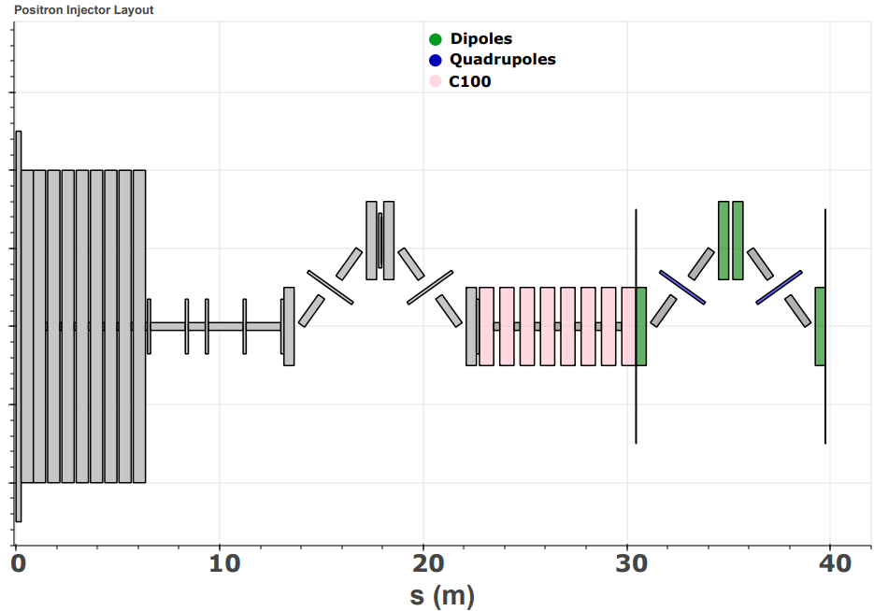
Positron Collection Scheme for Ce+BAF
Beam Dynamics: Design and optimization
Target optimization
e+ Collection system: QWT
Momentum collimation
Longitudinal optimization
Sami Habet

Slide 5
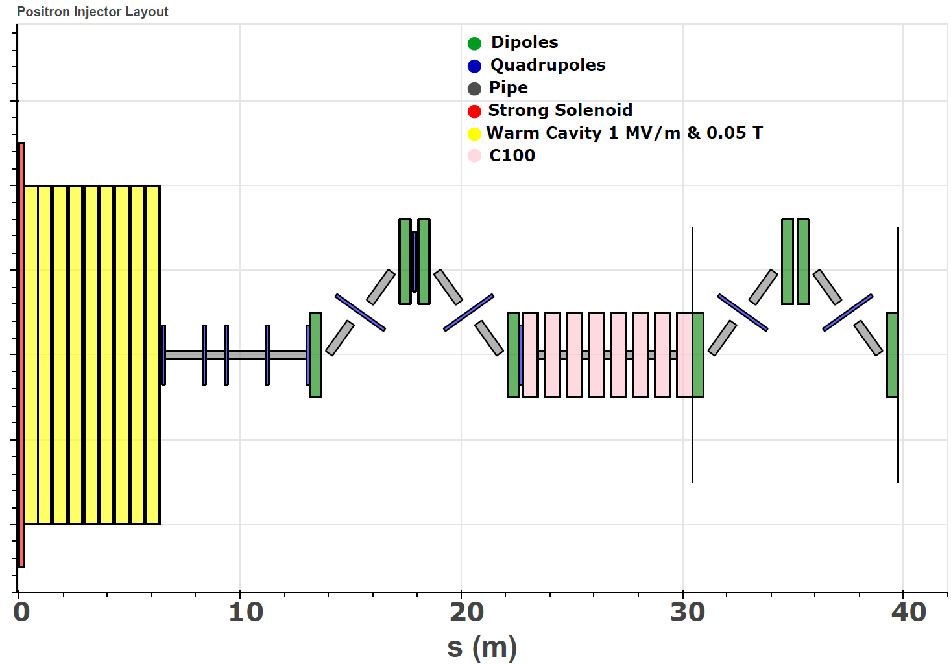
Positron Collection Scheme for Ce+BAF
Beam Dynamics: Design and optimization
Target optimization
e+ Collection system: QWT
Momentum collimation
Longitudinal optimisation
Conclusion
Sami Habet

Slide 6
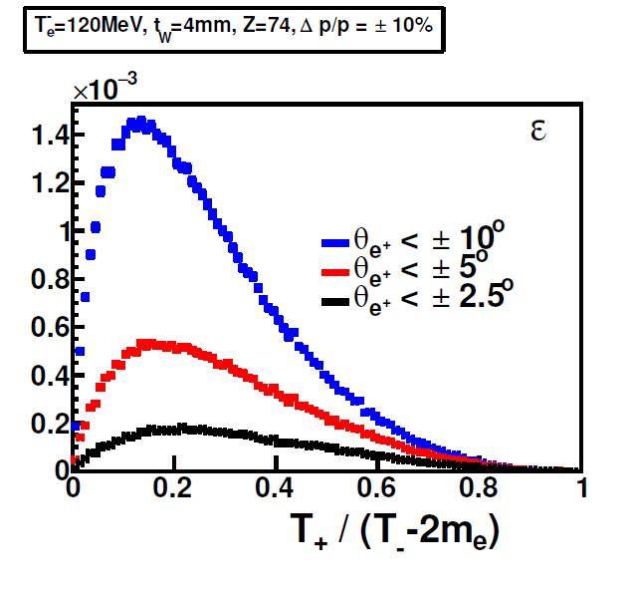
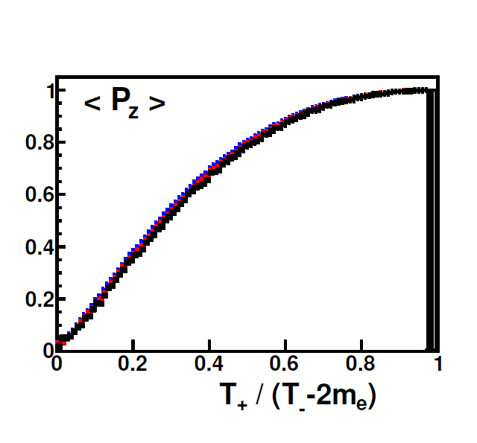
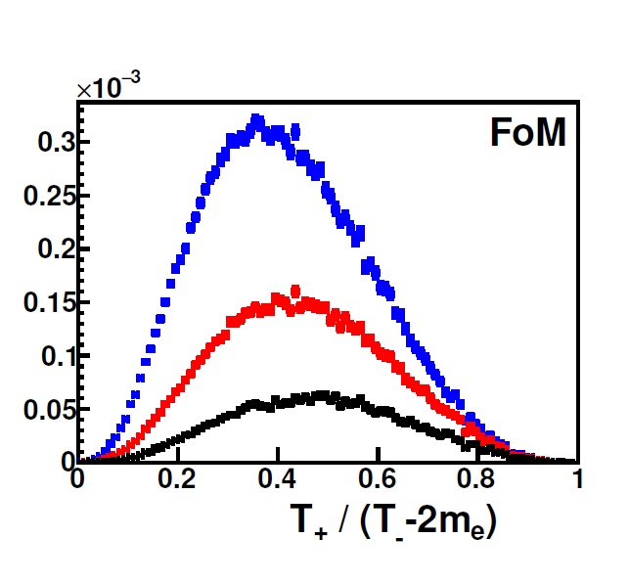


Positron characterization
Un-polarized mode
  Efficiency : $ε=\frac{N_{e^{+}}}{N_{e^{−}}}$
Polarized mode
  Figure-of-Merit: FoM= $εP_{e^{+}}^{2}$

Slide 7
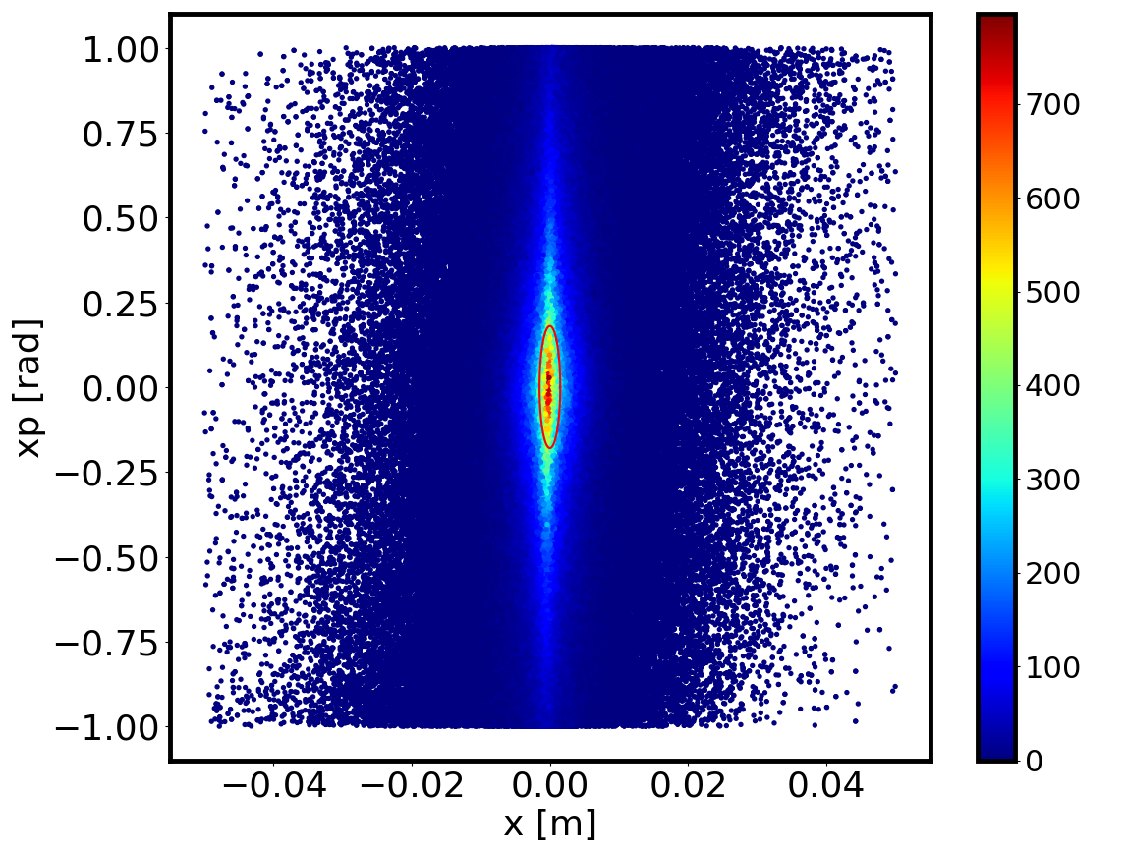
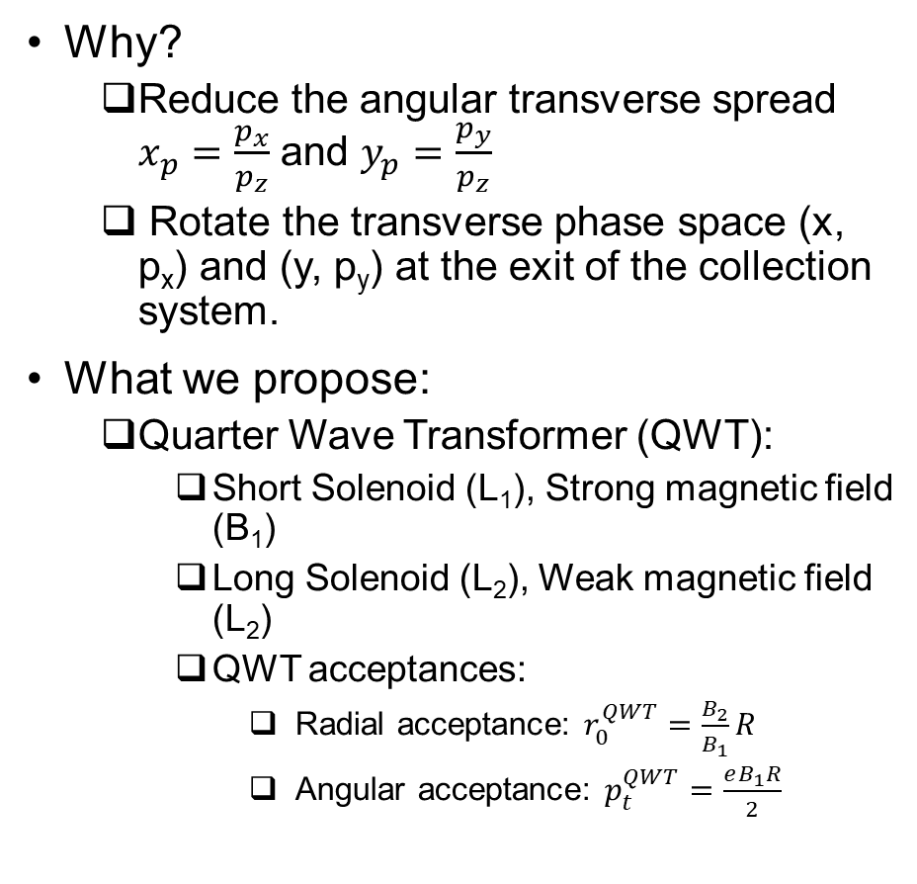
Positron Collection system
Why?
  Reduce the angular transverse spread $x_{p}=\frac{p_{x}}{p_{z}}$ and $y_{p}=\frac{p_{y}}{p_{z}}$
  Rotate the transverse phase space (x, p_{x}) and (y, p_{y}) at the exit of the collection system.
What we propose:
  Quarter Wave Transformer (QWT):
    Short Solenoid (L₁), Strong magnetic field (B₁)
    Long Solenoid (L₂), Weak magnetic field (L₂)
    QWT acceptances:
      Radial acceptance: $r_{0}^{QWT}=\frac{B_{2}}{B_{1}}R$
      Angular acceptance: $p_{t}^{QWT}=\frac{eB_{1}R}{2}$
Only e⁺ contained inside the red ellipse will be collected and transmitted.

Slide 8
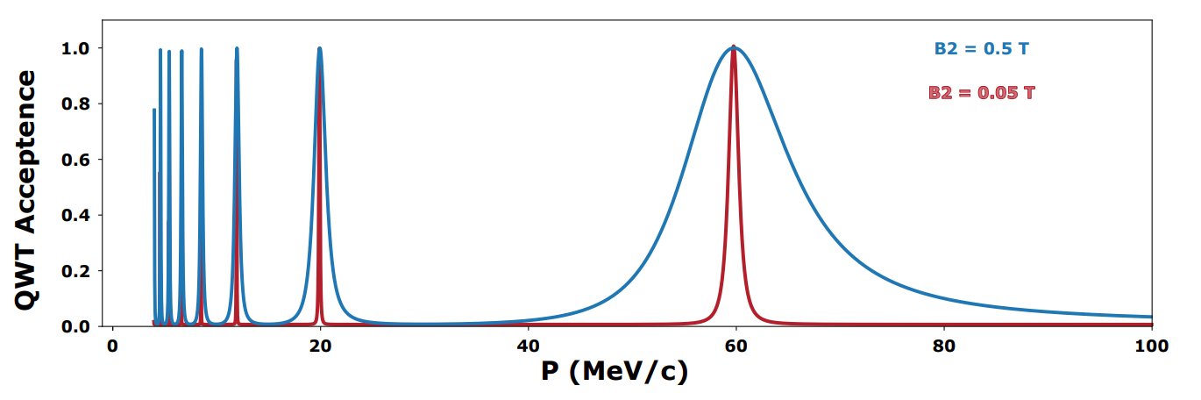
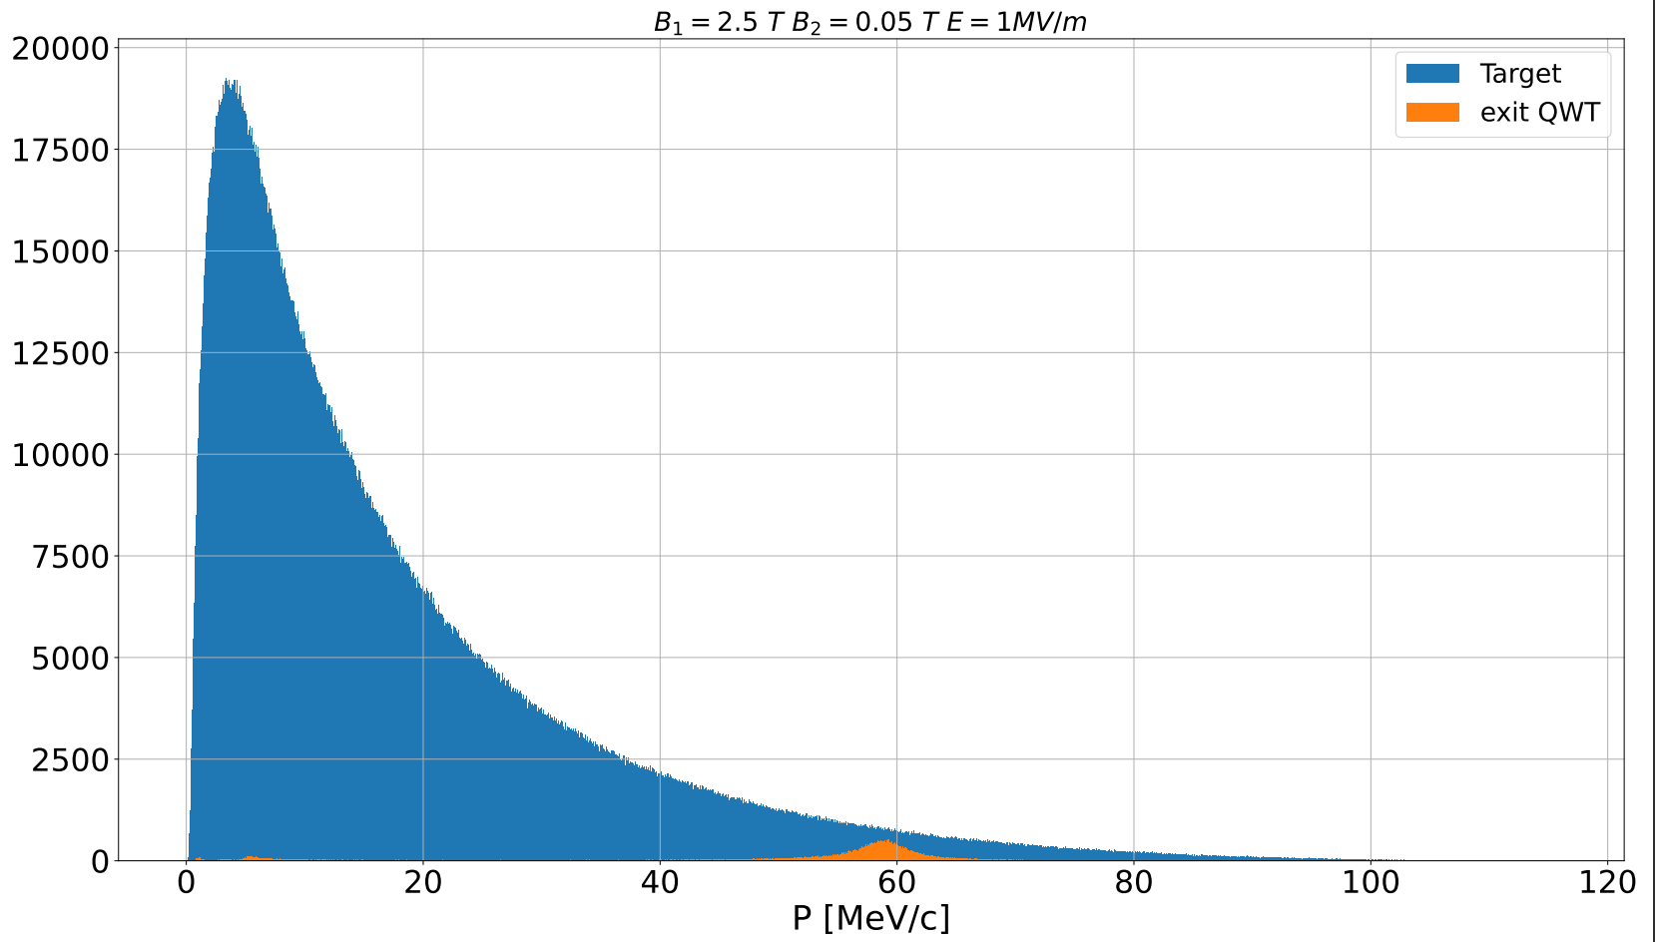
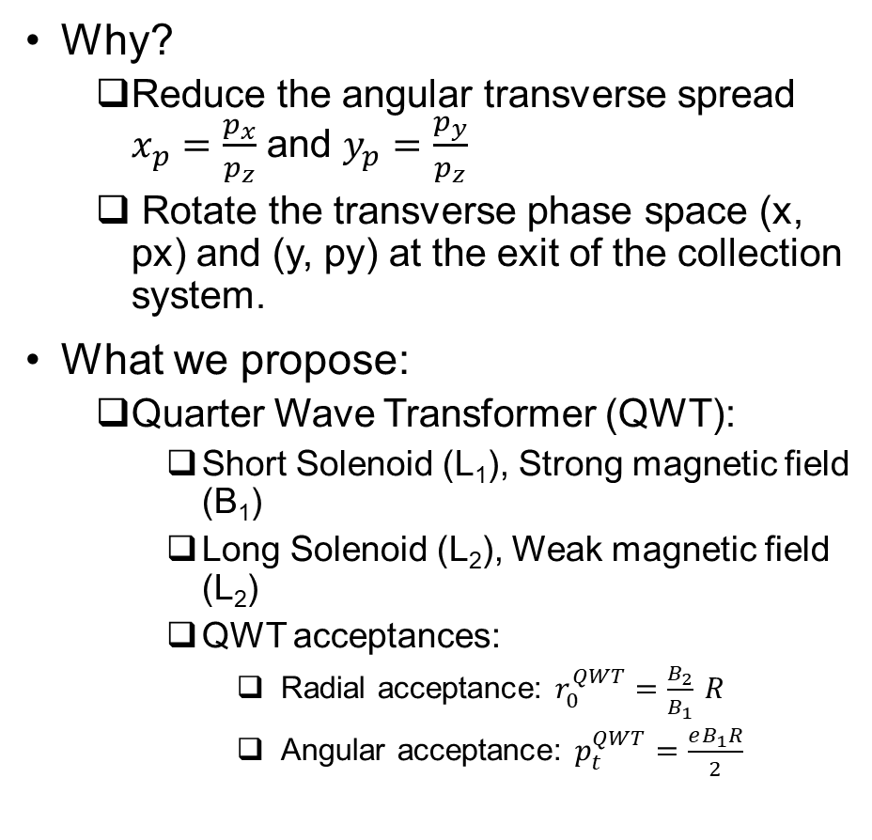
Positron Collection system
Why?
  Reduce the angular transverse spread $x_{p}=\frac{p_{x}}{p_{z}}$ and $y_{p}=\frac{p_{y}}{p_{z}}$
  Rotate the transverse phase space (x, px) and (y, py) at the exit of the collection system.
What we propose:
  Quarter Wave Transformer (QWT):
    Short Solenoid (L₁), Strong magnetic field (B₁)
    Long Solenoid (L₂), Weak magnetic field (L₂)
    QWT acceptances:
      Radial acceptance: $r_{0}^{QWT}=\frac{B_{2}}{B_{1}} R$
      Angular acceptance: $p_{t}^{QWT}=\frac{eB_{1}R}{2}$
Momentum acceptance

Slide 9
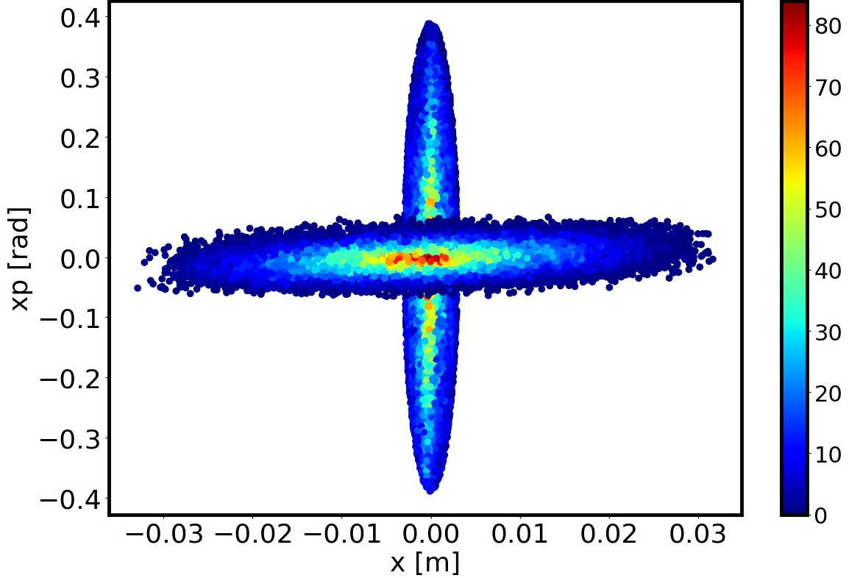
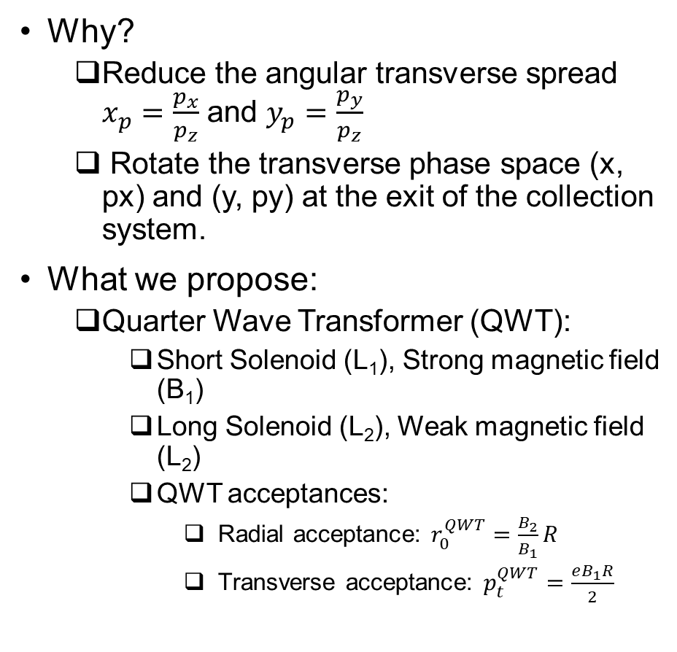
Positron Collection system
Why?
  Reduce the angular transverse spread $x_{p}=\frac{p_{x}}{p_{z}}$ and $y_{p}=\frac{p_{y}}{p_{z}}$
  Rotate the transverse phase space (x, px) and (y, py) at the exit of the collection system.
What we propose:
  Quarter Wave Transformer (QWT):
    Short Solenoid (L₁), Strong magnetic field (B₁)
    Long Solenoid (L₂), Weak magnetic field (L₂)
    QWT acceptances:
      Radial acceptance: $r_{0}^{QWT}=\frac{B_{2}}{B_{1}}R$
      Transverse acceptance: $p_{t}^{QWT}=\frac{eB_{1}R}{2}$
Momentum acceptance

Slide 10
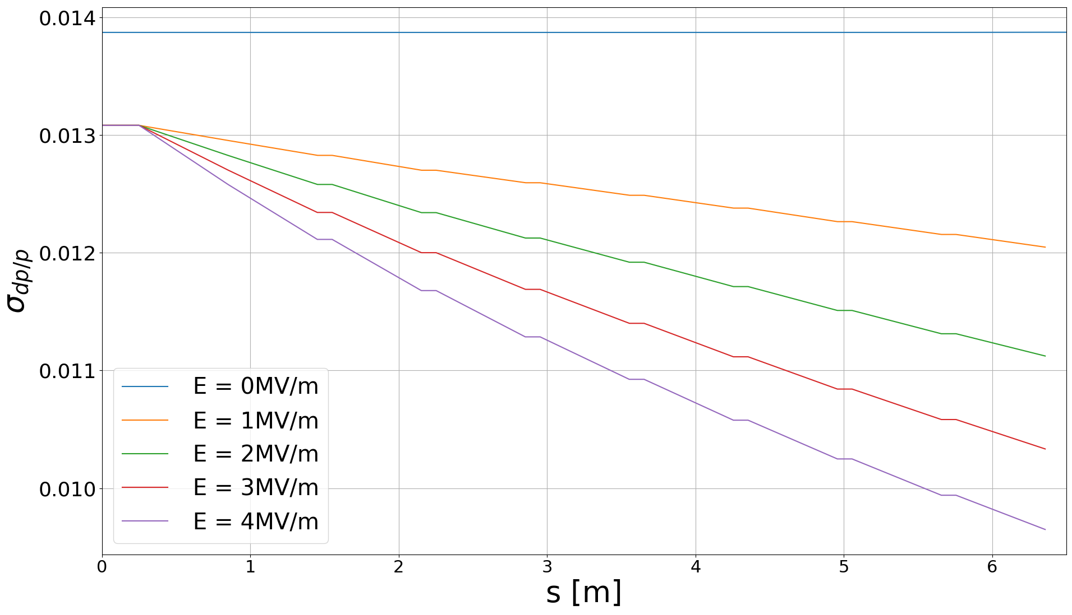
Accelerating warm section
Goal:
  Reduce the energy spread of the accepted e⁺ at p = 60 MeV/c
  Contibute to improve the
Optimization procedure:
  Perform off-crest setup.
  Allocate the maximum available gradient to the slowest particle, and assign less accelerating field to the fastest particle.
  Utilize distinct phase values.
Cavities configuration:
  F = 1497 Mhz
  L_{cell} = 0.2 cm
  T_{period} = 66 ns
  R_{cell} = 3 cm

Slide 11
Momentum collimation

Slide 12
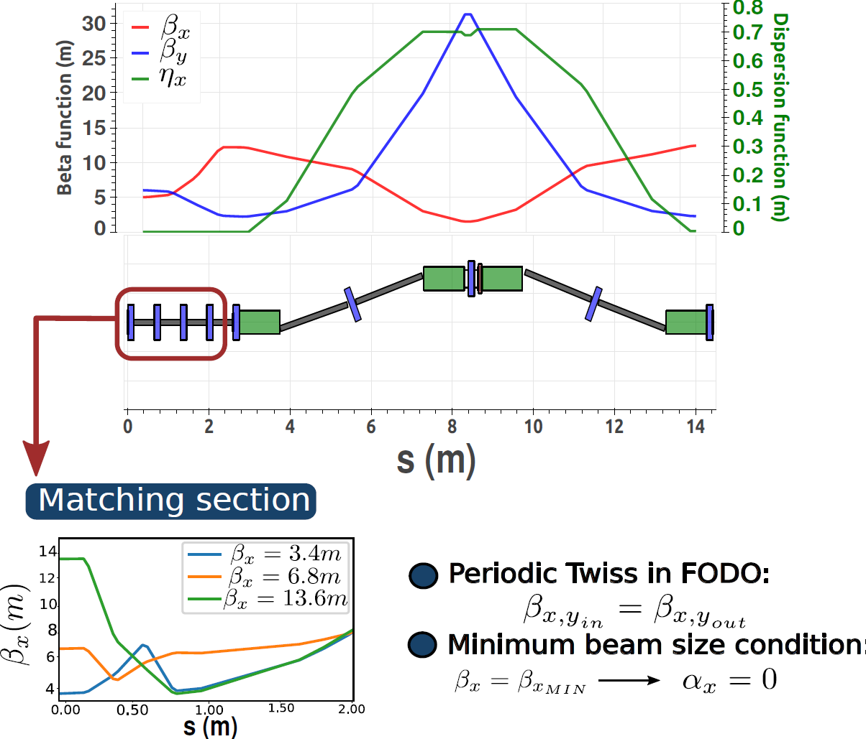
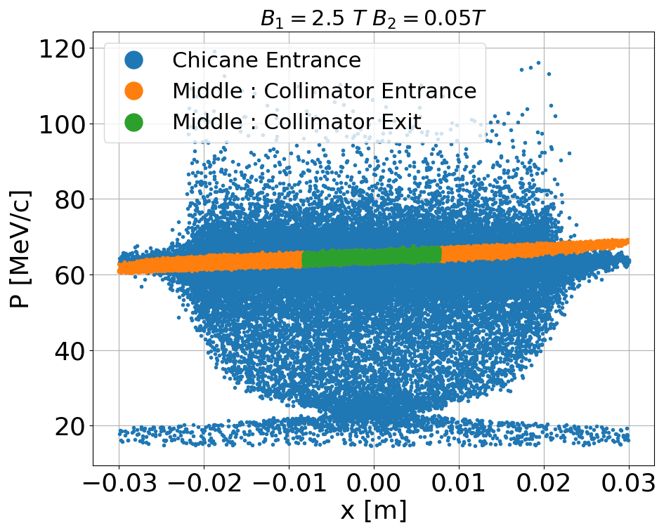
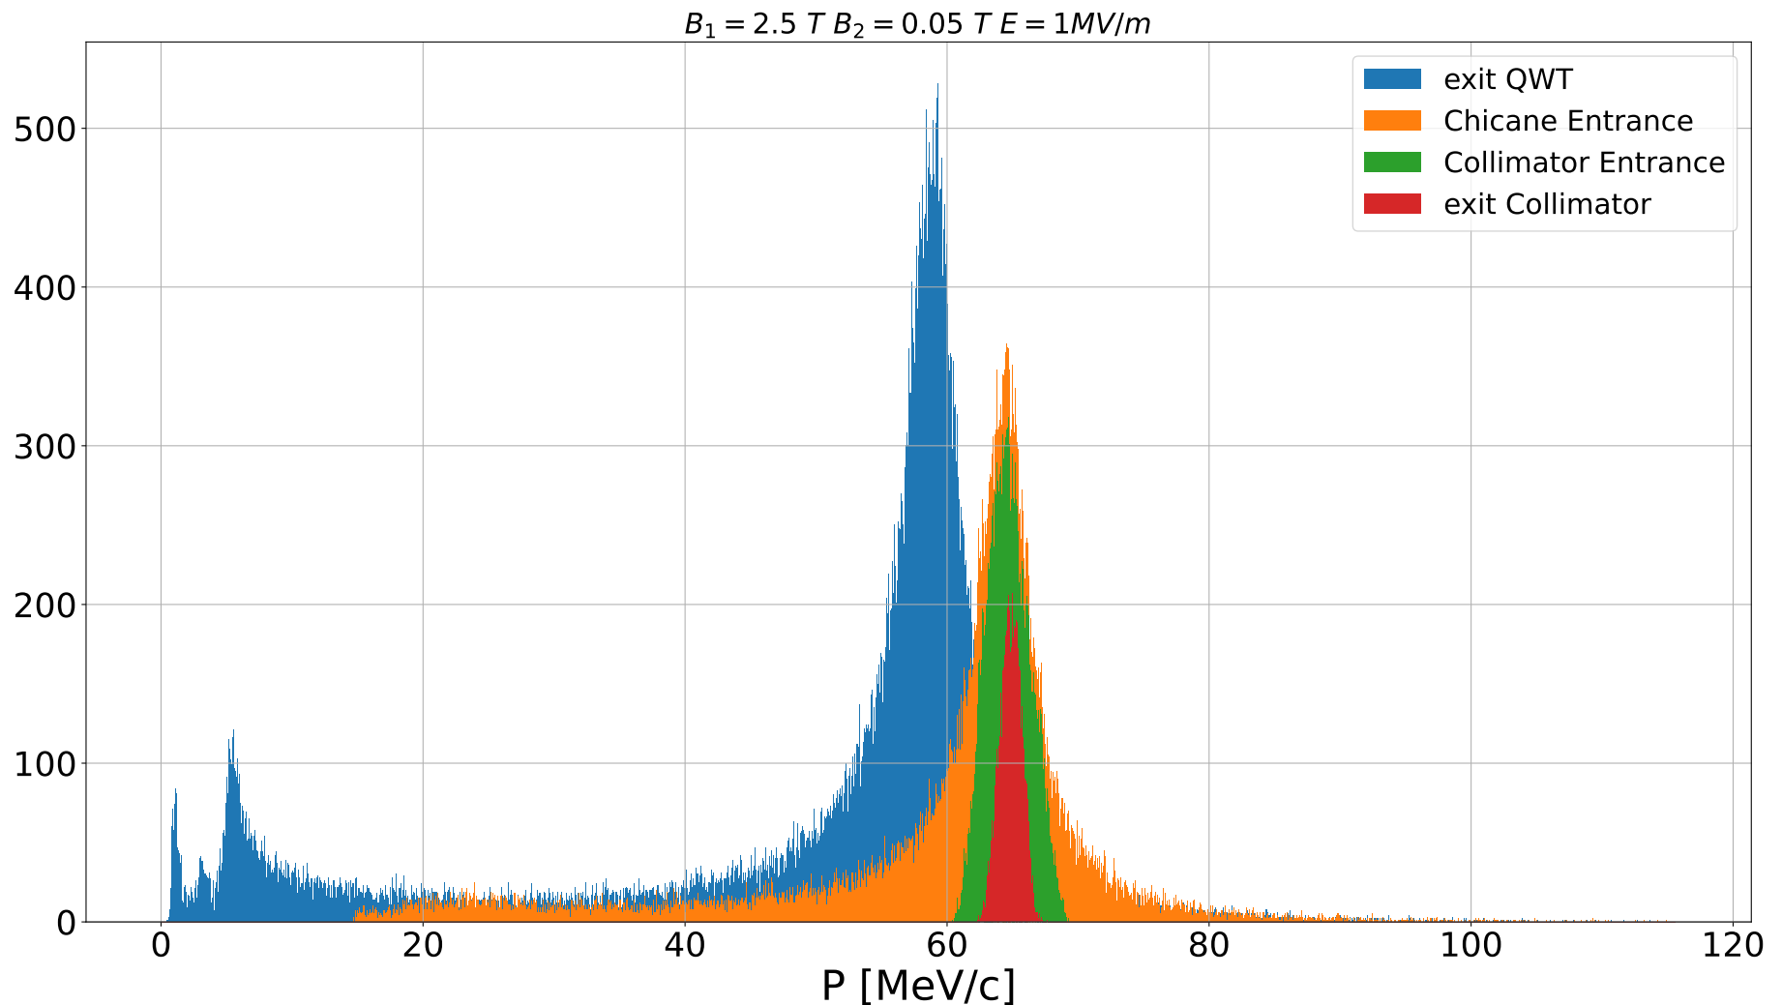
Momentum collimation

Slide 13
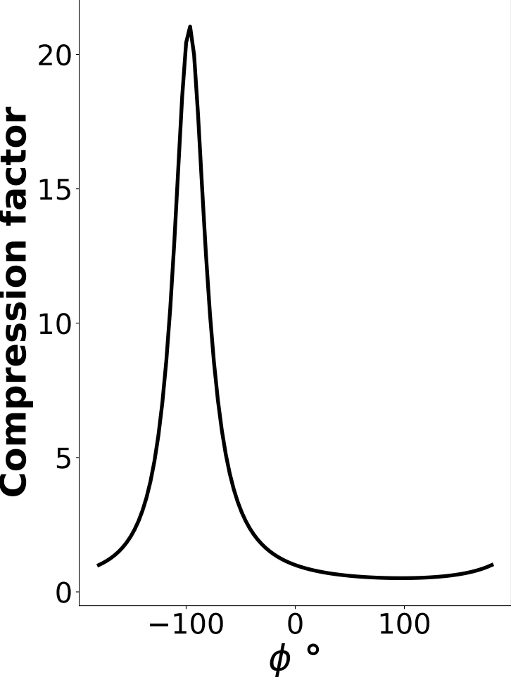
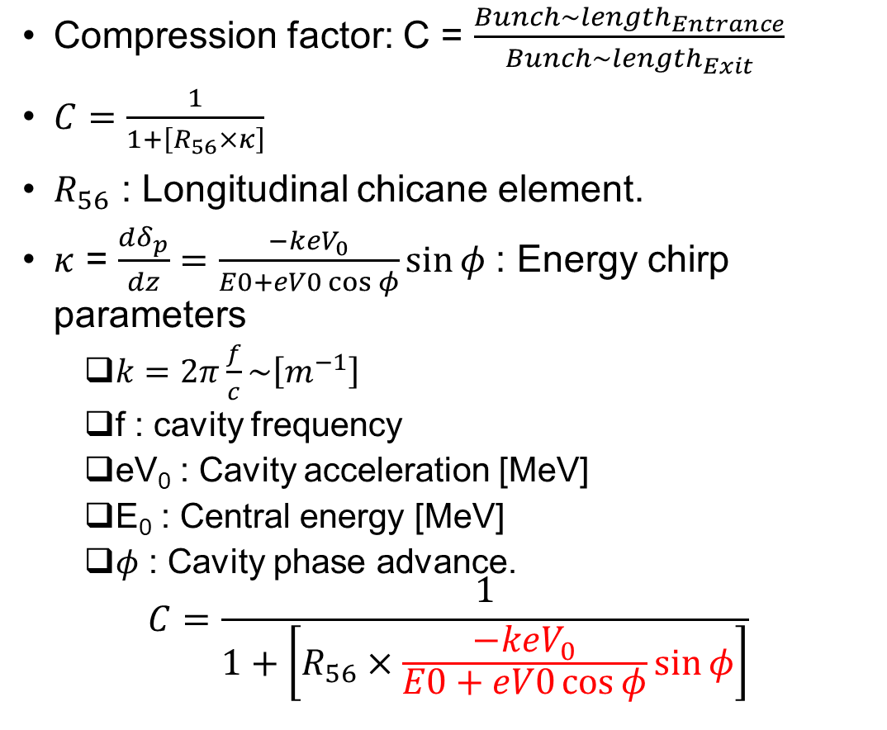
Longitudinal optimization: Energy spread and bunch length
Compression factor: C = $\frac{Bunch\sim length_{Entrance}}{Bunch\sim length_{Exit}}$
$C=\frac{1}{1+\left[R_{56}×κ\right]}$
$R_{56}$ : Longitudinal chicane element.
$κ$ = $\frac{dδ_{p}}{dz}=\frac{−keV_{0}}{E0+eV0\cos{φ}}\sin{φ}$: Energy chirp parameters
  $k=2π\frac{f}{c}\sim \left[m^{−1}\right]$
  f : cavity frequency
  eV₀ : Cavity acceleration [MeV]
  E₀ : Central energy [MeV]
  $φ$ : Cavity phase advance.
$$C=\frac{1}{1+\left[R_{56}×\frac{−keV_{0}}{E0+eV0\cos{φ}}\sin{φ}\right]}$$

Slide 14
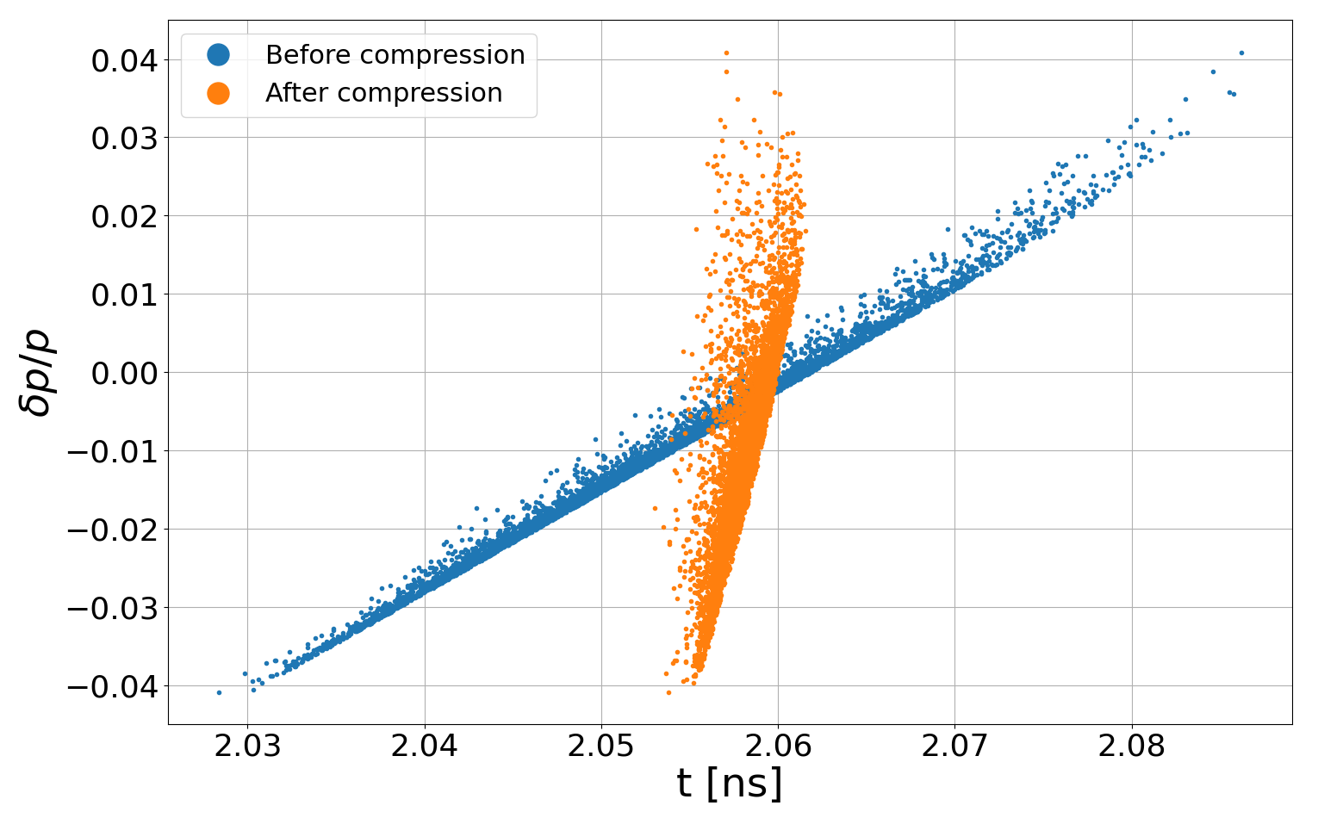
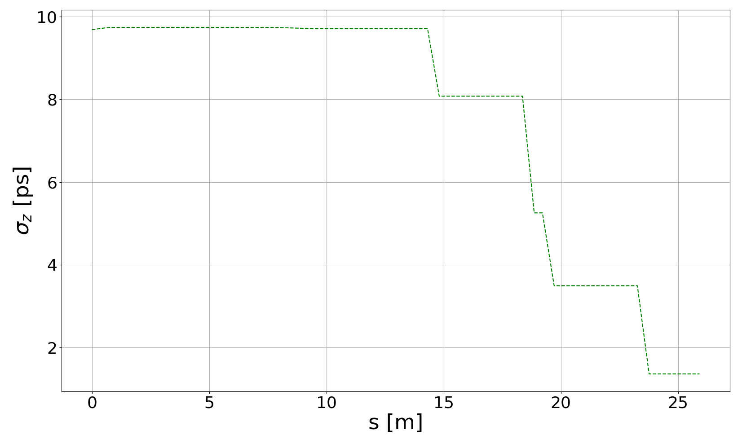
Longitudinal optimization: Energy spread and bunch length
Compression factor: C = $\frac{Bunch\sim length_{Entrance}}{Bunch\sim length_{Exit}}$
$C=\frac{1}{1+\left[R_{56}×κ\right]}$
$R_{56}$ : Longitudinal chicane element.
$κ$ = $\frac{dδ_{p}}{dz}=\frac{−keV_{0}}{E0+eV0\cos{φ}}\sin{φ}$: Energy chirp parameters
  $k=2π\frac{f}{c}\sim \left[m^{−1}\right]$
  f : cavity frequency
  eV₀ : Cavity acceleration [MeV]
  E₀ : Central energy [MeV]
  $φ$ : Cavity phase advance.
$$C=\frac{1}{1+\left[R_{56}×\frac{−keV_{0}}{E0+eV0\cos{φ}}\sin{φ}\right]}$$

Slide 15
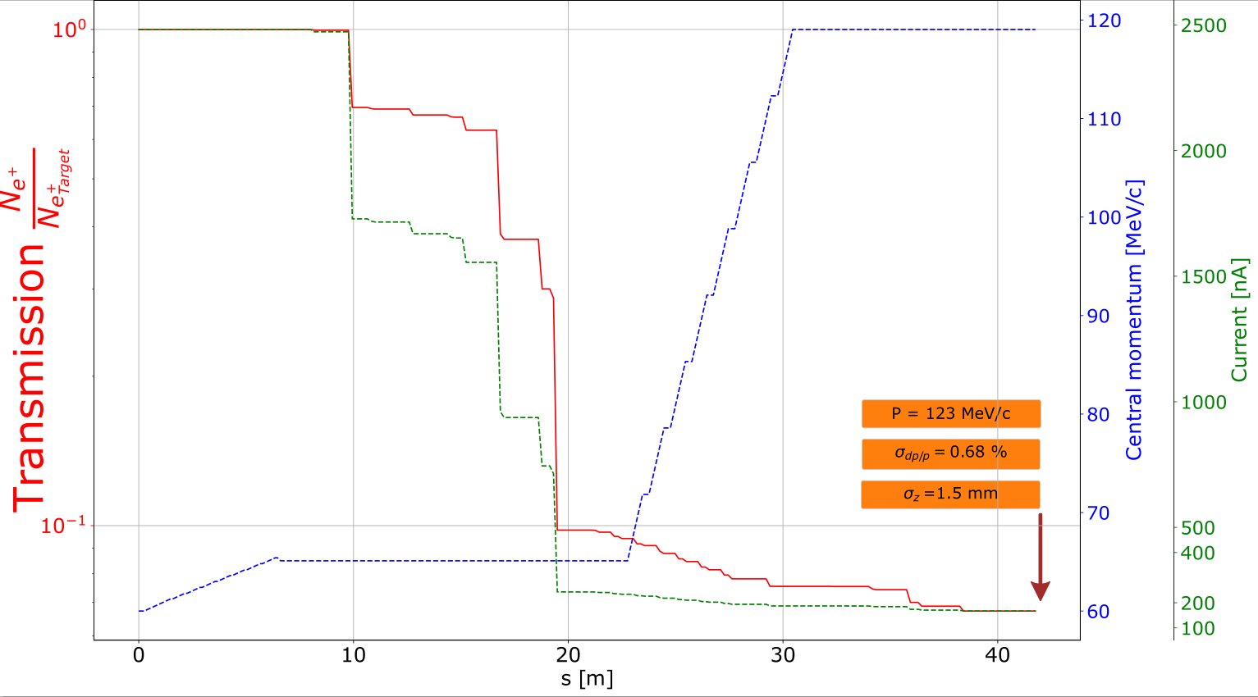
Ce⁺BAF Injection

Slide 16
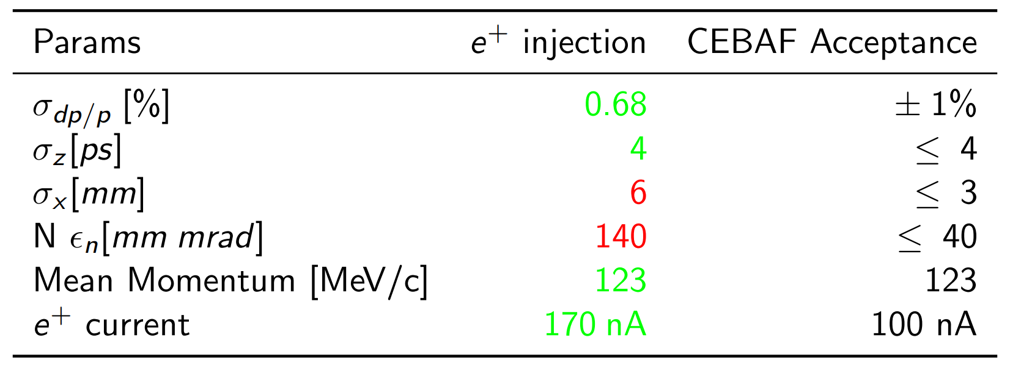
Summary

Slide 17
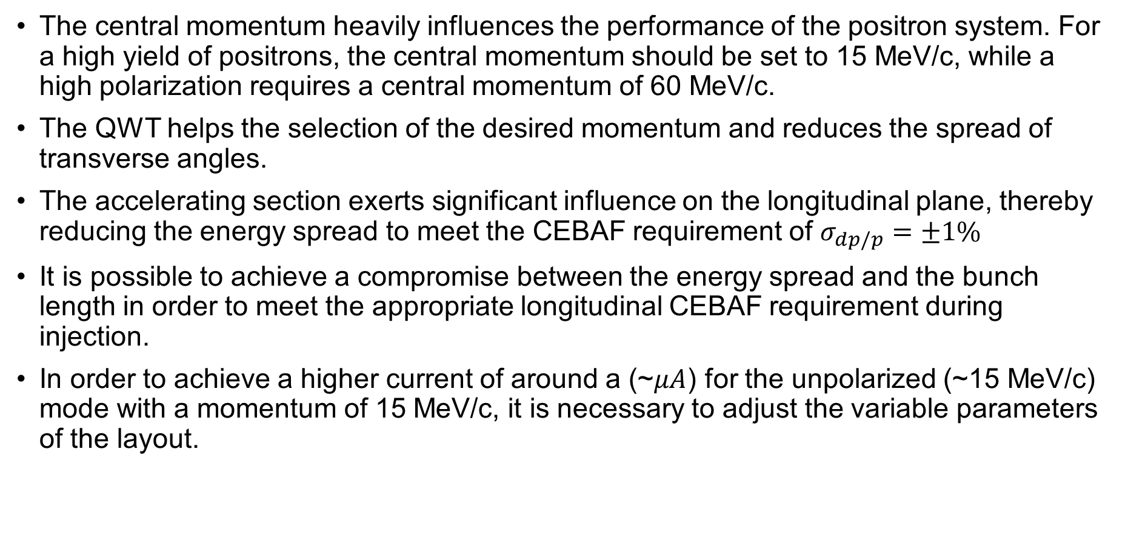
Conclusion
The central momentum heavily influences the performance of the positron system. For a high yield of positrons, the central momentum should be set to 15 MeV/c, while a high polarization requires a central momentum of 60 MeV/c.
The QWT helps the selection of the desired momentum and reduces the spread of transverse angles.
The accelerating section exerts significant influence on the longitudinal plane, thereby reducing the energy spread to meet the CEBAF requirement of $σ_{dp/p}=±1\%$
It is possible to achieve a compromise between the energy spread and the bunch length in order to meet the appropriate longitudinal CEBAF requirement during injection.
In order to achieve a higher current of around a (~$μA$) for the unpolarized (~15 MeV/c) mode with a momentum of 15 MeV/c, it is necessary to adjust the variable parameters of the layout.

Slide 18
Sami Habet
samih@jlab.org
THANK YOU!

